Slide 1
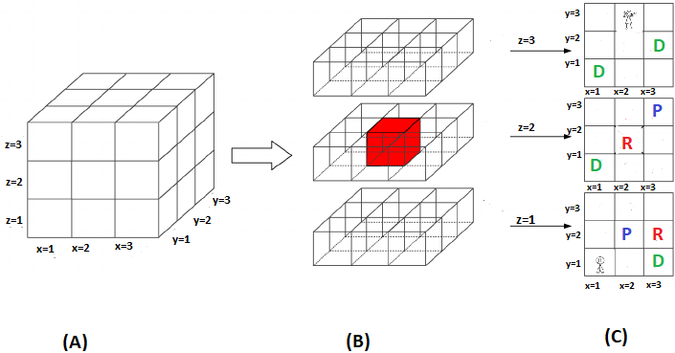
COSC 4368 Group Project Spring 2023 Learning Paths Using Reinforcement Learning for a 2-Agent Transportation 3D PD World

Slide 2
PD-World
Terminal State: Drop off cells contain 5 blocks each
Initial State: Agent F is in cell (1,1,1) and Agent M is in cell (3,2,3) and pickup cells contain 10 blocks
(1, 3, 3) | (2, 3, 3) | (3, 3, 3)
(1, 2, 3) | (2, 2, 3) | (3, 2, 3)
(1 , 1, 3) | (2, 1, 3) | (3, 1, 3)
M
Goal:
Transport all
from pickup
cells to
dropoff cells!
(1, 3, 2) | (2, 3, 2) | (3, 3, 2)
(1, 2, 2) | (2,2,2) | (3, 2, 2)
(1, 1, 2) | (2, 1, 2) | (3, 1, 2)
(1, 3, 1) | (2, 3, 1) | (3, 3, 1)
(1, 2, 1) | (2, 2, 1) | (3,2,1)
(1, 1, 1) | (2, 1, 1) | (3, 1, 1)
F
Pickup: Cells: (2,2,1), (3,3,2) (contain 10 blocks initially)
Dropoff Cells: (1,1,2), (1,1,3), (3,1,1), (3,2,3) (capacity 5 blocks)
Risky Cells: (2,2,2),(3,2,1) (Return twice negative reward for any action)

Slide 3
Key Questions to be Addressed
In spite of getting quite limited feedback is the RL approach able to “decent strategies” to transport blocks from sources to destination.
What RL hyper parameter settings lead to the best performance for the PD-World?
Is the RL approach able to learn efficient paths from block sources to block destinations?
Will the RL approach able to learn good agent coordination policies?
How well and how quickly can the RL approach adapt to changes in the PD-World?

Slide 4
PD-World
Operators‒there are eight of them:
North, South, East, West, Up, Down are applicable as long the agent does not leave the grid.
Pickup is only applicable if the agent is in a pickup cell that
contain at least one block and if the agent does not already carry a block.
Dropoff is only applicable if the agent is in a dropoff cell that contains
less that 4 blocks and the agent carries a block.
Moving of Agents: The female and male agent are alternate applying operators with the female agent acting first. Moreover, the two agents are not allowed to occupy the same cell at the same time, creating a blockage problem, limiting agent efficiency if they work in close proximity.

Slide 5
PD-World Coordinate System
The PD World Coordinate System is (x,y,z) with x,y,z∈{1,2,3}
Assuming an agent is in cell (x,y,z); if feasible
East moves the agent to cell (x+1,y,z)
West moves the agent to cell (x-1,y,z)
North moves the agent to cell (x,y+1,z)
South moves the agent to cell (x,y-1,z)
Up moves the agent to cell (x,y,z+1)
Down moves the agent to cell (x,y,z-1)
If applying a particular movement action results in leaving the coordinate system, this action is not applicable; for example, east, north and up are not applicable for an agent in cell (3,3,3)

Slide 6
Example State of the PD World
F
4
0
M
8
0
8
0

Slide 7
Rewards in the PD-World
Rewards:
Picking up a block from a pickup state: +14
Dropping off a block in a dropoff state: +14
Applying north, south, east, west, up, down: -1.
Applying north, south, east, west, up, down on a risk cell: -2.
Experiment Setup: The 2-agent system is run for a number of operator applications; e.g. 5000. If a terminal state is reached the system is reset to the initial state, but Q-Tables are not reinitialized, and the two agents continue to operate in the PD-World until the predetermined number of operators has been applied.

Slide 8
2023 Policies
PRandom: If pickup and dropoff is applicable,
choose this operator; otherwise, choose an operator
randomly.
PExploit: If pickup and dropoff is applicable, choose this
operator; otherwise, apply the applicable operator with the
highest q-value (break ties by rolling a dice for operators
with the same utility) with probability 0.85 and choose a
different applicable operator randomly with probability
0.15.
PGreedy: If pickup and dropoff is applicable, choose this
operator; otherwise, apply the applicable operator with the
highest q-value (break ties by rolling a dice for operators
with the same utility).

Slide 9
Performance Measures
Bank account of the 2-agent system
Number of operators applied to reach a terminal state from the initial state—this can happen multiple times in a single experiment!

Slide 10
Multi-Agent Learning Strategy
There are two approaches to choose from to implement 2-agent reinforcement learning:
Each agent uses his own reinforcement learning strategy and Q-Table. However, the position the other agent occupies is visible to each agent, and can be part of the employed reinforcement learning state space.
A single reinforcement learning strategy and Q-Table is used which moves both agents, selecting an operator for each agent and then executing the selected two operators with the female agent moving first.
Extra credit is given to groups who devise and implement both 2-agent learning approaches and compare their results.

Slide 11
4368 Group Project in a Nutshell
Policy
RL-System
RL-State
Space
Learning
Rate α
Adapting to Change
Utility
Update
Q-Learning/SARSA
What design
leads to the
best performance?
RL-System
Performance

Slide 12
PD-World State Space
The actual state space of the PD World is as follows:
(x, y, z, x’, y’, z’, i, i’, a, b, c, d, e, f) with
(x, y, z) is the position of the female agent and (x’, y’, z’) is the position of the male agents. Moreover, (x, y, z) ≠ (x’, y’, z’)
i and i’ is 1 if the respective agent carries a block and 0 if not.
(a,b,c,d,e,f) are the number of blocks in cells
(1,1,2), (1,1,3), (3,1,1), (3,2,3), (2,2,1), (3,3,2)
Initial State: (1,1,1,3,2,3,0,0,0,0,0,0,10,10)
Terminal State: (*,*,*,*,*,*,0,0,5,5,5,5,0,0)
there is a large number of terminal states; in a terminal state at least one agent has to be in a droppoff location, e.g. (3,2,3,2,2,2,0,0,5,5,5,5,0,0) is a terminal state.
Remark: The actual reinforcement learning approach likely
will use a simplified state space that aggregates multiple states of the actual state space into a single state in the reinforcement learning state space.

Slide 13
Multi-Agent Learning Strategy
There are two approaches to choose from to implement 2-agent reinforcement learning:
Each agent uses his own reinforcement learning strategy and Q-Table. However, the position the other agent occupies is visible to each agent, and can be part of the employed reinforcement learning state space.
A single reinforcement learning strategy and Q-Table is used which moves both agents, selecting an operator for each agent and then executing the selected two operators with the female agent moving first.
Extra credit is given to groups who devise and implement both 2-agent learning approaches and compare their results.

Slide 14
Mapping State Spaces to RL State Space
Most worlds have enormously large state spaces or even non-finite state spaces.
Moreover, how quickly Q/TD learning learns is inversely proportional to the size of the state space.
Consequently, smaller state spaces are used as RL-state spaces, and the original state space are rarely used as RL-state space.
World State Space
Reduction
RL-State Space

Slide 15
“Very Simple” Reinforcement Learning State Space0
Original State Space: (x, y, z, x’, y’, z’, i, i’, a, b, c, d, e, f) Female Agent Simplified Space (x,y,z,i)
Male Agent Simplified Space (x’,y’,z’,i’)
Comments:
The algorithm initially learns paths between pickup states and dropoff states—different paths for i=1 or for i=0
Minor complication: The q-values of those paths will decrease as soon as the particular pickup state runs out of blocks or the particular dropoff state cannot store any further blocks, as it is no longer attractive to visit these locations.
The states pace ignores the position of the other agent, and is therefore prone to blockage.

Slide 16
“Somewhat Simple” Reinforcement Learning State Space1
Original State Space: (x, y, z, x’, y’, z’, i, i’, a, b, c, d, e, f) Female Agent Simplified Space (x,y,z,i,x-x’,y-y’,z-z’)
Male Agent Simplified Space (x’,y’,z’, i’, x’-x,y’-y, z’-z)
Comments:
The algorithm initially learns paths between pickup states and dropoff states—different paths for i=1 or for i=0 or for i’=1 or for I’=0
Minor complication: The q-values of those paths will decrease is soon as the particular pickup state runs out of blocks or the particular dropoff state cannot store any further blocks, as it is no longer attractive to visit these locations.
There are significantly more states in this state space and q-learning will therefore be slower.

Slide 17
Complicated Reinforcement Learning State Space2
Original State Space: (x, y, z, x’, y’, z’, i, i’, a, b, c, d, e, f)
Female Agent Simplified Space (x,y,z,i,x-x’,y-y’,z-z’,a’,b’,c’,d’, e’, f’)
Male Agent Simplified Space (x’,y’,z’, i’, x’-x,y’-y, z’-z, a’,b’,c’,d’,e’, f’)
With a’,b’,c’,d’.e’.f’ being Boolean variables that are 1 if a pickup station still has blocks left or if a dropoff location still has capacity; otherwise, if the respective pickup location is empty or the respective dropoff location is full the value of the respective Boolean variable is 0.
Advantage: No need to unlearn paths; as no unlearning using this state space occurs the team of agents might get more efficient in later runs after already solving the transportation problem multiple times.
Disadvantage: Space is 64 times larger than Space1; is it possible to reduce this space using the ideas presented in the next slide, by only storing dropoff Boolean variable if i or i’ is 1, and only storing pickup Boolean variables of i or i’ is 0, reducing number of states in Space4 by a factor of more than 4.

Slide 18
Alternative More Complicated Reinforcement Learning State Space3 in a single Agent Setting
Reinforcement learning states have the form (x,y,z,i,s,t,u,v) where
(x,y,z) is the position of the agent
i is 1 if the agent carries a block; otherwise, 0.
s, t, u, v are boolean variables whose meaning depend on, if the agent carries a block or not.
Case 1: i=0 (agent does not carry a block)
s is 1, if cell (2,2,1) contains at least one block
t is 1, if cell (3,3,2) contains at least one block
u is 0, irrelevant
v is 0, irrelevant
Case 2: i=1 (agent does carry a block)
s is 1, if cell (1,1,2) contains less than 4 blocks
t is 1, if cell (1,1,3) contains less than 4 blocks
u is 1, if cell (3,1,1) contains less than 4 blocks
v is 1, if cell (3,2,3), contains less than 4 blocks
Can be used to reduce the
Number of states in Space2.
Slide has not been
Update yet

Slide 19
Analysis of Attractive Paths
See also: http://horstmann.com/gridworld/gridworld-manual.html http://cs.stanford.edu/people/karpathy/reinforcejs/gridworld_td.html

Slide 20
TD-Q-Learning for the PD-World
Remark: This is the QL approach you must use!!!
Goal: Measure the utility of using action a in state s, denoted by Q(a,s); the following update formula is used every time an agent reaches state s’ from s using actions a:
Q(a,s) ← (1-α)∗Q(a,s) +
α∗[R(s’,a,s)+ γ*max_{a’}Q(a’,s’)]
α is the learning rate; γ is the discount factor
a’ has to be an applicable operator in s’; e.g. pickup and drop-off are not applicable in a pickup/dropoff states if empty/full! The q-values of non-applicable operators are therefore not considered!
R(s’,a ,s) is the reward of reaching s’ from s
by applying a; e.g. -1 if moving, +13 if picking
up or dropping blocks for the PD-World.

Slide 21
SARSA
S’
a
s
Approach: SARSA selects, using the policy π, the action a’ to be applied to s’ and then updates Q-values as follows:
Q(a,s) ← Q(a,s) +
α [ R(s) + γ*Q(a’,s’) − Q(a,s) ]
SARSA vs. Q-Learning
SARSA uses the actually taken action for the update and is therefore more realistic as it uses the employed policy; however, it has problems with convergence.
Q-Learning is an off-policy learning algorithm and geared towards the optimal behavior although this might not be realistic to accomplish in practice, as in most applications policies are needed that allow for some exploration.

Slide 22
4368 Group Project in a Nutshell
Policy
RL-System
RL-State
Space
Learning
Rate α
Adapting to Change
Utility
Update
Q-Learning/SARSA
What design
leads to the
best performance?
RL-System
Performance

Slide 23
Suggested Implementation Steps
Write a function aplop: (x, y, z, x’, y’, z’, i, i’, a, b, c, d, e, f) × {m,f}→2^{{n,s,e,w,u,d,p,d}} where agent is ‘m’ or ‘f’
that returns the set of applicable operators for the male or female agen in
(x, y, z, x’, y’, z’, i, i’, a, b, c, d, e, f)
Write a function apply: (x, y, z, x’, y’, z’, i, i’, a, b, c, d, e, f) ×{n,s,e,w,u,d,p,d}→ ( , , , , , , , , , , , ,)
Implement the q-table data structure
Implement the SARSA/Q-Learning q-table update
Implement the 3 policies
Write functions that enable an agent to act according to a policy
for n steps which also computes the performance variables
Develop visualization functions for Q-Tables
Develop a visualization functions for the evolution of the PD-World
Develop functions to run experiments 1-4
Develop the compute or visualize attractive paths
Develop functions to analyze agent coordination.

Slide 24
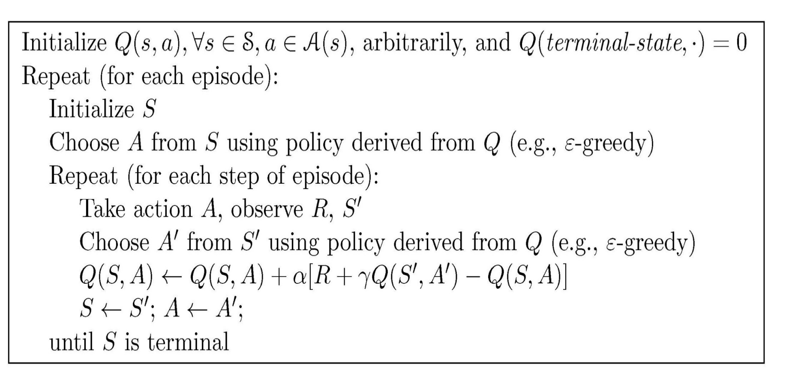
SARSA Pseudo-Code
S’
A
S

Slide 25
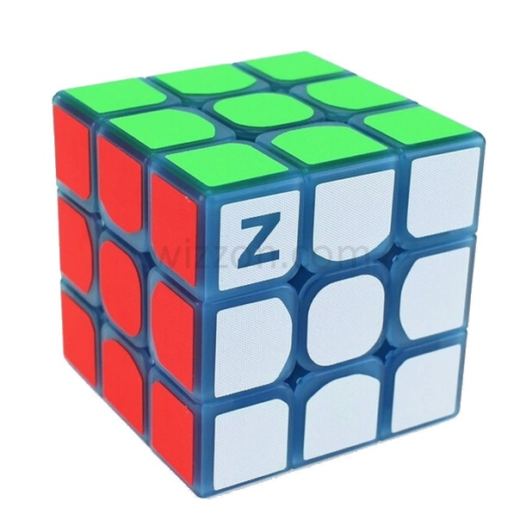
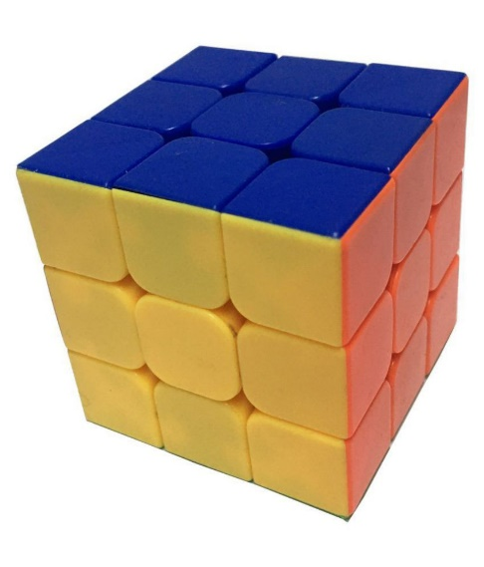
Visualization Challenges

