Slide 1
April 10 News
GHC Tasks for groups L, M and N have been posted. Group L will present on April 17. Group O’s topic will be posted next week.
There will be a Diffusion Model Lecture and Lab, taught by Raunak, on April 15!
We had some technical issues with the Task1 scores and comments; it looks like the Task1 comments disappeared; we expect to fix this problem in a couple of days.
Organization of Today’s Lecture
  Brief Discussion of Task 6
  Recap Naïve Bayes
  Bayesian Belief Networks (BBN)
  Brief Discussion Task 7 (April 17)
  Hidden Markov Models (HMM; April 24)

Slide 2
Reasoning Under Uncertainty
Quick Review Probability Theory
Bayes’ Theorem and Naïve Bayesian Systems short
Bayesian Belief Networks (BBN)
Hidden Markov Models (HMM) somewhat short

Slide 3
Bayesian Belief Networks (BBN)
  Structure and Concepts
  Netica Demo
  Task 6 ProblemSet3
  D-Separation
  How do they compute probabilities?
  How to design BBN using simple examples
  Other capabilities of Belief

Slide 4
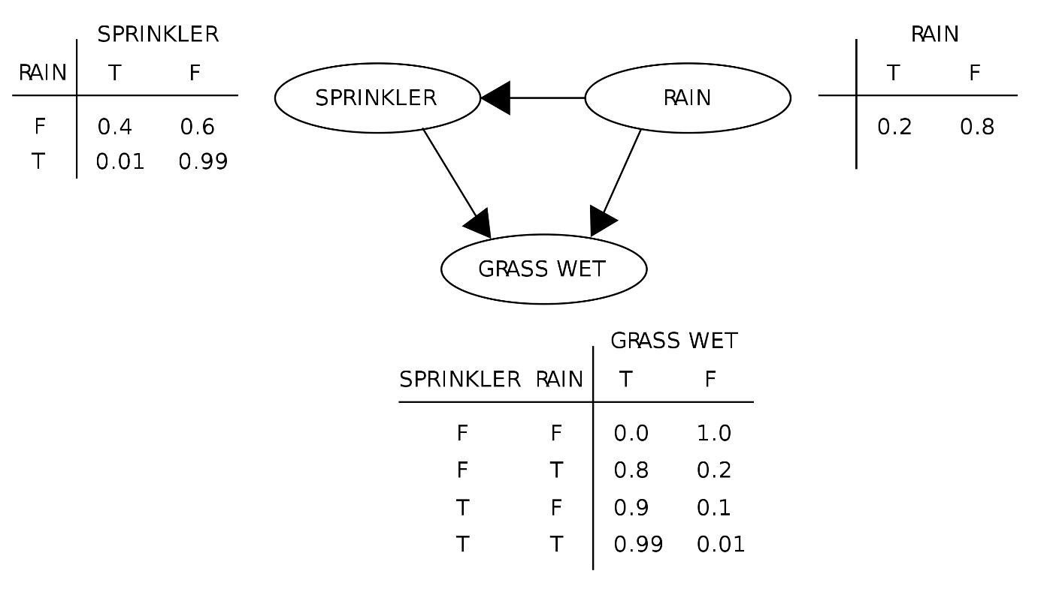
Example BBN
e.g. P(R)=0.2
e.g. P(S|R=F)=0.4
P(S|~R)=0.4
e.g. P(G|S,~R)=0.9
A BBN is a model of the joint probability distribution P(G,S,R) involving 3 Boolean random variables G, S, R. It captures which of those variables are dependent/independent.

Slide 5
Bayesian Belief Networks (BBN)
A Bayesian Belief Network is a probabilistic graphical model (a type of statistical model) that represents a set of random variables and their conditional dependencies via a directed acyclic graph (DAG).
Bayesian networks are ideal for taking an event that occurred and predicting the likelihood possible causes or effects of this event.
More powerful than Naïve Bayesian approaches, as BBN allows to express specific dependencies and independencies between random variables using a concept call d-separation.
Given n (Boolean) random variables X₁,…,X_{n}. A BBN is a model of the joint probability distribution P(X₁,…,X_{n}).
BBN allow inference given evidence e.g. X₁=0, X₃=1; that is, BBN compute how this evidence affects the probability of other variables; e.g:
  P(X₂|X₁=0, X₃=1)
  P(X₄|X₁=0, X₃=1)
  …

Slide 6
Netica Belief Network Tool
Install Netica (http://www.norsys.com/download.html ) on your computer by April 24, 2023!!
Netica Demo (not used in 2023): https://www.bing.com/videos/search?q=Netica+Belief+Network+Video&docid=608012763257973235&mid=211EC384EDBA2A0A61A8211EC384EDBA2A0A61A8&view=detail&FORM=VIRE

Slide 7


Bayes’ Nets: Big Picture
Two problems with using full joint distribution tables as our probabilistic models:
  Unless there are only a few variables, the joint is WAY too big to represent explicitly
  Hard to learn (estimate) anything empirically about more than a few variables at a time
Bayes’ nets: a technique for describing complex joint distributions (models) using simple, local distributions (conditional probabilities)
  More properly called graphical models
  We describe how variables locally interact
  Local interactions chain together to give global, indirect interactions
  For about 10 min, we’ll be vague about how these interactions are specified

Slide 8


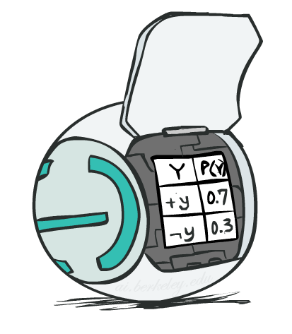
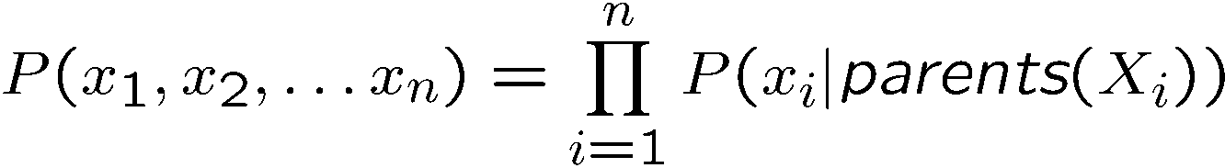
Bayes Net Semantics
A directed, acyclic graph, one node per random variable
A conditional probability table (CPT) for each node
  A collection of distributions over X, one for each combination of parents’ values
Bayes’ nets implicitly encode joint distributions
  As a product of local conditional distributions
  To see what probability a BN gives to a full assignment, multiply all the relevant conditionals together:

Slide 9
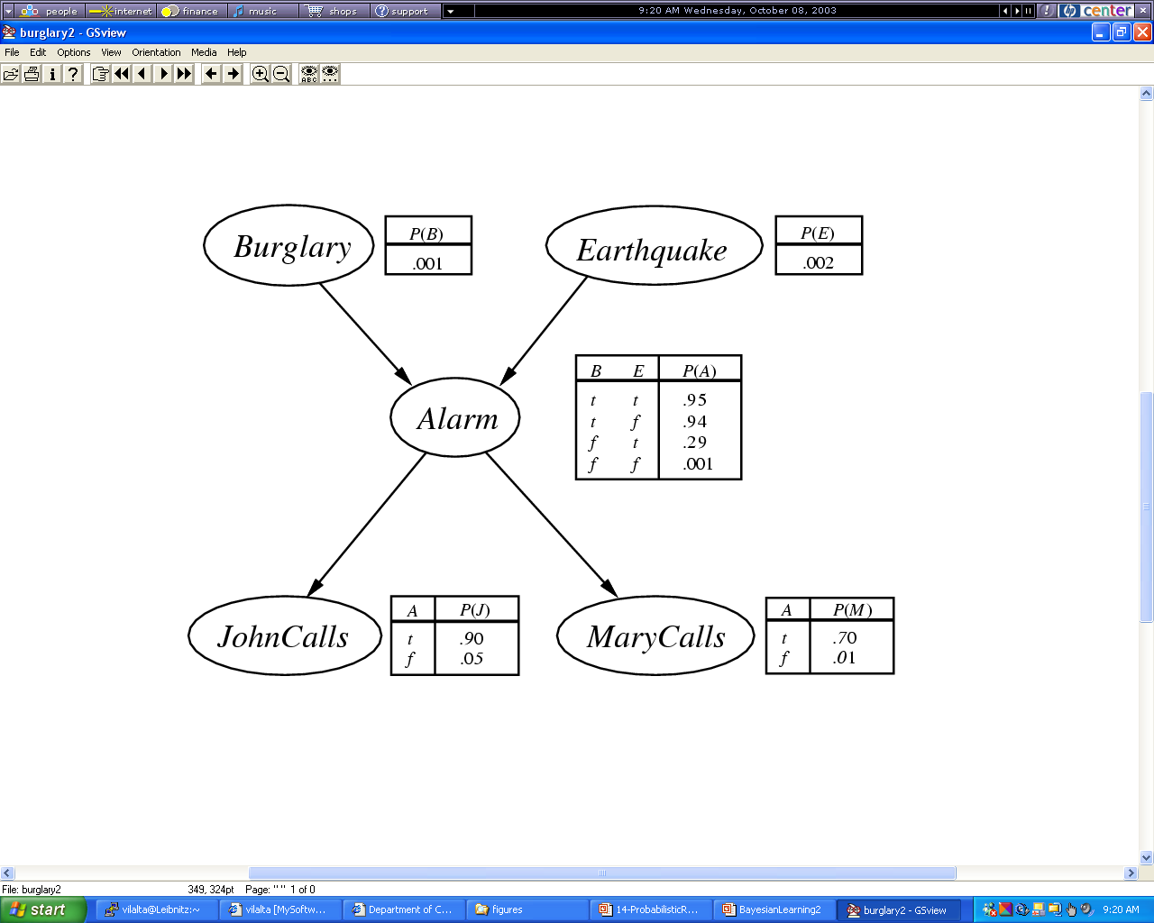
Example 2
BN: probability of a variable only depends on its direct successors; e.g.
P(b,e,a,~j,m)= P(b)*P(e)*P(a|b,e)*P(~j|a)*P(m|a)=0.01*0.02*0.95*0.1*0.7
Notes:
What is machine learning?

Slide 10
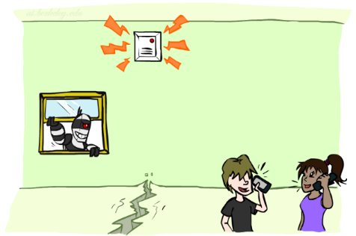

Example: Alarm Network
B | P(B)
+b | 0.001
-b | 0.999
B
E
E | P(E)
+e | 0.002
-e | 0.998
A
A | J | P(J|A)
+a | +j | 0.9
+a | -j | 0.1
-a | +j | 0.05
-a | -j | 0.95
A | M | P(M|A)
+a | +m | 0.7
+a | -m | 0.3
-a | +m | 0.01
-a | -m | 0.99
B | E | A | P(A|B,E)
+b | +e | +a | 0.95
+b | +e | -a | 0.05
+b | -e | +a | 0.94
+b | -e | -a | 0.06
-b | +e | +a | 0.29
-b | +e | -a | 0.71
-b | -e | +a | 0.001
-b | -e | -a | 0.999
J
M
Notes:
demo

Slide 11

Example: Alarm Network
B | P(B)
+b | 0.001
-b | 0.999
B
E
E | P(E)
+e | 0.002
-e | 0.998
A
A | J | P(J|A)
+a | +j | 0.9
+a | -j | 0.1
-a | +j | 0.05
-a | -j | 0.95
A | M | P(M|A)
+a | +m | 0.7
+a | -m | 0.3
-a | +m | 0.01
-a | -m | 0.99
B | E | A | P(A|B,E)
+b | +e | +a | 0.95
+b | +e | -a | 0.05
+b | -e | +a | 0.94
+b | -e | -a | 0.06
-b | +e | +a | 0.29
-b | +e | -a | 0.71
-b | -e | +a | 0.001
-b | -e | -a | 0.999
J
M
Remark: The probability tables on this page are slightly
different from those on the previous slide!
Notes:
demo

Slide 12


Size of a Bayes Net
How big is a joint distribution over N Boolean variables?
  2^{N}
How big is an N-node net if nodes have up to k parents?
  O(N * 2^{k+1})
Both give you the power to calculate
BNs: Huge space savings!
Also easier to elicit local CPTs
Also faster to answer queries (coming)

Slide 13
Rules for BBNs to Solve the Inference Problem
Simplifying Assumption: Let X₁,…,X_{n} be the variables of a belief network and all variables have binary states:
P(X₁,…,X_{n})= Π P(X_{i}|Parents(X_{i})) “allows to compute all atomic events/joint distribution”
P(X₁,…,X_{p-1})= P(X₁,…,X_{p-1},X_{p}) + P(X₁,…,X_{p-1},~X_{p})
P(X|Y) = α∗ P(X,Y) where α =1/P(Y)
P(X|Y)=P(Y|X)*P(X)/P(Y) Bayes Theorem
P(A,B)=P(A)*P(B|A)=P(A|B)*P(B)
P(X|Y)=R1 and P(~X|Y)=R2 ⇒ 1=R1+R2
Remark: The first 3 equations are sufficient to compute any probability in a belief network; however, using this approach is highly inefficient; e.g. with n=20 computing P(X₁|X₂) would require the addition of 2¹⁸+2¹⁹ probabilities. Therefore, more efficient ways to compute probabilities are needed; e.g. if X₁ and X₂ are independent, only P(X₁) needs to be computed. Another way to speedup computations is using probabilities that are already known and do not need to be computed and taking advantage of the fact that probabilities add up to 1
n
i=1

Slide 14


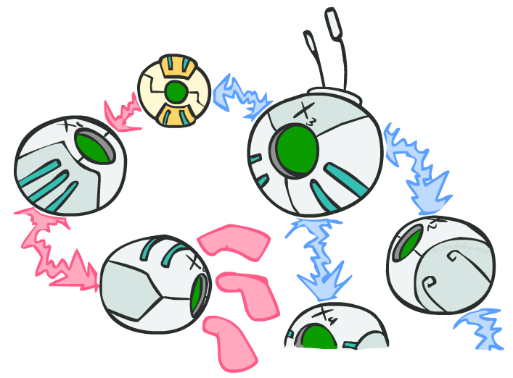
D-Separation
?
Query:
Check all (undirected!) paths between and
  If one or more active, then independence not guaranteed
  Otherwise (i.e. if all paths are inactive),
  then independence is guaranteed

Slide 15
D-Separation
Might also watch: 3b. Bayesian Networks: Independence and d-Separation (Chapter 4) - Bing video start: 14:00
Belief Networks abandon the simple independence assumptions of naïve Bayesian systems and replace them by a more complicated notion of independence called d-separation.
Problem: Given evidence involving a set of variables E; when are two X and Y of a belief network independent (d-separated)?
Why is this question important? If X and Y are d-separated (given E)
P(X&Y|E)=P(X|E)*P(Y|E) and
P(X|E&Y)=P(X|E)
D-separation is used a lot in belief network computations (see P(D|S1,S2) example to be discussed later); particularly to speed up belief network computations.

Slide 16
D-Separation :=All paths between members of X and Y must match one of the following 4 patters:
Y
X
E(in E, not in E)
sequential
(1a)
sequential
(1b)
divergent
(2)
convergent
(3)

Slide 17
Determining if a path is blocked
A
B
C
D
E
Is A d-separable from E given evidence {C}
A
B
C
D
E
A
C
B
D
E

Slide 18
D-Separation
A
D
C
B
More examples:
25-bn (washington.edu)
E
Questions
i) P(A,B|C) = P(A|C)*P(B|C) “Are A and B d-separable given evidence C
yes, because… one path A-C-B which is blocked in node C as C in evidence (pattern 2). However, A is not d-separable from B given no evidence (evidence=∅)
ii) P(C,E|D) = P(C|D)*P(E|D) “Are C and E d-separable given evidence D”
no, because there is a direct arrow from E to C; no path will over be blocked no matter what is in evidence
iii) Is A d-separable from D given evidence E?
There are two paths; A-C-E-D; this path is blocked in E (pattern 1b)
A-C-D; this path is not blocked (C would need to ingoing edges for blockage)
As not all paths are blocked A is not d-separable from D given E

Slide 19
Active / Inactive Paths
Question: Are X and Y conditionally independent given evidence variables {Z}?
  Yes, if X and Y “d-separated” by Z
  Consider all (undirected) paths from X to Y
  No active paths = independence!
A path is active if each triple is active:
  Causal chain A -> B -> C where B is unobserved (either direction)
  Common cause A <- B -> C where B is unobserved
  Common effect (aka v-structure)
  A -> B <- C where B or one of its descendants is observed
All it takes to block a path is a single inactive segment
Active Triples
Inactive Triples

Slide 20


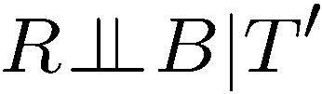
Example
Yes
R
B
T
T’
Notes:
T’: traffic report

Slide 21
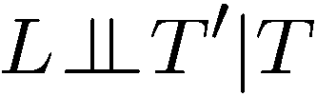


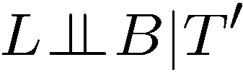

Example
L
Yes
R
B
Yes
D
T
Yes
T’

Slide 22



Example
Variables:
  R: Raining
  T: Traffic
  D: Roof drips
  S: I’m sad
Questions:
R
T
D
S
Yes

Slide 23

Structure Implications
Given a Bayes net structure, can run d-separation algorithm to build a complete list of conditional independences that are necessarily true of the form
This list determines the set of probability distributions that can be represented

Slide 24
Assume that the following belief network is given, consisting of nodes A, B, C, D, and E that can take values of true and false.
A/
B
E
C
D/.
b) Is E|CD d-separable from A|CD? Give a reason for your answer! [3]
There are 2 paths between A and E (in this case C and D are green and all other nodes are red):
A-C-B-E neither node C(in evidence) satisfies patterns 1a,1b or 2 nor node B (not in evidence) satisfies
pattern 3; therefore this path is not blocked; for this pathe to be clocked either B needs to ingoing arrows or
C needs at least one outgoing arrow for this path to be blocked.
A-C-D-E node D(in evidence) satisfies pattern 1a; consequently, this path is blocked.
However, as not all paths are blocked between E and A, A|CD is not d-separable from E|CD

Slide 25
April 17 News
GHC: Groups M and O will present April 24, and group N will present on April 29 (last class of the semester).
The Task6 deadline has been extended to Mo., April 22!
Lecture on Language Models taught by Mahin on April 22!
The scores of Task1-4 have been posted; we will also add some info on performance statistics in the next couple of days.
Organization of Today’s Class:
  Reasoning in Uncertain Environments
  Brief Discussion of Task 7
  GHC Presentation of Group M
  Hidden Markov Models (HMM; April 24)

Slide 26
Inference Problem
  Given a set of probabilities X and an unknown Probability P(A|B): Compute the probability of P(A|B) using the probabilities given in X.

Slide 27
Rules for BBNs to Solve the Inference Problem
Simplifying Assumption: Let X₁,…,X_{n} be the variables of a belief network and all variables have binary states:
P(X₁,…,X_{n})= Π P(X_{i}|Parents(X_{i})) “allows to compute all atomic events/joint distribution”
P(X₁,…,X_{p-1})= P(X₁,…,X_{p-1},X_{p}) + P(X₁,…,X_{p-1},~X_{p})
P(X|Y) = α∗ P(X,Y) where α =1/P(Y)
P(X|Y)=P(Y|X)*P(X)/P(Y) Bayes Theorem
P(A,B)=P(A)*P(B|A)=P(A|B)*P(B)
P(X|Y)=R1 and P(~X|Y)=R2 ⇒ 1=R1+R2
Remark: The first 3 equations are sufficient to compute any probability in a belief network; however, using this approach is highly inefficient; e.g. with n=20 computing P(X₁|X₂) would require the addition of 2¹⁸+2¹⁹ probabilities. Therefore, more efficient ways to compute probabilities are needed; e.g. if X₁ and X₂ are independent, only P(X₁) needs to be computed. Another way to speedup computations is using probabilities that are already known and do not need to be computed and taking advantage of the fact that probabilities add up to 1
n
i=1

Slide 28
Compute P(G|~R)
e.g. P(R)=0.2
e.g. P(S|R=F)=0.4
P(S|~R)=0.4
e.g. P(G|S,~R)=0.9
Compute: P(G|~R)=P(G,~R)/P(~R)=P(G,~R)/0.8=0.228/0.8=0.36
P(G,~R)=P(G,~R,S)+P(G,~R,~S)=
0.8*0.4*0.9 + 0.8*0.6*0=0.288
e.g. for the first formula we compute: P(~R)*P(S|~R)*P(G|~R,S)

Slide 29
Fred Complains / John Complains Problem
Assume that John and Fred are students taking courses together for which they receive a grade of A, B, or C. Moreover, sometimes Fred and John complain about their grades. Assume you have to model this information using a belief network that consists of the following variables:
Grade-John: John’s grade for the course (short GJ, has states A, B, and C)
Grade-Fred: John’s grade for the course (short GF, has states A, B, and C)
Fred-Complains: Fred complains about his grade (short FC, has states true and false)
John-Complains: John complains about his grade (short JC, has states true and false)
If Fred gets an A in the course he never complains about the grade; if he gets a B he complains about the grade in 50% of the cases, if he gets a C he always complains about the grade. If Fred does not complain, then John does not complain. If John’s grade is A, he also does not complain. If, on the other hand, Fred complains and John’s grade is B or C, then John also complains. Moreover: P(GJ=A)=0.1, P(GJ=B)=0.8, P(GJ=C)=0.1 and P(GF=A)=0.2, P(GF=B)=0.6, P(GF=C)=0.2.
Design the structure of a belief network including probability table that involves the above variables (if there are probabilities missing make up your own probabilities using common sense)
Using your results from the previous step, compute P(GF=C|JC=true) by hand! Indicate every step that is used in your computations and justify transformation you apply when computing probabilities!

Slide 30
Example FC/JC Network Design
GF
GJ
Specify Nodes and States
Specify Links
Determine Probability Tables
Use Belief Network
FC
JC
Nodes GF and GJ have states {A,B,C}
Nodes FC and JC have states {true,false};
Notations: in the following,
we use FC as a short notation for FC=true and
Use ~FC as a short notation for FC=false;
Similarly, we use JC as a short notation for JC=true and
Use ~JC as a short notation for JC=false.
We also write P(A,B) for P(A ∧B).

Slide 31
Example FC/JC Network Design
GF
GJ
Specify Nodes and States
Specify Links
Determine Probability Tables
Use Belief Network
FC
JC
Next probability tables have to be specified for each node in the network; for
each value of a variable conditional probabilities have to be specified that
depend on the variables of the parents of the node; for that above
example these probabilities are: P(GF), P(GJ), P(FC|GF), P(JC|FC,GJ):
P(GJ=A)=0.1, P(GJ=B)=0.8, P(GJ=C)=0.1
P(GF=A)=0.2, P(GF=B)=0.6, P(GF=C)=0.2
P(FC|GF=A)=0, P(FC|GF=B)=0.5, P(FC|GF=C)=1
P(JC|GJ=A,FC)=0, P(JC|GJ=A,~FC)=0, P(JC|GJ=B,FC)=1,
P(JC|GJ=B,~FC)=0, P(JC|GJ=C,FC)=1, P(JC|GJ=C,~FC)=0.

Slide 32
Remarks Computation in BBNs
A,B stands for A and B and ‘~’ represents ‘not’; e.g. P(A,~B|D) represents P(A and not(B)|D)
P(A,B|E) can be computed in 2 ways:
  P(A,B|E)= P(A|E)*P(B|A,E)
  P(A,B|E)= P(B|E)*P(A|B,E)
If A|E is d-separable from B|E there is a third way to compute P(A,B|E):
P(A,B|E)= P(A|E)*P(B|E)
P(A) can be computed as an exhaustive enumeration involving other variables: e.g. P(A)=P(A,B,C)+P(A,~B,C)+P(~A,B,C)+P(A,~B,~C)
The challenge to compute a probability for a believe network is transform this formula efficiently into a formula that only use probabilities which are stored in probability tables.
Using the fact that A|E is d-separated to B|E often allows to simplify those computations.

Slide 33
Advice for Computing Particular Probabilities
The goal is to reduce the probability you need to compute to probability computations that only involve probabilities that are given in the tables of the belief network.
Many things can be computed in different ways: P(A,B)=P(A)*P(B|A)=P(B)*A(A|B). Choose the way to compute it that takes advantage what is already in the probability tables of belief network or what probabilities you already computed. For example, if P(A|B) is already in a probability table use the second.
If you know P(B|A) and have to compute P(A|B) use Bayes Theorem which relates the two.
Sometimes you have formulas for P(S|A) and for P(~S|A) with two unknown probabilities and you take advantage of P(S|A)+P(~S|A)=1 to find the two unknown probabilities.
Take advantage of d-separation to simplify formulas/computation!
If everything fails, use the joint probably distribution; these always works but might be time consuming!

Slide 34
Fred/John Complains Problem
To be further discussed on April 24!
P(FC)=P(FC|GF=A)*P(GF=A) + P(FC|GF=B)*P(GF=B) + P(FC|GF=C)*P(GF=C) = 0*0.2 + 0.5x0.6 + 1x0.2 = 0.5
P(JC)= … (problem description) = P(FC,GJ=B) + P(FC,GJ=C) = (d-separation of FC and GJ) = P(FC)*0.8 + P(FC)*0.1=P(FC)*0.9=0.45
P(JC|FC)= P(JC,GJ=A|FC) + P(JC,GJ=B|FC) + P(JC,GJ=A|FC) = P(GJ=A|FC)*P(JC|GJ=A,FC) + … + … = (GJ and FC are d-separated) = P(GJ=A)*P(JC|GJ=A,FC) + P(GJ=B)*P(JC|GJ=B,FC) + P(GJ=A)* P(JC|GJ=A,FC) = 0.1*0 + 0.8x1 + 0.1x1 = 0.9
P(JC|GF=C)= P(JC,FC|GF=C) + P(JC,~FC|GF=C) = P(FC|GF=C)*P(JC|FC,GF=C) + P(~FC|GF=C)*P(JC|~FC,GF=C) = (given FC: JC and GF are d-separated) = P(FC|GF=C)*P(JC|FC) + P(~FC)GF=C)*P(JC|~FC) = 1*(JC|FC) + 0= 0.9
P(GF=C|JC)= (Bayes’ Theorem) = P(JC|GF=C)* P(GF=C) / P(JC) = 0.9*0.2/0.45=0.4
(1)
(3)
(4)
(2)
Remark: In the example P(GF=B) and P(GF=B|JC) are both 0.6, but
P(GF=C) is 0.2 whereas P(GF=C|JC)=0.4

Slide 35
Compute P(D|S1,S2)!!
S1
B
D
S2
All 3 variables of B have binary states: {T,F}
P(D) is a short notation for P(D=T) and P(S2|~D) is a short notation for P(S2=T|D=F).
B’s probability tables contain: P(D)=0.1, P(S1|D)=0.95, P(S2|D)=0.8, P(S1|~D)=0.2, P(S2|~D)=0.2
Task: Compute P(D|S1,S2)

Slide 36
Computing P(D|S1,S2)
P(D|S1,S2)=P(D)*P(S1,S2|D))/P(S1,S2) using Bayes Theorem
P(D|S1,S2)=P(D)*P(S1|D)*P(S2|D)/P(S1,S2) because S1|D indep S2|D
P(~D|S1,S2)=P(~D)*P(S1|~D)*P(S2|~D)/P(S1,S2) S1|D indep S2|D
(2+3) 1=(P(D)*P(S1|D)*P(S2|D) + P(~D)*P(S1|~D)*P(S2|~D))/P(S1,S2)
P(S1,S2)= P(D)*P(S1|D)*P(S2|D) + P(~D)*P(S1|~D)*P(S2|~D)
P(D|S1,S2)= α / α + β with
α=P(D)*P(S1|D)*P(S2|D) and β =P(~D)*P(S1|~D)*P(S2|~D)
For the example α=0.1*0.95*0.8=0.076 and β =0.9*0.2*0.2=0.036
P(D|S1,S2)=0.076/0.112=0.678
S1
B’s probability tables contain: P(D)=0.1, P(S1|D)=0.95, P(S2|D)=0.8, P(S1|~D)=0.2, P(S2|~D)=0.2
B
D
S2

Slide 37
How do Belief Network Tools Perform These Computations?
Basic Problem: How to compute P(Variable|Evidence) efficiently?
  The asked probability has to be transformed (using definitions and rules of probability, d-separation,…) into an equivalent expression that only involves known probabilities (this transformation can take many many steps especially if the belief network contains many variables and “long paths” between the variables).
  For a given expression a large number of transformation can be used (e.g. P(A,B,C)=…)
  In general, the problem has been shown to be NP-hard
Popular algorithms to solve this problem include: Junction Trees (Netica), Loop Cutset, Cutset Conditioning, Stochastic Simulation, Clustering (Hugin),…
https://www.codeweavers.com/compatibility/crossover/netica
http://www.norsys.com/download.html

Slide 38
Other Capabilities of Belief Network Tools
Learning belief networks from empirical data
Support for continuous variables
Support to map continuous variables into nominal variables
Support for popular density functions
Support for utility computations and decision support https://www.bing.com/videos/search?q=Netica+Belief+Network+Video&&view=detail&mid=D0AA17CC113DDD3AB796D0AA17CC113DDD3AB796&rvsmid=211EC384EDBA2A0A61A8211EC384EDBA2A0A61A8&FORM=VDQVAP https://www.youtube.com/watch?v=_TYVhyMy85w
… (many other things)

Slide 39
Fred/John Complains Problem
P(FC)=P(FC|GF=A)*P(GF=A) + P(FC|GF=B)*P(GF=B) + P(FC|GF=C)*P(GF=C) = 0*0.2 + 0.5x0.6 + 1x0.2 = 0.5
P(JC)= … (problem description) = P(FC,GJ=B) + P(FC,GJ=C) = (d-separation of FC and GJ) = P(FC)*0.8 + P(FC)*0.1=P(FC)*0.9=0.45
P(JC|FC)= P(JC,GJ=A|FC) + P(JC,GJ=B|FC) + P(JC,GJ=A|FC) = P(GJ=A|FC)*P(JC|GJ=A,FC) + … + … = (GJ and FC are d-separated) = P(GJ=A)*P(JC|GJ=A,FC) + P(GJ=B)*P(JC|GJ=B,FC) + P(GJ=A)* P(JC|GJ=A,FC) = 0.1*0 + 0.8x1 + 0.1x1 = 0.9
P(JC|GF=C)= P(JC,FC|GF=C) + P(JC,~FC|GF=C) = P(FC|GF=C)*P(JC|FC,GF=C) + P(~FC|GF=C)*P(JC|~FC,GF=C) = (given FC: JC and GF are d-separated) = P(FC|GF=C)*P(JC|FC) + P(~FC)GF=C)*P(JC|~FC) = 1*(JC|FC) + 0= 0.9
P(GF=C|JC)= (Bayes’ Theorem) = P(JC|GF=C)* P(GF=C) / P(JC) = 0.9*0.2/0.45=0.4
(1)
(3)
(4)
(2)
Remark: In the example P(GF=B) and P(GF=B|JC) are both 0.6, but
P(GF=C) is 0.2 whereas P(GF=C|JC)=0.4

Slide 40
Some Task 6 Probabilitees
P(M1=4|N=3, F1=0)
P(M1=3|N=3, F1=0)
P(M1=1|N=3, F1=1)
P(N=4)

Slide 41
Some Task 6 Probabilities
P(M1=4|N=3, F1=0)=0.05
P(M1=3|N=3, F1=0)=0.95
P(M1=1|N=3, F1=1)=0.5
P(N=4)=1/7=0.14…

