Slide 1
News March 25
March 27: Introduction to Autoencoders and Task4 Lab taught by Mahin.
Task2 is due Tu., March 26 end of the day…
Optional GHC AlphaGo Presentation on April 15!
Today’s Lecture:
Neural Network Basics and Deep Learning
More on Reinforcement Learning the Group Project

Slide 2
Neural Network Basics and Short Introduction to Deep Learning
Raunak Sarbajna
COSC 3337
November 16, 2023
Edited by Dr. Eick on March 24, 2024

Slide 3
What is machine learning?
What is artificial intelligence?
Artificial intelligence is the ability of a computer to perform tasks commonly associated with intelligent beings.
Machine learning is the study of algorithms that learn from examples and experience instead of relying on hard-coded rules and make predictions on new data.
What is deep learning?
Deep learning is a subfield of machine learning focusing on learning data representations as successive layers of increasingly meaningful representations.

Slide 4
Why Deep Learning ?
DL provides a flexible, learnable framework for representing visual, text, linguistic information
Can learn in supervised and unsupervised manner
DL represents an effective end-to-end learning system
Requires large amounts of training data
Since about 2010, DL has outperformed other ML techniques
First in vision and speech, then NLP, and other applications

Slide 5
“Traditional” machine learning:
handcrafted features
learned classifier
cat
Deep, “end-to-end” learning:
learned low-level features
learned mid-level features
learned high-level features
learned classifier
cat

Slide 6
Problems - No-Free-Lunch Theorem
Wolpert (2002) - The Supervised Learning No-Free-Lunch Theorems
The derived classification models for supervised learning are simplifications of the reality
The simplifications are based on certain assumptions
The assumptions fail in some situations
E.g., due to inability to perfectly estimate ML model parameters from limited data
In summary, No-Free-Lunch Theorem states:
No single classifier works the best for all possible problems
Since we need to make assumptions to generalize

Slide 7
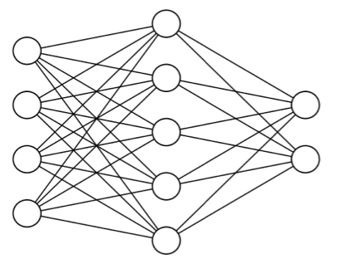
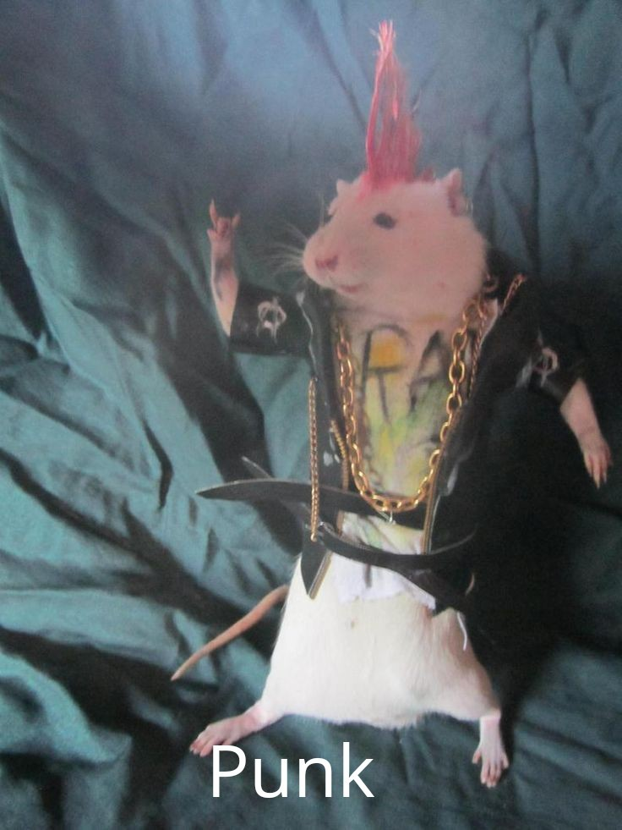
Pattern Recognition
Simple/intuitive for Humans. Hard for machines … but getting easier?
cat
dog
?????
Cat??
Nun

Slide 8
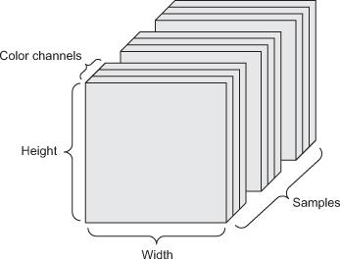
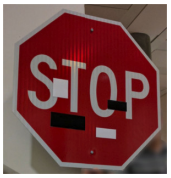
Machine Learning Data
Tensors: generalization of matrices to n dimensions (or rank, order, degree)
1D tensor: vector
2D tensor: matrix
3D, 4D, 5D tensors
numpy.ndarray(shape, dtype)
Training – validation – test split
Minibatches
small sets of input data used at a time
usually processed independently
Image from: https://arxiv.org/abs/1707.08945

Slide 9
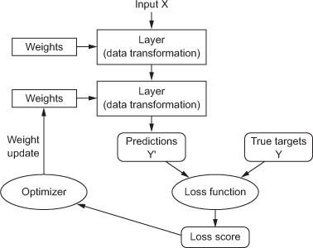
Basic Deep Neural Network Structure
Layers
Input data and targets
Loss function
Optimizer

Slide 10
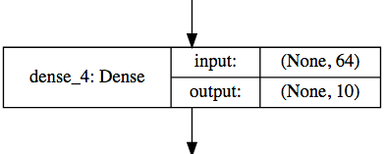
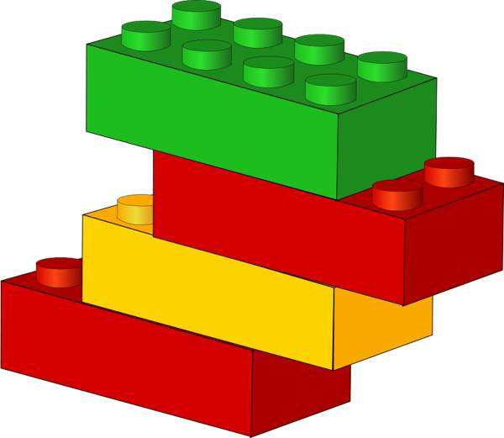
Layers
Data processing modules
Many different kinds exist
densely connected
convolutional
recurrent
pooling, flattening, merging, normalization, etc.
Input: one or more tensors output: one or more tensors
Usually have a state, encoded as weights
learned, initially random
When combined, form a network or a model

Slide 11
Input data and targets
The network maps the input data X to predictions Y′
During training, the predictions Y′ are compared to true targets Y using the loss function
cat
dog

Slide 12
Loss function
The objective function to be minimized (optimized) during training
the only thing the network cares about
there might also be other metrics you care about
Common tasks have “standard” loss functions:
mean squared error for regression
Accuracy in classification
Reconstruction error for autoencoder
https://lossfunctions.tumblr.com/

Slide 13
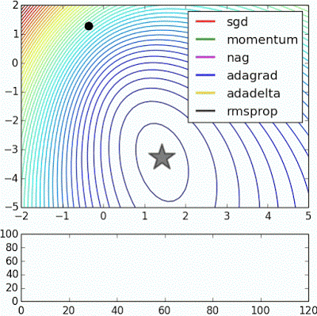
Optimizer
How to update the weights based on the loss function
Learning rate (+scheduling)
Stochastic gradient descent, momentum, and their variants
RMSProp is usually a good first choice
more info: http://ruder.io/optimizing-gradient-descent/
Animation from: https://imgur.com/s25RsOr
Notes:
RMSProp mentioned in Hinton’s lecture notes

Slide 14
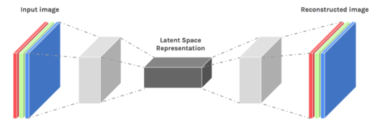
Autoencoders
Autoencoders are designed to reproduce their input, especially for images.
Key point is to reproduce the input from a learned encoding.
https://www.edureka.co/blog/autoencoders-tutorial/

