Slide 1
A Novel Spati0-temporal Framework for Detecting and Tracking Events in Twitter
Yongli Zhang and Christoph F. Eick
Department of Computer Science
University of Houston
Data Analysis and Intelligent Systems Lab (UH-DAIS)
AIKE’18

Slide 2
OUTLINE
INTRODUCTION
THE TWO-STAGE SYSTEM
EXPERIMENTAL RESULTS
RELATED WORK
FUTURE WORK
Conclusion
Data Analysis and Intelligent Systems Lab (UH-DAIS)
AIKE’18

Slide 3
1. Introduction
Motivation
People have been using Twitter to report “almost everything” from their daily lives as well as their view of the world; consequently, monitoring, analyzing and mining this rich and continuously user-generated content can reveal unprecedentedly valuable knowledge.
Such information can be used to help individuals, corporations, or government organizations to stay informed of “what is happening now” and to acquire actionable knowledge.
Broad applications for knowledge extracted from Twitter: Improve decision making, product recommendation, disaster and emergency management, emotion and happiness analysis, security, social and political analysis.
Data Analysis and Intelligent Systems Lab（UH-DAIS)
AIKE’18

Slide 4
Introduction
Research Focus:
Developing an efficient framework capable of detecting and tracking events in Twitter.
Integrating NLP techniques and machine learning techniques.
Data Analysis and Intelligent Systems Lab (UH-DAIS)
AIKE’18

Slide 5
Introduction
Research Focus:
Specifically, this work integrates an LDA-based approach for topic discovery and an density-contour based spatio-temporal clustering approach.
The density-contour based approach extends an approach called ST-COPOT [0], which is capable of processing very large data streams in approximately linear time.
Data Analysis and Intelligent Systems Lab（UH-DAIS)
AIKE’18

Slide 6
OUTLINE
INTRODUCTION
THE TWO-STAGE SYSTEM
EXPERIMENTAL RESULTS
RELATED WORK
FUTURE WORK
Conclusion
Data Analysis and Intelligent Systems Lab（UH-DAIS)
AIKE’18

Slide 7
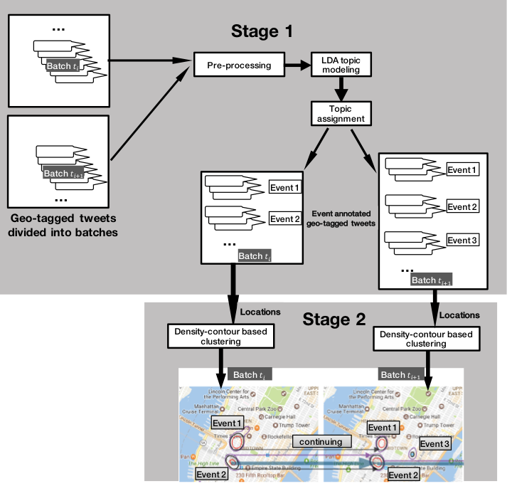
2. The Two-stage System
Data Analysis and Intelligent Systems Lab（UH-DAIS)
AIKE’18

Slide 8
The Two-stage System
Inputs:
Geotagged Tweets
the content of the tweet
its location in longitude and latitude
its time stamp
Data collection area
Outputs:
Set of topic-specific spatial clusters and a graph that summarizes how the spatial clusters evolve in time (graph of related spatial event clusters)
Data Analysis and Intelligent Systems Lab（UH-DAIS)
AIKE’18

Slide 9
The Two-stage System cont.
Stage 1: LDA-based topic extraction
Preprocessing: divide geotagged tweets into batches, text preprocessing: e.g. remove non-alphabetical characters, urls, stop words.
Latent Dirichlet Allocation: extract topics from all tweets inside each batch, obtaining a topic list.
Topic Assignment: assign topic label to each tweet from the topic list
Stage 2: Spatio-temporal event tracking
Obtain spatial event clusters
Obtain spatio-temporal clusters by identifying
continuing spatial clusters in consecutive batches
Supports relative and absolute density
Data Analysis and Intelligent Systems Lab（UH-DAIS)
AIKE’18

Slide 10
The Two-stage System cont.
Stage 1: LDA-based topic extraction
Latent Dirichlet Allocation:
Latent Dirichlet Allocation is a generative model that allows sets of observations to be explained by unobserved groups;
If observations are words collected into documents, it hypothesizes that each document is a mixture of a small number of topics and that each word’s creation is attributable to one of the document’s topics.
In a nutshell, LDA computes topics which are a weighted list of words.
Data Analysis and Intelligent Systems Lab（UH-DAIS)
AIKE’18

Slide 11
The Two-stage System cont.
Stage 1: LDA-based topic extraction
Topic Assignment:
After LDA-based topic discovery step, we get topic distribution and term distribution for each topic.
To determine the dominant topic in a tweet, we basically add the weights of topic words that occur in the tweet for each topic, and assign the topic with the highest sum to the tweet─we might also decide that there is no “dominating topic” for a particular tweet.
Data Analysis and Intelligent Systems Lab（UH-DAIS)
AIKE’18

Slide 12
The Two-stage System cont.
Stage 2: Spatio-temporal event tracking
“Absolute” and “relative” density estimation
Use non-parametric kernel density estimation (KDE) to obtain a 2-dimensional spatial density function f.
The kernel density estimator is defined as follows:
NOTE: Our current implementation uses Gaussian Kernel Density estimation: $K\left(\left(x,y\right);σ\right)=\left(\frac{1}{2σπ}\right)∗e\frac{−(x∗∗2+y∗∗2)}{2σ^{2}}$
$$K$$
Data Analysis and Intelligent Systems Lab（UH-DAIS)
AIKE’18

Slide 13
The Two-stage System cont.
Stage 2: Spatio-temporal event clustering and tracking
“Absolute” and “relative” density estimation
A straightforward relative risk function can be expressed as the ratio of the actual case density f and control case density g respectively:
In our application, we consider tweet locations of a particular event as the case, and all the geotagged tweets collected in the data collection area as the control case.
Data Analysis and Intelligent Systems Lab（UH-DAIS)
AIKE’18

Slide 14
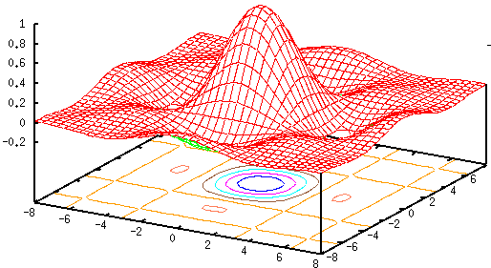
The Two-stage System cont.
Stage 2: Spatio-temporal event tracking
Extracting spatial event clusters
We use contouring algorithms and a post-processing to obtain polygons that describe the region of spatial event clusters [2]
Density function
Data Analysis and Intelligent Systems Lab (UH-DAIS)
AIKE’18

Slide 15
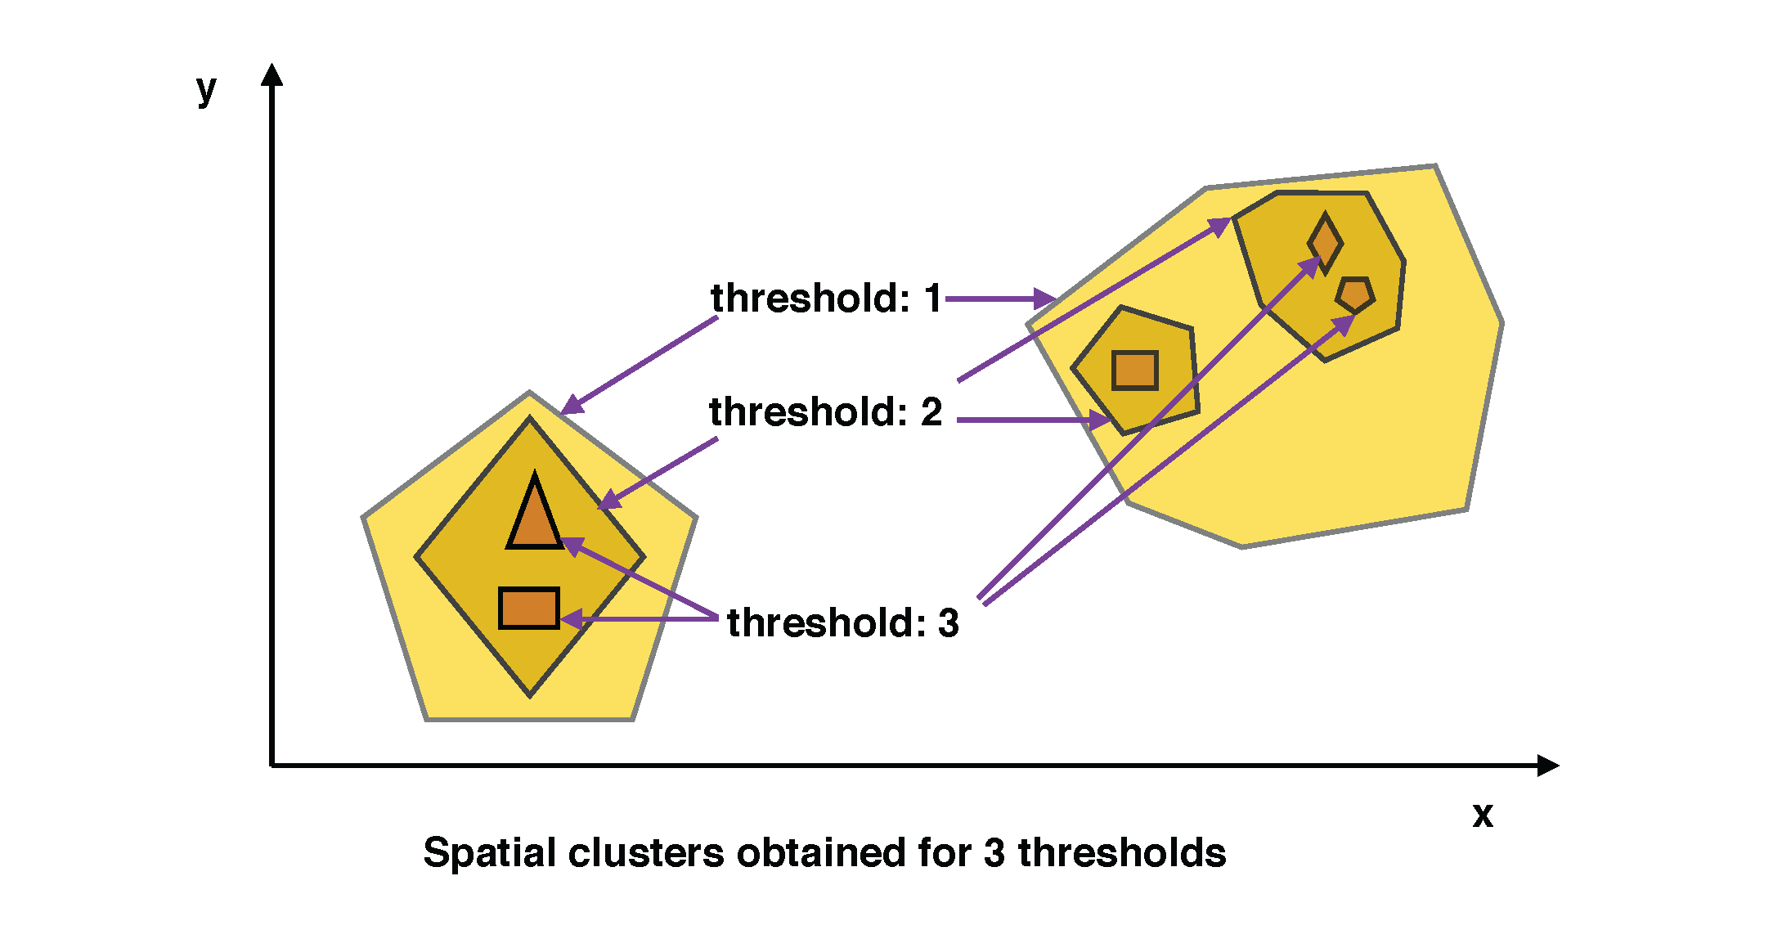
The Two-stage System cont.
Stage 2: Spatio-temporal event tracking
Extracting spatial event clusters
Contour Polygon Tree
Data Analysis and Intelligent Systems Lab（UH-DAIS)
AIKE’18

Slide 16
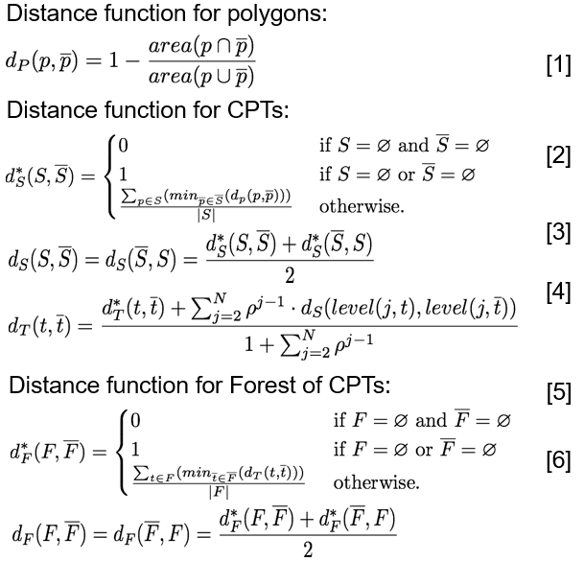
The Two-stage System cont.
Stage 2: Spatio-temporal event tracking
Extracting spatio-temporal event clusters
Topic continuity: by calculating the KL-divergence of topic lists for consecutive batches, we are able to calculate the distances between those topics;
Define a set of distance functions to identify continuing relationship from contour polygon trees obtained for two consecutive batches:
- continuing polygons
- continuing contour polygon trees
- continuing forests of contour
polygon trees
Data Analysis and Intelligent Systems Lab（UH-DAIS)
AIKE’18

Slide 17
OUTLINE
INTRODUCTION
THE TWO-STAGE SYSTEM
EXPERIMENTAL RESULTS
RELATED WORK
FUTURE WORK
Conclusion
Data Analysis and Intelligent Systems Lab (UH - DAIS)
AIKE’18

Slide 18
3. Experimental Results
Dataset: geotagged tweets related to the 2 events
We use two case studies to demonstrate our approach:
Case Study 1: Buffalo Snow Storm Event
On November 17-19 2014, a major lake effect snow storm, hit the Great Lakes region, dumping a record breaking 8 feet (2.4 m) of snow in the Buffalo, New York region. The storm stranded hundreds, killed 13, and caused a state of emergency.
Case Study 2: Ferguson Riots Event
On November 24-26: riots break out in Ferguson (a suburb of St. Louis, Missouri), after it was announced that there was insufficient evidence to indict officer Darren Wilson for shooting Michael Brown, the protests include mass looting and the burning of 12 buildings in Ferguson, as well as 29 arrests.
Data Analysis and Intelligent Systems Lab（UH-DAIS)
AIKE’18

Slide 19
Case Study 1: Buffalo Snow Storm Event
The KL-divergence between these topics are: 0.6424 (Nov 17->Nov 18), (Nov 18->Nov 19) 0.4524, both values indicate a strong continuity among the topics listed in table above.
As we can see, people start tweeting about the snow storm on Nov 17; however, the snow hasn’t caused serious problem yet. On Nov 18 and Nov 19, the topic shifts a little: people start tweeting the effect of the snowstorm, e.g. traffic, house, school, car et al.
Data Analysis and Intelligent Systems Lab（UH-DAIS)
AIKE’18

Slide 20
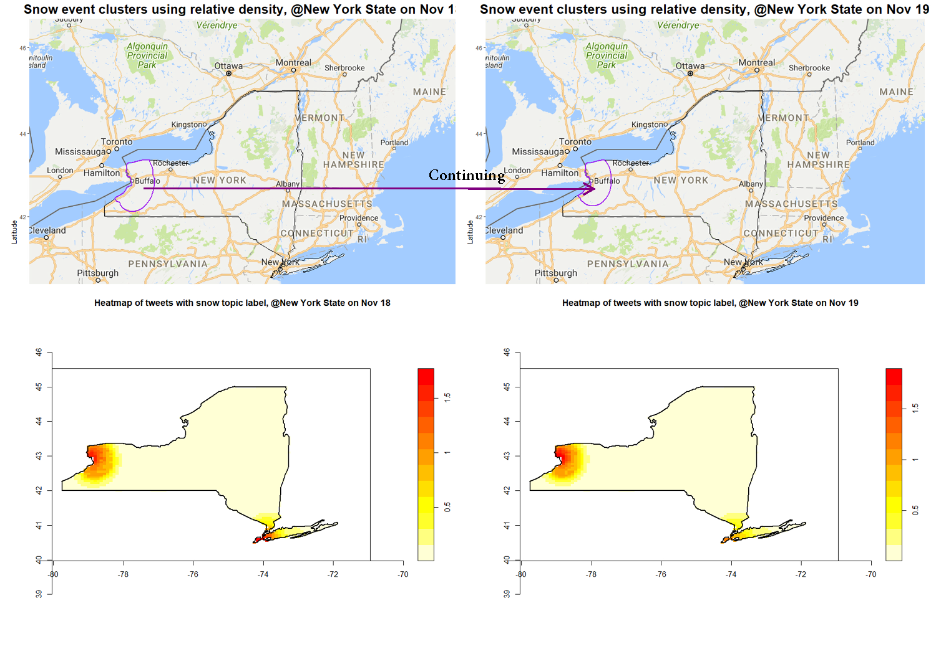
Case Study 1: Buffalo Snow Storm Event
State-wise result: relative density (top), absolute density (bottom)
Data Analysis and Intelligent Systems Lab（UH-DAIS)
AIKE’18

Slide 21
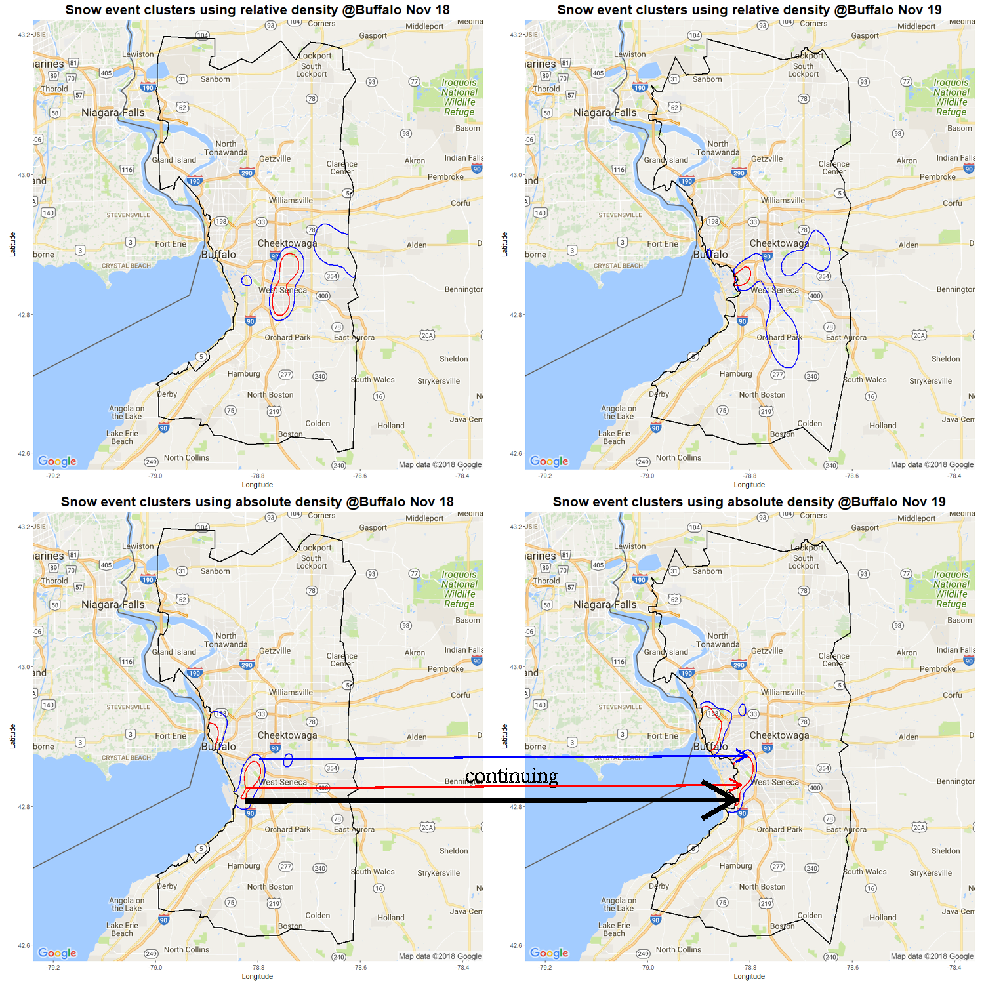
Case Study 1: Buffalo Snow Storm Event
Using relative density we are not able to identify any continuing clusters.
On November 18th, 3 dense regions are identified, east of Cheektowaga, West Seneca and a small region at West Seneca.
In terms of absolute density, there is a continuing cluster at the west of West Seneca. Another cluster is located in downtown Buffalo, the area of cluster increases on the following day.
City-wise result: relative density (top), absolute density (bottom)
Data Analysis and Intelligent Systems Lab（UH-DAIS)
AIKE’18

Slide 22
Case Study 2: Ferguson Riots Event
People start tweeting about the decision on Nov 24, moreover, riot has started.
On Nov 25 and Nov 26, the topic shifts a little, people start tweeting how the government handles the riot, e.g. national guard, police, etc.
Data Analysis and Intelligent Systems Lab（UH-DAIS)
AIKE’18

Slide 23
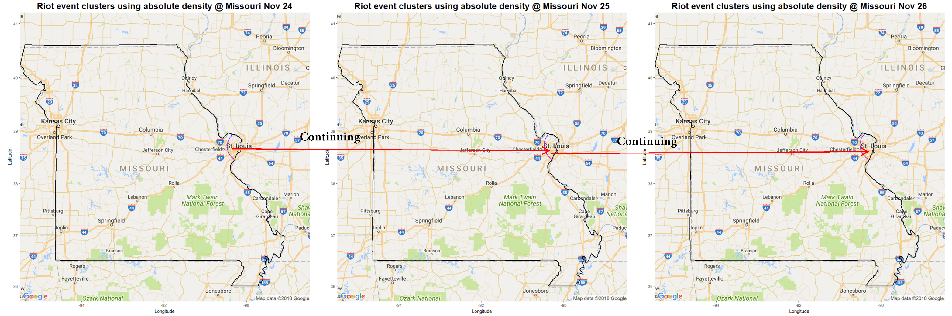
Case Study 2: Ferguson Riots Event
State-wise result @Missouri State
Using absolute density we are able to identify continuing clusters at and near St. Louis.
Data Analysis and Intelligent Systems Lab（UH-DAIS)
AIKE’18

Slide 24
Case Study 2: Ferguson Riots Event
Using relative density we are able to locate continuing clusters at Ferguson, the identified cluster becomes larger on November 25th, and on November 26th the density becomes higher which reflects that the riot event discussions become more intense.
Data Analysis and Intelligent Systems Lab（UH-DAIS)

Slide 25
OUTLINE
INTRODUCTION
THE TWO-STAGE SYSTEM
EXPERIMENTAL RESULTS
RELATED WORK
FUTURE WORK
Conclusion
Data Analysis and Intelligent Systems Lab (UH-DAIS)
AIKE’18

Slide 26
4. Related Work
Twitter-related Research Approaches
Latent Dirichlet Allocation as a probabilistic topic model has been very popular in recent years, it has used in a lot of Twitter-related research approaches [2, 4, 6].
Twitter Event Detection Approaches
some approaches detect real-world events by detecting abnormal spatial, temporal and semantic tweet frequencies and patterns in real time [10, 11];
some approaches detect events by analyzing hashtags [12, 13];
there are other approaches that use popular supervised, machine learning techniques for event detection (e.g. Naive Bayes, SVM) [14, 15].
AIKE’18
Data Analysis and Intelligent Systems Lab (UH-DAIS)

Slide 27
Related Work
Twitter Event Detection Approaches
there density-based clustering approaches for event detection in Twitter [16],
however, none of them are “serial” approaches, whereas our density-contour based approach uses time and space in a serial fashion, the serial approach is more efficient in terms of space and time complexity, the clustering results are easier to interpret as well.
Moreover, a lot of existing approaches are designed for specific application, e.g. disaster management [17], disease management [5], traffic management [1], etc. Some approaches need to build a classifier based on training data.
However, our system is quite general: it takes solely geotagged tweets as its input and applies to all trending topics, including disaster, concerts, games, riots etc; moreover, depending on the application; then, the user can detect and track events using either “absolute” density or “relative” density.
AIKE’18
Data Analysis and Intelligent Systems Lab (UH-DAIS)

Slide 28
OUTLINE
INTRODUCTION
THE TWO-STAGE SYSTEM
EXPERIMENTAL RESULTS
RELATED WORK
FUTURE WORK
Conclusion
Data Analysis and Intelligent Systems Lab (UH - DAIS)
AIKE’18

Slide 29
5. Future Work
A thorough experimental evaluation of the presented framework is needed.
We started working on the design of trending event engine that monitors twitter streams in real-time and alerts users to the occurrence of novel events and also provides the capability to produce movies that visualize the rise and fall of trending topics over time and space.
Part of the framework is reused in the Emotion Mapping and Emotion Change Analysis research (precious presentation)
Data Analysis and Intelligent Systems Lab (UH-DAIS)
AIKE’18

Slide 30
OUTLINE
INTRODUCTION
THE TWO-STAGE SYSTEM
EXPERIMENTAL RESULTS
RELATED WORK
FUTURE WORK
Conclusion
Data Analysis and Intelligent Systems Lab (UH-DAIS)
AIKE’18

Slide 31
6. Conclusion
We propose a novel serial, spatio-temporal system for detecting and tracking trending events in tweet streams.
The system characterizes such events using a set of weighted keywords, spatial regions describing where the particular event occurs, and by establishing continuity of those event regions over time.
The approach relies on contouring algorithms to obtain cluster regions and the paper proposes novel, area-weighted distance functions to assess temporal continuity.
Moreover, this is the first system that considers relative densities in addition to absolute densities for event tracking, and our experimental results demonstrate the need for providing such capabilities.
According to our experience, LDA-based topic discovery does not always “work as advertised”.
Data Analysis and Intelligent Systems Lab (UH-DAIS)
AIKE’18

Slide 32
References
[0] Y. Zhang and C. F. Eick, “St-Copot: Spatio-temporal clustering with contour polygon trees,” in Proceedings of the 25th ACM SIGSPATIAL International Conference on Geographic Informattion Systesm, 2017.
[1] Q. Yuan, G. Cong, Z. Ma, A. Sun, and N. M. Thalmann, “Who, where, when and what: discover spatio-temporal topics for twitter users,” in Proceedings of the 19th ACM SIGKDD international conference on Knowledge discovery and data mining. ACM, 2013, pp. 605–613.
[2] D. M. Blei, A. Y. Ng, and M. I. Jordan, “Latent dirichlet allocation,” Journal of machine Learning research, vol. 3, no. Jan, pp. 993–1022, 2003.
[3] J. Weng and B.-S. Lee, “Event detection in twitter.” ICWSM, vol. 11, pp. 401–408, 2011.
[4] J. H. Lau, N. Collier, and T. Baldwin, “On-line trend analysis with topic models: #twitter trends detection topic model online.” in COLING, 2012, pp. 1519–1534.
[5] J. Gomide, A. Veloso, W. Meira Jr, V. Almeida, F. Benevenuto, F. Ferraz, and M. Teixeira, “Dengue surveillance based on a computational model of spatio-temporal locality of twitter,” in Proceedings of the 3rd international web science conference. ACM, 2011, p. 3.
[6] X.-H. Phan, L.-M. Nguyen, and S. Horiguchi, “Learning to classify short and sparse text & web with hidden topics from large-scale data collections,” in Proceedings of the 17th international conference on World Wide Web. ACM, 2008, pp. 91–100.
[7] J. Bithell, “Estimation of relative risk functions,” Statistics in Medicine, vol. 10, no. 11, pp. 1745–1751, 1991.
[8] J. E. Kelsall, P. J. Diggle et al., “Kernel estimation of relative risk,” Bernoulli, vol. 1, no. 1-2, pp. 3–16, 1995.
[9] A. E. Gelfand, P. Diggle, P. Guttorp, and M. Fuentes, Handbook of spatial statistics. CRC press, 2010.
[10] S. Yardi and D. Boyd, “Tweeting from the town square: Measuring geographic local networks.” in ICWSM, 2010, pp. 194–201.
[11] J. Chae, D. Thom, H. Bosch, Y. Jang, R. Maciejewski, D. S. Ebert, and T. Ertl, “Spatiotemporal social media analytics for abnormal event detection and examination using seasonal-trend decomposition,” in Visual Analytics Science and Technology (VAST), 2012 IEEE Conference on. IEEE, 2012, pp. 143–152.
[12] A. Cui, M. Zhang, Y. Liu, S. Ma, and K. Zhang, “Discover breaking events with popular hashtags in twitter,” in Proceedings of the 21st ACM international conference on Information and knowledge management. ACM, 2012, pp. 1794–1798.
[13] W. Feng, C. Zhang, W. Zhang, J. Han, J. Wang, C. Aggarwal, and J. Huang, “Streamcube: hierarchical spatio-temporal hashtag clustering for event exploration over the twitter stream,” in Data Engineering (ICDE), 2015 IEEE
[14] H. Becker, M. Naaman, and L. Gravano, “Beyond trending topics: Realworld event identification on twitter.” Icwsm, vol. 11, no. 2011, pp. 438–441, 2011.
[15] K. Starbird, G. Muzny, and L. Palen, “Learning from the crowd: collaborative filtering techniques for identifying on-the-ground twitterers
during mass disruptions,” in Proceedings of 9th International Conference on Information Systems for Crisis Response and Management, ISCRAM, 2012.
[16] T. Sakai and K. Tamura, “Real-time analysis application for identifying bursty local areas related to emergency topics,” SpringerPlus, vol. 4, no. 1, p. 162, 2015.
[17] R. Thomson, N. Ito, H. Suda, F. Lin, Y. Liu, R. Hayasaka, R. Isochi, and Z. Wang, “Trusting tweets: The fukushima disaster and information source credibility on twitter,” in Proceedings of the 9th International ISCRAM Conference. Vancouver: Simon Fraser University, 2012, pp.1–10.
Data Analysis and Intelligent Systems Lab (UH-DAIS)
AIKE’18

Slide 33
Questions?
Data Analysis and Intelligent Systems Lab （UH-DAIS)
AIKE’18

Slide 34
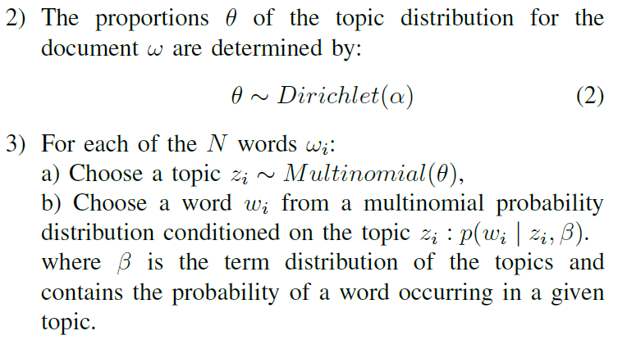
The Two-stage System cont.
Stage 1: LDA-based topic extraction
Latent Dirichlet Allocation: 3 steps:
Data Analysis and Intelligent Systems Lab（UH-DAIS)
AIKE’18

