Slide 1
Image-Space Morse Decomposition for 2D Vector Fields
Guoning Chen and Shuyu Xu
Department of Computer Science, University of Houston
chengu@cs.uh.edu

Slide 2
Outline
Background and motivation
Image-space Morse decomposition (ISMD) framework
Results of ISMD
An ensemble analysis based on ISMD
Discussions

Slide 3
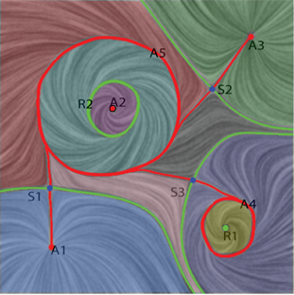
Background and Motivation
Why topology?
[Helman and Hesselink 1989; CGA91]
[Scheuermann et al. Vis97, TVCG98][Tricoche et al. Vis01, VisSym01]
[Theisel et al. CGF03][Polthier and Preuss 2003][Weinkauf et al VisSym04]
[Weinkauf et al. Vis05] [Chen et al. TVCG07]
It condenses the whole flow information into its skeletal representation or structure.
It provides a domain partitioning strategy which decomposes the flow domain into sub-regions. Within each sub-region, the flow behavior is homogeneous.

Slide 4
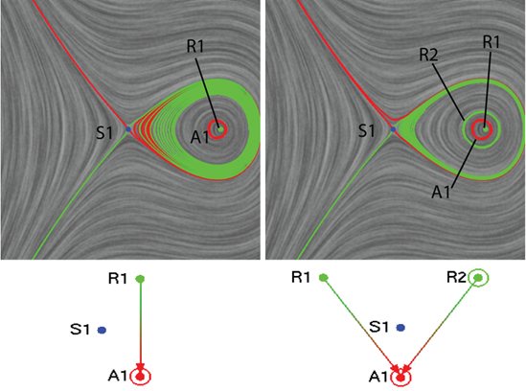
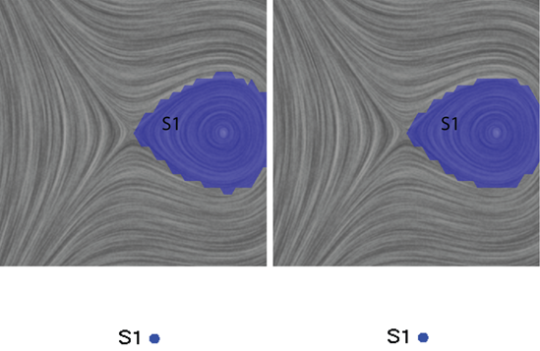
Background and Motivation
Why Morse decomposition?
[Conley 78] [Chen et al. TVCG08, TVCG12] [Szymczak EuroVis11] [Szymaczak and Zhang TVCG12] [Szymczak and Sipeki, Vis13]
It provides a more stable representation of vector field topology
Differential topology
Morse decomposition - MCG

Slide 5
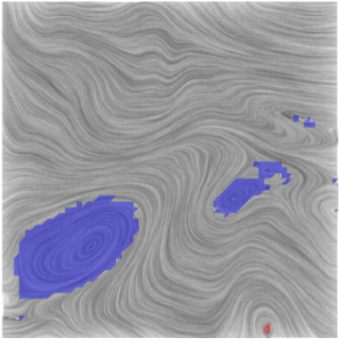
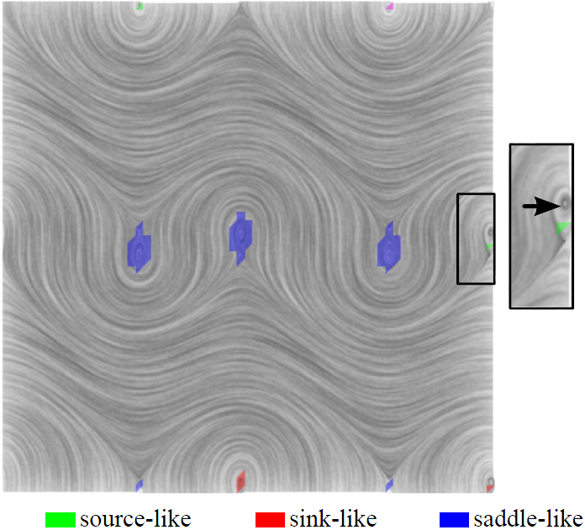
Background and Motivation
The problems of conventional Morse decomposition in object-space
Zig-zag boundaries of Morse sets
Possible inaccurate location of small features at boundary

Slide 6
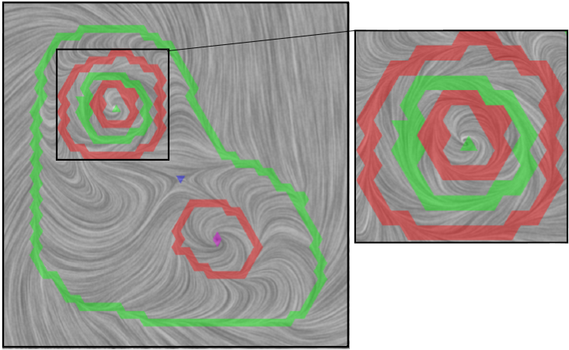
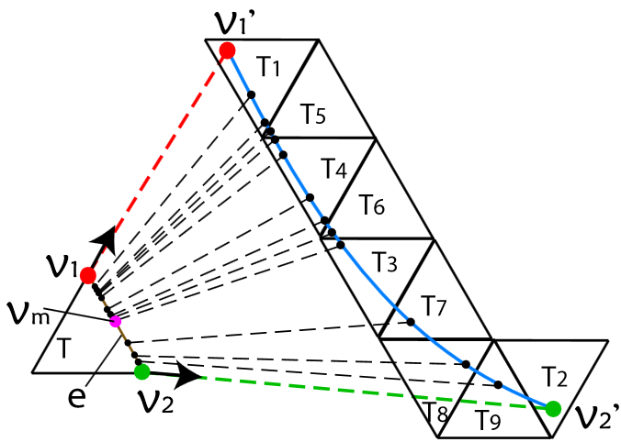
Background and Motivation
The problems of conventional Morse decomposition in object-space
Not able to show the stability of points falling in Morse sets
Slow and not easy to scale to higher-dimensional vector fields

Slide 7
Background and Motivation
Our contributions

Slide 8
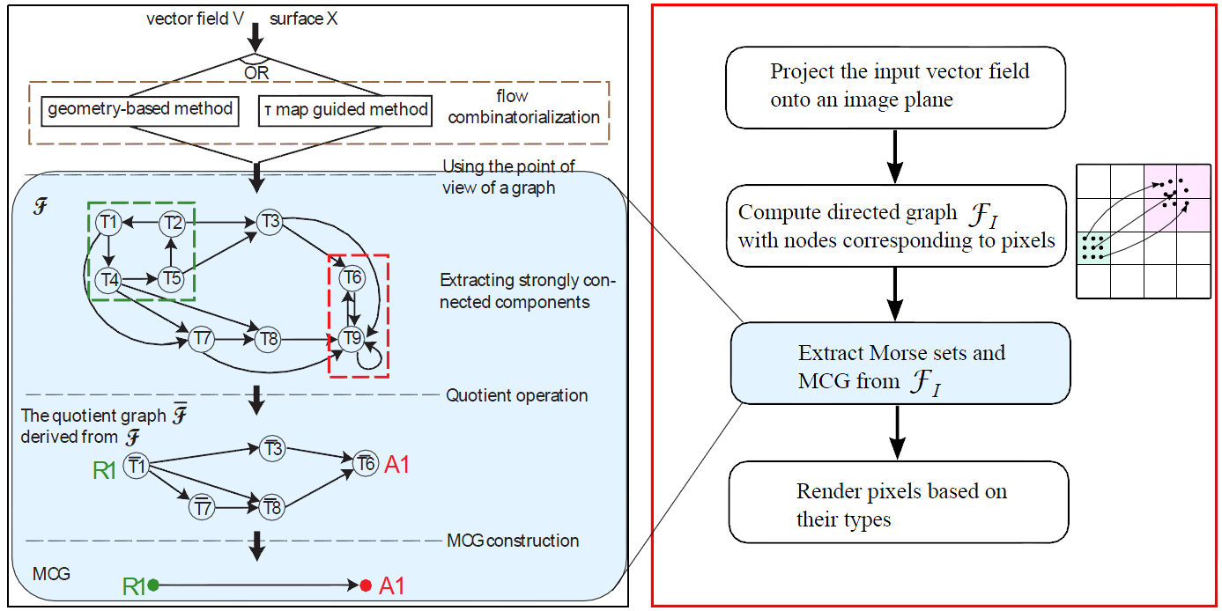
Image-Space Morse Decomposition

Slide 9
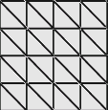
Image-Space Morse Decomposition
pixel j
node j
pixel k
node k
node i
pixel i
input
the projected vector field on an image plane
Densely placed samples within each pixel for the estimation of the flow map
The obtained sub-graph

Slide 10
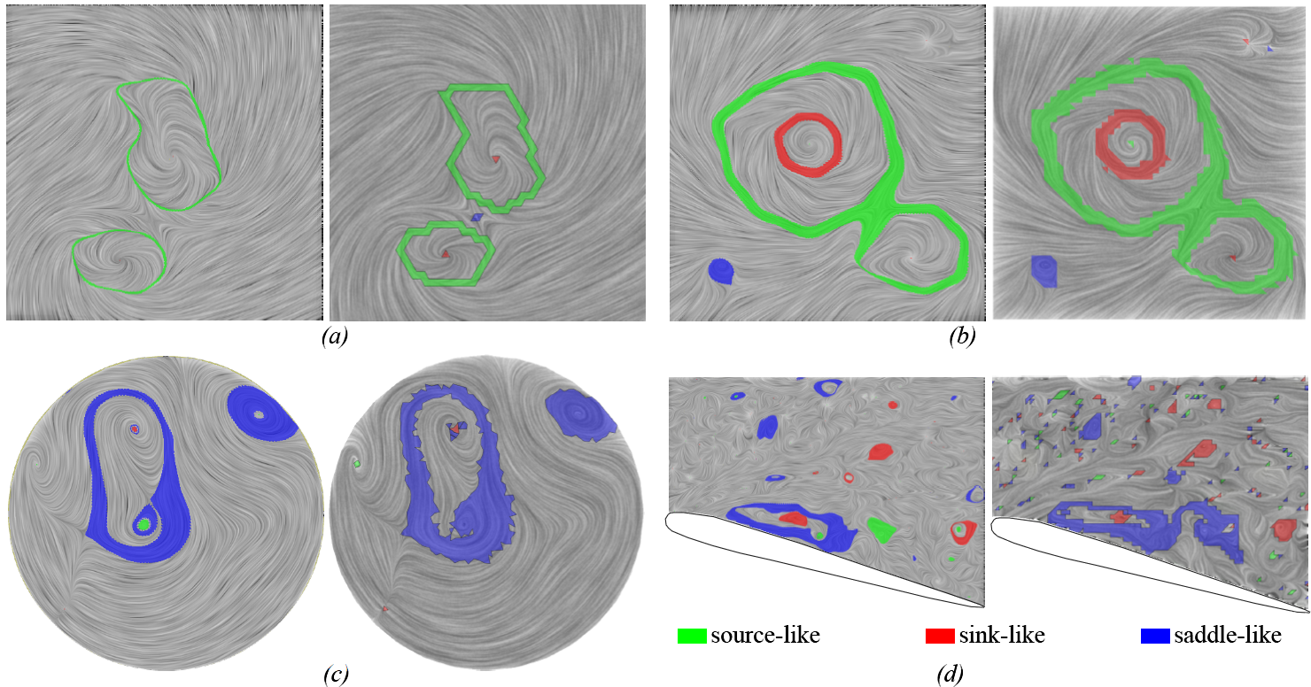
Results of ISMD

Slide 11
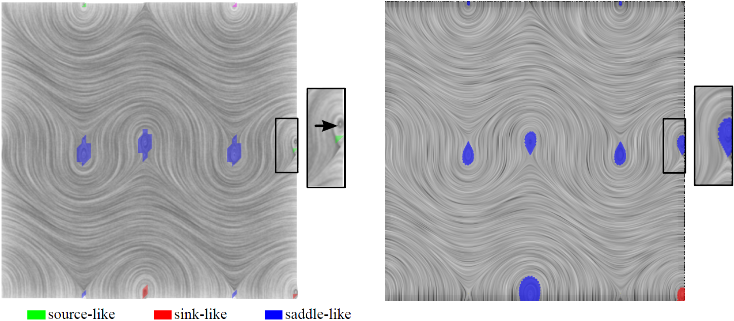
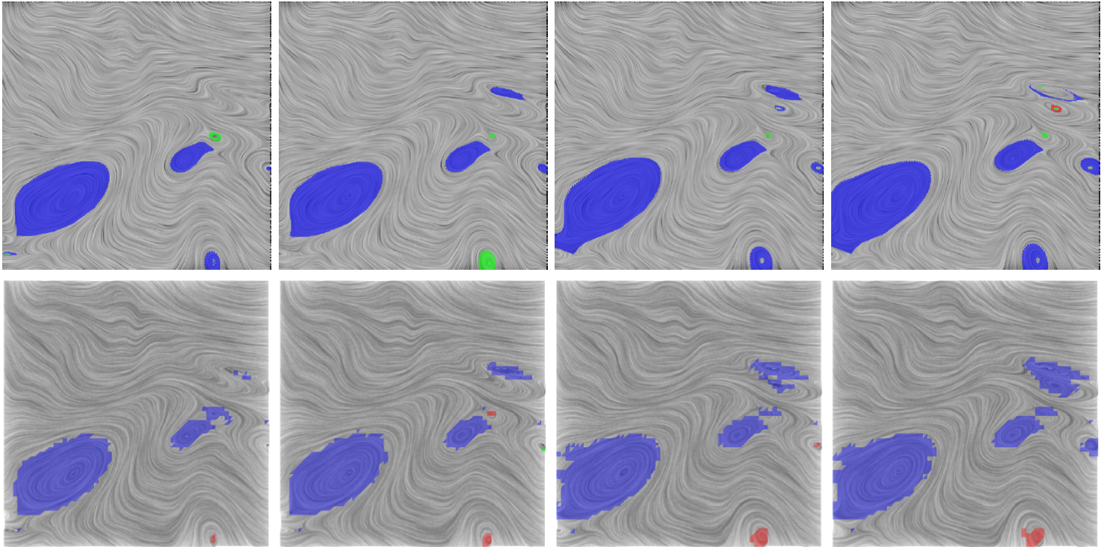
Results of ISMD
Conventional method
ISMD
ISMD
Conventional method

Slide 12
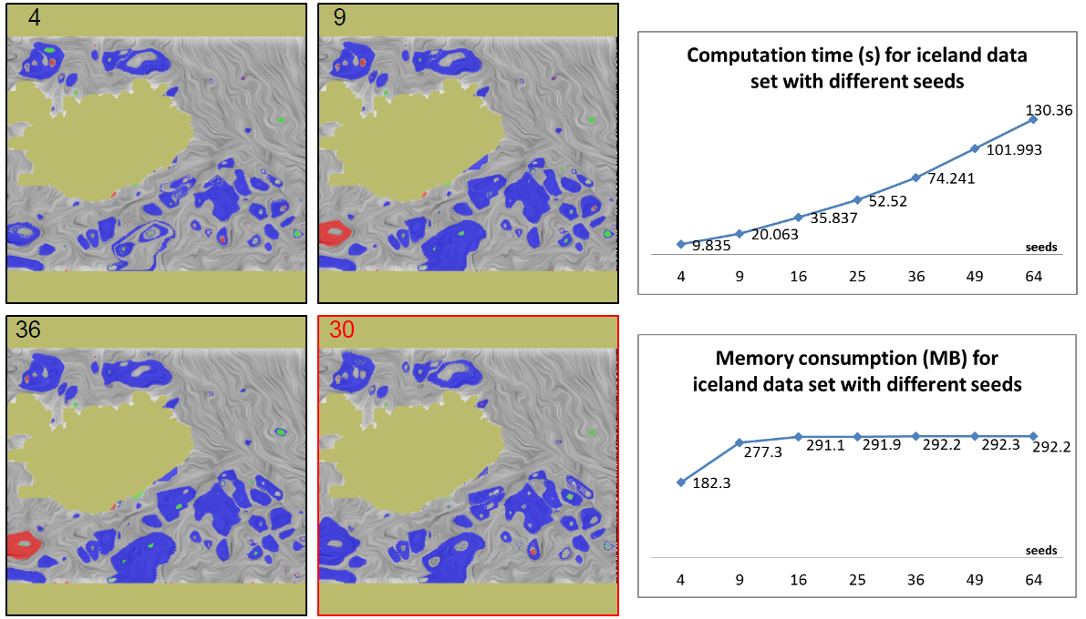
Performance Study
The effect of the number of seeds within each pixel

Slide 13
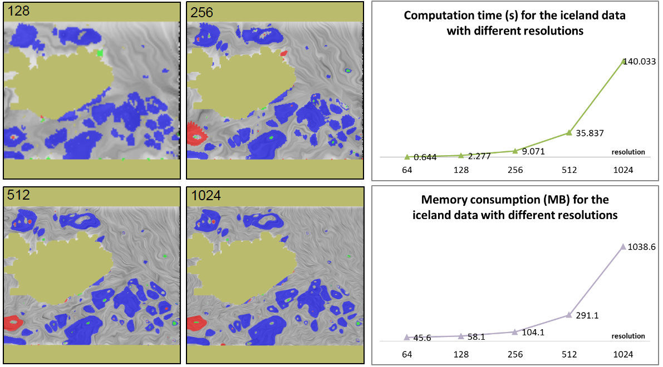
Performance Study
The effect of the image resolution

Slide 14
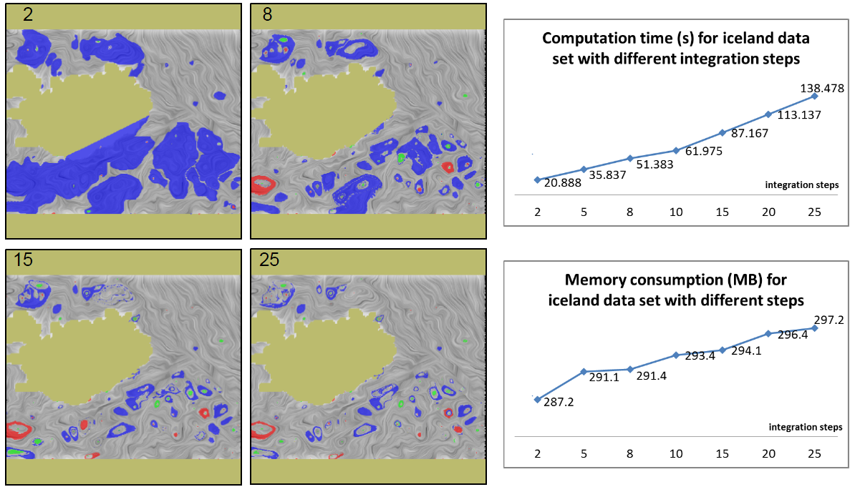
Performance Study
The effect of the integration step

Slide 15
Error Study
Error Type I: pixels in an ISMD Morse set but not in an object-space Morse set
Error Type II: pixels not in an ISMD Morse set but in an object-space Morse set.
Error Type I
Error Type II
Combined

Slide 16
Error Study

Slide 17
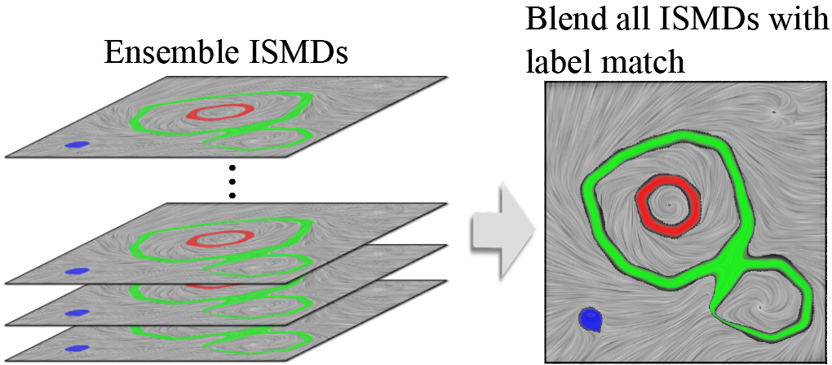
Study the Stability of Morse Sets
In this work, we consider two types of errors or uncertainty:
Contained in the data
Introduced by the numerical computation
For each type, we perform an ensemble computation using the ISMD framework.
We then combine the resulting ISMD with a simple pixel counting

Slide 18
Results of the Morse Set Stability Analysis
For errors introduced during the numerical computation, each run we randomly select one integrator from the possible candidates, including Euler, RK2, and RK4. We also randomly select the default integration step-size from 1/10 pixel size to ¼ pixel size.

Slide 19
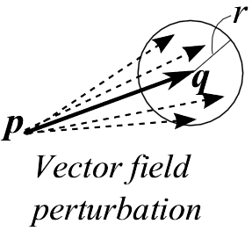
Results of the Morse Set Stability Analysis
Here, we randomly perturb the input vector field to generate a set of ensemble vector fields for this study. With the increase of the amount of perturbation, some of the Morse sets become unstable as highlighted.

Slide 20
How the above error and uncertainty affects the stability of Morse sets?

Slide 21
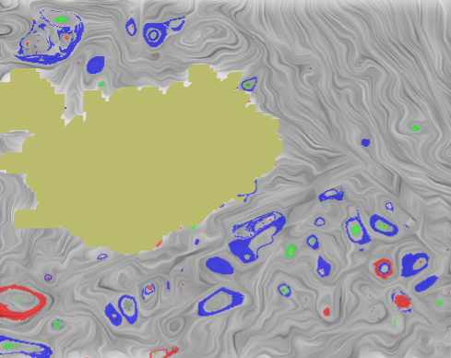
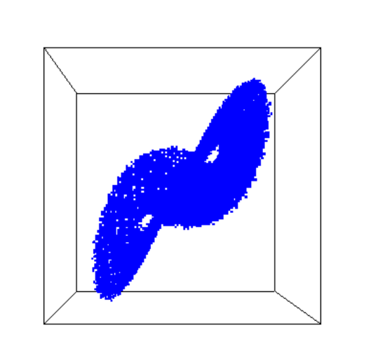
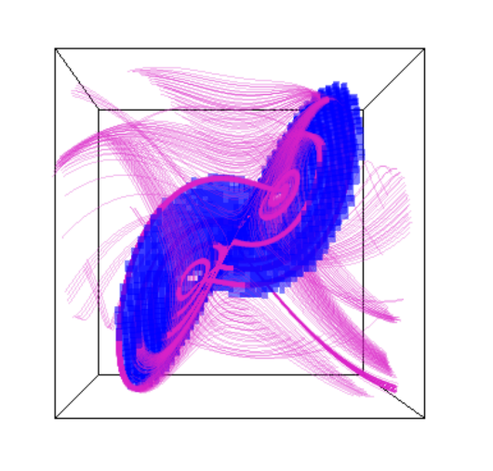
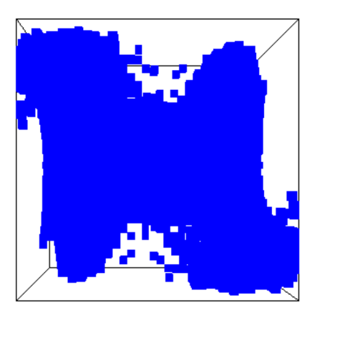
Discussions
Pros. of ISMD:
Simplicity
Easy to parallelize
Fine resolution
Cons. of ISMD:
Inaccurate
Extension to higher dimensional vector fields
Memory consumption
Inaccurate outer approximation.
The strange attractor in the Lorenz system.

Slide 22
Acknowledgments
People
Jacqueline H. Chen, Sandia National Lab
Mathew Maltude, Lawrence Livermore National Lab
James Liburdy, Oregon State University
Marzieh Berenjkoub
Funding Angency
National Science Foundation

