Slide 1
Vector Field Segmentation Based on Integral Curve Attributes
ChinaVis 2015
Lei Zhang and Guoning Chen, Department of Computer Science, University of Houston
Robert S. Laramee, Swansea University
David Thompson and Adrian Sescu, Mississippi State University

Slide 2
Outline
Background and pipeline
Attribute Fields
Definition and Computation
Segmentation Algorithm
Results
Conclusions and Discussions

Slide 3
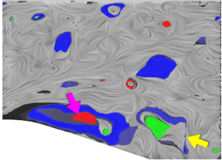
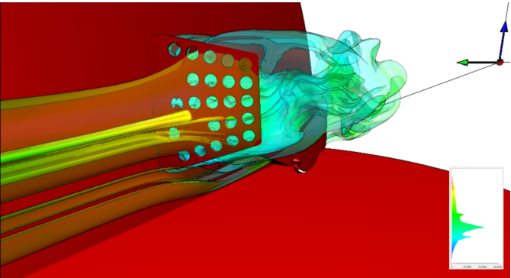
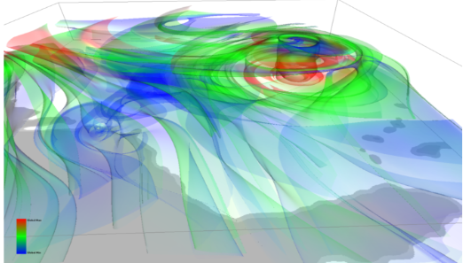
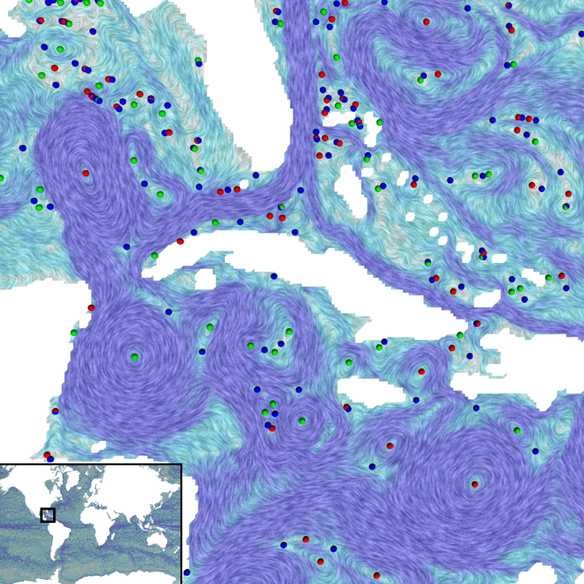
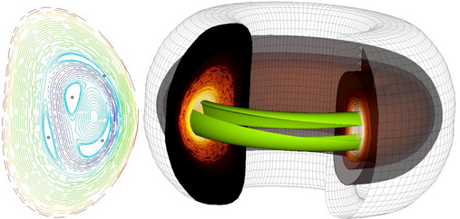
Vector Fields and Vector Field Analysis
Applications
Computational fluid dynamics
Mechanical engineering
Automobile/aircraft design
Climate study
Oceanography
New energy
Chemistry reaction
Medical applications
Computer graphics
…
[Chen and Xu 2015]
[Edmunds et al.2013]
[Edmunds et al.2012]
[Bhatia et al. 2012]
[Sanderson et al. 2011]

Slide 4
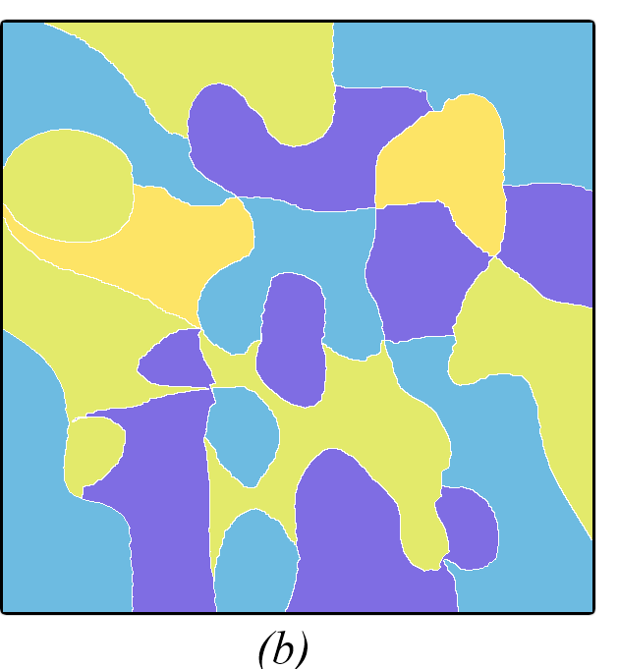
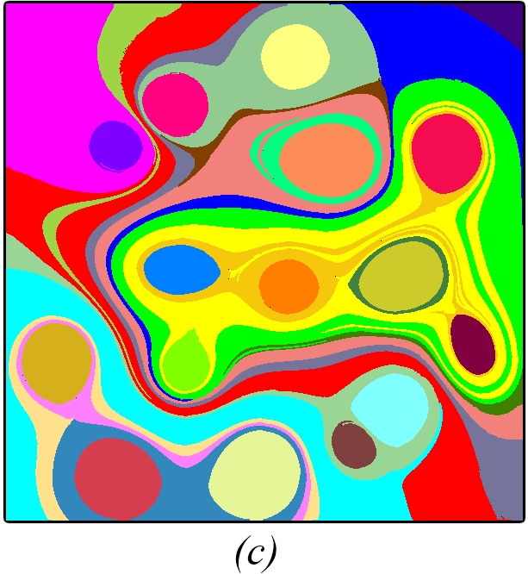
Problem and Motivation
Problem
flow segmentation
Motivation
local information
global information

Slide 5
Pipeline

Slide 6
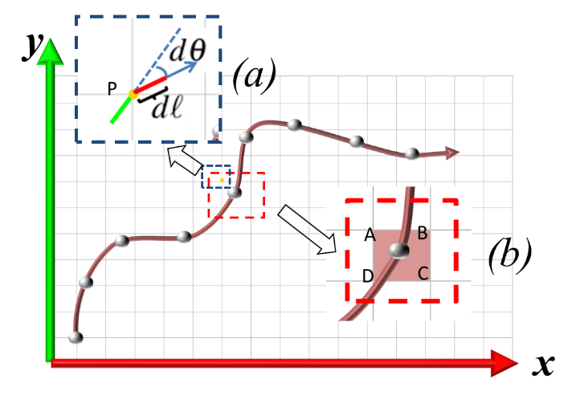
Attribute Fields and Their Computation
Computation of an attribute field
We employ a uniform sampling strategy for all examples
For steady flows, we compute streamlines until they reach the boundary of the domain, hit the fixed points, form loops, or longer than some user-specified threshold.
For unsteady flows, we currently consider only forward integration of pathlines and compute them within a user-specified time window.
The selected attributes are collected along the obtained integral curves using the following discrete version of the accumulation.
$$F\left(x,t\right)=\sum_{i=0}^{N}{k_{i}A_{l}(P_{i})}$$
Assuming the integral curve $C$ is represented by $N$ integration points $P_{i}$
We use box-filter for all the examples, therefore, $k_{i}=1$

Slide 7
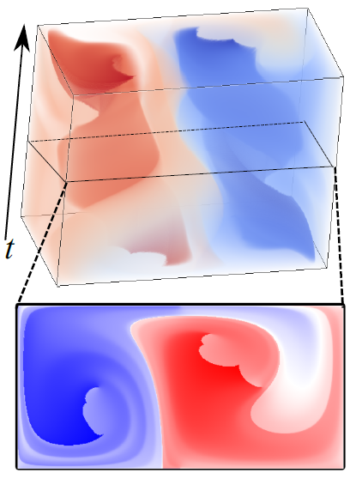
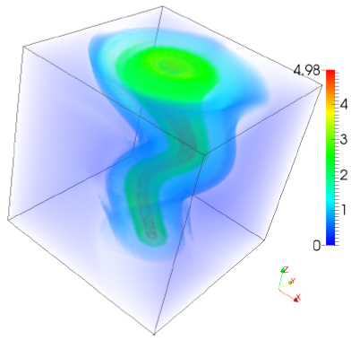
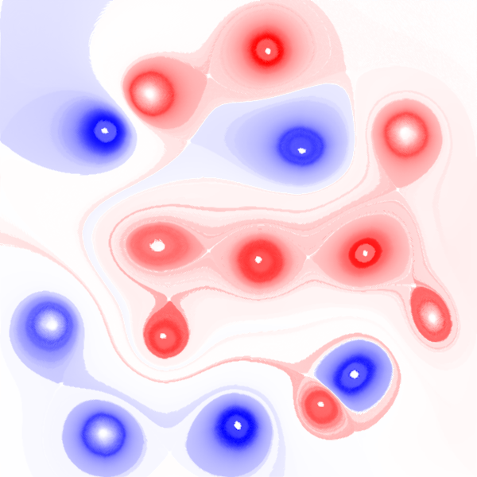
Attribute Fields for 2D Steady and Unsteady Flows
+
0
-
Attribute fields of the 2D steady flows are defined in the original flow domain (i.e., 2D)
The length field of the tornado data set
Attribute fields of the 2D unsteady flows are defined in a spatio-temporal domain (i.e., 3D)

Slide 8
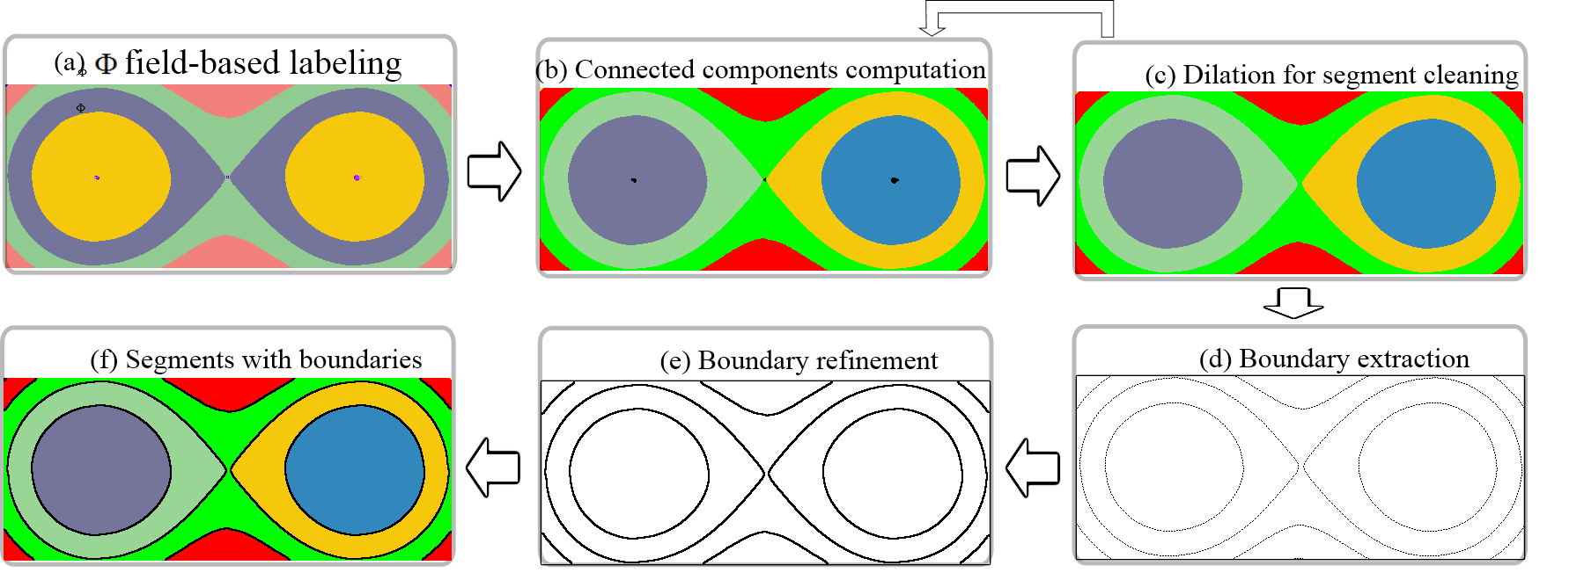
Segmentation Algorithm
Region classification
Connect component computation
Segment cleaning
Boundary extraction
Boundary refinement
*Note: two parameters need to be specified.
The initial clustering number m
The noise segment threshold $γ$

Slide 9
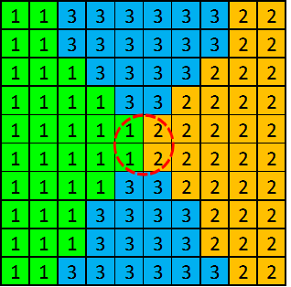
Segmentation Algorithm
Region classification
Connect component computation
Segment cleaning
Boundary extraction
Boundary refinement
After this step each sample point is labeled with the ID of the corresponding bin. Those points with the same label belong to the same cluster, even though they may not be physically connected.

Slide 10
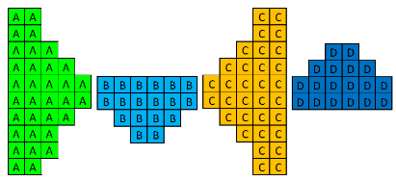
Segmentation Algorithm
Region classification
Connect component computation
Segment cleaning
Boundary extraction
Boundary refinement
compute the connected components based on their labeled IDs
Get the initial segmentation of the domain

Slide 11
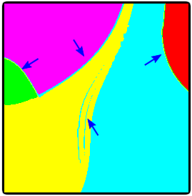
Segmentation Algorithm
Region classification
Connect component computation
Segment cleaning
Boundary extraction
Boundary refinement
Identify noise segment
Apply dilation operation

Slide 12
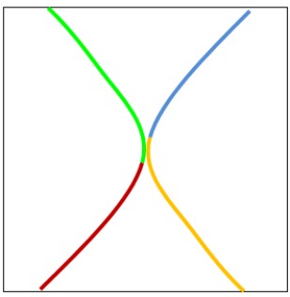
Segmentation Algorithm
Region classification
Connect component computation
Segment cleaning
Boundary extraction
Boundary refinement
Apply normal cut technique to identify the boundaries between segments

Slide 13
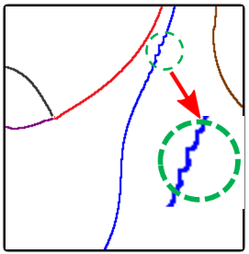
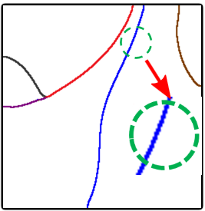
Segmentation Algorithm
Region classification
Connect component computation
Segment cleaning
Boundary extraction
Boundary refinement
Apply a Laplacian smoothing algorithm is applied to refine the boundaries

Slide 14
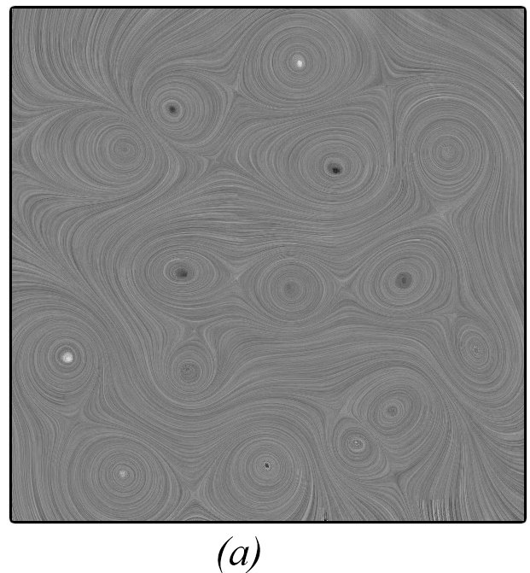
Results (I)
Comparison between the bottom-up algorithm and our method with a synthetic flow. $m=10, γ=0.05.$

Slide 15
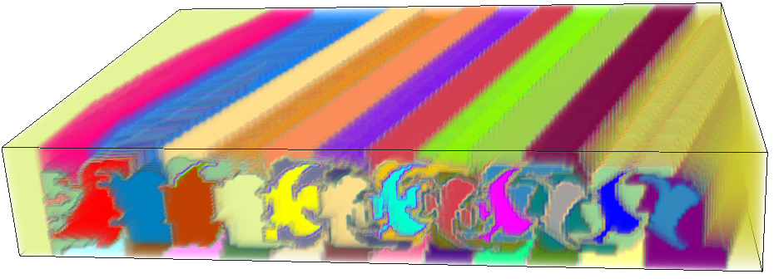
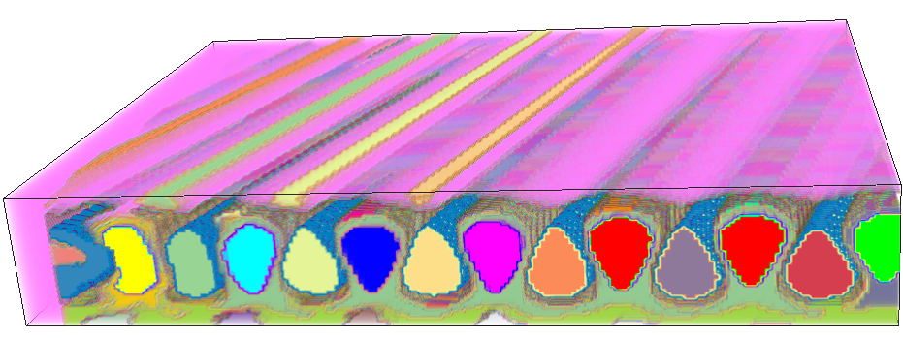
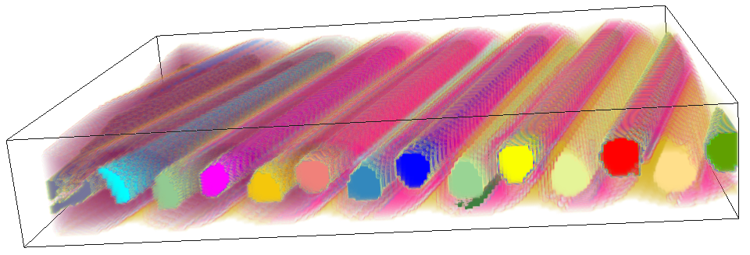
Results (II)
Segmentation of a 2D unsteady flow behind a square cylinder based on rotation field, determinant field, nsV field, curl field, respectively. $m=10, γ=0.01.$

Slide 16
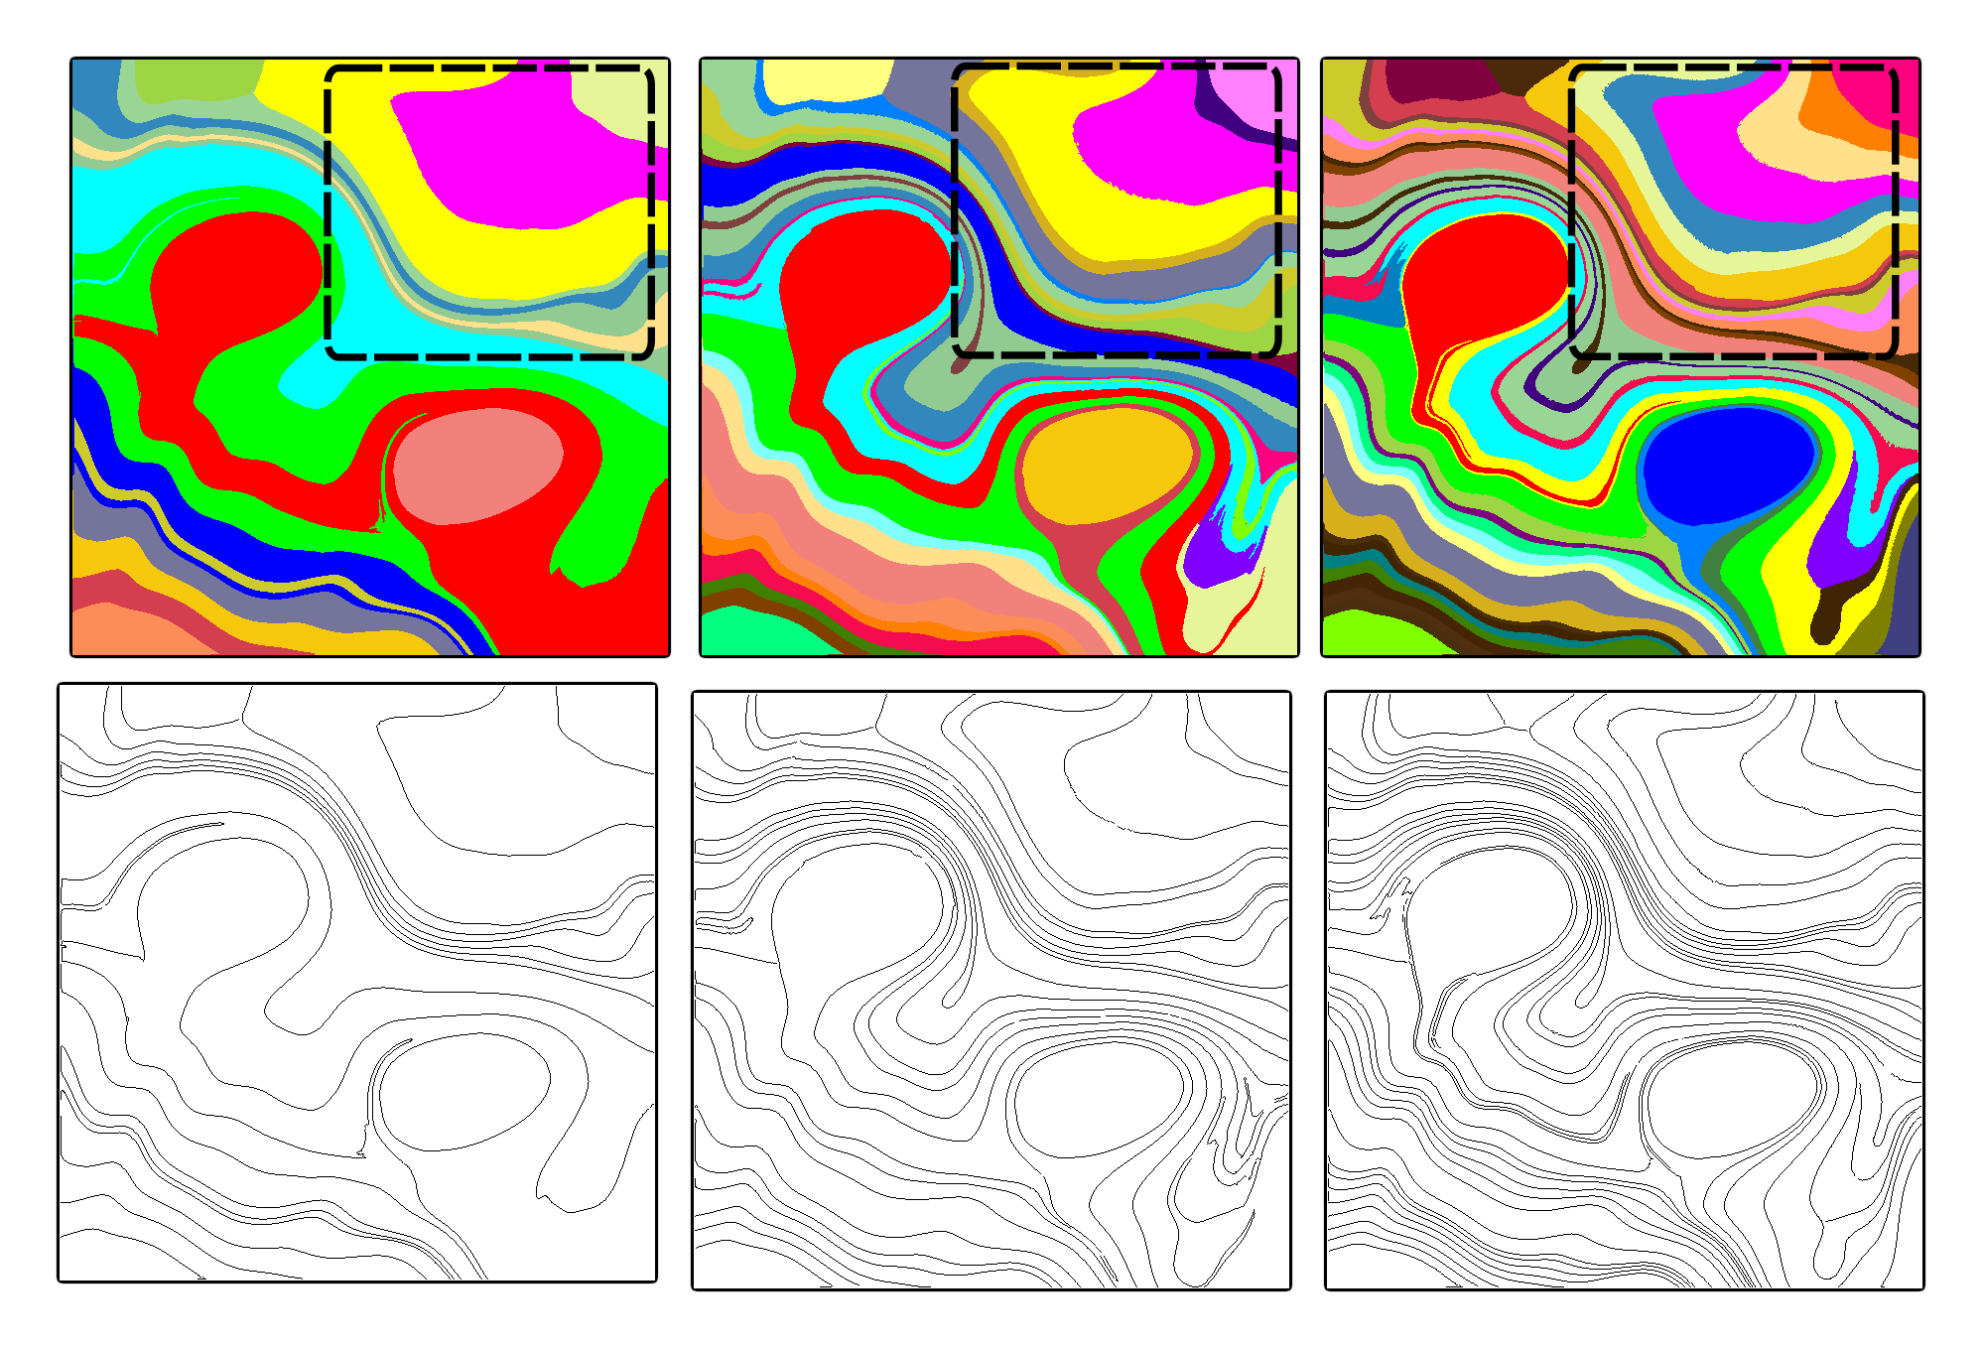
Results (III)
The effect of the number of bins m for the initial region classification

Slide 17
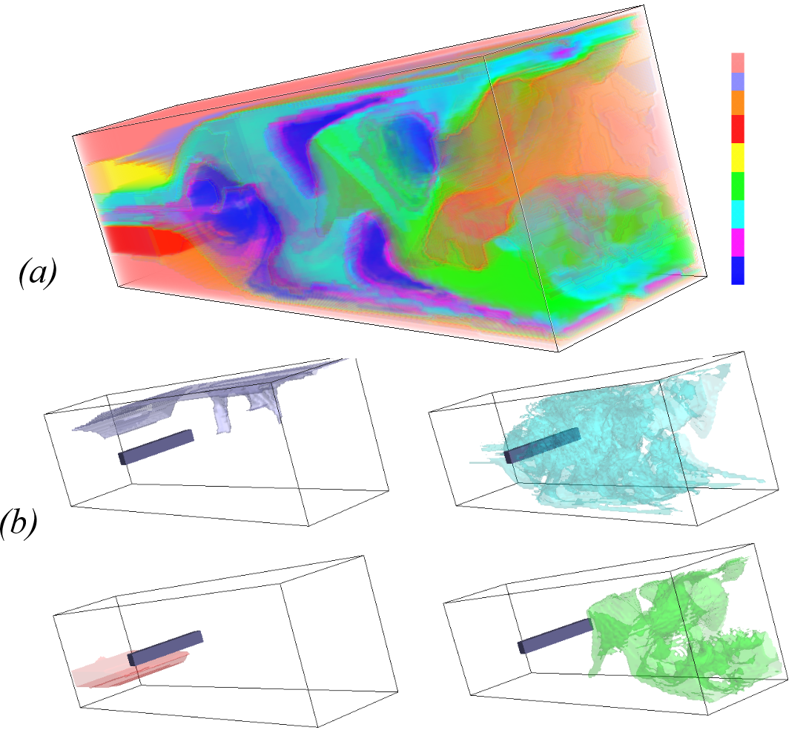
Results (IV)
Segmentation and estimated boundaries of a 3D steady flow behind cylinder.

Slide 18
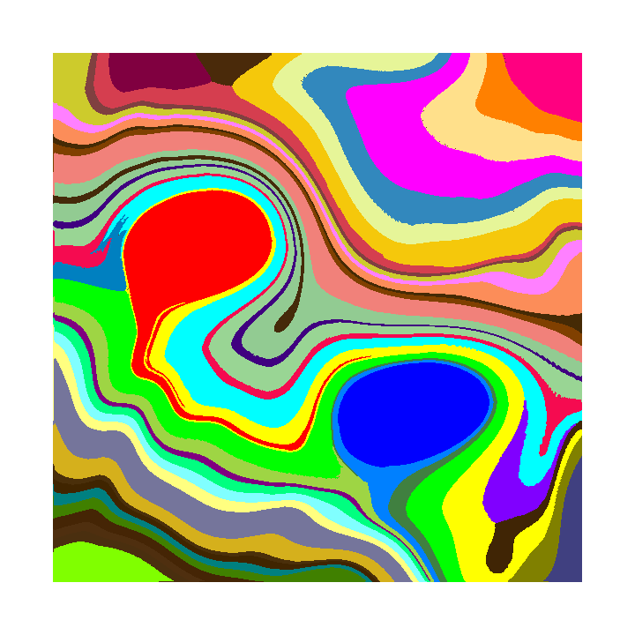
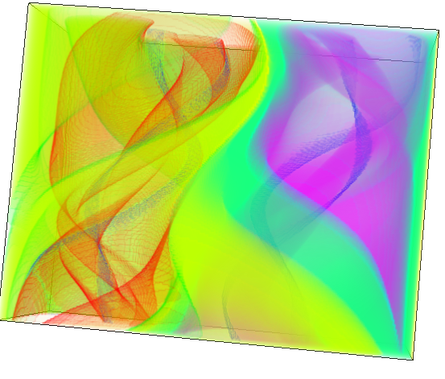
Conclusion and Discussions
The segments generated by our algorithm are better aligned with the flow than those obtained from existing local methods.
The domain experts can employ various attribute fields to explore different flow behaviors.

Slide 19
Conclusion and Discussions
Limitations:
The initial clusters are sensitive to the number of bins m, especially near the boundaries of the bins.
The boundaries of 3D vector field segments are estimated iso-surfaces rather than the real boundaries of the segments.

Slide 20
Acknowledgments
People
Jacqueline H. Chen, Sandia National Lab
Mathew Maltude, Lawrence Livermore National Lab
James Liburdy, Oregon State University
Funding Angency
National Science Foundation
LZHANG38@UH.EDU

