Slide 1
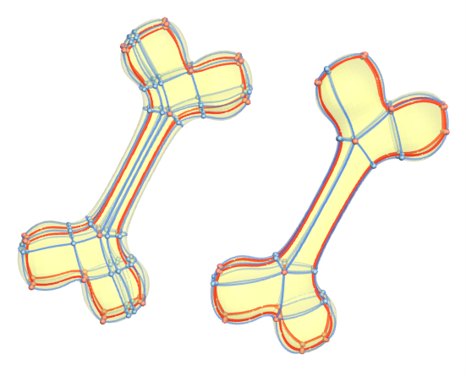
Hexahedral Mesh Re-parameterization from Aligned Base-Complex
Presenter: Xifeng Gao
Advisors: Guoning Chen and Zhigang Deng
Notes:
Thank you very much for the introduction. Now, I am going to present our paper: hexahedral mesh re-parameterization from aligned base-complex.
%%%%%%
our work is about the optimization of hex-meshes.
Let’s see the title: a hex-mesh is re-parameterized from a hex-mesh with aligned base-complex. Here, base-complex is a global structure of a hex-mesh. Then, our work has two parts. First, simply the global structure (as shown in the bone figure), and second, re-parameterization of the hex-mesh with simplified structure.

Slide 2
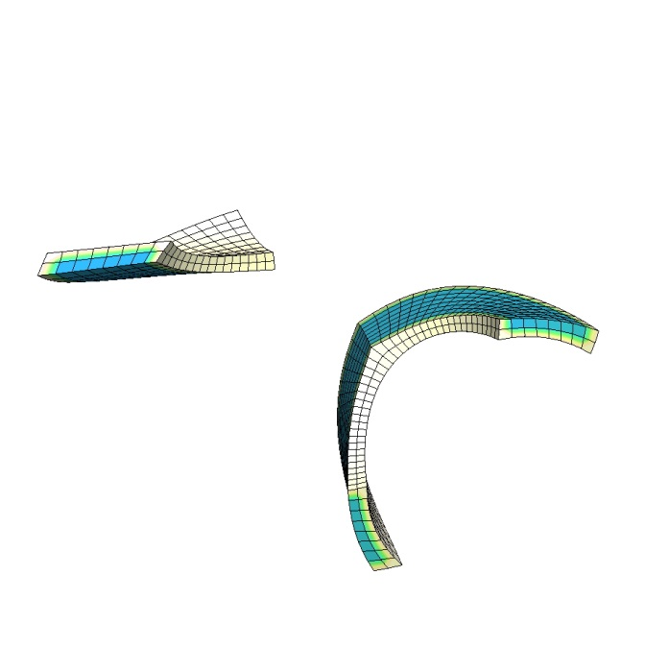
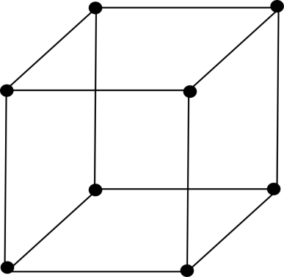
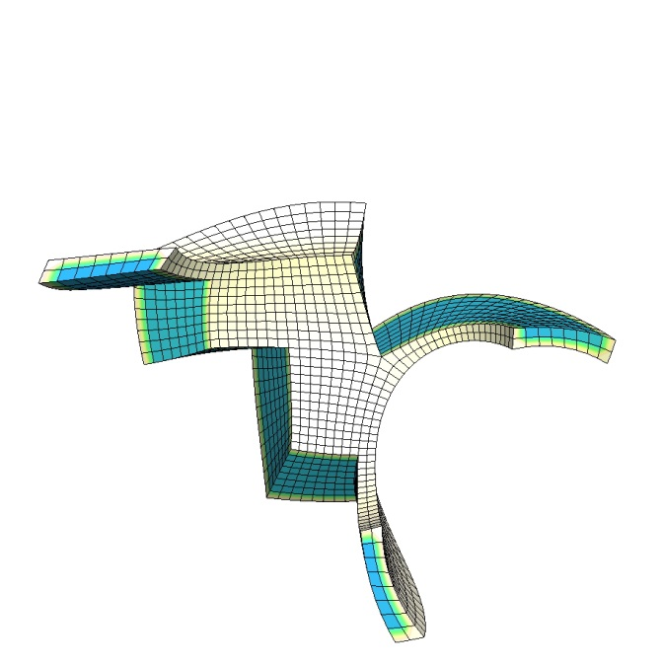
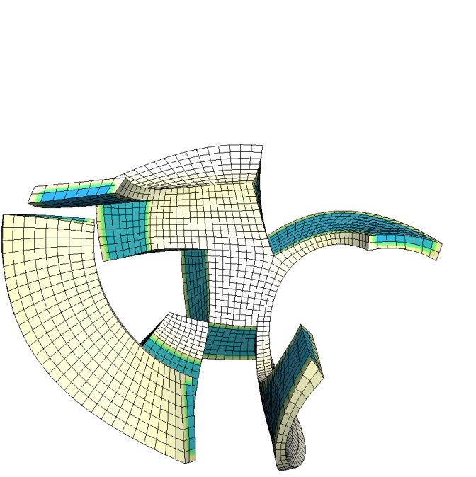
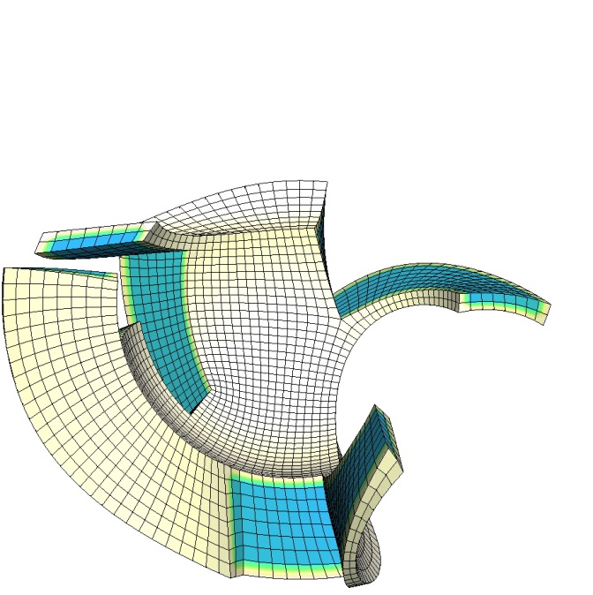
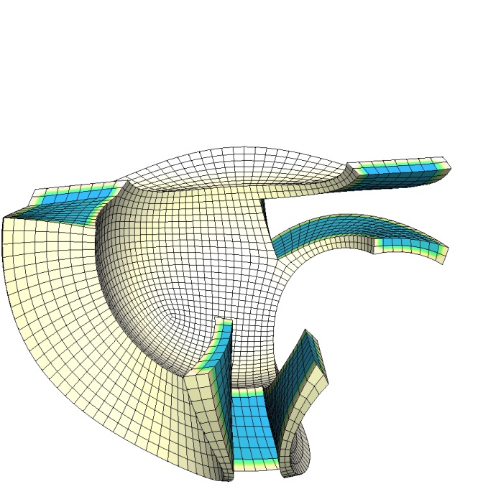
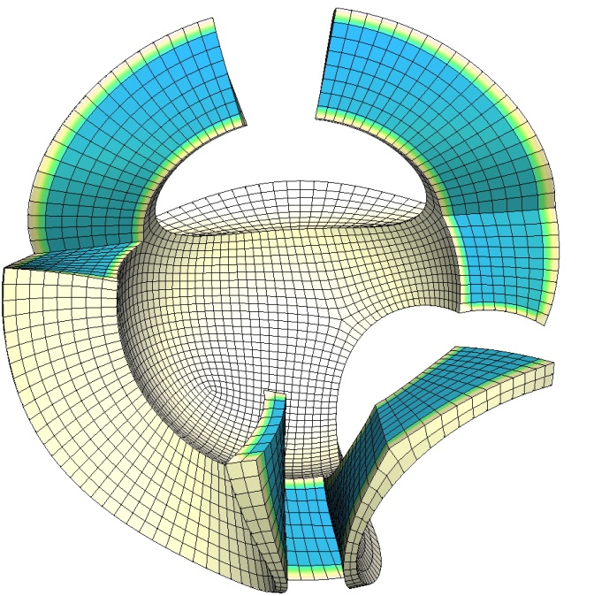
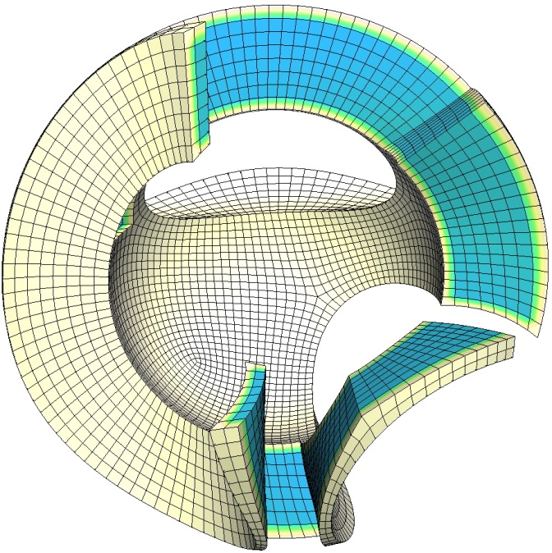
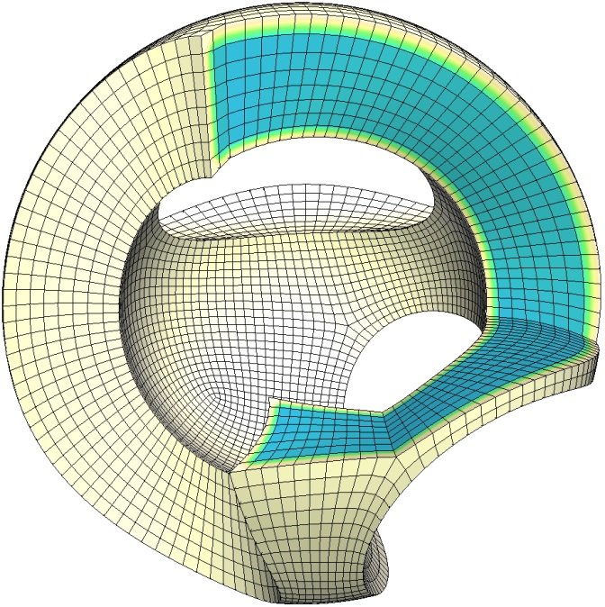
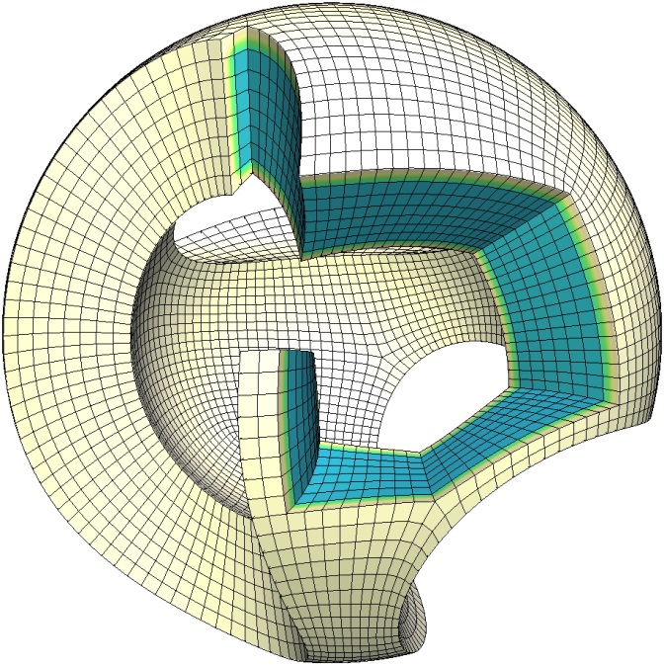
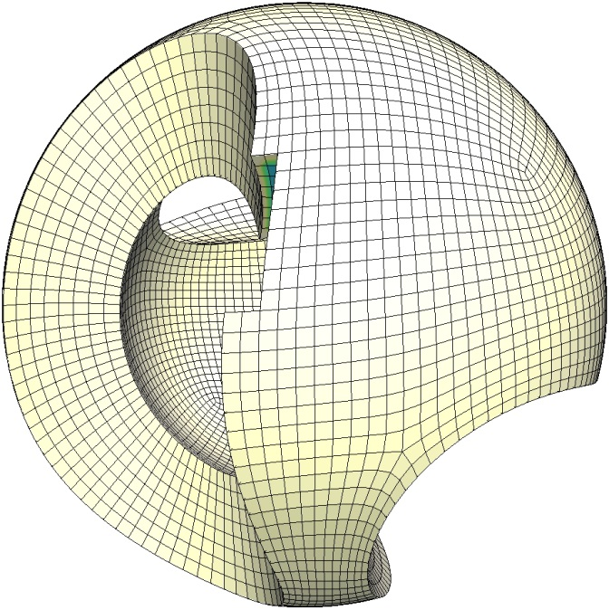
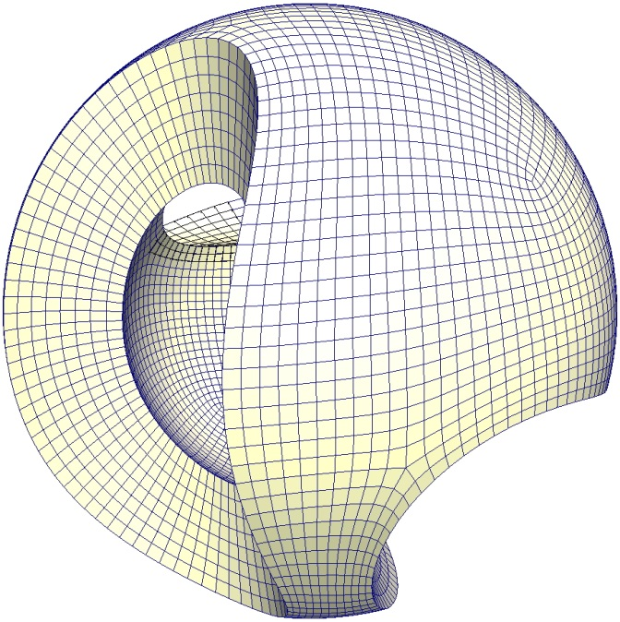
What Is A Hex-mesh?
Notes:
So, what is a hex mesh?
This shows a hex-mesh of a sculpture model. A hex-mesh consists of many hexahedral elements that fill the volume surrounded by a surface mesh. Each hex element consists of 8 corners, 12 edges, and 6 faces.
%%%The cube shown to the upper right corner illustrates such a hex element.
%%%Given a surface mesh, a hex-mesh is to fill cube-like (hexahedral) elements inside it. Each hex element consists of 8 corners, 12 edges, and 6 faces.
This shows a hex-mesh of a sculpture model. And A zoom-out hexahedral element is also shown.
%%%%%% to the right-upper corner.

Slide 3
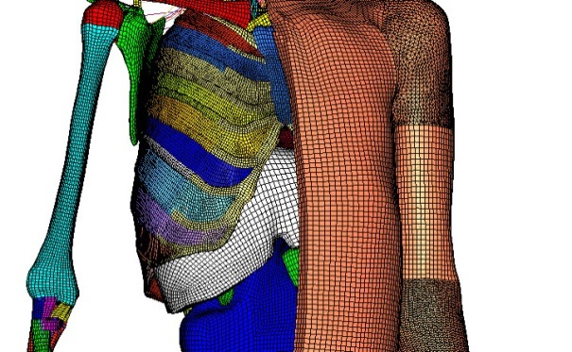
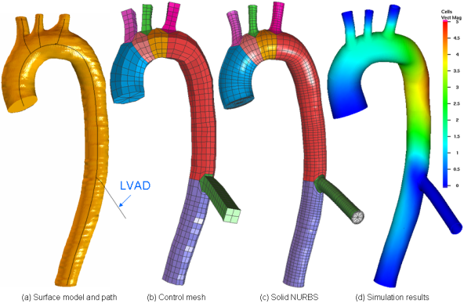
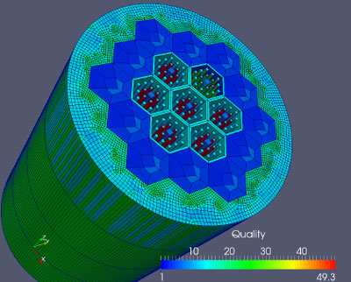
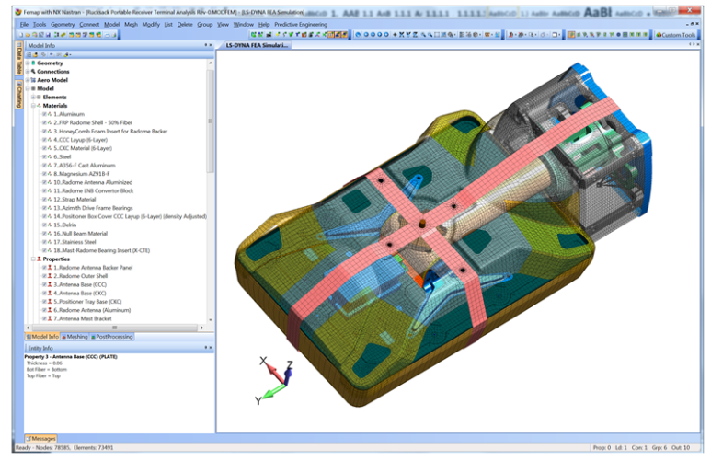
Needs for Hex-meshes
Medical
Biomechanics [Wayne State University]
Simulation-based medical planning [Zhang, et al. 2007]
CAD
Nuclear reactor manufacturing [Kitware]
FEA Simulation [Predictive engineering]
Notes:
Compared to tetrahedral meshes, hex-meshes offer a number of desired properties for simulations. For example, they have larger tolerance for anisotropy and less numerical stiffness, which usually lead to faster and more accurate simulations.
Therefore, hex-meshes are preferred in many medical and engineering related physically-based simulations, such as the human body biomechanics, patient-oriented medical planning, the simulation of mechanical parts for manufacturing, and the predictive engineering.
%%%%Compared to tetrahedral meshes, hex-meshes are preferred in medical and engineering related physical based simulations, such as the human body biomechanics, patient-oriented medical planning, The simulation of mechanical parts for manufacturing, and the predictive engineering.
This is mainly because of the larger tolerance for anisotropy and less numerical stiffness of simulations using hex-meshes, that leading to faster computations, and higher accuracy.
%%%%%% and their tensor product structure, which facilitating the generation of subsequent smooth representations, such as trivariate spline representation. Therefore , hex-meshes have many applications. Such as In medical and engineering applications as listed here, the human body biomechanics, patient-oriented medical planning, The simulation of mechanical parts for manufacturing, and the predictive engineering.
%%%. Hex-meshes have been widely used in medical and cad related fields. Such as
%%%%So, next is, what’s the applications of hex-meshes?

Slide 4
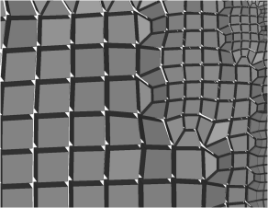
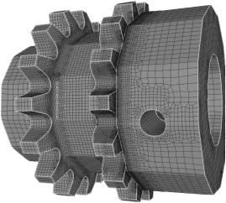
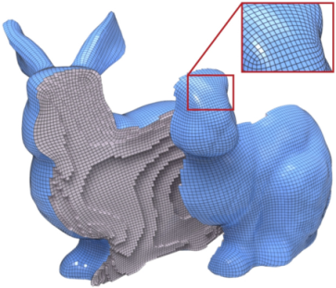
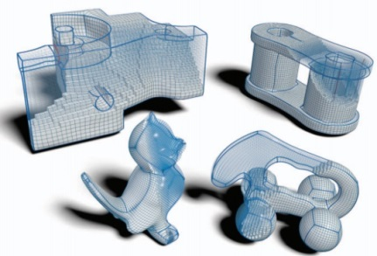
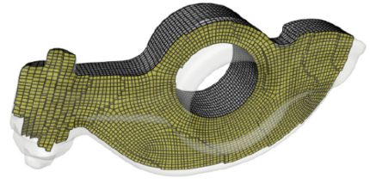
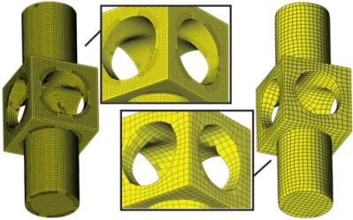
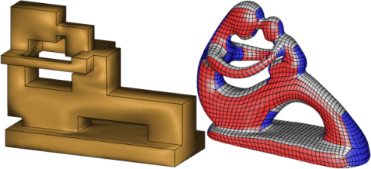
Related Work
Sweeping/Octree
[Owen, et al. 1998]
[Maréchal, et al. 2009]
Frame Field
[Nieser, et al. 2011]
[Li, et al. 2012]
[Jiang, et al. 2013]
Polycube
[Gregson, et al. 2011]
[Huang, et al. 2014]
[Livesu, et al. 2013]
Notes:
Despite its many desired properties, generating a high-quality hex-mesh is extremely challenging. There exist a number of techniques that can handle certain types of models.
They can be roughly classified into three groups. The first one is sweeping or octree based methods. They are typically used in engineering design to handle simple and CAD-like models.
Another two groups are frame field based and polycube based parameterization methods. They can handle more general models with high geometric quality.
However, all of these methods cannot well control the structures of the generated hex-meshes, which could be too complex for subsequent computations. IN our work, we propose the first effective technique to reduce the complexity of the structures of hex-meshes while maintaining a relatively good geometric quality.
%%%All of these methods have their advantages and disadvantages. But it is not our focus.
%%%%Recently, two groups of parameterization based methods, i.e., frame field based and Polycube based, have been introduced in the geometric modeling community to handle more general models. They rely either a volumetric frame field or a surface Polycube map to parameterize the volume domain for hex-meshing. All of these methods have their advantages and disadvantages. But it is not our focus.
%%%What we want to point out here is up-to-date, all of these methods cannot well control the structure of the generated hex-meshes, which can be too complex for subsequent computations. IN our work, we propose the first effective technique to reduce the complexity of the structures of hex-meshes while maintaining a relatively good geometric quality.
Compared to the sweeping or octree based methods, both frame field based and Polycube approaches are parameterization based methods. process and
Each of these two groups of methods has its advantages and disadvantages. But it is not our focus.
%%%%%%%However, generating a high-quality hex-mesh is extremely challenging. There are a number of existing techniques that can handle certain models, can be roughly classified into the following three groups. They are sweeping/octree based methods can only be applied to simple and cad-like models.
, Frame field based, and Polycube based approaches (summarize each type!!!).
All the previously proposed methods do not pay much attention to the global structures in the hex-meshes. IN our work, we propose to reduce the complexity of the structures of hex-meshes while maintaining a relatively good geometric quality.
%%%%%%%%
Past hex-meshing approaches can be classified into semi-manual based and volume parameterization based. Semi-manual based methods are relatively mature and are widely used in industry, such as the sweeping based hex-meshing techniques shown in the first row. However, much efforts and time are often required to produce a qualified hex-mesh.
Thus, volumetric parameterization based methods such as frame field based shown in the middle row and polycube based at the bottom row are proposed. The major advantages of these methods are that they can deal with many kinds of models with much less time and efforts. However, they are not perfect as well. One thing is that hex-meshes generated for some models are not guaranteed to be valid, and post-processing are also required.
All the previously proposed methods do not pay much attention to the global structures in the hex-meshes. IN our work, we propose to reduce the complexity of the structures of hex-meshes while maintaining a relatively good geometric quality.

Slide 5
Outline
Introduction
Global Structure
Optimization Problem
Structure Optimization
Geometry Optimization
Results & Limitations
Notes:
This is the outline of my talk. Next, we will introduce the global structure of a hex-mesh.
%%%A hex-mesh that fulfills the mentioned quality criteria are generally come with a well distributed singularity structure.

Slide 6
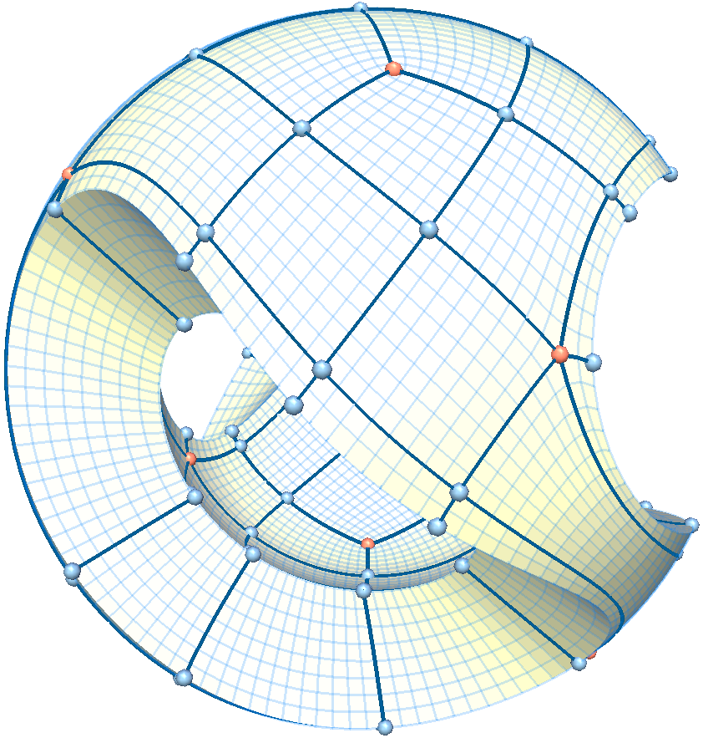
Global Structure of Hex-meshes
Singular node
Regular node
Global structure of a quad-mesh
Notes:
To understand the structure of a hex-mesh, we start with a brief review of the structure of a quad-mesh. This shows a quad-mesh of a sculpture model. Some singularities for the quad-mesh are highlighted in red. From these singularities, we can trace out a network structure that partitions the quad domain into a number of patches. Each patch is a quad shape. We refer to this structure as the base-complex of the given quad-mesh. %%%It is essentially a very coarse quad-mesh.
%%%%%It’s known that the global structure of a quad mesh is determined by its singular nodes, whose valence are not 4 as shown in the figure.
%%%have valences that are not 4, that is, the number of their adjacent edges are not 4. They are singularities of the quad-mesh
as highlighted by the black bold lines. This structure
%%%%, boundary edges has the number of neighboring hex elements not equal to 2 is singular, while those inside the volume with neighboring hex elements not equal to 4 is singulars.

Slide 7
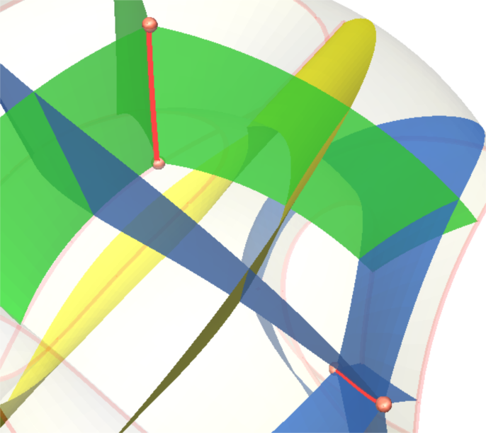
Global Structure of Hex-meshes
Singular edge
Notes:
Similarly, the global structure of a hex mesh is determined by its singular edges. For a singular edge inside the volume of a hex-mesh, the number of its adjacent hex elements is not 4. This figure shows two singular edges in red with valence 3 and 5, respectively.
%%%%, boundary edges has the number of neighboring hex elements not equal to 2 is singular, while those inside the volume with neighboring hex elements not equal to 4 is singulars.

Slide 8
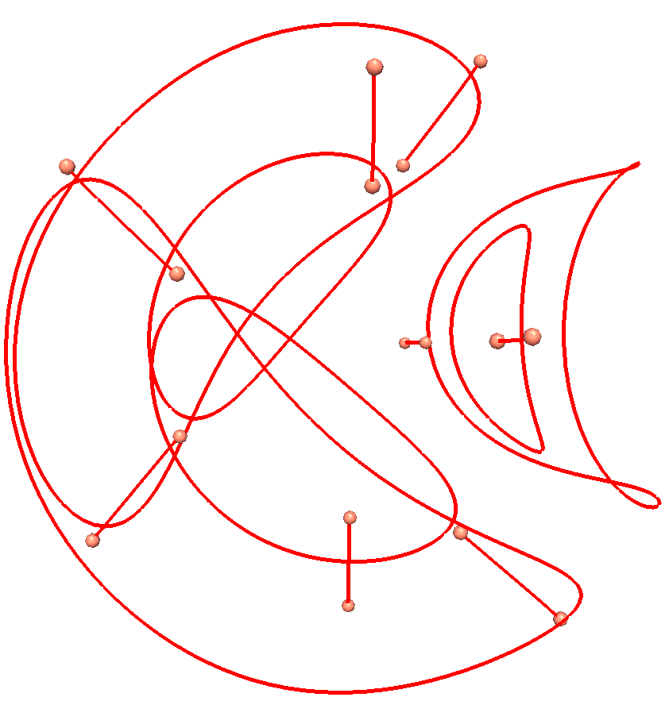
Global Structure of Hex-meshes
Singularity structure of a hex-mesh
Notes:
By collecting all the singular edges, we can obtain a graph, which is referred to as the singularity structure of the given hex-mesh.

Slide 9
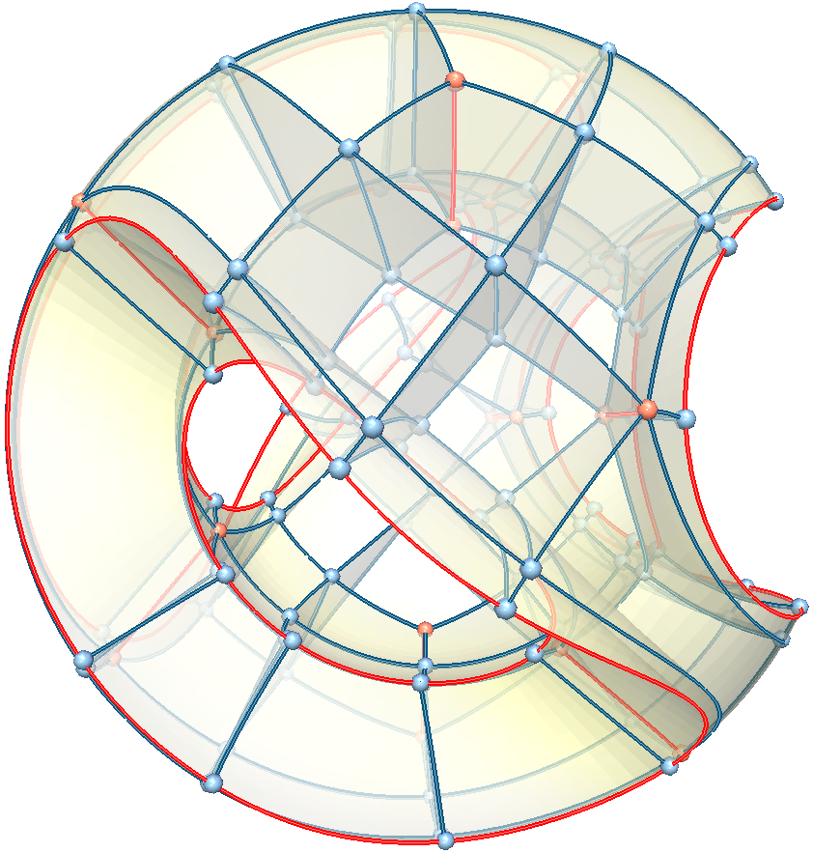
Global Structure of Hex-meshes
Red: singular nodes, and, singular edges
Blue: regular nodes, and regular edges
Base-complex of a hex-mesh
Notes:
From this singularity structure, we can similarly construct a base-complex for the hex-mesh. This base-complex consists of nodes, curves, surfaces, and components. Here, the red nodes and curves are the singularities, while the blue nodes and curves are generated during the construction of the base-complex.
This base-complex partitions the hex-mesh domain into a number of components. Each component is a cube-like block.
%%%%From the singularity structure, we can obtain an all-cuboid structure, which is called base-complex. It contains nodes, curves, surfaces, and components. Intuitively, this base-complex is the coarsest hex-mesh that has the same structure of the original hex-mesh.

Slide 10
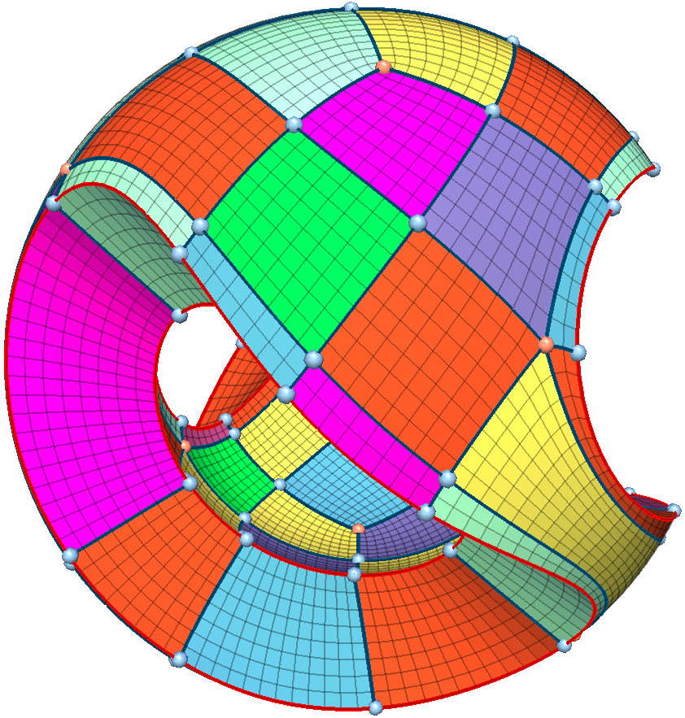
Global Structure of Hex-meshes
A hex-mesh is decomposed into cuboid-like components in different colors
Notes:
As shown in this image, different components and their corresponding elements are visualized in different colors. Intuitively, this base-complex is the coarsest hex-mesh that has the same structure to the original hex-mesh.
%%%%In this way, the hex-mesh can be decomposed into different component visualized in different colors by the base-complex. Each component is a cube-like blocks.

Slide 11
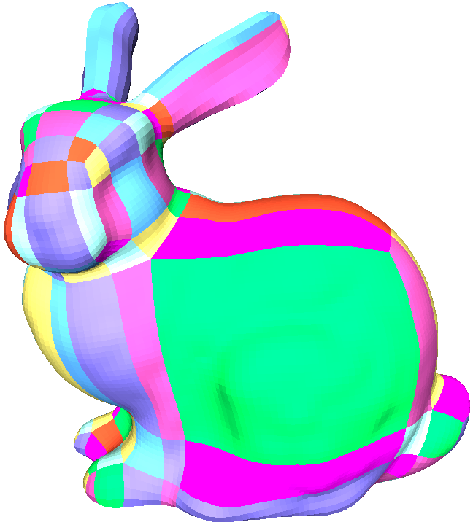
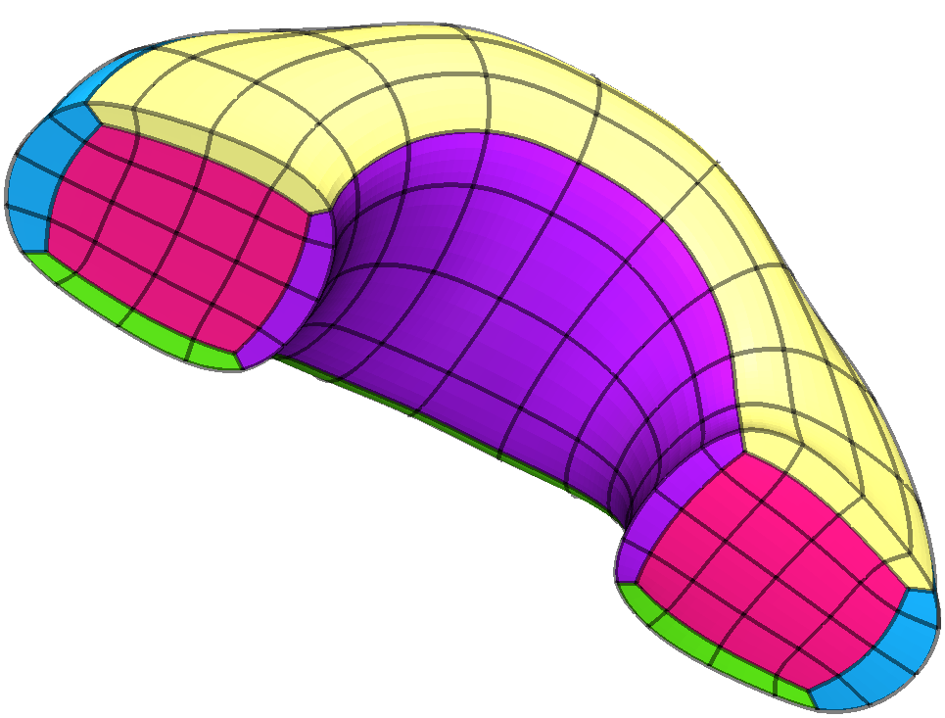
Motivation: B-spline fitting
Decomposed hex-mesh
Fitted volumetric trivariate B-splines
Coarser structure (less components) is preferred in providing high order smoothness
Notes:
Given a hex-mesh with its base-complex, people can fit high order basis functions within each component. However, only C0 continuity can be achieved across the boundaries of neighboring components. Therefore, in order to improve the smoothness of the basis function through the entire volume domain, the smaller number of components is preferred as it will reduce the number of boundaries.
%%%% However, there is no existing work that can guarantee to generate hex-meshes with simple global structures or base-complex.
Given a hex-mesh with its base-complex, people can fit high order basis functions within each component. however, there is only C0 continuity across the boundary of components. Therefore, in order to improve the smoothness of the functions, the smaller number of components is preferred. However, there is no existing work on generating hex-meshes with simple global structures.
%%%%%That means, the less components, the less boundaries, and the wider high order smoothness, therefore, the smaller number of components is preferred.
%%%%%%The reason is that, we can fit as high order as possible smoothness to a component, however, there is only C0 continuity across the boundary of components. That means, the less components, the less boundaries, and the wider high order smoothness.

Slide 12
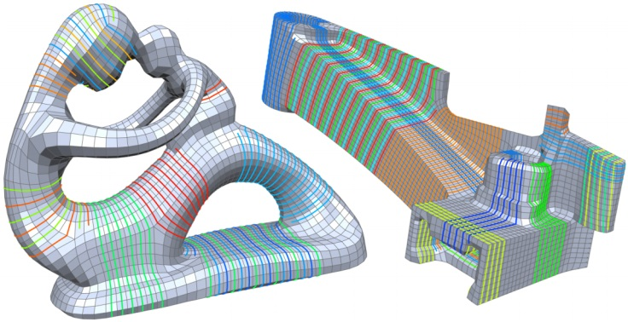
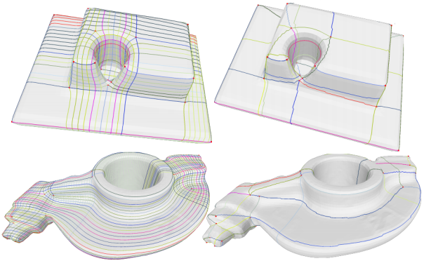
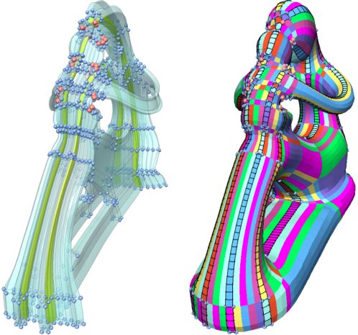
Motivation: Solution?
A similar problem in quad-meshing
[David, et al. 2011]
[Tarini, el al. 2011]
Have not found Helix configurations in all our tested models
More complicated scenarios may arise in hex-meshes, as shown in the fertility example
Notes:
There already exist some good work on solving this problem for quad meshes. For example, David and colleagues aligned singularities by removing helix configurations; while Tarini and colleagues simplified the base-complex by reconnecting the misaligned singularity pairs in the base-complex.
However, these methods are not trivial to be directly extended to 3D. This may partially because we have not found a similar helix configuration in the hex-meshes that we have experimented with. In addition, there are some more complicated scenarios in hex-meshes. For instance, the complicated structure of the fertility example shown at the bottom.
%%%All these motivate our work. that the existing method will not work
ing community, which could be called the misalignment of singularities
This problem is similar to the well-known issue-misalignment of singularities in quad-meshes. than in quad-meshes
%%%%It is a well known problem in quad meshes as well. There are already some good work on solving this problem in quad meshes, such as David and his colleagues remove helix configurations in the quad meshes, while Tarini and his colleagues reconnect base-complex connectivity in quad-meshes. However, these methods cannot be directly extended to 3D. For example, we didn’t find helix configuration existing in hex-meshes and there are different complicated scenarios in hex-meshes as shown in the fertility example at the bottom.
%%%, and there are one more dimensions added in 3D.
to simplify the global structures of quad-meshes
%%%%While there is no existing work on optimizing the global structure of hex-meshes, researchers.

Slide 13
Outline
Introduction
Global Structure
Optimization Problem
Structure Optimization
Geometry Optimization
Results & Limitations
Notes:
Next, we describe our solution.
%%%%%Now let’s talk about our global structure optimization approach

Slide 14
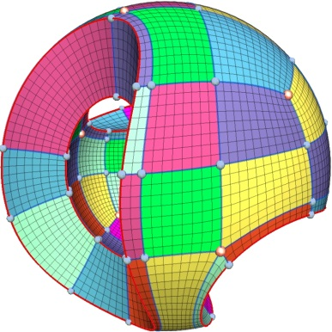
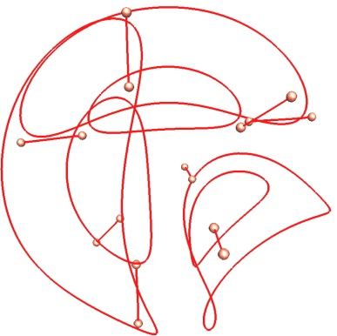
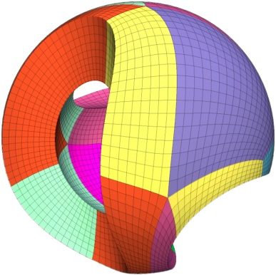
Optimization Problem
Given
A hex-mesh as input
singularity structure
Goal
Simplify the base-complex of the input hex-mesh while preserving the singularity structure
Notes:
Given a hex-mesh as input (shown to the left), our goal is to simplify its base-complex (as shown to the right) while maintaining its singularity structure (shown in the middle).

Slide 15
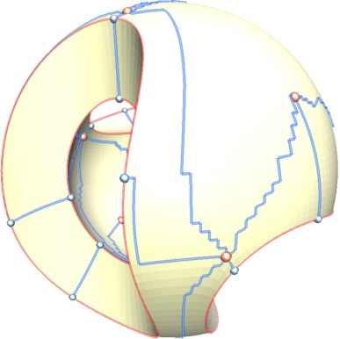
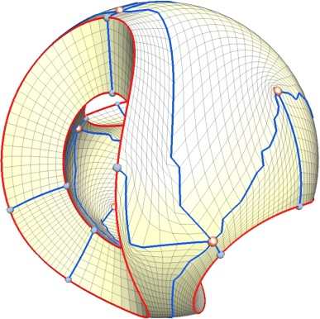
Pipeline
Structure Optimization
Geometry Optimization
Notes:
To achieve that, we propose to optimize the hex-meshes in two steps: first, we optimize the global structure to reduce the number of components, and second, we improve the geometric quality of the simplified mesh.

Slide 16
Outline
Introduction
Global Structure
Optimization Problem
Structure Optimization
Geometry Optimization
Results & Limitations
Notes:
Next, I will describe the first step of our pipeline.
%%%Let’s first see how we optimize the global structure of a hex-mesh

Slide 17
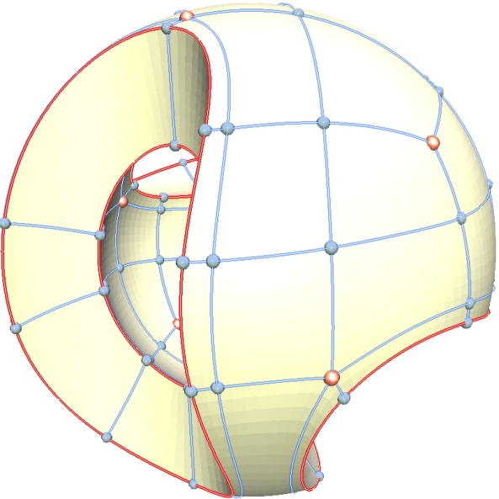
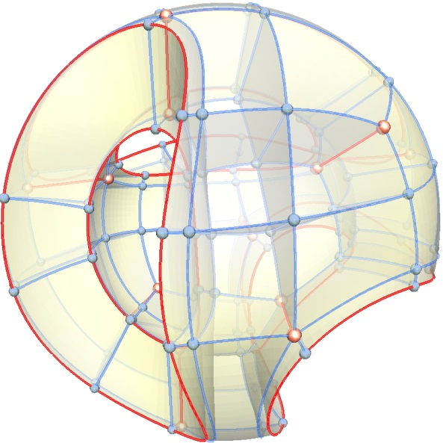
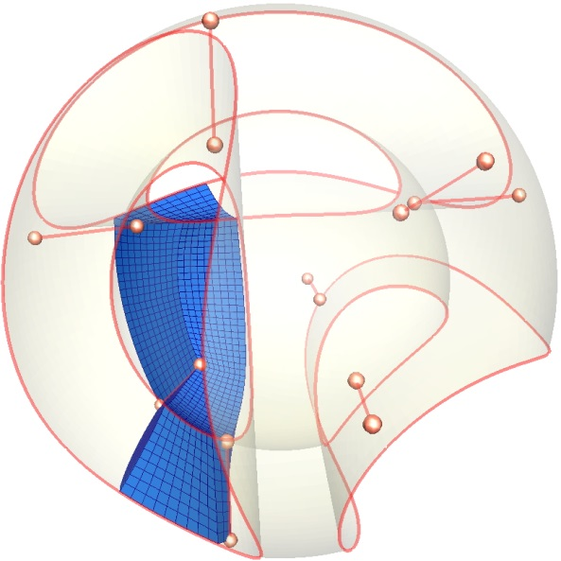
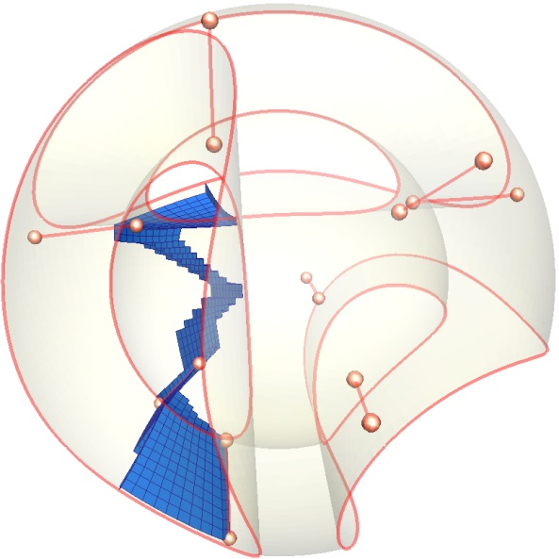
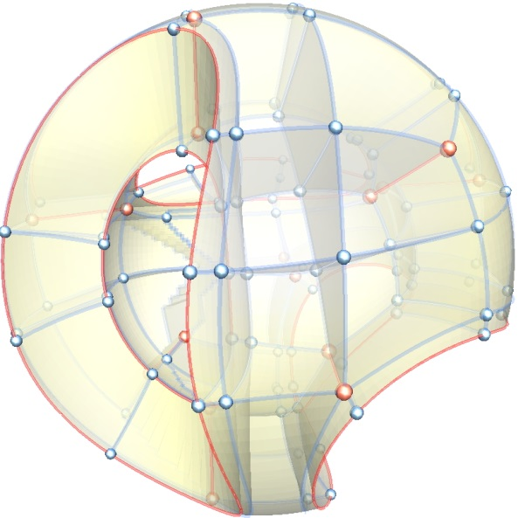
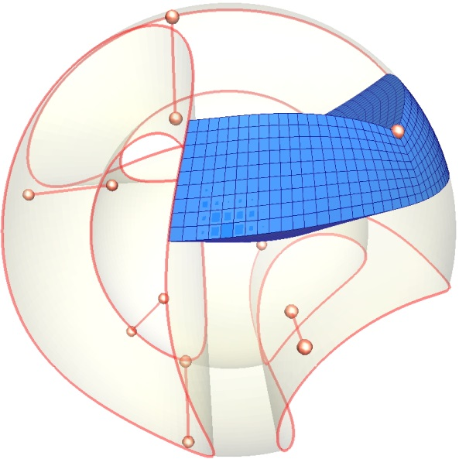
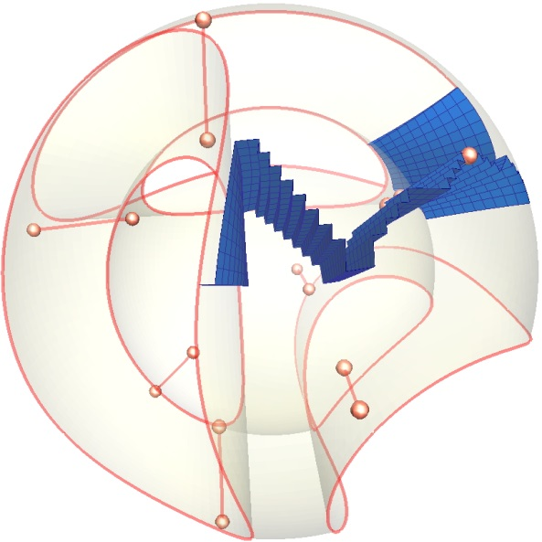
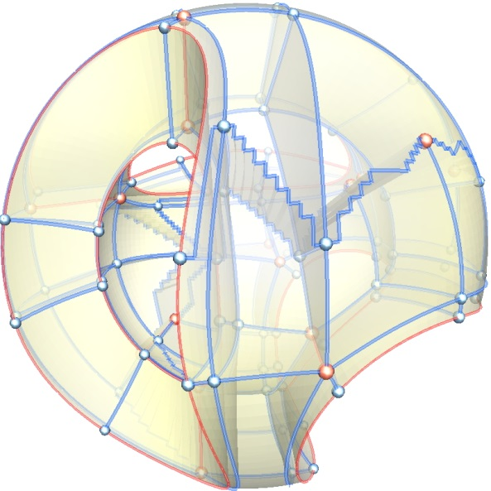
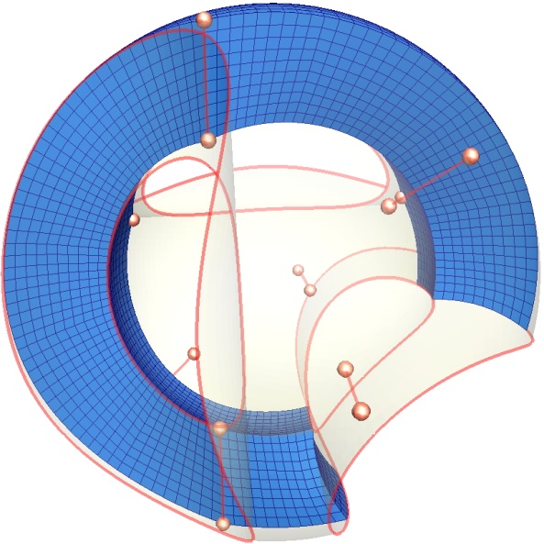
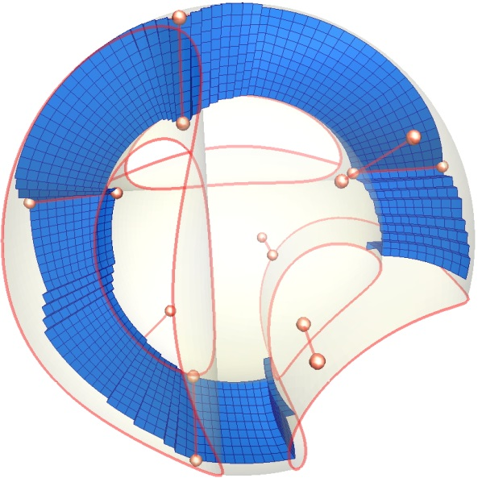
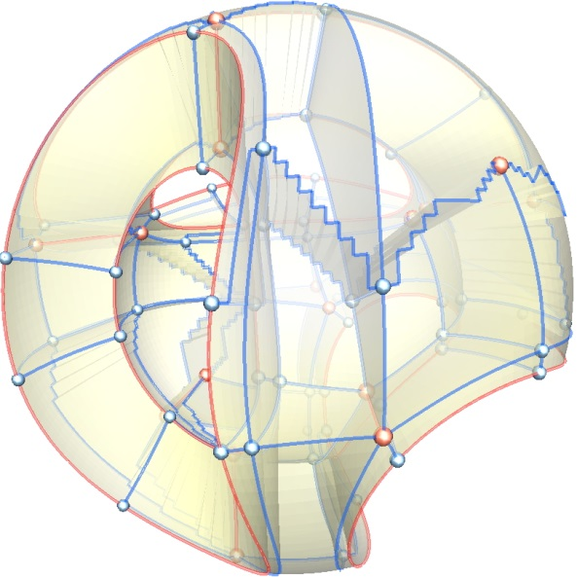
Structure Optimization—Demo
Regular base-complex edges are reconnected while singular edges are preserved
Notes:
This shows a demo of the structure optimization process, where the base-complex is simplified gradually.

Slide 18
Structure Optimization—Key Idea
A base-complex sheet is collapsed into a surface sheet
The definition of the base-complex sheets is adapted from the hexahedral sheet defined in [Borden et al. 2002]
Notes:
This illustrates the high level idea of our structure optimization step.
First, we adapted the concept of the hexahedral sheet for a hex mesh to define the base-complex sheet for a base-complex. The left figure shows an example of a base-complex sheet for a fandisk hex-mesh, as highlighted in yellow. This sheet is a corridor of components of the base-complex.
By collapsing this component sheet to a surface sheet, the components in this sheet can be removed from the base-complex, as shown in the right image. However, simply collapsing any base-complex sheet may change the singularity structure of the hex-mesh. To avoid that, we need to identify those sheets that collapsing them will NOT change the singularity structure. We call them the candidates for removal.
%%% to simplify the base-complex
The figure to the right shows the simplified base-complex after removing the components of the sheet.
%%%%%In order to achieve the structure optimization of the base-complex, we adapted the concept of the hexahedral sheet for hex mesh to define the base-complex sheet for base-complex. The left figure shows an example of the base-complex sheet for the fandisk mesh, which is a corridor of components of the base-complex.
By collapsing this component sheet to a surface sheet as shown in the right figure, it’s expected to reduce the number of components in the base-complex.
%%%%%%Our structure optimization is based on the removing of the base-complex sheets.
To maintain the singularity structure unchanged, we only collapse the specially selected sheets, which is called candidate.

Slide 19
Structure Optimization—A Candidate
Base-Complex Sheet (Candidate)
A sheet is considered as a candidate only if none of the singular edges in its left surface is directly connected with any singular edges in its right surface by a surface sheet (singular edges shown in red)
Notes:
To identify candidates, let us first decompose a base-complex sheet into three parts: a left surface sheet, a right surface sheet, and a middle volume part. A base-complex sheet is then considered as a candidate only if none of the singular edges (i.e., those red curves) in its left surface is DIRECTLY connected with any singular edges in its right surface via a surface in the base-complex. Based on this criterion, the sheet we show here is a candidate.

Slide 20
Structure Optimization—A Candidate
Candidate
Configuration
Extraction
Quad Surface
Notes:
Now we describe how to collapse a candidate to a surface sheet. Recall that, a candidate consists of a number of components. Each component is a cuboid.
%%%%Given a candidate sheet, recall that, it consists a number of components. Each component is a cuboid.

Slide 21
Structure Optimization—A Candidate
Candidate
Configuration
Extraction
Quad Surface
Notes:
For each component in the candidate, we first determine it’s configuration, for example, the yellow rectangle in the magnified view.
This configuration determines how the portion of the to-be-formed surface sheet is connected within this component.
We call the portion of the surface sheet for this component a patch.
There are three different types of configurations of how to connect the four involved corners to form the patch for a component.
%%%%%
Since the to be extracted surface sheet is formed by connecting four corners from each component contained in this candidate. Then, we first determine which four corners for a component is contributed to the final surface sheet;

Slide 22
Structure Optimization—Configuration
Original
Notes:
The first type is original. It has two cases, where for each of them, all its four corners are from either the left or right surface sheet of the candidate.

Slide 23
Structure Optimization—Configuration
Original
Diagonal
Notes:
The first original type has two cases, where for each of them, all its four corners are from either the left or right surface sheet of the candidate.

Slide 24
Structure Optimization—Configuration
Original
Diagonal
Trigonal
Notes:
The first original type has two cases, where for each of them, all its four corners are from either the left or right surface sheet of the candidate.

Slide 25
Structure Optimization—Configuration
Original
Two constraints:
If a case contains singular edges, it should be maintained
Any two neighboring cases can only be connected via one edge
Diagonal
Trigonal
Notes:
The first original type has two cases, where for each of them, all its four corners are from either the left or right surface sheet of the candidate.

Slide 26
Structure Optimization—A Candidate
Candidate
Configuration
Extraction
Quad Surface
Notes:
After determine the configurations for all the components in this candidate, we now can extract the surface sheet.
As this can be done component-wisely, we describe how we extract the patch for a component of the candidate.
%%%%We now can extract the to-be-formed surface sheet. Now, for a component, we describe how we extract the portion of the surface consisting of quad elements based on its configuration. %%%Then, guided by the configuration for a component, we extract the surface that consisting of quad elements.

Slide 27
Structure Optimization—Extraction
Notes:
This shows a component of the candidate,

Slide 28
Structure Optimization—Extraction
Notes:
Let us assume that it has a diagonal configuration, as illustrated by the red curves. The red curves connect the four corners of the configuration of this component. They form the boundary of the to-be-extracted patch. The two zig-zagged curves are computed through Dijstra algorithm.
%%%%%This component has the configuration illustrated by the red curves. The red curves connect the four corners of the configuration of this component. The two zig-zagged curves are computed through dijstra algorithm.

Slide 29
Structure Optimization—Extraction
Notes:
Given the corners and edges of the patch, we then find the interior quad elements that constitute the patch. First, we compute a weight for each vertex in the component. This weight is determined by the distance from this vertex to the boundary of this component.
%%%%The weight of a vertex is computed by adding the minimal distance from the vertex to the two newly extracted edges, 8 corners, 12 edges, and 6 faces.

Slide 30
Structure Optimization—Extraction
Notes:
With this weight field, we now can extract the patch. Note that the four red curves partition the surface of the component into two parts. We initiate the patch as one of these two as shown here.

Slide 31
Structure Optimization—Extraction
Notes:
Then, based on the previously computed weights, we procedurally remove the hex elements attaching to the patch to minimize its total weight.
%%%If the sum of the weights of the boundary quads of a hex-element is larger than the sum of the weights of its interior quads, then we remove this hex element, otherwise, maintain it unchanged.

Slide 32
Structure Optimization—Extraction
Notes:
By keeping peeling the hex elements, the patch gradually arrives at its optimal state. This is the final extracted patch for this component.

Slide 33
Structure Optimization—A Candidate
Candidate
Configuration
Extraction
Quad Surface
Notes:
After extracting the surface sheet, we then reconnect the associated components to form a simplified base-complex.

Slide 34
Structure Optimization—A Candidate
All the candidates have been removed from its base-complex
Notes:
By removing all the detected candidates, the final hex-mesh with simplified global structure can be achieved.

Slide 35
Outline
Introduction
Global Structure
Optimization Problem
Structure Optimization
Geometry Optimization
Results & Limitations
Notes:
We now turn to the discussion of second part of the pipeline: optimize the geometric location of the mesh.
%%%%Then, Let’s talk about the second part of the pipeline: optimize the geometric location of the mesh.

Slide 36
Geometry Optimization—Motivation
?
Notes:
A hex-mesh with simplified global structure typically has geometric artifacts. Through our geometric optimization, the artifacts can be removed.
%%%
, where the classical laplacian smoothing does not respect features on the boundary of the mesh

Slide 37
Geometry Optimization—Domains
Original mesh
Parametric domain
Base-Complex Face domain
Base-Complex Edge domain
We adapt the domain concept for volume from triangle [Pietroni, et al. 2010] and quad surfaces [Tarini, el al. 2011].
Notes:
Our geometric optimization is based on parameterization domains built upon base-complex elements, which is adapted from the 2D quad-mesh optimization used in Tarini’s work.
Specifically, in our work, for a base-complex face, its two neighboring components compose a face domain, while for a base-complex edge, its three, or four, or five neighboring components compose an edge domain, respectively. The images in the top row show a face domain and a number of edge domains in the original hex-mesh. The images in the bottom row show their corresponding configurations in the parameterization space. Here, for edge domains, a polar parameter space is used.
For each domain, we then can carry out a conformal volumetric re-parameterization to relocate the vertices to their optimal positions.
%%%% guided by their configuration in the parameter space.
Our parameterization based optimization is based on the parameterization domains built upon base-complex elements, which is adapted from 2D surfaces. For a base-complex face, its two neighboring components compose a domain, while for a base-complex edge, its three, or four, or five neighboring components compose a domain, respectively. As shown in the upper row. Bottom row shows the corresponding parameterization space.
For each domain, we can do a volumetric parameterization to relocate the positions of the vertices to their optimal positions.
%%%%%he cutting surface is actually a 2D … from 2D to 3D …. Through the optimization, all the nodes can be optimized into their optimal location. The edge domain re-parameterizaiotn can be achieved through the polar parameterizaiton that have been used in….
The upper row shows the original mesh, while the bottom row shwos the mesh in parameterzation domain.
Polar coordiniates, reference.

Slide 38
Geometry Optimization—Video
Notes:
This shows a demo of the geometric optimization process. It contains a few passes.
For each pass, we perform an optimization on the face and edge domains that do not have overlapping components, so that we can apply parallel computations.
After several passes, the geometric quality of the mesh has been improved.

Slide 39
Outline
Introduction
Global Structure
Optimization Problem
Structure Optimization
Geometry Optimization
Results & Limitations
Notes:
Next, I will show some results with our method.

Slide 40
Results
Notes:
For each model, the left hex-mesh is the original input, while the optimized mesh is shown to the right. From the color coding, we can observe that the number of components for each model has been significantly reduced.

Slide 41
Results
Notes:
For each model, the left hex-mesh is the original input, while the optimized mesh is shown to the right. From the color coding, we can observe that the number of components for each model has been greatly reduced.

Slide 42
Results
Notes:
For each model, the left hex-mesh is the original input, while the optimized mesh is shown to the right. From the color coding, we can observe that the number of components for each model has been greatly reduced.

Slide 43
Results
p is the number of the removed candidates
Notes:
The simplicity of the structure of the optimized hex-mesh can be controlled by a user-specified parameter p, where p is the number of the removed candidates.
The larger the p, the more components will be removed from the base0complex of the hex-mesh.

Slide 44
Results
Notes:
This table shows all the 32 models we have experimented with..

Slide 45
Results
Notes:
In the table, H is the number of hex-elements, m is the number of detected and removed candidates, S.J. represents the scaled Jacobian which measures the geometric quality, the higher the better, Bc is the number of the components in the base-complex, and AR is the reduced rate of the number of components. For each model, the upper row represents the original input, while the bottom row shows the statistics of the optimized mesh.
%%%%From the zoom-out figure, we can see that the global structures are greatly simplified while the geometric quality also being maintained.

Slide 46
Results
Notes:
From the statistics and the zoom-out figures, we can see that the global structures are greatly simplified while the geometric quality also being maintained.

Slide 47
Limitations
If the singularities
are badly placed
are with high valences
the simplified base-complex will still be too complicated to be used for some applications
Notes:
The limitation of our work are that
In the future, we plan to develop a more advanced technique to handle this scenario.

Slide 48
Acknowledgements
People
Alla Sheffer, Jin Huang, Wenping Wang, and Yang Liu for providing hex-mesh datasets
Chang H. Yun for proofreading
Anonymous reviewers for improving the quality of the work
Notes:
In the following, We would like to thank the funding agencies NSF, NIH, NSFC, and University of Houston.
We also would like to thank the following people for the efforts in providing data and improving the quality of the paper.
This concludes my talk.
15269397288

Slide 49
Thank You!

