Slide 1
Compute and Visualize Discontinuity Among Neighboring Integral Curves of 2D Vector Fields
Topology-Based Methods in Visualization 2015
Lei Zhang and Guoning Chen, Department of Computer Science, University of Houston
Robert S. Laramee, Swansea University
David Thompson and Adrian Sescu, Mississippi State University

Slide 2
Outline
Background and motivation
Attribute Fields
Definition and Computation
Discontinuity in the Attribute Fields
Correlations Among Attributes
Visual Exploration Based on Attribute Fields
Conclusions and Discussions

Slide 3
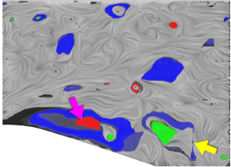
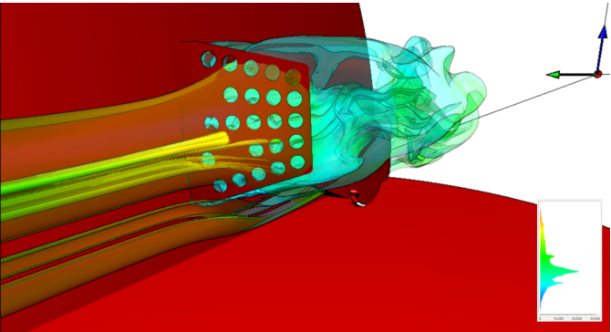
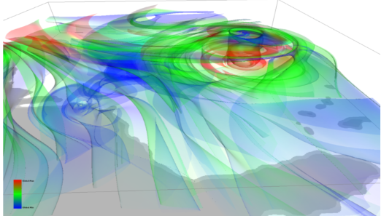
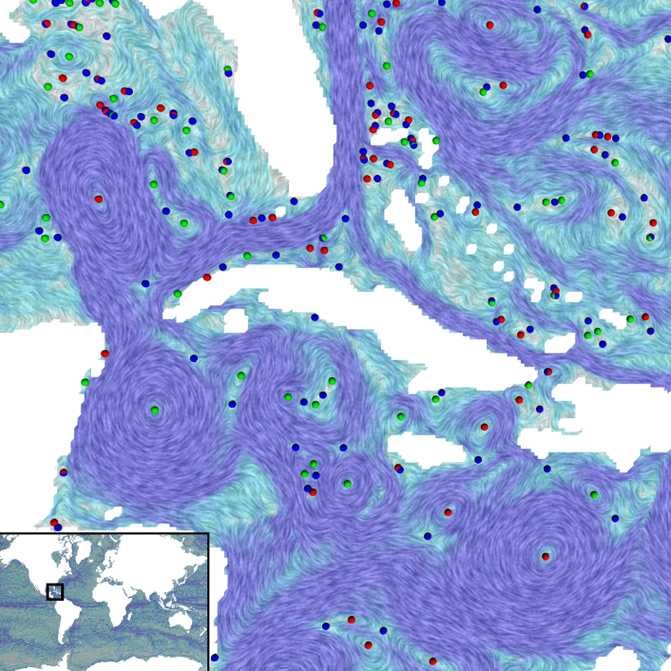
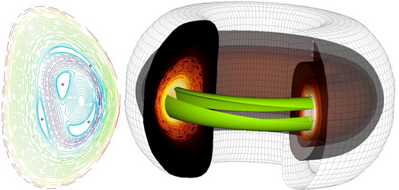
Vector Fields and Vector Field Analysis
Applications
Computational fluid dynamics
Mechanical engineering
Automobile/aircraft design
Climate study
Oceanography
New energy
Chemistry reaction
Medical applications
Computer graphics
…
[Chen and Xu 2015]
[Edmunds et al.2013]
[Edmunds et al.2012]
[Bhatia et al. 2012]
[Sanderson et al. 2011]

Slide 4
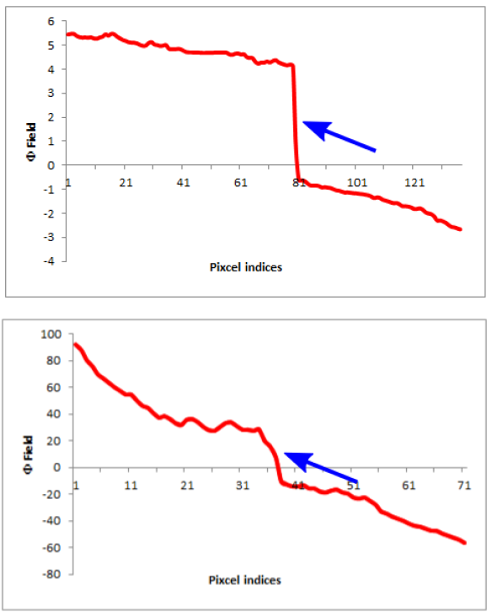
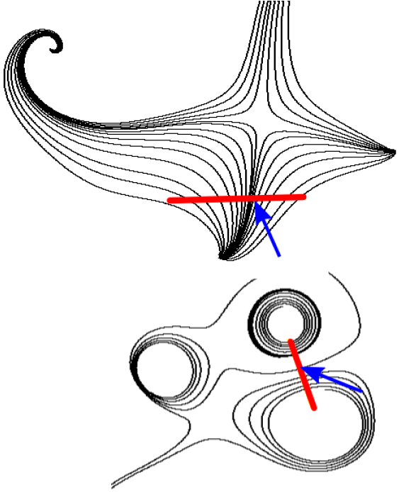
Integral Curve Attributes
Sharp or rapid change of attributes (highlighted by the arrows) at certain SPATIAL location
Seeded Streamlines
Plots of attributes along seeding segments

Slide 5
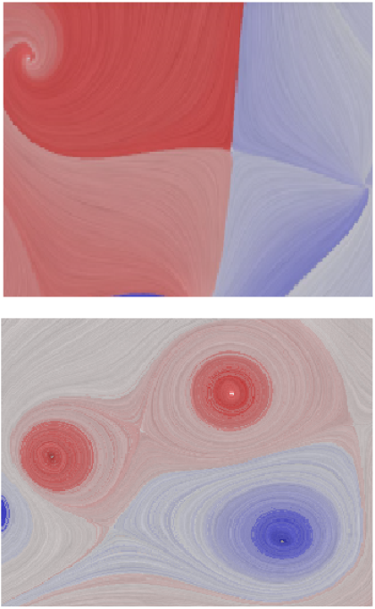
Integral Curve Attributes
+
0
Sharp or rapid change of attributes can be easily detected
-
Texture-based method has employed this Eulerian representation!
Seeded Streamlines
Encode attributes to spatial locations

Slide 6
Attribute Fields and Their Computation
Consider a vector field $\dot{x}=V(x,t)$defined in a spatio-temporal domain $D=M×T$,
The attribute of a streamline $C_{x}$ passing through $x∈M$ can be computed using
$$F\left(x\right)=\int_{0}^{1}{k\left(s\right)A_{l}\left(C_{x}\left(s\right),s\right)ds}$$
s is the arc-length parameter
while the attribute of a pathline $C_{x,t}$ passing through $(x,t)∈D$ can be computed using
$$F\left(x,t\right)=\int_{T_{1}}^{T_{2}}{k\left(τ\right)A_{l}\left(C_{x,t}\left(τ\right),τ\right)dτ}$$
$τ$ is the time parameter
[Shi et al. 2008]
Definition of attribute fields
The attribute values at any given positions $(x,t)$can be computed using the above formulas, which gives rise to an attribute field $F$.

Slide 7
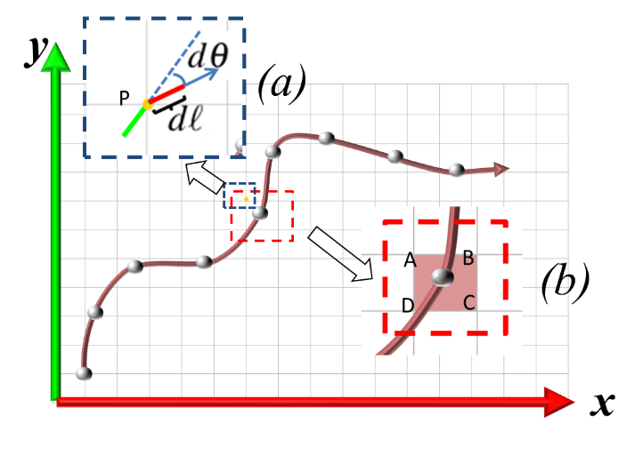
Attribute Fields and Their Computation
Computation of an attribute field
We employ a uniform sampling strategy for all examples
For steady flows, we compute streamlines until they reach the boundary of the domain, hit the fixed points, form loops, or longer than some user-specified threshold.
For unsteady flows, we currently consider only forward integration of pathlines and compute them within a user-specified time window.
The selected attributes are collected along the obtained integral curves using the following discrete version of the accumulation.
$$F\left(x,t\right)=\sum_{i=0}^{N}{k_{i}A_{l}(P_{i})}$$
Assuming the integral curve $C$ is represented by $N$ integration points $P_{i}$
We use box-filter for all the examples, therefore, $k_{i}=1$

Slide 8
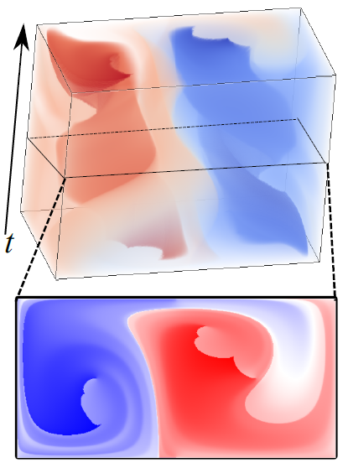
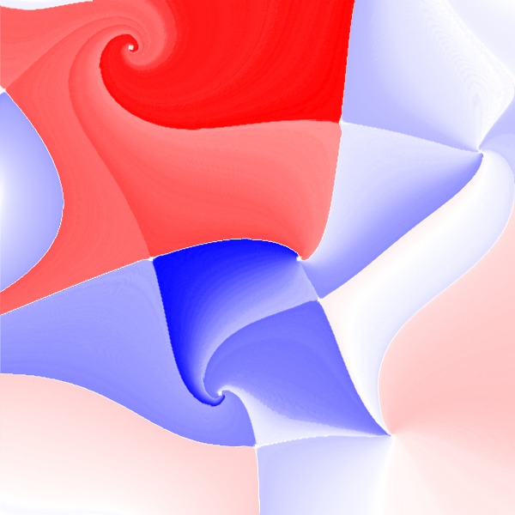
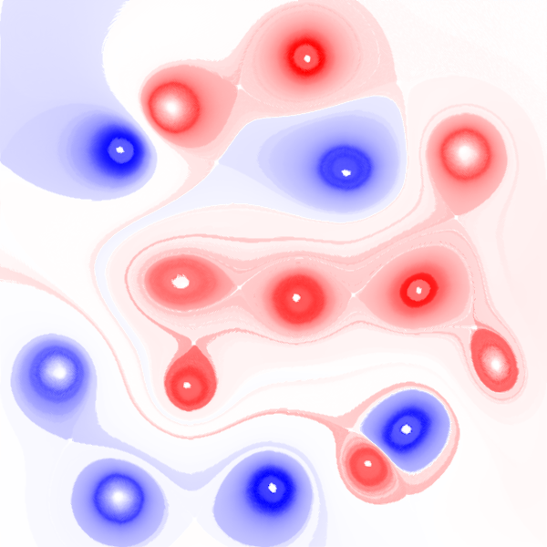
Attribute Fields for 2D Steady and Unsteady Flows
+
0
-
Attribute fields of the 2D steady flows are defined in the original flow domain (i.e., 2D)
Attribute fields of the 2D unsteady flows are defined in a spatio-temporal domain (i.e., 3D)

Slide 9
Choices of Attributes
List of attributes to consider, based on the recently work of [Shi et al. 2009] and [Pobitzer et al. 2012]
Rotation field Φ (i.e., winding angle)
Length field Ł
Average particle velocity field avgV
Non straight velocity field nsV,
Relative start end distance field seDist
Average direction field avgDir
Acceleration acce
curl field,
Hunt’s Q
$λ_{2}$
Although the framework of attribute field computation is much more general, in this paper, we concentrate on those scalar attributes

Slide 10
Discontinuity in Attribute Fields
Informal definition
Places in the flow domain whose attribute values exhibit sharp/rapid change when compared with their neighboring values.
Φ avgDir Ł acce
The average direction field may have some artificial discontinuity due to choice of the color coding. Here we simply map the angle $[0, 2π)$to white-red color.

Slide 11
Discontinuity in Attribute Fields
Informal definition
Places in the flow domain whose attribute values exhibit sharp/rapid change when compared with their neighboring values.
How to detect?
Using Canny edge detector
Using gradient magnitude field
Parameters for Canny edge detector: $σ=2.0, α=0.3, β=0.8$

Slide 12
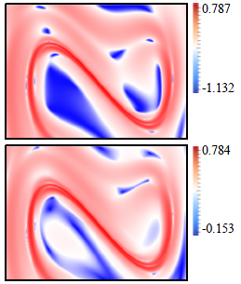
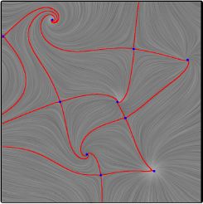
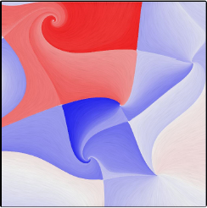
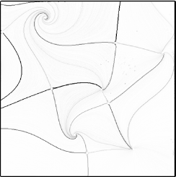
A Very Informal Discussion
Topology and LCS
FTLE
Cusp-like seeding curves
Start to end point direction
Topology
Φ field
$|∇Φ|$ field
Transportation structure of materials vs. LCS structure
[Shi et al. 2008]

Slide 13
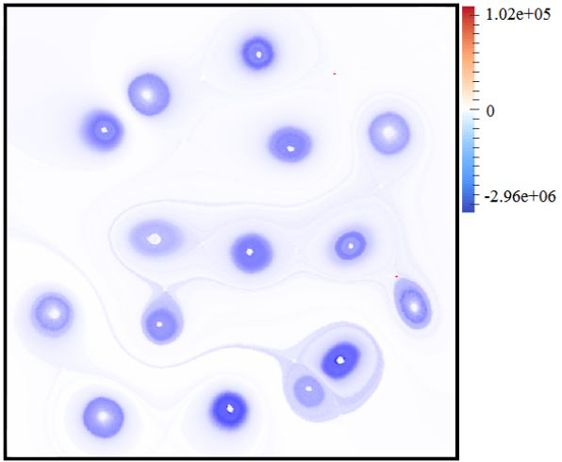
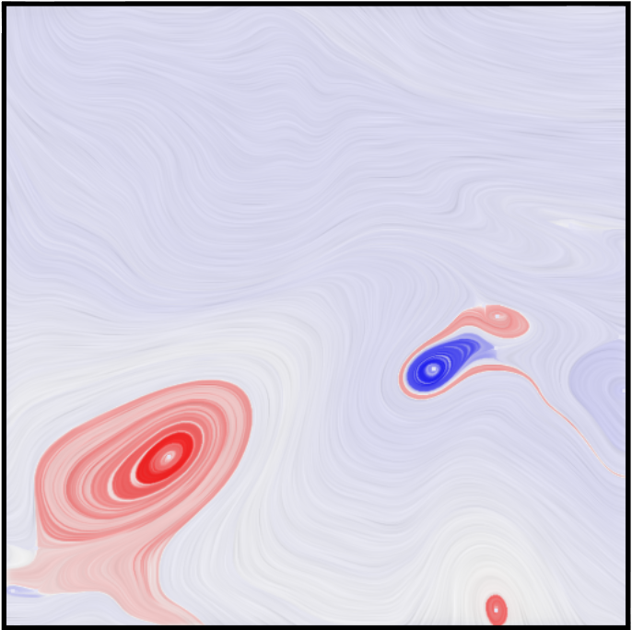
A Very Informal Discussion
Topology and LCS
Vortex regions
Cusp-like seeding curves
Singularity paths
curl field
Φ field

Slide 14
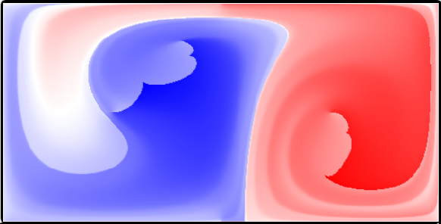
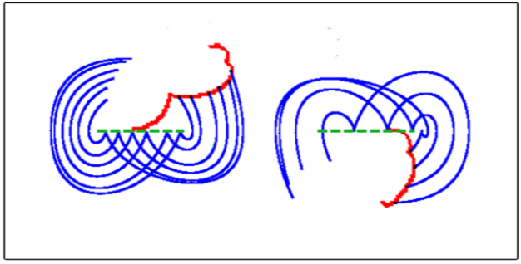
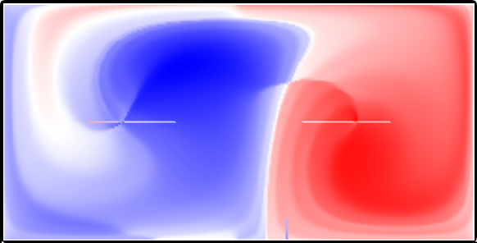
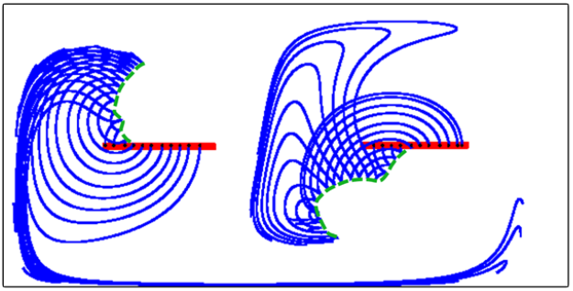
A Very Informal Discussion
Topology and LCS
Vortex regions
Cusp-like seeding curves
Sampled pathlines
Pathline-based Φ field
Singularity paths
Streak line-based Φ field
Sampled streak lines

Slide 15
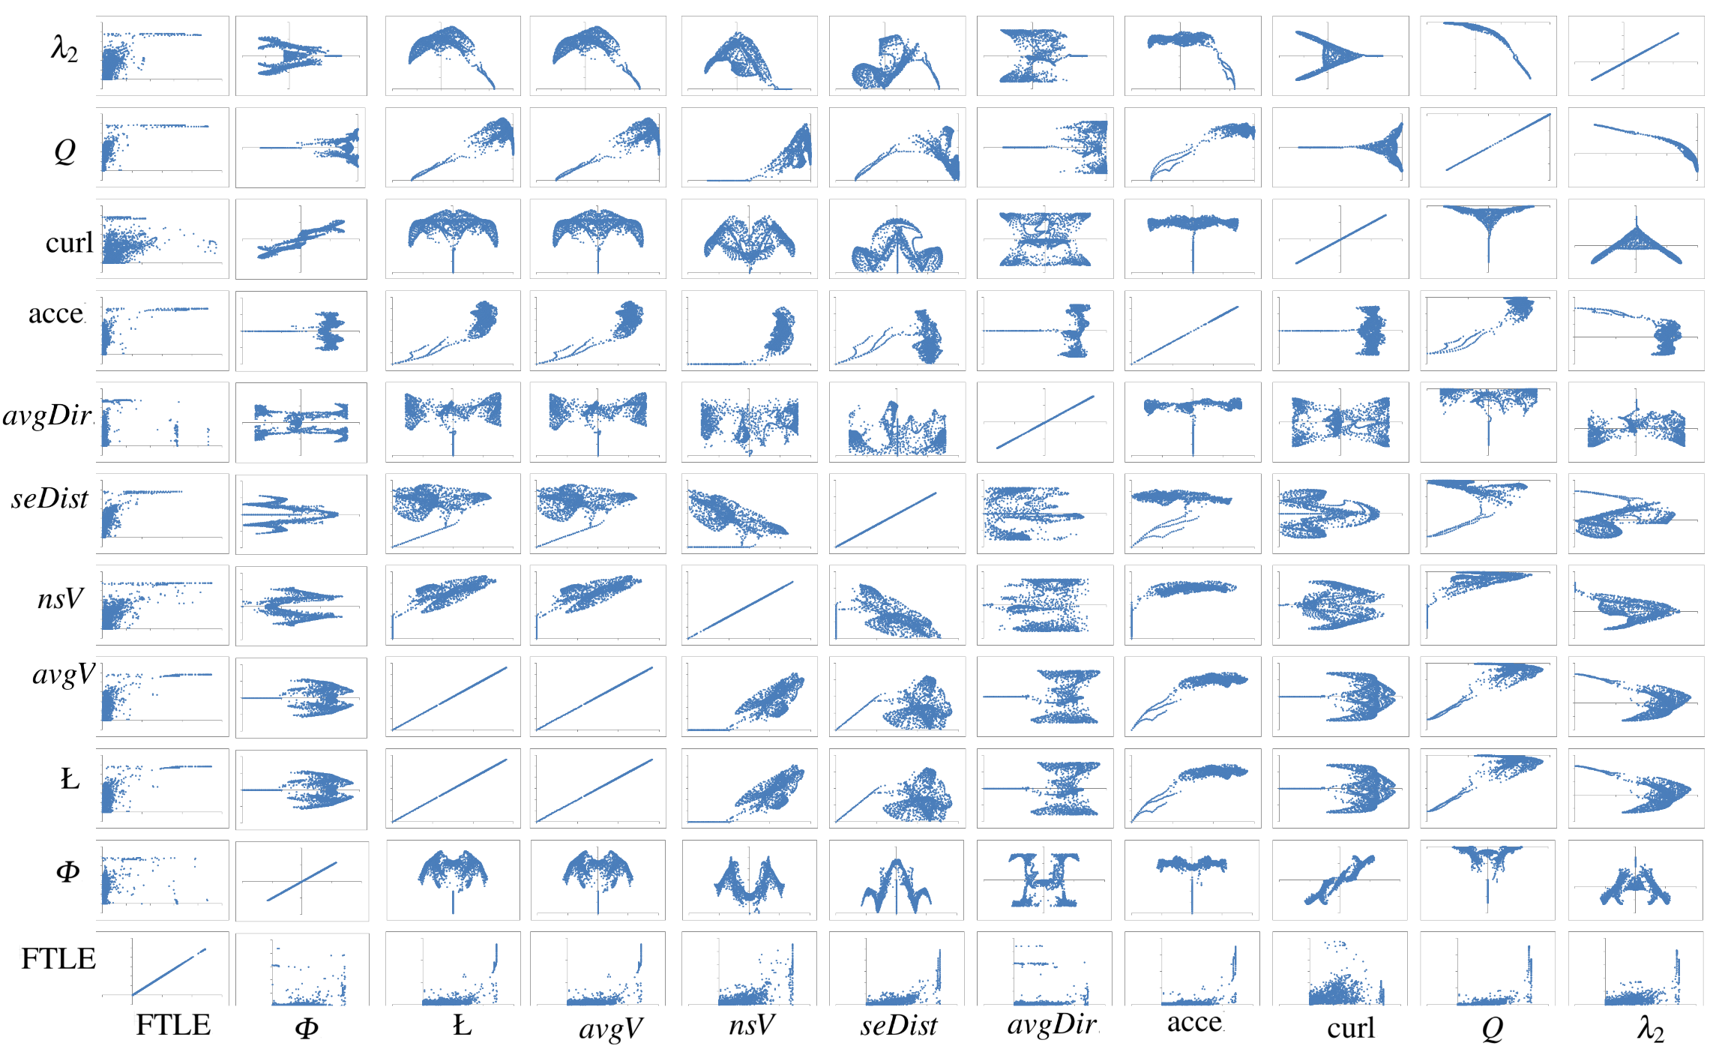
Correlations Among Attributes
Correlation Study Via Pairwise Scatter Plots of different attribute fields of the Double gyre flow

Slide 16
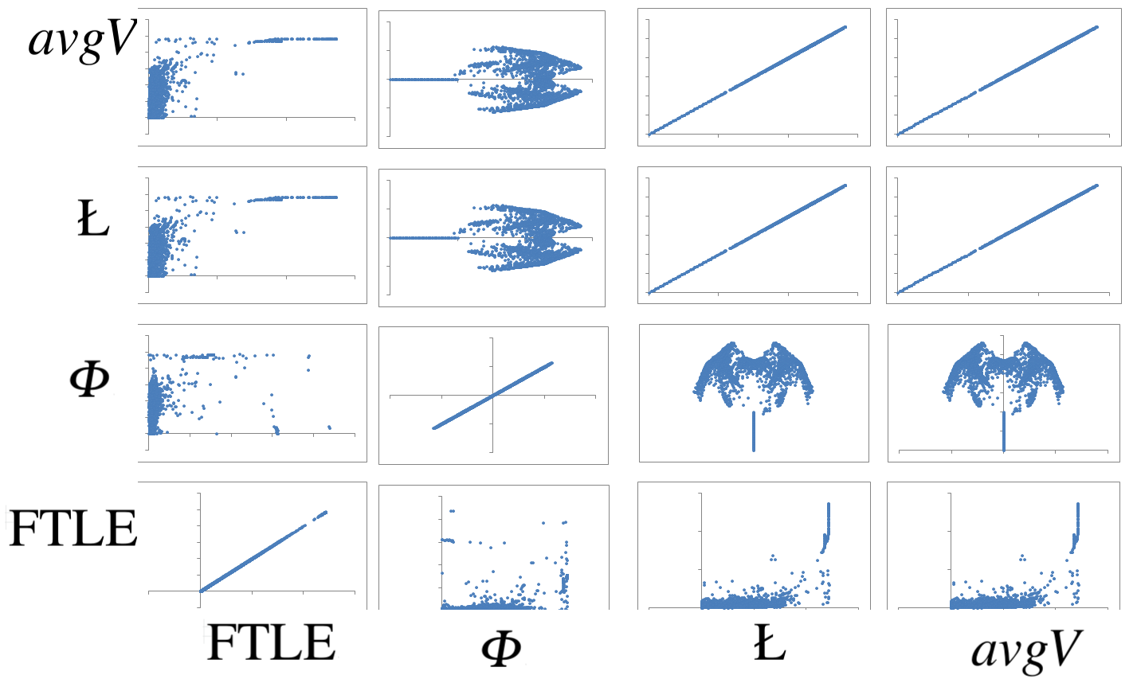
Correlations Among Attributes
Length Field Ł vs. Average Particle Velocity Field avgV
These two fields are highly correlated.
Because the arc-length of each integral curve is equal to the sum of the velocity magnitudes, scaled by the integration step-size, measured along this curve

Slide 17
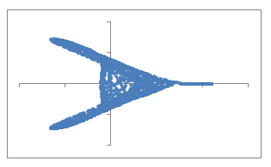
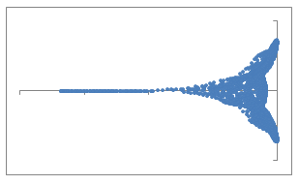
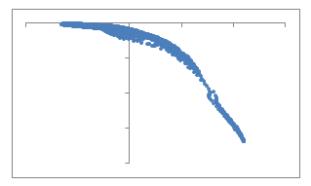
Correlations Among Attributes
curl
Φ, curl, Q, $λ_{2}$fields
curl
Q
All these four attribute fields are related to the rotational behavior of the flow.
Except for the Q field which is always negative, the other three fields’ values can be both positive and negative.
Among them, the plots related to curl field and Φ field demonstrate some symmetry patterns.

Slide 18
Correlations Among Attributes
Acceleration field acce vs. other attribute fields
When the value of the acce field is small, the other attributes tend to be small. When the value of the acce field is increasing and becomes large enough, the other attribute values tend to be large as well. This matches the common knowledge that the acceleration–a result of the external force based on Newton Second Law, is the source of many different flow behaviors, such as flow separation and rotation

Slide 19
Correlations Among Attributes
FTLE vs. the gradient of the attribute fields
It shows quite some strong correlation between the gradient of the attribute fields and the FTLE field.
This supports the discussion of the relationship between the transportation structure of certain materials and LCS.
[Shi et al. 2008]

Slide 20
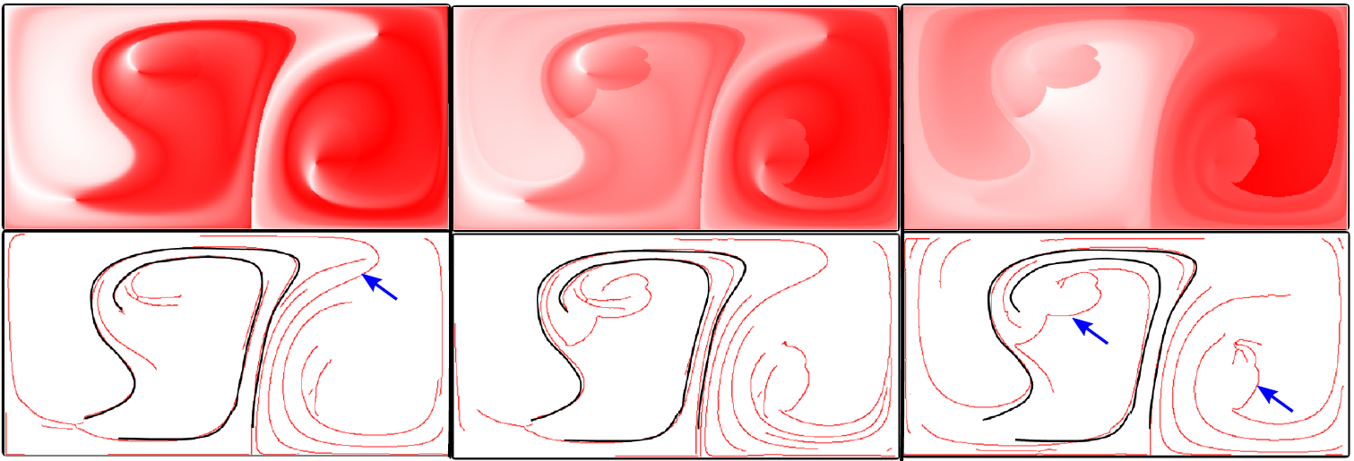
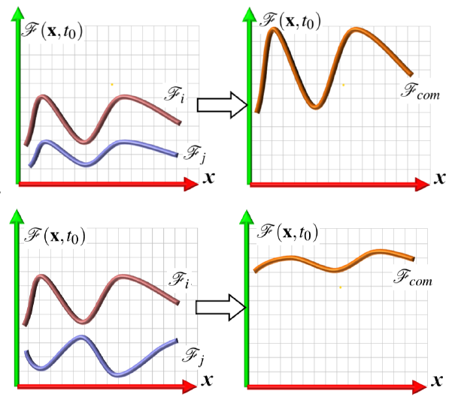
Correlations Among Attributes
$α_{1}×$avgDir + $α_{2}×$Φ
Spatial Correlation via Combined Attribute Fields
$$α_{1}=0.9$$
$$α_{2}=0.1$$
$$α_{1}=0.5$$
$$α_{2}=0.5$$
$$α_{1}=0.1$$
$$α_{2}=0.9$$
Black curves show stable edges under different combinations

Slide 21
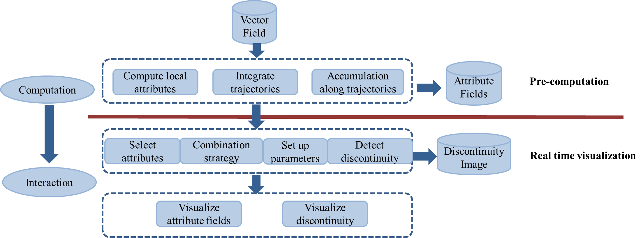
Visual Exploration Based on Attribute Fields

Slide 22
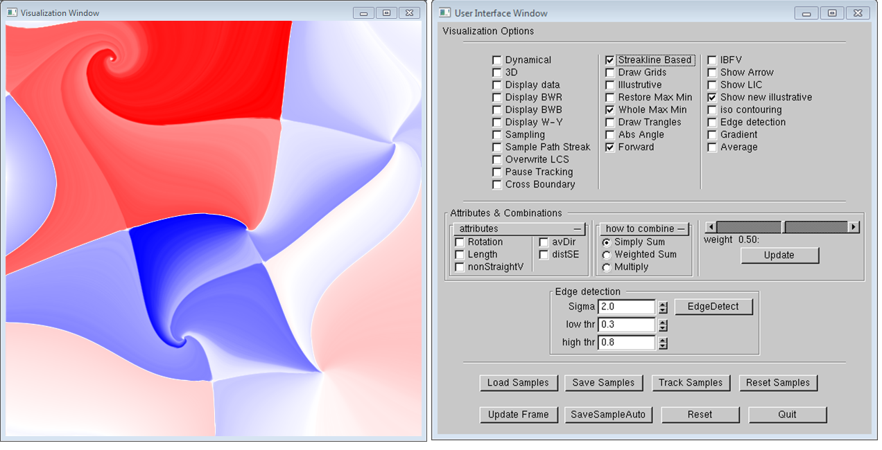
System Screenshot
User Interface
Visualization
Visualization Options
Parameters Setup

Slide 23
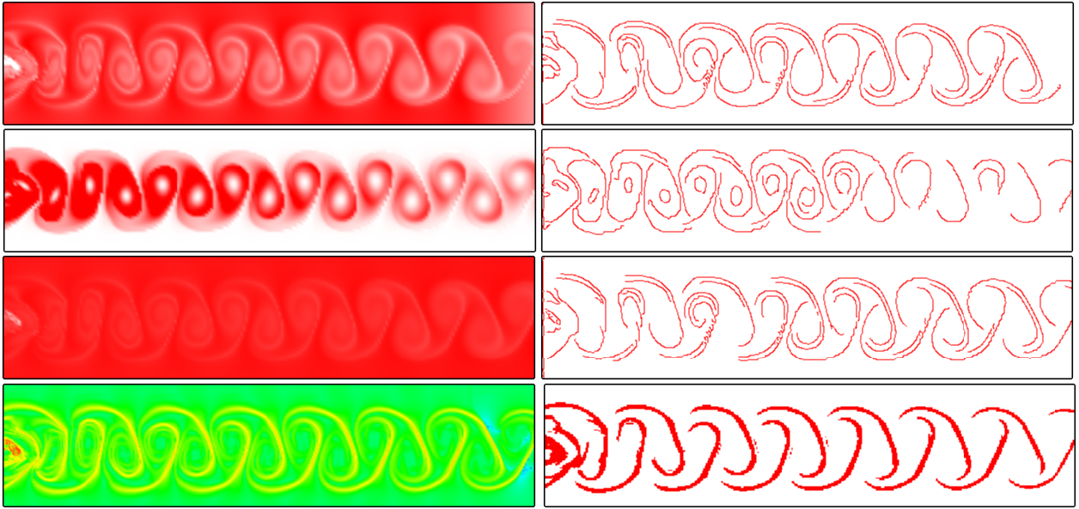
Some Results
avgV field
nsV field
Ł field
FTLE and LCS
Attribute fields (left) of the flow behind cylinder and detected edges (right)
The parameters of Canny edge detector are s =1.0, α =0.3, β= 0.8.

Slide 24
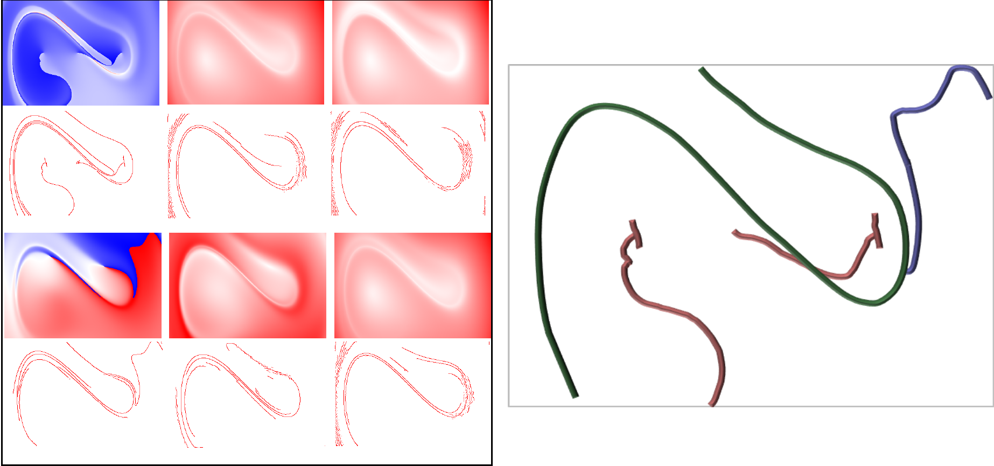
Some Results
Common edges
Attribute fields and their detected edges of force duffing oscillator
[Haller and Sapsis, 2011]

Slide 25
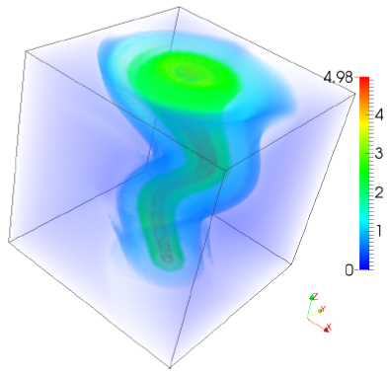
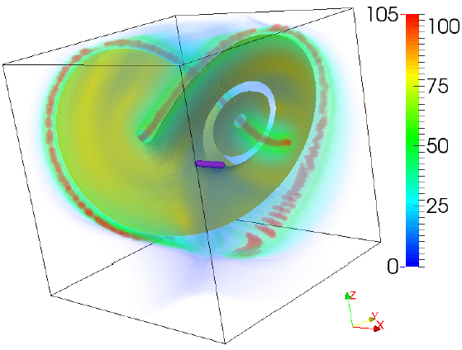
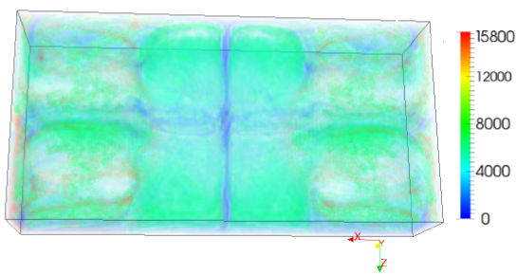
Some Results
Curl-based attribute field of the Bernard data set
The rotation field, Φ, of the Lorenze strange attractor
The length field of the tornado data set

Slide 26
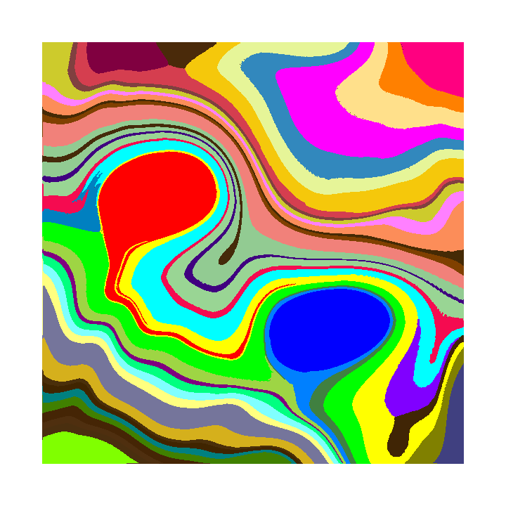
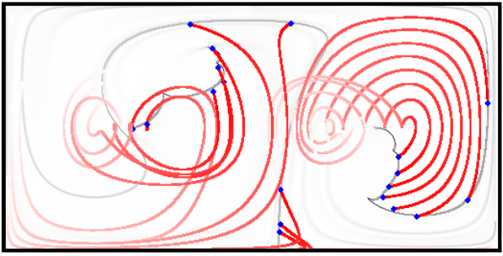
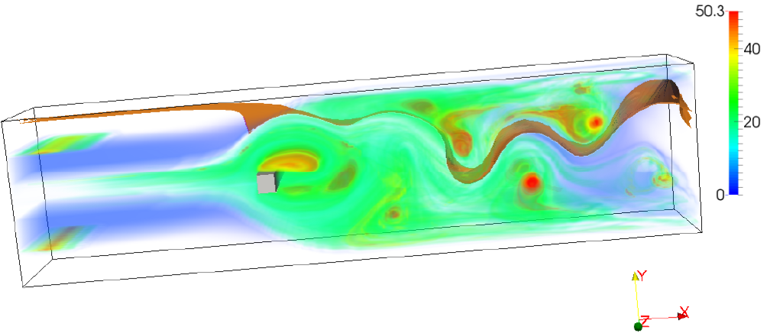
Conclusion and Discussions
Potential benefits of the attribute fields
Integral curve and surface seeding
Flow visualization in higher-dimensional space
Flow domain segmentation
Flow pattern retrieval
Multi-field analysis

Slide 27
Conclusion and Discussions
Potential benefits of the attribute fields
Integral curve and surface seeding
Flow visualization in higher-dimensional space
Flow domain segmentation
Flow pattern retrieval
Multi-field analysis
Problems of the attribute fields
Still lack of a rigorous description of the discontinuity and its relation to standard flow features.
Correlation analysis can be performed in a more general sense.
The correlation and dependency among different attribute fields are not fully investigated
The sampling strategy and integration time play an important role as FTLE computation.
Memory consumption.

Slide 28
Acknowledgments
People
Jacqueline H. Chen, Sandia National Lab
Mathew Maltude, Lawrence Livermore National Lab
James Liburdy, Oregon State University
Funding Angency
National Science Foundation

