Slide 1


Slide 2
Interactive Procedural Street Modeling
Guoning Chen¹, Gregory Esch¹, Peter Wonka²,
Pascal Müller³ and Eugene Zhang¹
¹ Oregon State University
² Arizona State University
³ Procedural Inc. / ETH Zürich
Notes:
First of all, thank you for staying till the last minute for the closing paper.
Our paper is “Interactive procedural street modeling”.

Slide 3
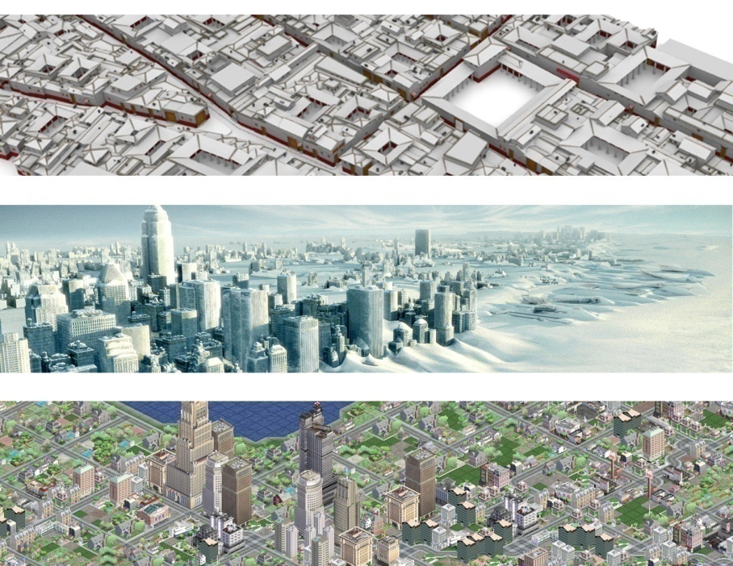
Street Modeling
Images by Eric Hanson and Ben Watson
Notes:
Urban environment modeling has found a wide variety of applications in movies, games and other disciplines.
To model an urban environment, streets must be placed first to satisfy the user’s requirements. We refer to this process as Street Modeling.

Slide 4
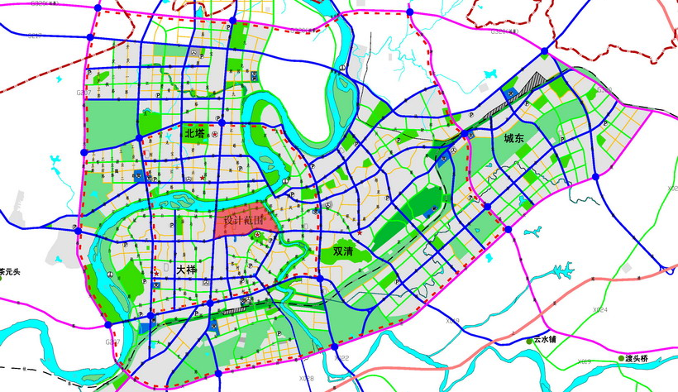
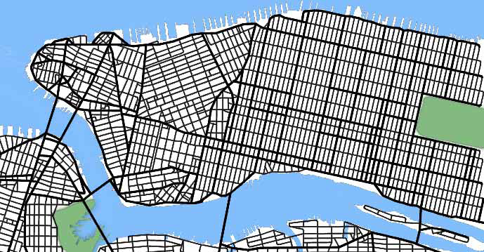
Current Practice
Manual Editing
Procedural Modeling [Parish & Müller 2001]
image from http://www.hnup.com/
→ Control
→ Efficiency
Notes:
There are two popular approaches to place streets.
With the first method, the user places street segments one at a time. This can provide complete control of the whole city map, but is labor-intensive. A large city map could take several man years to design.
The second approach uses procedural modeling techniques. The example shown on the right is a street network grown out of a single point using L-systems.
Procedural modeling techniques greatly reduce the labor cost. However, the user has little control of the final result.
//For example, if
Our goal is to achieve both efficiency and user control for street modeling.

Slide 5
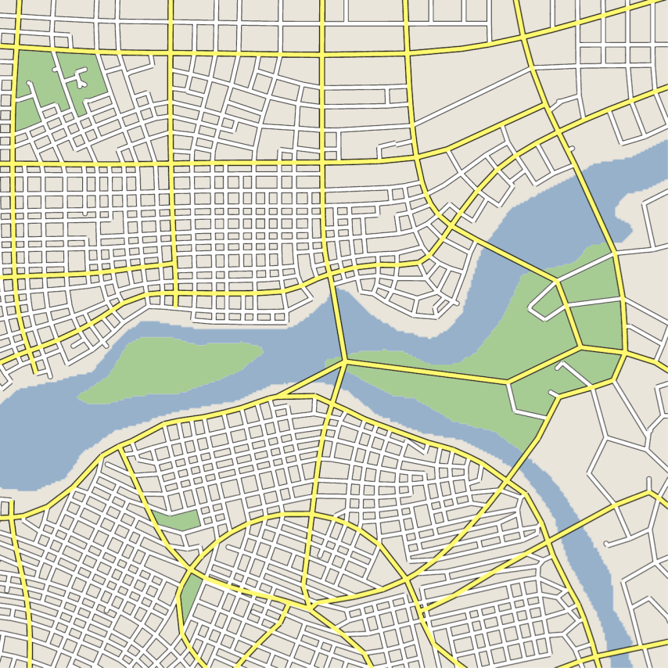
Our Solution
Notes:
We offer a solution to achieve such a goal. We make use of tensor fields as the underlying parameter for the street network placement. It provides the user sufficient and intuitive control, and places streets fast.

Slide 6
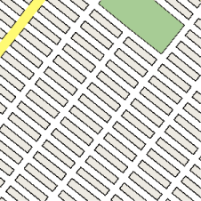
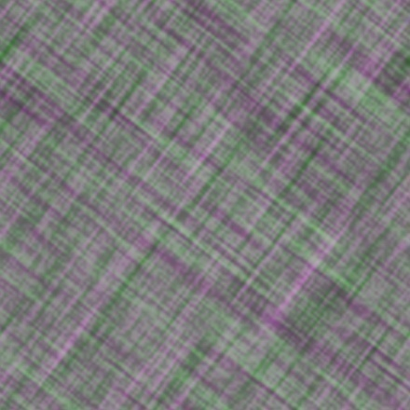
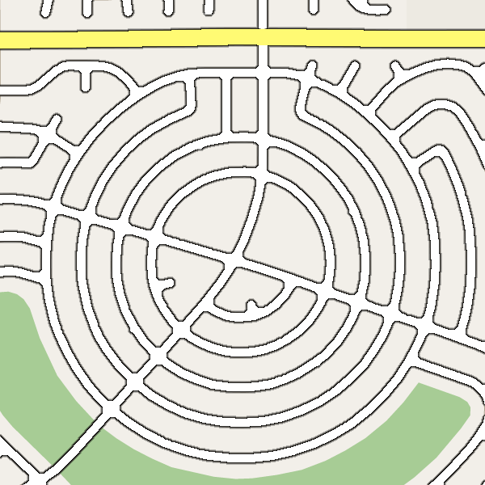
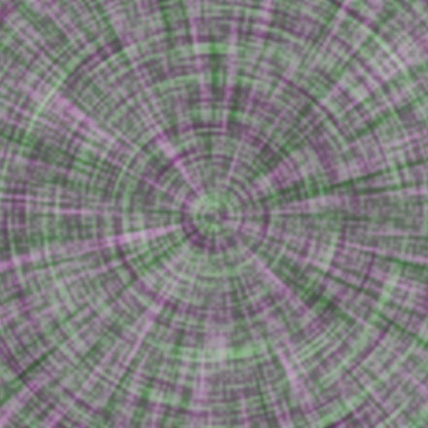
Street Patterns vs. Tensor Fields
© Google Maps, 2007
© Google Maps, 2007
Real street patterns
Tensor fields
Notes:
Why do we choose tensor fields? We show two examples of side-by-side comparison of street patterns and tensor fields.
The left column shows two popular street patterns.
The right column shows the visualization of two tensor fields. Notice how the street networks form patterns similar to tensor field directions.
This motivates us to resort to tensor field design to drive the street placement.
Before we delve into the technical details of this technique, I would like to clarify our expectation to the output street network. Here we are not trying to replicate the existing city map as accurate as possible.
Actually, there is no technique to do that except for placing streets one at a time.
Therefore, we seek to model a city map as realistic as possible.

Slide 7
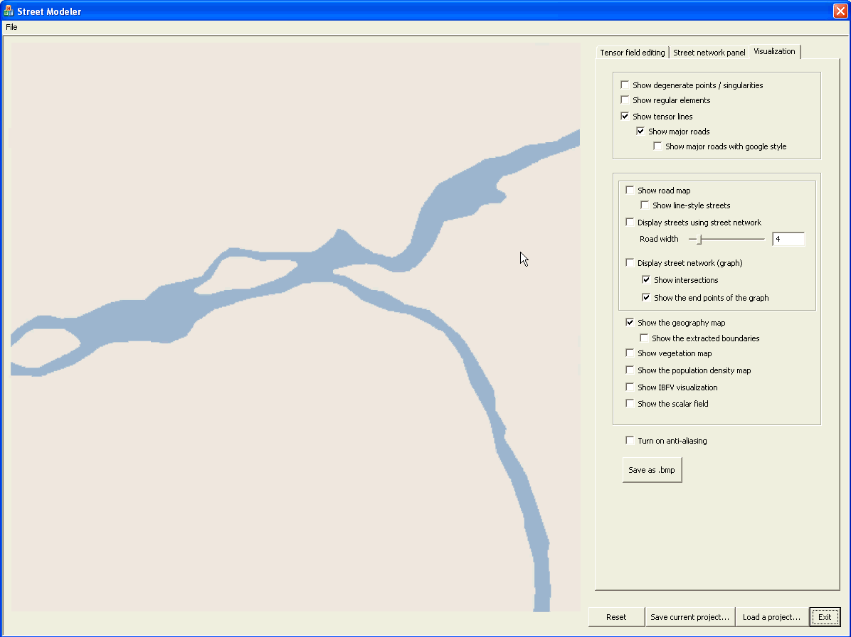
Notes:
This video will show the design of the virtual city map in about 3 minutes or shorter

Slide 8
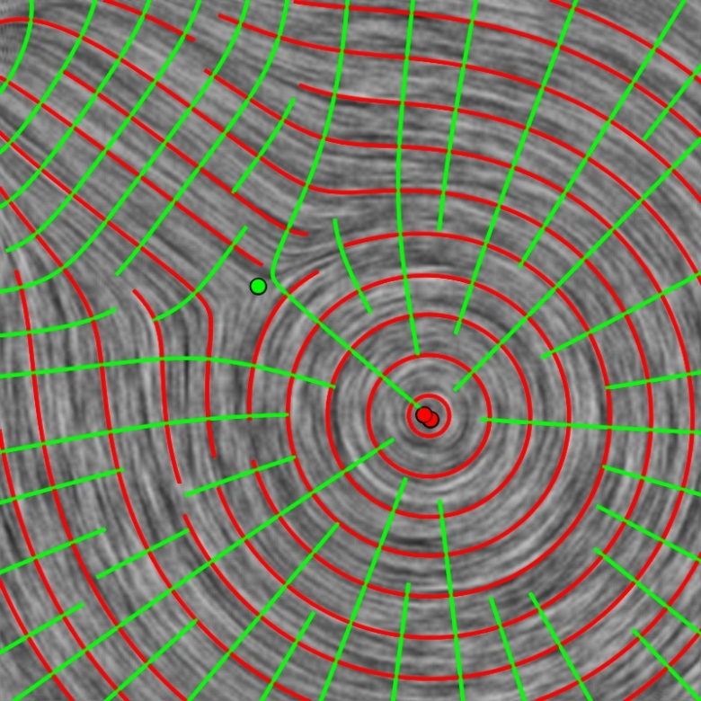
Tensor Field
  2nd Order Symmetric Tensor Fields
  Eigenvectors
  Eigenvector fields
  Hyper-streamlines
Notes:
The tensor fields we are using here are the second-order symmetric tensor fields, which has the form of the following matrix.
The computation domain we are using is a regular grid.
If the matrix is not degenerate (or singular), its two eigenvectors form a cross.
All the major eigenvectors in the computation domain give rise to a major eigenvector field.
Similarly, we have a minor eigenvector field.
We will place streets based on these two eigenvector fields.

Slide 9
System Pipeline
Input maps
W,F,H,P
Tensor field
Generation
tensor
field T
Street Graph
Generation
street
graph G
Notes:
We now explain stage 1.

Slide 10
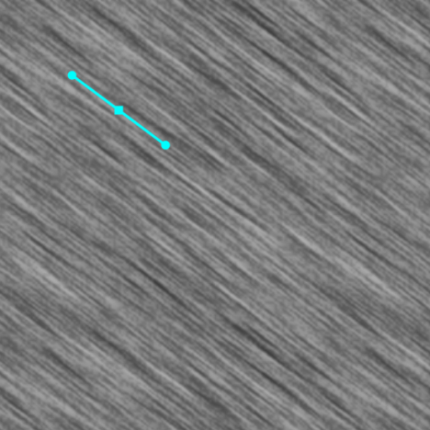
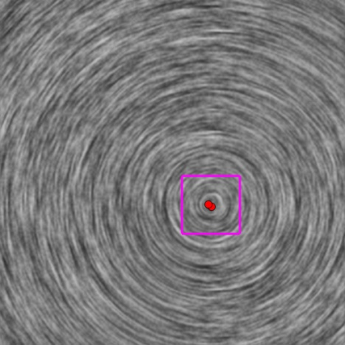
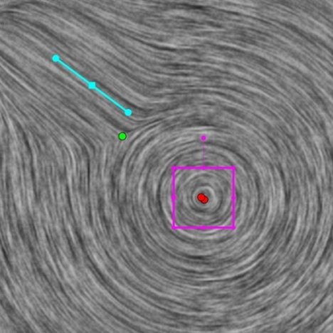
Tensor Field Design
Notes:
To design a tensor field, we make use of basis fields.
The basis fields are typically the patterns we have described earlier.
The patterns have nice mathematical representation, such as a regular element and a center.
In order to obtain the final tensor field, we combine the basis fields using a radial falloff function.

Slide 11
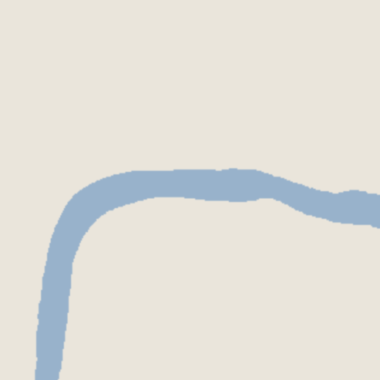
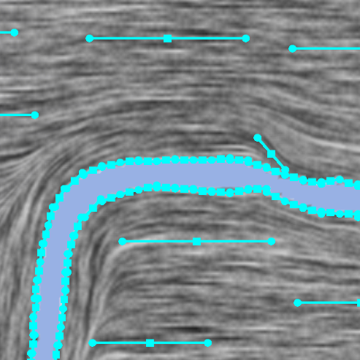
Map-based Tensor Fields
Generating tensor fields from topographical maps
Notes:
Before we have introduced the tensor field design using design elements.
In street design, we want the street placement satisfies the given geography constraints, such as rivers, shorelines, mountains, etc.
The initial tensor field is generated from the boundary information extracted from the input maps (typically a water map and a vegetation map if provided).
We use a water map as an example to generate the initial tensor field.
To do so, we first extract the boundaries from the given maps and discretize and represent them as a set of polylines.
Each line segment of the polylines will be assigned a regular elements.
After obtaining the initial tensor field, the user can keep modifying the tensor field by adding new elements or editing the existing elements.
The user can add more design elements to meet his requirements.

Slide 12
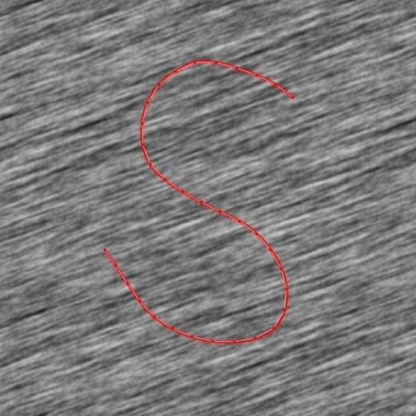
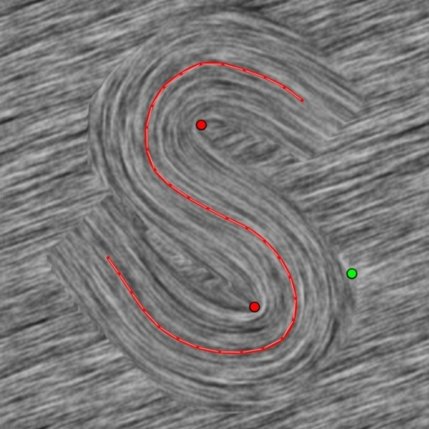
Brush Interface
Notes:
After generating the initial tensor field, we allow the user to edit the obtained field by modifying the design elements.
More usefully, we provide the user a tool that enables the re-orientating the streets.
Roughly speaking, the user can draw a curve using mouse and the system will re-generate the tensor field in the local neighborhood with user specified distance of the curve following the direction of the curve. Hence, the new generated streets will be re-oriented as well.
The implementation is similar to the initial field generation except that we only do this inside the local region.

Slide 13
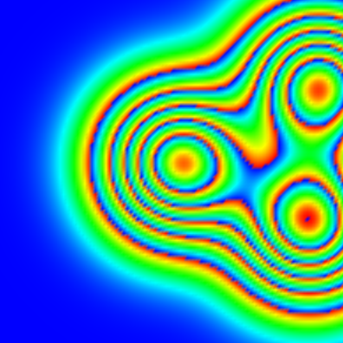
Non-Rectangular Intersections
Notes:
Another useful functionality for editing is the generation of non-right angle intersections.
Recall that the intersections of a street network obtained using symmetric tensor field will all have right angles (90 degree).
This is not always the case, to overcome this limitation, we introduce the idea of rotation field.
The rotation field is a scalar field. The value in this scalar field at a point represents how much we want to rotate the underlying eigenvector fields at that point. This results in the rotation of the intersections as well because the streets are placed following the eigenvector fields.
Technically, we can rotate major and minor eigenvector fields separately or together. The example shown here is the rotation of both major and minor eigenvector fields and make them close to each other.

Slide 14
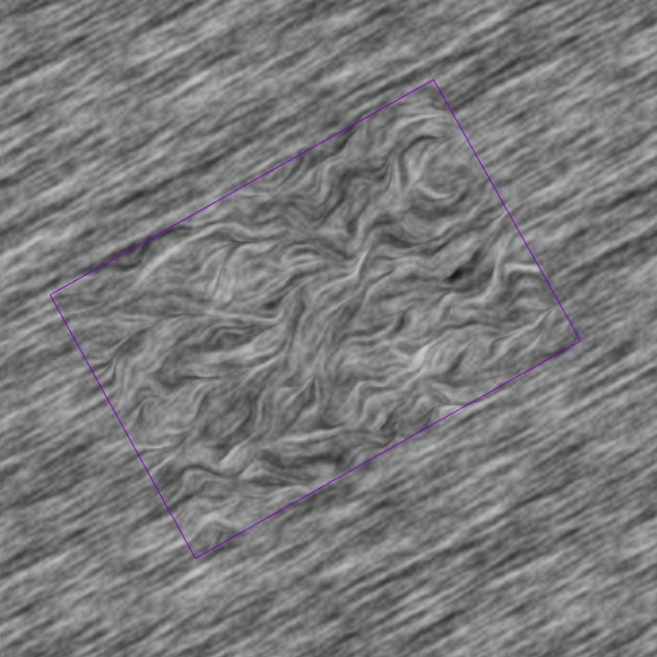
Organic Street Patterns
Adding Perlin noise [Perlin 1985]
Notes:
The other functionality is the generation of organic-like patterns using noise. In our work, Perlin noise is used.
The noise values are used to rotate the tensor field here.
When the tensor field satisfies the user’s requirements, we are ready to extract the street network.

Slide 15
System Pipeline
Input maps
W,F,H,P
Tensor field
Generation
tensor
field T
Street Graph
Generation
street
graph G
Notes:
We now describe the generation of the street network after obtaining the proper tensor field.
Recall that we make use of hyper-streamlines to obtain the streets.
We now introduce the hyper-streamline tracing.

Slide 16
Hyper-Streamline Placement
  [Jobard and Lefer 1997; Alliez et al. 2003; Zhang et al. 2007]
The method based on
Jobard and Lefer’s
Our method
Notes:
Recall that we make use of hyper-streamlines to obtain the streets.
We now introduce the our hyper-streamline tracing algorithm.
Originally, we made use of Jobard and Lefer’s evenly placed streamline tracing algorithm and take into account the sign ambiguity in the eigen vector fields to perform the tracing of hyper-streamlines. It turned out to produce disconnected street network. This is not what we want for a street network especially major road network.
To solve the connectivity problem, we introduce an improved tracing algorithm for the major road placement.
Instead of tracing the two orthogonal families of hyper-streamlines separately, we interleave the tracing between major eigenvector field and minor eigenvector field. Different from Jobard and Lefer’s method, we also allow the hyper-streamlines to trace after they are too close to existing hyper-streamlines. Note that our algorithm sacrificing the evenly placement feature.
Another difference is the seeding strategy. Instead of seeding a certain distance away from the current hyper-streamline. We sample along the obtained hyper-streamline with the same separation distance value for the tracing along the other eigenvector field. This guarantee well connectivity of major and minor hyper-streamlines.
Problem:
may create smaller regions

Slide 17
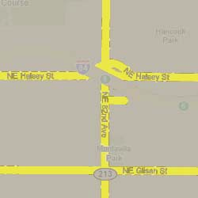
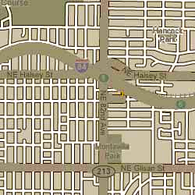
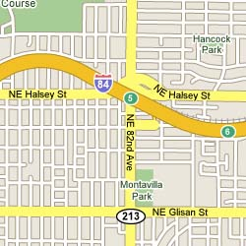
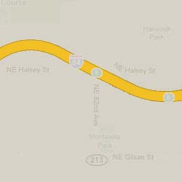
Street Network Hierarchy
Highways
Major Roads
Minor Roads
© Google Maps, 2007
Notes:
We observe that the streets in a city are usually classified into three basic levels.
1. Highways (shown in orange) are the state/interstate/local highways.
2. Major roads (shown in yellow) are the major commercial and traffic transit roads.
3. Minor roads (shown in white) are the roads in the residential regions or branches.
In this project, we focus on the algorithms for automatic placement of major and minor roads only.
Our further observation shows that the major road networks are usually connected to guarantee the major traffic transport of a city. And a major road network tends to divide a city region into blocks. Inside different blocks, minor roads may show different patterns.
These observations suggest that a multi-level design is need.

Slide 18
Multi-level
Street Network Generation
Notes:
This example shows the hierarchical street placement in our system. The user first place major roads using the hyper-streamline tracing algorithm introduced above. The major roads are then use to compute a major road network by computing the intersections between the two families of hyperstreamlines.

Slide 19
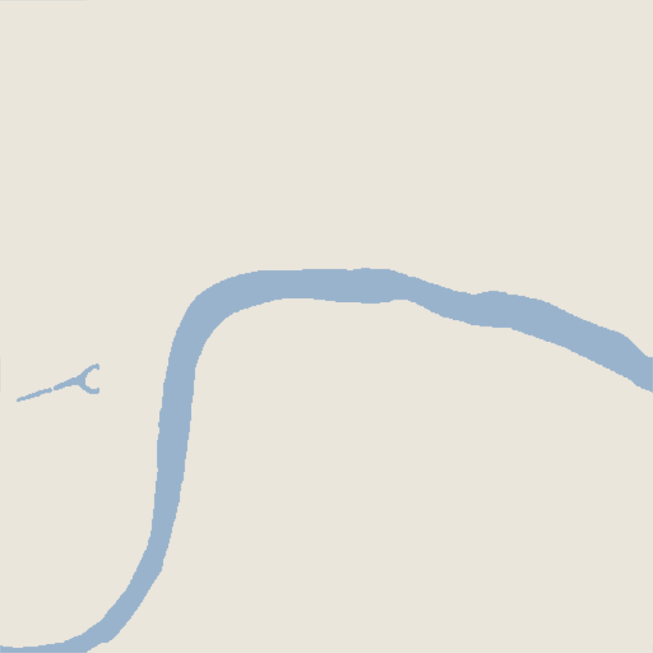
Density Transition
Notes:
We also make use of the population density information to control the density of the roads. Here is an illustrative example.
The population density can be input as a binary map.

Slide 20
Graph Level Editing
Layered editing
Graph noise
Notes:
Besides the conventional graph editing operations, such as moving or adding or deleting nodes or edges in a graph, we allow the user the ability to specify a unique road by layered editing and produce organic-like street network using noise after obtaining the graph.

Slide 21
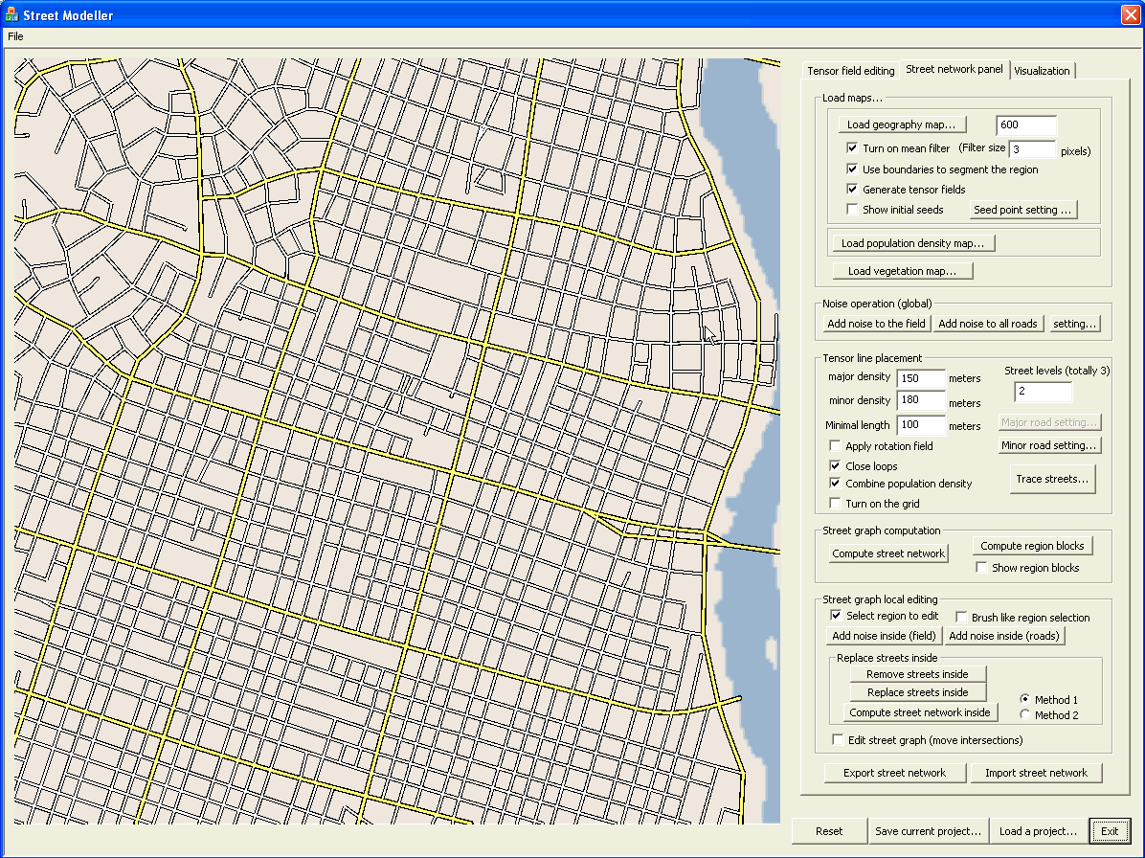
Local Region Editing
Notes:
We want to emphasize that our system allows the user to modify the existing street network.
To achieve this, the user first specify a region to modify; the streets inside the region are then removed;
The user then design new tensor field inside the region to satisfy the new constraints (requirements).
Finally, a new street network inside the region is generated and connected to the existing street network at the boundaries.
This functionality is developed for the need of urban planning when local re-organization of the city blocks is needed.

Slide 22
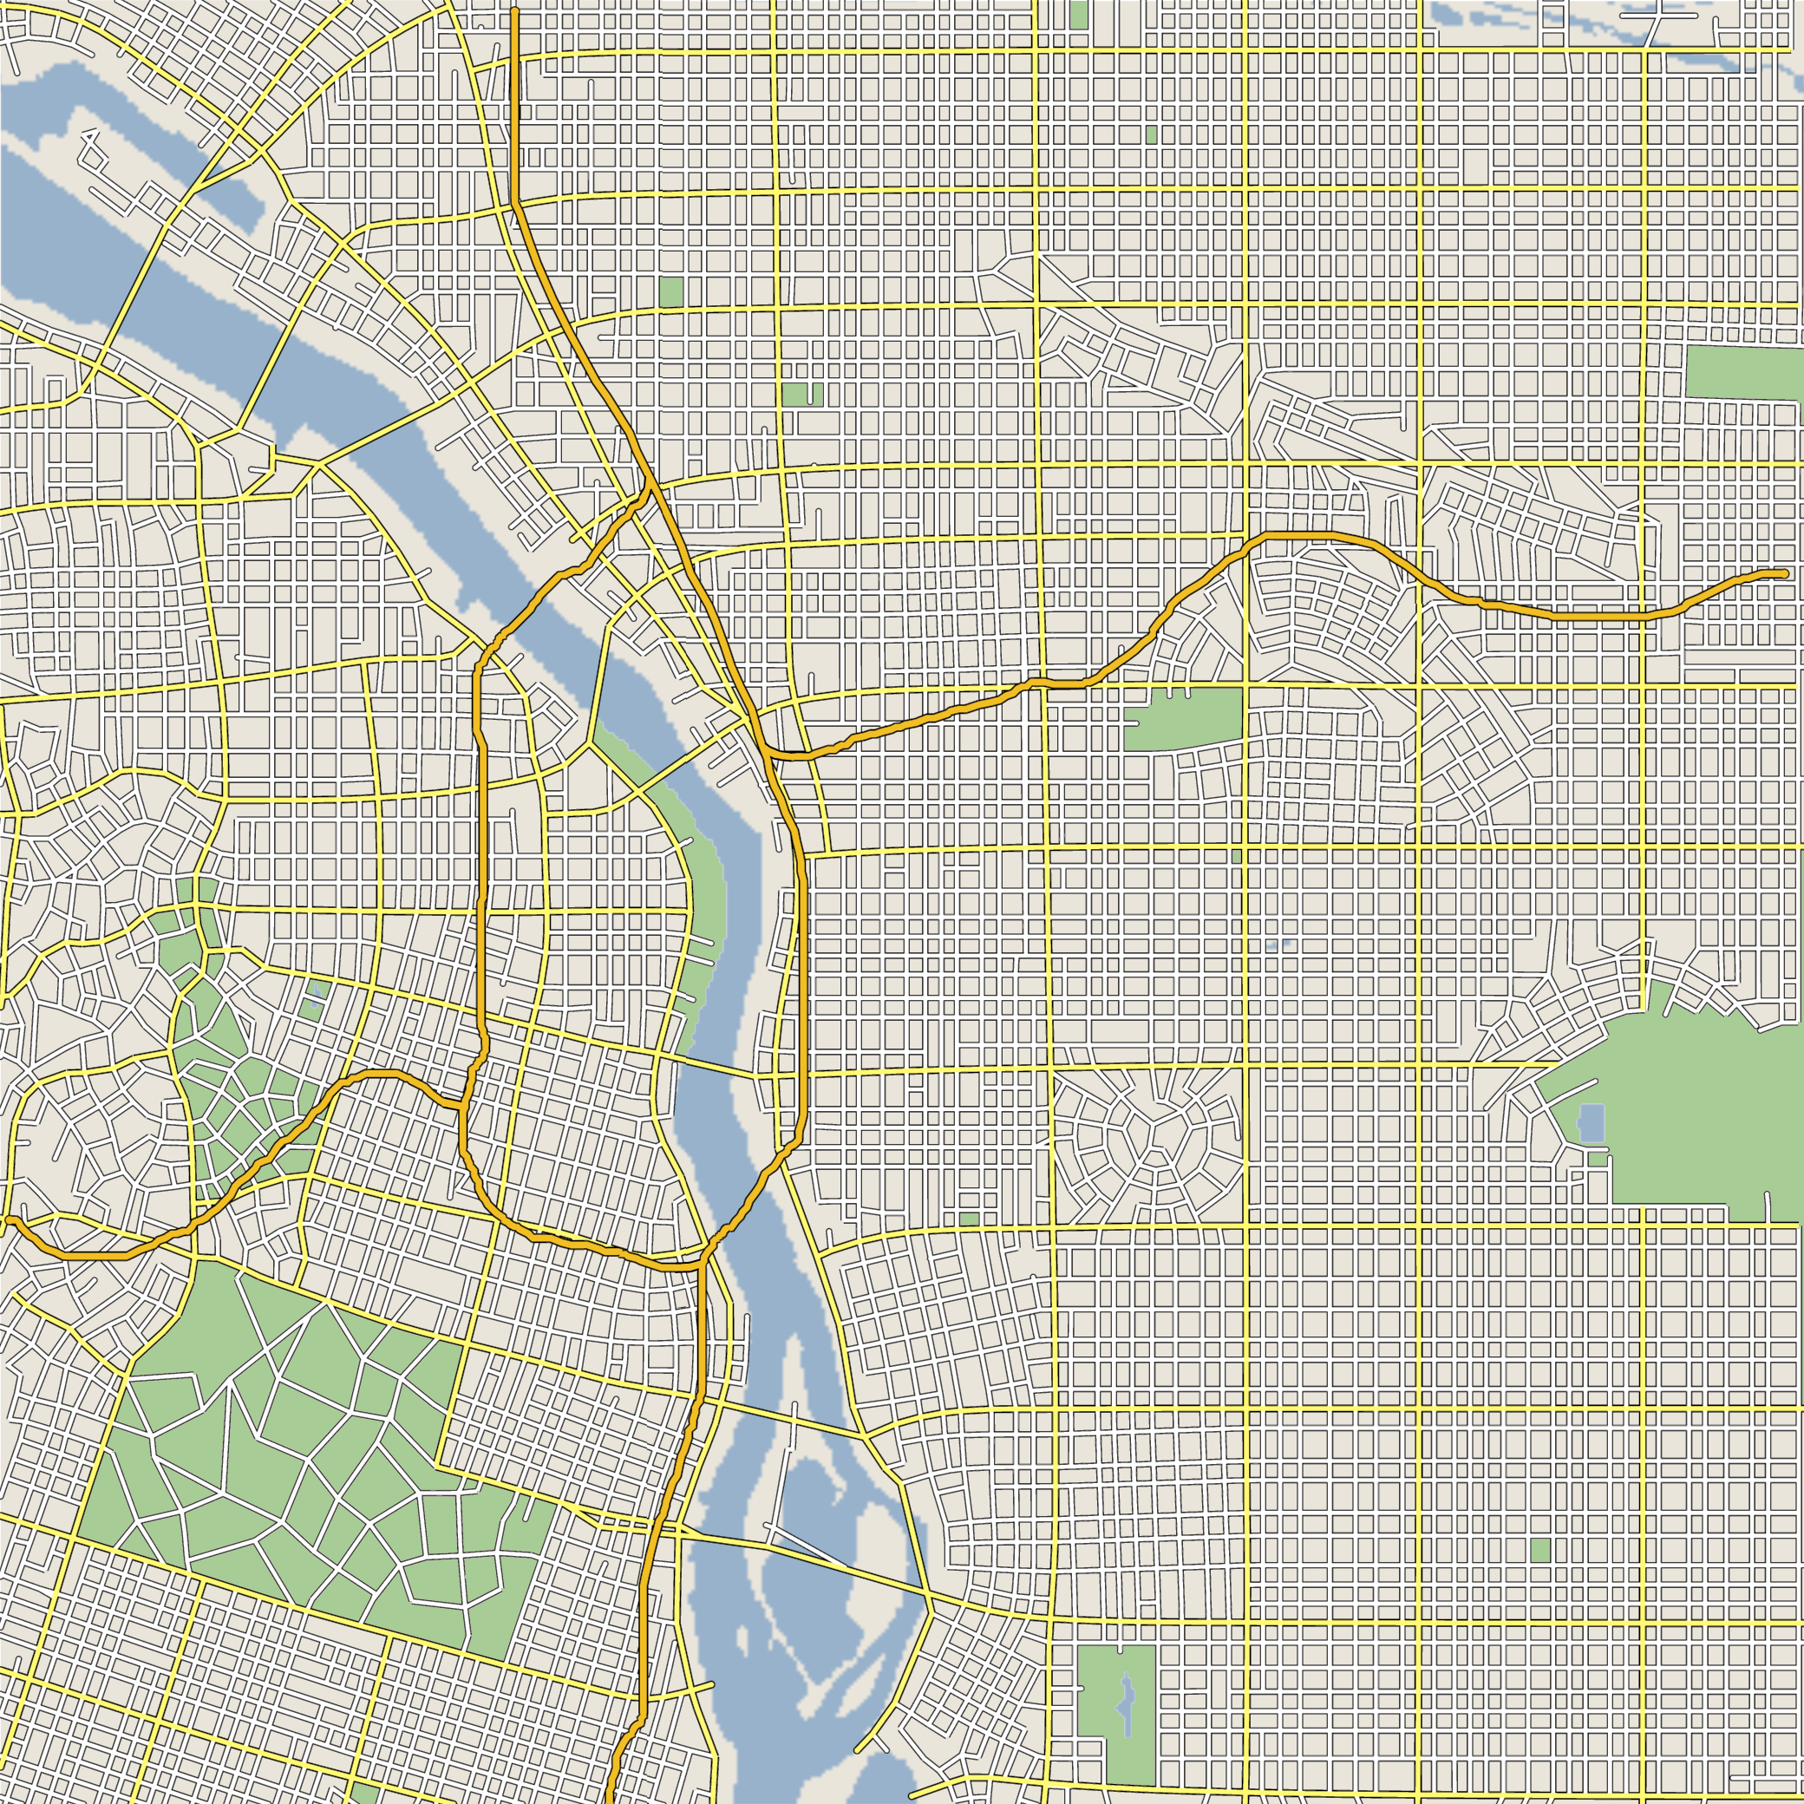
Results and Discussion
Downtown Portland,
OR, USA
28
Notes:
With the aforementioned techniques equipped, we have created a number of city maps.
This one shows a city map we created based on the downtown of Portland.

Slide 23
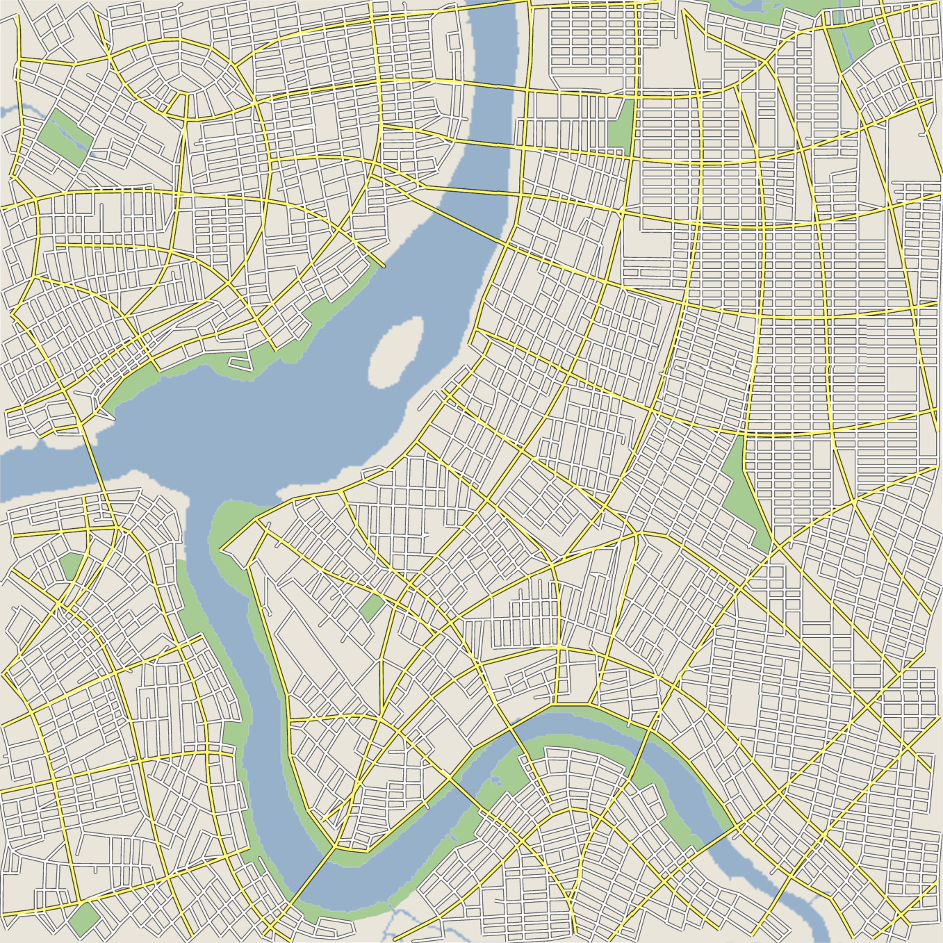
Results and Discussion
Downtown Taipei
29
Notes:
Here is another example of Taipei.

Slide 24

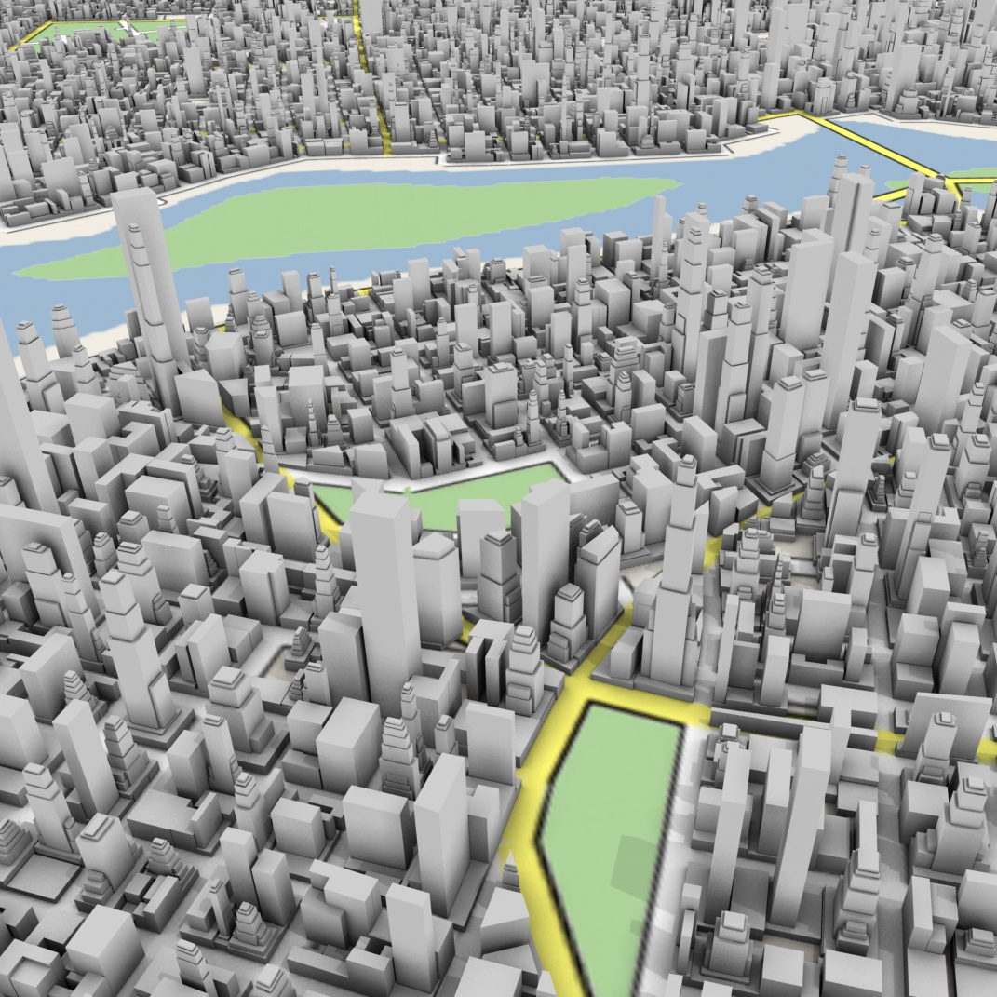
Results and Discussion
Notes:
We point out that the user can create a reasonably realistic street network in a few minutes. But more time can be spent to achieve higher quality street network by fine tuning.

Slide 25
Contributions
Connection between tensor fields and street graphs
Suitable modeling operations
A consistent framework
Technical novelties
Notes:
In this work, we address the problem of interactively modeling large street networks.

Slide 26
Future Work
Extend to related design problems
Explore a more flexible design system
Add image-based design
Notes:
We plan to extend this work to related design problems, such as modeling of cracks, fracture patterns, leaf venation patterns, bark, and ice
crystals.
We want to explore a more flexible design system and relax some constraints. For instance, the two preferred directions can be relaxed using N-symmetry fields. Multi-level resolution design can be added to the system as well.

Slide 27
Acknowledgment
People
  Andreas Ulmer for 3D geometry generation
  William Brendel for valuable discussions
  Madhusudhanan Srinivasan & Patrick Neill for video preparation
  Reviewers for improving the paper
Funding
  NSF
  ODOT
  NGA
Notes:
We would like to acknowledge the following people and the funding sources.

Slide 28
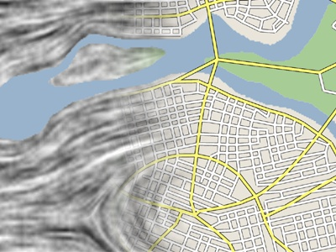
Thank you

