Slide 1
Visualization Rules in Your Diagrams
Guoning Chen
University of Houston

Slide 2
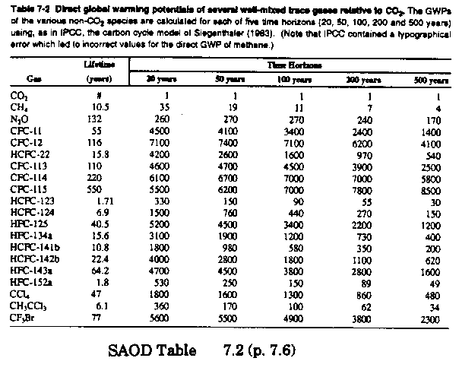
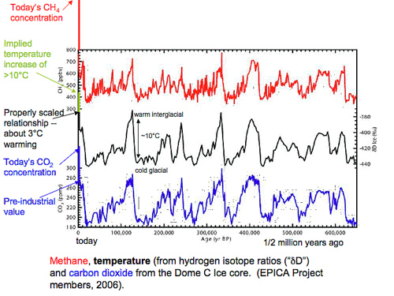
  A picture is worth a thousand words!!

Slide 3
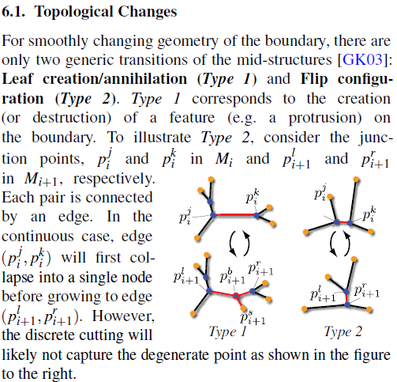
A case study for illustrative diagram
From [Martin et al. EG12]

Slide 4
A case study for illustrative diagram
From [Martin et al. EG12]

Slide 5
Whether an illustrative diagram is needed or not depends on the background knowledge of the readers of your work and the need of your effective presentation.
Also, learning from the successful papers from your community can help form a gauge to evaluate the quality of your illustrative diagrams.

Slide 6
A general comment for figures in the papers

Slide 7
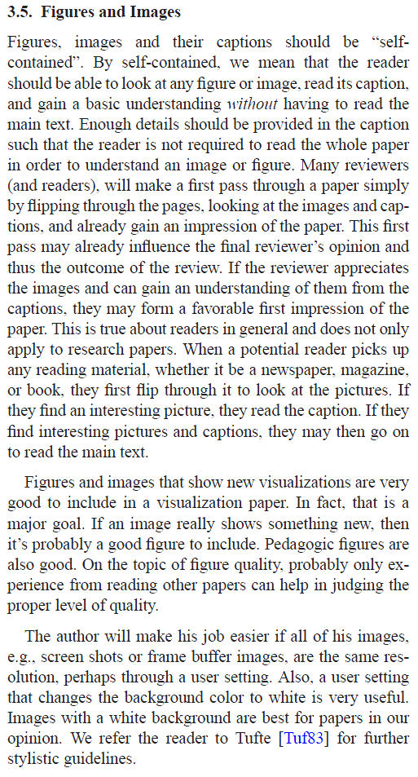
From Bob: How to Write a Visualization Research Paper:
A Starting Point

Slide 8
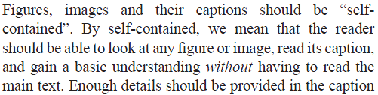
From Bob: How to Write a Visualization Research Paper:
A Starting Point

Slide 9
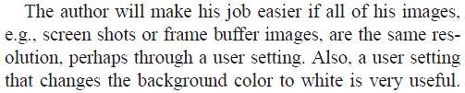
From Bob: How to Write a Visualization Research Paper:
A Starting Point

Slide 10
Use shapes wisely

Slide 11
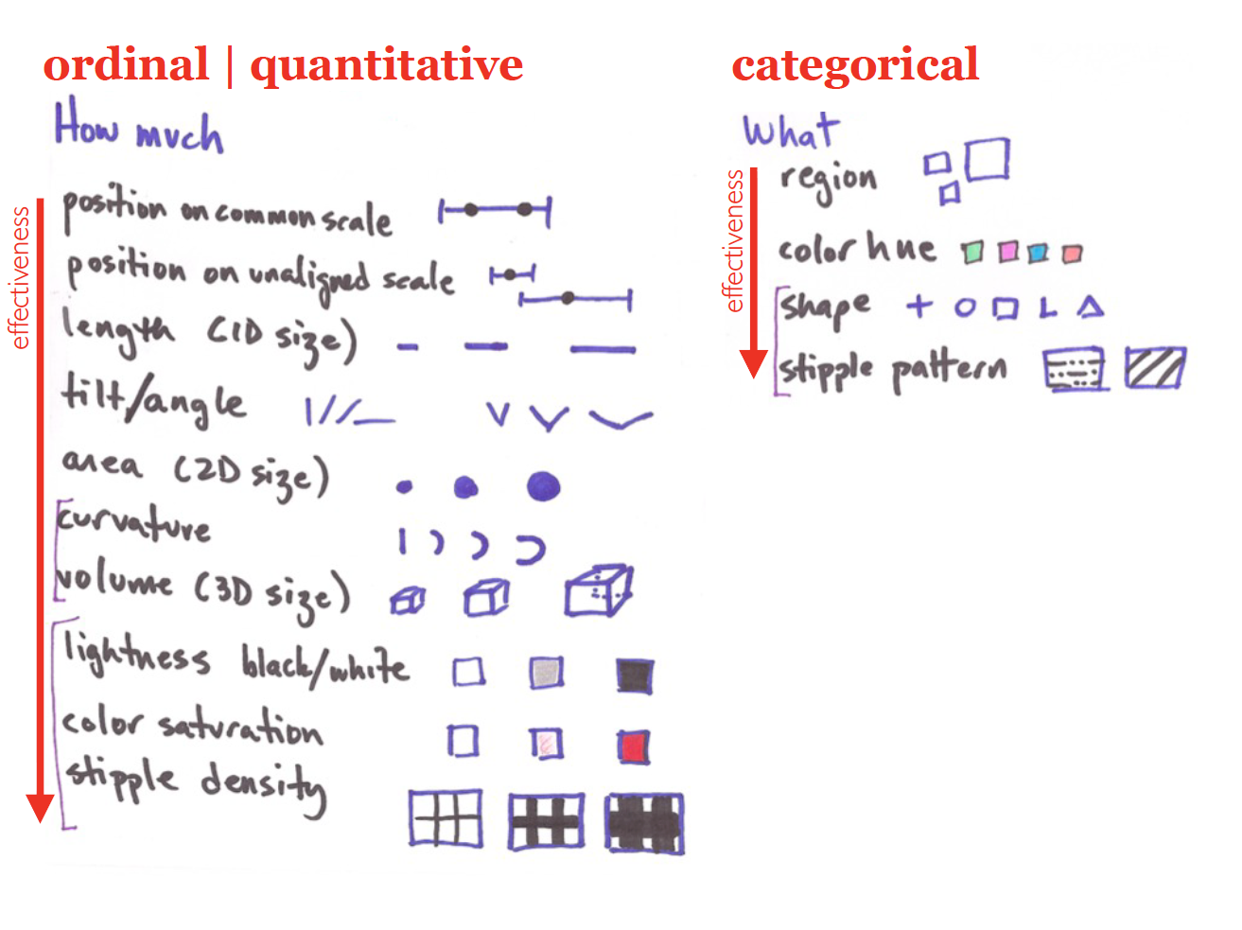
Material from Dr. Miriah Meyer, Univ. of Utah

Slide 12
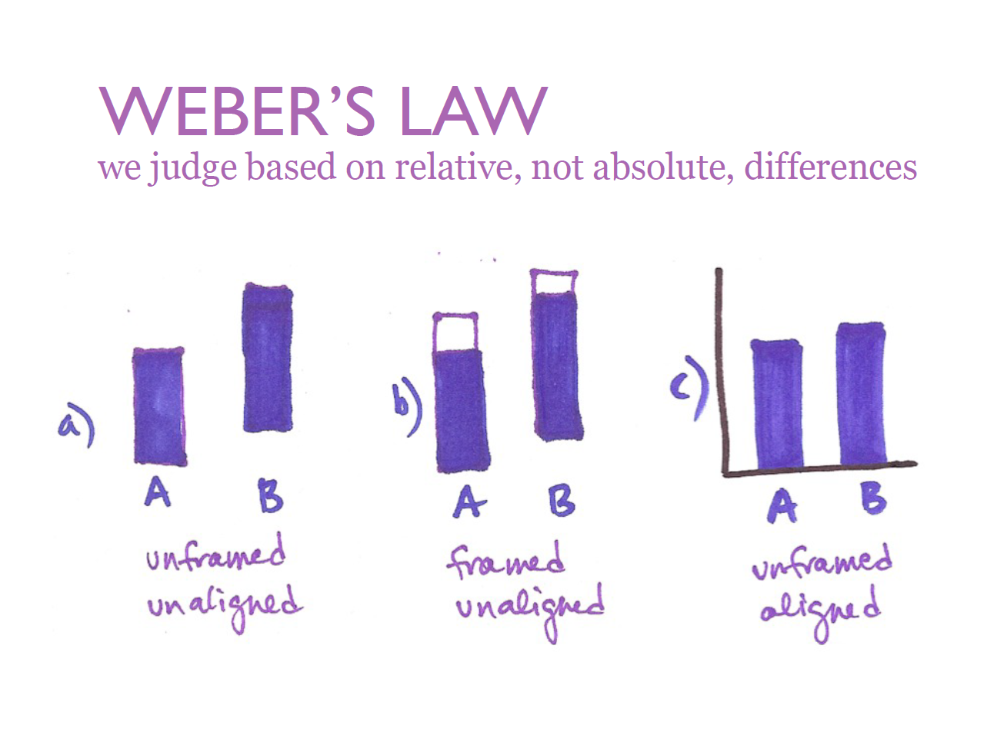
Material from Dr. Miriah Meyer, Univ. of Utah

Slide 13
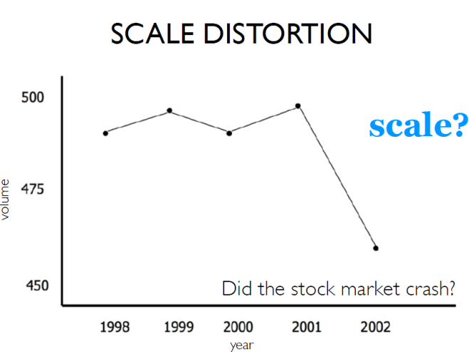
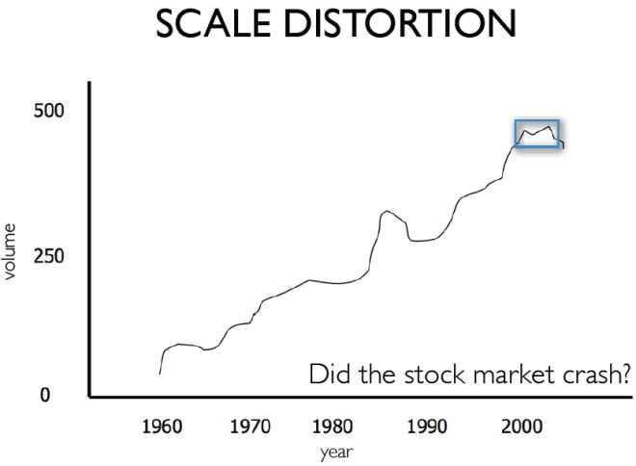
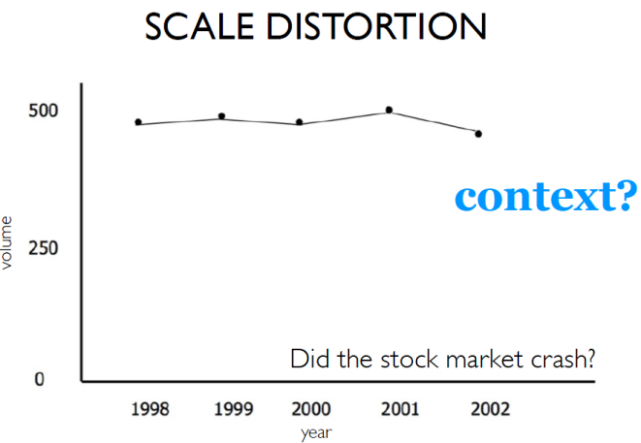
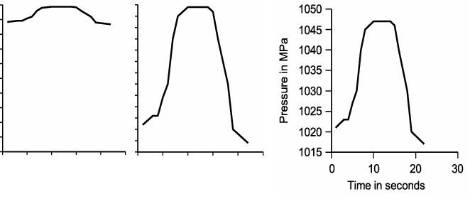
Clear, detailed, and thorough labeling should be used to defeat graphical distortion and ambiguity
More effective
Image from: Dr. Miriah Meyer, Univ. of Utah
Image from: Graphics & Visualization: Principles & Algorithms, Chapter 10

Slide 14
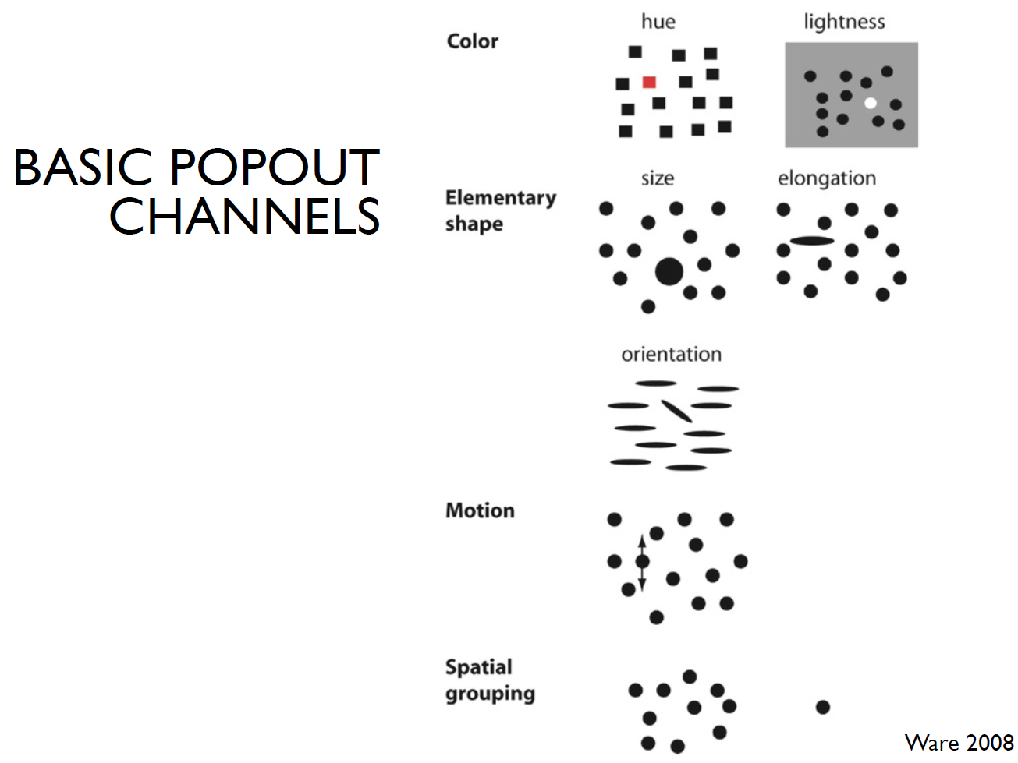

Slide 15
Use colors wisely

Slide 16
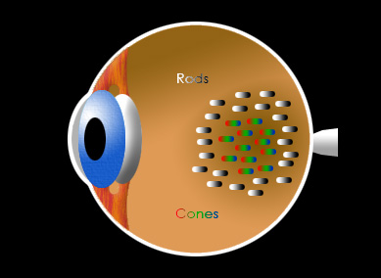
Sensors in Your Retina
Rods
  • ~115,000,000
  • Concentrated on the periphery of the retina
  • Sensitive to intensity
  • Most sensitive at 500 nm (~green)
Cones
  • ~7,000,000
  • Concentrated near the center of the retina
  • Sensitive to color
  • Three of cones: long(~red), medium (~green), and short (~blue) wavelengths
Source: starizona.com

Slide 17
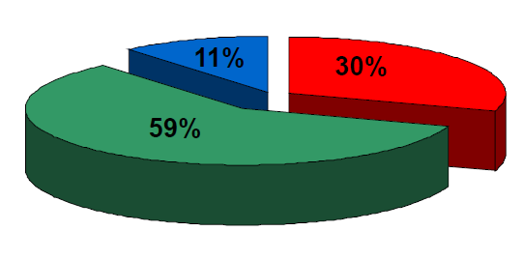
The Luminance Equation
$$Y=0.3×Red+0.59×Green+0.11×Blue$$
Material from Dr. Mike Bailey, Oregon State Univ.

Slide 18
Use good contrast as human eye is good at difference

Slide 19
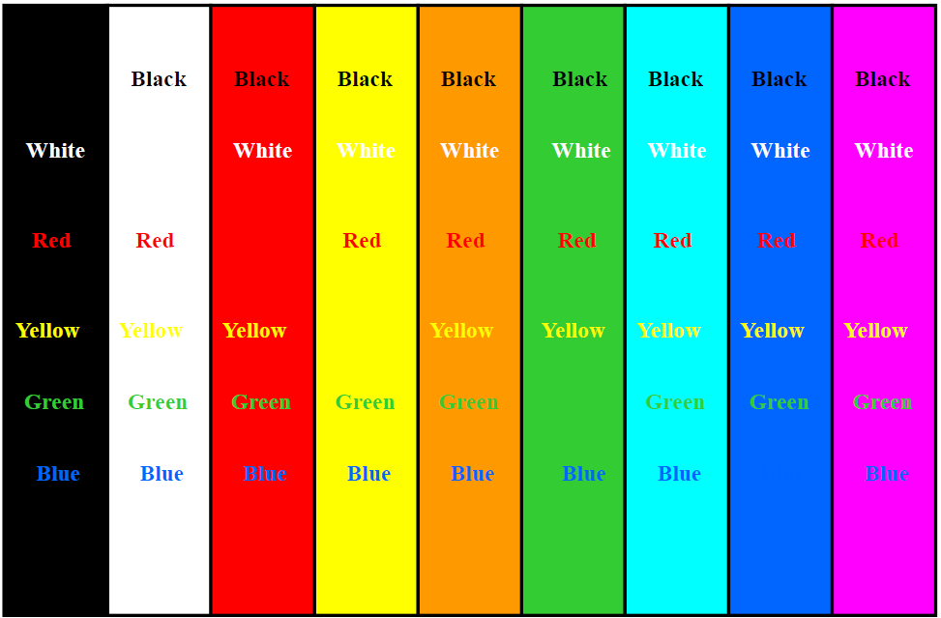
Use good contrast
ΔL* of about 0.40 makes good contrast
Material from Dr. Mike Bailey, Oregon State Univ.

Slide 20
Do Not Attempt to Fight Pre-Established
Color Meanings

Slide 21
Examples of Pre-Established Color Meanings
Red
Green
Blue
Stop
Off
Dangerous
Hot
High stress
Oxygen
Shallow
Money loss
On
Plants
Carbon
Moving
Money
Cool
Safe
Deep
Nitrogen

Slide 22







Use the Right Transfer Function Color Scale to Represent a Range of Scalar Values
Gray scale
Intensity Interpolation
Saturation interpolation
Two-color interpolation
Rainbow scale
Heated object interpolation
Blue-White-Red
Low
High
Given any 2 colors, make it intuitively obvious which represents “higher” and which represents “lower”

Slide 23

Counter Example

Slide 24
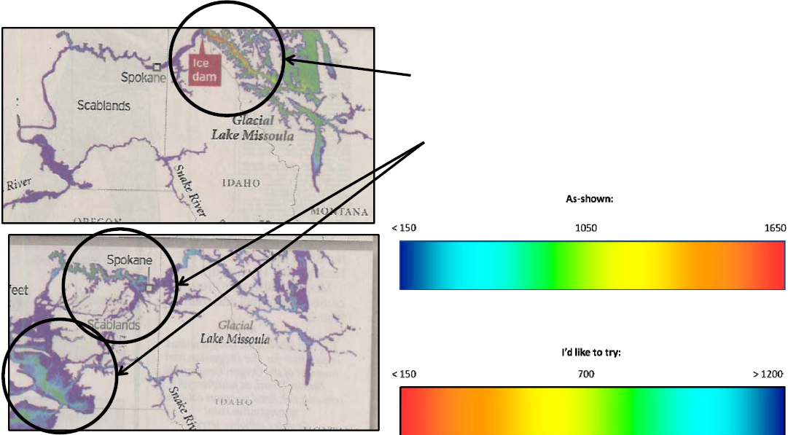
Much of the total dynamic range of the
color scale is used up in the first small
percent of the visualization, leaving little for the rest of the visualization
Counter Example
Material from Dr. Mike Bailey, Oregon State Univ.

Slide 25
Other Rules…
Limit the total number of colors if viewers are to discern information quickly.
Be aware that our perception of color changes with: 1) surrounding color; 2) how close two objects are; 3) how long you have been staring at the color; 4)sudden changes in the color intensity.
Beware of Mach Banding.
Be Aware of Color Vision Deficiencies (CVD)
It is not possible to list all the useful rules. They come with a lot of experience!

Slide 26
Beware of Color Pollution
Just because you have millions of colors to choose from

