Slide 1
Research Focus of UH-DMML
Helping Scientists to Make Sense of their Data
Geographical
Information Systems (GIS)
Machine
Learning
Data Mining
High Performance
Computing
Output: Graduated 12 PhD students (5 in 2009-11) and 76 Master Students
Christoph F. Eick

Slide 2


Some UH-DMML Graduates 1
Dr. Wei Ding, Assistant Professor Department of Computer Science, University of Massachusetts, Boston
Tae-wan Ryu, Professor,
Department of Computer Science, California State University, Fullerton
Sharon M. Tuttle, Professor,
Department of Computer Science,
Humboldt State University, Arcata, California
Christoph F. Eick

Slide 3
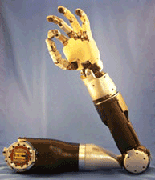
Some UH-DMML Graduates 2
Ruth Miller PhD Postdoc Washington University in St. Louis, Department of Genetics, Conrad Lab – Human Genetics and Reproductive Biology
Chun-sheng Chen, PhDTidalTV, Baltimore (an internet advertizing company)
Rachsuda Jiamthapthaksin PhD Lecturer Assumption University, Bangkok, Thailand
Justin Thomas MS Section Supervisor at Johns Hopkins University
Applied Physics Laboratory
Mei-kang Wu MS Microsoft, Bellevue, Washington
Jing Wang MS AOL, California
Christoph F. Eick

Slide 4

Research Areas and Projects
Data Mining and Machine Learning Group (http://www2.cs.uh.edu/~UH-DMML/index.html), research is focusing on:
  Spatial Data Mining
  Clustering
  Helping Scientists to Make Sense out of their Data
  Classification and Prediction
Current Projects
  Spatial Clustering Algorithms with Plug-in Fitness Functions and Other Non-Traditional Clustering Approaches
  Modeling and Understanding Progression in Spatial Datasets
  Methodologies and Algorithms for Mining Related Datasets
  Mining Complex Spatial Objects (polygons, trajectories)
  Data Mining with a lot of Cores
UH-DMML

Slide 5
Non-Traditional Clustering Algorithms
Clustering Algorithms
With plug-in Fitness Functions
Interestingness Hotspot
Discovery in Spatial Datasets
Mining Related
Datasets
Parallel
CLEVER
Parallel Computing
Randomized Hill Climbing
With a Lot of Cores
UH-DMML

Slide 6
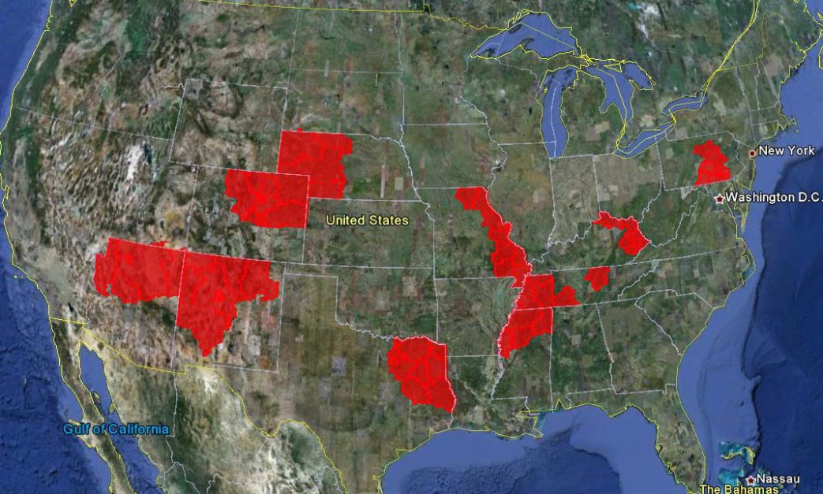
Discovering Spatial Interestingness Hotspots
Interestingness hotspots of areas where both income and CTR is high.
Ch. Eick

Slide 7
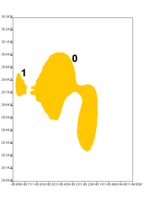
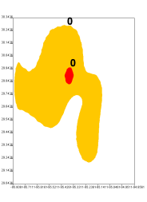
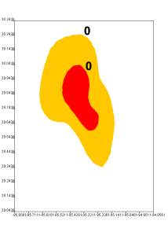
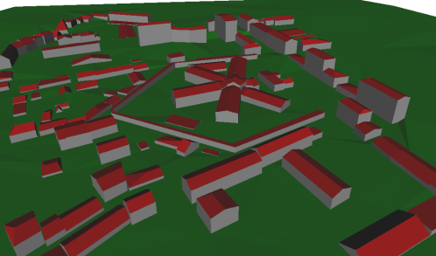
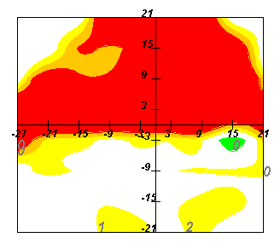
Models for Progression of Hotspots and Other Spatial Objects
3p
5p
7p
?
Ozone Hotspot
Evolution
?
Building Evolution
?
Progression of Glaucoma
Ch. Eick

Slide 8

Models for Progression of Hotspots and Other Spatial Objects
?
Task:
The goal is to develop models of progression
Those models allow to predict the next states, following a given sequence of states
Models are learnt, like ordinary machine learning models
Challenges:
Representation of Models of Change (e.g. How do we describe changes in building
structures?
2. Learning Models of Change from Training examples
Ch. Eick

Slide 9
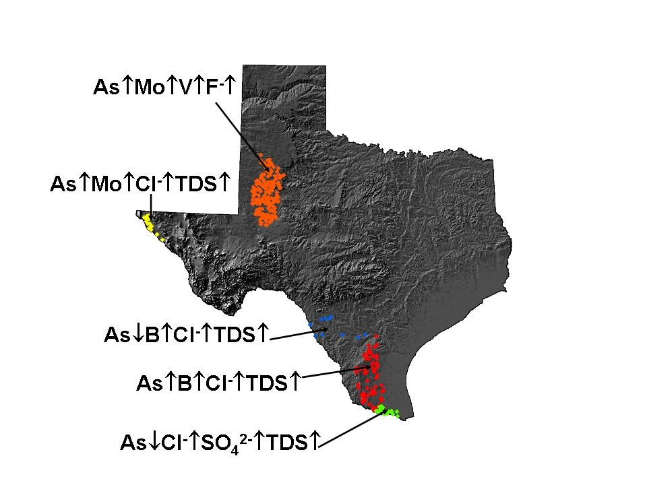
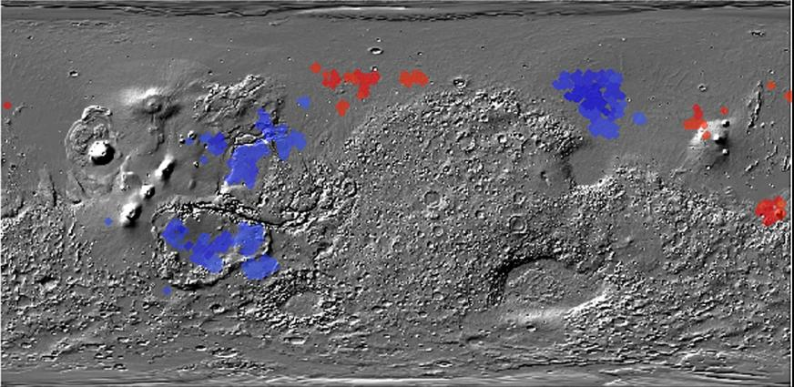
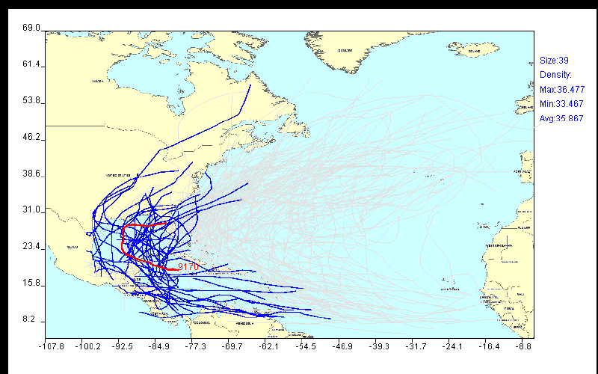
Helping Scientists to Make Sense out of their Data
Figure 1: Co-location regions involving deep and
shallow ice on Mars
Figure 2: Chemical co-location
patterns in Texas Water Supply
Figure 3: Mining Hurricane Trajectories
Ch. Eick

Slide 10
UH-DMML Mission Statement
The Data Mining and Machine Learning Group at the University of Houston aims
at the development of data analysis, data mining, and machine-learning techniques
and to apply those techniques to challenging problems in geology, astronomy,
environmental sciences, social sciences and medicine. In general, our research
group has a strong background in the areas of clustering and spatial data mining.
Areas of our current research include: meta-learning, density-based clustering and
clustering with plug-in fitness functions, association analysis, interestingness hotspot
discovery, geo-regression , change and progression analysis, polygon and trajectory
mining and using machine learning for simulation.
Website: http://www2.cs.uh.edu/~UH-DMML/index.html
Research Group Publications: http://www2.cs.uh.edu/~ceick/pub.html
Data Mining Course Website: http://www2.cs.uh.edu/~ceick/DM/DM.html
Ch. Eick

Slide 11
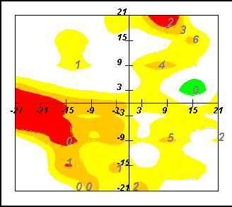
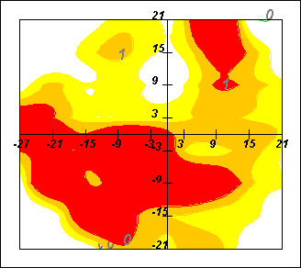
Mining Related Datasets Using Polygon Analysis
Work on a methodology that does the following:
Generate polygons from spatial cluster extensions / from continuous density or interpolation functions.
Meta cluster polygons / set of polygons
Extract interesting patterns / create summaries from polygonal meta clusters
Analysis of Glaucoma Progression
Analysis of Ozone Hotspots
Christoph F. Eick

Slide 12
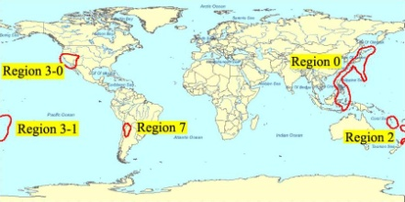
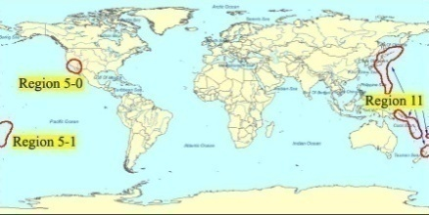
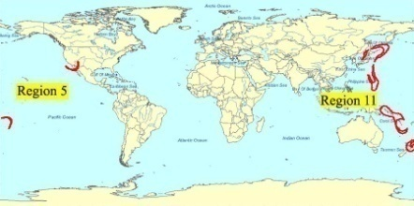
Methodologies and Tools to
Analyze and Mine Related Datasets
Subtopics:
Disparity Analysis/Emergent Pattern Discovery (“how do two groups differ with respect to their patterns?”) [SDE10]
Change Analysis ( “what is new/different?”) [CVET09]
Correspondence Clustering (“mining interesting relationships between two or more datasets”) [RE10]
Meta Clustering (“cluster cluster models of multiple datasets”)
Analyzing Relationships between Polygonal Cluster Models
Example: Analyze Changes with Respect to Regions of High Variance of Earthquake Depth.
Time 1
Time 2
Novelty (r’) = (r’—(r1 ∪…∪ rk))
Emerging regions based on the novelty change predicate
UH-DMML

Slide 13
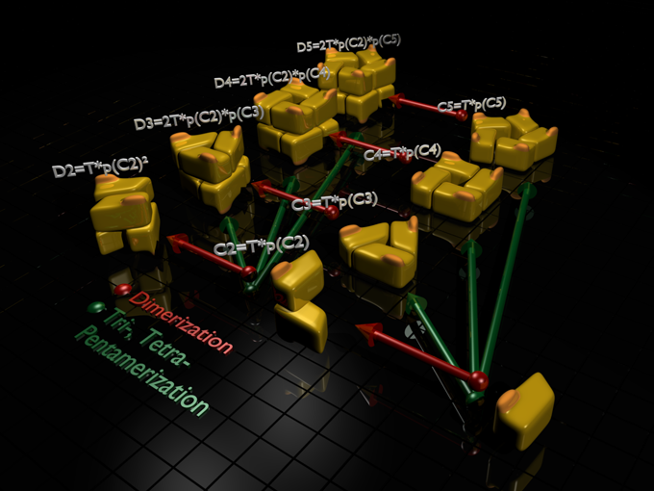
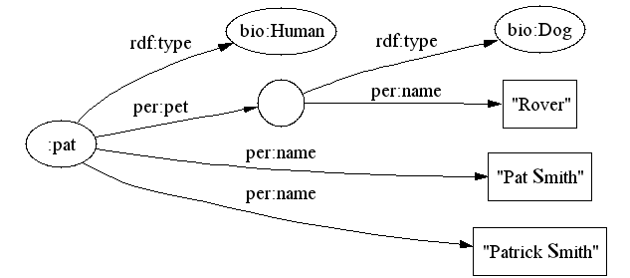
Clustering and Hotspot Discovery in Labeled Graphs
Potential Problems to be investigated:
1. Clustering Protein Based on Their Interactions
2. Generalize Region Discovery Framework to Graphs Partitioning
Using Plug-in Interestingness Functions
3. …
4. …
Ch. Eick

Slide 14
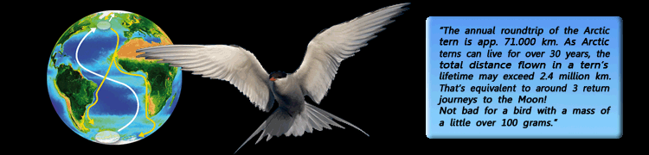
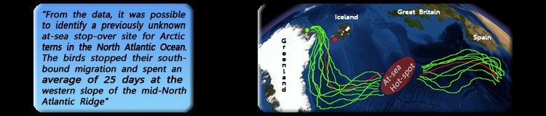
Mining Spatial Trajectories
Goal: Understand and Characterize Motion Patterns
Themes investigated: Clustering and summarization of trajectories, classification based on trajectories, likelihood assessment of trajectories, prediction of trajectories.
Arctic Tern
Arctic Tern Migration
Hurricanes in the Golf of Mexico
UH-DMML

Slide 15
Current UH-DMML Activities
Regional Knowledge
Extraction
Cluster
Correspondence
Analysis
Mining Related Datasets
& Polygon Analysis
Yahoo!
User
Modeling
Strasbourg
Building
Evolution
Knowledge
Scoping
Understanding
Glaucoma
POLY/TRAJ-
SNN
Discrepancy
Mining
Regional
Association
Analysis
Polygonal Meta
Clustering
Air Pollution
Analysis
Regional Regression
Parallel CLEVER
TRAJ-CLEVER
Poly-CLEVER
Classification
Clustering
Cluster Polygon
Generation
SCMRG
Sub-Trajectory
Mining
Trajectory
Density Estimation
MOSAIC
Repository
Clustering
Trajectory
Mining
Animal Motion
Analysis
Spatial Clustering Algorithms
With Plug-in Fitness Functions
Cougar^2
Christoph F. Eick

Slide 16
What Courses Should You Take to Conduct Data Mining Research?
Data Mining (COSC 6335)
Machine Learning
Parallel Programming/High Performance Computing, AI, Software Design, Data Structures, Databases, Sensor Networks,…
UH-DMML

Slide 17
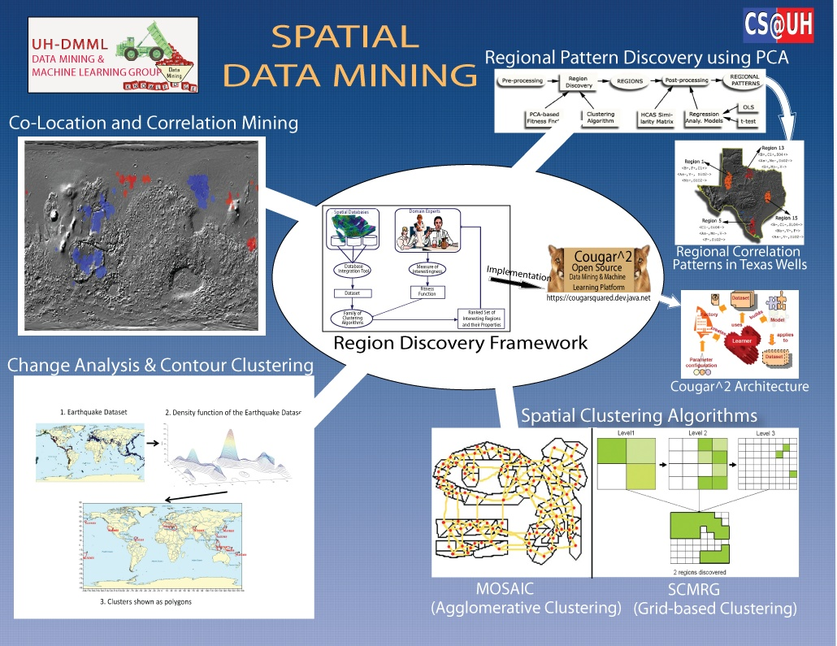
Notes:
In the last 4 years, our research group developed spatial data mining methodologies, algorithms and tools. One of our main contributions is a region discovery framework. The framework provides search engine type capabilities to scientists to “find interesting places in spatial datasets”. A second contribution is the development of a family spatial clustering algorithms with plug-in fitness functions. Plug-in fitness functions enable scientists to describe the characteristics of clusters they are interested in. A third contribution are co-location and correlation mining frameworks. The figure on the upper left depicts a data mining result concerning co-location patterns between deep and shallow ice on Mars. The area in red indicate regions on Mars in which deep and shallow ice are co-located, and the areas in blue indicate regions where deep and shallow ice are anti-co-located. Finally, more recently, we started some new research centering on change analysis in spatial datasets.

Slide 18
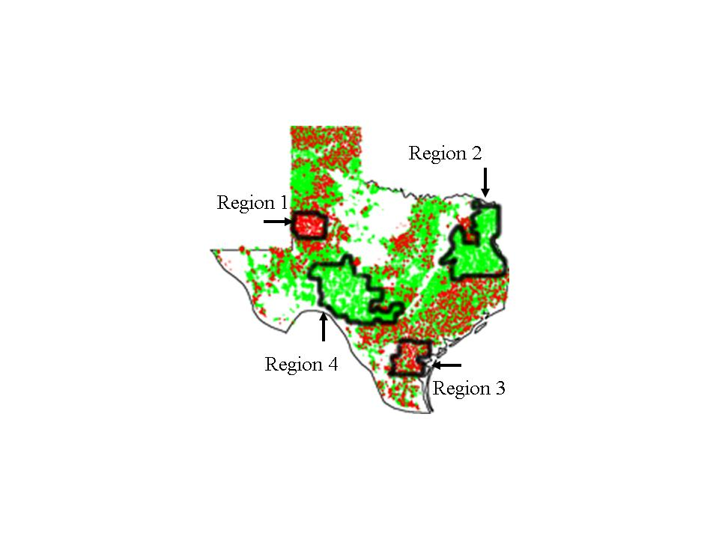
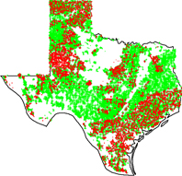
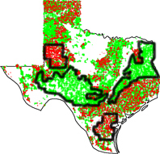
Extracting Regional Knowledge from Spatial Datasets
Application 1: Supervised Clustering [EVJW07]
Application 2: Regional Association Rule Mining and Scoping [DEWY06, DEYWN07]
Application 3: Find Interesting Regions with respect to a Continuous Variables [CRET08]
Application 4: Regional Co-location Mining Involving Continuous Variables [EPWSN08]
Application 5: Find “representative” regions (Sampling)
Application 6: Regional Regression [CE09]
Application 7: Multi-Objective Clustering [JEV09]
Application 8: Change Analysis in Spatial Datasets [RE09]
β=1.01
RD-Algorithm
β=1.04
Wells in Texas:
Green: safe well with respect to arsenic
Red: unsafe well
UH-DMML
Notes:
In contrast to other work in spatial data mining, our work centers on extracting regional or local knowledge from spatial datasets, and not on finding global patters. In particular, we are interested in assisting scientists in finding interesting regions in spatial datasets based on their particular notation of interestingness.

Slide 19

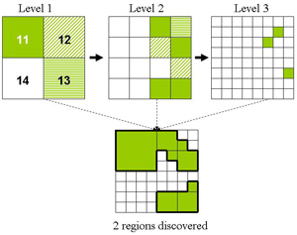
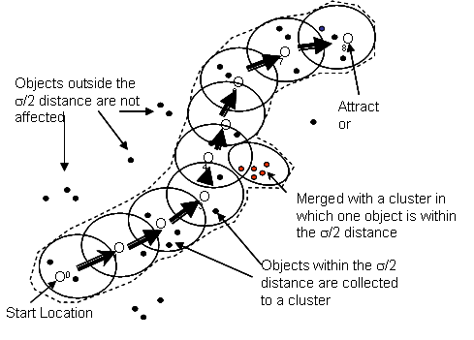
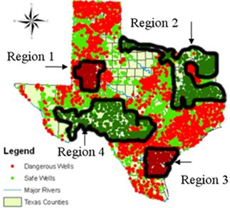
A Framework for Extracting Regional Knowledge from Spatial Datasets
Objective: Develop and implement an integrated framework to automatically discover interesting regional patterns in spatial datasets.
Domain
Experts
Hierarchical Grid-based & Density-based Algorithms
Spatial Databases
Regional
Knowledge
Integrated Data Set
Measures of
interestingness
Regional Association Rule Mining
Algorithms
Family of
Clustering Algorithms
Fitness Functions
Ranked Set of Interesting Regions and their Properties
Framework for Mining Regional Knowledge
Spatial Risk Patterns of Arsenic
UH-DMML
Notes:
Given:
A dataset O with a schema R
A distance function d defined on instances of R
A fitness function q(X) that evaluates clustering X={c₁,…,c_{k}} as follows:
q(X)= Σ_{c∈X} reward(c)=Σ_{c∈X} interestingness(c)∗size(c)^{β} with β>1
Objective:
Find c₁,…,c_{k} ⊆ O such that:
c_{i}∩c_{j}=∅ if i≠j
X={c₁,…,c_{k}} maximizes q(X)
All cluster c_{i}∈X are contiguous (each pair of objects belonging to c_{i} has to be delaunay-connected with respect to c_{i} and to d)
c₁∪,…,∪c_{k} ⊆ O
c₁,…,c_{k} are usually ranked based on the reward each cluster receives, and low reward clusters are frequently not reported

Slide 20
Finding Regional Co-location Patterns in Spatial Datasets
Figure 1: Co-location regions involving deep and
shallow ice on Mars
Figure 2: Chemical Co-location
patterns in Texas Water Supply
Objective: Find co-location regions using various clustering algorithms and novel
fitness functions.
Applications:
1. Finding regions on planet Mars where shallow and deep ice are co-located, using point and raster datasets. In figure 1, regions in red have very high co-location and regions in blue have anti co-location.
2. Finding co-location patterns involving chemical concentrations with values on the wings of their statistical distribution in Texas’ ground water supply. Figure 2 indicates discovered regions and their associated chemical patterns.
UH-DMML

Slide 21
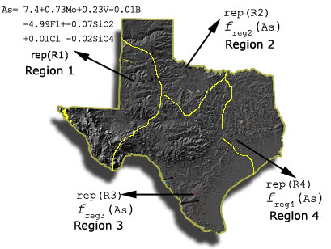
REG^2: a Regional Regression Framework
Motivation: Regression functions spatially vary, as they are not constant over space
Goal: To discover regions with strong relationships between dependent & independent variables and extract their regional regression functions.
Discovered Regions and Regression Functions
Clustering algorithms with plug-in fitness functions are employed to find such region; the employed fitness functions reward regions with a low generalization error.
Various schemes are explored to estimate the generalization error: example weighting, regularization, penalizing model complexity and using validation sets,…
REG^2 Outperforms Other Models in SSE_TR
 | AIC Fitness | VAL Fitness | RegVAL Fitness | WAIC Fitness
Arsenic | 5.01% | 11.19% | 3.58% | 13.18%
Boston | 29.80% | 35.69% | 38.98% | 36.60%
Regularization Improves Prediction Accuracy
UH-DMML

Slide 22
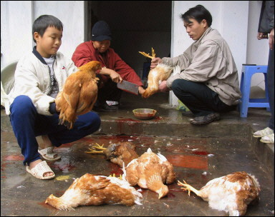
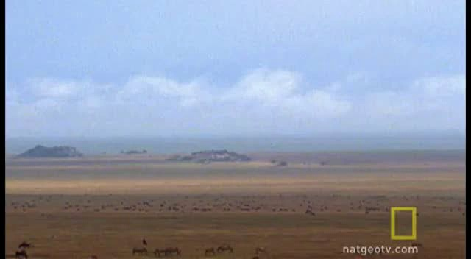
Mining Motion Pattern of Animals
Diverse animal groups, such as birds, fish, mammals (terrestrial/marine/flying: wildebeest/whales/bats), reptiles (e.g. sea turtles), amphibians, insects and marine invertebrates undertake migration.
Wildebeest
Bird Flu/H5N1
Understanding
Motion Patterns
Predicting
Future Events
Primary goals:
Why is Mining Animal Motion Patterns Important?
Understanding of the ecology, life history, and behavior
Effective conservation and effective control
Conserving the dwindling population of endangered species
Early detection and prevention of disease outbreaks
Correlating climate change with animal motion patterns
UH-DMML

Slide 23
Selected Related Publications
T. Stepinski, W. Ding, and C. F. Eick, Controlling Patterns of Geospatial Phenomena, to appear in Geoinformatica, Spring 2010.
V. Rinsurongkawong and C.F. Eick, Correspondence Clustering: An Approach to Cluster Multiple Related Spatial Datasets, to appear in Proc. Pacific-Asia Conference on Knowledge Discovery and Data Mining (PAKDD), acceptance rate: 10%, Hyderabad, India, June 2010.
C.-S. Chen, V. Rinsurongkawong, A.Nagar, and C. F. Eick, Mining Trajectories using Non-Parametric Density Functions, submitted to a conference, February 2010.
W. Ding, T. Stepinski, D. Jiang, R. Parmar and C. F. Eick, Discovery of Feature-based Hot Spots Using Supervised Clustering, in International Journal of Computers & Geosciences, Elsevier, March 2009.
R. Jiamthapthaksin, C. F. Eick, and V. Rinsurongkawong, An Architecture and Algorithms for Multi-Run Clustering, CIDM, Nashville, Tennessee, April 2009.
C.-S. Chen, V. Rinsurongkawong, C. F. Eick, M. Twa, Change Analysis in Spatial Data by Combining Contouring Algorithms with Supervised Density Functions in Proc. Pacific-Asia Conference on Knowledge Discovery and Data Mining (PAKDD), acceptance rate: 29%, Bangkok, May 2009.
J. Thomas, and C. F. Eick, Online Learning of Spacecraft Simulation Models, acceptance rate: 30%, in Proc. of the 21st Innovative Applications of Artificial Intelligence Conference (IAAI), Pasadena, California, July 2009.
R. Jiamthapthaksin, C. F. Eick, and R. Vilalta, A Framework for Multi-Objective Clustering and its Application to Co-Location Mining, in Proc. Fifth International Conference on Advanced Data Mining and Applications (ADMA), acceptance rate: 12%, Beijing, China, August 2009.
O.U. Celepcikay and C. F. Eick, REG^2: A Regional Regression Framework for Geo-Referenced Datasets, in Proc. 17th ACM SIGSPATIAL International Conference on Advances in GIS (ACM-GIS), acceptance rate: 20%, Seattle, Washington, November 2009.
W. Ding, R. Jiamthapthaksin, R. Parmar, D. Jiang, T. Stepinski, and C. F. Eick, Towards Region Discovery in Spatial Datasets, in Proc. Pacific-Asia Conference on Knowledge Discovery and Data Mining (PAKDD), acceptance rate: 12%, Osaka, Japan, May 2008.
C. F. Eick, R. Parmar, W. Ding, T. Stepinki, and J.-P. Nicot, Finding Regional Co-location Patterns for Sets of Continuous Variables in Spatial Datasets, in Proc. 16th ACM SIGSPATIAL International Conference on Advances in GIS (ACM-GIS), acceptance rate: 19%, Irvine, California, November 2008.
J. Choo, R. Jiamthapthaksin, C.-S. Chen, O. Celepcikay, C. Giusti, and C. F. Eick, MOSAIC: A Proximity Graph Approach to Agglomerative Clustering, in Proc. 9th International Conference on Data Warehousing and Knowledge Discovery (DaWaK), acceptance rate: 29%, Regensburg, Germany, September 2007.
C. F. Eick, B. Vaezian, D. Jiang, and J. Wang, Discovery of Interesting Regions in Spatial Datasets Using Supervised Clustering, in Proc. 10th European Conference on Principles and Practice of Knowledge Discovery in Databases (PKDD), acceptance rate: 13%, Berlin, Germany, September 2006.
W. Ding, C. F. Eick, J. Wang, and X. Yuan, A Framework for Regional Association Rule Mining in Spatial Datasets, in Proc. IEEE International Conference on Data Mining (ICDM), acceptance Rate: 19%, Hong Kong, China, December 2006.
A. Bagherjeiran, C. F. Eick, C.-S. Chen, and R. Vilalta, Adaptive Clustering: Obtaining Better Clusters Using Feedback and Past Experience, in Proc. Fifth IEEE International Conference on Data Mining (ICDM), acceptance rate: 21%, Houston, Texas, November 2005.
C. F. Eick, N. Zeidat, and Z. Zhao, Supervised Clustering --- Algorithms and Benefits, in Proc. International Conference on Tools with AI (ICTAI), acceptance rate: 30%, Boca Raton, Florida, November 2004.
C. F. Eick, N. Zeidat, and R. Vilalta, Using Representative-Based Clustering for Nearest Neighbor Dataset Editing, in Proc. Fourth IEEE International Conference on Data Mining (ICDM), acceptance rate: 22%, Brighton, England, November 2004.
UH-DMML

