Slide 1
Deep Learning: Autoencoders, VAE, CNN
Md Mahin

Slide 2
Topics
Basic Deep Learning Models
Autoencoders
Variational Auto-encoders
CNN
BERT
[I would discuss lot of materials from https://www.youtube.com/watch?v=QDX-1M5Nj7s]

Slide 25
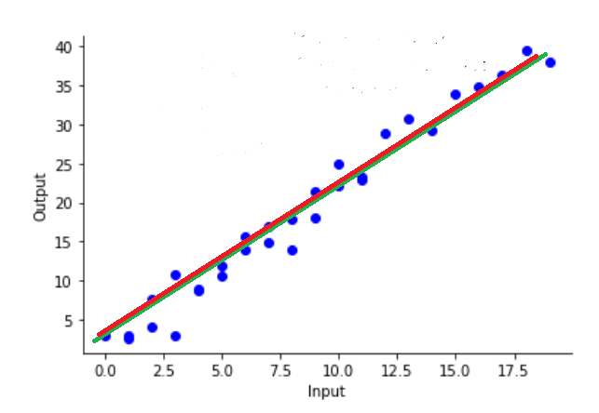
Loss Function
A function that calculates loss
Loss_function(x) will return a y
Every model have some internal parameter set
They try to learn the parameters such a way that it minimizes loss and maximizes accuracy
At the same time they need to be careful about bias and overfitting

Slide 26
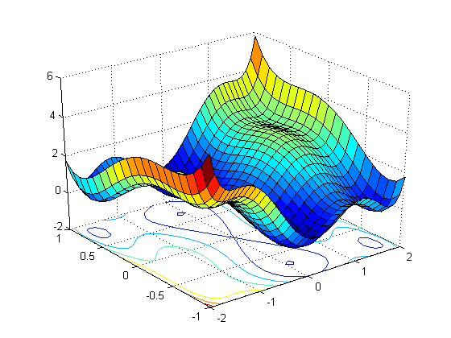
Smooth loss function vs non-smooth
→Suppose you want to minimize a function for two variables
→ There can be infinite number of combinations between two continuous variables → Training can take days
→ How can you optimize the whole searching procedure

Slide 29
Reading Materials and references
https://www.youtube.com/watch?v=QDX-1M5Nj7s
https://www.analyticsvidhya.com/blog/2021/10/feed-forward-neural-networks-intuition-on-forward-propagation/
https://adatis.co.uk/introduction-to-artificial-neural-networks-part-two-gradient-descent-backpropagation-supervised-unsupervised-learning/
https://www.oreilly.com/library/view/neural-networks-and/9781492037354/ch01.html
https://towardsdatascience.com/neural-networks-forward-pass-and-backpropagation-be3b75a1cfcc
https://towardsdatascience.com/forward-propagation-in-neural-networks-simplified-math-and-code-version-bbcfef6f9250
https://towardsdatascience.com/an-introduction-to-gradient-descent-and-backpropagation-81648bdb19b2

Slide 30
Autoencoders
They can be used for
Reducing dimensionality of data: useful for learning non-linear features
Data Augmentation: Generating new data
Extracting particular features from data
Famous models:
Variational Autoencoder (VAE)
UNET
Generative Adversarial Network (GAN)

Slide 31
Why Autoencoders?
Map high-dimensional data to two dimensions for visualization
Compression
Learn abstract features in an unsupervised way so you can apply them to a supervised task
Unlabled data can be much more plentiful than labeled data
Learn a semantically meaningful representation where you can, e.g., interpolate between different images.

Slide 32
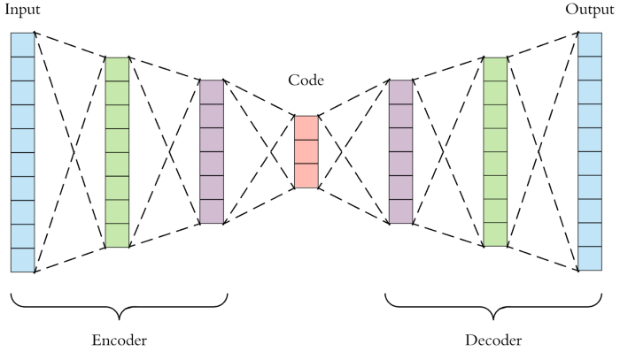
Autoencoder Architecture

Slide 33
Classical ML

Slide 34
Classical ML

Slide 35
Autoencoders

Slide 36
Autoencoders

Slide 37
Autoencoders
A feed-forward neural net who
Take input x and predict x.
Bottleneck layer with dimension is much smaller than the input.

Slide 38
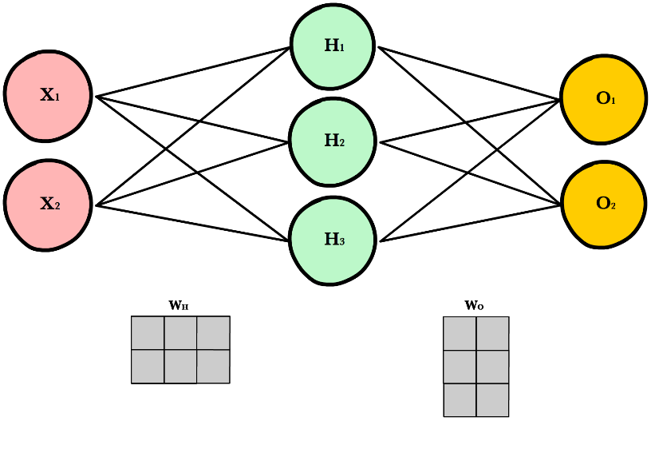
How Autoencoders Works
x: Input vector or array
$\hat{x}:$ Output vector or array
V: A matrix of weights. For example if D has 3 neurons, K has 2 neuron, for every connection there will be a weight and it is a 3 * 2 weight matrix
U: Another matrix of weights. For example if D has 3 neurons, K has 2 neuron, for every connection there will be a weight and it is a 2 * 3 weight matrix

Slide 39
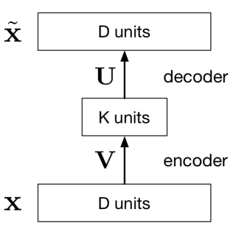
How it works
Vx: A matrix multiplication project D dimensional x to k dimensional plane. Shown for 3 to 2. Dimensionality Reduction
Ux : Project k dimensional hidden unit to D dimensional $\hat{x}$
Overall Output is: $\hat{x}=UVx$ [A linear function]
How it learn:
Learn the U, V matrix or all weights so that we get minimum loss
L(x, $\hat{x})={|\left|x−\hat{x}\right||}^{2}$
We minimize L to learn U,V

Slide 40
Denoising using autoencoder

Slide 41
Generative Models
Designed to learn the patterns to produce new data points similar to the original dataset.
Generative models are more about creating or replicating data.
Applications
Image and Video Generation: Creating new images and videos
Data Augmentation: Generating new data to enhance machine learning models, especially when the original dataset is small.
Drug Discovery: Simulating molecular structures for new drug candidates.
Art and Design: Creating artworks, music, and design elements.
Voice Synthesis: Generating realistic human speech.
Popular Models
VAE
GAN

Slide 42
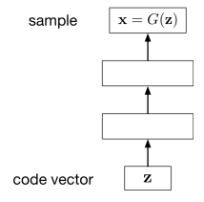
Generative Models
One of the goals of unsupervised learning is to learn representations of images, sentences, etc.
A generative model is a function of representation z.
X= G(z) [G is the generator function]
Example: VAE, GAN

Slide 43
How generative models work

Slide 44
Variational AutoEncoder(VAE)
→ It contains a encoder and a decoder layer just like any autoencoder
→ Difference is hidden layer learns a distribution of features
→ Because of this distribution learning the VAE has some advantage over normal autoencoder as generator
→ The decoder will now be able to generate completely new images
→ GAN is another architecture that has similar capabilities

Slide 45
A Simple VAE
→ In this model encoders and decoders are built with simple fully connected layers
→ The target domain for this architecture is simple in nature such as digit dataset.

Slide 46
How Learning Distribution Help
Normal AE
VAE

Slide 47
VAE Model
Trains a generator network with maximum likelihood $p(x)=\int{p\left(z\right)p\left(x | z\right)dz}$
Problem: if z is low-dimensional and the decoder is deterministic, then p(x) = 0 almost everywhere!
The model only generates samples over a low-dimensional sub-manifold of X.
Solution: define a noisy observation model, e.g.
$$p(x|z)=N(x;G_{θ}\left(z\right),ηI$$ where $G_{θ}$ is the function computed by the decoder with parameters $θ$.

Slide 48
VAE Model
Hot to compute: $p(x)=\int{p\left(z\right)p\left(x | z\right)dz}$
$G_{θ}\left(z\right)$is very complicated, so there’s no hope of finding a closed form.
Instead, we will try to maximize a lower bound on $log p\left(x\right);s$imilar to the EM algorithm.

Slide 49
How VAE Learn Distribution
Direct computation of p(x) is costly
It introduce a further function to approximate the posterior distribution as
$q_{ϕ}(z|x)≈p_{θ}(z|x)$
Approximate q(z) which is known to p(z|x)
the idea is to jointly optimize the generative model parameters $θ$ to reduce the reconstruction error between the input and the output and $ϕ$ to make $q_{ϕ}(z|x)$ as close as $p_{θ}\left(z | x\right)$
Min $D_{KL}(q_{ϕ}(.|x)||p_{θ}(.|x))$
It uses KL divergence to make the parameters similar and define new loss function using ELBO method that does both task at the same time
$L_{θ,ϕ}\left(x\right)=\log{p_{θ}\left(x\right)−D_{KL}(q_{ϕ}(.|x)||p_{θ}(.|x))}$

Slide 50
Reparameterization Trick
Back propagation won’t work on random node z (if we think it as just distribution)
So z is made into two deterministic node for mean and std and random part separated as Gaussian error

Slide 51
Class Conditional VAE
A class-conditional VAE provides the labels to both the encoder and the decoder.
Since the latent code z no longer has to model the image category, it can focus on modeling the stylistic features

Slide 52
References and Reading Materials
Variational Autoencoder Lacture by Roger Grosse and Jimmy Ba [CSC421/2516 Lecture 17: Variational Autoencoders ]
Variational Autoencoder Wikipedia: CSC421/2516 Lecture 17: Variational Autoencoders
Ali Ghodsi, Lec : Deep Learning, Variational Autoencoder [https://www.youtube.com/watch?v=uaaqyVS9-rM]
https://www.simplilearn.com/tutorials/deep-learning-tutorial/what-are-autoencoders-in-deep-learning
https://www.jeremyjordan.me/autoencoders/
https://tonyjesuthasan.medium.com/autoencoders-a-comprehensive-guide-d0723c2f988b
https://towardsdatascience.com/understanding-variational-autoencoders-vaes-f70510919f73
https://www.jeremyjordan.me/variational-autoencoders/

Slide 53
Language Models
To understand, interpret, and generate human language.
Applications
Text Generation: Creating articles, stories, or even poetry.
Translation: Translating languages more accurately.
Voice Assistants: Improving the conversational abilities of Siri, Alexa, etc.
Sentiment Analysis: Determining if a review is positive or negative.
Example
LSTM, RNN, Transformers

Slide 54
Transformers
Faster model than the predecessors
Use attention mechanism
Can understand language words parallels, understanding whole context of the sentence
More effective for tasks like language translation, summarization, question-answering, and text generation.
Self-attention mechanism
Enables the model to weigh the importance of different parts of the input data differently to focus on the most relevant parts to make decisions.
Contrasts RNNs and LSTMs, where each word depends on the previous ones.

Slide 55
Large Language models
Vast libraries of language knowledge, created to help computers understand how we speak and write
AI models with a large number of parameters(billions ) that enable them to process and generate human language.
Examples
GPT
BERT etc.

Slide 58
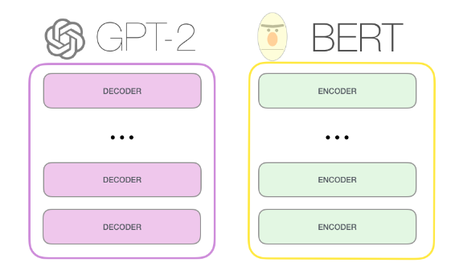
GPT-2, BERT

Slide 60
What is GPT?
GPT: Generative Pre-Trained Transformer (OpenAI)[1]
A language model
It can predict the likelihood of an output sequence given an input sequence.
Based on a specific neural network architecture type called Transformer
Transformers uses similar auto encoder architecture
Current GPT versions are: GPT-3, 3.5, 4

Slide 61
How Intelligent Are GPT?
Source: https://openai.com/research/gpt-4 [3]

Slide 62
Technical Details on GPT3
Trained with 45 TB of text data
Has 175 billion parameters
60% data are from common crawl
Crawl free web data
Generally it is petabytes in size
They filtered important data
Others are: Books + Wiki
96 decoder layer
Built on a system with 285k cpu cores, 10k gpus, 400 Gbps network connectivity for each HPU server (a Super computer built by Macrosoft and Open AI)
How it is trained[3]
Paper on GPT3[4], GPT-4

Slide 63
GPT 4
It is multimodal:
Can work with text, images, videos, audios to take input unlike previous versions
Capabilities:
Generate recopies just from a image of foods from your fridge
Create a basic website just from a basic drawing
Exhibits human-level performance on various professional and academic benchmarks.
For example, it passes a simulated bar exam with a score around the top 10% of test takers; in contrast, GPT-3.5’s score was around the bottom 10%.
Has one trillion parameters

Slide 64
Parameter Comparison
More parameters, more heavy a model is, with more capabilities
Some Comparison:
Bert: 110m-340m
GPT2: 1.5B
T5: 11B
Turing NLG: 17B
GPT3: 175B
GPT4: 1T

Slide 65
Remarks
For any task you can chose any architecture based on your need
Architectures have their own target purpose and job
The building block of your architecture will change based on the nature of your data and complexity of your features
For example:
For complex objects you may use Convolution Layers
For sequence or time series you may include sequence deep learning models such as LSTM or GRU in your model

Slide 66
References and reading materials
https://towardsdatascience.com/gpt-3-101-a-brief-introduction-5c9d773a2354
https://www.theverge.com/2022/2/2/22914085/alphacode-ai-coding-program-automatic-deepmind-codeforce
https://openai.com/research/gpt-4
https://www.youtube.com/watch?v=VPRSBzXzavo
https://arxiv.org/abs/2005.14165
https://arxiv.org/abs/2303.08774
https://towardsdatascience.com/gpt-4-vs-chatgpt-an-exploration-of-training-performance-capabilities-and-limitations-35c990c133c5
https://builtin.com/data-science/beginners-guide-language-models
https://sebastianraschka.com/blog/2023/llm-reading-list.html
https://www.moveworks.com/insights/large-language-models-strengths-and-weaknesses

Slide 67
Convolutional Neural Networks (CNNs / ConvNets)

Slide 68
Object detection from image

Slide 69
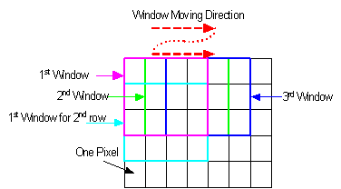
Sliding window

Slide 70
Sliding window error

Slide 71
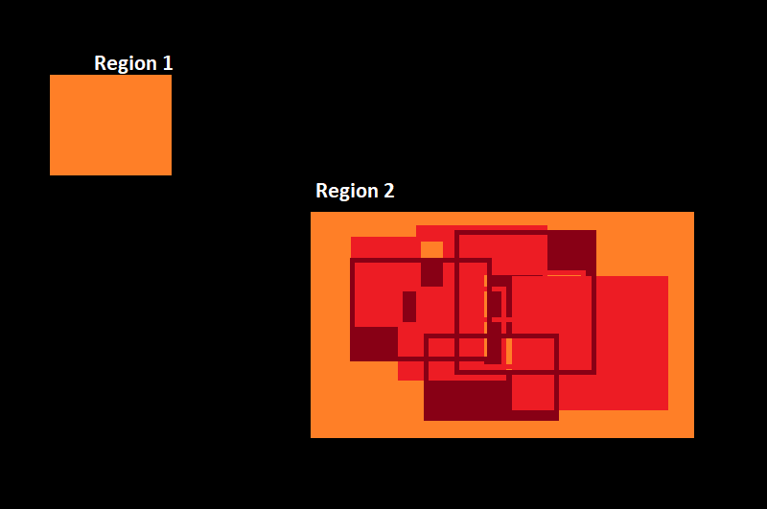
heatmap

Slide 72
detection

Slide 73
problem
Al most al ML model’s performance depends how you are training it
Bias: dependent towards seen samples
Low performance when unseen samples are very different from the seen samples
And objects from images can be very different and thus hard to train manually
What if something can learn extracting the features from the images automatically?

Slide 74
What and Why
CNN is a type of neural network model that can extract higher representations of the image.
In classical image classification you define the image features. CNN takes the image’s raw pixel data, trains the model and then extracts the features for better classification.
Regular Neural Nets don’t scale well to full images
Full connectivity is wasteful and the huge number of parameters would quickly lead to overfitting.

Slide 75
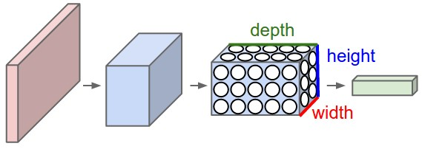
NN vs CNN

Slide 76
CNN

Slide 77
Layers
Input(2D or 3D input)
Convolutional Layer
Relu Layer
Maxpool Layer
Fully Connected Layer
Additional Layer liker Dropout Layer

Slide 78
Convolutional Layer
The CONV layer’s parameters consist of a set of learnable filters.
Every filter is small spatially (along width and height), but extends through the full depth of the input.
Each place contains weight
Only uses local connectivity [The spatial extent of this connectivity is a hyperparameter called the receptive field of the neuron (equivalently this is the filter size)]
Layers share parameters

Slide 79
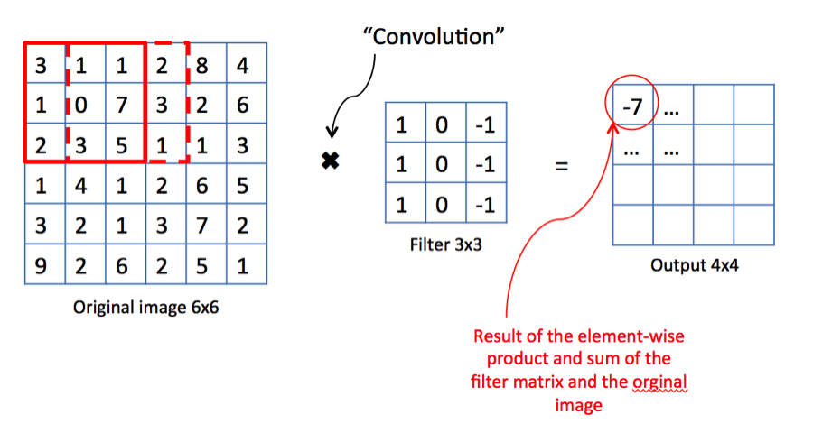
Convolutional Layer

Slide 80
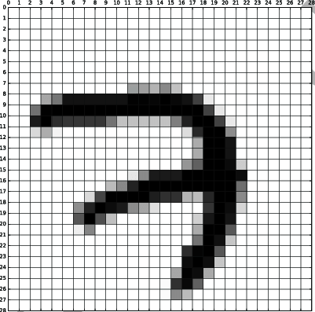
Convolutional Layer

Slide 81
maxPooling Layer
Maxpool layers are used in CNN to replace output with the max summary of the feature maps to reduce the data size and processing time.
Max pooling takes two hyperparameters: stride and size. Stride will determine the pixels that maxpool filters will move. Size will determines how big the value pools in every step.

Slide 82
maxPooling Layer

Slide 83
Sample Image

Slide 84
Use of CNN
Image classification (LeNet, InceptionNet, ResNet)
Image segmentation (UNet, FCNN, RCNN)
Image Generation(GAN)

Slide 85
A complex VAE using cnn
→ In this model encoders and decoders are built with complex convolution layers
→ Convolution layers contains way more number of neurons than simple fully-connected layers
→ The target domain for this architecture is complex in nature, not simple like digits. Example: Complex objects like animal images

Slide 86
Reference and Reading materials
https://www.kaggle.com/code/mehmetlaudatekman/support-vector-machine-object-detection
https://cs231n.github.io/convolutional-networks/?fbclid=IwAR3mPWaxIpos6lS3zDHUrL8C1h9ZrzBMUIk5J4PHRbKRfncqgUBYtJEKATA
http://cs231n.stanford.edu/slides/2018/cs231n_2018_lecture05.pdf
https://towardsdatascience.com/understanding-cnn-convolutional-neural-network-69fd626ee7d4
https://cs231n.github.io/convolutional-networks/?fbclid=IwAR3mPWaxIpos6lS3zDHUrL8C1h9ZrzBMUIk5J4PHRbKRfncqgUBYtJEKATA

