Slide 1
News Aug. 22, 2023
http://www2.cs.uh.edu/~ceick/DM/DM.html: main source of course information. Please take a closer look at this website; you will be given the opportunity to ask questions about the course during the next lectures.
COSC 6335 is F2F; almost all lectures will be taught in classroom S 120!
Will use MS Team ….6335 for the Teaching of the course and we will also use Canvas; the subdivision between Canvas & MS Teams has not be determined yet.
TA: Md. Mahin
This week: Introduction to Data Mining and Course Information
Next Week: Introduction to Exploratory Data Analysis/Data Science Basics followed by an Introduction to Density Estimation.
We will use Kritik https://www.kritik.io/ for COSC 6335 Problem Set Task Peer Reviewing’
Group Homework Credit Groups will be set up approx. Sept. 1; we will set up those groups’
This course has 3 problem sets which likely will contain 2 group tasks; the groups for these group tasks will be set up approx. Sept. 24.

Slide 2
First 5 Lectures COSC 6335
DM Questionnaire1: Learning about your expectations and potential misconceptions about the course!
Dr. Eick http://www2.cs.uh.edu/~ceick/ceick.html (more about myself on Sept. 7, 2023!)
COSC 6335 Webpage http://www2.cs.uh.edu/~ceick/DM/DM.html
Introduction to Data Mining (today)
Course Information COSC 6335 (today & Aug. 24)
Data Science Basics/EDA (Aug. 29+31)
Introduction to Kritik (August 31)
Introduction to Density Estimation (August 31+Sept. 5)
Finish Discussion of 5 and 6 and Introduce ProblemSet1 (Sept. 5)

Slide 3
Data Mining: Introduction
Lecture Notes for Chapter 1
Introduction to Data Mining
by
Tan, Steinbach, Kumar
With many additions and changes by Ch. Eick

Slide 4
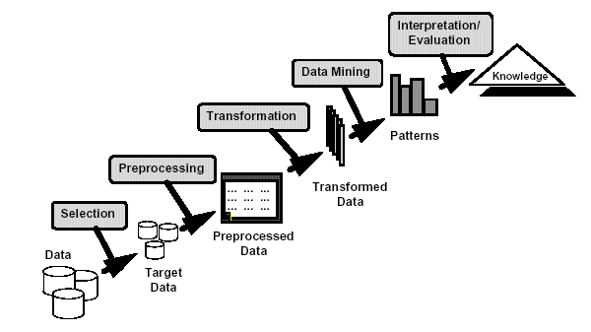
What is Data Mining / KDD? https://acronyms.thefreedictionary.com/KDD
Many Definitions
  Non-trivial extraction of implicit, valid, previously unknown and potentially useful information from data
  Exploration & analysis, by automatic or
  semi-automatic means, of
  large quantities of data
  in order to discover
  meaningful patterns
KDD:= Knowledge Discovery in Databases(old)/in Data/and Data Mining

Slide 5


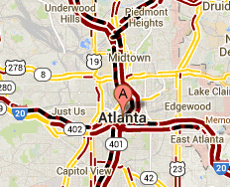
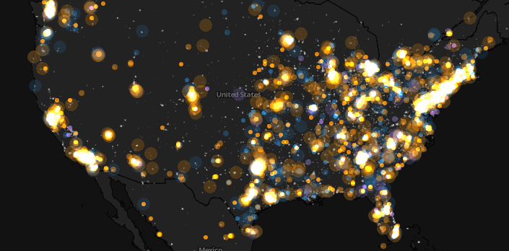
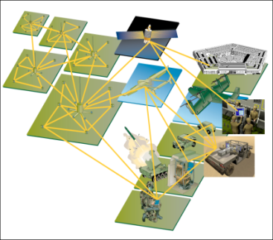
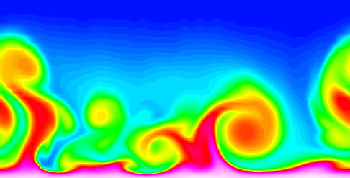
Large-scale Data is Everywhere!
There has been enormous data growth in both commercial and scientific databases due to advances in data generation and collection technologies
New mantra
  Gather whatever data you can whenever and wherever possible.
Expectations
  Gathered data will have value either for the purpose collected or for a purpose not envisioned.
E-Commerce
Cyber Security
Traffic Patterns
Social Networking: Twitter
Sensor Networks
Computational Simulations
Notes:
5

Slide 6




Why Data Mining? Commercial Viewpoint
Lots of data is being collected
and warehoused
  Web data
    Yahoo has Peta Bytes of web data
    Facebook has billions of active users
  purchases at department/
  grocery stores, e-commerce
    Amazon handles millions of visits/day
  Bank/Credit Card transactions
Computers have become cheaper and more powerful
Competitive Pressure is Strong
  Provide better, customized services for an edge (e.g. in Customer Relationship Management) example: Spam Filter
Notes:
6

Slide 7
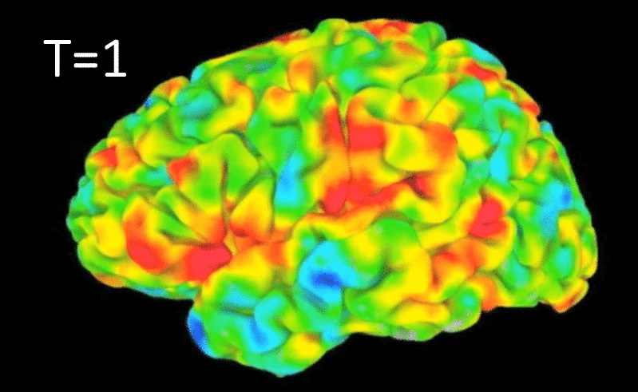
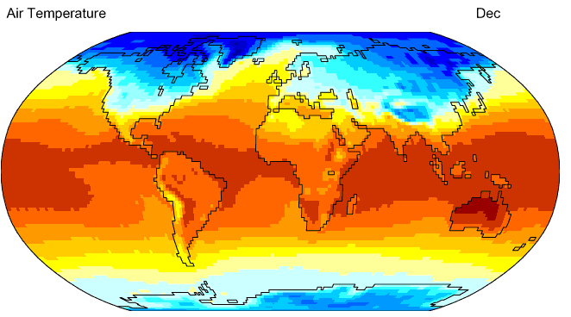
Why Data Mining? Scientific Viewpoint
Data collected and stored at
enormous speeds
  remote sensors on a satellite
    NASA EOSDIS archives over
    petabytes of earth science data / year
  telescopes scanning the skies
    Sky survey data
  High-throughput biological data
  scientific simulations
    terabytes of data generated in a few hours
Data mining helps scientists
  in automated analysis of massive datasets
  In hypothesis formation
fMRI Data from Brain
Sky Survey Data
Gene Expression Data
Surface Temperature of Earth
Notes:
7

Slide 8

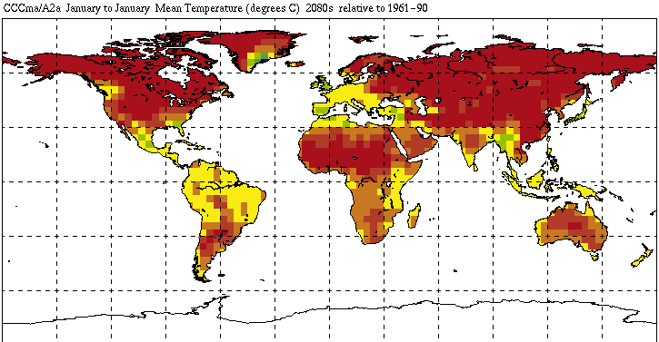

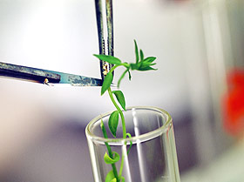
Great Opportunities to Solve Society’s Major Problems
Improving health care and reducing costs
Predicting the impact of climate change
Finding alternative/ green energy sources
Reducing hunger and poverty by
increasing agriculture production

Slide 9
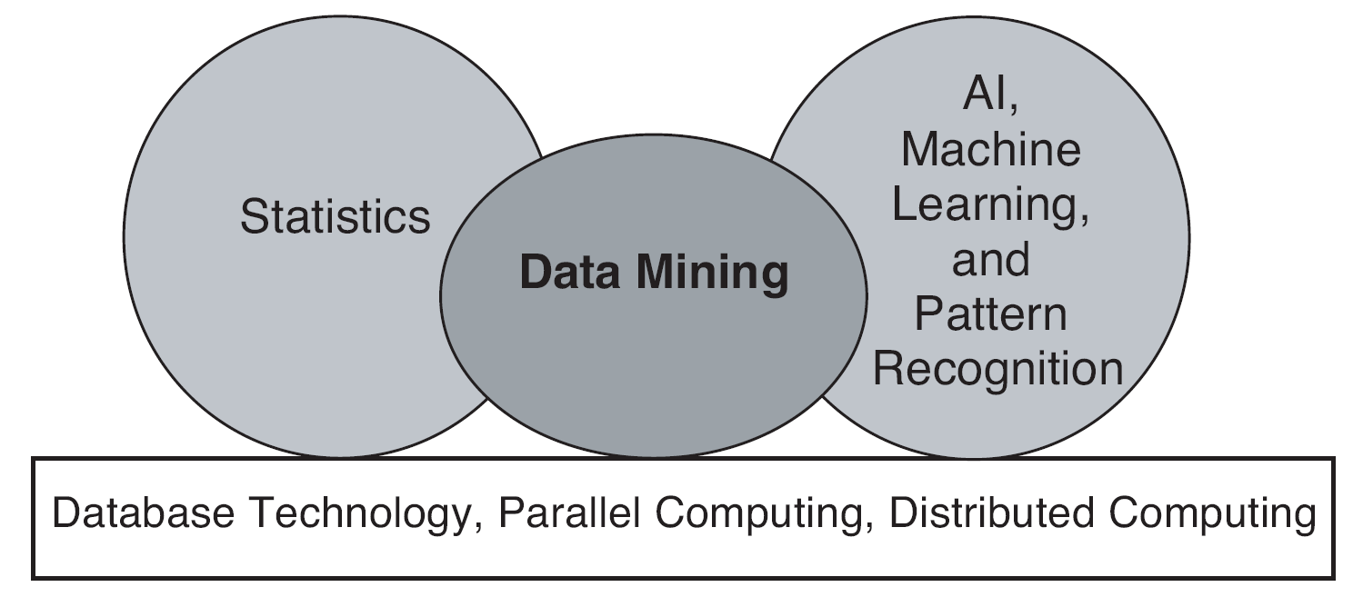
Origins of Data Mining
Draws ideas from machine learning/AI, pattern recognition, statistics, visualization and database systems
Traditional techniques may be unsuitable due to data that is
  Large-scale
  High dimensional
  Heterogeneous
  Complex
  Distributed
A key component of the emerging field of data science and data-driven discovery

Slide 10
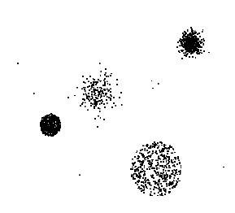

Data Mining Tasks …
Data
Clustering
Predictive Modeling
Association
Analysis
Anomaly
Detection
Summarization
Milk

Slide 11
Data Mining Tasks
Prediction Methods
  Use some variables to predict unknown or future values of other variables.
Description Methods
  Find human-interpretable patterns that describe the data; create summaries

Slide 12
Data Mining Tasks...
Classification [Predictive]
Clustering [Descriptive]
Association Rule Discovery [Descriptive]
Sequential Pattern Discovery [Descriptive]
Regression [Predictive]
Deviation Detection / Anomaly Detection [Predictive]

Slide 13
Classification: Definition
Given a collection of records (training set )
  Each record contains a set of attributes, one of the attributes is the class.
Find a model for class attribute as a function of the values of other attributes.
Goal: previously unseen records should be assigned a class as accurately as possible.
  A test set is used to determine the accuracy of the model. Usually, the given data set is divided into training and test sets, with training set used to build the model and test set used to validate it.

Slide 14
Classification Example
categorical
categorical
continuous
class
Test
Set
Learn
Classifier
Training
Set
Model

Slide 15
Predictive Modeling: Classification
Find a model for class attribute as a function of the values of other attributes
Model for predicting credit worthiness
Class

Slide 16
Classification: Application 1
Direct Marketing
  Goal: Reduce cost of mailing by targeting a set of consumers likely to buy a new cell-phone product.
  Approach:
    Use the data for a similar product introduced before.
    We know which customers decided to buy and which decided otherwise. This {buy, don’t buy} decision forms the class attribute.
    Collect various demographic, lifestyle, and company-interaction related information about all such customers.
      Type of business, where they stay, how much they earn, etc.
    Use this information as input attributes to learn a classifier model.
From [Berry & Linoff] Data Mining Techniques, 1997

Slide 17
Classification: Application 2
Customer Attrition/Churn:
  Goal: To predict whether a customer is likely to be lost to a competitor.
  Approach:
    Use detailed record of transactions with each of the past and present customers, to find attributes.
      How often the customer calls, where he calls, what time-of-the day he calls most, his financial status, marital status, etc.
    Label the customers as loyal or disloyal.
    Find a model for loyalty.
From [Berry & Linoff] Data Mining Techniques, 1997

Slide 18
Classification: Application 3
Sky Survey Cataloging
  Goal: To predict class (star or galaxy) of sky objects, especially visually faint ones, based on the telescopic survey images (from Palomar Observatory).
      3000 images with 23,040 x 23,040 pixels per image.
  Approach:
    Segment the image.
    Measure image attributes (features) - 40 of them per object.
    Model the class based on these features.
    Success Story: Could find 16 new high red-shift quasars, some of the farthest objects that are difficult to find!
From [Fayyad, et.al.] Advances in Knowledge Discovery and Data Mining, 1996

Slide 19
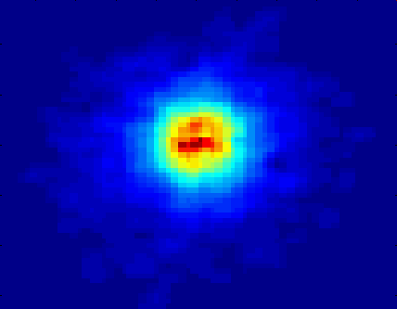
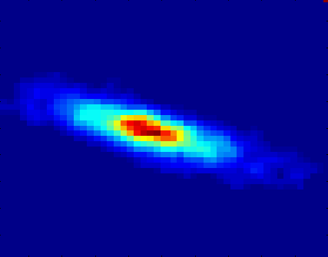
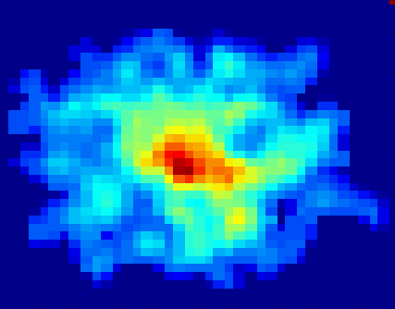
Classifying Galaxies
Courtesy: http://aps.umn.edu
Early
Class:
Stages of Formation
Attributes:
Image features,
Characteristics of light waves received, etc.
Intermediate
Late
Data Size:
72 million stars, 20 million galaxies
Object Catalog: 9 GB
Image Database: 150 GB

Slide 20
News August 24, 2023
We will be taking attendance starting Tuesday, August 29 throughout the semester. Attendance counts 2% towards the course grade. Attendance will be taken approx. 2:40p; that is, if you show up 20 minutes late, your attendance will not count.
Please read Chapter 3 of the Tan book before the next lecture; link can be found in the course website.
We will be conducting a survey about your knowledge about R and Python today around 3p
The will a lab taught by Mahin Sept. 5 (probably, 60 minutes); topics: R/Python refresher & Task1 (partially)
Task1 (Individual task) should be available by Sept. 1 the latest.
Task2 will center on developing a data storytelling tool which compares pairs of boxplots; should be available by Sept. 1 the latest.

Slide 21
Regression
Predict a value of a given continuous valued variable based on the values of other variables, assuming a linear or nonlinear model of dependency.
Greatly studied in statistics, neural network fields.
Examples:
  Predicting sales amounts of new product based on advetising expenditure.
  Predicting wind velocities as a function of temperature, humidity, air pressure, etc.
  Time series prediction of stock market indices.

Slide 22
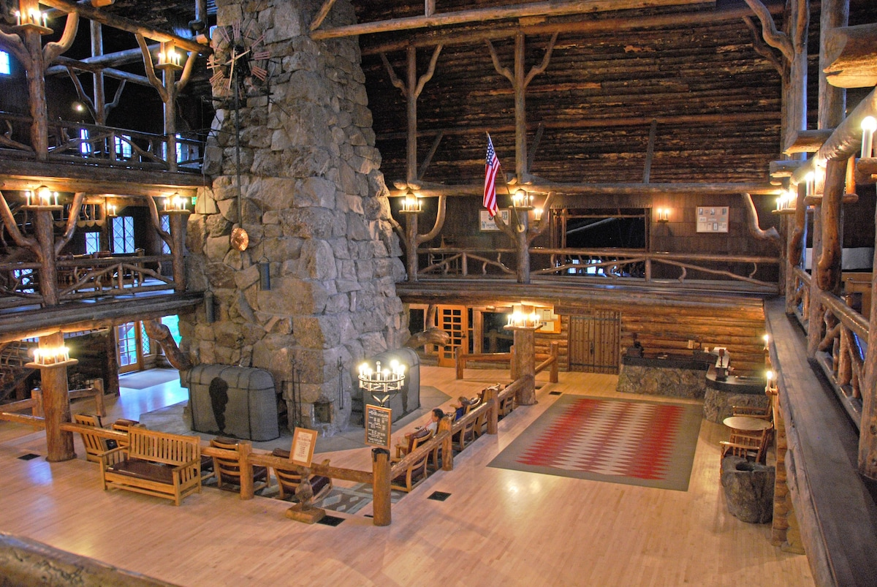
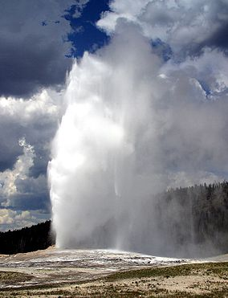
Old Faithful Geyser
http://www.web.pdx.edu/~jfreder/M212/oldfaithful.pdf
Old Faithful Geyser - Yellowstone National Park (HD) - Bing video
http://www.geyserstudy.org/geyser.aspx?pGeyserNo=OLDFAITHFUL
Important Prediction Question:
When is the next eruption?
http://en.wikipedia.org/wiki/Old_Faithful

Slide 23
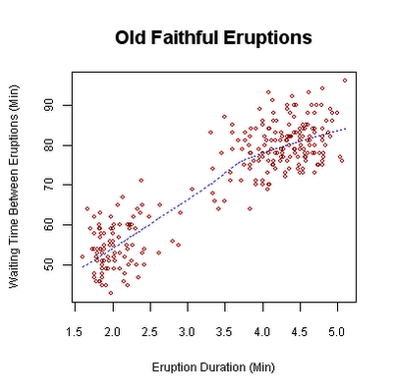
Scatter Plot Old Faithful Eruptions
http://en.wikipedia.org/wiki/Old_Faithful

Slide 24
Clustering Definition
Given a set of data points, each having a set of attributes, and a similarity measure among them, find clusters such that
  Data points in one cluster are more similar to one another.
  Data points in separate clusters are less similar to one another.
Similarity Measures:
  Euclidean Distance if attributes are continuous.
  Other Problem-specific Measures.

Slide 25
Illustrating Clustering
Euclidean Distance Based Clustering in 3-D space.
Intracluster distances
are minimized
Intercluster distances
are maximized

Slide 26
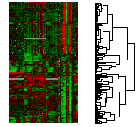
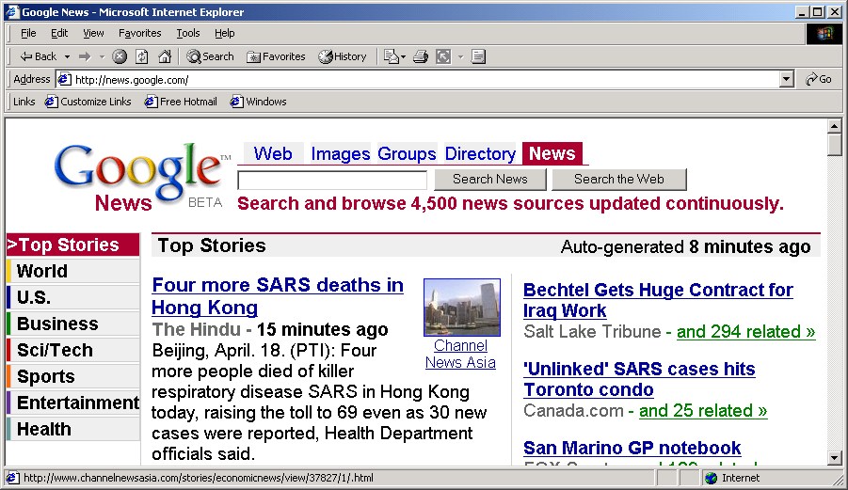
Applications of Cluster Analysis
Understanding
  Customer profiling for targeted marketing
  Group related documents for browsing
  Group genes and proteins that have similar functionality
  Group stocks with similar price fluctuations
Summarization
  Reduce the size of large data sets
Courtesy: Michael Eisen
Use of K-means to partition Sea Surface Temperature (SST) and Net Primary Production (NPP) into clusters that reflect the Northern and Southern Hemispheres.

Slide 27
Clustering: Application 1
Document Clustering:
  Goal: To find groups of documents that are similar to each other based on the important terms appearing in them.
  Approach: To identify frequently occurring terms in each document. Form a similarity measure based on the frequencies of different terms. Use it to cluster.
  Gain: Information Retrieval can utilize the clusters to relate a new document or search term to clustered documents.

Slide 28
Illustrating Document Clustering
Clustering Points: 3204 Articles of Los Angeles Times.
Similarity Measure: How many words are common in these documents (after some word filtering).

Slide 29
Application 2: Clustering of S&P 500 Stock Data
Observe Stock Movements every day.
Clustering points: Stock-{UP/DOWN}
Similarity Measure: Two points are more similar if the events described by them frequently happen together on the same day.

Slide 30
A Question asked by a Student in COSC 6335
Clustering and Classification divide objects into some groups. So
when I am performing clustering I also have to do classification?
Are they both dependent / related?

Slide 31
Clustering vs. Classification
Traditional Clustering
Classification
Goal is to identify groups of similar objects
Groups (clusters, new classes) are discovered
Dataset consists of attributes
Unsupervised (class label has to be learned)
Important: Similarity assessment which derives a “distance function” is critical, because clusters are discovered based on distances/density.
Pre-defined classes
Datasets consist of attributes and a class labels
Supervised (class label is known)
Goal is to predict classes from the object properties/attribute values→learn a model
Classifiers are learnt from sets of classified examples
Important: classifiers need to have a high accuracy

Slide 32
Association Rule Discovery: Definition
Given a set of records each of which contain some number of items from a given collection;
  Produce dependency rules which will predict occurrence of an item based on occurrences of other items.
Rules Discovered:
{Milk} --> {Coke}
{Diaper, Milk} --> {Beer}

Slide 33
Association Rule Discovery: Example Application
Supermarket shelf management.
  Goal: To identify items that are bought together by sufficiently many customers.
  Approach: Process the point-of-sale data collected with barcode scanners to find dependencies among items.
  A classic rule --
    If a customer buys diaper and milk, then he is very likely to buy beer.
    So, don’t be surprised if you find six-packs stacked next to diapers!

Slide 34
Sequential Pattern Discovery: Definition
Given is a set of objects, with each object associated with its own timeline of events, find rules that predict strong sequential dependencies among different events.
Rules are formed by first disovering patterns. Event occurrences in the patterns are governed by timing constraints.
(A B) (C) (D E)
(A B) (C) (D E)
<= xg
>ng
<= ws
<= ms

Slide 35
Sequential Pattern Discovery: Examples
In telecommunications alarm logs,
  (Inverter_Problem Excessive_Line_Current)
  (Rectifier_Alarm) --> (Fire_Alarm)
In point-of-sale transaction sequences,
  Computer Bookstore:
  (Intro_To_Visual_C) (C++_Primer) --> (Perl_for_dummies,Tcl_Tk)
  Athletic Apparel Store:
  (Shoes) (Racket, Racketball) --> (Sports_Jacket)

Slide 36
Graph Mining
Goal: Find interesting and/or frequent patterns in (large) graphs; the purpose is to extract patters (sub-graphs) of interest from graphs.
Example Applications:
  Analyzing molecular graphs https://www.sciencedirect.com/science/article/abs/pii/S1359644612002759
  Analyzing the link structure of webpages
  Analyzing social networks http://leitang.net/papers/graph_mining.pdf
Even though sub-graph isomorphism is a NP-complete problem, many graph mining tools for frequent sub-graph mining exist (like e.g., gSpan or GASTON).
Challenges: The huge number of possible patterns in graphs and the large size of typical graphs make graph mining difficult: the slow running times of most graph mining algorithms hamper the application of this technology---even with very fast hardware!

Slide 37
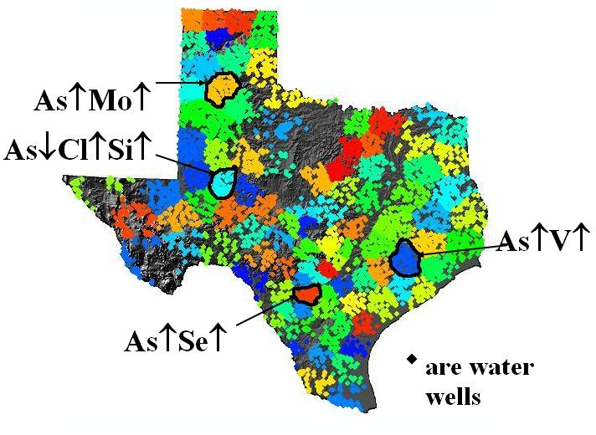
Co-location Mining
Task: Find regions in Texas where high/low concentrations of chemicals are co-located in the Texas Water Supply.
Figure 2: Chemical co-location
patterns in Texas’ Water Supply¹

Slide 38
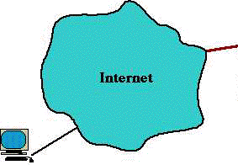
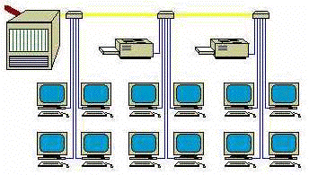
Deviation/Anomaly Detection
Detect significant deviations from normal behavior
Applications:
  Credit Card Fraud Detection
  Network Intrusion
  Detection
Typical network traffic at University level may reach over 100 million connections per day

Slide 39
Challenges of Data Mining
Scalability
Dimensionality
Complex and Heterogeneous Data
Data Quality
Data Ownership and Distribution
Privacy Preservation
Streaming Data

Slide 40
Data Mining Software
http://www.kdnuggets.com/software/index.html

Slide 41
Data Mining Conferences (Ranked by Importance!)
KDD 2022 KDD 2022 | Washington DC, U.S. (now calls itself the number 1 Data Science Conference, will scan though Website during the August 26 lecture)
ICDM 2022: IEEE International Conference on Data Mining 2022 (ICDM2022) | IEEE ICDM 2022 (usf.edu)
ECML/PKDD 2022: https://2022.ecmlpkdd.org

Slide 42
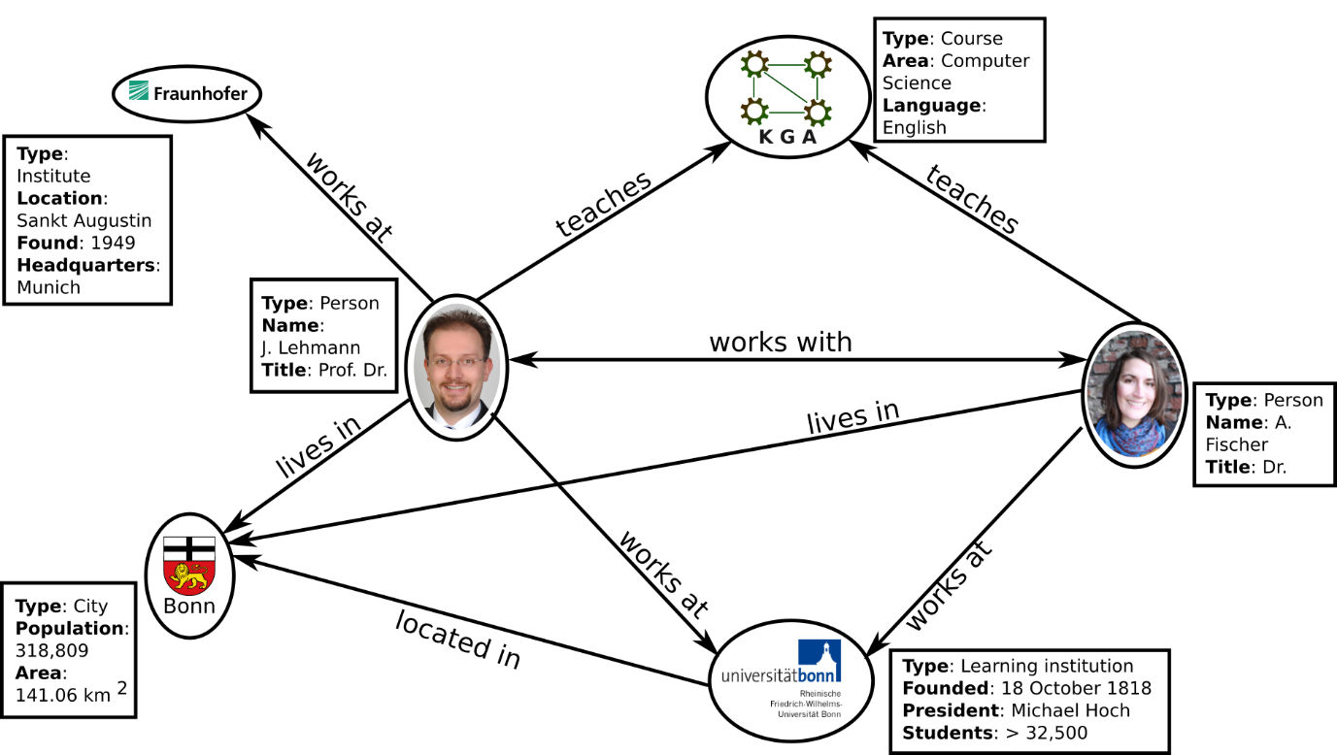
Data Mining Competitions
Netflix Price: https://www.netflixprize.com/
KDD Cup 2020: https://www.kdd.org/kdd2020/kdd-cup
ICDM Contest 2020: http://icdm2020.bigke.org/ https://adimen.si.ehu.eus/~rigau/publications/jws2016.pdf

Slide 43
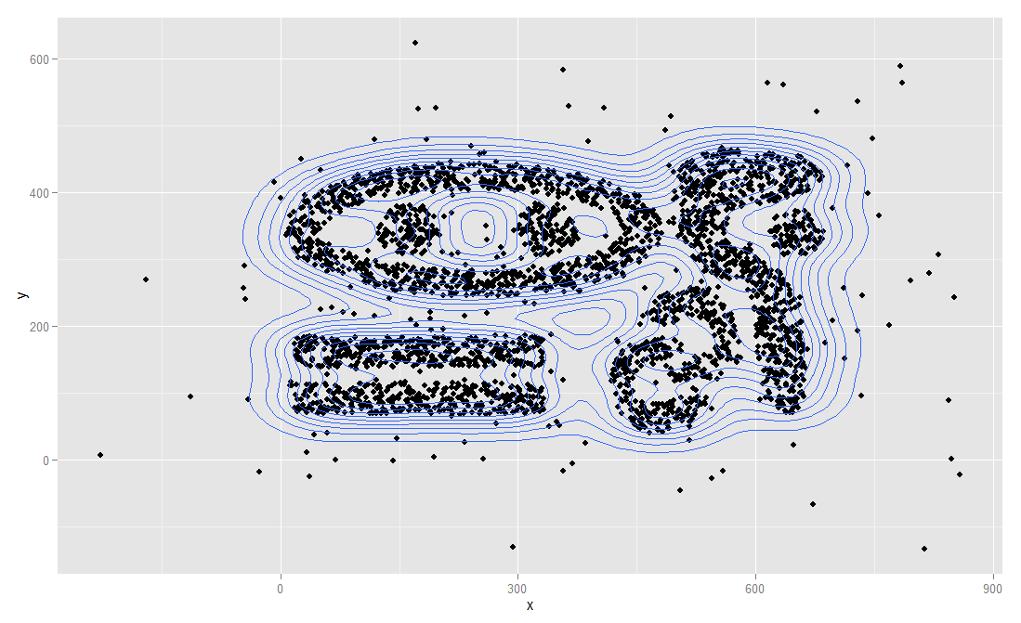
Example: Which Data Points are Outliers?
Remark: Using a model-based approach, points on the same density contour line should
have the same likelihood to be outliers with respect to the underlying statistical model M.

Slide 44
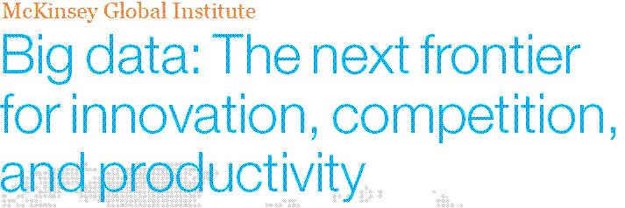
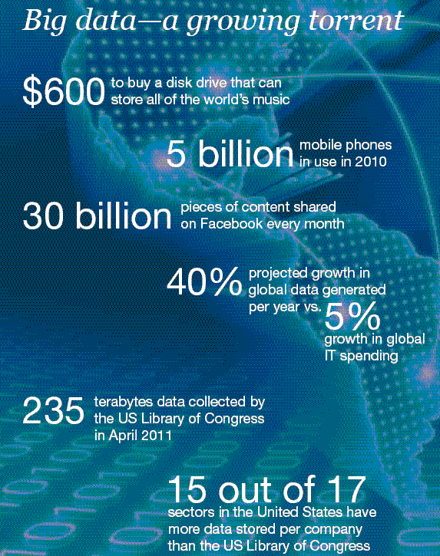
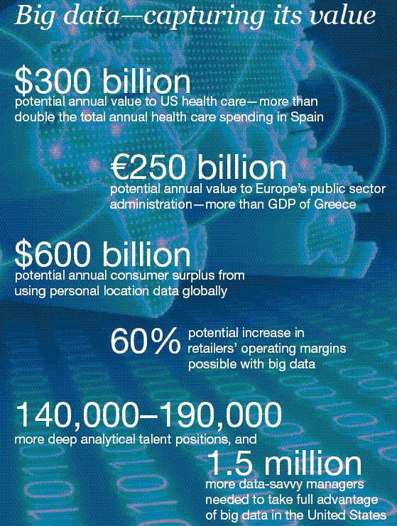
Great opportunities to improve productivity in all walks of life

