Slide 1
COSC 6335 Data Mining Fall 2009: Assignment3a Post Analysis
Christoph F. Eick
Department of Computer Science,
University of Houston

Slide 2
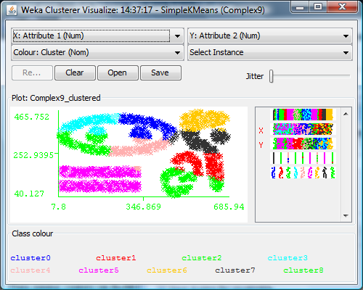
K-Means Complex9
Ruchika

Slide 3
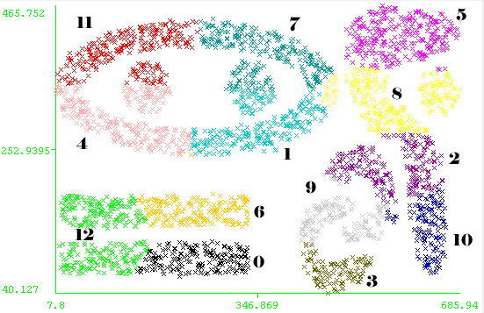
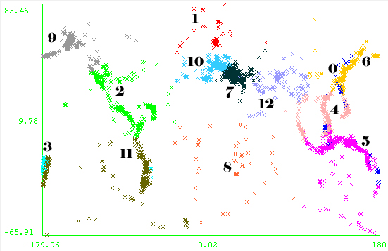
Faris K-Means
Notes:
We are interested in change analysis that centers on identifying changes concerning interesting regions between two dataset O_{old} and O_{new} sampled at different time frames.
The approach employs supervised density functions that create density maps from spatial datasets.
Regions where density functions take high or low values are considered interesting by this approach.
Interesting regions are identified using contouring techniques.

Slide 4
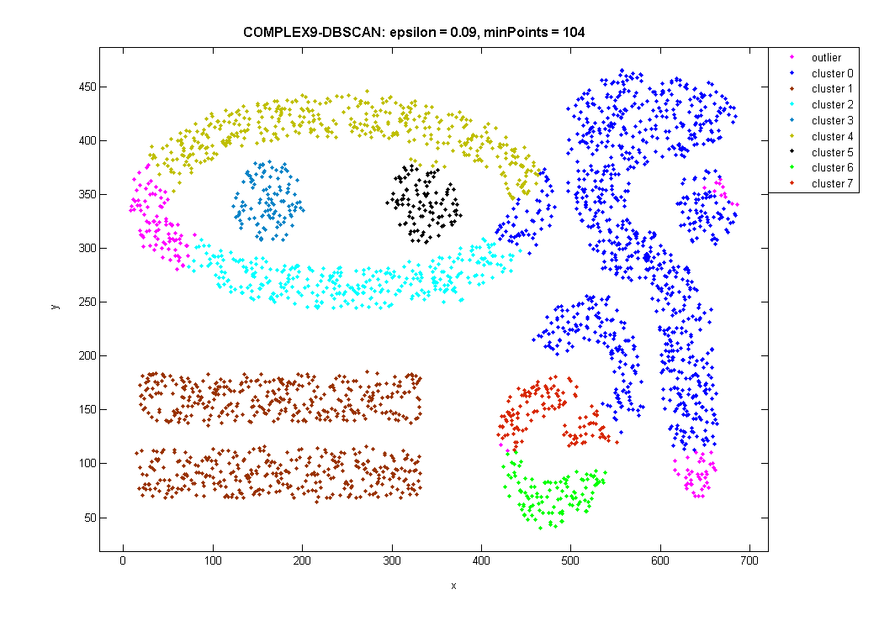
Student Result Complex9

Slide 5
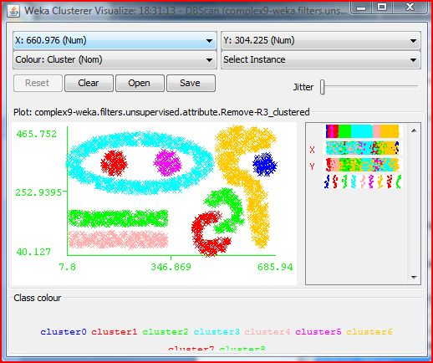
Kaavya
My values are epsilon = 0.0255 and m = 4.

Slide 6
Earth Quake Backgroud
http://www.geo.ua.edu/intro03/quakes.html
http://www.cessind.org/images/images/earthquakeglobal.gif (skip!)
http://www.data.scec.org/Module/storyline.html (important!)
http://library.thinkquest.org/03oct/00758/en/disaster/earthquake/faultlines.html
Notes:
Detecting changes in spatial datasets is important for many fields such as
early warning systems that monitor environmental conditions or sudden disease outbreaks,
epidemiology,
crime monitoring, and
automatic surveillance.
This paper introduces a novel methodology and algorithms that discover patterns of change in spatial datasets.

Slide 7
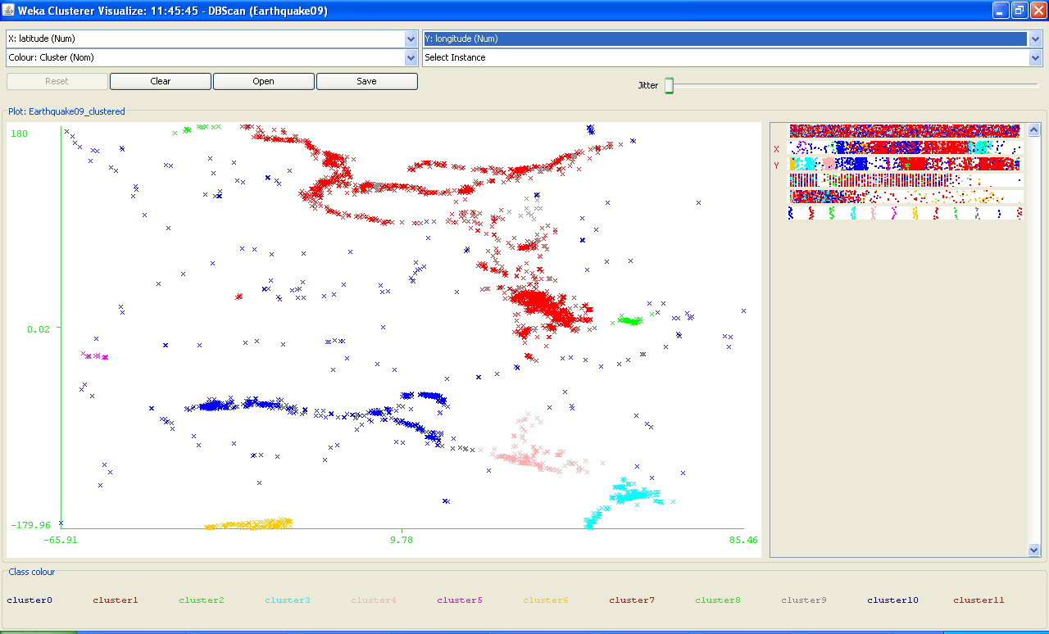
Student Results Earthquake
Anarug:Earthquake dataset ε=0.028 MinPoints =10

Slide 8
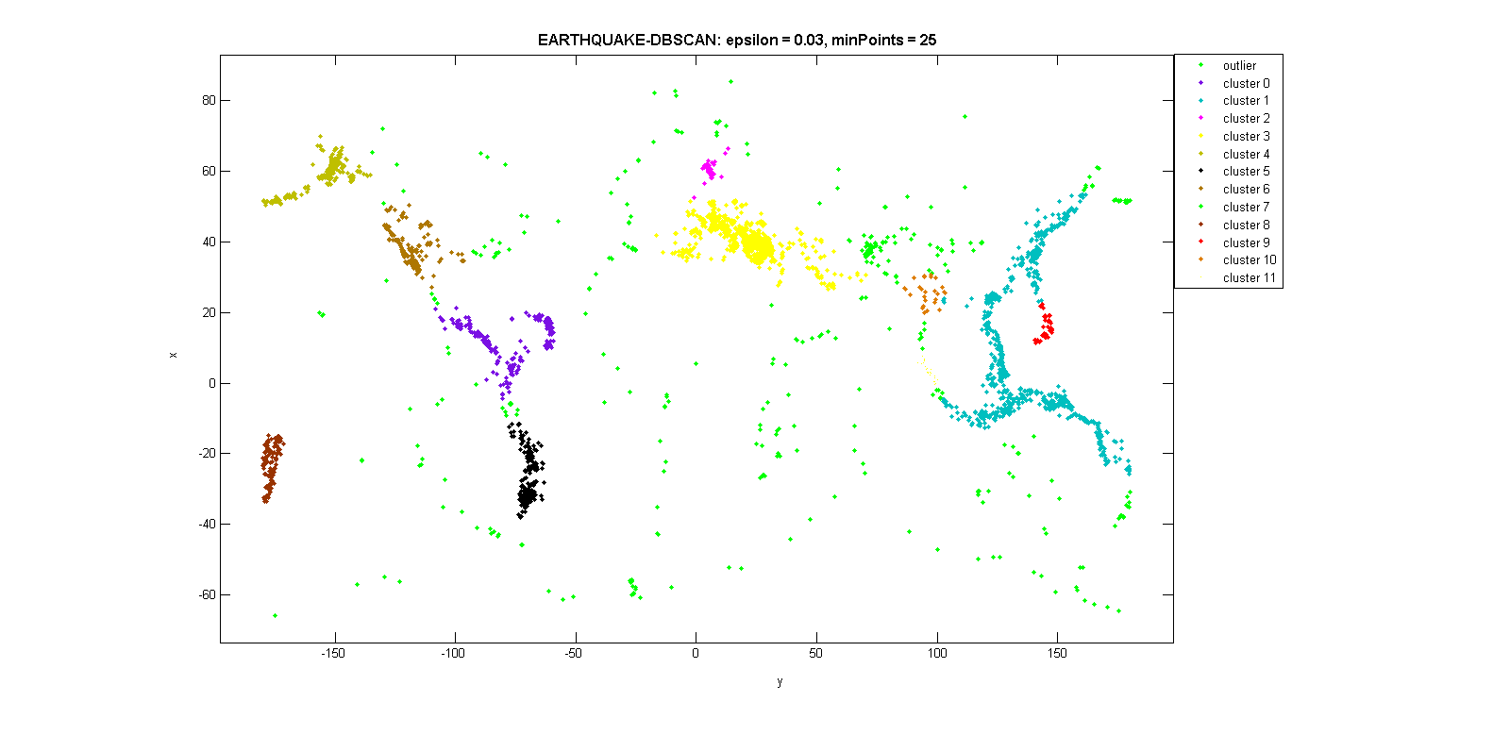
Le

Slide 9
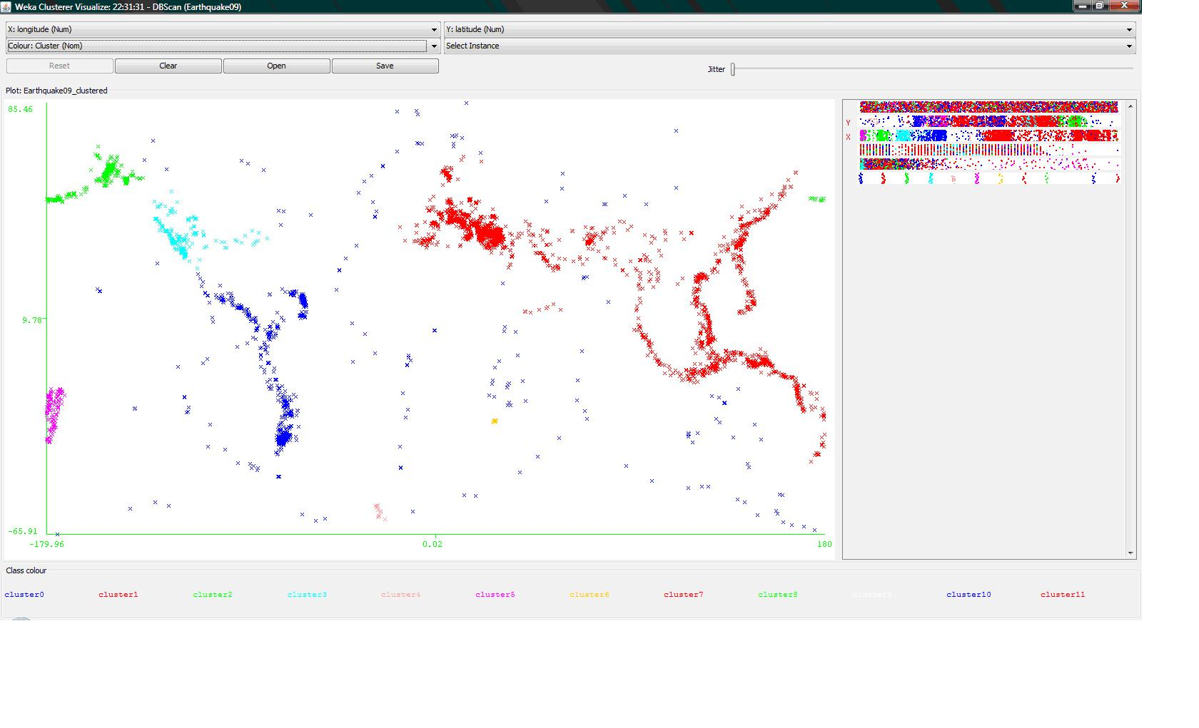
3. Moustafa
Notes:
Density estimation is called supervised because in addition to the density based on the locations of objects, we take the variable of interest z(o) into consideration when measuring density.
In contrast to past work in density estimation, our approach employs weighted influence functions to measure the density in datasets O: the influence of o on v is weighted by z(o) and measured as a product of z(o) and a Gaussian kernel function.
The figure depicts an example of results from Supervised Density Estimation.
A dataset O is a dataset in which objects belong to two classes in blue and yellow color.
O contains the points which are assumed to have spatial attributes (x,y) and attribute of interest z where z takes the value +1 if the objects belong to class yellow and -1 if the objects belong to class blue.
Figure b visualizes the supervised density function of the dataset O.
Figure c shows the density contour map for the density threshold 10 in red and -10 in blue.

