Slide 1
Spatial Analysis using Python
Md Mahin

Slide 2
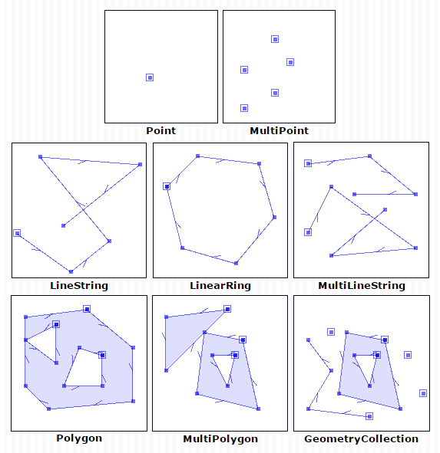
Spatial Objects
Core:
Point: (x coordinate, y coordinate) or (longitude, latitude)
Example: Any location
Line String: Space between two points.
Example: Roads
Polygon: Collection of points.
Example: State
Derived:
Linear Ring: Lines creating a ring
Multi Line String: Multiple line touching each other
Geometry Collection: Collection of all types of objects

Slide 3
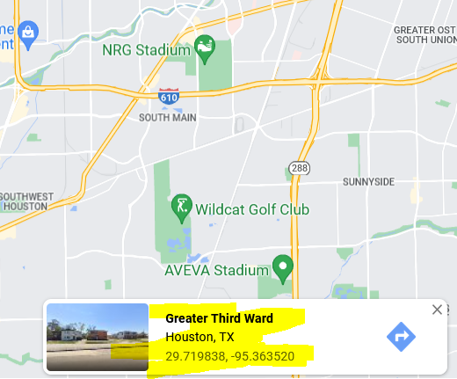
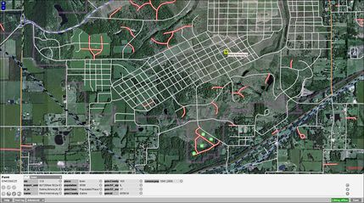
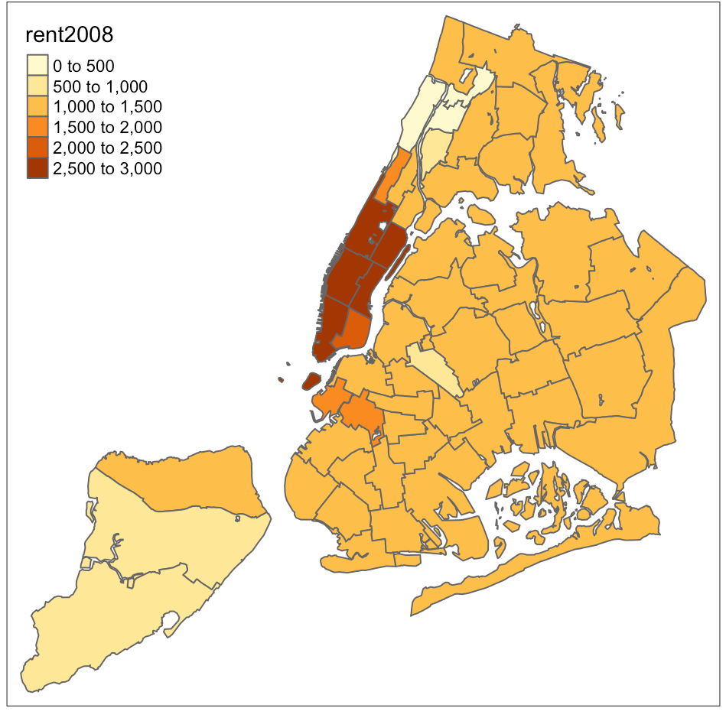
Some Examples
Google Map Point
Street Map
States

Slide 4
Some Important Sources
Shape files: Different polygonal data comes in form of shape files, such as:
USA Counties: https://catalog.data.gov/dataset/tiger-line-shapefile-current-nation-u-s-counties-and-equivalent-entities
Open Street Map: Source for open source street network

Slide 5
Tools to Handle Spatial Objects
Shapely: A polygon library. Easy to perform polygonal operations on it.
Geopandas: A python library that makes it smooth to handle spatial datasets
Matplotlib: Python tool to visualize data
Others: Networkx, OSM to handle road networks, alpha shape to generate polygons from points, numpy to create grids etc.
[Each tool offers different services. Often one tool is not enough and we need to combine multiple tools to work]

Slide 6
Shapely Introduction
Objects: Has libraries to support following objects:
Points, LineString, Polygons, Multiline, Polygons, Multipolygones, Collection
Operations: Supports of finds following operations among shapely objects
Find Relations: contains, intersects, overlaps, touches
Perform Operations: Intersection, Union

Slide 7
Case Study

Slide 8
Reading Files
If your data is written in a CSV file:
Use normal pandas to read file
For csv file, convert objects from string to shapely object
Example:
If your file is written as shapefile
Use Geopandas to read file
Change the geometric coordinate system (different system provides different types of coordinates)
Example:
import pandas as pd df =pd.read_csv(file_path) df[‘geometry’]=shapely.wkt.loads(df[‘geometry’][count]) for count in range(len(df[‘geometry’]))
import geopandas as gpd df =pd.read_file(file_path) df = df.to_crs(“epsg:4326”)

Slide 9
Perform Different Operations Using Shapely and GeoPandas
Getting bounds of a polygon: polygon.bounds
Getting centroid of a polygon: polygon.centroid
Merge all polygons: unary_union(polygones)
Find relation among objects using shapely: Polygon1.intersects(polygon2)

Slide 10
Create Your Own Objects
Shapley Point: Shapely.Point(longitude, latitude)
Shapley Polygon: Shapely.Polygon([point1, point2…pointn])
Shapely Line String: Shapely.LineString([point1, point2])

Slide 11
Create or Handel Grid
Use numpy to create or handle grid
Use coordinate bounds to get boundary of the grid
minx, maxx, miny, maxy = polygon.bounds grid = numpy.mgrid[minx:maxx:10,miny,maxy,10] for x in range(grid[0]): for y in range(grid[1]): point = shapely.Point(grid[0][x],grid[1][y])

Slide 12
Contour Plots using Grid
Can visualizes two dimensional densities
import matplotlib.pyplot as plt fig, ax = plt.subplots(1, 1, figsize=(10, 8)) xx,yy = grid \\ use numpy grid data = add_data_to_grid_points(xx,yy) \\ Write a function cfset = ax.contourf(xx, yy, data, levels=[0, 0.8, 1.6, 2.4, 3.2], cmap='coolwarm', alpha=.7) cset = ax.contour(xx, yy, data, levels=[0, 0.8, 1.6, 2.4, 3.2], cmap='coolwarm', alpha=.5) ax.clabel(cset, inline=1, fontsize=10) ax.set_adjustable('box') ax.autoscale(True) h1, l1 = cset.legend_elements() plt.xlabel('Longitude') plt.ylabel('Latitude') plt.show()

Slide 13
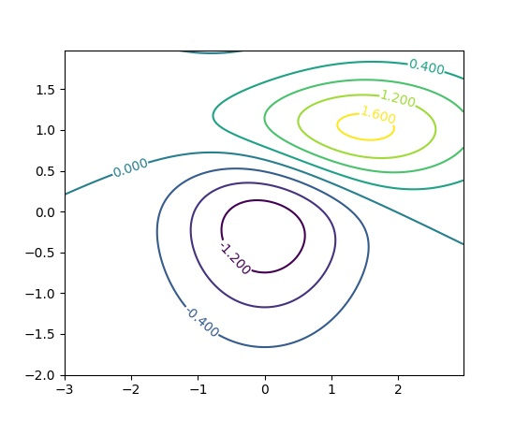
Example

Slide 14
Spatial Objects Visualization
Use mixture of shapely, geopandas and matplotlib
Convert shapely object to geopandas dataframe and use matplotlib to visualize
import matplotlib.pyplot as plt import geopandas as gpd fig, ax = plt.subplots(1, 1, figsize=(10, 8)) gdf = gpd.GeoDataFrame(index=[0], crs='epsg:4326', geometry=[polygon]) gdf.plot(linewidth=0.8, ax=ax, edgecolor='red', color='r', facecolor="none") Plt.show

Slide 15
Example

Slide 16
Writing File (csv)
Convert data into pandas dataframe and wright
import pandas as pd df = pd.DataFrame() df['variable1'] = list1 df['variable2'] = list2 df[‘geometry'] = list_geometry df.to_csv(path)

Slide 17
Writing File (shapefile)
Create pandas dataframe
Assign coordinate system
Convert to geodataframe and write
import pandas as pd Import geopandas as gpd df = pd.DataFrame() df['variable1'] = list1 df[‘geometry'] = list_geometry crs = {'init': 'epsg:4326'} gdf = gpd.GeoDataFrame(df, crs= crs, geometry = df.geometry) gdf.to_file(path)

Slide 18
Visualizing Earthquack(code)
import pandas as pd from shapely.geometry import Point import matplotlib.pyplot as plt import geopandas as gpd fig, ax = plt.subplots(1, 1, figsize=(10, 8)) df = pd.read_csv(eartquack.csv) contiguousUSA_shape = gpd.read_file(contiguousUSA.shp) contiguousUSA_shape = contiguousUSA_shape.to_crs("epsg:4326") gdf = gpd.GeoDataFrame(index=[0], crs='epsg:4326', geometry=[contiguousUSA_shape['geometry'][0]]) gdf.plot(linewidth=0.8, ax=ax, edgecolor='red', color='r', facecolor="none") for count in range(len(df['latitudes'])): point = Point([df['longitudes'][count],df['latitudes'][count]]) gdf = gpd.GeoDataFrame(index=[0], crs='epsg:4326', geometry=[point]) gdf.plot(linewidth=0.8, ax=ax, edgecolor='green', color='green', facecolor="none") plt.show()

Slide 19
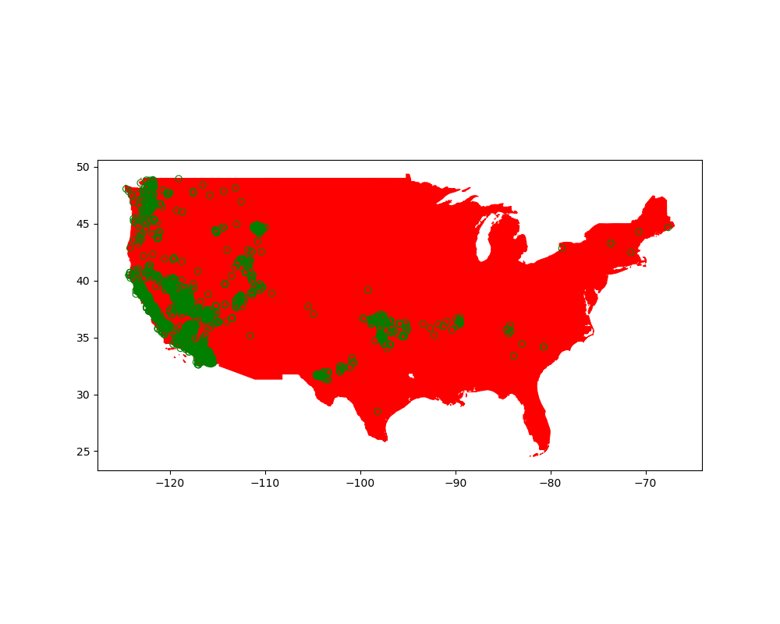
Output

Slide 20
References
https://shapely.readthedocs.io/en/stable/manual.html
https://geopandas.org/en/stable/docs.html
https://matplotlib.org/stable/index.html
https://spatialanalysis.github.io/handsonspatialdata/basic-mapping.html

