Slide 1
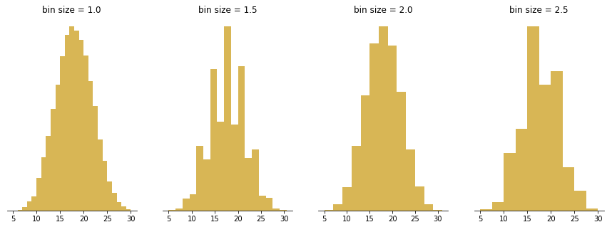
Motivation for Task2
Christoph F. Eick
Which (equi-bin) Histogram should we use???
Statistics at Rice Faculty - David W. Scott
Histograms can be viewed as density functions; therefore, deriving good histograms is a topic of density estimation which was covered by Mahin in the last lecture
Histogram - Scott - 2010 - WIREs Computational Statistics - Wiley Online Library
In Task2 you task will develop software which creates a “good equi-bin” histogram for a given 1D-dataset of observations
However, to define what the characteristics of a good histogram are is challenging and was therefore investigated by density estimation research. We will not address this question in today’s lecture but we will rather look at a “bad” histogram.

Slide 2
Example “Bad Histogram”
Example Problem from the midterm exam 2009: Assume you have an attribute A that has the attribute values that range between 0 and 6; its particular values are: 0.62 0.97 0.98 1.01. 1.02 1.07 2.96 2.97 2.99 3.02 3.03 3.06 4.96 4.97 4.98 5.02 5.03 5.04. Assume this attribute A is visualized as a equi-bin histogram with 6 bins: [0,1), [1,2), [2,3],[3,4), [4,5), [5,6]. Does the histogram provide a good approximation of the distribution/density function of attribute A? If not, provide a better histogram for attribute A. Give reasons for your answers!
https://en.wikipedia.org/wiki/Histogram

Slide 3
Christoph F. Eick
Advice for Approaching Task2
Try to understand the problem specification and start thinking about the problem and read useful background information.
Think about how to design your Task2 Program
Take a look at the 2 training examples and try to come up with a good histogram on your own!
There will be more discussion conc. Task2 in the Sept. 23, particularly about evaluation of histograms!

Slide 4
Christoph F. Eick
How will your program be graded?
Task2 is not peer reviewed; Mahin will grade Task2
Task2 will be graded based on
a. Validity of the Output: Is the program running; does your program produce valid histograms for datasets D1,…,D5; 45%
b. Quality of the Report (Explain Algorithm you use, provide pseudo code of the algorithm, explain how the algorithm works for an example (e.g. dataset D2); assess the quality of the histograms you generated; conclusion which summarizes the challenges of the task and the strength and weakness of your algorithm (1/3 to ½ page using single line spacing and a 12pt font). 33%
c. Quality of produced Histograms 22%
3. Also include output your program as an appendix for your report
Take a look at the 2 training examples and try to come up with a good histogram on your own!
There will be more discussion conc. Task2 in the Sept. 23, particularly about evaluation of histograms!

Slide 5
Christoph F. Eick
More Task2 Discussions
Briefly scan through the current draft of Task2!
Discussion: What are good histograms for D1, D2, and D3?
Discussion will be conducted using the 2 Wordfiles (link in webpage)

