Slide 1
UH-DMML: Dr. Eick’s Research Group
Part of: http://www.tlc2.uh.edu/dmmlg
Data Mining and Machine Learning Group,
Computer Science Department,
University of Houston, TX
June 9, 2009
Dr. Christoph F. Eick
Namrata Agarwal Fatih Akdag Abraham Bagherjeiran*
Ulvi Celepcikay Chun-Sheng Chen Wei Ding*
Christian Giusti* Rachsuda Jiamthapthaksin Dan Jiang*
Rebecca Kern Seungchan Lee* Rachana Parmar*
Sujing Wang Vadeerat Rinsurongkawong Justin Thomas*

Slide 2

Current Topics Investigated
Region Discovery Framework
Applications of
Region Discovery Framework
Spatial Databases
Domain
Expert
6
4
Change analysis in
spatial datasets
Discovering
regional knowledge
in geo-referenced datasets
Database Integration Tool
Measure of
Interestingness
Acquisition Tool
Data Set
Fitness Function
Region Discovery
Display
Discovering risk patterns of arsenic
Family of
Clustering Algorithms
Ranked Set of Interesting Regions and their Properties
Visualization
Tools
5
9
Cougar^2:
Open Source
DMML Framework
1
7
Development of Clustering Algorithms with Plug-in Fitness Functions
Polygons as
Cluster Models
8
Machine Learning
Domain-driven
clustering
Multi-run
Multi-objective
Clustering
2
Adaptive Clustering
Distance Function Learning
3
Using Machine Learning for
Spacecraft Simulation

Slide 3
1. Development of
Clustering Algorithms with Plug-in Fitness Functions

Slide 4
Clustering with Plug-in Fitness Functions
Motivation:
Finding subgroups in geo-referenced datasets has many applications.
However, in many applications the subgroups to be searched for do not share the characteristics considered by traditional clustering algorithms, such as cluster compactness and separation.
Consequently, it is desirable to develop clustering algorithms that provide plug-in fitness functions that allow domain experts to express desirable characteristics of subgroups they are looking for.
Only very few clustering algorithms published in the literature provide plug-in fitness functions; consequently existing clustering paradigms have to be modified and extended by our research to provide such capabilities.
Many other applications for clustering with plug-in fitness functions exist.

Slide 5
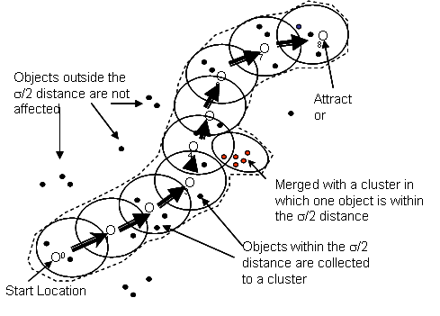
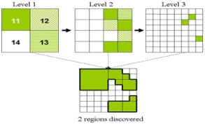
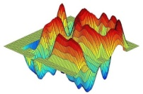
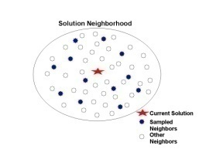
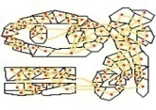
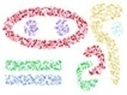
Current Suite of Clustering Algorithms
Representative-based: SCEC, SRIDHCR, SPAM, CLEVER
Grid-based: SCMRG, SCHG
Agglomerative: MOSAIC, SCAH
Density-based: SCDE
Density-based
Grid-based
Representative-based
Agglomerative-based
Clustering Algorithms

Slide 6
2. Domain-Driven Clustering

Slide 7
Domain Driven Data Mining
Objectives: To develop a unifying domain-driven framework for clustering with plug-in fitness functions and region discovery, which incorporates domain knowledge and domain-specific evaluation measures into the clustering algorithms and tools, so that “actionable knowledge” can be discovered.
Idea: Domain-driven clustering framework provides a family of clustering algorithms and a set of fitness functions, along with the capability of defining new fitness functions. Fitness functions are the core components in the framework as they capture a domain expert’s notion of the interestingness. The fitness function is independent from the clustering algorithm employed.
1. Define problem
2. Create/Select a fitness function
3. Select a clustering algorithm
4. Select parameters of the clustering algorithm
(and fitness function)
Hydrologist
5. Run the clustering algorithm to discover
interesting regions and associated patterns
6. Analyze the results
Fig. 1. A procedure of applying domain-driven clustering framework for actionable region discovery with involvement of domain experts
Fig. 2. An example of top 5 regions
ranked by interestingness

Slide 8
3. Multi-run Multi-Objective Clustering

Slide 9




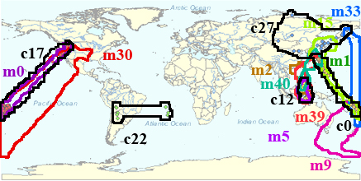
Multi-Run Clustering
Rachsuda Jiamthapthaksin and Vadeerat Rinsurongkawong
Objective:
  To obtain better clustering results by combining clusters that originate from multiple runs of clustering algorithms.
  To reduce extensive human effort in selecting appropriate parameters for an arbitrary clustering algorithm and identifying alternative clusters.
  To selectively store clusters in the repository on the fly which is radical departure from traditional clustering.
Key Idea: By defining states that represent parameter settings of a clustering algorithm, Multi-run clustering actively learns a state utility function; the utility function plays an important role in guiding the clustering algorithm to seek novel solutions.
S1
S3
S4
S2
State Utility
Learning
Parameters
Clustering
Algorithm
X
M
X
Steps in multi-run clustering:
S1: Parameter selection.
S2: Run a clustering algorithm.
S3: Compute a state feedback.
S4: Update the state utility table.
S5: Update the cluster list M.
S6: Summarize clusters discovered M’.
S5
Storage Unit
M
S6
Cluster
Summarization Unit
M’
Notes:
Fig. 1 (Top-left). An illustration of MR-CLEVER: (a) and (b) depict clustering results of the 1st and 2nd runs respectively, (c) depicts the distinct and high quality clusters in M at the end of the 2nd run, and (d) depicts the final clusters produced by MR-CLEVER.
Fig. 2 (Bottom-left). Overlay the multi-run clustering result (in color) by the top 5 rewards clusters of the best run (in black) on Earthquake dataset and High Variance fitness function.
Fig. 3. (Right) An architecture of multi-run clustering system (MRCS)

Slide 10
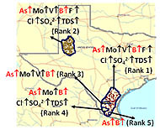
Multi-Objective Clustering
Rachsuda Jiamthapthaksin
Objectives:
  to obtain a set of clusters that satisfy multiple objectives with respect to a large set of objectives
  to reduce extensive human effort in managing and summarizing large sets of clusters obtained for a specific dataset
  Domain-driven—users can create groupings based on their specific needs
Key Idea: MOC architecture relies on clustering algorithms that support plug-in fitness functions and on multi-run clustering in which clustering algorithms are run multiple times maximizing different subsets of objectives that are captured in compound fitness functions. MOC provides search engine type capabilities to users, enabling them to query a large set of clusters with respect to different objectives and thresholds.
Steps in multi-run clustering:
S1: Generate a
compound fitness function.
S2: Run a clustering algorithm.
S3: Update the cluster list M.
S4: Summarize clusters
discovered M’.
Goal-driven Fitness
Function Generator
Q’
Clustering
Algorithm
A Spatial
Dataset
M
X
Storage Unit
Q’
Cluster
Summarization
Unit
M’
Fig. 1. An architecture of multi-objective clustering
Fig. 2. the top 5 regions ordered by rewards
using user-defined query {As↑,Mo↑}

Slide 11
4. Discovering Regional Knowledge in Geo-Referenced Datasets
Okay, but Ulvi should update it in late August 2009.

Slide 12

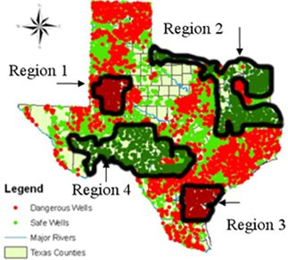
Mining Regional Knowledge in Spatial Datasets
Objective: Develop and implement an integrated framework to automatically discover interesting regional patterns in spatial datasets.
Domain
Experts
Hierarchical Grid-based & Density-based Algorithms
Spatial Databases
Regional
Knowledge
Integrated Data Set
Measures of
interestingness
Regional Association Rule Mining
Algorithms
Family of
Clustering Algorithms
Fitness Functions
Ranked Set of Interesting Regions and their Properties
Framework for Mining Regional Knowledge
Spatial Risk Patterns of Arsenic
Notes:
Given:
A dataset O with a schema R
A distance function d defined on instances of R
A fitness function q(X) that evaluates clustering X={c₁,…,c_{k}} as follows:
q(X)= Σ_{c∈X} reward(c)=Σ_{c∈X} interestingness(c)∗size(c)^{β} with β>1
Objective:
Find c₁,…,c_{k} ⊆ O such that:
c_{i}∩c_{j}=∅ if i≠j
X={c₁,…,c_{k}} maximizes q(X)
All cluster c_{i}∈X are contiguous (each pair of objects belonging to c_{i} has to be delaunay-connected with respect to c_{i} and to d)
c₁∪,…,∪c_{k} ⊆ O
c₁,…,c_{k} are usually ranked based on the reward each cluster receives, and low reward clusters are frequently not reported

Slide 13
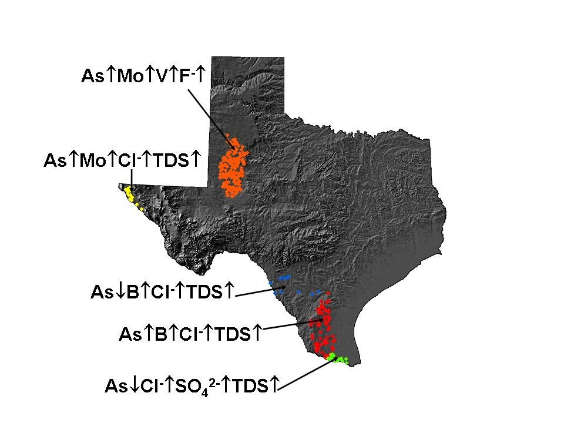
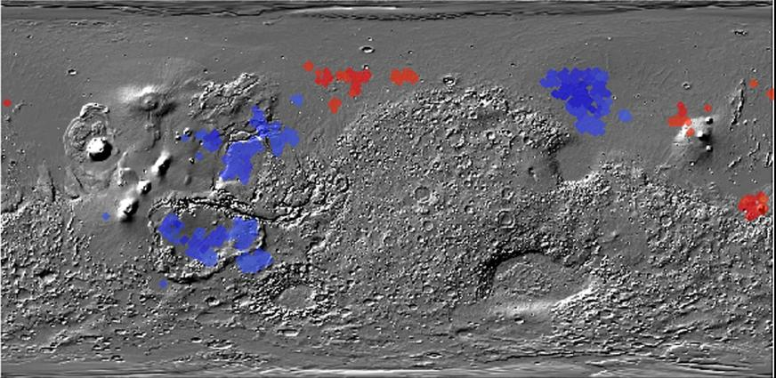
Finding Regional Co-location Patterns in Spatial Datasets
Figure 1: Co-location regions involving deep and
shallow ice on Mars
Figure 2: Chemical co-location
patterns in Texas Water Supply
Objective: Find co-location regions using various clustering algorithms and novel fitness functions.
Applications:
1. Finding regions on planet Mars where shallow and deep ice are co-located, using point and raster datasets. In figure 1, regions in red have very high co-location and regions in blue have anti co-location.
2. Finding co-location patterns involving chemical concentrations with values on the wings of their statistical distribution in Texas’ ground water supply. Figure 2 indicates discovered regions and their associated chemical patterns.

Slide 14
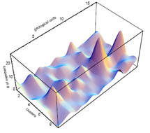
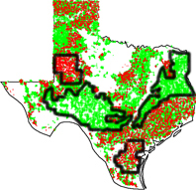
Regional Pattern Discovery via Principal Component Analysis
Oner Ulvi Celepcikay
Apply PCA-Based Fitness Function & Assign Rewards
Calculate Principal Components & Variance Captured
Discover Regions & Regional Patterns (Globally Hidden)
Objective: Discovering regions and regional patterns using principal component analysis
Applications: Region discovery, regional pattern discovery (i.e. finding interesting sub-regions in Texas where arsenic is highly correlated with fluoride and pH) in spatio-temporal data, and regional regression.
Idea: Correlations among attributes tend to be hidden globally. But with the help of statistical approaches and our region discovery framework, some interesting regional correlations among the attributes can be discovered.

Slide 15
5. Discovering Risk Patterns of Arsenic

Slide 16
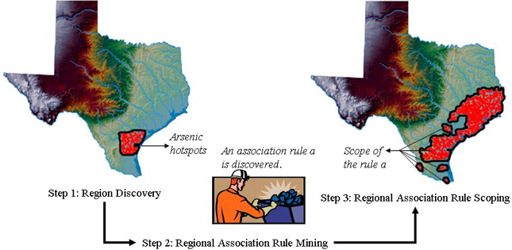
Discovering Spatial Patterns of Risk from Arsenic:
A Case Study of Texas Ground Water
Wei Ding, Vadeerat Rinsurongkawong and Rachsuda Jiamthapthaksin
Objective: Analysis of Arsenic Contamination and its Causes.
Collaboration with Dr. Bridget Scanlon and her research group at the University of Texas in Austin.
Our approach
Experimental Results
Notes:
Wei, Rachsuda, Vadeerat

Slide 17
6. Change Analysis in
Spatial Datasets
Add transparencies, describing applications; otherwise okay, but Vadeerat should update it in July 2009

Slide 18
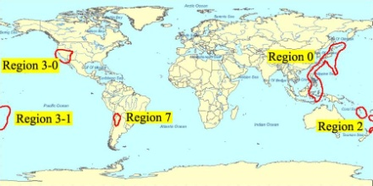
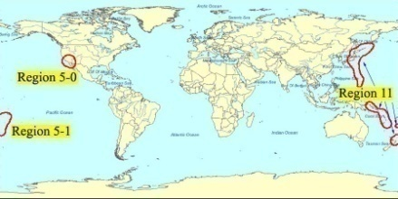
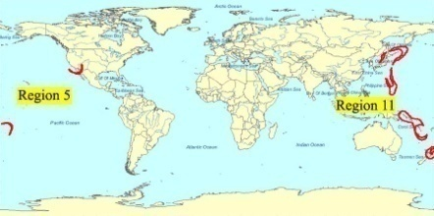
Change Analysis in Spatial Datasets
How the interesting regions in one time frame differ from the interesting regions in the next time frame with respect to a user defined interestingness perspective
Challenges of emergent pattern discovery include:
  The development of a formal framework that characterizes different types of emergent patterns
  The development of a methodology to detect emergent patterns in spatio-temporal datasets
  The capability to find emergent patterns in regions of arbitrary shape and granularity
  The development of scalable emergent pattern discovery algorithms that are able to cope with large data sizes and large numbers of patterns
Example: High Variance of Earthquake Depth
Time 1
Time 2
Novelty (r’) = (r’—(r1 ∪…∪ rk))
Emerging regions based on the novelty change predicate

Slide 19
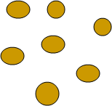
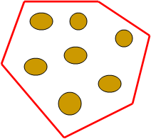

Change Analysis: Approaches
Vadeerat Rinsurongkawong and Chun-Sheng Chen
Advantages: We can detect various types of changes in data with continuous attributes and unknown object identity
Extensional Cluster
Extensional clusters partition the input dataset into subsets, and return these subsets as clustering results.
Intensional clusters are clustering models which represent functions that determine whether a given object belongs to a particular cluster or not. Polygons are used as models for spatial clusters.
Cluster
Intensional Cluster
Two approaches for analyzing relationships between two cluster models are introduced:
Direct Change Analysis for Intentional Clusters
  Intensional clusters of O_{old} and O_{new} are directly compared, mostly relying on polygon operations.
Indirect Change Analysis through Forward-Backward Analysis Based on Re-clustering
  Creates cluster models for O_{old} and O_{new} and re-clusters the old data using the new model, and the new data using the old model, and then compares cluster extensions.
Basic change predicates is introduced
These base predicates can be used to define more complex cluster relationships..
Let r, r₁,…, r_{k} be regions in O_{old} and r’, r₁’,…, r’_{k} be regions in O_{new}.
  Agreement(r,r’)= | r ∩ r’| / | r ∪ r’|
  Containment(r,r’)= | r ∩ r’| / | r |
  Novelty (r’) = (r’ —(r₁ ∪…∪ r_{k}))
  Disappearance(r)= (r—(r’₁ ∪…∪ r’_{k}))
The operations are preformed on sets of objects in the case of the re-clustering approach and on polygons in the case of the direct approach

Slide 20
7. Polygons as Models for Spatial Clusters

Slide 21
Shape-Aware Clustering Algorithms
Assign higher number because deemphasized; somewhat okay, but Chun-sheng should update this set in late August 2009.

Slide 22
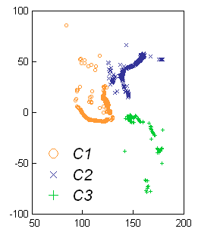
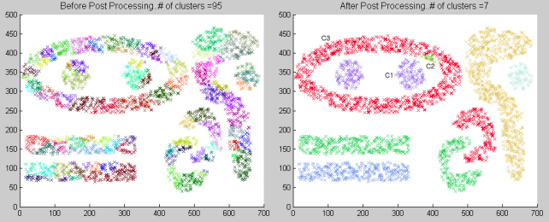
Discovering Clusters of Arbitrary Shapes
Rachsuda Jiamthapthaksin, Christian Giusti, and Jiyeon Choo
Objective: Detect arbitrary shape clusters effectively and efficiently.
2nd Approach: Approximate arbitrary shapes using unions of small convex polygons.
3rd Approach: Employ density estimation techniques for discovering arbitrary shape clusters.
1st Approach: Develop cluster evaluation measures for non-spherical cluster shapes.
Derive a shape signature for a given shape. (boundary-based, region-based, skeleton based shape representation)
Transform the shape signature into a fitness function and use it in a clustering algorithm.
Notes:
Rachsuda, Christian, Jiyeon, …
Figure 1: Chain-like clusters in Volcano dataset.
Figure 2 (a) Binary Complex9
original dataset; two class values
Figure 2 (b) Binary Complex9
dataset density function

Slide 23
8. Machine Learning

Slide 24















Distance Function Learning Using Intelligent Weight Updating and Supervised Clustering
Distance function: Measure the similarity between objects.
Objective: Construct a good distance function using AI and machine learning techniques that learn attribute weights.
The framework:
Generate a distance function:
Apply weight updating schemes / Search Strategies to find a good distance function candidate
Clustering:
Use this distance function candidate in a clustering algorithm to cluster the dataset
Evaluate the distance function:
We evaluate the goodness of the distance function by evaluating the clustering result according to a predefined evaluation function.
Weight Updating Scheme /
Search Strategy
Clustering X
Distance
Function Q
Cluster
q(X) Clustering
Evaluation
Bad distance function Θ1
Good distance function Θ2
Goodness of
the Distance
Function Q
Notes:
Chunsheng

Slide 25
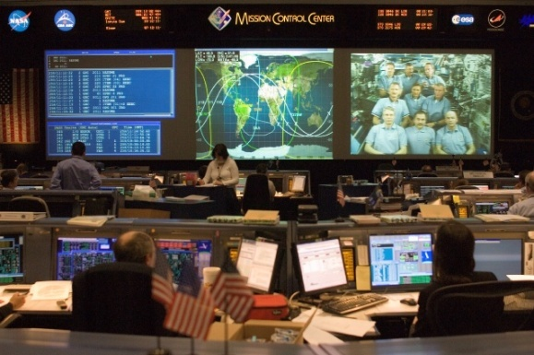
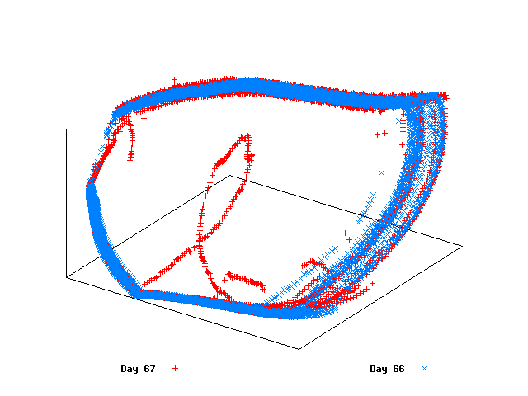
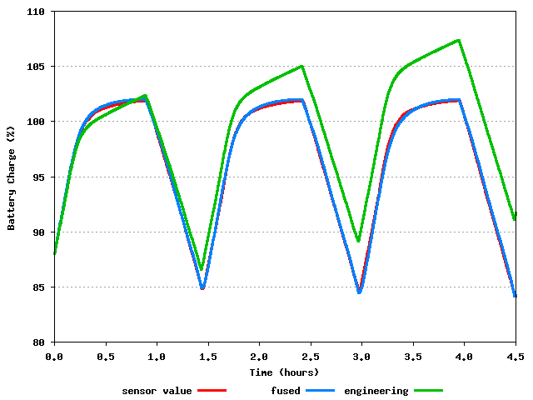
Online Learning of Spacecraft Simulation Models
Developed an online machine learning methodology for increasing the accuracy of spacecraft simulation models
Directly applied to the International Space Station for use in the Johnson Space Center Mission Control Center
Approach
  Use a regional sliding-window technique , a contribution of this research, that regionally maintains the most recent data
  Build new system models incrementally from streaming sensor data using the best training approach (regression trees, model trees, artificial neural networks, etc…)
  Use a knowledge fusion approach, also a contribution of this research, to reduce predictive error spikes when confronted with making predictions in situations that are quite different from training scenarios
Benefits
  Increases the effectiveness of NASA mission planning, real-time mission support, and training
  Reacts the dynamic and complex behavior of the International Space Station (ISS)
  Removes the need for the current approach of refining models manually
Results
  Substantial error reductions up to 76% in our experimental evaluation on the ISS Electrical Power System
  Cost reductions due to complete automation of the previous manually-intensive approach

Slide 26
9. Cougar^2: Open Source Data Mining and Machine Learning Framework

Slide 27

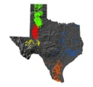
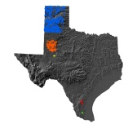
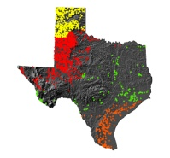
Cougar^2: Open Source Data Mining and Machine Learning Framework
Rachana Parmar, Justin Thomas, Rachsuda Jiamthapthaksin, Oner Ulvi Celepcikay
Department of Computer Science, University of Houston, Houston TX
Cougar^2¹ is a new framework for data mining and machine learning. Its goal is to simplify the transition of algorithms on paper to actual implementation. It provides an intuitive API for researchers. Its design is based on object oriented design principles and patterns. Developed using test first development (TFD) approach, it advocates TFD for new algorithm development. The framework has a unique design which separates learning algorithm configuration, the actual algorithm itself and the results produced by the algorithm. It allows easy storage and sharing of experiment configuration and results.
The framework architecture follows object oriented design patterns and principles. It has been developed using Test First Development approach and adding new code with unit tests is easy. There are two major components of the framework: Dataset and Learning algorithm.
Datasets deal with how to read and write data. We have two types of datasets: NumericDataset where all the values are of type double and NominalDataset where all the values are of type int where each integer value is mapped to a value of a nominal attribute. We have a high level interface for Dataset and so one can write code using this interface and switching from one type of dataset to another type becomes really easy.
Learning algorithms work on these data and return reusable results. To use a learning algorithm requires configuring the learner, running the learner and using the model built by the learner. We have separated these tasks in three separate parts: Factory – which does the configuration, Learner – which does actually learning/data mining task and builds the model and Model – which can be applied on new dataset or can be analyzed.
ABSTRACT
METHODS
ABSTRACT
FRAMEWORK ARCHITECTURE
Dataset
Factory
builds
Model
creates
uses
Learner
applies
to
Parameter configuration
Dataset
MOTIVATION
Typically machine learning and data mining algorithms are written using software like Matlab, Weka, RapidMiner (Formerly YALE) etc. Software like Matlab simplify the process of converting algorithm to code with little programming but often one has to sacrifice speed and usability. On the other extreme, software like Weka and RapidMiner increase the usability by providing GUI and plug-ins which requires researchers to develop GUI. Cougar^2 tries to address some of the issues with these software.
Reusable and Efficient software
Test First Development
Platform Independent
Support research efforts into new algorithms
Analyze experiments by reading and reusing learned models
Intuitive API for researchers rather than GUI for end users
Easy to share experiments and experiment results
A SUPERVISED LEARNING EXAMPLE
Dataset
Outlook
Dataset
Sunny
Overcast
No
Temp.
Hot
Model (Decision Tree)
Cold
Decision Tree Factory
Model (Decision Tree)
Decision Tree Factory
Decision Tree Learner
Decision Tree Learner
No
Yes
A REGION DISCOVERY EXAMPLE
CURRENT WORK
BENEFITS OF COUGAR^2
Several algorithms have been implemented using the framework. The list includes SPAM, CLEVER and SCDE. Algorithm MOSAIC is currently under development. A region discovery framework and various interestingness measures like purity, variance, mean squared error have been implemented using the framework.
Developed using: Java, JUnit, EasyMock
Hosted at: https://cougarsquared.dev.java.net
Dataset
Region Discovery Factory
Region Discovery Algorithm
Region Discovery Model
1: First version of Cougar^2 was developed by a Ph.D. student of the research group – Abraham Bagherjeiran
Notes:
27

