Slide 1
Variational Autoencoders
Md Mahin

Slide 2
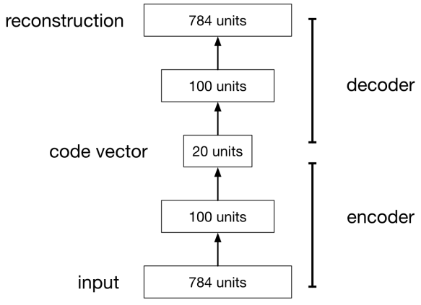
Autoencoders
An autoencoder is a feed-forward neural net whose job it is to take an input x and predict x.
To make this non-trivial, we need to add a bottleneck layer whose dimension is much smaller than the input.

Slide 3
Why Autoencoders?
Map high-dimensional data to two dimensions for visualization
Compression
Learn abstract features in an unsupervised way so you can apply them to a supervised task
Unlabled data can be much more plentiful than labeled data
Learn a semantically meaningful representation where you can, e.g., interpolate between different images.

Slide 4
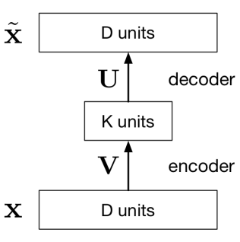
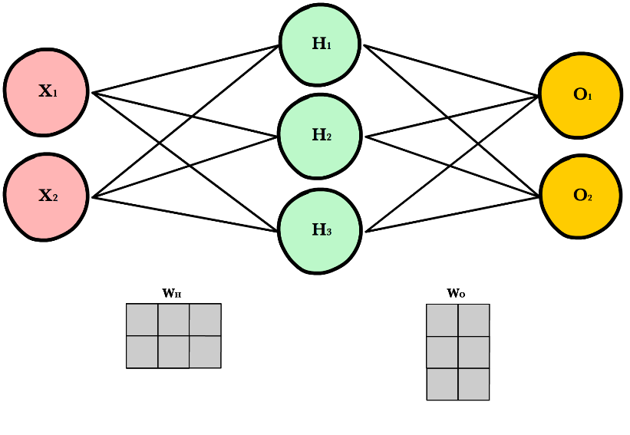
How Autoencoders Works
x: Input vector or array
$\hat{x}:$ Output vector or array
V: A matrix of weights. For example if D has 3 neurons, K has 2 neuron, for every connection there will be a weight and it is a 3 * 2 weight matrix
U: Another matrix of weights. For example if D has 3 neurons, K has 2 neuron, for every connection there will be a weight and it is a 2 * 3 weight matrix

Slide 5
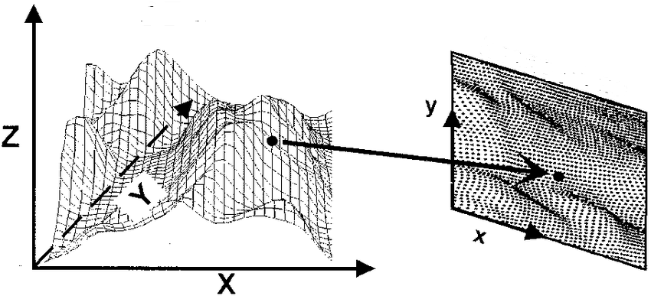
How it works
Vx: A matrix multiplication project D dimensional x to k dimensional plane. Shown for 3 to 2. Dimensionality Reduction
Ux : Project k dimensional hidden unit to D dimensional $\hat{x}$
Overall Output is: $\hat{x}=Uvx$ [A linear function]
How it learn:
Learn the U, V matrix or all weights so that we get minimum loss
L(x, $\hat{x})={|\left|x−\hat{x}\right||}^{2}$
We minimize L to learn U,V

Slide 6
Difference with PCA
Autoencoder
PCA
Find the subspace that minimizes the reconstruction error
Deep nonlinear autoencoders learn to project the data, not onto a subspace, but onto a nonlinear manifold
Non linear dimensionality reduction
Autoencoder with just one layer without activation is similar to PCA
Find the subspace that maximizes the projected variance
Project on a linear subspace
Linear dimensionality reduction

Slide 7
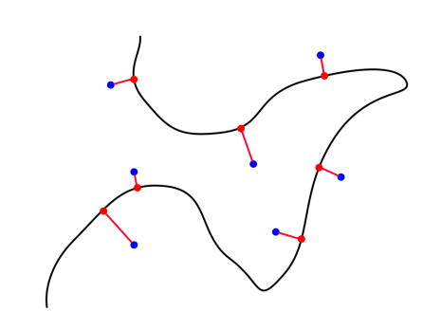
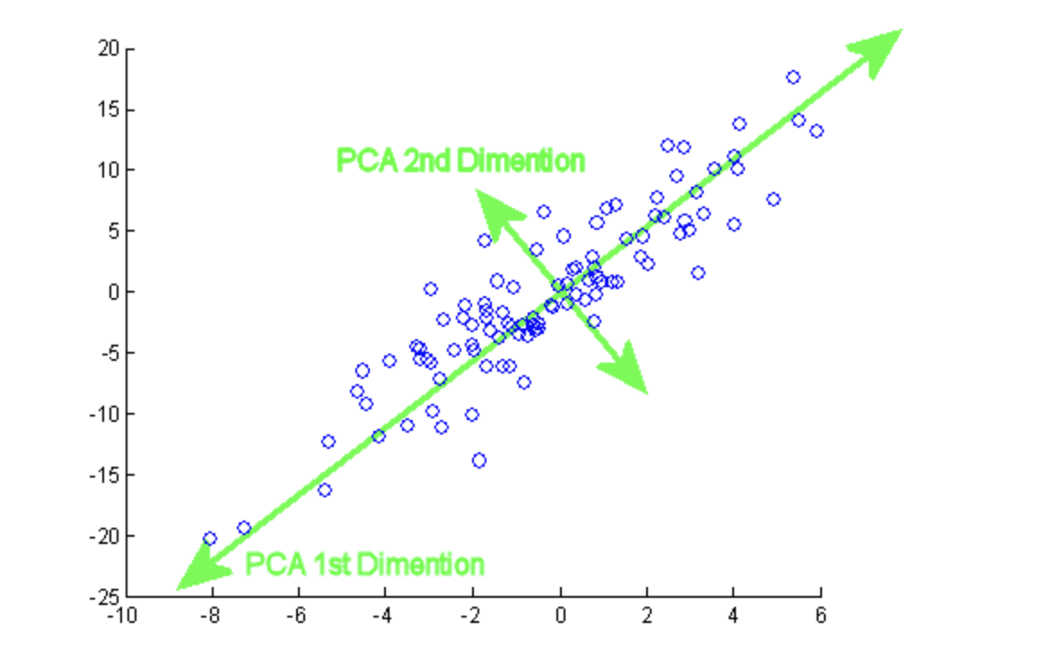
Difference with PCA
Autoencoder Projection
PCA Projection

Slide 8
Benefit of Deep Autoencoder
Nonlinear autoencoders can learn more powerful codes for a given dimensionality, compared with linear autoencoders (PCA)
Some limitations of autoencoders

Slide 9
Some limitations of autoencoders
They’re not generative models, so they don’t define a distribution
How to choose the latent dimension?

Slide 10
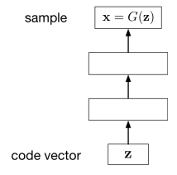
Generative Models
One of the goals of unsupervised learning is to learn representations of images, sentences, etc.
A generative model is a function of representation z.
X= G(z) [G is the generator function]
Example: VAE, GAN

Slide 11
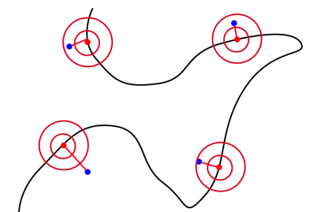
How Learning Distribution Help
Normal AE
VAE

Slide 12
How VAE Learn Distribution
VAE based on variational inference
Decoder does is calculate p(z|x)= p(x,z)/p(x)
What generator part does is:
$p(x)=\int{p\left(z\right)p\left(x | z\right)dz}$
One problem: if z is low-dimensional and the decoder is deterministic
The model only generates samples over a low-dimensional sub-manifold of X.
A noisy observation model is learnt
$p(x|z)=N(x;G_{θ}\left(z\right),ηI)$
$θ$ is μ and α learnt by the decoder

Slide 13
How VAE Learn Distribution
Direct computation of p(x) is costly
It introduce a further function to approximate the posterior distribution as
$q_{ϕ}(z|x)≈p_{θ}(z|x)$
Approximate q(z) which is known to p(z|x)
the idea is to jointly optimize the generative model parameters $θ$ to reduce the reconstruction error between the input and the output and $ϕ$ to make $q_{ϕ}(z|x)$ as close as $p_{θ}\left(z | x\right)$
Min $D_{KL}(q_{ϕ}(.|x)||p_{θ}(.|x))$
It uses KL divergence to make the parameters similar and define new loss function using ELBO method that does both task at the same time
$L_{θ,ϕ}\left(x\right)=\log{p_{θ}\left(x\right)−D_{KL}(q_{ϕ}(.|x)||p_{θ}(.|x))}$

Slide 14
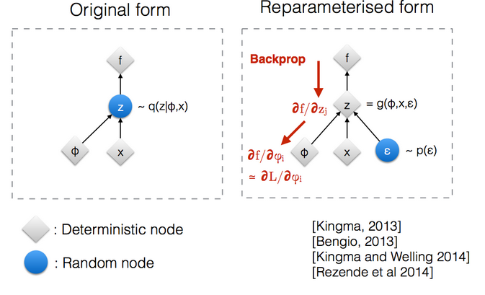
Reparameterization Trick
Back propagation won’t work on random node z (if we think it as just distribution)
So z is made into two deterministic node for mean and std and random part separated as Gaussian error

Slide 15
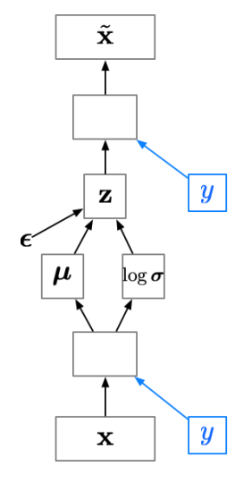
Class Conditional VAE
A class-conditional VAE provides the labels to both the encoder and the decoder.
Since the latent code z no longer has to model the image category, it can focus on modeling the stylistic features

Slide 16
References
Variational Autoencoder Lacture by Roger Grosse and Jimmy Ba [CSC421/2516 Lecture 17: Variational Autoencoders ]
Variational Autoencoder Wikipedia: CSC421/2516 Lecture 17: Variational Autoencoders
Ali Ghodsi, Lec : Deep Learning, Variational Autoencoder [https://www.youtube.com/watch?v=uaaqyVS9-rM]

