Slide 1
COSC 6335: Classification
Introduction to Classification: Basic Concepts and Decision Trees
Overfitting
Neural Networks Part 1
Support Vector Machines
K-Nearest Neighbors (only if enough time)
Neural Networks Part 2 (related to Task 4)

Slide 2
Data Mining Classification: Basic Concepts, Decision Trees, and Model Evaluation
Lecture Notes for Chapter 4
Introduction to Data Mining
by
Tan, Steinbach, Kumar

Slide 3
COSC 6335: Classifiction Part 1: Introduction to Classification: Basic Concepts and Decision Trees
Decision Tree Basics
Decision Tree Induction Algorithms
Overfitting and Underfitting (separate Slideshow!)
Other Issues with Decision Trees
Advantages and Disadvantages of Decision Trees
Model Evaluation

Slide 4
Classification: Definition
Given a collection of records (training set )
Each record contains a set of attributes, one of the attributes is the class.
Find a model for the class attribute as a function of the values of other attributes.
Goal: previously unseen records should be assigned a class as accurately as possible.
A test set is used to determine the accuracy of the model. Usually, the given data set is divided into training and test sets, with training set used to build the model and test set used to validate it.

Slide 5
Illustrating Classification Task

Slide 6
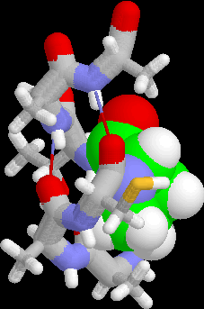
Examples of Classification Task
Predicting tumor cells as benign or malignant
Classifying credit card transactions as legitimate or fraudulent
Classifying secondary structures of protein as alpha-helix, beta-sheet, or random coil
Categorizing news stories as finance, weather, entertainment, sports, etc

Slide 7
Classification Techniques
Decision Tree based Methods covered in Part1
Rule-based Methods
Memory based reasoning, instance-based learning covered in Part2
Neural Networks
Naïve Bayes and Bayesian Belief Networks
Support Vector Machines covered in Part2
Ensemble Methods covered in Part2

Slide 8
Example of a Decision Tree
categorical
categorical
continuous
class
Splitting Attributes
Refund
Yes
No
NO
MarSt
Single, Divorced
Married
TaxInc
NO
< 80K
> 80K
NO
YES
Training Data
Model: Decision Tree

Slide 9
Another Example of Decision Tree
categorical
categorical
continuous
class
MarSt
Single, Divorced
Married
NO
Refund
Yes
No
NO
TaxInc
< 80K
> 80K
NO
YES
There could be more than one tree that fits the same data!

Slide 10
Decision Tree Classification Task
Decision Tree

Slide 11
Apply Model to Test Data
Test Data
Start from the root of tree.
Refund
Yes
No
NO
MarSt
Single, Divorced
Married
TaxInc
NO
< 80K
> 80K
NO
YES

Slide 12
Apply Model to Test Data
Test Data
Refund
Yes
No
NO
MarSt
Single, Divorced
Married
TaxInc
NO
< 80K
> 80K
NO
YES

Slide 13
Apply Model to Test Data
Test Data
Refund
Yes
No
NO
MarSt
Single, Divorced
Married
TaxInc
NO
< 80K
> 80K
NO
YES

Slide 14
Apply Model to Test Data
Test Data
Refund
Yes
No
NO
MarSt
Single, Divorced
Married
TaxInc
NO
< 80K
> 80K
NO
YES

Slide 15
Apply Model to Test Data
Test Data
Refund
Yes
No
NO
MarSt
Single, Divorced
Married
TaxInc
NO
< 80K
> 80K
NO
YES

Slide 16
Apply Model to Test Data
Test Data
Refund
Yes
No
NO
MarSt
Single, Divorced
Married
Assign Cheat to “No”
TaxInc
NO
< 80K
> 80K
NO
YES

Slide 17
Decision Tree Classification Task
Decision Tree

Slide 18
2. Decision Tree Induction
Many Algorithms:
Hunt’s Algorithm (one of the earliest)
CART
ID3, C4.5
SLIQ,SPRINT

Slide 19
General Structure of Hunt’s Algorithm
Let D_{t} be the set of training records that reach a node t
General Procedure:
If D_{t} contains records that belong the same class y_{t}, then t is a leaf node labeled as y_{t}
If D_{t} is an empty set, then t is a leaf node labeled by the default class, y_{d}
If D_{t} contains records that belong to more than one class, use an attribute test to split the data into smaller subsets. Recursively apply the procedure to each subset.
D_{t}
?

Slide 20
COSC 6335: Classifiction Part 1: Introduction to Classification: Basic Concepts and Decision Trees
Decision Tree Basics
Decision Tree Induction Algorithms
Overfitting and Underfitting (separate Slideshow!)
Other Issues with Decision Trees
Advantages and Disadvantages of Decision Trees
Model Evaluation

Slide 21
Hunt’s Algorithm
Refund
Don’t
Cheat
Yes
No
Don’t
Cheat
Don’t
Cheat
Refund
Refund
Yes
No
Yes
No
Don’t
Cheat
Marital
Status
Don’t
Cheat
Marital
Status
Single,
Divorced
Single,
Divorced
Married
Married
Cheat
Don’t
Cheat
Taxable
Income
Don’t
Cheat
< 80K
>= 80K
Don’t
Cheat
Cheat

Slide 22
Tree Induction
Greedy strategy (
Split the records based on an attribute test that optimizes certain criterion.
Remark: Finding optimal decision trees is NP-hard.
http://en.wikipedia.org/wiki/NP-hard
Issues
Determine how to split the records
How to specify the attribute test condition?
How to determine the best split?
Determine when to stop splitting

Slide 23
Tree Induction
Greedy strategy (http://en.wikipedia.org/wiki/Greedy_algorithm ) Creates the tree top down starting from the root, and splits the records based on an attribute test that optimizes certain criterion.
Issues
Determine how to split the records
How to specify the attribute test condition?
How to determine the best split?
Determine when to stop splitting

Slide 24
Side Discussion “Greedy Algorithms”
Fast and therefore attractive to solve NP-hard and other problems with high complexity. Later decisions are made in the context of decision selected early dramatically reducing the size of the search space.
They do not backtrack: if they make a bad decision (based on local criteria), they never revise the decision.
They are not guaranteed to find the optimal solutions, and sometimes can get deceived and find really bad solutions.
In spite of what is said above, a lot successful and popular algorithms in Computer Science are greedy algorithms.
Greedy algorithms are particularly popular in AI and Operations Research.
Popular Greedy Algorithms: Decision Tree Induction,…

Slide 25
How to Specify Test Condition?
Depends on attribute types
Nominal
Ordinal
Continuous
Depends on number of ways to split
2-way split
Multi-way split

Slide 26
Splitting Based on Nominal Attributes
Multi-way split: Use as many partitions as distinct values.
Binary split: Divides values into two subsets. Need to find optimal partitioning.
CarType
Family
Luxury
Sports
CarType
CarType
{Sports, Luxury}
OR
{Family, Luxury}
{Family}
{Sports}

Slide 27
Splitting Based on Ordinal Attributes
Multi-way split: Use as many partitions as distinct values.
Binary split: Divides values into two subsets. Need to find optimal partitioning.
What about this split?
Size
Small
Large
Medium
Size
Size
{Small, Medium}
OR
{Medium, Large}
{Large}
{Small}
Size
{Small, Large}
{Medium}

Slide 28
Splitting Based on Continuous Attributes
Different ways of handling
Discretization to form an ordinal categorical attribute
Static – discretize once at the beginning
Dynamic – ranges can be found by equal interval bucketing, equal frequency bucketing (percentiles), clustering, or supervised
clustering.
Binary Decision: (A < v) or (A ≥ v)
consider all possible splits and finds the best cut v
can be more compute intensive

Slide 29
Splitting Based on Continuous Attributes

Slide 30
Tree Induction
Greedy strategy.
Split the records based on an attribute test that optimizes certain criterion.
Issues
Determine how to split the records
How to specify the attribute test condition?
How to determine the best split?
Determine when to stop splitting

Slide 31
How to determine the Best Split?
Before Splitting: 10 records of class 0, 10 records of class 1
Before: E(1/2,1/2)
After: 4/20*E(1/4,3/4) + 8/20*E(1,0) + 8/20*(1/8,7/8)
Gain: Before-After
Pick Test that has the highest gain!
Remark: E stands for Gini, H, Impurity, …

Slide 32
How to determine the Best Split
Greedy approach:
Nodes with homogeneous class distribution (pure nodes) are preferred
Need a measure of node impurity:
Non-homogeneous,
High degree of impurity
Homogeneous,
Low degree of impurity

Slide 33
Measures of Node Impurity
Gini Index
Entropy
Misclassification error
Remark: All three approaches center on selecting tests that maximize purity. They just disagree in how exactly purity is measured.

Slide 34
How to Find the Best Split
Before Splitting:
M0
A?
B?
Yes
No
Yes
No
Node N1
Node N2
Node N3
Node N4
M1
M2
M3
M4
M12
M34
Gain = M0 – M12 vs M0 – M34

Slide 35
Measure of Impurity: GINI
Gini Index for a given node t :
(NOTE: p( j | t) is the relative frequency of class j at node t).
Maximum (1 - 1/n_{c}) when records are equally distributed among all classes, implying least interesting information
Minimum (0.0) when all records belong to one class, implying most interesting information

Slide 36
Examples for computing GINI
P(C1) = 0/6 = 0 P(C2) = 6/6 = 1
Gini = 1 – P(C1)² – P(C2)² = 1 – 0 – 1 = 0
P(C1) = 1/6 P(C2) = 5/6
Gini = 1 – (1/6)² – (5/6)² = 0.278
P(C1) = 2/6 P(C2) = 4/6
Gini = 1 – (2/6)² – (4/6)² = 0.444

Slide 37
Splitting Based on GINI
Used in CART, SLIQ, SPRINT.
When a node p is split into k partitions (children), the quality of split is computed as,
where, n_{i} = number of records at child i,
n = number of records at node p.

Slide 38
Binary Attributes: Computing GINI Index
Splits into two partitions
Effect of Weighing partitions:
Larger and Purer Partitions are sought for.
B?
Yes
No
Node N1
Node N2
Gini(N1) = 1 – (5/7)² – (2/7)² = …
Gini(N2) = 1 – (1/5)² – (4/5)² = …
Gini(Children) = 7/12 * Gini(N1) + 5/12 * Gini(N2)=y

Slide 39
Categorical Attributes: Computing Gini Index
For each distinct value, gather counts for each class in the dataset
Use the count matrix to make decisions
Multi-way split
Two-way split
(find best partition of values)

Slide 40
Continuous Attributes: Computing Gini Index
Use Binary Decisions based on one value
Several Choices for the splitting value
Number of possible splitting values = Number of distinct values
Each splitting value has a count matrix associated with it
Class counts in each of the partitions, A < v and A ≥ v
Simple method to choose best v
For each v, scan the database to gather count matrix and compute its Gini index
Computationally Inefficient! Repetition of work.

Slide 41
Continuous Attributes: Computing Gini Index...
For efficient computation: for each attribute,
Sort the attribute on values
Linearly scan these values, each time updating the count matrix and computing gini index
Choose the split position that has the least gini index
Sorted Values
Split Positions

Slide 42
Alternative Splitting Criteria based on INFO
Entropy at a given node t:
(NOTE: p( j | t) is the relative frequency of class j at node t).
Measures homogeneity of a node.
Maximum (log n_{c}) when records are equally distributed among all classes implying least information
Minimum (0.0) when all records belong to one class, implying most information
Entropy based computations are similar to the GINI index computations

Slide 43
Examples for computing Entropy
P(C1) = 0/6 = 0 P(C2) = 6/6 = 1
Entropy = – 0 log 0 – 1 log 1 = – 0 – 0 = 0
P(C1) = 1/6 P(C2) = 5/6
Entropy = – (1/6) log₂ (1/6) – (5/6) log₂ (1/6) = 0.65
P(C1) = 2/6 P(C2) = 4/6
Entropy = – (2/6) log₂ (2/6) – (4/6) log₂ (4/6) = 0.92

Slide 44
Splitting Based on INFO...
Information Gain:
Parent Node, p is split into k partitions;
n_{i} is number of records in partition i
Measures Reduction in Entropy achieved because of the split. Choose the split that achieves most reduction (maximizes GAIN)
Used in ID3 and C4.5
Disadvantage: Tends to prefer splits that result in large number of partitions, each being small but pure.

Slide 45
Splitting Based on INFO...
Gain Ratio:
Parent Node, p is split into k partitions
n_{i} is the number of records in partition i
Adjusts Information Gain by the entropy of the partitioning (SplitINFO). Higher entropy partitioning (large number of small partitions) is penalized!
Used in C4.5
Designed to overcome the disadvantage of Information Gain

Slide 46
Entropy and Gain Computations
Assume we have m classes in our classification problem. A test S subdivides the examples D= (p₁,…,p_{m}) into n subsets D₁ =(p₁₁,…,p_{1m}) ,…,D_{n} =(p₁₁,…,p_{1m}). The qualify of S is evaluated using Gain(D,S) (ID3) or GainRatio(D,S) (C5.0):
Let H(D=(p₁,…,p_{m}))= Σ_{i=1} (p_{i} log₂(1/p_{i})) (called the entropy function)
Gain(D,S)= H(D) − Σ_{i=1} (|D_{i}|/|D|)*H(D_{i})
Gain_Ratio(D,S)= Gain(D,S) / H(|D₁|/|D|,…, |D_{n}|/|D|)
Remarks:
|D| denotes the number of elements in set D.
D=(p₁,…,p_{m}) implies that p₁+…+ p_{m} =1 and indicates that of the |D| examples p₁*|D| examples belong to the first class, p₂*|D| examples belong to the second class,…, and p_{m}*|D| belong the m-th (last) class.
H(0,1)=H(1,0)=0; H(1/2,1/2)=1, H(1/4,1/4,1/4,1/4)=2, H(1/p,…,1/p)=log₂(p).
C5.0 selects the test S with the highest value for Gain_Ratio(D,S), whereas ID3 picks the test S for the examples in set D with the highest value for Gain (D,S).
m
n

Slide 47
Information Gain vs. Gain Ratio
Result:
I_Gain_Ratio:
city>age>car
Result:
I_Gain:
age > car=city
D=(2/3,1/3)
Gain(D,city=)= H(1/3,2/3) – ½ H(1,0) –
½ H(1/3,2/3)=0.45
G_Ratio_pen(city=)=H(1/2,1/2)=1
city=la
city=sf
D1(1,0)
D2(1/3,2/3)
G_Ratio_pen(car=)=H(1/2,1/3,1/6)=1.45
D=(2/3,1/3)
Gain(D,car=)= H(1/3,2/3) – 1/6 H(0,1) –
½ H(2/3,1/3) – 1/3 H(1,0)=0.45
car=merc
car=taurus
car=van
D1(0,1)
D2(2/3,1/3)
D3(1,0)
G_Ratio_pen(age=)=log₂(6)=2.58
D=(2/3,1/3)
Gain(D,age=)= H(1/3,2/3) – 6*1/6 H(0,1)
= 0.90
age=22
age=25
age=27
age=35
age=40
age=50
D1(1,0)
D2(0,1)
D3(1,0)
D4(1,0)
D5(1,0)
D6(0,1)

Slide 48
Splitting Criteria based on Classification Error
Classification error at a node t :
Measures misclassification error made by a node.
Maximum (1 - 1/n_{c}) when records are equally distributed among all classes, implying least interesting information
Minimum (0.0) when all records belong to one class, implying most interesting information

Slide 49
Examples for Computing Error
P(C1) = 0/6 = 0 P(C2) = 6/6 = 1
Error = 1 – max (0, 1) = 1 – 1 = 0
P(C1) = 1/6 P(C2) = 5/6
Error = 1 – max (1/6, 5/6) = 1 – 5/6 = 1/6
P(C1) = 2/6 P(C2) = 4/6
Error = 1 – max (2/6, 4/6) = 1 – 4/6 = 1/3

Slide 50
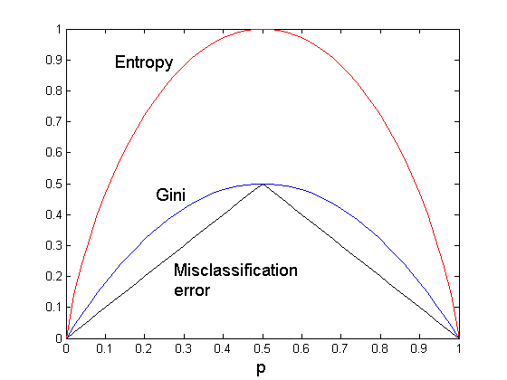
Comparison among Splitting Criteria
For a 2-class problem:

Slide 51
Tree Induction
Greedy strategy.
Split the records based on an attribute test that optimizes certain criterion.
Issues
Determine how to split the records
How to specify the attribute test condition?
How to determine the best split?
Determine when to stop splitting

Slide 52
Stopping Criteria for Tree Induction
Stop expanding a node when all the records belong to the same class
Stop expanding a node when all the records have similar attribute values
Early termination (to be discussed later)

Slide 53
Example: C4.5
Simple depth-first construction.
Uses Information Gain
Sorts Continuous Attributes at each node.
Needs entire data to fit in memory.
Unsuitable for Large Datasets.
Needs out-of-core sorting.
You can download the software from: http://www.cse.unsw.edu.au/~quinlan/c4.5r8.tar.gz

Slide 54
3. Overfitting
Discussed in a separate slide show!

Slide 55
4. Other Issues
Data Fragmentation
Search Strategy
Decision Boundaries of Decision Tree Models
Oblique Decision Trees

Slide 56
Data Fragmentation
Number of instances gets smaller as you traverse down the tree
Number of instances at the leaf nodes could be too small to make any statistically significant decision ➔ increases the danger of overfitting

Slide 57
Search Strategy
Finding an optimal decision tree is NP-hard
The algorithm presented so far uses a greedy, top-down, recursive partitioning strategy to induce a reasonable solution
Other strategies?
Bottom-up
Bi-directional

Slide 58
Decision Boundary
Border line between two neighboring regions of different classes is known as decision boundary
Decision boundary is parallel to axes because test condition involves a single attribute at-a-time

Slide 59
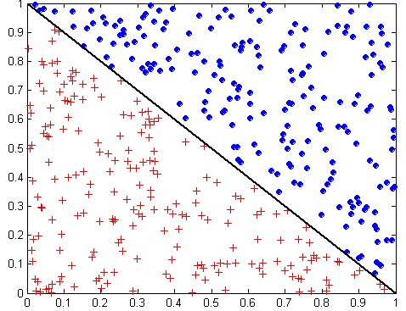
Oblique Decision Trees
x + y < 1
Class = +
Class =
Test condition may involve multiple attributes
More expressive representation
Finding optimal test condition is computationally expensive

Slide 60
5. Advantages Decision Tree Based Classification
Inexpensive to construct
Extremely fast at classifying unknown records
Easy to interpret for small-sized trees; strategy understandable to domain expert
Okay for noisy data
Can handle both continuous and symbolic attributes
Useful for exploratory data analysis
Accuracy is comparable to other classification techniques for many simple data sets
Decent average performance over many datasets
Can handle multi-modal class distributions
Kind of a standard—if you want to show that your “new” classification technique really “improves the world” → compare its performance against decision trees (e.g. C 5.0) using 10-fold cross-validation
Does not need distance functions; only the order of attribute values is important for classification: 0.1,0.2,0.3 and 0.331,0.332, and 0.333 is the same for a decision tree learner.

Slide 61
Disadvantages Decision Tree Based Classification
Relies on rectangular approximation that might not be good for some dataset
Selecting good learning algorithm parameters (e.g. degree of pruning) is non-trivial; however, some of the competing methods have worth parameter selection problems
Ensemble techniques, neural networks, support vector machines, and sometimes kNN, might obtain higher accuracies for a specific dataset.

Slide 62
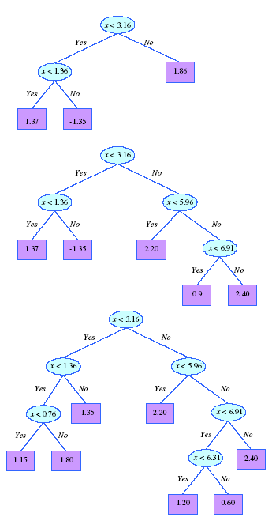
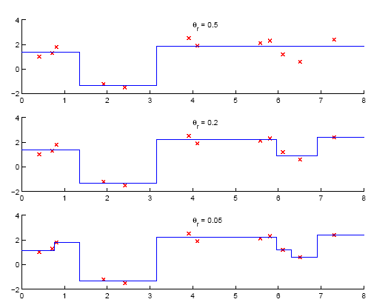
Not covered in 2022
6. Regression Trees

Slide 63
Summary Regression Trees
Not in textbook!
Regression trees work as decision trees except
Leafs carry numbers which predict the output variable instead of class label
If a leaf is created the average value of the dependent variables of the examples associated with the leaf node is used as the prediction of the leaf node.
Instead of entropy/purity the squared prediction error serves as the performance measure.
Tests that reduce the squared prediction error the most are selected as node test; test conditions have the form y>threshold where y is an independent variable of the prediction problem.
Instead of using the majority class, leaf labels are generated by averaging over the values of the dependent variable of the examples that are associated with the particular class node
Like decision trees, regression tree employ rectangular tessellations with a fixed number being associated with each rectangle; the number is the output for the inputs which lie inside the rectangle.
In contrast to ordinary regression that performs curve fitting, regression tries use averaging with respect to the output variable when making predictions; the output for inputs of a particular patch is constant.

Slide 64
7. Model Evaluation
Problems of Model Performance Evaluation
1. What performance metrics do we use to evaluate classification models?
2. How to obtain reliable estimates?
http://en.wikipedia.org/wiki/Cross-validation_(statistics)
the “gold standard” to determine accuracy is to use 10-fold cross validation repeated 10 times
Alternatively, class stratified cross validation is frequently used

Slide 65
N-Fold Cross Validation
10-fold cross validation is the most popular technique to evaluate classifiers based on a performance metric (e.g. accuracy)
Leave one out and stratified cross validation also has some popularity
Cross validation is usually performed class stratified (frequencies of examples of a particular class are approximately the same in each fold).
Example should be assigned to folds randomly (if not → cheating!)
Accuracy:= % of testing examples classified correctly
Example: 3-fold Cross-validation; examples of the dataset are subdivided into 3 joints sets (preserving class frequencies); then training/test-set pairs are constructed as follows:
1
2
1
3
2
3
Training:
3
2
1
Testing:

Slide 66
Metrics for Performance Evaluation
Focus on the predictive capability of a model
Rather than how fast it takes to classify or build models, scalability, etc.
Confusion Matrix:
Important: If there are problems with obtaining
a “good” classifier: inspect the confusion matrix!
 | PREDICTED CLASS
ACTUAL CLASS |  | Class=Yes | Class=No
 | Class=Yes | a | b
 | Class=No | c | d
a: TP (true positive)
b: FN (false negative)
c: FP (false positive)
d: TN (true negative)

Slide 67
News Nov. 11, 2022
Task4 is an individual task; start working on Task4 soon; there will be a Task4 Q&A next Friday; please send any questions/doubts you have to Mahin by Th., Nov. 17 at noon!
Task5, in which you review a paper, has been posted; Task5 is a group task and we retain the groups from Task3! Task5 will be discussed in the class next Friday.
The final exam has been scheduled in S 105 for Friday, December 9, 2p; it will take approx. 2 hours.
Today’s background: Field in Oklahoma.
Today’s Schedule:
Model Evaluation
Group H GHC Presentation
Support Vector Machines
Break
Maybe, k-nearest neighbor classifiers
Association Analysis centering on Apriori

Slide 68
Confusion Matrix

Slide 69
Metrics for Performance Evaluation…
Most widely-used metric:
 | PREDICTED CLASS
ACTUAL CLASS |  | Class=Yes | Class=No
 | Class=Yes | a (TP) | b (FN)
 | Class=No | c (FP) | d (TN)

Slide 70
Cost-Sensitive Measures
 | PREDICTED CLASS
ACTUAL CLASS |  | Class=Yes | Class=No
 | Class=Yes | a=6 | b=6
 | Class=No | c=0 | d=6
Precision: The classifier predict class C; how often is this decision correct?
Recall: The correct class is C; how often does the classifier predict class C correctly?
F-measure somewhat combines recall and precision using harmonic mean

Slide 71
Confusion Matrix

Slide 72
Another Example
Difference Between Precision and Recall
Assume we have a search engine with assigns a relevance value r to each document and then returns all web documents whose relevance threshold is above a user-defined relevance threshold θ. Moreover, we assume for the particular web search, we conduct, there are 16 relevant documents.
Case 1: we use θ=0.6 and the search returns 5 documents with 4 of those documents are being relevant; in this case we receive: precision: 0.8 and recall=0.25.
Case 2: we use a lower threshold of θ=0.4 and in this case we the search returns 24 documents with 12 being relevant; in this case, we receive: precision=0.5 and recall=0.75.
The example shows that the classification algorithm performance can be tweaked by choosing an appropriate threshold which considers the different cost of false positives and false negatives θ; e.g. if the cost of false negatives is higher than those of false positives, we tend to use lower thresholds to miss fewer relevant documents
Costs in the example:
FP: Cost of having to read irrelevant document
FN: Cost of not missing a relevant document

Slide 73
Model Evaluation
Metrics for Performance Evaluation
How to evaluate the performance of a model?
Methods for Performance Evaluation
How to obtain reliable estimates?
Methods for Model Comparison
How to compare the relative performance among competing models?

Slide 74
Test of Significance
Given two models:
Model M1: accuracy = 85%, tested on 30 instances
Model M2: accuracy = 75%, tested on 5000 instances
Test we run independently (“unpaired”)
Can we say M1 is better than M2?
How much confidence can we place on accuracy of M1 and M2?
Can the difference in performance measure be explained as a result of random fluctuations in the test set?

Slide 75
Confidence Interval for Accuracy
Prediction can be regarded as a Bernoulli trial
A Bernoulli trial has 2 possible outcomes
Possible outcomes for prediction: correct or wrong
Collection of Bernoulli trials has a Binomial distribution:
x ∼ Bin(N, p) x: number of correct predictions
e.g: Toss a fair coin 50 times, how many heads would turn up? Expected number of heads = N×p = 50 × 0.5 = 25
Given x (# of correct predictions) or equivalently, acc=x/N, and N (# of test instances), Can we predict p (true accuracy of model)?

Slide 76
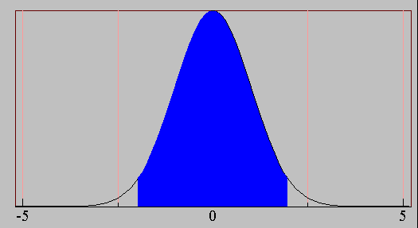
Confidence Interval for Accuracy
Area = 1 - α
For large test sets (N > 30),
acc has a normal distribution with mean p and variance p(1-p)/N
Confidence Interval for p:
Z_{α/2}
Z_{1- α /2}

Slide 77
Unpaired Testing: Comparing 2 Models
Accuracy Classifer1
acc1
Do the Blue Areas Overlap??
Z_{α/2}
Z_{1- α /2}
If the blue areas do not
overlap: one classifier is
significantly better
than the other one
1−α is degree of confidence.
acc2
Accuracy Classifer2

Slide 78
Confidence Interval for Accuracy
Consider a model that produces an accuracy of 80% when evaluated on 100 test instances:
N=100, acc = 0.8
Let 1-α = 0.95 (95% confidence)
From probability table, Z_{α/2}=1.96
1-α | Z
0.99 | 2.58
0.98 | 2.33
0.95 | 1.96
0.90 | 1.65
N | 50 | 100 | 500 | 1000 | 5000
p(lower) | 0.670 | 0.711 | 0.763 | 0.774 | 0.789
p(upper) | 0.888 | 0.866 | 0.833 | 0.824 | 0.811

Slide 79
Comparing Performance of 2 Models
Given two models, say M1 and M2, which is better?
M1 is tested on D1 (size=n1), found error rate = e₁
M2 is tested on D2 (size=n2), found error rate = e₂
Assume D1 and D2 are independent (‘unpaired’)
If n₁ and n₂ are sufficiently large, then
Approximate:

Slide 80
Comparing Performance of 2 Models
To test if performance difference is statistically significant: d = e1 – e2
d ~ N(d_{t},σ_{t}) where d_{t} is the true difference
Since D1 and D2 are independent, their variance adds up:
At (1-α) confidence level,
standard normal
distribution

Slide 81
An Illustrative Example
Given: M1: n1 = 30, e1 = 0.15 M2: n2 = 5000, e2 = 0.25
d = |e2 – e1| = 0.1 (2-sided unpaired test)
At 95% confidence level, Z_{α/2}=1.96 => Interval contains 0 => difference is not statistically significant

Slide 82
Paired t-Test
The two-sample t-test is used to determine if two population means are equal. The data may either be paired or not paired. For paired t test, the data is dependent, i.e. there is a one-to-one correspondence between the values in the two samples. For example, same subject measured before & after a process change, or same subject measured at different times. For unpaired t test, the sample sizes for the two samples may or may not be equal.

Slide 83
Comparing 2 Algorithms Using the Same Data
http://www.itl.nist.gov/div898/handbook/eda/section3/eda3672.htm (t-table)
If models are generated on the same test sets D1,D2, …, Dk (e.g., via cross-validation; k-1 “degrees of freedom”; paired t-test)
For each set: compute d_{j} = e_{1j} – e_{2j}
d_{j} has mean d and “variance” τ_{t}
Estimate:
If the confidence interval does not contain 0 you can reject the hypothesis that ‘the difference in accuracy/error rate is 0” with confidence α, and therefore infer that one of the two methods is significantly better than the other method; if it includes 0, we cannot infer that one method is significantly better.
Student’s t-distribution

Slide 84
Paired Tests --- Is One Classifier Better??
Accuracy Differences Between the Two Classifiers
Acc-dif
Z_{α/2}
Z_{1- α /2}
Key Question: Does the blue area include 0?
Yes: both classifiers are not significantly different
No: One classifier is significantly more accurate

Slide 85
Example1: Comparing Models on the same Data
2 models M1 and M2 are compared with 4-fold cross validation; M1 accomplishes accuracies of 0.84, 0.82, 0.80, 0.82 and M2 accomplishes accuracies of 0.80, 0.79, 0.75, 0.82. The average difference is 0.03 and the required confidence level is 90% (α=0.1)
2.35
Reject
Remark: If we would require 95% of confidence, we obtain
0.03±0.1089*3,182, and would not reject the hypothesis.

Slide 86
An alternative way to compute it!
skip
Compute variance for the difference in accuracy
Compute t statistics value
See if t value is in (-∞,-t_{α/2,k-1}) or (t_{α/2,k-1,}∞)
Yes, reject null hypothesis: one method is significantly better than the other method
No, no method is significantly better
t is t_{α,k-1} distributed
if the various measurements
of d_{i} are independent

Slide 87
Example1: Comparing Models on the same Data Using t-Statistic
skip
2 models M1 and M2 are compared with 4-fold cross validation; M1 accomplishes accuracies of 0.84, 0.82, 0.80, 0.82 and M2 accomplishes accuracies of 0.80, 0.79, 0.75, 0.82. The average difference is 0.03 and the required confidence level is α.
2.35<2.77<3.18➔reject at confidence level 90%, but do not reject at level 95%

Slide 88
Problems with the student t-test for cross validation
Type 1 Error: probability of rejecting the null hypothesis, although it is true; in our case, the type 1 error is the probability of concluding one classifier is better, although this is not the case.
Type 2 Error: Null hypothesis is not rejected, although it should be rejected
In general, if (training set, test set pairs) are independent, the type 1 error of the student t-test is α.
In the case of n-fold cross validation the training sets are overlapping and not independent, and therefore the type 1 error is significantly larger than α for n-fold cross validation, due to the fact that the variance of accuracy differences between classifiers is underestimated by the student t-test approach.
Consequently, modifications of the student t-test have been proposed, e.g. [Bouckaert&Frank], for n-fold cross validation.

Slide 89
A modified t-statistics for r runs of k-fold cross-validation [Bouckaert&Frank]
Compute variance for r runs of k-fold cross-validation
Compute modified t statistics value
See if t value is in (-∞,-t_{α/2,k-1}) or (t_{α/2,k-1,}∞):
Yes, reject null hypothesis: one method is significantly better than the other method
No, no method is significantly better
Variance of t-variable is increased
considering the fact that test- and
training sets overlap; n2/n1 is
the ratio of test examples over
training examples.
http://www.cs.waikato.ac.nz/~ml/publications/2004/bouckaert-frank.pdf

Slide 90
[Bouckaert&Frank] for Example1
Example 1: 1 run of 4-fold cross-validation
Sqrt(4)=2 is used in
the standard t-test whereas
here we use a smaller number
which corresponds to using
a higher variance estimate.
Remark: was 2.77 for
original t-test

