Slide 1
Data Mining
Cluster Analysis: Advanced Concepts and Algorithms
Lecture Notes for Chapter 8
Introduction to Data Mining
by
Tan, Steinbach, Kumar
Introduction to Data Mining, 2nd Edition Tan, Steinbach, Karpatne, Kumar

Slide 2
News November 28, 2023
Final Exam has been scheduled for Thursday, December 7, 11a and will take 105 minutes. I detailed review list will be posted in 2-3 days on the course website.
Dr. Eick's office hours this week are: WE 9:10-10a and TH 8:50-10a!
Task5 has been posted Sunday morning and is due Saturday, December 2, 11:59p.
Today’s topics
  Advanced Clustering
  GHC Presentation Group M
  Maybe, Spatial Data Mining (our last topic)

Slide 3
Outline: Advanced Clustering
Advanced Prototype-based Clustering covered today
  Fuzzy c-means
  Mixture Model Clustering (EM)
Subspace Clustering: CLIQUE covered in 2023
Clustering with Density Functions: DENCLUE
Shared Nearest Neighbor (SNN) not covered in 2023

Slide 4
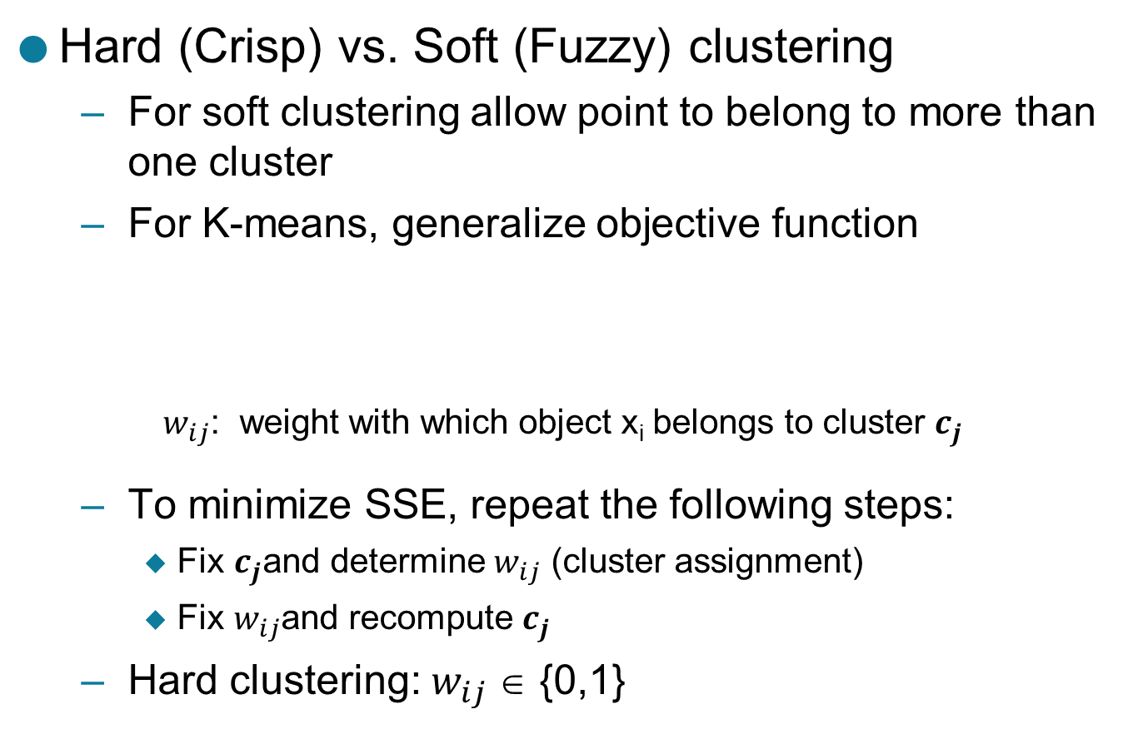
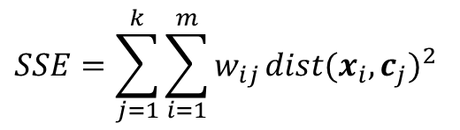
1. Hard (Crisp) vs Soft (Fuzzy) Clustering
Hard (Crisp) vs. Soft (Fuzzy) clustering
  For soft clustering allow point to belong to more than one cluster
  For K-means, generalize objective function
    $w_{ij}$: weight with which object x_{i} belongs to cluster $c_{j}$
  To minimize SSE, repeat the following steps:
    Fix $c_{j}$and determine $w_{ij}$ (cluster assignment)
    Fix $w_{ij}$and recompute $c_{j}$
  Hard clustering: $w_{ij}$∈ {0,1}
$$SSE=\sum_{j=1}^{k}{\sum_{i=1}^{m}{w_{ij}}}{dist(x_{i},c_{j})}^{2}$$

Slide 5

Soft (Fuzzy) Clustering: Estimating Weights
c₁
x
c₂
1
2.5
5
$$SSE=w_{x1}{\left(2.5−1\right)}^{2}+w_{x2}{\left(5−2.5\right)}^{2}$$
$={2.25w}_{x1}+{6.25w}_{x2}$
SSE(x) has a minimum value of 2.25 when w_{x1} = 1, w_{x2} = 0

Slide 6
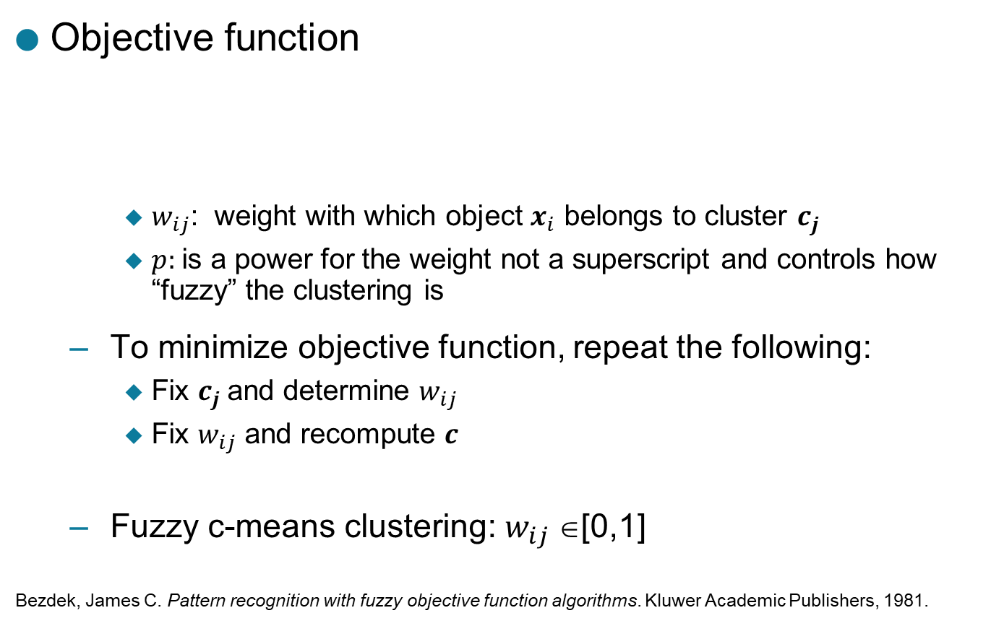
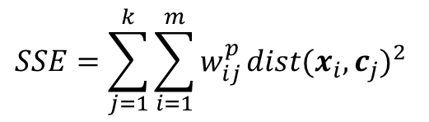
Fuzzy C-means
p: fuzzifier (p > 1)
Objective function
    $w_{ij}$: weight with which object $x_{i}$ belongs to cluster $c_{j}$
    $p:$is a power for the weight not a superscript and controls how “fuzzy” the clustering is
  To minimize objective function, repeat the following:
    Fix $c_{j}$and determine $w_{ij}$
    Fix $w_{ij}$ and recompute $c$
  Fuzzy c-means clustering: $w_{ij}$∈[0,1]
  Bezdek, James C. Pattern recognition with fuzzy objective function algorithms. Kluwer Academic Publishers, 1981.
$$SSE=\sum_{j=1}^{k}{\sum_{i=1}^{m}{w_{ij}^{p}}}{dist(x_{i},c_{j})}^{2}$$

Slide 7

Fuzzy C-means
c₁
x
c₂
1
2.5
5
$$SSE=w_{x1}^{2}{\left(2.5−1\right)}^{2}+w_{x2}^{2}{\left(5−2.5\right)}^{2}$$
$={2.25w}_{x1}^{2}+{6.25w}_{x2}^{2}$
Subject to: w_{x1}+w_{x2}=1
Remark: Hyperparameter p is assumed
to be 2 in this example
SSE(x) has a minimum value of 1.654 when w_{x1} = 0.74, w_{x2} = 0.26

Slide 8
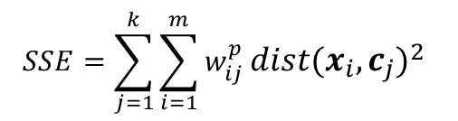
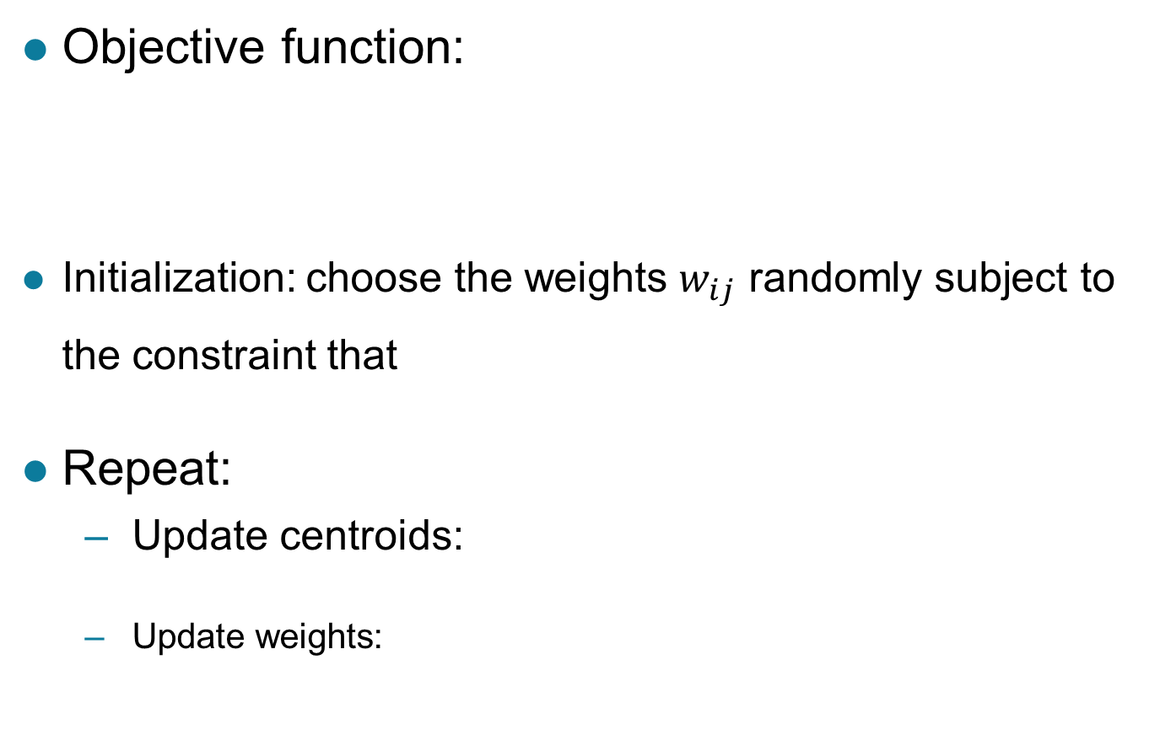

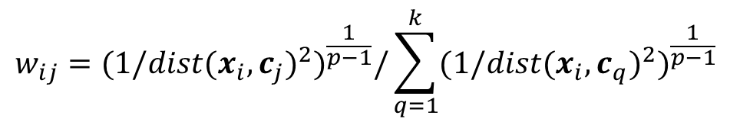
Fuzzy C-means
Objective function:
Initialization: choose the weights $w_{ij}$ randomly subject to the constraint that
Repeat:
  Update centroids:
  Update weights:
p: fuzzifier (p > 1)
$$SSE=\sum_{j=1}^{k}{\sum_{i=1}^{m}{w_{ij}^{p}}}{dist(x_{i},c_{j})}^{2}$$
$$c_{j}=\sum_{i=1}^{m}{w_{ij}x_{i} /}\sum_{i=1}^{m}{w_{ij}}$$
$$w_{ij}={{(1/dist(x_{i},c_{j})}^{2})}^{\frac{1}{p−1}}/\sum_{q=1}^{k}{{{(1/dist(x_{i},c_{q})}^{2})}^{\frac{1}{p−1}}}$$

Slide 9
Fuzzy K-means Applied to Sample Data

Slide 10
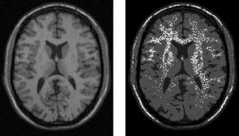
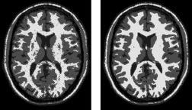
An Example Application: Image Segmentation
Modified versions of fuzzy c-means have been used for image segmentation
  Especially fMRI images (functional magnetic resonance images)
References
  Gong, Maoguo, Yan Liang, Jiao Shi, Wenping Ma, and Jingjing Ma. "Fuzzy c-means clustering with local information and kernel metric for image segmentation." Image Processing, IEEE Transactions on 22, no. 2 (2013): 573-584.
  From left to right: original images, fuzzy c-means, EM, BCFCM
  Ahmed, Mohamed N., Sameh M. Yamany, Nevin Mohamed, Aly A. Farag, and Thomas Moriarty. "A modified fuzzy c-means algorithm for bias field estimation and segmentation of MRI data." Medical Imaging, IEEE Transactions on 21, no. 3 (2002): 193-199.

Slide 11
Clustering Using Mixture Models
Idea is to model the set of data points as arising from a mixture of distributions
  Typically, normal (Gaussian) distribution is used
  But other distributions have been very profitably used
Clusters are found by estimating the parameters of the statistical distributions using the Expectation-Maximization (EM) algorithm
    k-means is a special case of this approach
    Provides a compact representation of clusters
    The probabilities with which point belongs to each cluster provide a functionality similar to fuzzy clustering.

Slide 12
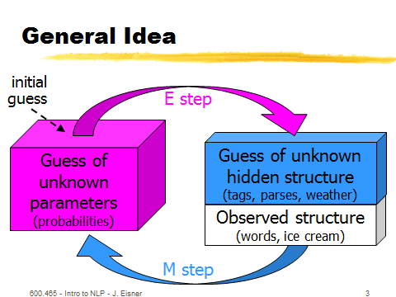
General Idea EM Algorithm
EM Algorithm
Gaussian Mixture Models:
http://pypr.sourceforge.net/mog.html http://scikit-learn.org/stable/modules/mixture.html
Works like K-means

Slide 13
Parameter of K-Means/GMM Models
K-means models are characterized by k centroids
EM/Gaussian Mixture Models are characterized by k Gaussian with each Gaussian characterized by:
  Weight of the particular Gaussian; sometime called mixing coefficient
  Mean value
  Covariance Matrix
EM-style algorithms:
  E-Step: Assign objects to clusters (deterministic in the case of K-means; probabilistic in the case of EM)
  M-Step: updates the model parameters (e.g. centroids in the case of K-means; the mixture model parameter in the case of EM)
  Repeat sequences of E-M steps until there is some convergence
  Start with an initial assignment of objects to clusters

Slide 14
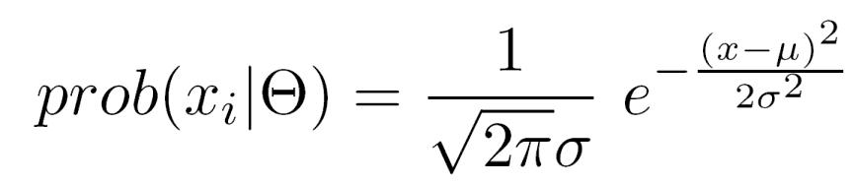
Probabilistic Clustering: Example
Informal example: consider
modeling the points that
generate the following
histogram.
Looks like a combination of two
normal (Gaussian) distributions
Suppose we can estimate the
mean and standard deviation of each normal distribution.
  This completely describes the two clusters
  We can compute the probabilities with which each point belongs to each cluster
  Can assign each point to the
  cluster (distribution) for which it
  is most probable.

Slide 15
Probabilistic Clustering: EM Algorithm
Initialize the parameters
Repeat
  For each point, compute its probability under each distribution
  Using these probabilities, update the parameters of each distribution
Until there is no change
Very similar to of K-means
Consists of assignment and update steps
Can use random initialization
  Problem of local minima
For normal distributions, typically use K-means to initialize
If using normal distributions, can find elliptical as well as spherical shapes.

Slide 16
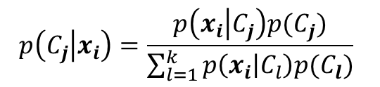

Probabilistic Clustering: Updating Centroids
Update formula for weights assuming an estimate for statistical parameters
Very similar to the fuzzy k-means formula
  Weights are probabilities
  Weights are not raised to a power
  Probabilities calculated using Bayes rule:
Need to assign weights to each cluster
  Weights may not be equal
  Similar to prior probabilities
  Can be estimated:
$$x_{i} is a data point$$
$$C_{j} is a cluster$$
$$c_{j} is a centroid$$
$$p\left(C_{j} | x_{i}\right)=\frac{p\left(x_{i} | C_{j}\right)p(C_{j})}{\sum_{l=1}^{k}{p\left(x_{i} | C_{l}\right)p(C_{l})}}$$

Slide 17
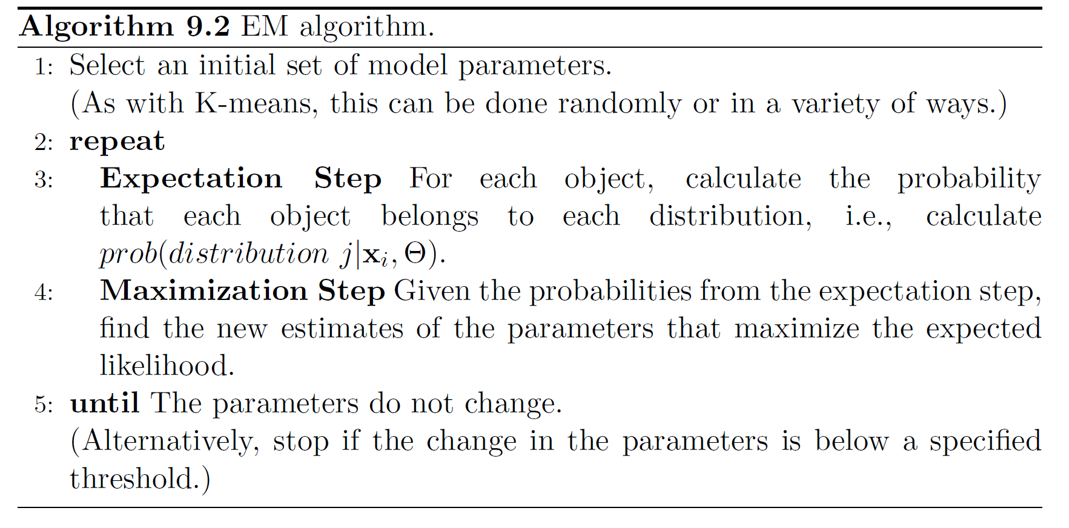
More Detailed EM Algorithm

Slide 18
Probabilistic Clustering Applied to Sample Data

Slide 19
Probabilistic Clustering: Dense and Sparse Clusters
?

Slide 20
Problems with EM
Convergence can be slow
Only guarantees finding local maxima
Makes some significant statistical assumptions
Number of parameters for Gaussian distribution grows as O(d²), d the number of dimensions
  Parameters associated with covariance matrix
  K-means only estimates cluster means, which grow as O(d)

Slide 21
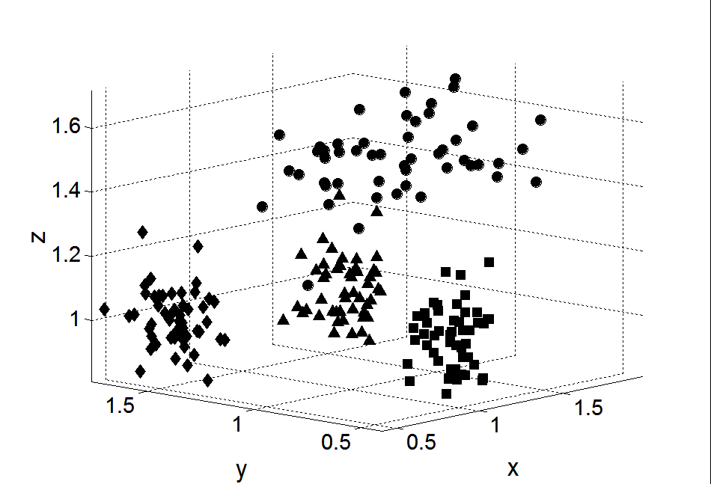
2. Subspace Clustering
Until now, we found clusters by considering all of the attributes
Some clusters may involve only a subset of attributes, i.e., subspaces of the data

Slide 22
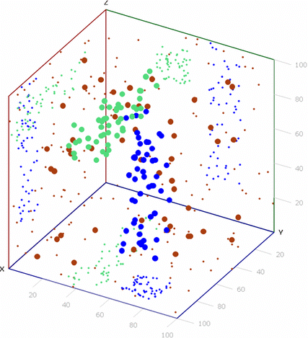
Clusters in subspaces

Slide 23
Clique – A Subspace Clustering Algorithm
A grid-based clustering algorithm that methodically finds subspace clusters
  Partitions the data space into rectangular units of equal volume in all possible subspaces
  Measures the density of each unit by the fraction of points it contains
  A unit is dense if the fraction of overall points it contains is above a user specified threshold, τ
  A cluster is a set of contiguous (touching) dense units

Slide 24
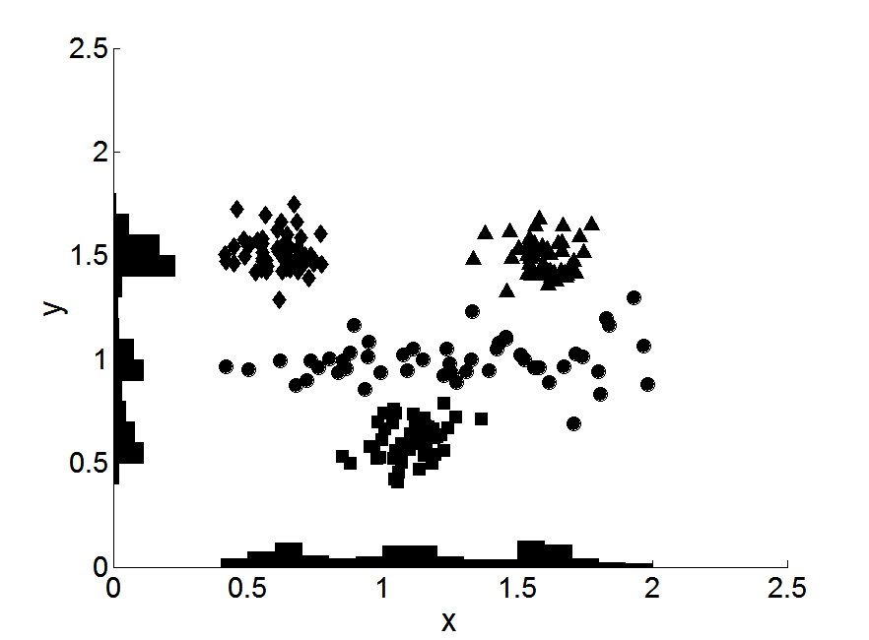
Clique Idea

Slide 25
Clique Algorithm
It is impractical to check volume units in all possible subspaces, since there is an exponential number of such units
Monotone property of density-based clusters:
  If a set of points cannot form a density based cluster in k dimensions, then the same set of points cannot form a density based cluster in all possible supersets of those dimensions
Very similar to Apriori algorithm
Can find overlapping clusters

Slide 26
Clique Algorithm

Slide 27
Limitations of Clique
Time complexity is exponential in number of dimensions
  Especially if “too many” dense units are generated at lower stages
May fail if clusters are of widely differing densities, since the threshold is fixed
  Determining appropriate threshold and unit interval length can be challenging

Slide 28
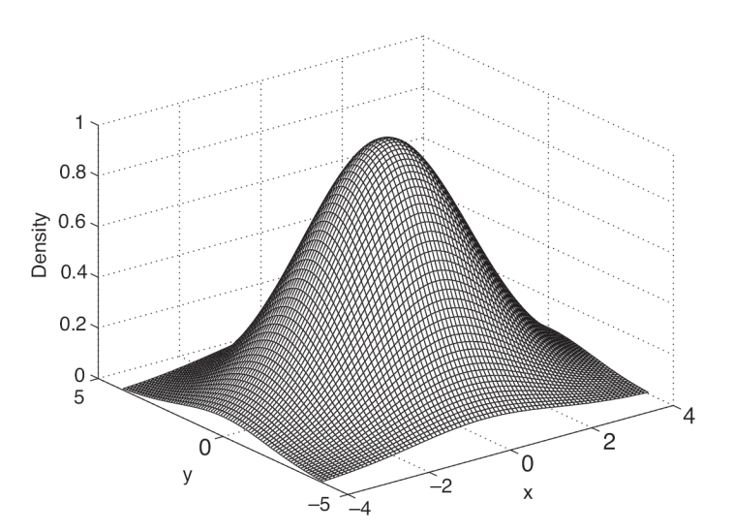
3. Denclue (DENsity CLUstering)
Based on the notion of kernel-density estimation
  Contribution of each point to the density is given by an influence or kernel function
  Overall density is the sum of the contributions of all points
Formula and plot of Gaussian Kernel

Slide 29
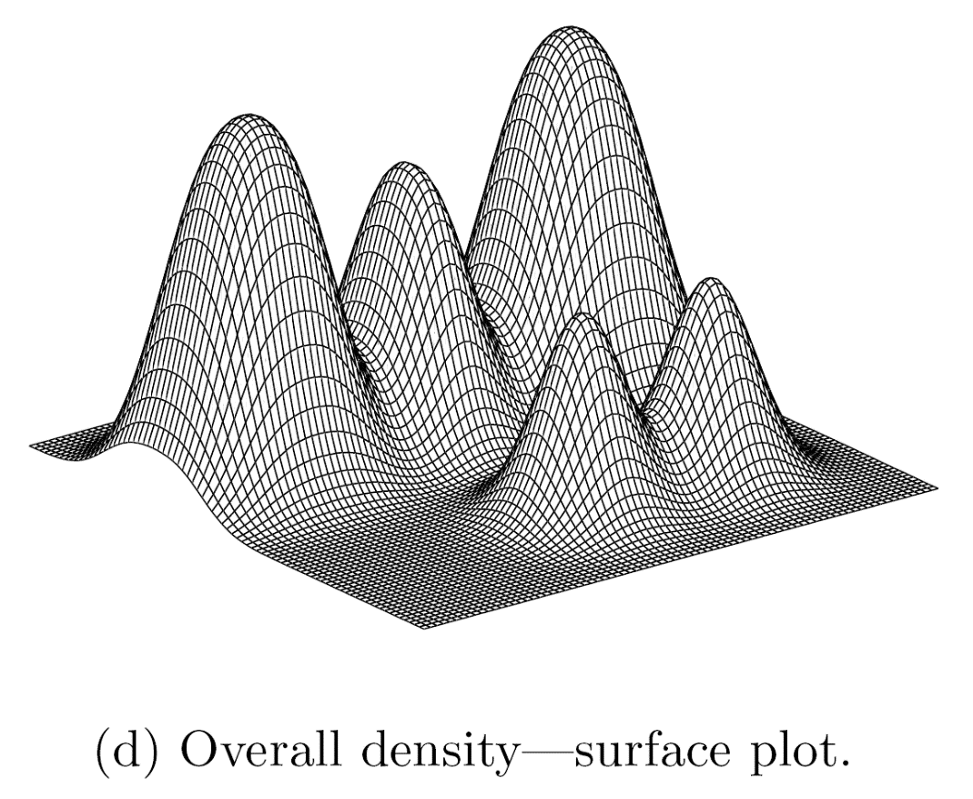
Example of Density from Gaussian Kernel

Slide 30
DENCLUE Algorithm
Find the density function
Identify local maxima (density attractors)
Assign each point to the density attractor
  Follow direction of maximum increase in density
Define clusters as groups consisting of points associated with density attractor
Discard clusters whose density attractor has a density less than a user specified minimum, ξ
Combine clusters connected by paths of points that are connected by points with density above ξ

Slide 31
4. Graph-Based Clustering: SNN Approach
Might be skipped
Due to the lack of time!
Shared Nearest Neighbor (SNN) graph: the weight of an edge is the number of shared neighbors between vertices given that the vertices are connected
i
j
i
j
4
If two points are similar to many of the same points, then they are likely similar to one another, even if a direct measurement of similarity does not indicate this.

Slide 32
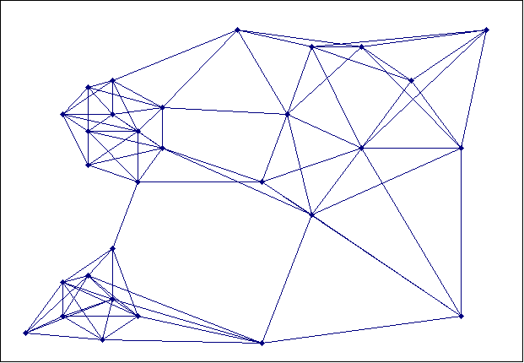
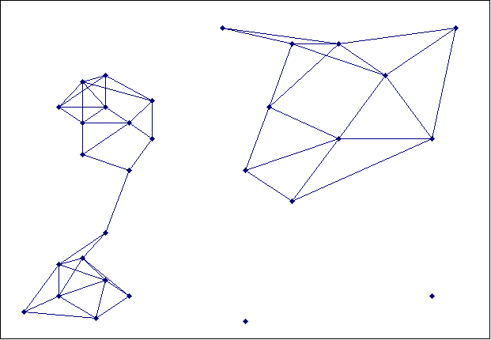
Creating the SNN Graph
Sparse Graph
Link weights are similarities between neighboring points
Shared Near Neighbor Graph
Link weights are number of Shared Nearest Neighbors

Slide 33
SNN Density-Based Clustering
Combines:
  Graph based clustering (similarity definition based on number of shared nearest neighbors)
  Density based clustering (DBScan-like approach)
SNN density measures whether a point is surrounded by similar points (with respect to its nearest neighbors)

Slide 34
SNN Clustering Algorithm
Compute the similarity matrix
This corresponds to a similarity graph with data points for nodes and edges whose weights are the similarities between data points
Sparsify the similarity matrix by keeping only the k most similar neighbors
This corresponds to only keeping the k strongest links of the similarity graph
Construct the shared nearest neighbor graph from the sparsified similarity matrix.
At this point, we could apply a similarity threshold and find the connected components to obtain the clusters (Jarvis-Patrick algorithm)
Find the SNN density of each Point.
Using a user specified parameters, Eps, find the number points that have an SNN similarity of Eps or greater to each point. This is the SNN density of the point

Slide 35
SNN Clustering Algorithm …
Find the core points
Using a user specified parameter, MinPts, find the core points, i.e., all points that have an SNN density greater than MinPts
Form clusters from the core points
If two core points are within a “radius”, Eps, of each other they are placed in the same cluster
Discard all noise points
All non-core points that are not within a “radius” of Eps of a core point are discarded
Assign all non-noise, non-core points to clusters
This can be done by assigning such points to the nearest core point
(Note that steps 4-8 are DBSCAN)

Slide 36
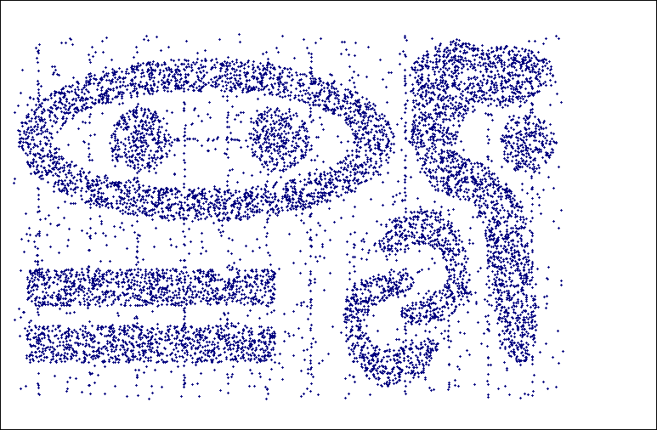
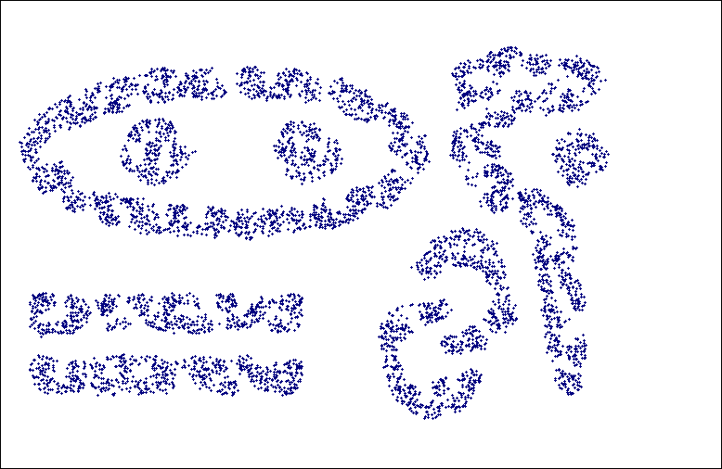
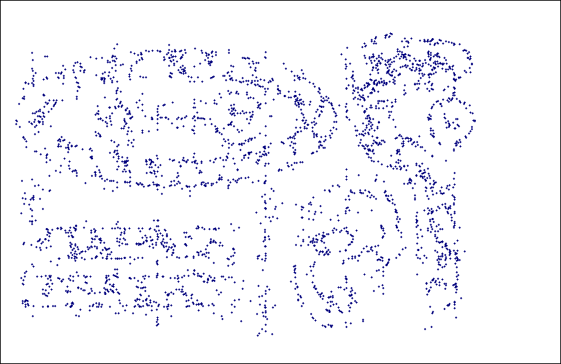
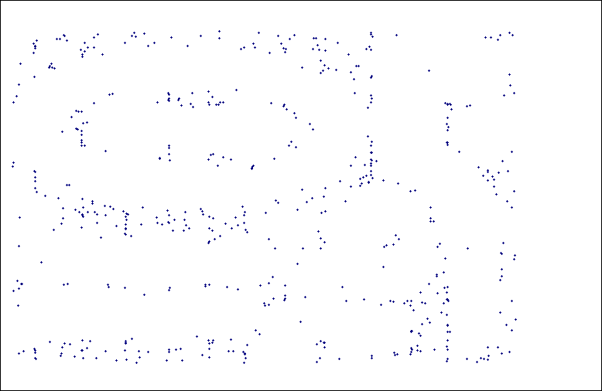
SNN Density
a) All Points b) High SNN Density
c) Medium SNN Density d) Low SNN Density

Slide 37
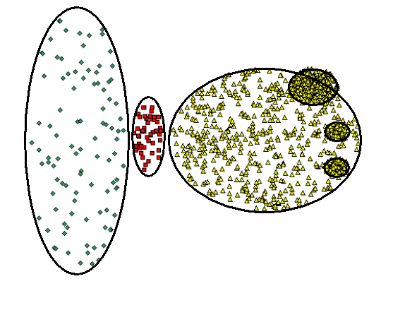
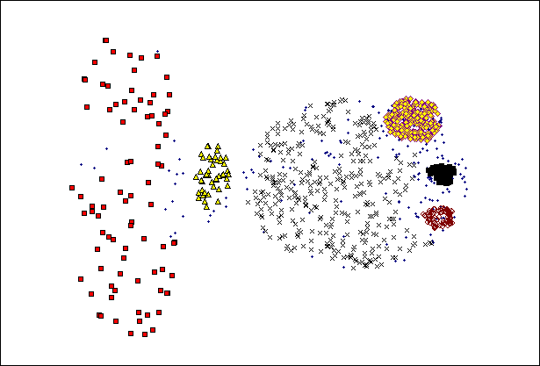
SNN Clustering Can Handle Differing Densities
Original Points
SNN Clustering

Slide 38
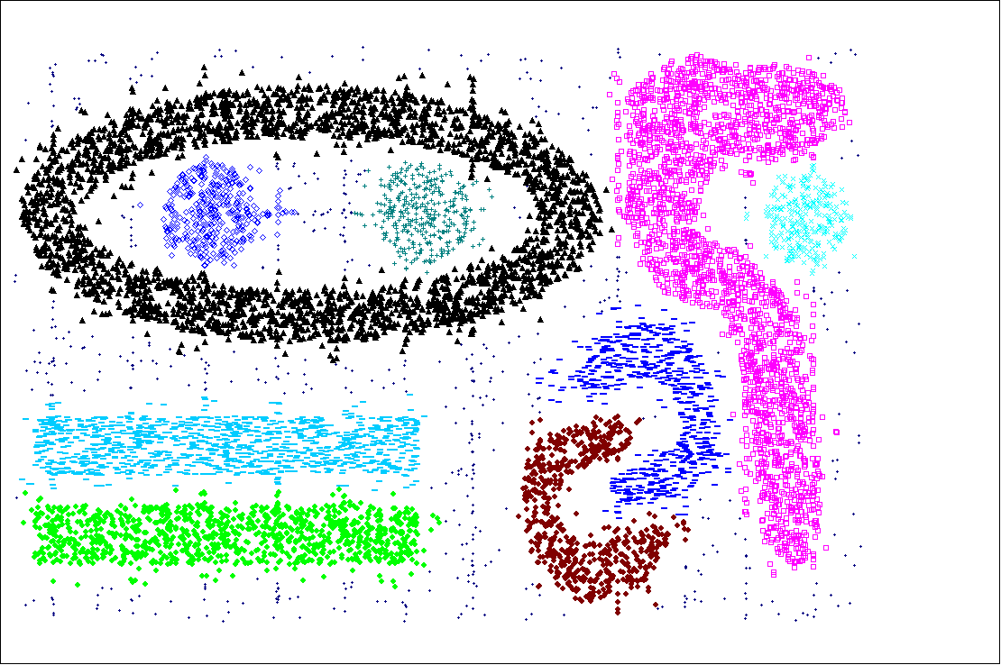
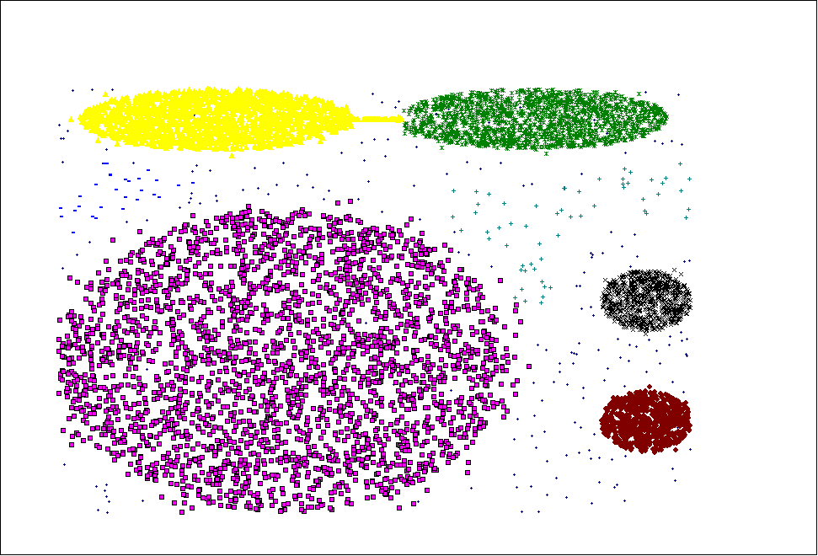
SNN Clustering Can Handle Other Difficult Situations

Slide 39
Limitations of SNN Clustering
Complexity of SNN Clustering is high
  O( n * time to find numbers of neighbor within Eps)
  In worst case, this is O(n²)
  For lower dimensions, there are more efficient ways to find the nearest neighbors
    R* Tree
    k-d Trees
Parameterization is not easy

Slide 40
The last six slides might not be covered but are likely useful to study for the final exam!

Slide 41
Comparison of MIN and EM-Clustering
We assume EM clustering using the Gaussian (normal) distribution.
MIN is hierarchical, EM clustering is partitional.
Both MIN and EM clustering are complete.
MIN has a graph-based (contiguity-based) notion of a cluster, while EM clustering has a prototype (or model-based) notion of a cluster.
MIN will not be able to distinguish poorly separated clusters, but EM can manage this in many situations.
MIN can find clusters of different shapes and sizes; EM clustering prefers globular clusters and can have trouble with clusters of different sizes.
Min has trouble with clusters of different densities, while EM can often handle this.
Neither MIN nor EM clustering finds subspace clusters.

Slide 42
Comparison of MIN and EM-Clustering
MIN can handle outliers, but noise can join clusters; EM clustering can tolerate noise, but can be strongly affected by outliers.
EM can only be applied to data for which a centroid is meaningful; MIN only requires a meaningful definition of proximity.
EM will have trouble as dimensionality increases and the number of its parameters (the number of entries in the covariance matrix) increases as the square of the number of dimensions; MIN can work well with a suitable definition of proximity.
EM is designed for Euclidean data, although versions of EM clustering have been developed for other types of data. MIN is shielded from the data type by the fact that it uses a similarity matrix.
MIN makes no distribution assumptions; the version of EM we are considering assumes Gaussian distributions.

Slide 43
Comparison of MIN and EM-Clustering
EM has an O(n) time complexity; MIN is O(n²log(n)).
Because of random initialization, the clusters found by EM can vary from one run to another; MIN produces the same clusters unless there are ties in the similarity matrix.
Neither MIN nor EM automatically determine the number of clusters.
MIN does not have any user-specified parameters; EM has the number of clusters and possibly the weights of the clusters.
EM clustering can be viewed as an optimization problem; MIN uses a graph model of the data.
Neither EM or MIN are order dependent.

Slide 44
Comparison of DBSCAN and K-means
Both are partitional.
K-means is complete; DBSCAN is not.
K-means has a prototype-based notion of a cluster; DB uses a density-based notion.
K-means can find clusters that are not well-separated. DBSCAN will merge clusters that touch.
DBSCAN handles clusters of different shapes and sizes; K-means prefers globular clusters.

Slide 45
Comparison of DBSCAN and K-means
DBSCAN can handle noise and outliers; K-means performs poorly in the presence of outliers
K-means can only be applied to data for which a centroid is meaningful; DBSCAN requires a meaningful definition of density
DBSCAN works poorly on high-dimensional data; K-means works well for some types of high-dimensional data
Both techniques were designed for Euclidean data, but extended to other types of data
DBSCAN makes no distribution assumptions; K-means is really assuming spherical Gaussian distributions

Slide 46
Comparison of DBSCAN and K-means
K-means has an O(n) time complexity; DBSCAN is O(n^2)
Because of random initialization, the clusters found by K-means can vary from one run to another; DBSCAN always produces the same clusters
DBSCAN automatically determines the number of clusters; K-means does not
K-means has only one parameter, DBSCAN has two.
K-means clustering can be viewed as an optimization problem and as a special case of EM clustering; DBSCAN is not based on a formal model.

