Slide 1
A Short Tutorial on R
Arko Barman with modification by C.F. Eick
COSC 4335 Data Mining
Spring 2015

Slide 2
R… what is that?
Free, open source statistical analysis software
Competitor to commercial softwares like MATLAB and SAS – none of which are free
Need to install only basic functionalities
Install packages as and when needed – somewhat like Python
Excellent visualization features!

Slide 3
Let’s get started!
Link for installation: http://cran.r-project.org/mirrors.html
Choose a mirror link to download and install
Latest version is R-3.1.1
Choose default options for installation
Don’t worry about customizing startup options!
Just click ‘Okay’, ‘Next’ and ‘Finish’!

Slide 4
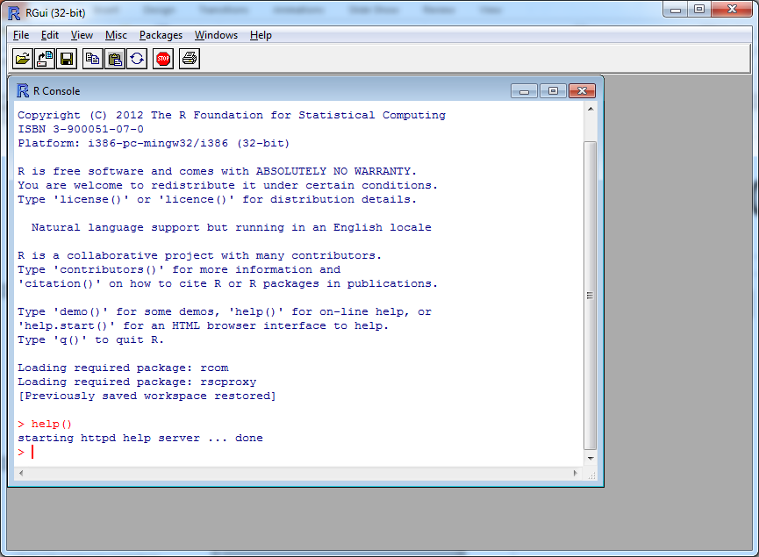
How R looks…
Command line

Slide 5
Things to remember
R is an interpreter
Case sensitive
Comment lines start with #
Variable names can be alphanumeric, can contain ‘.’ and ‘_’
Variable names must start with a letter or ‘.’
Names starting with ‘.’ cannot have a digit as the second character
To use an additional package, use library(<name>) e.g. library(matrixStats)
Package you are trying to use must be installed before using

Slide 6
Things to remember
Variable declaration not needed (like MATLAB)
Variables are also called objects
Commands are separated by ‘;’ or newline
If a command is not complete at the end of a newline, prompt shows ‘+’
Use command q() to quit
For help on a command, use help(<command>) or ?<command name>
For examples using a command, use example(<command>)

Slide 7
Trying out…
setwd(<folder_name>)
source(<script_file>) – runs the R script <script_file>
sink(<output_file>) – saves outputs to <output_file>
sink() – restores output to console
ls() – prints list of objects in workspace
rm(<object1>, <object2>, … ) – removes objects from workspace

Slide 8
Other things to know!
Writing scripts - use Notepad/Notepad++ and save with extension .r OR use Rcmdr package
Installing a package - Packages>Install package(s)… choose the package you want to install

Slide 9
Vectors in R
assign("x", c(10.4, 5.6, 3.1, 6.4, 21.7))
x
c() concatenates vectors/numbers end to end
x<- c(10.4, 5.6, 3.1, 6.4, 21.7)
x
y<-c(x,0,x)
y
v<-2*x+y+1
v
min(v)
max(y)
range(x)
cat(v)

Slide 10
Sequences in R
v<-c(1:10)
w<-1:10
x<-2*1:10 (Note operator precedence here)
y<-seq(-4,7)
y<-seq(-4,7,2)

Slide 11
Arrays and Matrices
x <- array(1:20, dim=c(4,5))
X
i <- array(c(1:3,3:1), dim=c(3,2))
i
x[i] <- 0
#(1,3), (2,2), (3,1 are set to 0)
x
xy <- x %o% y #(outer product of x and y)
xy
z <- aperm(xy, c(2,1)) (Permutations of an array xy)
z

Slide 12
Arrays and Matrices
Number of rows
seq1<-seq(1:6)
mat1<-matrix(seq1,2)
mat1
mat2<-matrix(seq1,2,byrow=T)
mat2
http://www.ats.ucla.edu/stat/r/library/matrix_alg.htm
General use: matrix(data,nrow,ncol,byrow)
Notice that ncol is redundant and optional!

Slide 13
Arrays and Matrices
Number of rows
seq1<-seq(1:6)
mat1<-matrix(seq1,2)
mat1
mat2<-matrix(seq1,2,byrow=T)
mat2
http://www.ats.ucla.edu/stat/r/library/matrix_alg.htm
General use: matrix(data,nrow,ncol,byrow)
Notice that ncol is redundant and optional!

Slide 14
Arrays and Matrices
Number of rows
> x*c(3,4,0,1,2)
[,1] [,2] [,3] [,4] [,5]
[1,] 3 10 9 0 68
[2,] 8 18 20 14 0
[3,] 0 28 33 30 19
[4,] 4 0 48 48 40
> x
[,1] [,2] [,3] [,4] [,5]
[1,] 1 5 9 13 17
[2,] 2 6 10 14 18
[3,] 3 7 11 15 19
[4,] 4 8 12 16 20
> x%*%c(3,4,0,1,2) #Matrix Multiplication
[,1]
[1,] 70
[2,] 80
[3,] 90
[4,] 100

Slide 15
Data Frames
Efficient way to store and manipulate tables
e.g.
v1 = c(2, 3, 5)
v2 = c("aa", "bb", "cc")
v3 = c(TRUE, FALSE, TRUE)
df = data.frame(v1, v2, v3)
df

Slide 16
Factor
A vector of categorical data
e.g.
> data = c(1,2,2,3,1,2,3,3,1,2,3,3,1)
> fdata = factor(data)
> fdata
[1] 1 2 2 3 1 2 3 3 1 2 3 3 1
Levels: 1 2 3

Slide 17
Importing data
Skip today!
mydata <- read.table("c:/mydata.csv", header=TRUE, sep=",", row.names="id")
Path to the file
Note the use of / instead of \
Whether or not to
treat the first row
as header
Delimiter
(default –
White space)
Row names
(optional)
http://stat.ethz.ch/R-manual/R-devel/library/utils/html/read.table.html
mydata <-read.csv(<filename>, header = TRUE, row.names = <rows>)
Commonly used for CSV files

Slide 18
Let’s import a file
Skip today!
Download the file
http://archive.ics.uci.edu/ml/machine-learning-databases/adult/adult.data
Notice that the data is in CSV format and there are no headers!
mydata<-csv.read(<path>, header = FALSE)
You can also read xls files using read.xls which is a part of gdata package!
install.packages(pkgs="gdata")
library(gdata)
data <- read.xls(<path>)
data

Slide 19
Selecting/removing columns
> mydata<-data.frame(a=1:5,b=2:6,c=c(1,1,1,3,3))
> mydata[c(-1,-2)]
c
1 1
2 1
3 1
4 3
5 3
> mydata
a b c
1 1 2 1
2 2 3 1
3 3 4 1
4 4 5 3
5 5 6 3

Slide 20
Other manipulations
Selecting observations
mySubset2<-mydata[1:5,]
mySubset2
Selecting observations based on variable values
mySubset3<-mydata[which(mydata$c==1 & mydata$a>2),]
mySubset3
To avoid using mydata$ prefix in columns
attach(mydata)
mySubset3<-mydata[which(c==1,]
mySubset3
detach(mydata)
Be careful when using multiple datasets!!!
Remember this if you use multiple datasets!!!

Slide 21
Sampling, Splitting, Subsets
mySubset4<-mydata[sample(nrow(mydata), 3),]
mySubset4
mydata1<-split(mydata,mydata$class)
mydata1
http://www.endmemo.com/program/R/split.php
Groups data of different classes together!
mySubset5<-subset(mydata,a==2 & c>0,select=c(a,c))
mySubset5
Most general form for manipulating data!
Total number of observations
Number of samples
> mydata1<-split(mydata,mydata$c)
> mydata
a b c
1 1 2 1
2 2 3 1
3 3 4 1
4 4 5 3
5 5 6 3
> mydata1
$`1`
a b c
1 1 2 1
2 2 3 1
3 3 4 1
$`3`
a b c
4 4 5 3
5 5 6 3
Good Manual on Data Import:
http://cran.r-project.org/doc/manuals/R-data.html

Slide 22
Other common operations…
merge() - used for merging two or more data frames into a single frame
cbind() – adds new column(s) to an existing data frame
rbind() – adds new row(s) to an existing data frame

Slide 23
Visualization in R
Different types of plots – helpful for data visualization and statistical analysis
Basic plot
Download ‘sampledata2’ from TA webpage>Resources
mydata<-read.csv(<path>,header=TRUE)
attach(mydata)
plot(x1,x2)

Slide 24
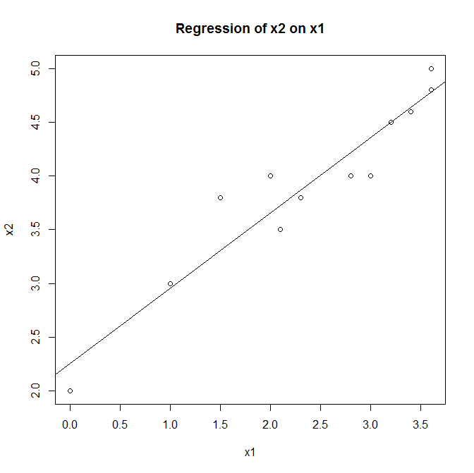
Visualization in R
abline() – adds one or more straight lines to a plot
lm() – function to fit linear regression model
> x1<-c(1:5,1:3)
> x2<-c(2,2,2,3,6,7,5,1)
> abline(lm(x2~x1))
title('Regression of x2 on
X1')
> plot(x1,x2)
> abline(lm(x2~x1))
> title('Regression of x2 on
+ x1')
> lm(x1~x2)
Coefficients:
(Intercept) x2
2.57353 0.01471
> lm(x2~x1)
Coefficients:
(Intercept) x1
3.40541 0.03604
> abline(1,2)
http://data.princeton.edu/R/linearmodels.html

Slide 25
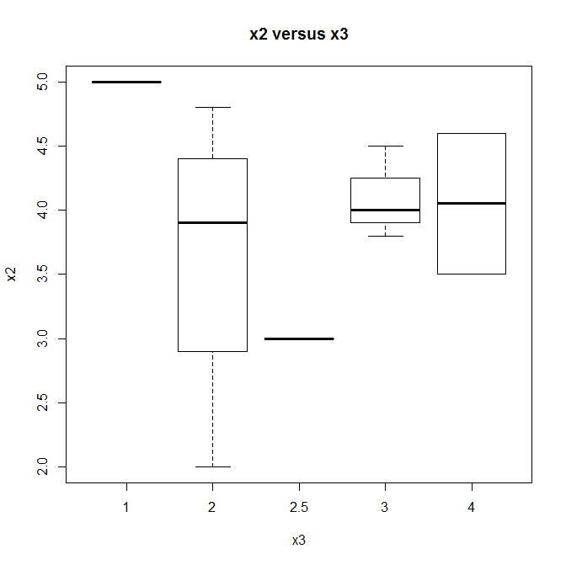
Visualization in R
Boxplot
boxplot(x2~x3,data=mydata,main="x2 versus x3", xlab="x3",ylab="x2")

Slide 26
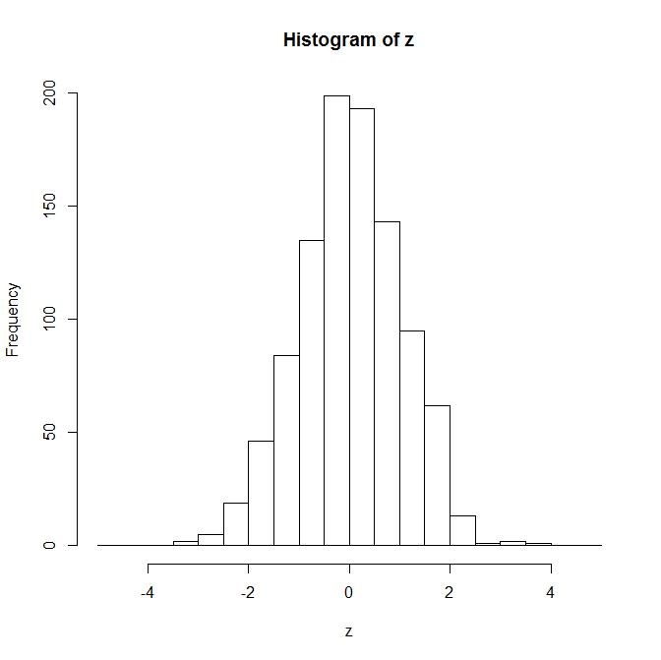
Visualization in R
Histogram
z = rnorm(1000, mean=0,sd=1)
hist (z)
hist (z, breaks = 5)
bins = seq (-5, 5, by = 0.5)
hist (z, breaks = bins)
Generate 1000 samples
of a standard normal
random variable

Slide 27
Visualization in R
scatterplot() – for 2D scatterplots
scatterplot3d() – for 3D scatterplots
plot3d() – for interactive 3D plots (rgl package)
scatter3d() – another interactive 3d plot (Rcmdr package)
dotchart() – for dot plots
lines() – draws one or more lines
pie() – for drawing pie chart
pie3d() – for drawing 3D exploded pie charts (plotrix package)

Slide 28
Questions?

