Slide 1
First 2-3 Lectures
COSC 4335 Webpage: http://www2.cs.uh.edu/~ceick/UDM/4335.html
Introduction to Data Mining (broken into pieces)
Course Syllabus & Course Information
Data Mining Knowledge Sources
Examples of Different Data Mining Tasks
Student Questionnaire
Brief Introduction to Data Science (different pptx)
Data (short; different pptx)
Next Topic: Exploratory Data Analysis

Slide 2
Introduction --- Part2
Another Introduction to Data Mining
Course Information

Slide 3
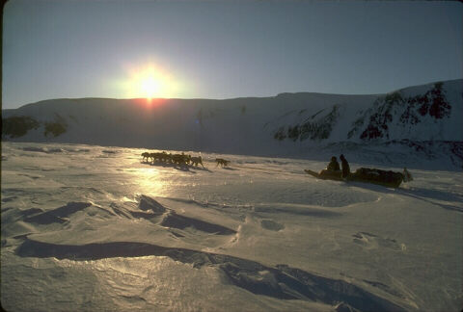
Knowledge Discovery in Data [and Data Mining] (KDD)
Let us find something interesting!
Definition := “KDD is the non-trivial process of identifying valid, novel, potentially useful, and ultimately understandable patterns in data” (Fayyad)
Frequently, the term data mining is used to refer to KDD.
Many commercial and experimental tools and tool suites are available (see http://www.kdnuggets.com/siftware.html)
Field is more dominated by industry than by research institutions
Notes:
The first technology I like to …
The above picture is, in my opinion, a good description of the task of knowledge discovery in that it illustrates a huge search space that contains very very few interesting things, and if applied in practice, KDD is frequently like finding a needle in a hay stack, except that you are not sure what you are looking for...

Slide 4
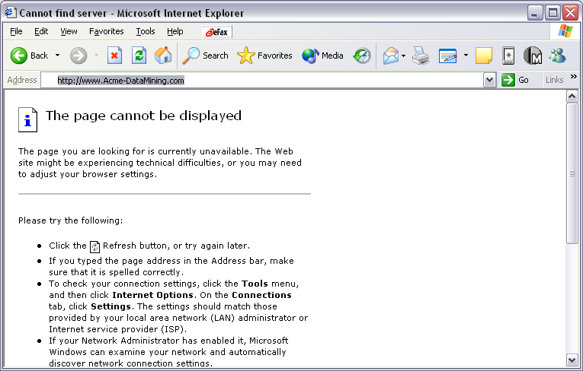
YAHOO!’s View of Data Mining
ACME CORP ULTIMATE DATA MINING BROWSER
What’s New?
What’s Interesting?
Predict for me
http://www.sigkdd.org/kdd2008/

Slide 5
Are All the “Discovered” Patterns Interesting?
A data mining system/query may generate thousands of patterns, not all of them are interesting.
Suggested approach: Human-centered, query-based, focused mining
Interestingness measures: A pattern is interesting if it is easily understood by humans, valid on new or test data with some degree of certainty, potentially useful, novel, or validates some hypothesis that a user seeks to confirm
Objective vs. subjective interestingness measures:
Objective: based on statistics and structures of patterns, e.g., support, confidence, etc.
Subjective: based on user’s belief in the data, e.g., unexpectedness, novelty, actionability, etc.

Slide 6
Data Mining: Confluence of Multiple Disciplines
Machine
Learning
Pattern
Recognition
Statistics
Applications
Data Mining
Visualization
Algorithm
Database
Technology
High-Performance
Computing

Slide 7
KDD Process: A Typical View from ML and Statistics
Pattern
Information
Knowledge
Input Data
Data Pre-Processing
Data Mining
Post-Processing
Data integration
Normalization
Feature selection
Dimension reduction
Association Analysis
Classification
Clustering
Outlier analysis
Summary Generation
…
Pattern evaluation
Pattern selection
Pattern interpretation
Pattern visualization
This is a view from typical machine learning and statistics communities

Slide 8
Data Mining Competitions
Netflix Price: http://www.netflixprize.com//index
ICDM Cup 2018: https://tianchi.aliyun.com/competition/introduction.htm?spm=5176.100066.0.0.47cbd780fgnIJX&raceId=231662
KDD Cup 2017: http://www.kdd.org/kdd2017/News/view/announcing-kdd-cup-2017-highway-tollgates-traffic-flow-prediction

Slide 9
COSC 4335 in a Nutshell
Preprocessing Data Mining Post Processing
Association Analysis Pattern Evaluation
Clustering Visualization
Summarization
Classification &
Prediction
Anomaly Detection
Data Analysis
Using R for Data Analytics and Programming

Slide 10
Prerequisites
The course is basically self contained; however, the following skills are important to be successful in taking this course:
Basic knowledge of programming
Programming languages of your own choice and data mining tools, particularly R, will be used in the programming projects
Basic knowledge of statistics
Basic knowledge of data structures
Data Management and Discrete Math---can take it concurrently with this course.

Slide 11
Course Objectives
will know what the goals and objectives of data mining are
will have a basic understanding on how to conduct a data mining project
will obtain some knowledge and practical experience in data analysis and making sense out of data
will have sound knowledge of popular classification techniques, such as decision trees, support vector machines and nearest-neighbor approaches.
will have basic knowledge in anomaly detection
will have detailed knowledge of popular clustering algorithms, such as K-means, DBSCAN, and hierarchical clustering.
will have sound knowledge of R, an open source statistics/data mining environment
will get some basic background in data visualization and basic statistics
will learn how to interpret data analysis and data mining results.
will obtain some basic knowledge about Data Science and Data Storytelling
will obtain practical experience in in applying data mining techniques to real world data sets and in developing software on the top of data mining and data analysis algorithms.

Slide 12
Order of Coverage (subject to change!)
Introduction →Exploratory Data Analysis → Basic Introduction to R Part1 → Similarity Assessment →Clustering → Programming in R → Classification and Prediction →How to Conduct a Data Mining Project → Data Science and Data Storytelling →Anomaly/Outlier Detection → Preprocessing → Association Analysis → Summary

Slide 13
In particular, R will be used for most course projects,
The bad news is that it is more challenging to get
started with R (compared to Weka---but Weka is a
"dead" language), although you should be okay after
you used R for some weeks. On the other hand, the
good news about R is that it continues to grow quickly in
popularity. A recent poll at KDnuggets found that 34%
of respondents do at least half of their data mining in R.
Although it's a domain specific language, it's versatile.
As we have not used R in the course before, we expect some startup problems
and ask you for your patience, but, on the positive side
knowing R will be a plus when conducting research projects
and when looking for jobs after you graduate, due to
R's completeness and R's rising popularity.

Slide 14
Where to Find References?
Data mining and KDD
Conference proceedings: ICDM, KDD, PKDD, PAKDD, SDM,ADMA etc.
Journal: Data Mining and Knowledge Discovery
Database field (SIGMOD member CD ROM):
Conference proceedings: VLDB, ICDE, ACM-SIGMOD, CIKM
Journals: ACM-TODS, J. ACM, IEEE-TKDE, JIIS, etc.
AI and Machine Learning:
Conference proceedings: ICML, AAAI, IJCAI, ECML, etc.
Journals: Machine Learning, Artificial Intelligence, etc.
Statistics:
Conference proceedings: Joint Stat. Meeting, etc.
Journals: Annals of statistics, etc.
Visualization:
Conference proceedings: CHI, etc.
Journals: IEEE Trans. visualization and computer graphics, etc.

Slide 15
Textbooks
Recommended Text: P.-N. Tang, M. Steinback, and V. Kumar: Introduction to Data Mining,
Addison Wesley, 2018. Link to Book HomePage
Mildly Recommended Text Jiawei Han and
Micheline Kamber, Data Mining: Concepts and
Techniques, Morgan Kaufman Publishers, second
Edition, 2011.
Link to Data Mining Book Home Page

Slide 16
Fall 2018 Course Projects/Assignments
Project 1: Exploratory Data Analysis (Individual project; 2.5 weeks))
Project 2: Clustering, Similarity Assessment and R-Programming (Individual Project, 4 weeks)
Project 3: Classification and Prediction (Individual Project, 2-3 weeks)
Project 4: Anomaly Detection (Group Project, 2 weeks)

Slide 17
Teaching Assistant Romita Banerjee
Duties:
Grading of assignments
Help students with homework, programming projects and problems with the course material
Grading of Exams (partially)
Teaching 2 Labs; maybe a single lecture
Office:
Office Hours: see webpage
E-mail:
Remark: Some students in my research group will also help with teaching the course

Slide 18
Web and News Group
Course Webpage (http://www2.cs.uh.edu/~ceick/UDM/4335.html )
COSC 4335 News Group: will use Piazza!

Slide 19
Exams
Open Textbook and Notes (no computers!)
Count about 50% towards the course grade
3 exams
Get a detailed review list before the exam
75+% of the exam problems covers material that was discussed in the lecture

Slide 20
Teaching Philosophy and Advice
Read the sections of the textbook and/or slides before you come to the lecture; if you work continuously for the class you will do better and lectures will be more enjoyable. Starting to review the material that is covered in this class 1 week before the next exam is not a good idea.
Do not be afraid to ask questions! I really like interactions with students in the lectures… If you do not understand something at all send me an e-mail before the next lecture!
If you have a serious problem talk to me, before the problem gets out of hand.

Slide 21
Where to Find References? DBLP, CiteSeer, Google
Data mining and KDD (SIGKDD: CDROM)
Conferences: ACM-SIGKDD, IEEE-ICDM, SIAM-DM, PKDD, PAKDD, etc.
Journal: Data Mining and Knowledge Discovery, KDD Explorations, ACM TKDD
Database systems (SIGMOD: ACM SIGMOD Anthology—CD ROM)
Conferences: ACM-SIGMOD, ACM-PODS, VLDB, IEEE-ICDE, EDBT, ICDT, DASFAA
Journals: IEEE-TKDE, ACM-TODS/TOIS, JIIS, J. ACM, VLDB J., Info. Sys., etc.
AI & Machine Learning
Conferences: Machine learning (ML), AAAI, IJCAI, COLT (Learning Theory), CVPR, NIPS, etc.
Journals: Machine Learning, Artificial Intelligence, Knowledge and Information Systems, IEEE-PAMI, etc.
Web and IR
Conferences: SIGIR, WWW, CIKM, etc.
Journals: WWW: Internet and Web Information Systems,
Statistics
Conferences: Joint Stat. Meeting, etc.
Journals: Annals of statistics, etc.
Visualization
Conference proceedings: CHI, ACM-SIGGraph, etc.
Journals: IEEE Trans. visualization and computer graphics, etc.

Slide 22
Summary
Data mining: discovering interesting patterns from large amounts of data
A natural evolution of database technology, in great demand, with wide applications
A KDD process includes data cleaning, data integration, data selection, transformation, data mining, pattern evaluation, and knowledge presentation
Mining can be performed in a variety of information repositories
Data mining functionalities: characterization, discrimination, association, classification, clustering, outlier and trend analysis, etc.

