Slide 1
Exploratory Data Analysis
Remark: covers Chapter 3 of the Tan book in Part
Organization
Why Exloratory Data Analysis?
Summary Statistics
Visualization
About Data

Slide 2
1. Why Data Exploration?
A preliminary exploration of the data to better understand its characteristics.
Key motivations of data exploration include
Helping to select the right tool for preprocessing, data analysis and data mining
Making use of humans’ abilities to recognize patterns
People can recognize patterns not captured by data analysis tools
Related to the area of Exploratory Data Analysis (EDA)
Created by statistician John Tukey
Seminal book is Exploratory Data Analysis by Tukey
A nice online introduction can be found in Chapter 1 of the NIST Engineering Statistics Handbook
http://www.itl.nist.gov/div898/handbook/index.htm

Slide 3
Exploratory Data Analysis
Get Data
Exploratory Data Analysis
Preprocessing
Data Mining

Slide 4
Techniques Used In Data Exploration
In EDA, as originally defined by Tukey
The focus was on visualization
Clustering and anomaly detection were viewed as exploratory techniques
In data mining, clustering and anomaly detection are major areas of interest, and not thought of as just exploratory
In our discussion of data exploration, we focus on
Summary statistics
Visualization

Slide 5
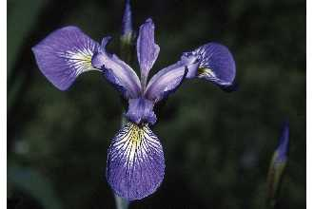
Iris Sample Data Set
Many of the exploratory data techniques are illustrated with the Iris Plant data set.
Can be obtained from the UCI Machine Learning Repository http://www.ics.uci.edu/~mlearn/MLRepository.html
From the statistician Douglas Fisher
Three flower types (classes):
Setosa
Virginica
Versicolour
Four (non-class) attributes
Sepal width and length
Petal width and length
Virginica. Robert H. Mohlenbrock. USDA NRCS. 1995. Northeast wetland flora: Field office guide to plant species. Northeast National Technical Center, Chester, PA. Courtesy of USDA NRCS Wetland Science Institute.

Slide 6
2. Summary Statistics
Summary statistics are numbers that summarize properties of the data
Summarized properties include frequency, location and spread
Examples: location - mean spread - standard deviation
Most summary statistics can be calculated in a single pass through the data

Slide 7
Frequency and Mode
The frequency of an attribute value is the percentage of time the value occurs in the data set
For example, given the attribute ‘gender’ and a representative population of people, the gender ‘female’ occurs about 50% of the time.
The mode of a an attribute is the most frequent attribute value
The notions of frequency and mode are typically used with categorical data

Slide 8
Percentiles
For continuous data, the notion of a percentile is more useful.
Given an ordinal or continuous attribute x and a number p between 0 and 100, the pth percentile is a value of x such that p% of the observed values of x are less than .
For instance, the 50th percentile is the value such that 50% of all values of x are less than .
Key Idea: associate attribute value with a rank!!

Slide 9
R Box Plots (different from textbook)
R Box Plots
Invented by J. Tukey
displaying the distribution of data based on percentiles
Following figure shows the basic parts of a box plots
http://chartsgraphs.wordpress.com/2008/11/18/boxplots-r-does-them-right/
Corrected on: 9/9/2013
outlier
Maximum (or at most 1.5 IQR off the 75th percentile)
75th percentile
IQR
50th percentile
25th percentile
Minimum (or at most 1.5 IQR off the 25th percentile)

Slide 10
Measures of Location: Mean and Median
The mean is the most common measure of the location of a set of points.
However, the mean is very sensitive to outliers.
Thus, the median or a trimmed mean is also commonly used.

Slide 11
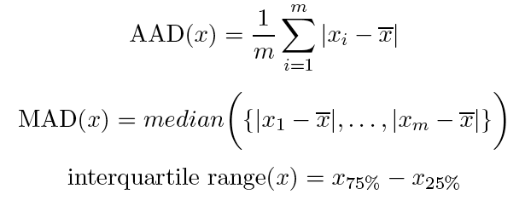
Measures of Spread: Range and Variance
Range is the difference between the max and min
The variance or standard deviation
However, this is also sensitive to outliers, so that other measures are often used.
0, 2, 3, 7, 8
11.5
standard_deviation(x)= s_{x}
3.3
(Mean Absolute Deviation) [Han]
(Absolute Average Deviation) [Tan]
2.8
3
(Median Absolute Deviation)
5

Slide 12
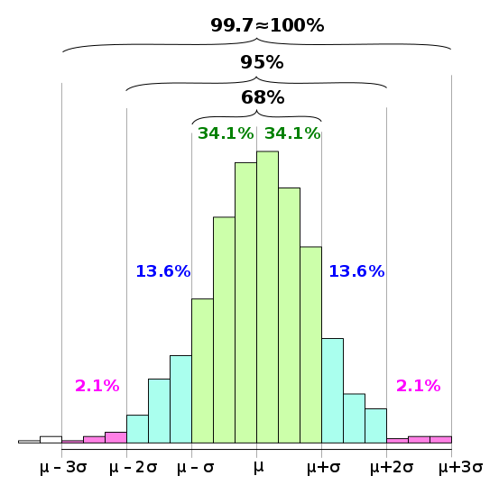
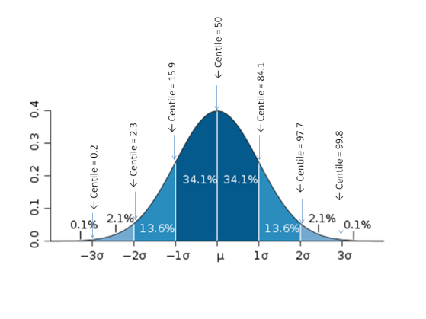
68-95-99.7 Rule
For more details see:
https://en.wikipedia.org/wiki/68%E2%80%9395%E2%80%9399.7_rule
This rule assumes a Gaussian
distribution!
Remark:
is mean value and
is standard deviation

Slide 13
68-95-99.7 Rule continued
Range | Expected fraction of population inside range | Approximate expected frequency outside range | Approximate frequency for daily event
μ ± 0.5σ | 0.382924922548026 | 2 in 3 | Four times a week
μ ± σ | 0.682689492137086 | 1 in 3 | Twice a week
μ ± 1.5σ | 0.866385597462284 | 1 in 7 | Weekly
μ ± 2σ | 0.954499736103642 | 1 in 22 | Every three weeks
μ ± 2.5σ | 0.987580669348448 | 1 in 81 | Quarterly
μ ± 3σ | 0.997300203936740 | 1 in 370 | Yearly
μ ± 3.5σ | 0.999534741841929 | 1 in 2149 | Every six years
μ ± 4σ | 0.999936657516334 | 1 in 7004157870000000000♠15787 | Every 43 years (twice in a lifetime)

Slide 14
Correlation
https://en.wikipedia.org/wiki/Correlation_and_dependence

Slide 15
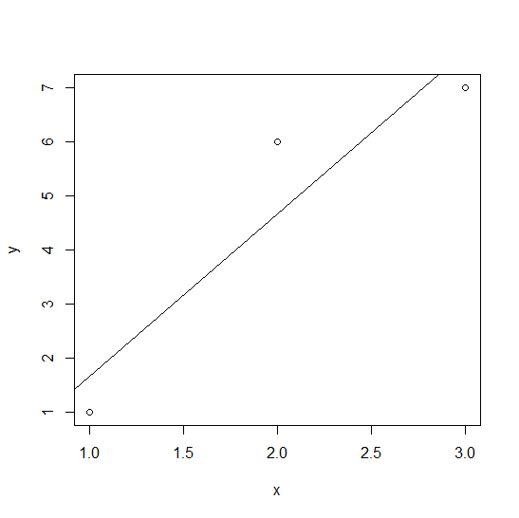
Fitting Linear Models
> x<-c(1,2,3)
> y<-c(1,6,7)
> dataset<-data.frame(x,y)
> mod<-lm(y ~ x, data=dataset)
> mod$coeff
(Intercept) x
-1.333333 3.000000
> plot(x,y)
> abline(c(-1.3333,3))
> summary(mod)$r.squared
[1] 0.8709677
More details: https://en.wikibooks.org/wiki/R_Programming/Linear_Models
In statistics, the coefficient of determination, denoted R² or r² and pronounced "R squared", is the
proportion of the variance in the dependent variable that is predictable from the independent variable; see:
https://en.wikipedia.org/wiki/Coefficient_of_determination

Slide 16
3. Visualization
Visualization is the conversion of data into a visual or tabular format so that the characteristics of the data and the relationships among data items or attributes can be analyzed or reported.
Visualization of data is one of the most powerful and appealing techniques for data exploration.
Humans have a well developed ability to analyze large amounts of information that is presented visually
Can detect general patterns and trends
Can detect outliers and unusual patterns

Slide 17
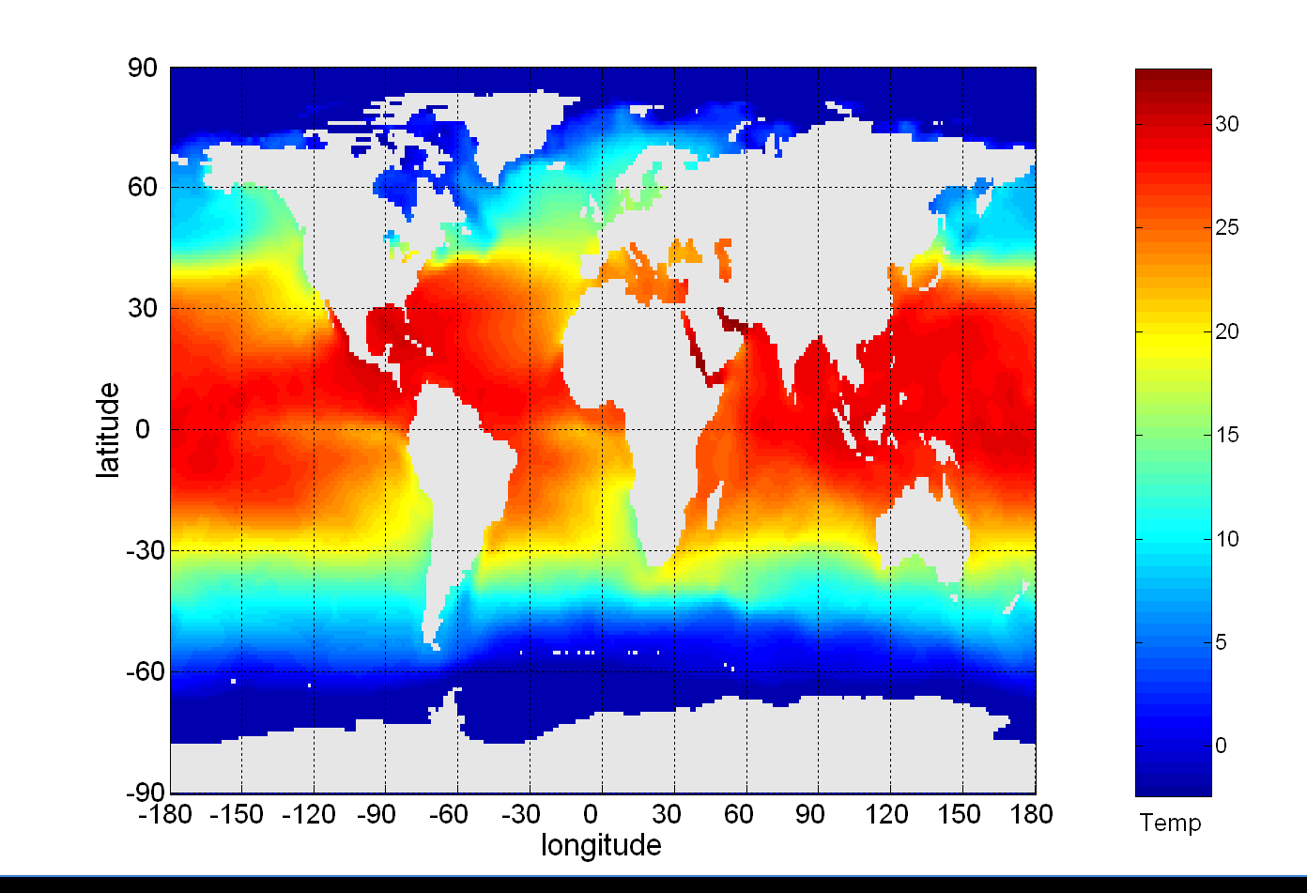
Example: Sea Surface Temperature
The following shows the Sea Surface Temperature (SST) for July 1982
Tens of thousands of data points are summarized in a single figure

Slide 18
Representation
Is the mapping of information to a visual format
Data objects, their attributes, and the relationships among data objects are translated into graphical elements such as points, lines, shapes, and colors.
Example:
Objects are often represented as points
Their attribute values can be represented as the position of the points or the characteristics of the points, e.g., color, size, and shape
If position is used, then the relationships of points, i.e., whether they form groups or a point is an outlier, is easily perceived.

Slide 19
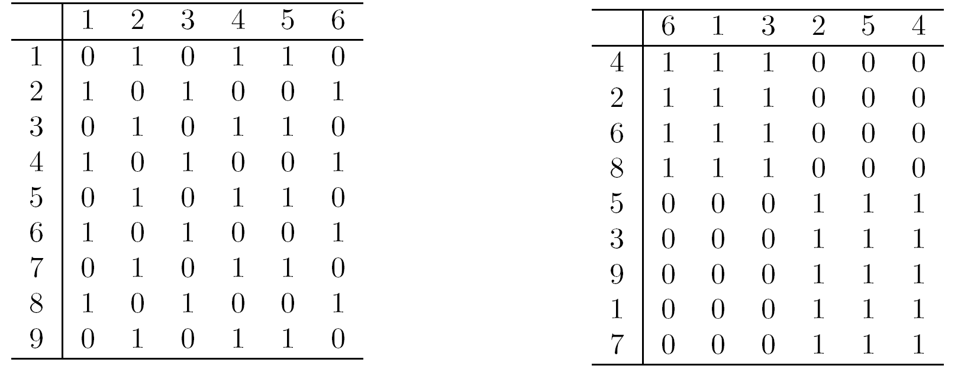
Arrangement
Is the placement of visual elements within a display
Can make a large difference in how easy it is to understand the data
Example:

Slide 20
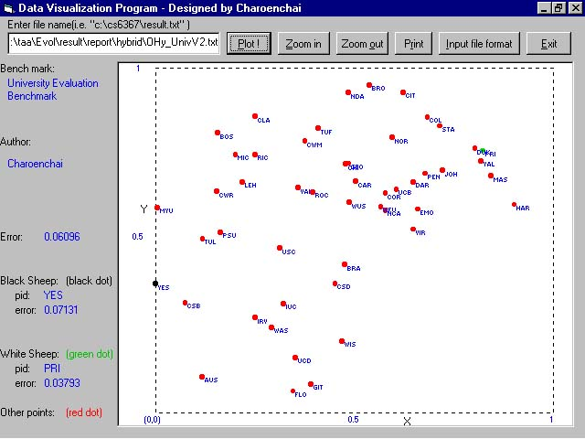
Example: Visualizing Universities

Slide 21
Selection
Is the elimination or the de-emphasis of certain objects and attributes
Selection may involve the chosing a subset of attributes
Dimensionality reduction is often used to reduce the number of dimensions to two or three
Alternatively, pairs of attributes can be considered
Selection may also involve choosing a subset of objects
A region of the screen can only show so many points
Can sample, but want to preserve points in sparse areas

Slide 22
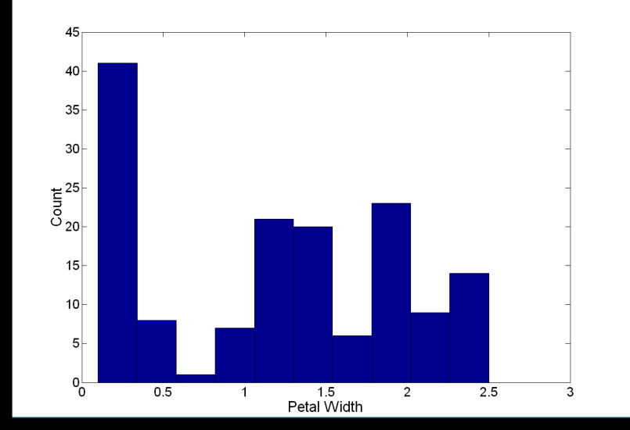
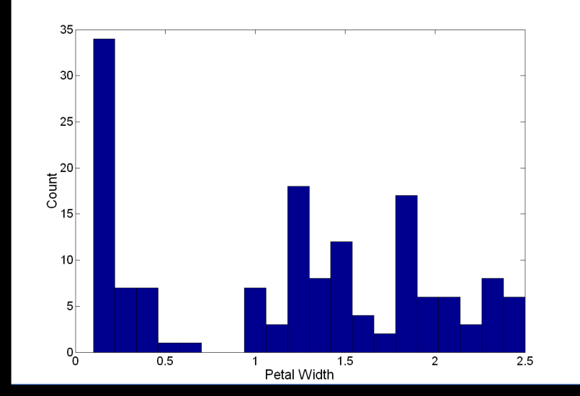
Visualization Techniques: Histograms
Histogram
Usually shows the distribution of values of a single variable
Divide the values into bins and show a bar plot of the number of objects in each bin.
The height of each bar indicates the number of objects
Shape of histogram depends on the number of bins
Example: Petal Width (10 and 20 bins, respectively)

Slide 23
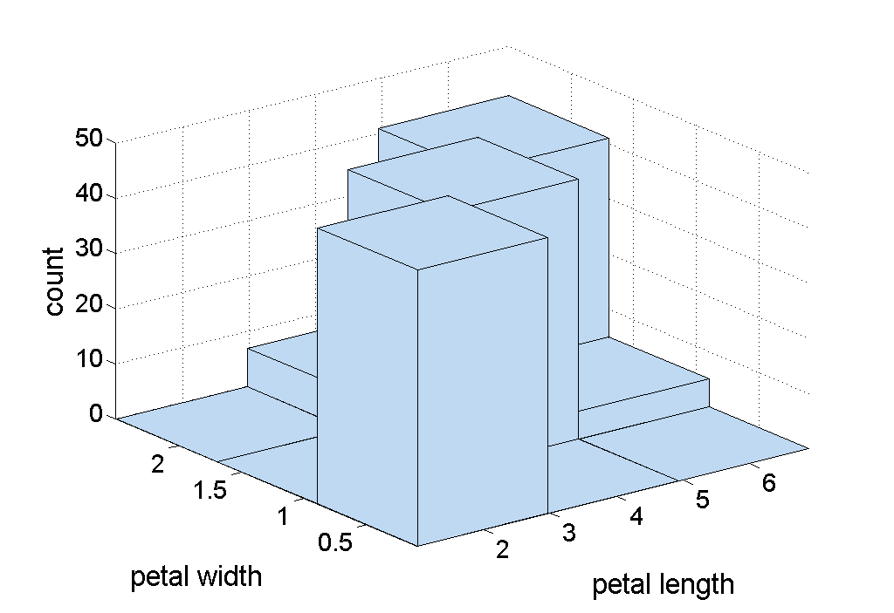
Two-Dimensional Histograms
Show the joint distribution of the values of two attributes
Example: petal width and petal length
What does this tell us?

Slide 24
Visualization Techniques: Histograms
Several variations of histograms exist: equi-bin(most popular), other approaches use variable bin sizes…
Choosing proper bin-sizes and bin-starting points is a non trivial problem!!
Example Problem from the midterm exam 2009: Assume you have an attribute A that has the attribute values that range between 0 and 6; its particular values are: 0.62 0.97 0.98 1.01. 1.02 1.07 2.96 2.97 2.99 3.02 3.03 3.06 4.96 4.97 4.98 5.02 5.03 5.04. Assume this attribute A is visualized as a equi-bin histogram with 6 bins: [0,1), [1,2), [2,3],[3,4), [4,5), [5,6]. Does the histogram provide a good approximation of the distribution/density function of attribute A? If not, provide a better histogram for attribute A. Give reasons for your answers! [7]

Slide 25
Visualization Techniques: Box Plots
Box Plots (we do not use the version depicted below!)
Invented by J. Tukey
Another way of displaying the distribution of data
Following figure shows the basic part of a box plot
outlier
90th percentile
Also see: https://en.wikipedia.org/wiki/Box_plot
75th percentile
50th percentile
25th percentile
10th percentile

Slide 26
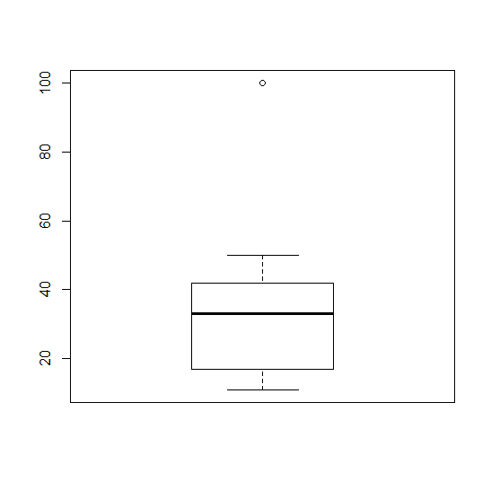
Boxplots in R (we use those!!)
By default, boxplot() in R plots the maximum and the minimum non-outlying values instead of the 10th and 90th percentiles as the book describes. Outliers in BPs are values that are 1.5*IQR or more away from the box, where IQR is the height of the box!
See:
> a<-c(11,12, 22, 33, 34, 100)
> boxplot(a)
> b<-c(11,12, 22, 33, 34, 65)
> boxplot(b)
a<-c(11,12,22, 33, 34, 50, 100)
boxplot(a)
outlier
90th percentile
Maximum non-outlier
75th percentile
50th percentile
IQR (a proxy for standard
deviation)
25th percentile
10th percentile
Minimum non-outlier
Notes:
*

Slide 27
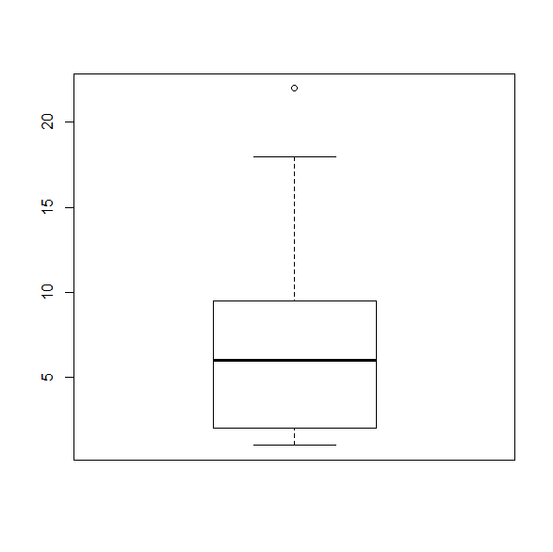
Example of R Box Plots (Mid1 Question)
b) The following boxplot has been created using the following R-code for an attribute x:
> x<-c(1,2,2,2,4,4,8,9,9,10,18,22)
> boxplot(x)
R version 3.4.3: Kite-Eating Tree
What is the median for the attribute x? What is the IQR for the attribute x? The lower whisker of the boxplot as at
1; what does this tell you? According the boxplot 18 is not an outlier and 22 as an outlier; why do you believe this
is the case? [5]
Median is 6=(4+8)/2 [1]
IQR=9.5-2=7.5 [1]
1 is the lowest value in the dataset that is not an outlier [1] Every value that is 1.5∗IQR above the 75th percentile is
an outlier; that is, for the particular boxplots values above 9.5+1.5*7.5=20.75 and below the 25th percentile -9.25
are outliers; consequently, 22 is an outlier and 1 and 18 is not, and the whiskers are therefore at 1 and 18! [2]

Slide 28
Visualization Techniques: Scatter Plots
Scatter plots
Attributes values determine the position
Two-dimensional scatter plots most common, but can have three-dimensional scatter plots
Often additional attributes can be displayed by using the size, shape, and color of the markers that represent the objects
It is useful to have arrays of scatter plots can compactly summarize the relationships of several pairs of attributes
For prediction scatter plots see: http://en.wikipedia.org/wiki/Scatter_plot
http://en.wikipedia.org/wiki/Correlation (Correlation)
See example for classification, also called supervised scatter plots, on the next slide

Slide 29
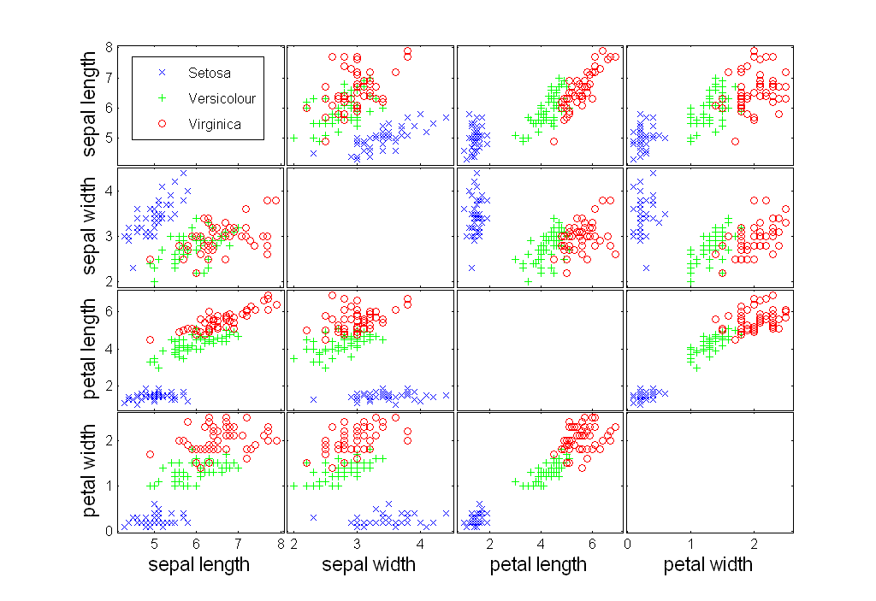
Scatter Plot Array of Iris Attributes

Slide 30
Scatter Plot Old Faithful Eruptions
http://en.wikipedia.org/wiki/Old_Faithful

Slide 31
Visualization Techniques: Contour Plots
Contour plots
Useful when a continuous attribute is measured on a spatial grid
They partition the plane into regions of similar values
The contour lines that form the boundaries of these regions connect points with equal values
The most common example is contour maps of elevation
Can also display temperature, rainfall, air pressure, etc.
An example for Sea Surface Temperature (SST) is provided on the next slide
https://plot.ly/r/contour-plots/

Slide 32
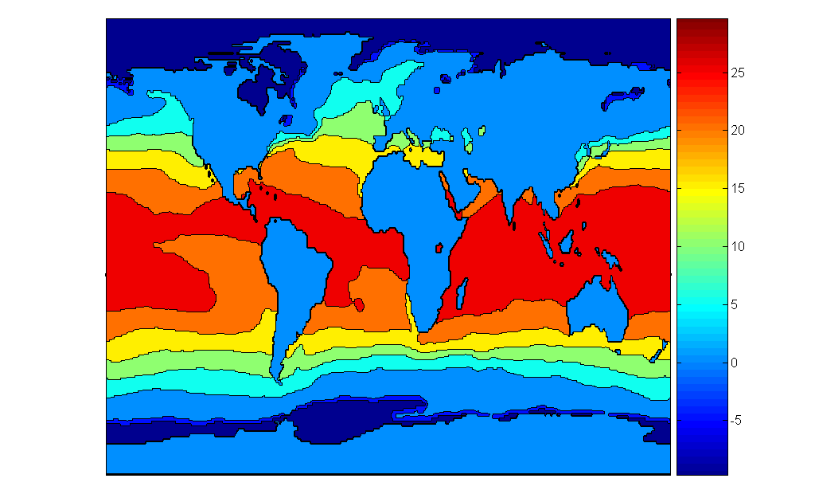
Contour Plot Example: SST Dec, 1998
Celsius

Slide 33
Density Plots
http://ggplot2.tidyverse.org/reference/geom_density_2d.html
https://python-graph-gallery.com/2d-density-plot/

Slide 34
Visualization Techniques: Parallel Coordinates
Parallel Coordinates
Used to plot the attribute values of high-dimensional data
Instead of using perpendicular axes, use a set of parallel axes
The attribute values of each object are plotted as a point on each corresponding coordinate axis and the points are connected by a line
Thus, each object is represented as a line
Often, the lines representing a distinct class of objects group together, at least for some attributes
Ordering of attributes is important in seeing such groupings

Slide 35
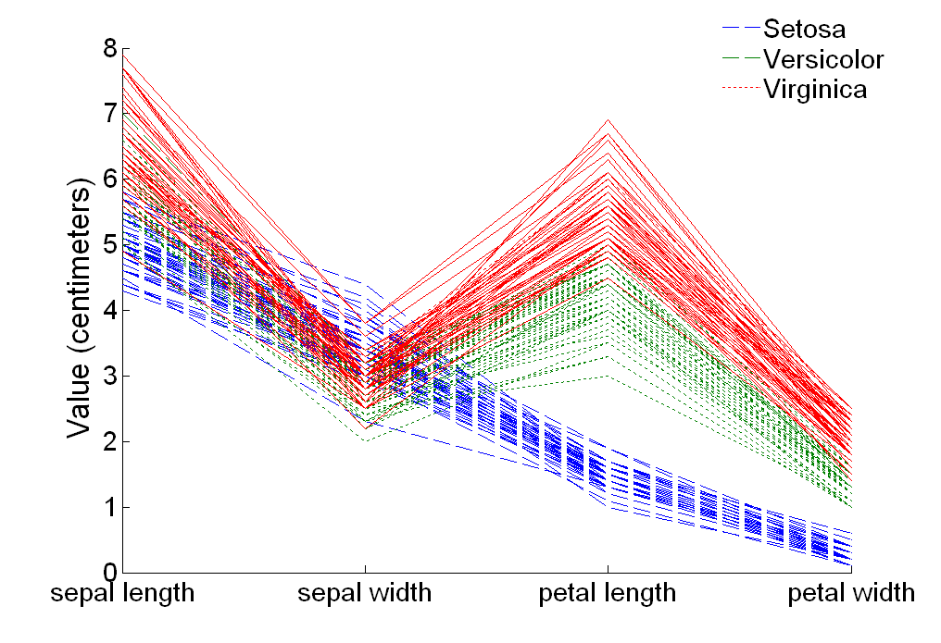
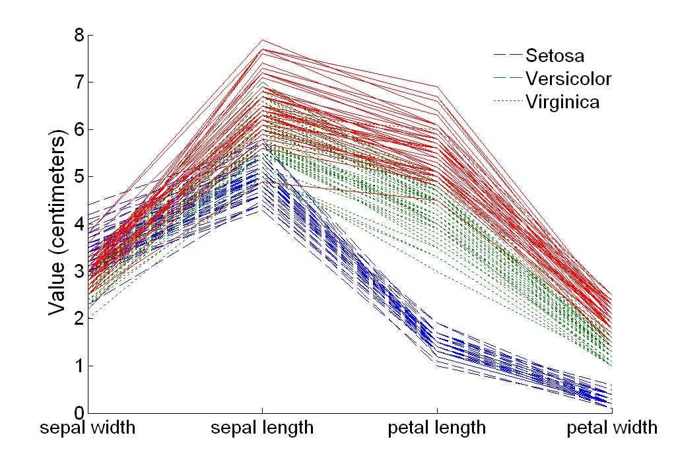
Parallel Coordinates Plots for Iris Data

Slide 36
Other Visualization Techniques
Star Coordinate Plots
Similar approach to parallel coordinates, but axes radiate from a central point
The line connecting the values of an object is a polygon
Chernoff Faces
Approach created by Herman Chernoff
This approach associates each attribute with a characteristic of a face
The values of each attribute determine the appearance of the corresponding facial characteristic
Each object becomes a separate face
Relies on human’s ability to distinguish faces
http://people.cs.uchicago.edu/~wiseman/chernoff/
http://kspark.kaist.ac.kr/Human%20Engineering.files/Chernoff/Chernoff%20Faces.htm#

Slide 37
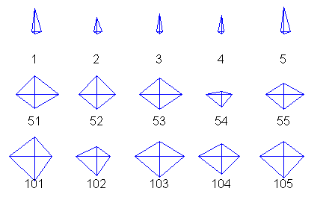
Star Plots for Iris Data
Setosa
Versicolour
Virginica
Pedal length
Sepal Width
Sepal length
Pedal width

Slide 38
Chernoff Faces for Iris Data
Translation: sepal length→size of face; sepal width →forhead/jaw relative to arc-length;
Pedal length→shape of forhead; pedal width→ shape of jaw; width of mouth→…; width between eyes→…
Setosa
Versicolour
Virginica

Slide 39
Useful Background “Engineering St. Handbook”
http://www.itl.nist.gov/div898/handbook/eda/section1/eda15.htm (graphical techniques)
http://www.itl.nist.gov/div898/handbook/eda/section3/eda35.htm (quantitative analysis)
http://www.itl.nist.gov/div898/handbook/eda/section2/eda23.htm (testing assumptions)
http://www.itl.nist.gov/div898/handbook/eda/section3/eda34.htm (survey graphical techniques)
Remark: The material is very good if your focus is on prediction, hypothesis testing, clustering; however, providing good visualizations/statistics for classification problems is not discussed much…

Slide 40
4. About Data
Remark: This subsection discusses “basics concerning data sets (first half of Chapter 2) but does not discuss preprocessing. Preprocessing will be discussed in late October.

Slide 41
What is Data?
Collection of data objects and their attributes
An attribute is a property or characteristic of an object
Examples: eye color of a person, temperature, etc.
Attribute is also known as variable, field, characteristic, or feature
A collection of attributes describe an object
Object is also known as record, point, case, sample, entity, or instance
Attributes
Objects

Slide 42
Attribute Values
Attribute values are numbers or symbols assigned to an attribute
Distinction between attributes and attribute values
Same attribute can be mapped to different attribute values
Example: height can be measured in feet or meters
Different attributes can be mapped to the same set of values
Example: Attribute values for ID and age are integers
But properties of attribute values can be different
ID has no limit but age has a maximum and minimum value

Slide 43
Types of Attributes
There are different types of attributes
Nominal
Examples: ID numbers, eye color, zip codes
Ordinal
Examples: rankings (e.g., taste of potato chips on a scale from 1-10), grades, height in {tall, medium, short}
Interval
Examples: calendar dates, temperatures in Celsius or Fahrenheit.
Ratio
Examples: temperature in Kelvin, length, time, counts

Slide 44
Properties of Attribute Values
The type of an attribute depends on which of the following properties it possesses:
Distinctness: = ≠
Order: < >
Addition: + -
Multiplication: * /
Nominal attribute: distinctness
Ordinal attribute: distinctness & order
Interval attribute: distinctness, order & addition
Ratio attribute: all 4 properties

Slide 45
Attribute Type
Description
Examples
Operations
Nominal
The values of a nominal attribute are just different names, i.e., nominal attributes provide only enough information to distinguish one object from another. (=, ≠)
zip codes, employee ID numbers, eye color, sex: {male, female}
mode, entropy, contingency correlation, χ² test
Ordinal
The values of an ordinal attribute provide enough information to order objects. (<, >)
hardness of minerals, {good, better, best}, grades, street numbers
median, percentiles, rank correlation, run tests, sign tests
Interval
For interval attributes, the differences between values are meaningful, i.e., a unit of measurement exists. (+, - )
calendar dates, temperature in Celsius or Fahrenheit
mean, standard deviation, Pearson's correlation, t and F tests
Ratio
For ratio variables, both differences and ratios are meaningful. (*, /)
temperature in Kelvin, monetary quantities, counts, age, mass, length, electrical current
geometric mean, harmonic mean, percent variation

Slide 46
Attribute Level
Transformation
Comments
Nominal
Any permutation of values
If all employee ID numbers were reassigned, would it make any difference?
Ordinal
An order preserving change of values, i.e., new_value = f(old_value) where f is a monotonic function.
An attribute encompassing the notion of good, better best can be represented equally well by the values {1, 2, 3} or by { 0.5, 1, 10}.
Interval
new_value =a * old_value + b where a and b are constants
Thus, the Fahrenheit and Celsius temperature scales differ in terms of where their zero value is and the size of a unit (degree).
Ratio
new_value = a * old_value
Length can be measured in meters or feet.

Slide 47
Discrete and Continuous Attributes
Discrete Attribute
Has only a finite or countably infinite set of values
Examples: zip codes, counts, or the set of words in a collection of documents
Often represented as integer variables.
Note: binary attributes are a special case of discrete attributes
Continuous Attribute
Has real numbers as attribute values
Examples: temperature, height, or weight.
Practically, real values can only be measured and represented using a finite number of digits.
Continuous attributes are typically represented as floating-point variables.
Different evaluation measures are used in conjunction with continuous attributes

Slide 48
Types of data sets
The remainder of the slides in this file
will not be discussed in Fall 2018!
Record
Data Matrix
Document Data
Transaction Data
Graph
World Wide Web
Molecular Structures
Ordered
Spatial Data
Temporal Data
Sequential Data
Genetic Sequence Data

Slide 49
Important Characteristics of Structured Data
Dimensionality
Curse of Dimensionality
Sparsity
Only presence counts
Resolution
Patterns depend on the scale

Slide 50
Record Data
Data that consists of a collection of records, each of which consists of a fixed set of attributes

Slide 51
Data Matrix
If data objects have the same fixed set of numeric attributes, then the data objects can be thought of as points in a multi-dimensional space, where each dimension represents a distinct attribute
Such data set can be represented by an m by n matrix, where there are m rows, one for each object, and n columns, one for each attribute

Slide 52
Document Data
Each document becomes a `term' vector,
each term is a component (attribute) of the vector,
the value of each component is the number of times the corresponding term occurs in the document.

Slide 53
Transaction Data
A special type of record data, where
each record (transaction) involves a set of items.
For example, consider a grocery store. The set of products purchased by a customer during one shopping trip constitute a transaction, while the individual products that were purchased are the items.

Slide 54
Graph Data
Examples: Generic graph and HTML Links

Slide 55
Chemical Data
Benzene Molecule: C₆H₆

Slide 56
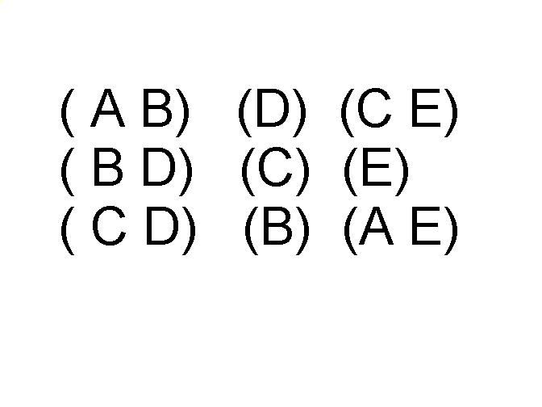
Ordered Data
Sequences of transactions
Items/Events
An element of the sequence

Slide 57
Ordered Data
Genomic sequence data

Slide 58
Ordered Data
Spatio-Temporal Data
Average Monthly Temperature of land and ocean

