Slide 1
Introduction to Data Science
Contains new material that will be discussed in November 2018

Slide 2
What is Data Science?
What words come to mind when you think of Data Science?
What experience do you have with Data Science?
Why are you taking an Introduction to Data Science / Data Mining Class?

Slide 3
Definition of Data Science
There are many, but most say data science is:
Broad – broader than any one existing discipline
Interdisciplinary: Computer Science, Statistics, Information Science, databases, mathematics
Applied focus on extracting knowledge from data to inform decision making.
Focuses on the skills needed to collect, manage, store, distribute, analyze, visualize, reuse data and on data storytelling.
There are many visual representations of Data Science

Slide 4
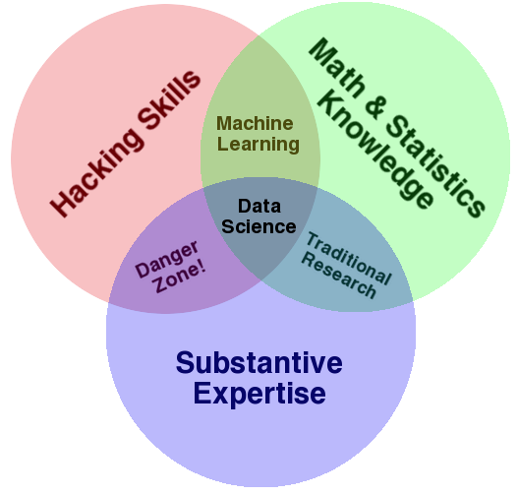
Some definitions

Slide 5
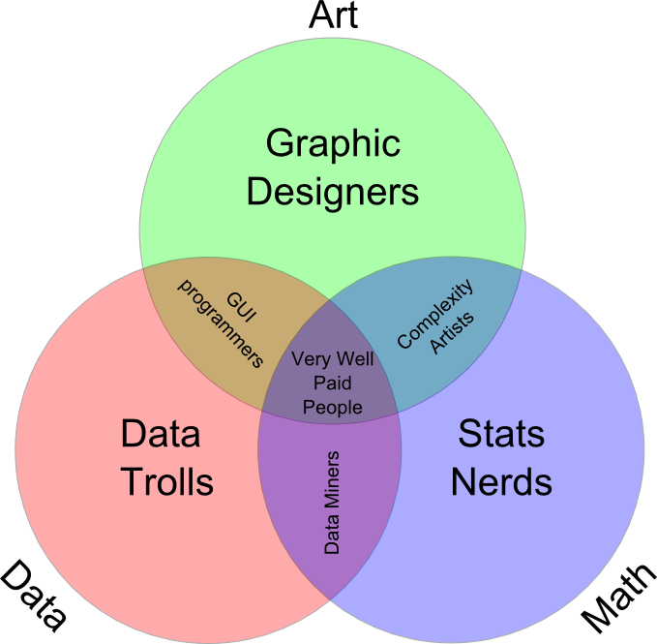
More Definitions.

Slide 6
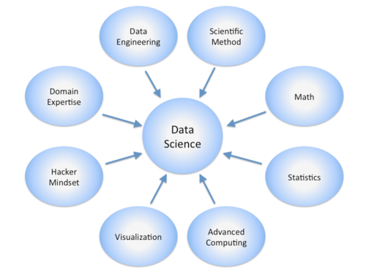
Data Science is Broad!

Slide 7
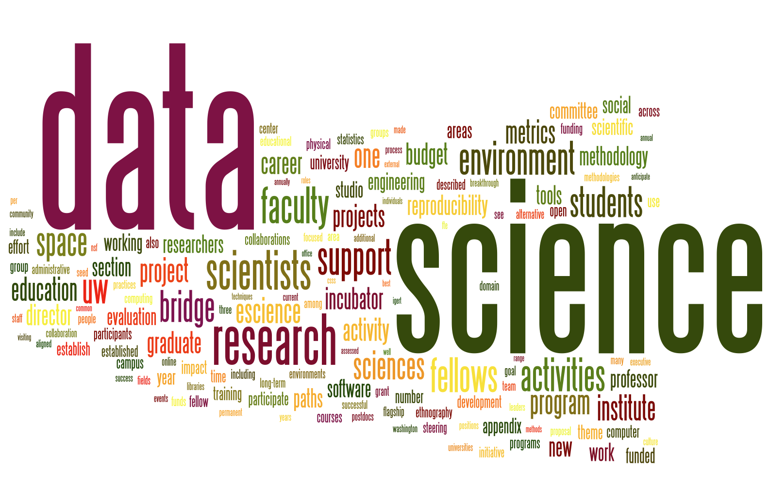
Data Science Word Cloud

Slide 8
Data Analysis
We analyze data to extract meaning from it.
Virtually all data analysis focuses on data reduction
Data reduction comes in the form of:
Descriptive statistics
Measures of association
Graphical visualizations
The objective is to abstract from all of the data some feature or set of features that captures evidence of the process you are studying

Slide 9
The Data Lifecycle
Data science considers data at every stage of what is called the data lifecycle.
This lifecycle generally refers to everything from collecting data to analyzing it to sharing it so others can re-analyze it.
New visions of this process in particular focus on integrating every action that creates, analyzes, or otherwise touches data.
These same new visions treat the process as dynamic – archives are not just digital shoe boxes under the bed.
There are many representations of the this lifecycle.

Slide 10
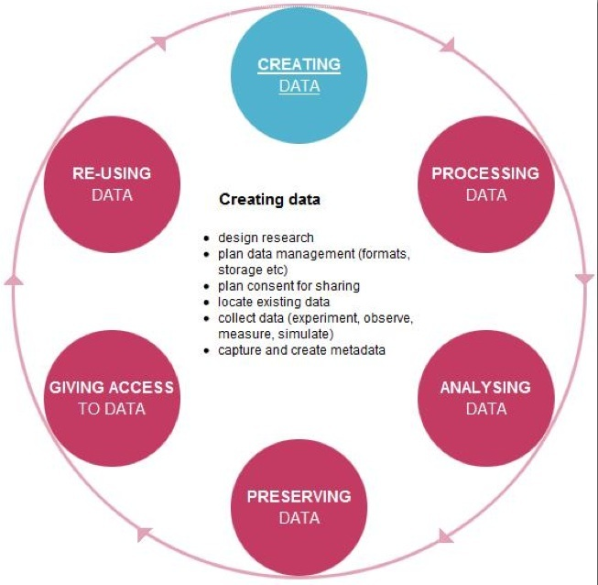

Slide 11
Data Curation
Data curation is a term used to indicate management
activities related to organization and integration
of data collected from various sources, annotation of the
data, and publication and presentation of the data such
that the value of the data is maintained over time, and the
data remains available for reuse and preservation.

Slide 13
What is Missing?
Most definitions of data science underplay or leave out discussions of:
Substantive theory
Metadata
Privacy and Ethics

Slide 14
Privacy and Ethics
Data, the elements of data science, and even so-called “Big Data” are not new.
One thing that is new is the greater variety of data and, most importantly, the amount of data available about humans.
Discussion and good policy regarding privacy, security, and the ethical use of data about people lags behind the methods of collecting, sharing, archiving, and analyzing data.
We will return to these issues later in the course.

Slide 15
Big Data
The launch of the Data Science conversation has been sparked primarily by the so-called “Big Data” revolution.
As mentioned, we have always had data that taxed our technical and computational capacities.
“Big Data” makes front-page news, however, because of the explosion of data about people.
Contemporary definitions of Big Data focus on:
Volume (the amount of data)
Velocity (the speed of data in and out)
Variety (the diverse types of data)

Slide 16
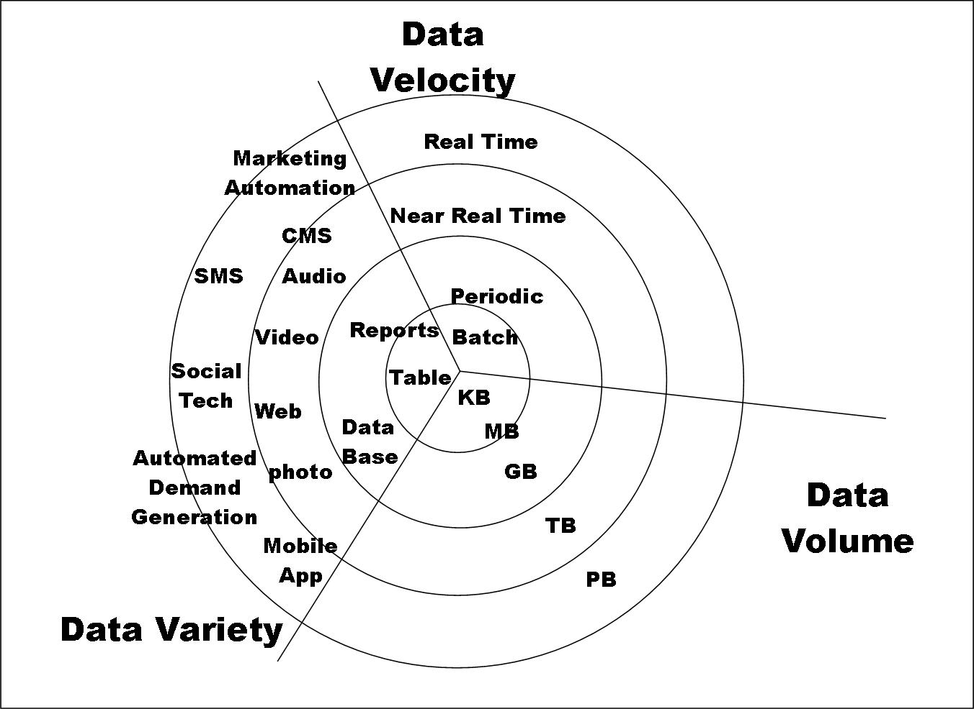

Slide 17
Importance of Data Science
“It is a capital mistake to theorize before one has data.”- Arthur Conan Doyle, Author of Sherlock Holmes
If you’re a scientist, and you have to have an answer, even in the absence of data, you’re not going to be a good scientist.” – Neil deGrasse Tyson, Astrophysicist
“Without big data analytics, companies are blind and deaf, wandering out onto the Web like deer on a freeway.” – Geoffrey Moore, Partner at MDV
Data Analysis and Intelligent Systems Lab
Notes:
r

Slide 18
Resposibilities of Data Scientists
1. We have to have some committment to telleth
„Torture the data long enough and it will confess to anything." Nobel Prize winning economist Ronald Coase
“To find signals in data, we must learn to reduce the noise - not just the noise that resides in the data, but also the noise that resides in us. It is nearly impossible for noisy minds to perceive anything but noise in data.” ― Stephen Few, Signal: Understanding What Matters in a World of Noise
2. We have to know what we are doing
Data Analysis and Intelligent Systems Lab
Notes:
r

Slide 19
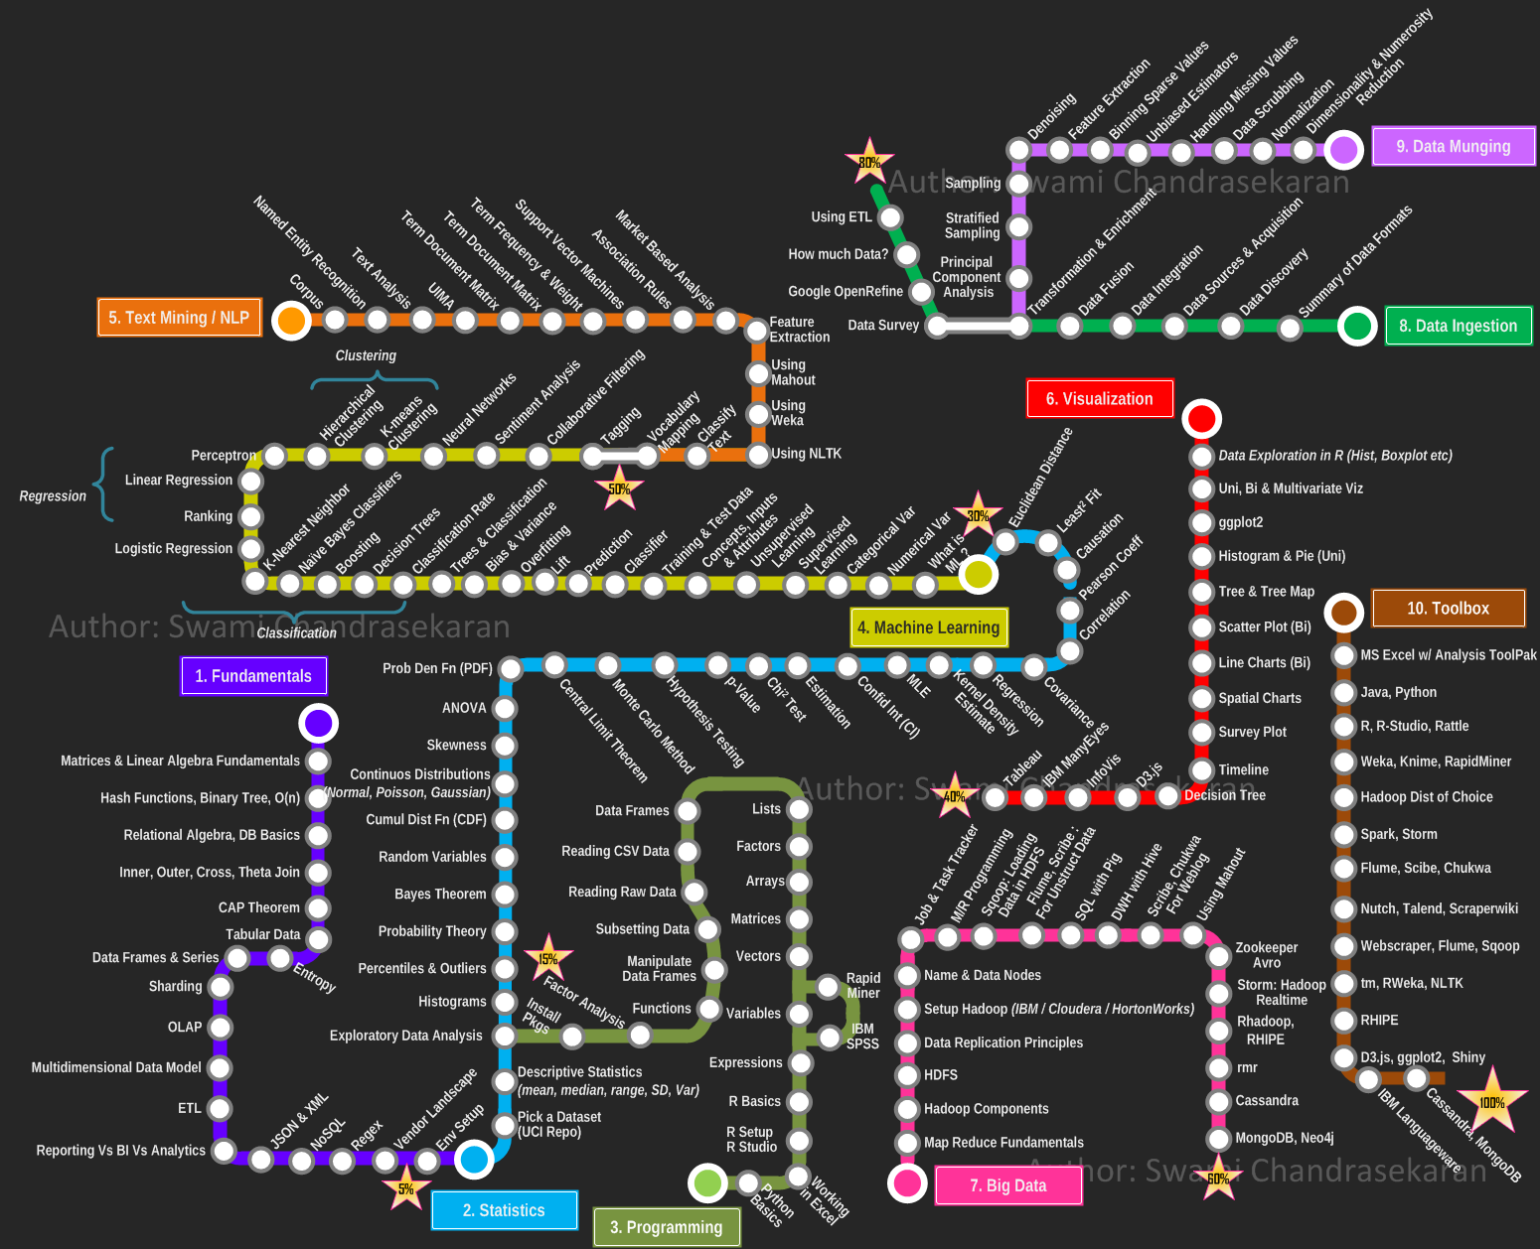
Talk Outline
Data Science According to Swami Chandrasekaran
Importance of Data Science
Data Science is More than Using Tools
Data Storytelling
Examples of Data Storytelling
Conclusion
Data Analysis and Intelligent Systems Lab

Slide 20
COSC Data Science Curriculum
COSC 3335: Data Science II (starting in 2019)
Credit Hours: 3.0 Lecture Contact Hours: 3 Lab Contact Hours: 0
Prerequisite: ‘Data Structures’
Data science process, data preprocessing, exploratory data analysis, data visualization, basic statistics, basic machine learning concepts, classification and prediction, similarity assessment, clustering, post-processing and interpreting data analysis results, use of data analysis tools and programming languages and data analysis case studies.
Data Analysis and Intelligent Systems Lab
Notes:
r

Slide 21
COSC 4335 - Data Science II
Second Data Science Course
Prerequisite: COSC 3335 (Data Science I)
Mandatory List:
Comprehensive, Semester-long Data Analysis Project
More coverage of neural networks and deep learning
More in depth coverage of ensemble learning approaches.
More coverage of prediction techniques e.g. linear regression, non-linear regression, SVM regression, regression trees,…
More coverage on overfitting, model evaluation and using statistical testing for model comparison
Maybe List:
Kernels
Density Estimation (Parametric and Non-parametric)
More on time series analysis
Anomaly detection
Belief networks and hidden Markov models
Dimensionality Reduction
Notes:
r

Slide 22
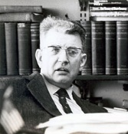
Data Science is More than Using Tools
The problem with data is that it says a lot, but it also says nothing. ‘Big data’ is terrific, but it’s usually thin. To understand why something is happening, we have to engage in both forensics and guess work.”- Sendhil Mullainathan, Professor of economics, Harvard
“But a theory is not like an airline or bus timetable. We are not interested simply in the accuracy of its predictions. A theory also serves as a base for thinking. It helps us to understand what is going on by enabling us to organize our thoughts. Faced with a choice between a theory which predicts well but gives us little insight into how the system works and one which gives us this insight but predicts badly, I would choose the latter, and I am inclined to think that most economists would do the same.” ― Ronald H. Coase, Essays on Economics and Economists
Data Analysis and Intelligent Systems Lab
Notes:
r

Slide 23
Data Science and Storytelling
“Data scientists are involved with gathering data, massaging it into a tractable form, making it tell its story, and presenting that story to others.” – Mike Loukides, VP, O’Reilly Media
“Our challenge as data scientists is to translate this haystack of information into guidance for staff so they can make smart decisions…We “humanize” the data by turning raw numbers into a story about our performance. Data scientists want to believe that data has all the answers. But the most important part of our job is qualitative: asking questions, creating directives from our data, and telling its story. ” Jeff Bladtand and Bob Filbin
Data Analysis and Intelligent Systems Lab
Notes:
r

Slide 24
Data Science and Storytelling 2
Google’s Chief Economist Dr. Hal R.Varian stated, "The ability to take data—to be able to understand it, to process it, to extract value from it, to visualize it, to communicate it—that’s going to be a hugely important skill in the next decades."
“When hiring data scientists, people tend to focus primarily on technical qualifications. It’s hard to find candidates who have the right mix of computational and statistical skills. But what’s even harder is finding people who have those skills and are good at communicating the story behind the data.” Michael Li
Data Analysis and Intelligent Systems Lab
Notes:
r

Slide 25
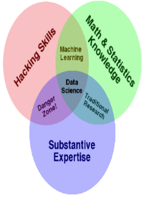
Data Storytelling is Currently “Hot”
Evidence:
Quotations of Leaders in Data Science we presented earlier
Watch Commercials: https://www.tableau.com/solutions/customer/storytelling-data-0
Popularity of TED Talks, most of which mostly center on data storytelling.
New productsaps: https://www.esri.com/arcgis-blog/story-maps/
…
A lot of data storytelling contests
Data Analysis and Intelligent Systems Lab
Notes:
r

