Slide 1
First 2-3 Lectures: Intro to DM/DS
COSC 3337 Webpage: http://www2.cs.uh.edu/~ceick/UDM/3337.html
Part 1: Introduction to DM/DS
Part 2: Introduction & Course Information
Introduction Part3: Data Science and Data
Will begin the discussion of Exploratory Data Analysis on August 29
Will talk about undergraduate research opportunities on August 29
Dr. Eick & UH-DAIS http://www2.cs.uh.edu/~ceick/ceick.html

Slide 2
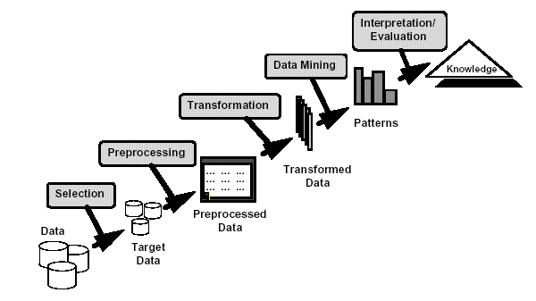
What is Data Mining?
Many Definitions
  Non-trivial extraction of implicit, previously unknown and potentially useful information from data
  Exploration & analysis, by automatic or
  semi-automatic means, of
  large quantities of data
  in order to discover
  meaningful patterns
Other Name: Knowledge Discovery in Data (KDD)
KDD is the No. 1 Data Mining Conference: watch conference video: KDD 2019 - Anchorage, Alaska on Vimeo

Slide 3
Definitions of Data Science
Data Science is an interdisciplinary field about processes and systems to extract knowledge or insights from data in various forms, either structured or unstructured, which is a continuation of some of the data analysis fields such as statistics, data mining, and predictive analytics, similar to Knowledge Discovery in Data (KDD).
Data Science is a multi-disciplinary field that uses scientific methods, processes, algorithms and systems to extract knowledge and insights from structured and unstructured data. Data science is the same concept as data mining and big data: "use the most powerful hardware, the most powerful programming systems, and the most efficient algorithms to solve problems“… Data science is a "concept to unify statistics, data analysis, machine learning and their related methods" in order to "understand and analyze actual phenomena" with “data technology“ (Wikipedia)

Slide 4

Why Mine Data? Commercial Viewpoint
Lots of data is being collected
and warehoused
  Web data, e-commerce
  purchases at department/
  grocery stores
  Bank/Credit Card
  transactions
Computers have become cheaper and more powerful
Competitive Pressure is Strong
  Provide better, customized services for an edge (e.g. in Customer Relationship Management)

Slide 5
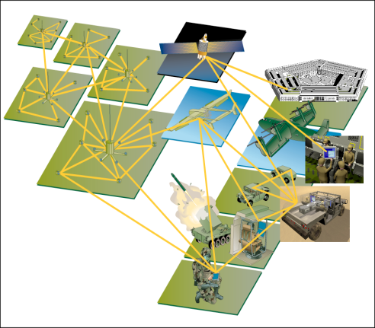
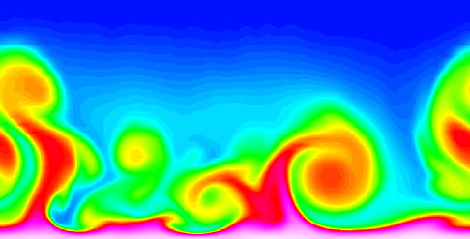
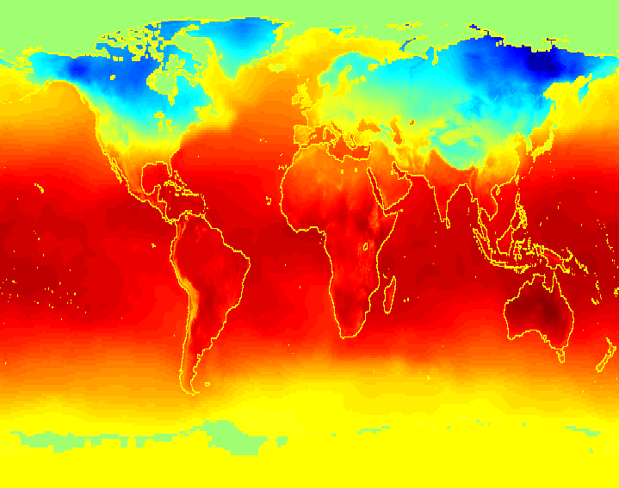
Why Mine Data? Scientific Viewpoint
Data collected and stored at
enormous speeds (GB/hour)
  remote sensors
  microarrays generating gene
  expression data
  scientific simulations
  generating terabytes of data
Traditional techniques infeasible for raw data
Data mining may help scientists
  in classifying and segmenting data
  in Hypothesis Formation
  summarizing data

Slide 6
Origins of Data Mining
Draws ideas from machine learning/AI, pattern recognition, statistics, and database systems
Traditional Techniques
may be unsuitable due to
  Enormity of data
  High dimensionality
  of data
  Heterogeneous,
  distributed nature
  of data
Statistics/
AI
Machine Learning/
Pattern
Recognition
Data Mining
Database systems

Slide 7
DM/DS Methods
Prediction Methods
  Use some variables to predict unknown or future values of other variables.
Description Methods
  Find human-interpretable patterns that describe the data; create summaries
From [Fayyad, et.al.] Advances in Knowledge Discovery and Data Mining, 1996

Slide 8
DM/DS Tasks...
Classification [Predictive]
Regression [Predictive]
Clustering [Descriptive]
Association Analysis Association [Descriptive]
  Rule Discovery
  Sequential Pattern Discovery
Deviation Detection / Anomaly Detection [Predictive/Descriptive]

Slide 9
Classification: Definition
Given a collection of records (training set )
  Each record contains a set of attributes, one of the attributes is the class.
Find a model for class attribute as a function of the values of other attributes.
Goal: previously unseen records should be assigned a class as accurately as possible.
  A test set is used to determine the accuracy of the model. Usually, the given data set is divided into training and test sets, with training set used to build the model and test set used to validate it.

Slide 10
Classification Example
categorical
categorical
continuous
class
Test
Set
Learn
Classifier
Training
Set
Model

Slide 11
Classification: Application 1
Direct Marketing
  Goal: Reduce cost of mailing by targeting a set of consumers likely to buy a new cell-phone product.
  Approach:
    Use the data for a similar product introduced before.
    We know which customers decided to buy and which decided otherwise. This {buy, don’t buy} decision forms the class attribute.
    Collect various demographic, lifestyle, and company-interaction related information about all such customers.
      Type of business, where they stay, how much they earn, etc.
    Use this information as input attributes to learn a classifier model.
From [Berry & Linoff] Data Mining Techniques, 1997

Slide 12
Classification: Application 2
Customer Attrition/Churn:
  Goal: To predict whether a customer is likely to be lost to a competitor.
  Approach:
    Use detailed record of transactions with each of the past and present customers, to find attributes.
      How often the customer calls, where he calls, what time-of-the day he calls most, his financial status, marital status, etc.
    Label the customers as loyal or disloyal.
    Find a model for loyalty.
From [Berry & Linoff] Data Mining Techniques, 1997

Slide 13
Classification: Application 3
Sky Survey Cataloging
  Goal: To predict class (star or galaxy) of sky objects, especially visually faint ones, based on the telescopic survey images (from Palomar Observatory).
      3000 images with 23,040 x 23,040 pixels per image.
  Approach:
    Segment the image.
    Measure image attributes (features) - 40 of them per object.
    Model the class based on these features.
    Success Story: Could find 16 new high red-shift quasars, some of the farthest objects that are difficult to find!
From [Fayyad, et.al.] Advances in Knowledge Discovery and Data Mining, 1996

Slide 14
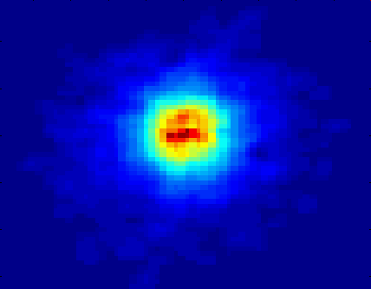
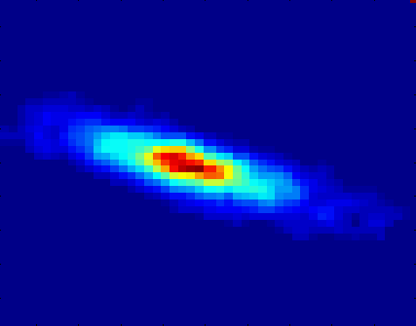
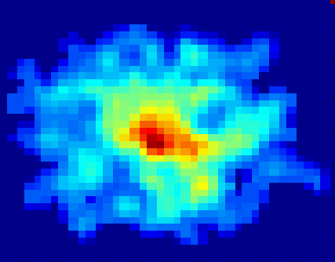
Classifying Galaxies
Courtesy: http://aps.umn.edu
Early
Class:
Stages of Formation
Attributes:
Image features,
Characteristics of light waves received, etc.
Intermediate
Late
Data Size:
72 million stars, 20 million galaxies
Object Catalog: 9 GB
Image Database: 150 GB

Slide 15
DM/DS Tasks
Prediction Methods
  Use some variables to predict unknown or future values of other variables.
Description Methods
  Find human-interpretable patterns that describe the data; create summaries
From [Fayyad, et.al.] Advances in Knowledge Discovery and Data Mining, 1996

Slide 16
Clustering Definition
Given a set of data points, each having a set of attributes, and a similarity measure among them, find clusters such that
  Data points in one cluster are more similar to one another.
  Data points in separate clusters are less similar to one another.
Similarity Measures:
  Euclidean Distance if attributes are continuous.
  Other Problem-specific Measures.

Slide 17
Illustrating Clustering
Euclidean Distance Based Clustering in 3-D space.
Intracluster distances
are minimized
Intercluster distances
are maximized

Slide 18
Clustering: Application 1
Document Clustering:
  Goal: To find groups of documents that are similar to each other based on the important terms appearing in them.
  Approach: To identify frequently occurring terms in each document. Form a similarity measure based on the frequencies of different terms. Use it to cluster.
  Gain: Information Retrieval can utilize the clusters to relate a new document or search term to clustered documents.

Slide 19
Illustrating Document Clustering
Clustering Points: 3204 Articles of Los Angeles Times.
Similarity Measure: How many words are common in these documents (after some word filtering).

Slide 20
Application 2: Clustering of S&P 500 Stock Data
Observe Stock Movements every day.
Clustering points: Stock-{UP/DOWN}
Similarity Measure: Two points are more similar if the events described by them frequently happen together on the same day.

Slide 21
A Question asked by a Student in COSC 6335
Clustering and Classification divide objects into some groups. So
when I am performing clustering I also have to do classification?
Are they both dependent / related?

Slide 22
Clustering vs. Classification
Traditional Clustering
Classification
Goal is to identify groups of similar objects
Groups (clusters, new classes) are discovered
Dataset consists of attributes
Unsupervised (class label has to be learned)
Important: Similarity assessment which derives a “distance function” is critical, because clusters are discovered based on distances/density.
Pre-defined classes
Datasets consist of attributes and a class labels
Supervised (class label is known)
Goal is to predict classes from the object properties/attribute values→learn a model
Classifiers are learnt from sets of classified examples
Important: classifiers need to have a high accuracy

Slide 23
Association Rule Discovery: Definition
Given a set of records each of which contain some number of items from a given collection;
  Produce dependency rules which will predict occurrence of an item based on occurrences of other items.
Rules Discovered:
{Milk} --> {Coke}
{Diaper, Milk} --> {Beer}

Slide 24
Association Rule Discovery: Application
Supermarket shelf management.
  Goal: To identify items that are bought together by sufficiently many customers.
  Approach: Process the point-of-sale data collected with barcode scanners to find dependencies among items.
  A classic rule --
    If a customer buys diaper and milk, then he is very likely to buy beer.
    So, don’t be surprised if you find six-packs stacked next to diapers!

Slide 25
Sequential Pattern Discovery: Examples
In telecommunications alarm logs,
  (Inverter_Problem Excessive_Line_Current)
  (Rectifier_Alarm) --> (Fire_Alarm)
In point-of-sale transaction sequences,
  Computer Bookstore:
  (Intro_To_Visual_C) (C++_Primer) --> (Perl_for_dummies,Tcl_Tk)
  Athletic Apparel Store:
  (Shoes) (Racket, Racketball) --> (Sports_Jacket)

Slide 26
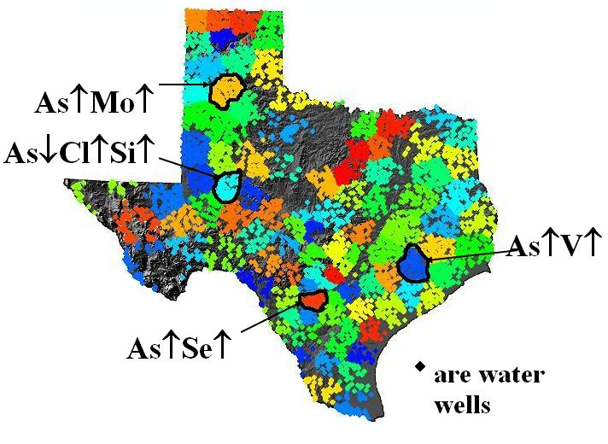
Co-location Mining
Task: Find regions in Texas where high/low concentrations of chemicals are co-located in the Texas Water Supply.
Figure 2: Chemical co-location
patterns in Texas’ Water Supply¹

Slide 27
Regression
Predict a value of a given continuous valued variable based on the values of other variables, assuming a linear or nonlinear model of dependency.
Greatly studied in statistics, neural network fields.
Examples:
  Predicting sales amounts of new product based on advetising expenditure.
  Predicting wind velocities as a function of temperature, humidity, air pressure, etc.
  Time series prediction of stock market indices.

Slide 28
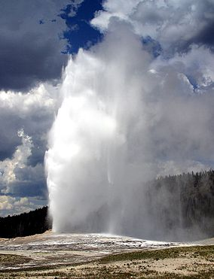
Old Faithful Geyser
Old Faithful Geyser - Yellowstone National Park (HD) - Bing video
http://www.web.pdx.edu/~jfreder/M212/oldfaithful.pdf
http://www.geyserstudy.org/geyser.aspx?pGeyserNo=OLDFAITHFUL
http://en.wikipedia.org/wiki/Old_Faithful

Slide 29
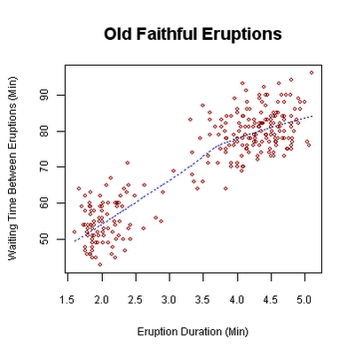
Scatter Plot Old Faithful Eruptions
http://en.wikipedia.org/wiki/Old_Faithful

Slide 30
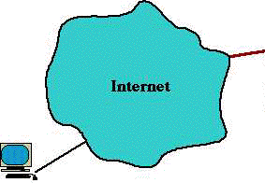
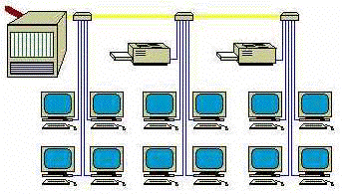
Outlier/Anomaly Detection
Detect significant deviations from normal behavior
Applications:
  Credit Card Fraud Detection
  Network Intrusion
  Detection
  Data Cleaning
Typical network traffic at University level may reach over 100 million connections per day

Slide 31
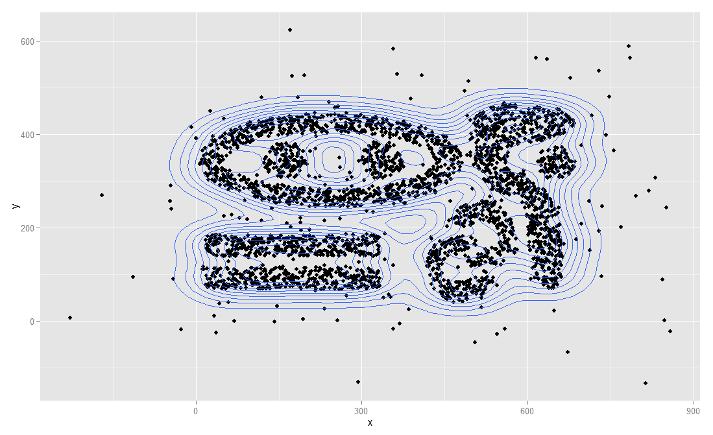
Examples: Which Data Points are Outliers?
Remark: Using a model-based approach, points on the same density contour line should
have the same likelihood to be outliers with respect to the underlying statistical model M.

Slide 32
Challenges of Data Mining
Scalability
Dimensionality
Complex and Heterogeneous Data
Data Quality
Data Ownership and Distribution
Privacy Preservation
Streaming Data

Slide 33
Data Mining Software
http://www.kdnuggets.com/software/index.html

Slide 34
Data Mining Conferences (Ranked by Importance!)
KDD 2022 KDD 2023 | Long Beach, CA, USA - KDD 2023 (calls itself the number 1 Data Science Conference)
ICDM 2022: IEEE International Conference on Data Mining 2022 (ICDM2022) | IEEE ICDM 2022 (usf.edu)
ECML/PKDD 2022: https://2022.ecmlpkdd.org

