Slide 1
What is Data Science?
What words come to mind when you think of Data Science?
What experience do you have with Data Science?
Why are you taking the Data Science I class?

Slide 2
Data Science Definitions
Data Science is an interdisciplinary field about processes and systems to extract knowledge or insights from data in various forms, either structured or unstructured, which is a continuation of some of the data analysis fields such as statistics, data mining, and predictive analytics, similar to Knowledge Discovery in Data (KDD).
Data Science is a multi-disciplinary field that uses scientific methods, processes, algorithms and systems to extract knowledge and insights from structured and unstructured data. Data science is the same concept as data mining and big data: "use the most powerful hardware, the most powerful programming systems, and the most efficient algorithms to solve problems" Data science is a "concept to unify statistics, data analysis, machine learning and their related methods" in order to "understand and analyze actual phenomena" with data technology“ (Wikipedia)

Slide 3
Data Science Definitions II
There are many, but most say data science is:
Broad – broader than any one existing discipline
Interdisciplinary: Computer Science, Statistics, Information Science, Databases, Mathematics
Applied focus on extracting knowledge from data to inform decision making.
Focuses on the skills needed to collect, manage, store, distribute, analyze, visualize, reuse data and on data storytelling.
There are many visual representations in Data Science

Slide 4
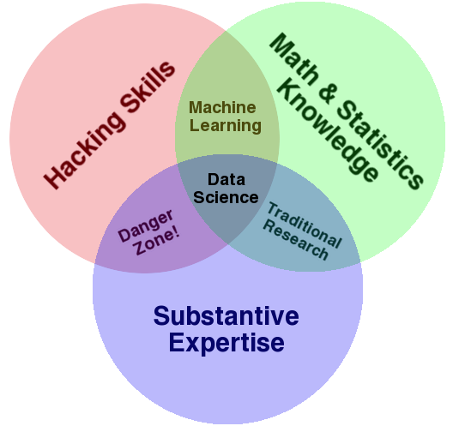
Some More Definitions

Slide 5
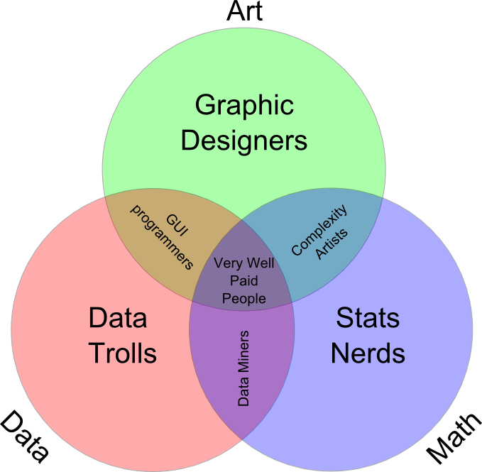
More Definitions

Slide 6
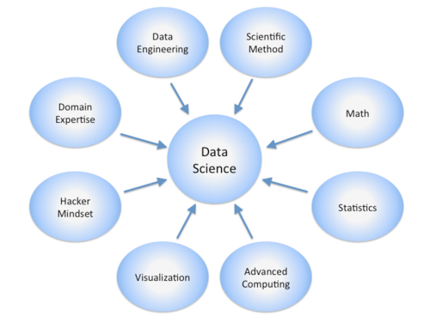
Data Science is Broad!

Slide 7
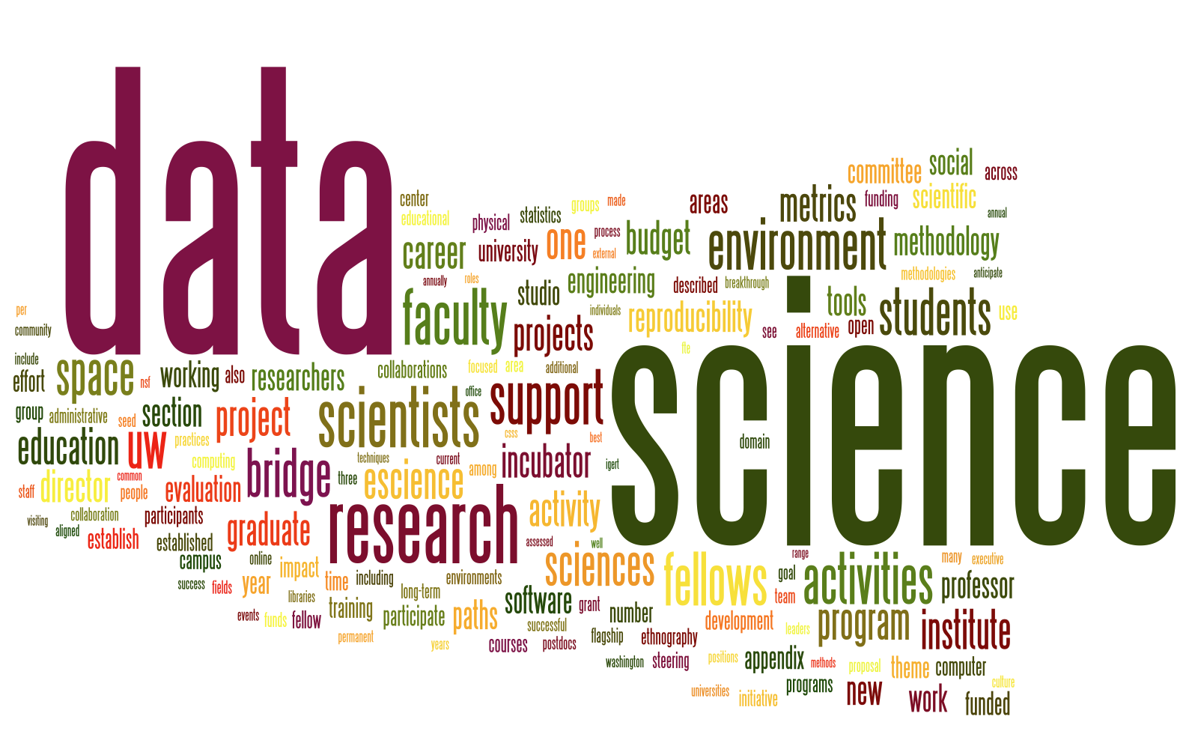
Data Science Word Cloud

Slide 8
Data Analysis
We analyze data to extract meaning from it.
Virtually all data analysis focuses on data reduction
Data reduction comes in the form of:
Descriptive statistics
Measures of association
Graphical visualizations
The objective is to abstract from all of the data some feature or set of features that captures evidence of the process you are studying

Slide 9
The Data Lifecycle
Data science considers data at every stage of what is called the data lifecycle.
This lifecycle generally refers to everything from collecting data to analyzing it to sharing it so others can re-analyze it.
New visions of this process in particular focus on integrating every action that creates, analyzes, or otherwise touches data.
These same new visions treat the process as dynamic – archives are not just digital shoe boxes under the bed.
There are many representations of the this lifecycle.

Slide 10
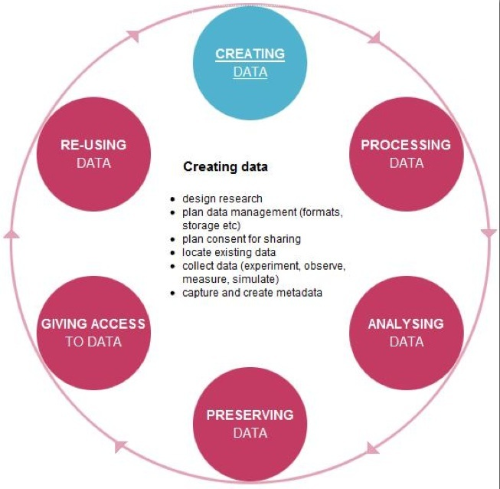

Slide 11
Data Curation
Data curation is a term used to indicate management
activities related to organization and integration
of data collected from various sources, annotation of the
data, and publication and presentation of the data such
that the value of the data is maintained over time, and the
data remains available for reuse and preservation.

Slide 12
News August 29, 2023
Task1 ProblemSet1 should be available on Sept. 5 or earlier; check course website!
Plans for today’s class
Finish Introduction to Data Science/Data Mining
3p: Conduct Survey R/Python Knowledge of Students in the course
Data Science Basics & Exploratory Data Analysis
Plans for the August 31 class
Continue Data Science Basics & Exploratory Data Analysis
Preprocessing for DS/Data Mining
Optional: Brief Discussion of Task1 of ProblemSet1
More Discussion GHC and Announce GHC Groups
There will be a lab as part of the Sept. 5 class; bring laptop!

Slide 13
What is Missing?
Most definitions of data science underplay or leave out discussions of:
Substantive theory
Metadata
Privacy and Ethics

Slide 14
Privacy and Ethics
Data, the elements of data science, and even so-called “Big Data” are not new.
One thing that is new is the greater variety of data and, most importantly, the amount of data available about humans.
Discussion and good policy regarding privacy, security, and the ethical use of data about people lags behind the methods of collecting, sharing, archiving, and analyzing data.

Slide 15
Big Data
The launch of the Data Science conversation has been sparked primarily by the so-called “Big Data” revolution.
As mentioned, we have always had data that taxed our technical and computational capacities.
“Big Data” makes front-page news, however, because of the explosion of data about people.
Contemporary definitions of Big Data focus on:
Volume (the amount of data)
Velocity (the speed of data in and out)
Variety (the diverse types of data)

Slide 16
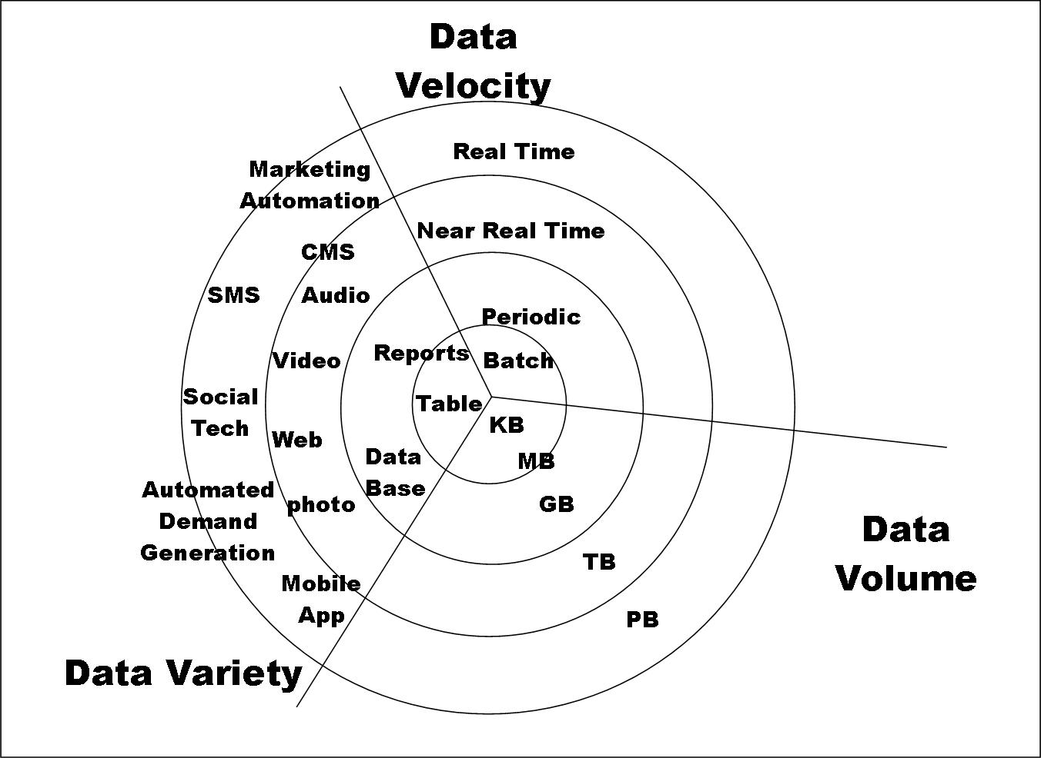

Slide 17
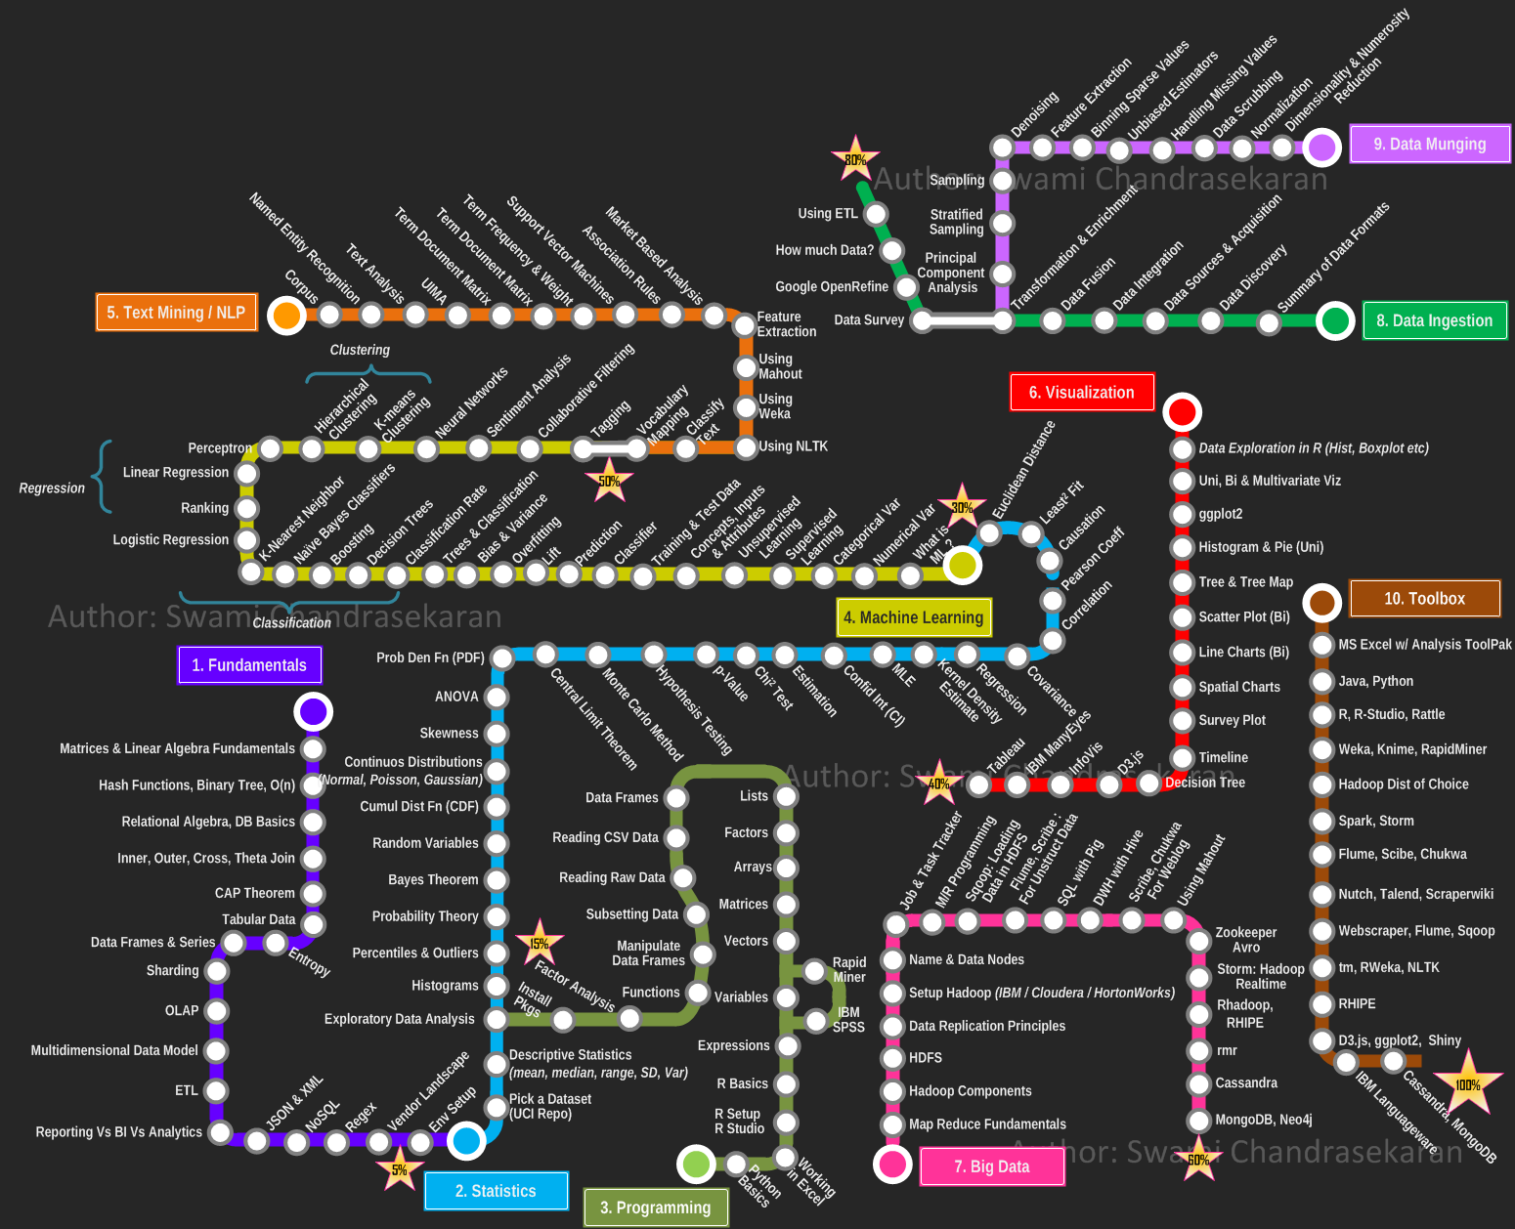
Talk Outline
Data Science According to Swami Chandrasekaran
Importance of Data Science
Data Science is More than Using Tools
Data Storytelling
Examples of Data Storytelling
Conclusion
Data Analysis and Intelligent Systems Lab

Slide 18
Data Science and Storytelling
Google’s Chief Economist Dr. Hal R.Varian stated, "The ability to take data—to be able to understand it, to process it, to extract value from it, to visualize it, to communicate it—that’s going to be a hugely important skill in the next decades."
“When hiring data scientists, people tend to focus primarily on technical qualifications. It’s hard to find candidates who have the right mix of computational and statistical skills. But what’s even harder is finding people who have those skills and are good at communicating the story behind the data.” Michael Li
Data Analysis and Intelligent Systems Lab
Notes:
r

Slide 19
Data Science and Storytelling 2
Not covered in August 2023, except we showed one video!
“Data scientists are involved with gathering data, massaging it into a tractable form, making it tell its story, and presenting that story to others.” – Mike Loukides, VP, O’Reilly Media
“Our challenge as data scientists is to translate this haystack of information into guidance for staff so they can make smart decisions…We “humanize” the data by turning raw numbers into a story about our performance. Data scientists want to believe that data has all the answers. But the most important part of our job is qualitative: asking questions, creating directives from our data, and telling its story. ” Jeff Bladtand and Bob Filbin
Telling Stories with Data in 3 Steps (Quick Study) - Bing video (showed this video on Aug. 24, 2023)
The Power in Effective Data Storytelling | Malavica Sridhar | TEDxUIUC - Bing video starting 6:40
20 of the Best Video Storytelling Examples EVER | Wyzowl
20 Best Data Storytelling Examples (updated for 2023) — Juice Analytics
Data Analysis and Intelligent Systems Lab
Notes:
r

Slide 20
Comment
This concludes the Introduction to Data Science/Data Mining
The remaining slides of this slide show and other slides will be discussed in a lecture centering of “Data Storytelling”, in the second half of November 2023…
There will be also some limited coverage of Data Science Ethics in November, 2023.

Slide 21
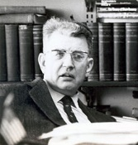
Data Science is More than Using Tools
Slides which follow were not covered in August 2023!
The problem with data is that it says a lot, but it also says nothing. ‘Big data’ is terrific, but it’s usually thin. To understand why something is happening, we have to engage in both forensics and guess work.”- Sendhil Mullainathan, Professor of economics, Harvard
“But a theory is not like an airline or bus timetable. We are not interested simply in the accuracy of its predictions. A theory also serves as a base for thinking. It helps us to understand what is going on by enabling us to organize our thoughts. Faced with a choice between a theory which predicts well but gives us little insight into how the system works and one which gives us this insight but predicts badly, I would choose the latter, and I am inclined to think that most economists would do the same.” ― Ronald H. Coase, Essays on Economics and Economists
Data Analysis and Intelligent Systems Lab
Notes:
r

Slide 22
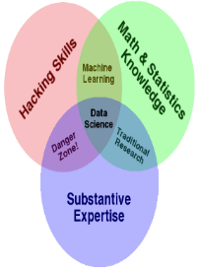
Data Storytelling is Currently “Hot”
Evidence:
Quotations of Leaders in Data Science we presented earlier
Watch Commercials: https://www.tableau.com/solutions/customer/storytelling-data-0
Popularity of TED Talks, most of which mostly center on data storytelling.
New productsaps: https://www.esri.com/arcgis-blog/story-maps/
…Learn Data Story telling on Tableau 2022 in 7 mins - Bing video
A lot of data storytelling contests
Data Analysis and Intelligent Systems Lab
Notes:
r

Slide 23
Importance of Data Science
“It is a capital mistake to theorize before one has data.”- Arthur Conan Doyle, Author of Sherlock Holmes
If you’re a scientist, and you have to have an answer, even in the absence of data, you’re not going to be a good scientist.” – Neil deGrasse Tyson, Astrophysicist
“Without big data analytics, companies are blind and deaf, wandering out onto the Web like deer on a freeway.” – Geoffrey Moore, Partner at MDV
Data Analysis and Intelligent Systems Lab
Notes:
r

Slide 24
Resposibilities of Data Scientists
1. We have to have some committment to telleth
„Torture the data long enough and it will confess to anything." Nobel Prize winning economist Ronald Coase
“To find signals in data, we must learn to reduce the noise - not just the noise that resides in the data, but also the noise that resides in us. It is nearly impossible for noisy minds to perceive anything but noise in data.” ― Stephen Few, Signal: Understanding What Matters in a World of Noise
2. We have to know what we are doing
Data Analysis and Intelligent Systems Lab
Notes:
r

Slide 25
COSC Data Science Curriculum
COSC 3337: Data Science II (starting in 2019)
Credit Hours: 3.0 Lecture Contact Hours: 3 Lab Contact Hours: 0
Prerequisite: ‘Data Structures’
Data science process, data preprocessing, exploratory data analysis, data visualization, basic statistics, basic machine learning concepts, classification and prediction, similarity assessment, clustering, post-processing and interpreting data analysis results, use of data analysis tools and programming languages and data analysis case studies.
Data Analysis and Intelligent Systems Lab
Notes:
r

