Slide 1
News October 12, 2023
Dr. Eick: No office hour on Tu., Oct. 17; extra office Fr., Oct. 20, 2-3p; Janet will teach the Oct. 17 lecture “Introduction to Clustering”
Problem Set 2 has been posted last week; Task 3 is due on Nov. 4!
Today’s activities:
Brief Discussion Group Project
GHC Presentation Group G
Similarity Assessment
Data Storytelling (if enough time)

Slide 2
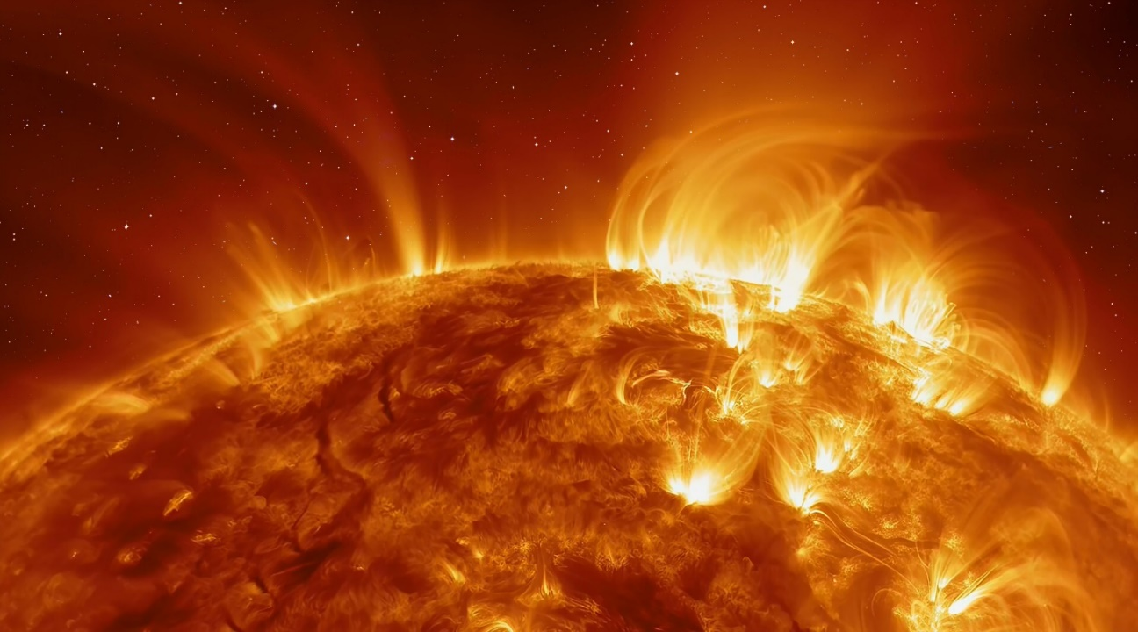
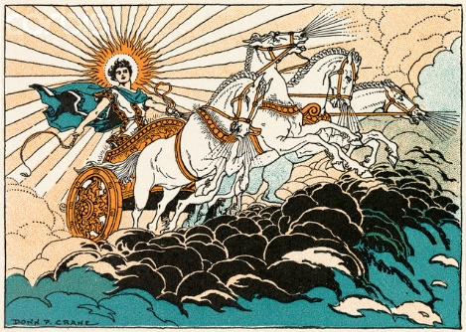
Geo-AI Plan
Will continue to work in Word Format with tracking changes for Section 1, 2, 4 and 5. Need the text to modify it for the other Sections; what will I get?
Other sections will be send to the other authors in a second file.
Dr. Eick and Mahin will meet at noon on Sunday
Dr. Eick will work on Section 4 and will send you a “complete” draft likely with a small number of instructions either today at 5p or Sunday at 11:30a. You will enhance this Word file and send it to the other authors by Monday 10a at latest. Appendix and Other sections will also be sent by Monday at 10a the latest to the other authors.
Send me a summary of all non-Houston results by Sunday at 10:30a; send it in a separate Word file.
Dr. Eick will work on Sections 3.a and 6 and maybe conclusion on Sunday, unlikely TFriday
Will write abstract Monday late or Tuesday the latest
Will convert the paper in LaTeX starting Tuesday
Will hopefully still submit the paper Wednesday, end of the day!
Helios: Summarization, Mapping, Hotspot Discovery and Change Analysis of High-Intensity Solar Flare Events
UH-DAIS

Slide 3
Group Project Tasks
You will produce two kind of solar flare intensity summaries (for batches of solar flare events):
Frequency-based using the attribute total.counts
Energy-based using the attributes the duration.s and energy.kev---you can propose alternative methods, if you feel they are more suitable.
Intensity summaries a location-based and allow analyzing spatial variation.
You will design and implement intensity hotspot discovery algorithms
You will map these intensity summaries and hotspots
You will produce time series of hotspots.
You will compare 2004-2005 solar flares with 2015-2016 solar flares, and summarize major changes between the two periods, by:
Computing Basic Statistics
By using methods you developed in the previous steps

Slide 4
Other Remarks Group Project
Try to understand the dataset as soon as possible.
There are a lot of papers which used the NASA Solar Flare Dataset
Analysis is conducted for batches
In the group project you have more freedom with respect to how you solve the particular problem at hand.
In the group project you need to break down tasks into subtasks, which is not necessary for other problem set tasks in the course.
Raunak and Dr. Eick are still trying to understand solar flares and the solar flare datasets themselves.

