Slide 1
Non-Parametric Density Functions
Christoph F. Eick
Last updated 11/1/23

Slide 2
Influence Functions
The influence function of a data object is a function f_{B}^{y} : F^{d} → R₀⁺ which is defined in terms of a basic influence function f_{B}
Examples of basic influence functions are:
>

Slide 3
News November 9, 2023
Average of Task2 was 35.9/45 points (about 80%)
Midterm2 Exam on Tu., Nov. 14 in SW101 at 11:30---same time and same place.
Group Project is due Sa., November 11!
Data Science Showcase December 1, 2023
Today’s Program
Review and a little more about NPDE
Continue watching video about Autoencoders
GHC presentation group L
Review for the Midterm2 Exam

Slide 4
Key Idea: Kernel Density Estimation
D={x1,x2,x3,x4}
f^{D}_{Gaussian}(x)= influence(x1,x) + influence(x2,x) +
influence(x3,x) + influence(x4)= 0.04+0.06+0.08+0.6=0.78
x1
0.04
x3
y
0.08
x2
x4
0.06
x
0.6
Remark: the density value of y would be larger than the one for x

Slide 5
Notations
O={o₁,…,o_{n}} is a dataset whose density has to be measured
r is the dimensionality of O
n is the number of objects in O
d: F^{r}X F^{r}→ R₀⁺ is a distance function for the objects in O; d is assumed to be Euclidian distance unless specified otherwise
d_{k}(x) is the distance of x its k-nearest neighbor in O

Slide 6
Gaussian Kernel Density Estimation
Density functions f_{B}: defined as the sum of the influence functions of all data points. Given N data objects, O={o₁,…, o_{n}} the density function is defined as—normalized version:
Non-Normalized Version:
Example: Gaussian Kernel Non-parametric Density Function f
Remark: σ is called kernel or bandwidth; named h in some textbooks!

Slide 7
2D Gaussian Kernel Function
Let O be a 2D dataset containing n pairs of numbers
2D Gaussian Kernel: G_{2D}(x,y,σ)= (1/(2π∗σ**2))∗e^{−(x**2+y**2)/(2σ**2)}
ψ_{Gauss}(q_{x},q_{y})= 1/n∗Σ_{(x,y)∈O} G_{2D}(q_{x}−x, q_{y}−y,σ)
See also: Multivariate kernel density estimation – Wikipedia and 03Gaussiankernel.nb (wisc.edu)
Remark: We claim that ψ_{Gauss}(q_{x},q_{y}) produces a similar result as using f_{Gauss} ((q_{x},q_{y})) in conjunction with Manhattan distance except that the returned density of ψ_{Gauss} is normalized by multiplying its value by 1/(n∗2π∗σ**2); that is:
f_{Gauss} ((q_{x},q_{y}))∗ 1/(n∗2π∗σ**2)=ψ_{Gauss}(q_{x},q_{y})

Slide 8
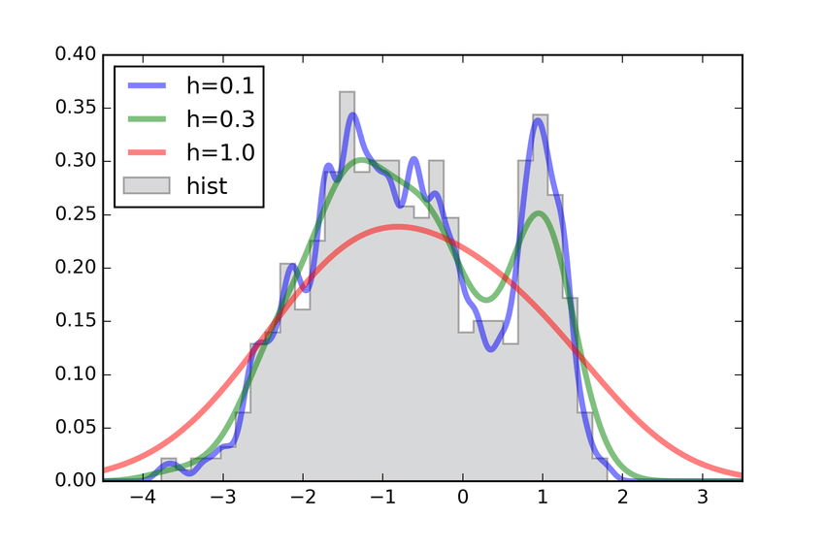
1D Kernel Density Function
Remark: h is σ, the bandwidth, in the earlier formulas!

Slide 9
kNN-based Density Functions
Example: kNN density function with variable kernel width—width is proportional to d_{k}(x) in point x: the distance of the k^{th} nearest neighbor in O to x; is usually difficult to normalize due to the variable kernel width; therefore, the integral over the density function does not add up to 1 and usually is ∞.
Parameter selection: Instead of the width σ, k has to be selected!
or Alpaydin mentions the following variation:

