Slide 1
Christoph F. Eick A Brief Introduction to Naïve and Parametric Density Estimation

Slide 2
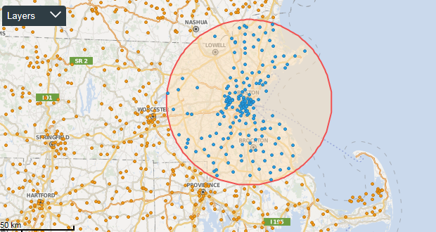
News Sept. 21, 2023
Please read the specification of Task2; it will be discussed in the Sept. 26 lecture.
Problem Set2 contains a group task (size 3), and we will set up the groups next week; you should receive an e-mail from Mahin about this matter by Sept. 25 the latest.
Task1 is due in 31/55 hours in Kritik.
Today’s Class:
Naïve and Parametric Density Estimation
GHC Presentation Group D
Non-parametric Density Estimation
Maybe, density-based Clustering.

Slide 3
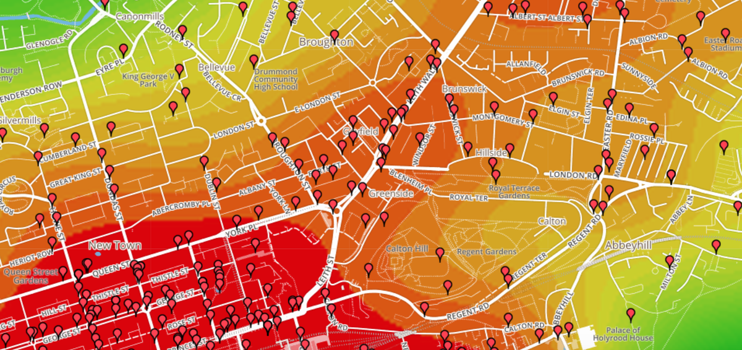
Motivation

Slide 4
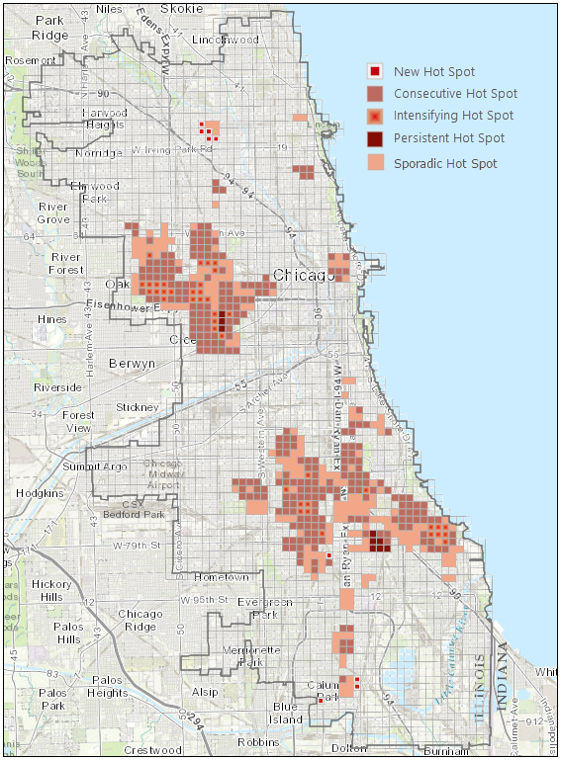
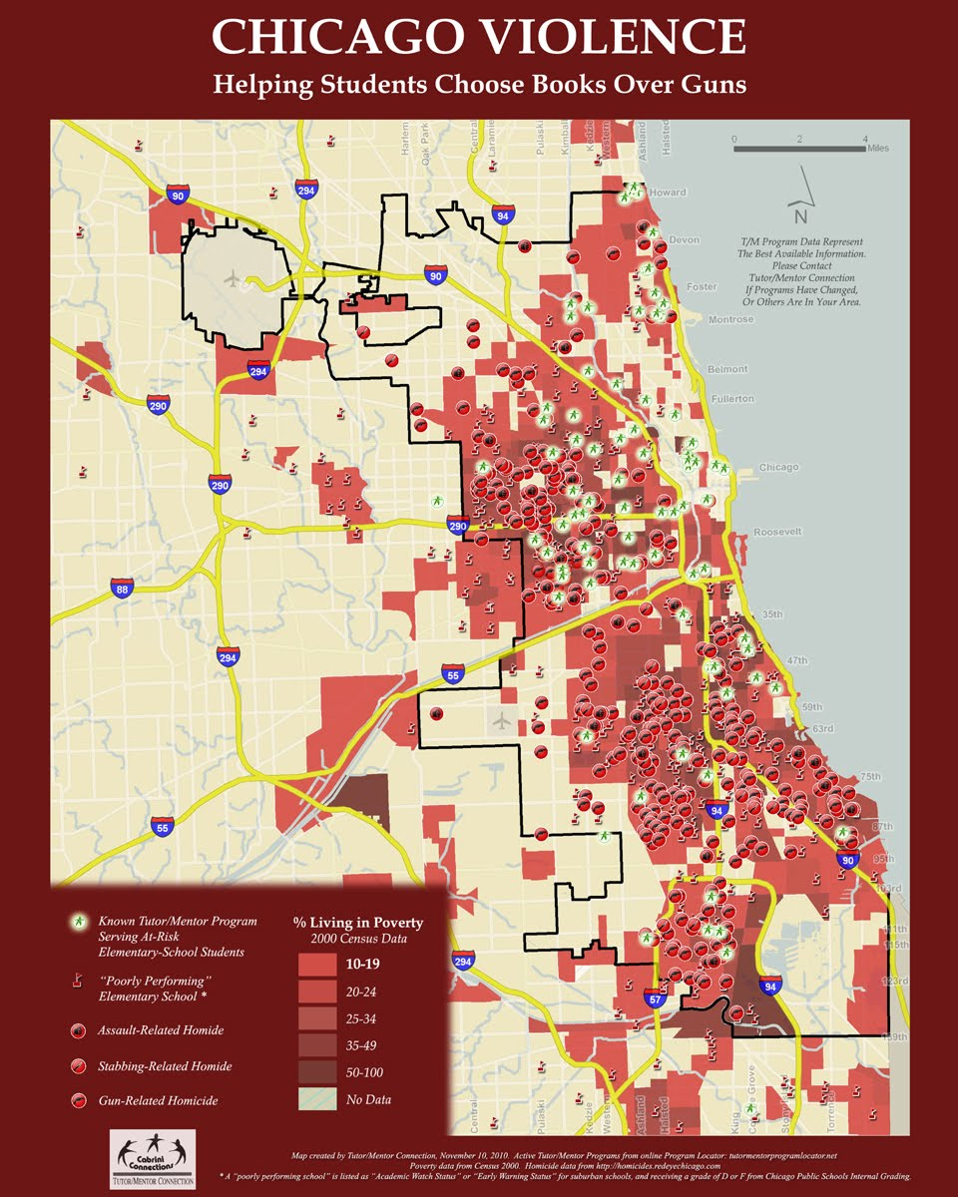
Motivation

Slide 5
Motivation

Slide 6
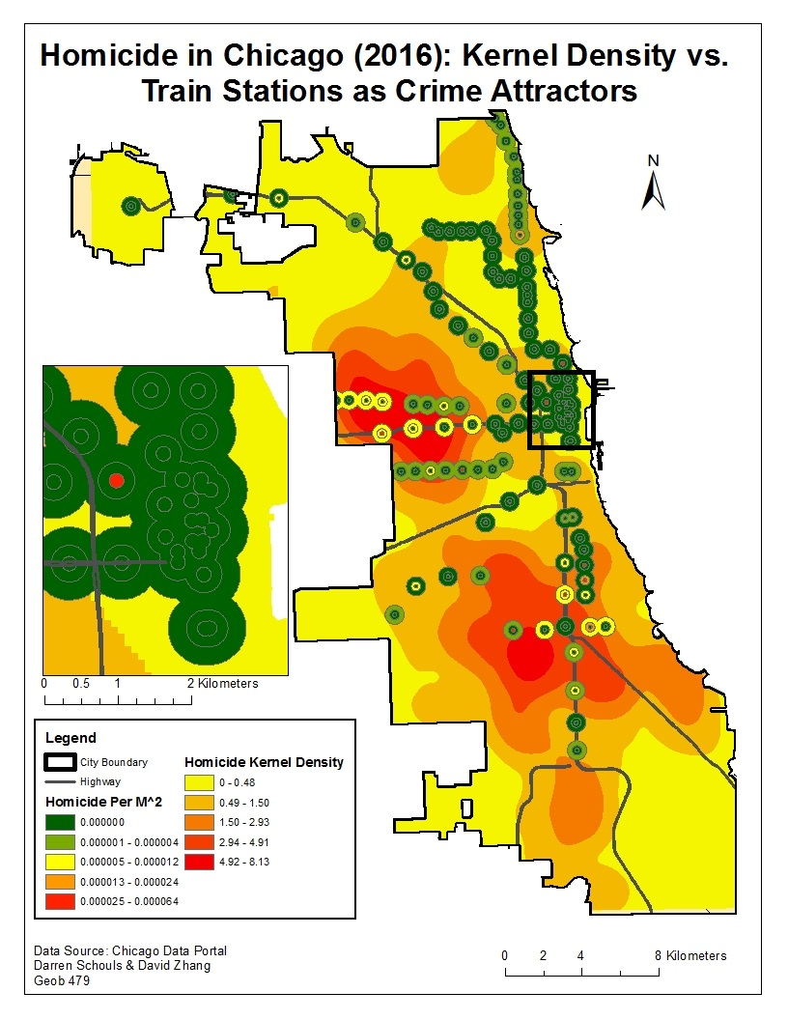
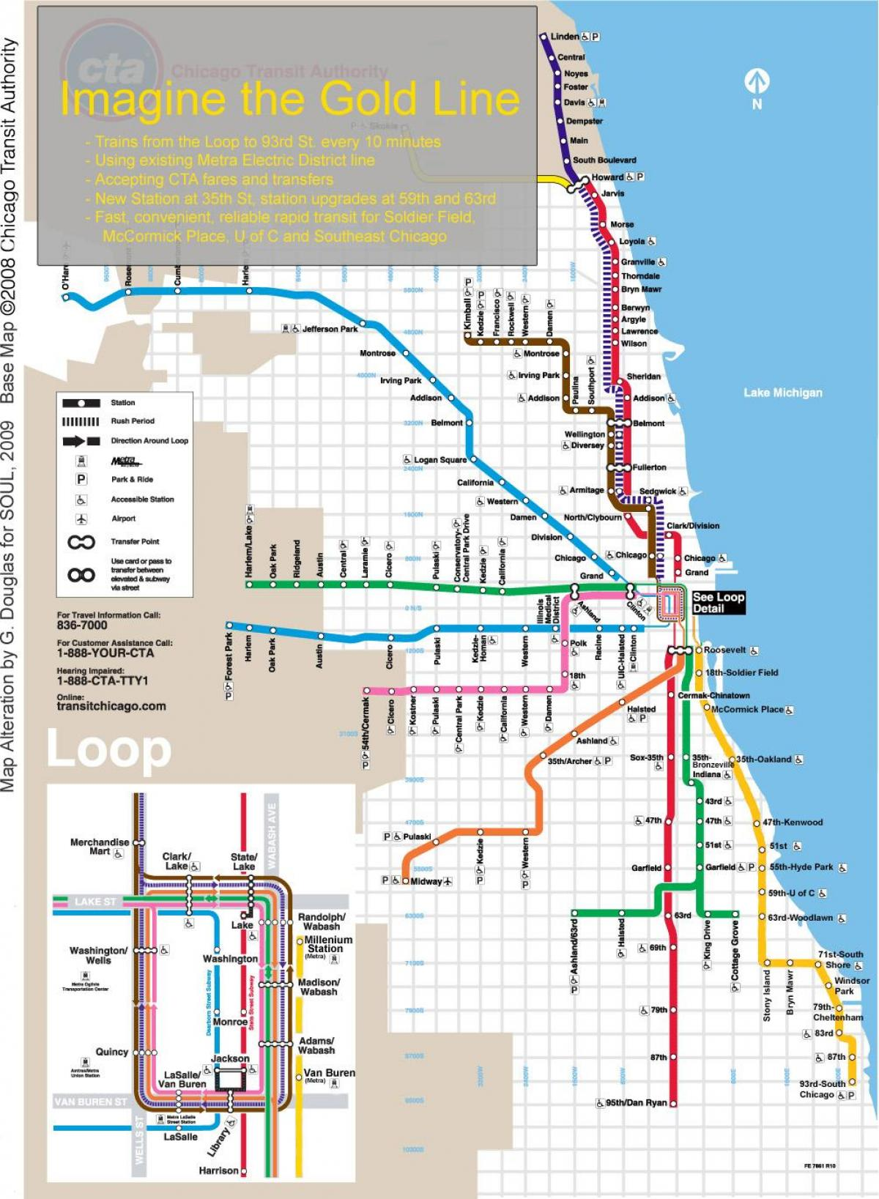
Motivation

Slide 7
Coverage of Density Estimation in COSC 3337
Naïve Density Estimation (short)
Non-Parametric Density Estimation
Parametric Density Estimation from a Bird’s Perspective (short)

Slide 8
Naïve Density Estimation
2 popular approaches:
Wrap a radius r with diameter 2ε around a query point p; its density is defined as:
φ(p)=“Number of points within the radius r of p”
Put a grid over the dataset; the density of a point is computed as follows:
φ(p)=“Number of points in the grid-cell p belongs to”
Grid size and ε are parameters of the two approaches.
Although simplistic, naïve density estimation has been successfully used in many applications.
Like any other density estimation approaches the naïve approach works better in low-dimensional spaces, particularly 2D and 3D.
In general, density estimation approaches rarely work well in high dimensional spaces

Slide 9
Curse of Dimensionality
When dimensionality increases, data becomes increasingly sparse in the space that it occupies
Definitions of density and distance between points, which are critical for clustering, density estimation and outlier detection, become less meaningful
Randomly generate 500 points
Compute difference between max and min distance between any pair of points

Slide 10
Parametric Estimation
Given X = { x^{t} }_{t}
goal: infer probability distribution p(x)
Parametric estimation:
Assume a form for p (x | θ) and estimate θ, its sufficient statistics, using X
e.g., N ( μ, σ²) where θ = { μ, σ²}
Problem: How can we obtain θ from X?
Assumption: X contains samples of a one-dimensional random variable
Later multivariate estimation: X contains multiple and not only a single measurement.
Example; Gaussian Distribution http://en.wikipedia.org/wiki/Normal_distribution

Slide 11
Maximum Likelihood Estimation
Density function p with parameters θ is given and x^{t}~p (X |θ)
Likelihood of θ given the sample X={x¹,…x^{t}}
L_{t}(θ|X) =L(θ|X) = p(X |θ) = ∏_{t} p(x^{t}|θ)
We look θ for that “maximizes the likelihood of the sample”!
Log likelihood
L(θ|X) = log L_{t}(θ|X) = ∑_{t} log p (x^{t}|θ)
Maximum likelihood estimator (MLE)
θ* = argmax_{θ} L(θ|X)
Homework: Sample: 0, 3, 4, 5 and x~N(μ,σ)? Use MLE to find (μ,σ)!

Slide 12
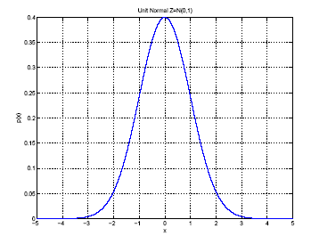
Gaussian (Normal) Distribution
p(x) = N ( μ, σ²)
MLE for μ and σ²:
μ
σ
http://en.wikipedia.org/wiki/Probability_density_function

Slide 13
Multivariate Data
Multiple measurements (sensors)
d inputs/features/attributes: d-variate
N instances/observations/examples

Slide 14
Multivariate Parameters
Example: 16 0 0
0 16 -3
0 -3 1
Correlation: http://en.wikipedia.org/wiki/Correlation

Slide 15
Parameter Estimation
http://en.wikipedia.org/wiki/Multivariate_normal_distribution
http://webscripts.softpedia.com/script/Scientific-Engineering-Ruby/Statistics-and-Probability/Multivariate-Gaussian-Distribution-35454.html

Slide 16
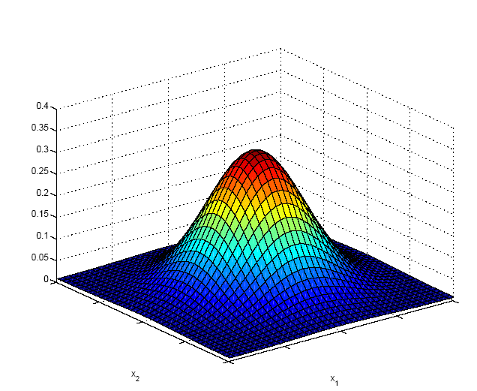
Multivariate Normal Distribution
Mahalanobis distance between x and μ
(5.9)

Slide 17
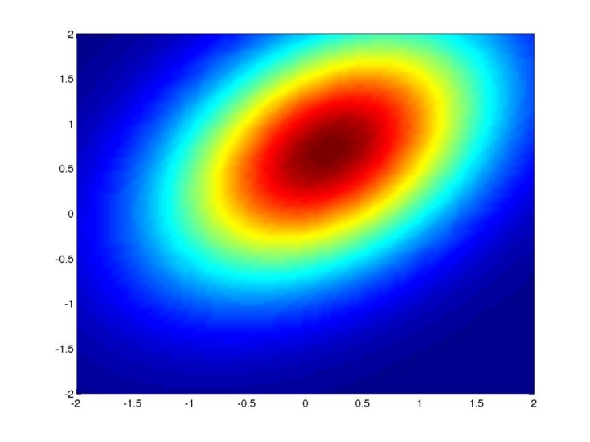
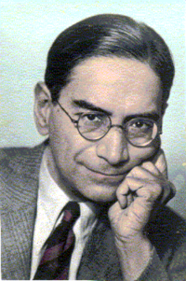
Mahalanobis Distance
http://en.wikipedia.org/wiki/Mahalanobis_distance
The Mahalanobis distance is based on correlations between variables by which different patterns can be identified and analyzed. It differs from Euclidean distance in that it takes into account the correlations of the data set and is scale-invariant.
Squared Mahalanobis distance between x and μ between ‘[‘ and ‘]’
http://www.analyzemath.com/Calculators/inverse_matrix_3by3.html

Slide 18
Multivariate Normal Distribution
Mahalanobis distance: (x – μ)^{T} ∑^{–1} (x – μ)
measures the distance from x to μ in terms of ∑ (normalizes for difference in variances and correlations)
Bivariate: d = 2
Remark: ρ is the correlation between the two variables
Called z-score zi for xi

Slide 19
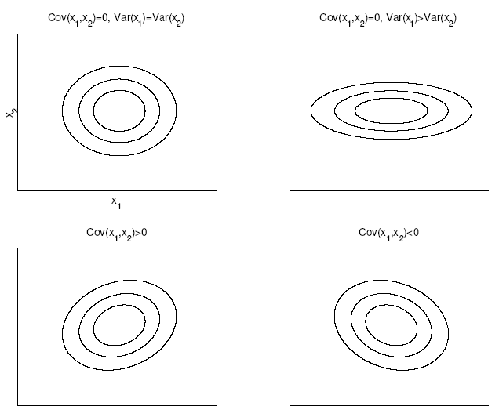
Bivariate Normal

Slide 20
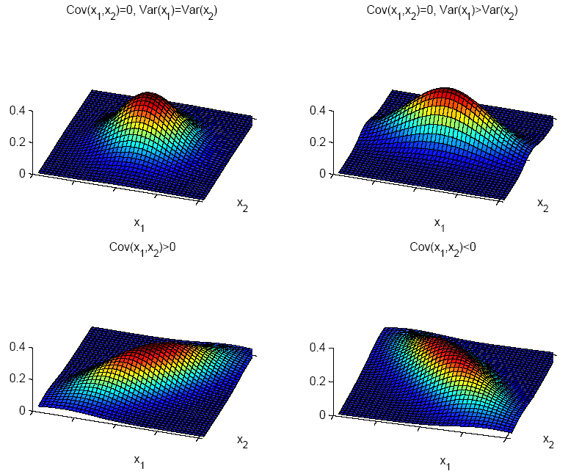

Slide 21
Model Selection
Assumption | Covariance matrix | No of parameters
Shared, Hyperspheric | S_{i}=S=s²I | 1
Shared, Axis-aligned | S_{i}=S, with s_{ij}=0 | d
Shared, Hyperellipsoidal | S_{i}=S | d(d+1)/2
Different, Hyperellipsoidal | S_{i} | K d(d+1)/2
As we increase complexity (less restricted S), bias decreases and variance increases
Assume simple models (allow some bias) to control variance (regularization
Remark: Mixtures of Gaussians is a more advanced approach which uses multiple multi-variate Gaussians.

Slide 22
Gaussian Mixture Models (GMM)
GMMs are the popular parametric density estimation approach; see Mixture model – Wikipedia
Will discuss GMM in detail, when we discuss the EM clustering algorithm and outlier detection
Might or might not discuss GMMs earlier, if we believe the are relevant for the Solar Flare Group project.

