Slide 1
A brief introduction to
Recurrent Neural Networks
Data Science I
Navid Ayoobi
Fall 2022

Slide 2
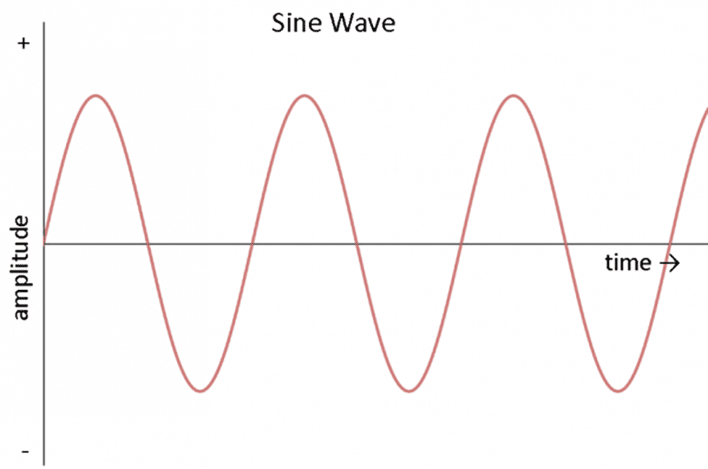
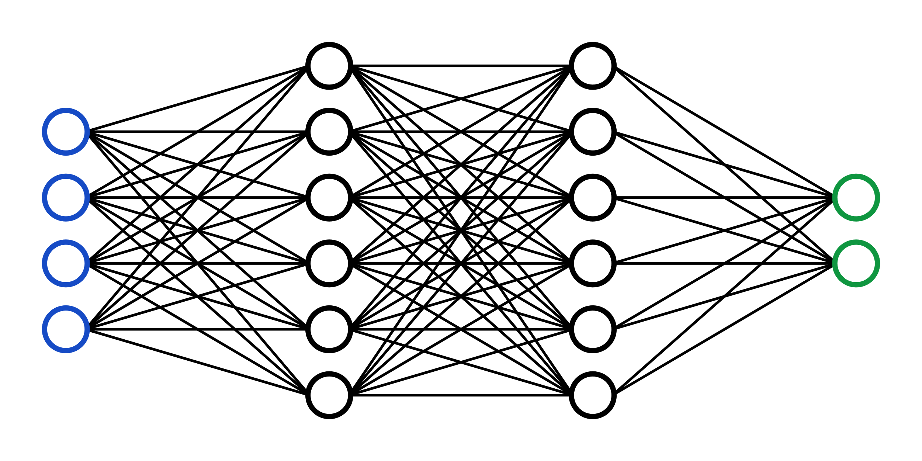
RNNs
are a family of neural networks for processing sequential data.
$$x_{i}$$
$x_{1},x_{2},$ $x_{3},x_{4},$…, $x_{n−1},x_{n}$
y
.
.
.
Fully connected NN
Predicting next time sample
2

Slide 3
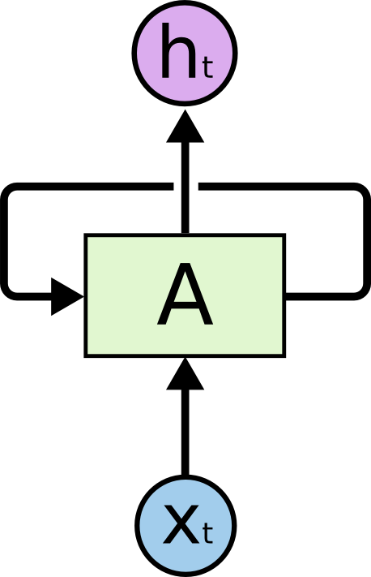
RNNs
state
input
Hidden state 𝐡 aggregates information in the inputs [$x_{1},x_{2},$ $x_{3},x_{4},$…, $x_{n−1},x_{n}$]
3

Slide 4
RNN
4

Slide 5
Shortcomings
RNN is good at short-term dependence
RNN is bad at long-term dependence
5

Slide 6
Long Short-Term Memory (LSTM)
6

Slide 7
LSTM – Forget gate
7

Slide 8
LSTM – Forget gate
8

Slide 9
LSTM – Input gate
9

Slide 10
LSTM – Output gate
10

Slide 11
Bidirectional RNN
Bidirectional RNN
Standard RNN
11

Slide 12
Dimensionality Reduction
Visualization
Classification based on the features extracted from the time series
Time series
LSTM Encoder
LSTM Decoder
12

Slide 13
LSTM encoder-decoder
13

Slide 14
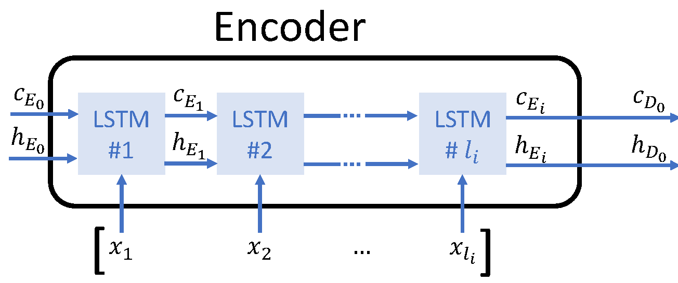
LSTM encoder
Visualization
(2-3 dimensions)
Classification
(d dimensions)
Summary
14

Slide 15
References
https://colah.github.io/posts/2015-08-Understanding-LSTMs/
Goodfellow, Ian, Yoshua Bengio, and Aaron Courville. Deep learning. MIT press, 2016.
Hochreiter, Sepp, and Jürgen Schmidhuber. "Long short-term memory." Neural computation 9, no. 8 (1997): 1735-1780.
Géron, Aurélien. Hands-on machine learning with Scikit-Learn, Keras, and TensorFlow. " O'Reilly Media, Inc.", 2022.

Slide 16
Task 3 Review

Slide 17
UCI HAR Dataset
UCI HAR Dataset/train
15

Slide 18
Body acceleration
Angular velocity
Gravitational acceleration
in 3 dimensions
9 Features
16

Slide 19
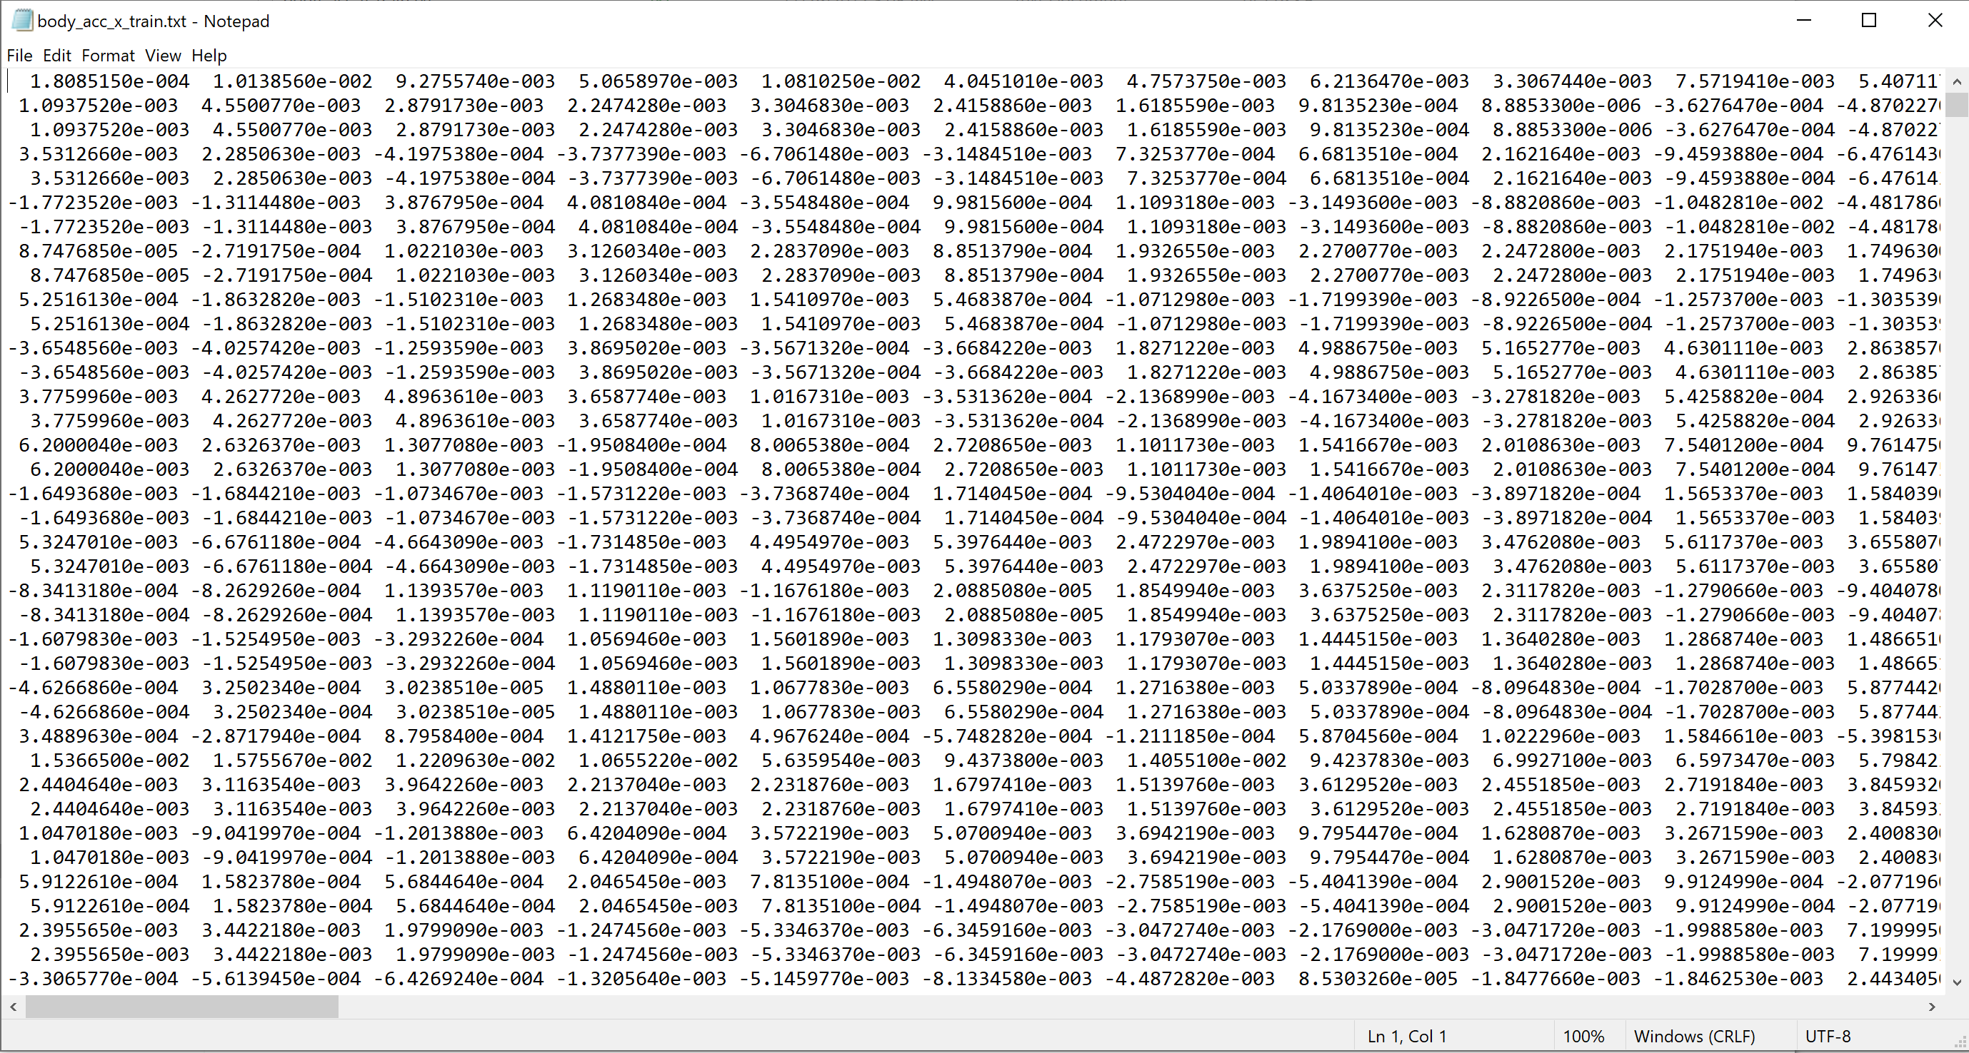
Time steps
Samples
17

Slide 20
Training set
Testing set
2.56 S (128 time steps)
50% = 64 time steps
1
2
3
4
5
.
.
.
.
.
.
18

