Slide 1
Software We Will Use:
R
Can be downloaded from
http://cran.r-project.org/ for Windows, Mac or Linux
Notes:
*

Slide 2
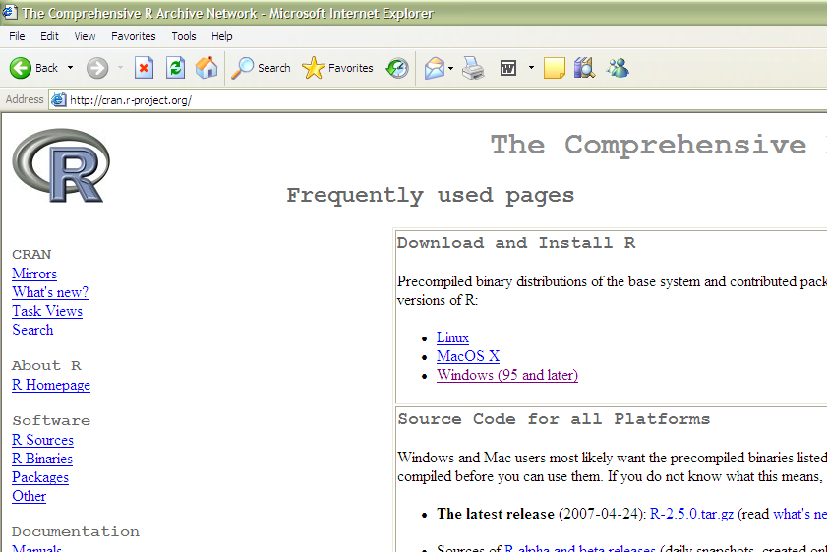
Downloading R for Windows:
Notes:
*

Slide 3
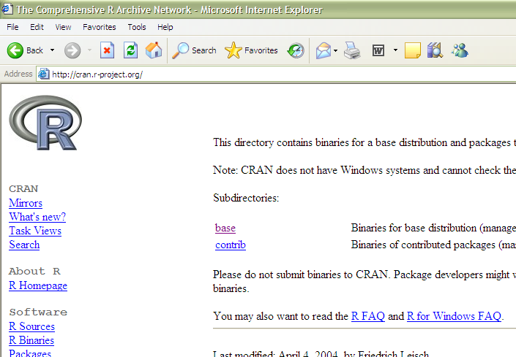
Downloading R for Windows:
Notes:
*

Slide 4
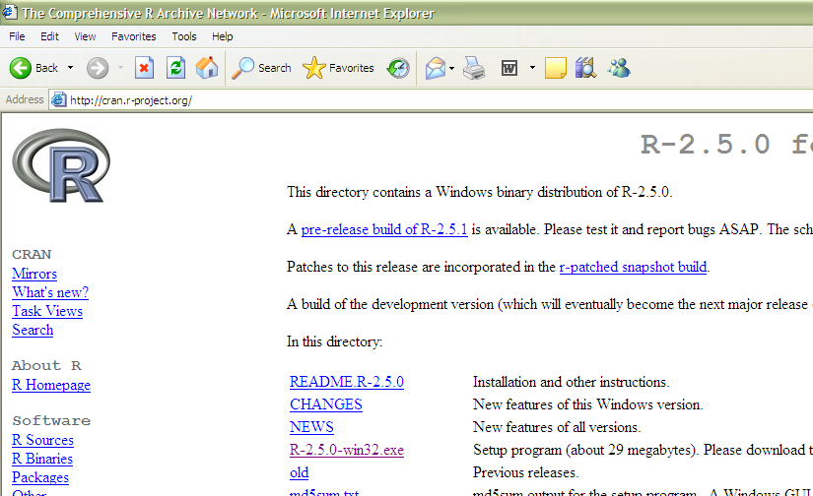
Downloading R for Windows:
Notes:
*

Slide 5
Reading Data into R
Download it from the web at
http://www2.cs.uh.edu/~ml_kdd/Complex&Diamond/Complex9.txt
http://www2.cs.uh.edu/~ceick/UDM/Features.csv
http://www2.cs.uh.edu/~ceick/UDM//exams_and_names.csv
What is your working directory?
> getwd()
Change it to your deskop:
> setwd("C:/Users/8yetula8/Desktop")
Read it in:
> data<-read.csv(“Complex9.txt")
#now doing things with the Complex9 dataset
require('fpc')
getwd()
setwd("C:\\Users\\C. Eick\\Desktop/UDM")
a<-read.csv("Complex8.txt")
d<-data.frame(a=a[,1],b=a[,2],c=factor(a[,3]))
plot(d$a,d$b)
y<-dbscan(d[1:2], 22, 20, showplot=1)
y
http://cran.r-project.org/web/packages/fpc/fpc.pdf
May need: install.packages(“fpc”)
Notes:
*

Slide 6
Reading Data into R
data<-read.csv("Features.csv")
Look at the first 5 rows:
>data[1:3,]
Look at the first column:
data[,1]
Look at the second and column:
data[,2:3]
Notes:
*

Slide 7
Types of Data in R
R often distinguishes between qualitative (categorical) attributes and quantitative (numeric)
In R,
qualitative (categorical) = “factor”
quantitative (numeric) = “numeric”
Notes:
*

Slide 8
Types of Data in R
For example, the state in the third column of features.csv is a factor
> data[1:10,3]
[1] 0 0 0 0 0 0 0 0 0 0
Levels: 0 1 2 3 4 5 6 7 8
> is.factor(data[,3])
[1] TRUE
> data[,3]+10
[1] NA NA NA NA NA NA NA NA …
Warning message:
+ not meaningful for factors …
Notes:
*

Slide 9
Types of Data in R
The fourth column seems like some version of the zip code. It should be a factor (categorical) not numeric, but R doesn’t know this.
> is.factor(data[,2])
[1] FALSE
Use as.factor to tell R that an attribute should be categorical
> as.factor(data[1:10,2])
[1] 306.174 307.565 307.74 308.157 309.592 309.613 312.594 315.093 316.174
[10] 316.908
10 Levels: 306.174 307.565 307.74 308.157 309.592 309.613 312.594 ... 316.908
Notes:
*

Slide 10
Working with Data in R
Creating Data:
> aa<-c(1,10,12)
> aa
[1] 1 10 12
Some simple operations:
> aa+10
[1] 11 20 22
> length(aa)
[1] 3
Notes:
*

Slide 11
Working with Data in R
Creating More Data:
> bb<-c(2,6,79)
> my_data_set<-data.frame(attributeA=aa,attributeB=bb)
> my_data_set
attributeA attributeB
1 1 2
2 10 6
3 12 79
Notes:
*

Slide 12
Working with Data in R
Indexing Data:
> my_data_set[,1]
[1] 1 10 12
> my_data_set[1,]
attributeA attributeB
1 1 2
> my_data_set[3,2]
[1] 79
> my_data_set[1:2,]
attributeA attributeB
1 1 2
2 10 6
Notes:
*

Slide 13
Working with Data in R
Indexing Data:
> my_data_set[c(1,3),]
attributeA attributeB
1 1 2
3 12 79
Arithmetic:
> aa/bb
[1] 0.5000000 1.6666667 0.1518987
Notes:
*

Slide 14
Working with Data in R
Summary Statistics:
> mean(my_data_set[,1])
[1] 7.666667
> median(my_data_set[,1])
[1] 10
> sqrt(var(my_data_set[,1]))
[1] 5.859465
Notes:
*

Slide 15
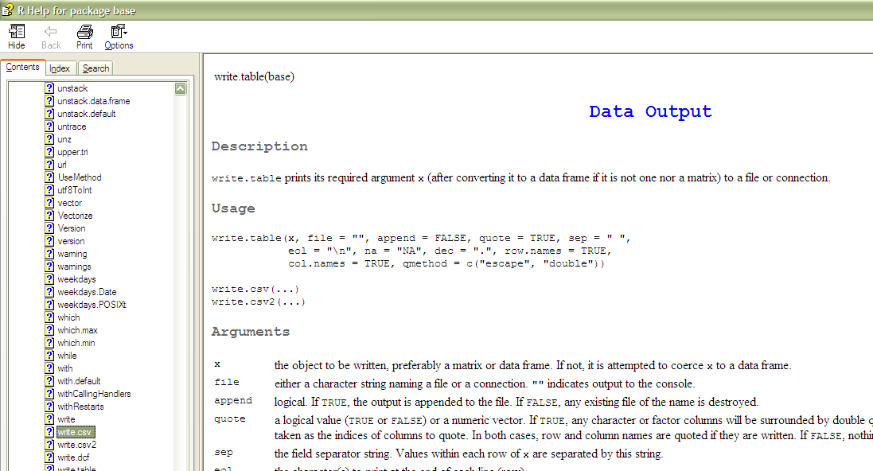
Working with Data in R
Writing Data:
> setwd("C:/…")
> write.csv(my_data_set,"my_data_set_file.csv")
Help!:
> ?write.csv
*
Notes:
*

Slide 16
Sampling
Sampling involves using only a random subset of the data for analysis
Statisticians are interested in sampling because they often can not get all the data from a population of interest
Data miners are interested in sampling because sometimes using all the data they have is too slow and unnecessary
Notes:
*

Slide 17
Sampling
The key principle for effective sampling is the following:
using a sample will work almost as well as using the entire data sets, if the sample is representative
a sample is representative if it has approximately the same property (of interest) as the original set of data
Notes:
*

Slide 18
Sampling
The simple random sample is the most common and basic type of sample
In a simple random sample every item has the same probability of inclusion and every sample of the fixed size has the same probability of selection
It is the standard “names out of a hat”
It can be with replacement (=items can be chosen more than once) or without replacement (=items can be chosen only once)
More complex schemes exist (examples: stratified sampling, cluster sampling)
Notes:
*

Slide 19
Sampling in R:
The function sample() is useful.
http://stat.ethz.ch/R-manual/R-patched/library/base/html/sample.html
Notes:
*

Slide 20
In class exercise #3:
Explain how to use R to draw a sample of 10 observations with replacement from the first quantitative attribute in the data set
http://www2.cs.uh.edu/~ceick/UDM/Features.csv
>x<-1:10
…
> sample(x,4)
[1] 1 9 2 3
> sample(x,4)
[1] 5 6 9 4
> sample(x,4,prob=[1:10])
[1] 6 4 9 10
> sample(x,4,prob=1:10)
[1] 2 9 7 6
> sample(x,4,prob=1:10)
[1] 9 10 7 6
> sample(x, 4, replace=TRUE,prob=1:10)
[1] 9 8 9 5
> sample(x, 4, replace=TRUE,prob=1:10)
[1] 8 9 10 8
Notes:
*

Slide 21
Sampling
Light is a continuous signal
-- we perceive it by sampling at various points in space
Human retina
-- Poisson-disc distribution to avoid occlusion, maintaining a minimum distance between photoreceptors
Photo: retinalmicroscopy.com
skip
Notes:
*

Slide 22
Creating Samples Using Statistical Distributions
http://stat.ethz.ch/R-manual/R-patched/library/stats/html/Normal.html
> rnorm(5)
[1] -0.5799835 1.2574456 0.1624869 -0.2344024 0.5068000
> rnorm(5, mean=-2, sd=0.5)
[1] -1.6601134 -1.9418365 -1.8857518 -0.9762908 -1.8755199
http://en.wikipedia.org/wiki/Normal_distribution
Notes:
*

Slide 23
The Histogram
Histogram (Page 111):
“A plot that displays the distribution of values for attributes by dividing the possible values into bins and showing the number of objects that fall into each bin.”
Page 112 – “A Relative frequency histogram replaces the count by the relative frequency”. These are useful for comparing multiple groups of different sizes.
The corresponding table is often called the frequency distribution (or relative frequency distribution).
The function “hist” or ‘histogram’ in R is useful.
Notes:
*

Slide 24
In class exercise #6:
Make a frequency histogram in R for the exam scores using bins of width 10 beginning at 120 and ending at 200.
Using the first exam in the file
http://www2.cs.uh.edu/~ceick/UDM//exams_and_names.csv
Use hist for this task
Density histogram use: hist(…, freq=FALSE)
Relative frequency histograms use:
library(lattice)
histogram(…)
)
http://stat.ethz.ch/R-manual/R-devel/library/base/html/seq.html
http://msenux.redwoods.edu/math/R/hist.php
Notes:
*

Slide 25
In class exercise #6:
Make a frequency histogram in R for the exam1 scores using bins of width 10 beginning at 120 and ending at 200.
Answer:
exam<-read.csv("exams_and_names.csv")
hist(exam [,2],breaks=seq(120,200,by=10),
col="red",
xlab="Exam Scores", ylab="Frequency",
main="Exam Score Histogram")
hist(exam[,3],breaks=seq(100,220,by=20),
col="red",
xlab="Exam Scores", ylab="Frequency",
main="Exam Score Histogram")
https://stat.ethz.ch/R-manual/R-devel/library/graphics/html/hist.html
Notes:
*

Slide 26
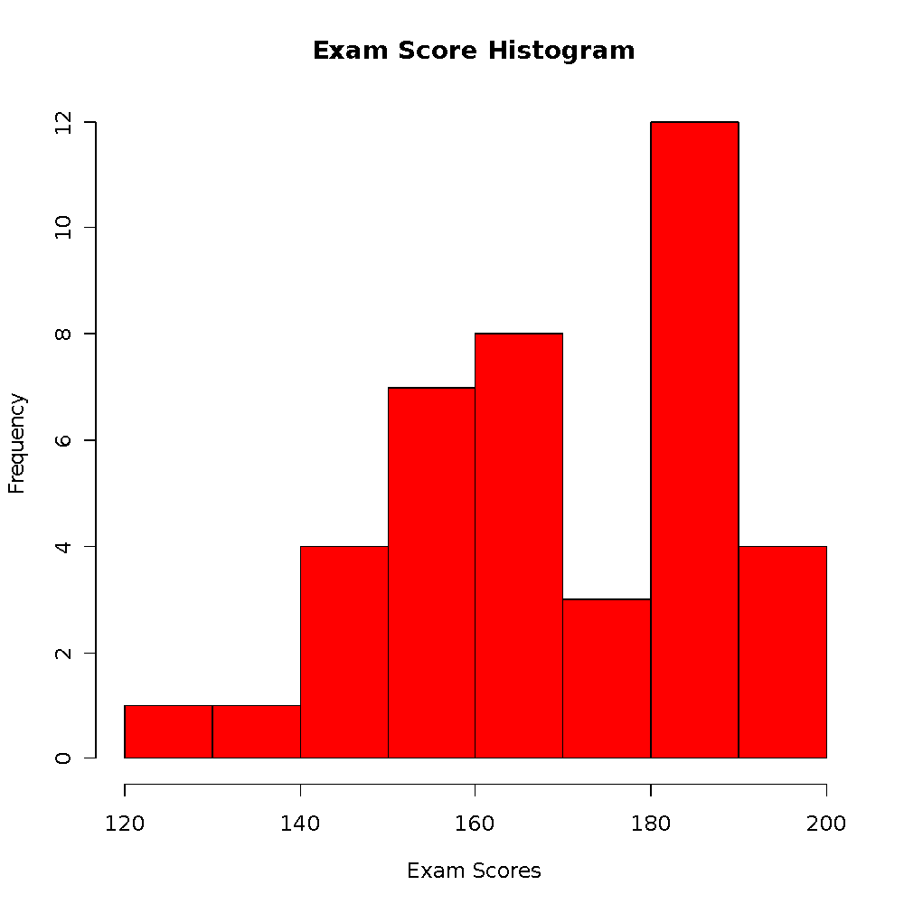
In class exercise #6:
Make a frequency histogram in R for the exam scores using bins of width 10 beginning at 120 and ending at 200.
Answer:
Notes:
*

Slide 27
The Empirical Cumulative Distribution Function (Page 115)
“A cumulative distribution function (CDF) shows the probability that a point is less than a value.”
“For each observed value, an empirical cumulative distribution function (ECDF) shows the fraction of points that are less than this value.” (Page 116)
A plot of the ECDF is sometimes called an ogive.
The function “ecdf” in R is useful. The plotting features are poorly documented in the help(ecdf) but many examples are given.
Notes:
*

Slide 28
In class exercise #7:
Make a plot of the ECDF for the exam scores using the function “ecdf” in R.
Notes:
*

Slide 29
In class exercise #7:
Make a plot of the ECDF for the exam scores using the function “ecdf” in R.
Answer:
> plot(ecdf(exam_scores[,1]),
verticals= TRUE,
do.p = FALSE,
main ="ECDF for Exam Scores",
xlab="Exam Scores",
ylab="Cumulative Percent")
Notes:
*

Slide 30
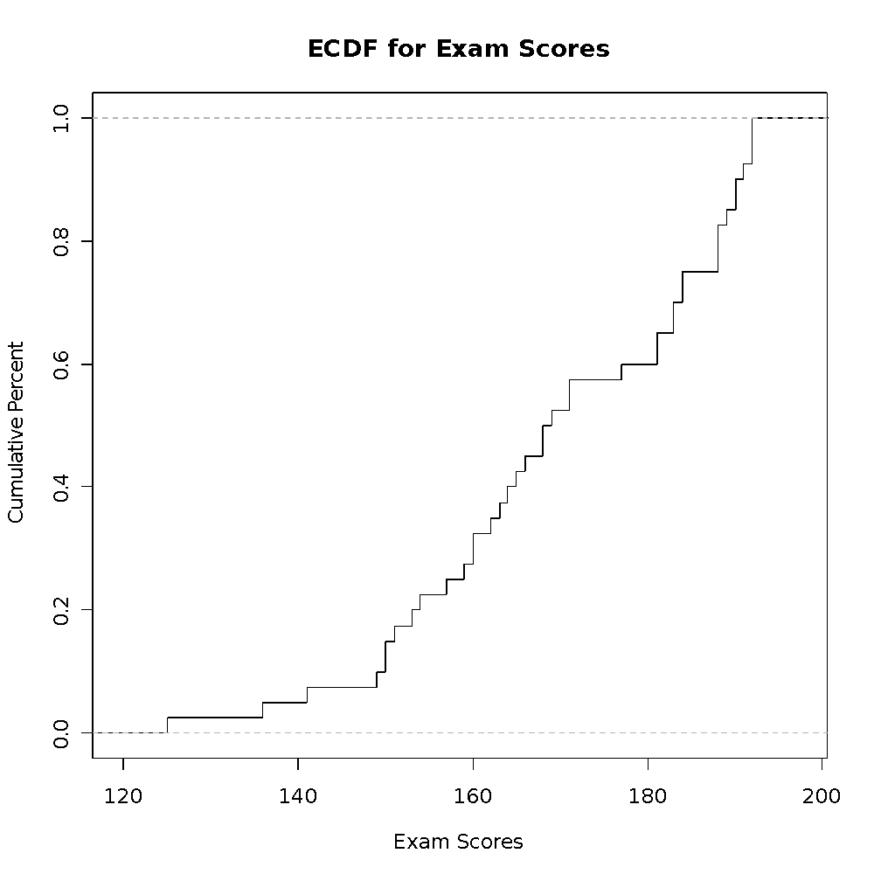
In class exercise #7:
Make a plot of the ECDF for the exam scores using the function “ecdf” in R.
Answer:
Notes:
*

Slide 31
Comparing Multiple Distributions
If there is a second exam also scored out of 200 points, how will I compare the distribution of these scores to the previous exam scores?
187 143 180 100 180
159 162 146 159 173
151 165 184 170 176
163 185 175 171 163
170 102 184 181 145
154 110 165 140 153
182 154 150 152 185
140 132
Note, this data is at
Notes:
*

Slide 32
Comparing Multiple Distributions
Histograms can be used, but only if they are relative frequency histograms.
Plots of the ECDF are often even more useful, since they can compare all the percentiles simultaneously. These can also use different color/type lines for each group with a legend.
Notes:
*

Slide 33
In class exercise #9:
Plot the ECDF for both the first and second exams on the same graph. Provide a legend.
Notes:
*

Slide 34
In class exercise #9:
Plot the ECDF for both the first and second exams on the same graph. Provide a legend.
Answer:
> plot(ecdf(exam_scores[,1]),
verticals= TRUE,do.p = FALSE,
main ="ECDF for Exam Scores",
xlab="Exam Scores",
ylab="Cumulative Percent",
xlim=c(100,200))
> lines(ecdf(more_exam_scores[,1]),
verticals= TRUE,do.p = FALSE,
col.h="red",col.v="red",lwd=4)
> legend(110,.6,c("Exam 1","Exam 2"),
col=c("black","red"),lwd=c(1,4))
Notes:
*

Slide 35
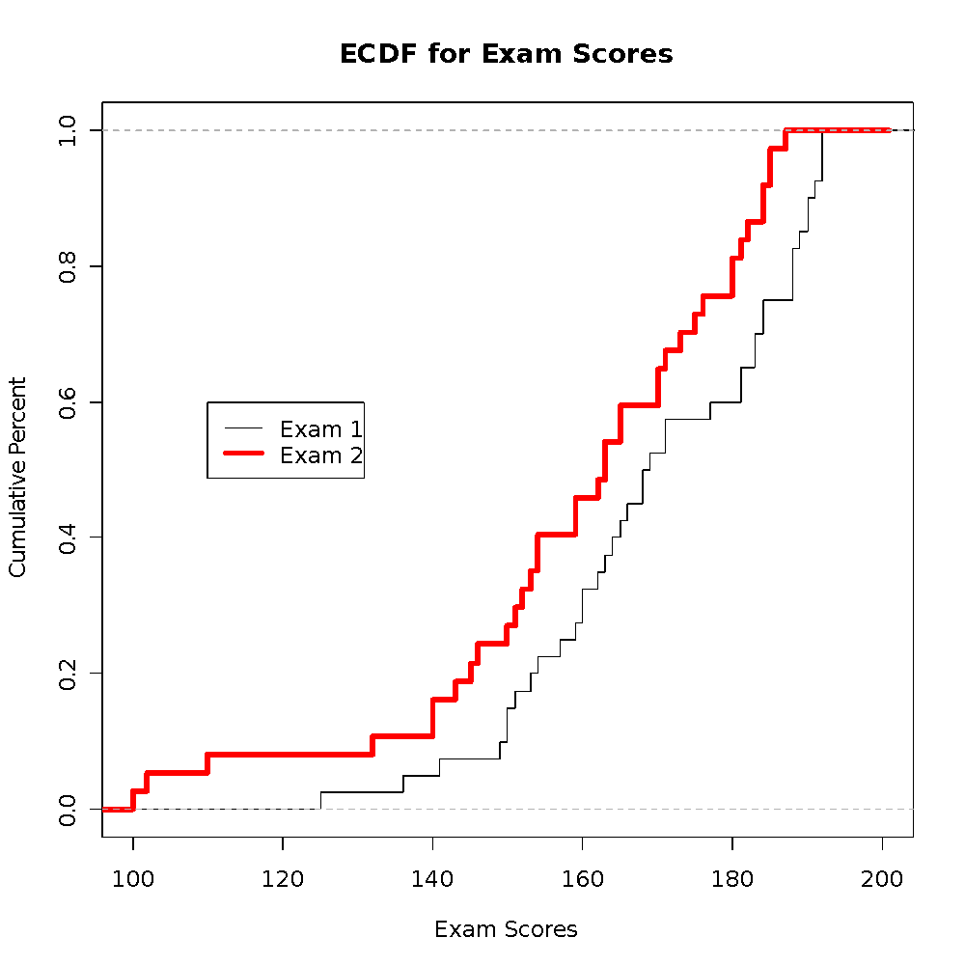
In class exercise #9:
Plot the ECDF for both the first and second exams on the same graph. Provide a legend.
Answer:
Notes:
*

Slide 36
In class exercise #10:
Based on the plot of the ECDF for both the first and second exams from the previous exercise, which exam has lower scores in general? How can you tell from the plot?
Notes:
*

Slide 37
Visualizing Paired Numeric Data
The data at
http://www2.cs.uh.edu/~ceick/UDM//exams_and_names.csv
contains the same exam scores along with an identifier of the student.
For visualizing paired numeric data, scatter plots are extremely useful. Use plot() in R.
Hint:
When the data set has two or more numeric attributes, examining scatter plots of all possible pairs is often useful. The function pairs() in R does this for you. The book calls this a scatter plot matrix (Page 116).
Notes:
*

Slide 38
In class exercise #11:
Use R to make a scatter plot of the exam scores at http://www2.cs.uh.edu/~ceick/UDM//exams_and_names.csv
with the first exam on the x-axis and the second exam on the y-axis. Scale the x-axis and y-axis both from 100 to 200. Add the diagonal line (y=x) to the plot. What does this plot reveal?
Notes:
*

Slide 39
In class exercise #11:
Use R to make a scatter plot of the exam scores at
with the first exam on the x-axis and the second exam on the y-axis. Scale the x-axis and y-axis both from 100 to 200. Add the diagonal line (y=x) to the plot. What does this plot reveal?
Answer:
data<-read.csv("exams_and_names.csv")
plot(data$Exam.1,data$Exam.2,
xlim=c(100,200),ylim=c(100,200),pch=19,
main="Exam Scores",xlab="Exam 1",ylab="Exam 2")
abline(c(0,1))
Notes:
*

Slide 40
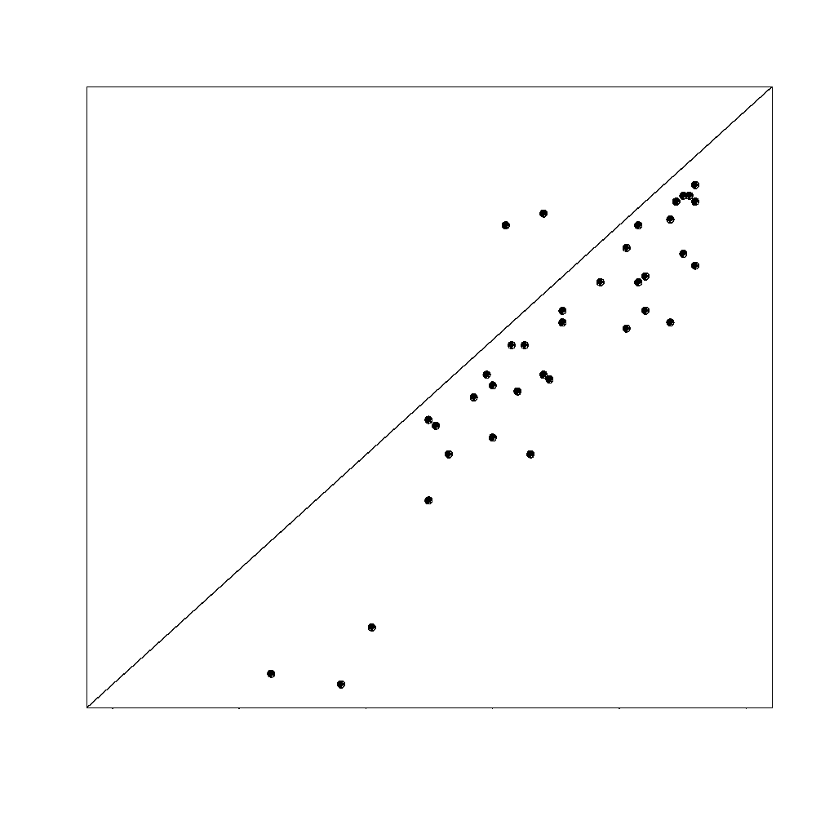
In class exercise #11:
Use R to make a scatter plot of the exam scores at
http://www2.cs.uh.edu/~ceick/UDM//exams_and_names.csv
with the first exam on the x-axis and the second exam on the y-axis. Scale the x-axis and y-axis both from 100 to 200. Add the diagonal line (y=x) to the plot. What does this plot reveal?
Answer:
Useful Code:
http://stats.stackexchange.com/questions/30788/whats-a-good-way-to-use-r-to-make-a-scatterplot-that-separates-the-data-by-trea
Notes:
*

Slide 41
Labeling Points on a Scatter Plot
The R commands text() and identify() are useful for labeling points on the scatter plot.
Notes:
*

Slide 42
In class exercise #12:
Use the text() command in R to label the points for the students who scored lower than 150 on the first exam. Use the identify command to label the points for the two students who did better on the second exam than the first exam. Use the first column in the data set for the labels.
Notes:
*

Slide 43
In class exercise #12:
Use the text() command in R to label the points for the students who scored lower than 150 on the first exam. Use the identify command to label the points for the two students who did better on the second exam than the first exam. Use the first column in the data set for the labels.
Answer:
text(data$Exam.1[data$Exam.1<150],
data$Exam.2[data$Exam.1<150],
labels=data$Student[data$Exam.1<150],adj=1)
identify(data$Exam.1,data$Exam.2,
labels=data$Student)
Notes:
*

Slide 44
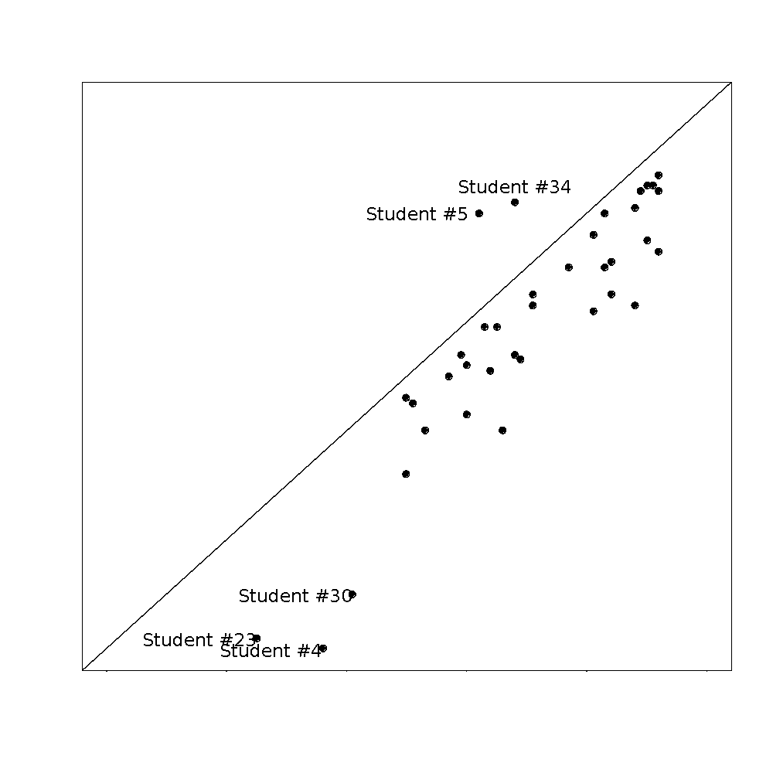
In class exercise #12:
Use the text() command in R to label the points for the students who scored lower than 150 on the first exam. Use the identify command to label the points for the two students who did better on the second exam than the first exam. Use the first column in the data set for the labels.
Notes:
*

Slide 45
Adding Noise to a Scatter Plot
When both variables are discrete, many points in a scatter plot may be plotted over top of one another, which tends to skew the relationship.
A solution is to add a small amount of noise to the points so that they are jittered a little bit.
Note: If you have too many points to display cleanly on a scatter plot, sampling may also be helpful.
Notes:
*

Slide 46
In class exercise #13:
Add noise uniformly distributed on the interval -0.5 to 0.5 to both the x and y values in the graph in the previous exercise.
Notes:
*

Slide 47
In class exercise #13:
Add noise uniformly distributed on the interval -0.5 to 0.5 to both the x and y values in the graph in the previous exercise.
Answer:
data$Exam.1<-data$Exam.1+runif(40)-.5
data$Exam.2<-data$Exam.2+runif(40)-.5
plot(data$Exam.1,data$Exam.2,
xlim=c(100,200),ylim=c(100,200),
pch=19,
main="Exam Scores",xlab="Exam 1",ylab="Exam 2")
abline(c(0,1))
http://stat.ethz.ch/R-manual/R-patched/library/stats/html/Uniform.html
Notes:
*

Slide 48
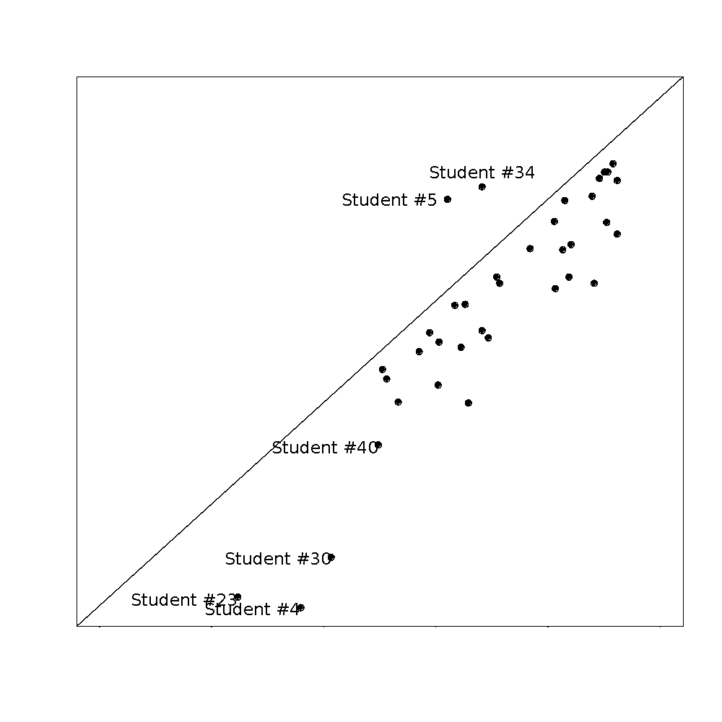
In class exercise #13:
Add noise uniformly distributed on the interval -0.5 to 0.5 to both the x and y values in the graph in the previous exercise.
Notes:
*

