Slide 1
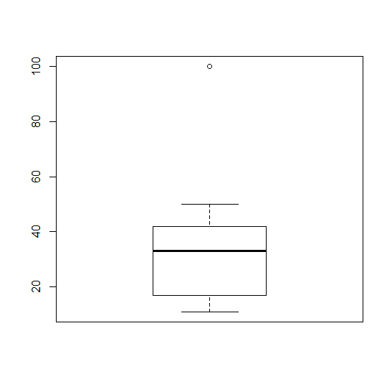
Boxplots in R
The function boxplot() in R plots boxplots
By default, boxplot() in R plots the maximum and the minimum non-outlying values instead of the 10th and 90th percentiles as the book describes
See:
> a<-c(11,12, 22, 33, 34, 100)
> boxplot(a)
> b<-c(11,12, 22, 33, 34, 65)
> boxplot(b)
a<-c(11,12,22, 33, 34, 50, 100)
boxplot(a)
outlier
90th percentile
Maximum
75th percentile
50th percentile
25th percentile
10th percentile
Minimum
Notes:
*

Slide 2
Boxplots (Pages 114-115)
Boxplots help you visualize the differences in the medians relative to the variation
Example: The median value of Attribute A was 2.0 for men and 4.1 for women. Is this a “big” difference?
Notes:
*

Slide 3
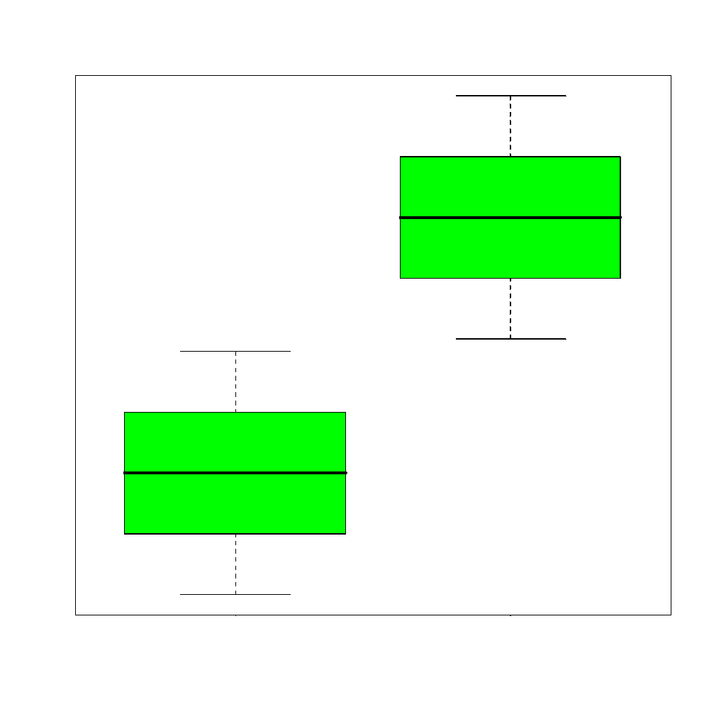
Boxplots (Pages 114-115)
Boxplots help you visualize the differences in the medians relative to the variation
Example: The median value of Attribute A was 2.0 for men and 4.1 for women. Is this a “big” difference?
Maybe yes:
Notes:
*

Slide 4
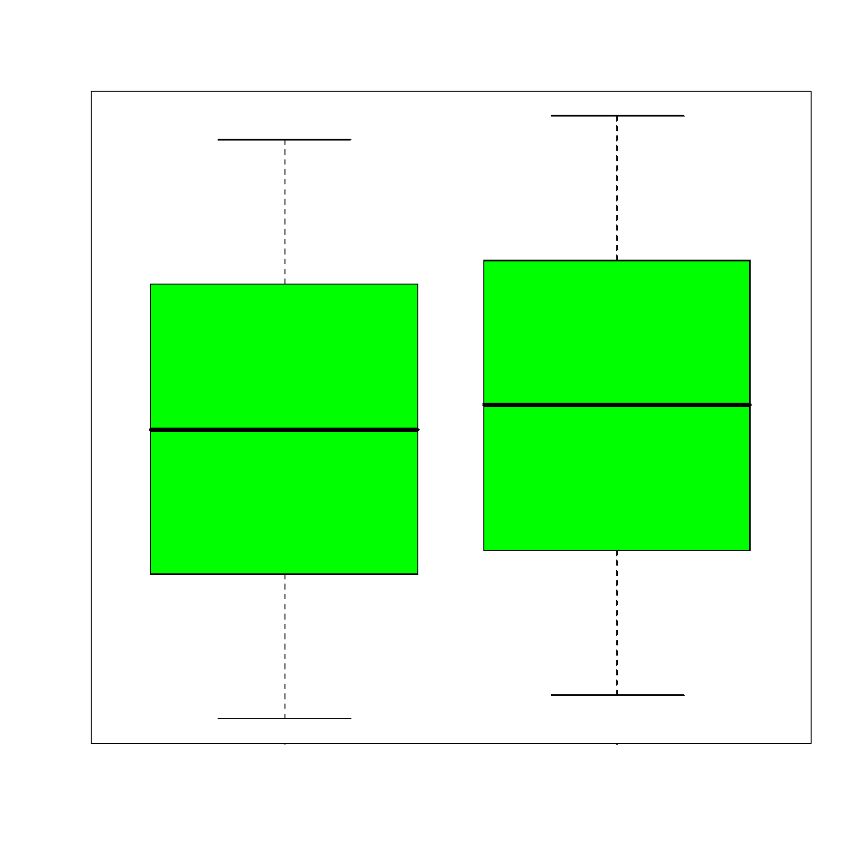
Boxplots (Pages 114-115)
Boxplots help you visualize the differences in the medians relative to the variation
Example: The median value of Attribute A was 2.0 for men and 4.1 for women. Is this a “big” difference?
Maybe yes: Maybe no:
Notes:
*

Slide 5
In class exercise #14:
Use boxplot() in R to make boxplots comparing the first and second exam scores in the data at
http://sites.google.com/site/stats202/data/exams_and_names.csv
This is paired data, but I’m ignoring that for now.
Notes:
*

Slide 6
In class exercise #14:
Use boxplot() in R to make boxplots comparing the first and second exam scores in the data at
http://sites.google.com/site/stats202/data/exams_and_names.csv
Answer:
data<-read.csv("exams_and_names.csv")
boxplot(data[,2],data[,3],col="blue",
main="Exam Scores",
names=c("Exam 1","Exam 2"),ylab="Exam Score")
https://stat.ethz.ch/R-manual/R-devel/library/graphics/html/boxplot.html
Notes:
*

Slide 7
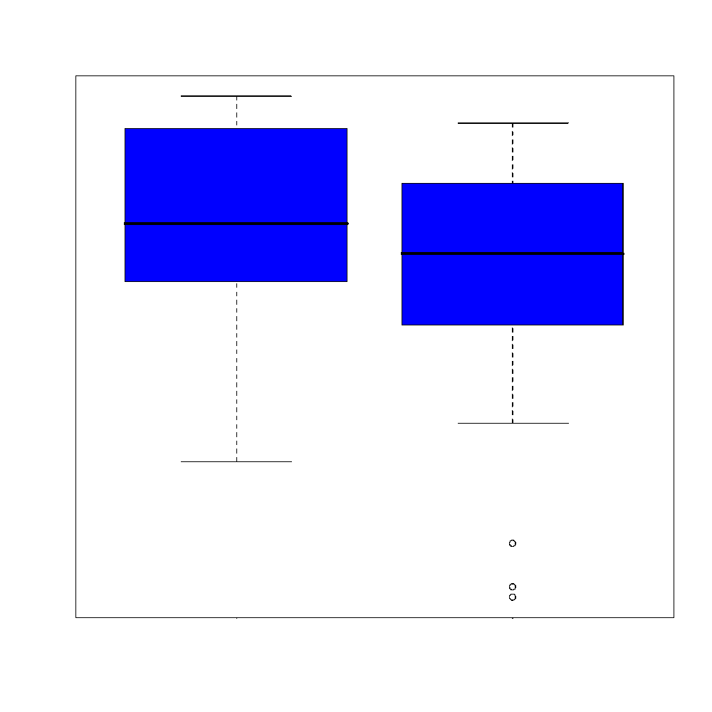
In class exercise #14:
Use boxplot() in R to make boxplots comparing the first and second exam scores in the data at
http://sites.google.com/site/stats202/data/exams_and_names.csv
Answer:
Notes:
*

Slide 8
Using Color in Plots
In R, the graphing parameter “col” can often be used to specify different colors for points, lines etc.
Some advantages of color:
- provides a nice way to differentiate
- makes it more interesting to look at
Some disadvantages of color:
- Some people are color blind
- Most printing is in black and white
- Color can be distracting
- A poor color scheme can make the graph difficult to read
Notes:
*

Slide 9
3-Dimesional Plots
3D plots can sometimes be useful
One example is the 3D scatter plot for plotting 3 attributes (page 119)
The function scatterplot3d() makes fairly nice 3D scatter plots in R
-this is not in the base package so you need to do:
install.packages("scatterplot3d")
library(scatterplot3d)
However, it may be better to show the 3rd dimension by simply using a 2D plot with different plotting characters (page 119)
Notes:
*

Slide 10
3-Dimesional Plots
Never use the 3rd dimension in a manner that conveys no extra information just to make the plot look more impressive
Notes:
*

Slide 11
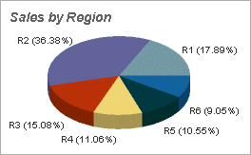
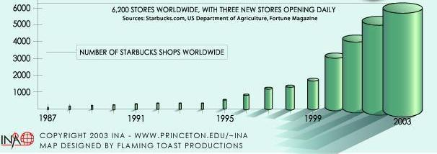
3-Dimesional Plots
Never use the 3rd dimension in a manner that conveys no extra information just to make the plot look more impressive
Examples:
Notes:
*

Slide 12
Do’s and Don’ts (Page 130)
Read the ACCENT Principles
http://www.datavis.ca/gallery/accent.php
Read Tufte’s Guidelines
Notes:
*

Slide 13
Compressing Vertical Axis
✓
Bad Presentation
Good Presentation
Quarterly Sales
Quarterly Sales
$
$
200
50
100
25
0
0
Q1
Q2
Q3
Q4
Q1
Q2
Q3
Q4
Notes:
*

Slide 14
No Zero Point On Vertical Axis
✓
Good Presentations
Bad Presentation
$
Monthly Sales
45
Monthly Sales
42
$
45
39
36
42
39
0
J
F
M
A
M
J
or
36
$
J
F
M
A
M
J
60
40
Graphing the first six months of sales
20
0
J
F
M
M
J
A
Notes:
*

Slide 15
No Relative Basis
Bad Presentation
✓
Good Presentation
A’s received by students.
A’s received by students.
Freq.
%
300
30%
200
20%
100
10%
0
0%
FR
SO
JR
SR
FR
SO
JR
SR
FR = Freshmen, SO = Sophomore, JR = Junior, SR = Senior
Notes:
*

Slide 16
Chart Junk
✓
Bad Presentation
Good Presentation
Minimum Wage
Minimum Wage
$
1960: $1.00
4
1970: $1.60
2
1980: $3.10
0
1960
1970
1980
1990
1990: $3.80
Notes:
*

Slide 17
Mean vs. Median
While both are measures of center, the median is sometimes preferred over the mean because it is more robust to outliers (=extreme observations) and skewness
If the data is right-skewed, the mean will be greater than the median
If the data is left-skewed, the mean will be smaller than the median
If the data is symmetric, the mean will be equal to the median
Notes:
*

Slide 18
Notes:
*

Slide 19
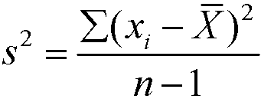
Measures of Spread:
The range is the maximum minus the minimum. This is not robust and is extremely sensitive to outliers.
The variance is
where n is the sample size. This is also not very robust to outliers. var() in R
The standard deviation is simply the square root of the variance. It is on the scale of the original data. It is roughly the average distance from the mean. sd() in R
The interquartile range is the 3rd quartile minus the 1st quartile. This is quite robust to outliers.
Notes:
*

Slide 20
Measures of Association:
The covariance between x and y is defined as
where n is the sample size. This will be positive if x and y have a positive relationship and negative if they have a negative relationship.
The correlation is the covariance divided by the product of the two standard deviations. It will be between -1 and +1 inclusive. It is often denoted r. It is sometimes called the coefficient of correlation.
These are both very sensitive to outliers.
Notes:
*

Slide 21
Correlation (r):
Y
Y
X
X
r = -1
r = -.6
Y
Y
X
X
r = +1
r = +.3
Notes:
*

Slide 22
In class exercise #16:
Match each plot with its correct coefficient of correlation.
Choices: r=-3.20, r=-0.98, r=0.86, r=0.95,
r=1.20, r=-0.96, r=-0.40
A)
B)
C)
D)
E)
Notes:
*

Slide 23
In class exercise #17:
Make two vectors of length 1,000,000 in R using
runif(1000000) and compute the coefficient of correlation using cor(). Does the resulting value surprise you?
Notes:
*

Slide 24
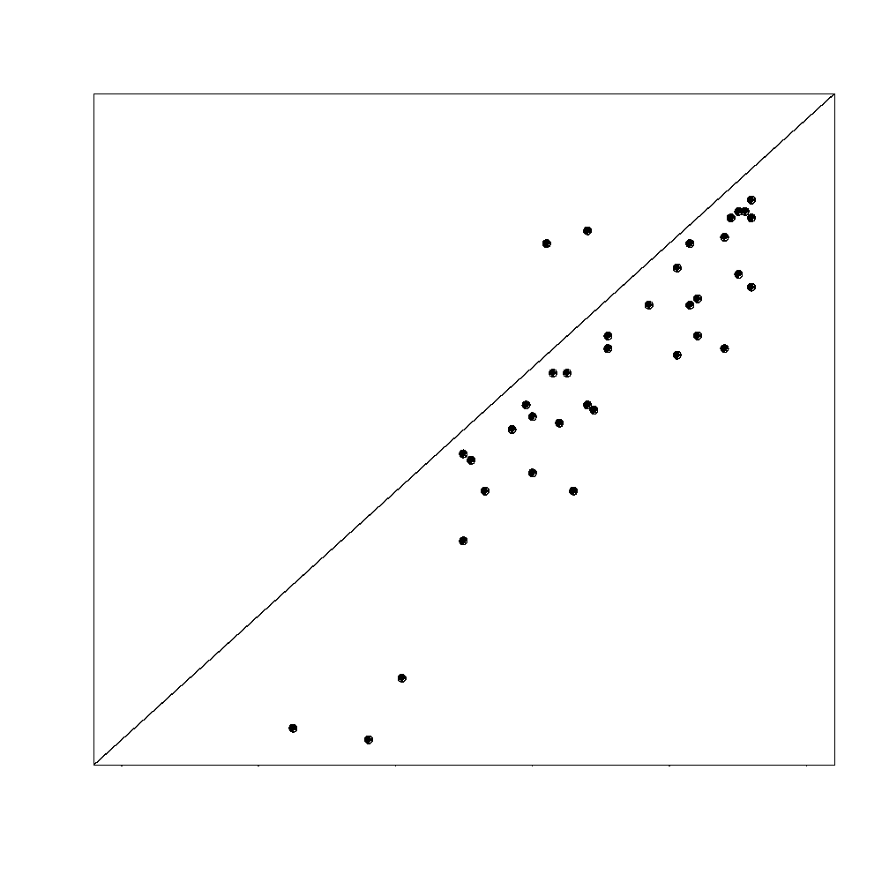
In class exercise #18:
What value of r would you expect for the two exam scores in
http://sites.google.com/site/stats202/data/exams_and_names.csv
which are plotted below. Compute the value to check your intuition.
> data = read.csv(“exams_and_names.csv”, header=T)
> cor(data[,2],data[,3],use="pairwise.complete.obs")
Notes:
*

