Slide 1
Preprocessing and Undergraduate Research

Slide 2
COSC 3337: Data Quality & Preprocessing
Organization
1. Data Quality
2. Data Preprocessing Methods
Aggregation
Sampling
Dimensionality Reduction
Feature subset selection
Feature creation
Attribute Transformation
Discretization

Slide 3
1. Data Quality
What kinds of data quality problems?
How can we detect problems with the data?
What can we do about these problems?
Examples of data quality problems:
Noise and outliers
missing values
duplicate data

Slide 4
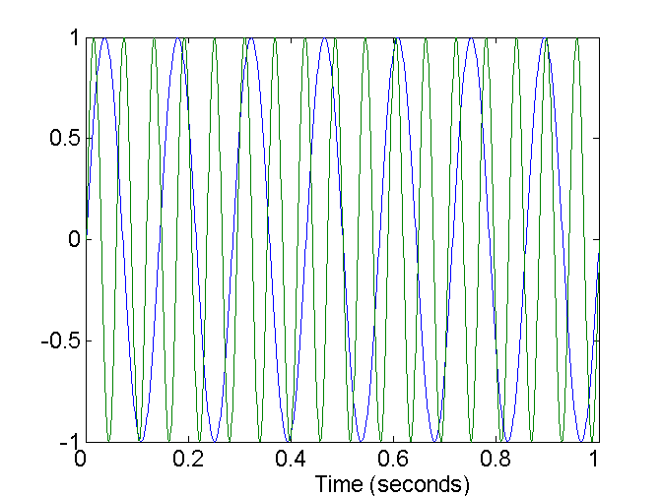
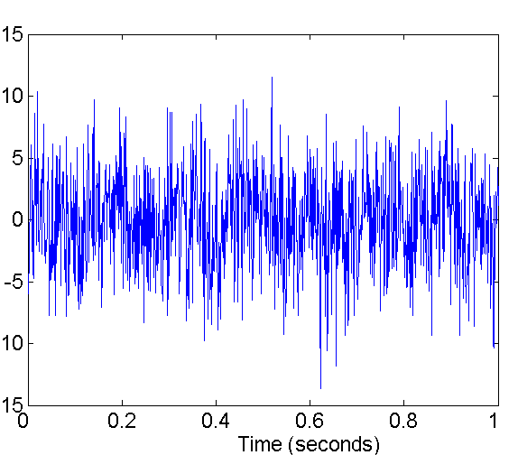
Noise
Noise refers to modification of original values
Examples: distortion of a person’s voice when talking on a poor phone and “snow” on television screen
Two Sine Waves
Two Sine Waves + Noise

Slide 5
Outliers
Outliers are data objects with characteristics that are considerably different than most of the other data objects in the data set

Slide 6
Missing Values
Reasons for missing values
Information is not collected (e.g., people decline to give their age and weight)
Attributes may not be applicable to all cases (e.g., annual income is not applicable to children)
Handling missing values
Eliminate Data Objects
Estimate Missing Values
Ignore the Missing Value During Analysis
Replace with all possible values (weighted by their probabilities)
Learn a model that predicts the missing values

Slide 7
Duplicate Data
Data set may include data objects that are duplicates, or almost duplicates of one another
Major issue when merging data from heterogeous sources
Examples:
Same person with multiple email addresses
Duplicate Identifies in Medical Databases: http://library.ahima.org/xpedio/groups/public/documents/ahima/bok1_044000.hcsp?dDocName=bok1_044000
Data cleaning
Process of dealing with duplicate data issues

Slide 8
COSC 3337 News Sept. 5, 2023
The specification of Task1 will be available by the end of today at the course Website. Please read it before the next Lecture. Please start working on it! It is due on Sa., Sept. 23 in MS Teams!
Group Homework Credit Tasks for Group A (Sept. 12) and Group B (Sept. 14) have been posted. More discussion on GHC presentations in the next lecture!
Today’s Class
Introduction to Preprocessing (20 minutes)
Lab centering on R and Task1 taught by Raunak (55-60 minutes)

Slide 9
2. Data Preprocessing Methods
Goal: Create a Data Set so that a Data Mining / Data Analysis method can be applied to it!
Sub-activities of Data Preprocessing include:
Aggregation
Sampling
Dimensionality Reduction
Feature subset selection
Attribute Transformation
Feature creation
Discretization and Binning

Slide 10
Aggregation
Combining two or more attributes (or objects) into a single attribute (or object)
Purpose
Data reduction
Reduce the number of attributes or objects
Change of scale
Cities aggregated into regions, states, countries, etc
More “stable” data
Aggregated data tends to have less variability

Slide 11
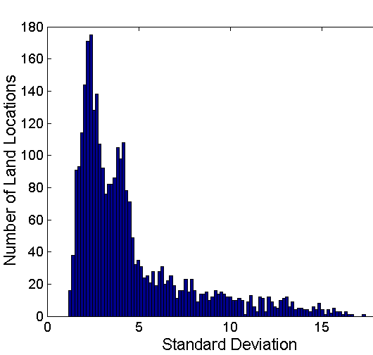
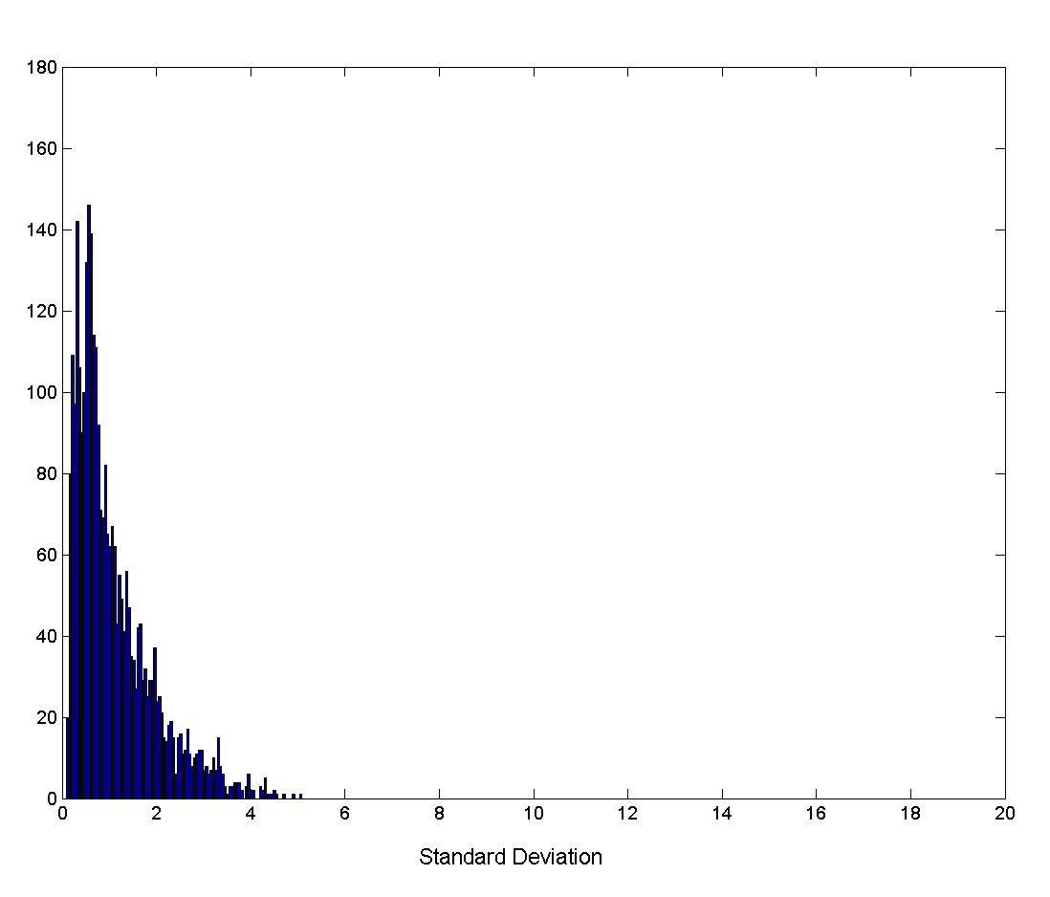
Aggregation
Variation of Precipitation in Australia
Standard Deviation of Average Monthly Precipitation
Standard Deviation of Average Yearly Precipitation

Slide 12
Sampling
Sampling is the main technique employed for data selection.
It is often used for both the preliminary investigation of the data and the final data analysis.
Statisticians sample because obtaining the entire set of data of interest is too expensive or time consuming.
Sampling is used in data mining/data science because processing the entire set of data of interest is too expensive or time consuming.

Slide 13
Sampling …
The key principle for effective sampling is the following:
using a sample will work almost as well as using the entire data sets, if the sample is representative
A sample is representative if it has approximately the same property (of interest) as the original set of data

Slide 14
Types of Sampling
Sampling without replacement
As each item is selected, it is removed from the population
Sampling with replacement
Objects are not removed from the population as they are selected for the sample.
In sampling with replacement, the same object can be picked up more than once
Stratified sampling
Split the data into several partitions; then draw random samples from each partition

Slide 15
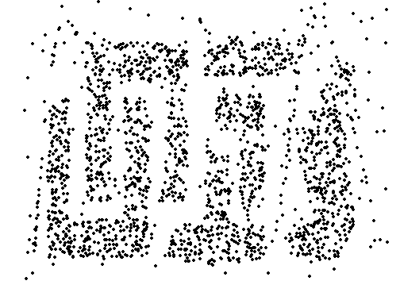
Sample Size
8000 points 2000 Points 500 Points

Slide 16
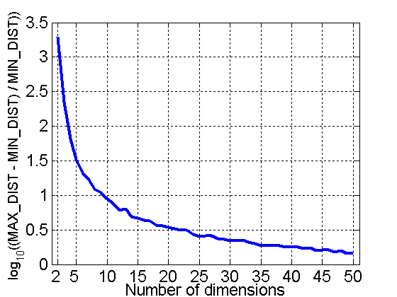
Curse of Dimensionality
When dimensionality increases, data becomes increasingly sparse in the space that it occupies
Definitions of density and distance between points, which is critical for clustering and outlier detection, become less meaningful
Randomly generate 500 points
Compute difference between max and min distance between any pair of points

Slide 17
Dimensionality Reduction
Purpose:
Avoid curse of dimensionality
Reduce amount of time and memory required by data mining algorithms
Allow data to be more easily visualized
May help to eliminate irrelevant features or reduce noise
Techniques
Principle Component Analysis
Singular Value Decomposition
Multi-dimensional Scaling
…

Slide 18
Dimensionality Reduction: PCA
Goal is to find a projection that captures the largest amount of variation in data
x₂
e
x₁

Slide 19
Dimensionality Reduction: PCA
Find the m eigenvectors of the covariance matrix
The eigenvectors define the new space
Select only those m eigenvectors that contribute the most to the variation in the dataset (m<n)
Relies on linear transformations
x₂
e
x₁

Slide 20
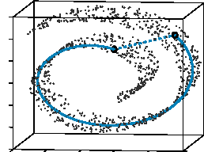
Dimensionality Reduction: ISOMAP
By: Tenenbaum, de Silva, Langford (2000)
Construct a neighbourhood graph
For each pair of points in the graph, compute the shortest path distances – geodesic distances
Map the objects in the dataset—similarly to multi-dimensional scaling— into a lower dimensional space, preserving their geodesic distances.
ISOMAP is a non-linear dimensionality reduction technique
http://en.wikipedia.org/wiki/Isomap

Slide 21
COSC 3337 News Sept. 7, 2023
Task1 carries a weight of about 30% and Task2 carries a weight of a about 20% of the available points for the problem sets. There will be 4 problem set tasks! Weights: about 30%, group project about 15%, exams (3) 49%, attendance and GHC: 3%.
Group Homework Credit Tasks for Group A (Sept. 12) and Group B (Sept. 14) have been posted. Groups introduce their members; you have 11-14 minutes for your presentation, you make your presentation inside MS Teams as part of the COSC 3337 lecture meeting; share your screen-open_your_mike_mute, most group members should be involved in the presentation.
Today’s Class
Covariance matrix – Wikipedia probability - Finding correlation coefficient from covariance matrix - Mathematics Stack Exchange
Decision Trees for EDA
Quick Walk ThroughTask1
New Topic: Classification
EDA: will demo R code useful for Task1 in the Sept. 12 week.

Slide 22
Feature Subset Selection
Another way to reduce dimensionality of data
Redundant features
duplicate much or all of the information contained in one or more other attributes
Example: purchase price of a product and the amount of sales tax paid
Irrelevant features
contain no information that is useful for the data mining task at hand
Example: students' ID is often irrelevant to the task of predicting students' GPA

Slide 23
Feature Subset Selection
Techniques:
Brute-force approch:
Try all possible feature subsets as input to data mining algorithm
Embedded approaches:
Feature selection occurs naturally as part of the data mining algorithm
Filter approaches:
Features are selected before data mining algorithm is run
Wrapper approaches:
Use the data mining algorithm as a black box to find best subset of attributes

Slide 24
Feature Creation
Create new attributes that can capture the important information in a data set much more efficiently than the original attributes.
Has gained a lot of popularity in the decade through the introduction of kernels: http://en.wikipedia.org/wiki/Kernel_method
General Idea: Either map data into a new space or augment dataset with newly created features.

Slide 25
Decision Boundary of Decision Trees
Border line between two neighboring regions of different classes is known as decision boundary
Decision boundary is parallel to axes because test condition involves a single attribute at-a-time

Slide 26
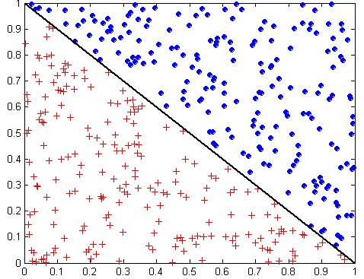
Power Feature Creation
What is the characteristics of this decision boundary?
Will rectangular approximations, decision trees use, work well for this classification task?

Slide 27
The Power of Feature Creation 2
x + y < 1
Class = +
Class =
Feature Creation: Create a new feature z=x+y and the classification now become trivial and can be solved by a single node decision tree (see above!)

Slide 28
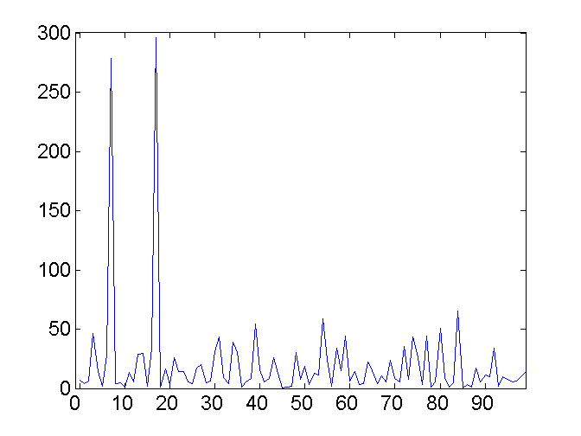
Mapping Data to a New Space
Fourier transform
Wavelet transform
Kernel functions (made popular by SVMs)
Two Sine Waves
Two Sine Waves + Noise
Frequency

Slide 29
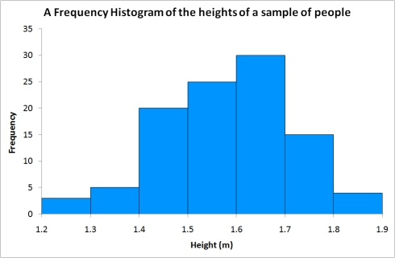
Discretization
In mathematics, discretization concerns the process of transferring continuous functions, models, and equations into discrete (symbolic, categorical) counterparts.
In data mining the most important discretization task is transforming numerical attributes into nominal and ordinal attributes. Binning and histograms are particularly useful for this task.
Transform the numerical
attribute values into symbolic
values using the categories that
were created in the previous step
Create histogram
for the numerical attribute
Associate a category with
each bin range

Slide 30
Undergraduate Research
Undergraduate Research - University of Houston (uh.edu)
The Council for Undergraduate Research defines undergraduate research as “…the inquiry or investigation conducted by an undergraduate in collaboration with a faculty mentor that makes an original intellectual or creative contribution to the discipline.”
Involving yourself in undergraduate research adds a dimension to your university experience that will better prepare you for your future. As a researcher, whether in the lab or field, you will find discovery, challenges, and learn problem-solving skills beyond those you develop in the classroom or teaching laboratory. As an investigator you will learn to work independently as well as part of a team. You will improve both your oral and written communication skills. You will be a better candidate for whatever is the next step in your future.

Slide 31
Why Undergraduate Research?
There are multiple reasons for participating in undergraduate research. Below is not an exhaustive list and each may not apply to you.
Intellectual challenge. Research will challenge you in new ways and can help you decide your path in the field of computing.
Apply classroom learning to hands-on project(s). Research allows you to pursue existing new interests and apply what you have learned. You have the potential to discover something new and advance existing knowledge.
Impact society and the future. Many projects address the needs and problems of society.
Prepares you for graduate school if you intend to pursue a Ph.D. or a M.S.
Networking and Collaboration. Research is usually a collaborative effort. The strong connections you make may become beneficial when it comes to seeking recommendation letters for graduate school or employment references.

Slide 32
Things you could do…
Undergraduate Research - Course Credit - University of Houston (uh.edu)

Slide 33
PowerPoint Presentation (uh.edu)
This slideshow discusses
past, ongoing, and future research
in Dr. Eick’s research group.

