Slide 1
COSC 4368 News Jan. 18, 2023
MS Team COSC4368 will be used for lectures, discussions,…
The course website will play a key role in the teaching of the course: http://www2.cs.uh.edu/~ceick/4368.html
Always use this website to get updated versions of lectures, assignments…
There will be 2 exams, 3 Problem Sets, a 7-week group project in 2023 (more on that later... )
There will be also group homework credit task in which a group a students solve a homework style problem and present the solutions during the lecture. Each group will have a different task.
The first 1.5-2 lectures will give an Introduction to AI and will give course information, followed by 4-5 lectures, mostly centering on Search.

Slide 2
COSC 4368 News2 Jan. 18
The Background of today’s lecture the Lower Tatra mountains in Slovakia.
We have 2 Tas: Steve Aigbe and Md. Mahin; they will have office hours starting next week; Dr. Eick has officehours MO 4-4:45p and TH 2:45-4p (using MS Teams)→see webpage.
Please take a closer look at the course website in the next 5 days; there will be a Q&A near the beginning of the lecture on Mo., January 23 to answer your questions about the form and content of COSC 4368.
UH Excused Absence policy applies for missing course exams; if you miss exams for other reasons, or you do not follow the procedures, outlined in the policy, you will receive a grade of ‘F’ for the missed exam.
It is also necessary that you regularly check your cougar-net e-mail which is associated with your MS Teams account; not doing that asks for trouble.
You are encouraged to use MS Teams for chat about course related matters.
However, please use e-mail and not MS Teams chat to discuss personal matters with Dr. Eick and/or the course TAs.

Slide 3
COSC 4368 and “What is AI?”
Introduction to AI (today, and MO)
  What is AI?
  Sub-fields of AI / Example problems investigated by AI research
  What is going on with respect to AI?
Course Information (today, and MO)

Slide 4
Part1a: Definitions of AI
“AI centers on the simulation of intelligence using computers”
“AI develops programming paradigms, languages, tools, and environments for application areas for which conventional programming fails”
  Symbolic programming (LISP)
  Functional programming
  Heuristic Programming
  Logical Programming (PROLOG)
  Rule-based Programming (Expert system shells)
  Soft Computing (Belief network tools, fuzzy logic tool boxes,…)
  Object-oriented programming (Smalltalk)

Slide 5
More Definitions of AI
Rich/Knight: ”AI is the study of how to make computers do things which, at the moment, people do better”
Winston: “AI is the study of computations that make it possible to perceive, reason, and act.
Turing Test: If an artificial intelligent system is not distinguishable from a human being, it is definitely intelligent.
https://en.wikipedia.org/wiki/Turing_test
Eugene Goostman Winner 2014 Touring Test: https://en.wikipedia.org/wiki/Eugene_Goostman

Slide 6
Physical Symbol System Hypothesis
“What the brain does can be thought of at some level as a kind of computation”
Physical Symbol System Hypothesis (PSSH): A physical symbol system has the sufficient and necessary means for general, intelligent actions.
Remarks PSSH:
Subjected to empirical validation
If false → AI is quite limited
Important for psychology and philosophy

Slide 7
Questions/Thoughts about AI
What are the limitations of AI? Can computers only do what they are told? Can computers be creative? Can computers think? What problems cannot be solved by computers today?
Computers show promise to control the current waste of energy and other natural resources.
Computer can work in environment that are unsuitable for human beings.
If computers control everything --- who controls the computers?
If computers are intelligent what civil rights should be given to computers?
If computers can perform most of our work; what should the human beings do?
Only those things that can be represented in computers are important.
It is fun to play with computers.

Slide 8
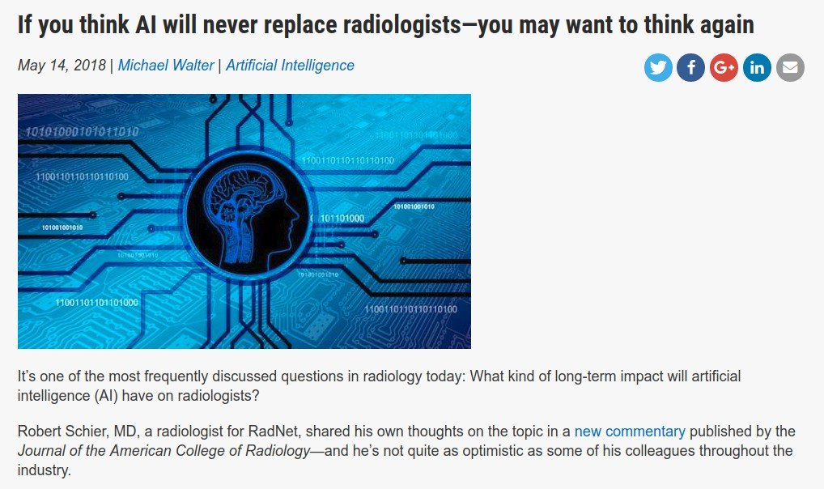
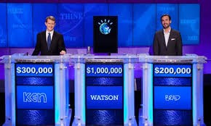
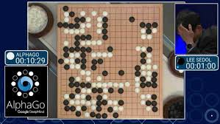
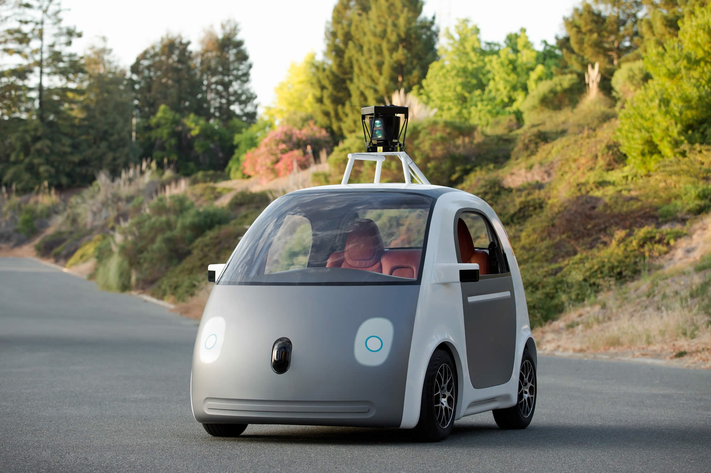

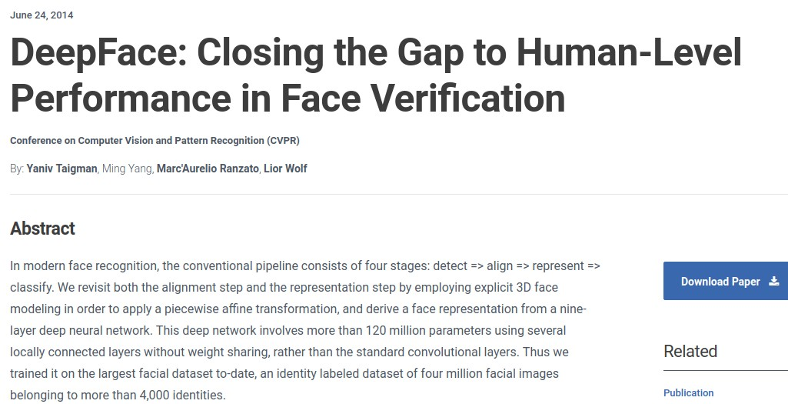
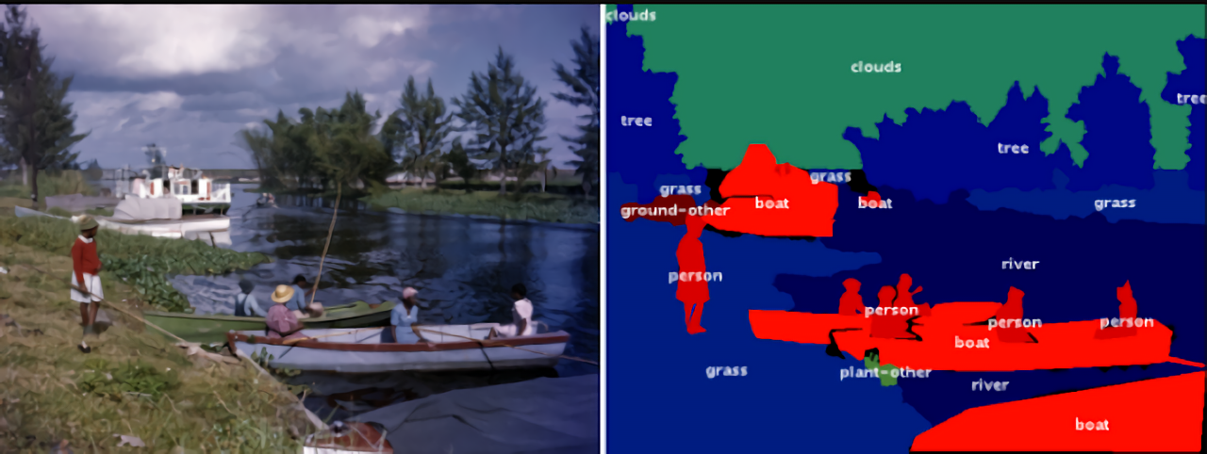
AI Success Stories
https://en.wikipedia.org/wiki/Watson_%28computer%299
https://en.wikipedia.org/wiki/Watson_%28computer%29
https://techcrunch.com/2017/05/24/alphago-beats-planets-best-human-go-player-ke-jie/
Image Annotation
https://www.bosch.com/stories/experience-automated-driving/
https://venturebeat.com/2018/10/22/googles-fluid-annotation-uses-ai-to-speed-up-image-dataset-annotation/

Slide 9



Companies
”An important shift from a mobile first world to an AI first world” [CEO Sundar Pichai @ Google I/O 2017]
Created AI and Research group as 4th engineering division, now 8K people [2016]
Created Facebook AI Research, Mark Zuckerberg very optimistic and invested
Others: IBM, Amazon, Apple, Uber, Salesforce, Baidu, Tencent, etc.

Slide 10





Governments
Will have a detailed discussion of US and China AI policies in April 2023!
What does Biden Administration says about AI
Understanding China's AI Strategy | Center for a New American Security (en-US) (cnas.org)
Released domestic strategic plan to become world leader in AI by 2030 [2017] https://www.nytimes.com/2017/07/20/business/china-artificial-intelligence.html China has a 'stunning lead' over the US in the research of 37 out of 44 critical and emerging technologies, new study finds (msn.com) ASPI’s Critical Technology Tracker | Australian Strategic Policy Institute | ASPI
”Whoever becomes the leader in this sphere [AI] will become the ruler of the world” [Putin, 2017] https://www.theverge.com/2017/9/4/16251226/russia-ai-putin-rule-the-world Russa’s
https://yourstory.com/2018/02/budget-2018-artificial-intelligence-fuel-indian-economy/
Europe’s AI strategy further to be discussed

Slide 11
Universities
Universities created new Colleges which center on AI and
Societal Aspects of Computing and Data:
Video: MIT to Spend $1 Billion on Program to Study AI Ethics | PCMag

Slide 12
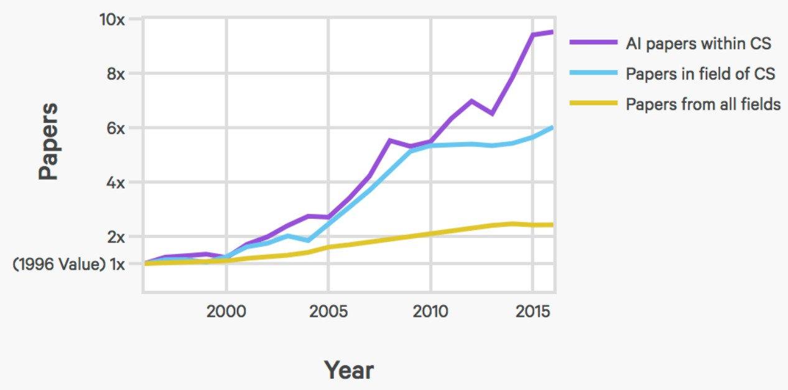
AI index: number of published AI papers

Slide 13
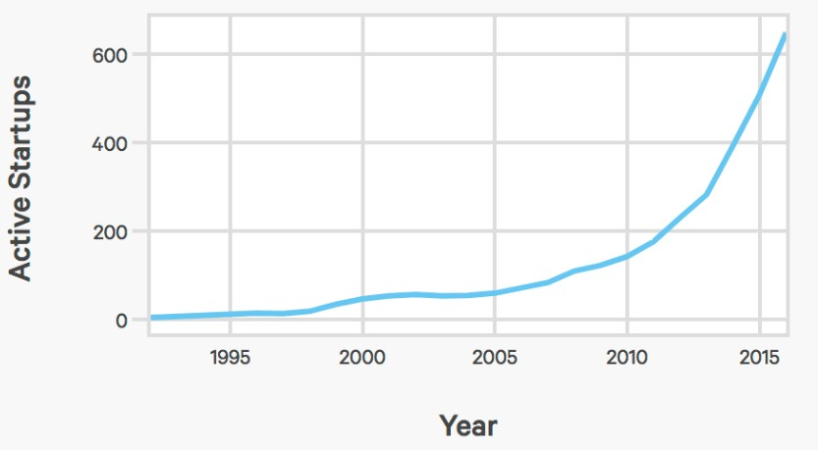
AI index: number of AI startups

Slide 14
Stanford CS221 enrollments
800
600
400
200
0
2012
2013
2014
2015
2016
2017
2018
Slowing down? Probably due to the CS221 spring offering...
14

Slide 15
Topics Covered in COSC 4368
More general topics:
  Exposure to many search algorithms
  Making sense out of data (kind of Data Science)
AI-specific Topics:
  Reasoning in uncertain environments and belief networks
  Heuristic search, Constraint Satisfaction Problems, and Games
  Learning from examples, reinforcement learning and deep learning
  Evolutionary Computing
  Game Theory (short)
  Ethical and Societal Aspects of AI (a little more coverage in 2023)
  Exposure to AI tools (belief networks, NN, Support Vector Machines, and either CNN or GAN)
Optional/Dropped topics: Logical reasoning, Planning, Multi-Agent Systems

Slide 16
Tentative Course Organization
1. Introduction to AI
2. Search
3. Game Theory (short)
4. Evolutionary Computing
5. Reinforcement Learning
6. Supervised Learning, centering on Basics, Support Vector Machines and Neural Networks
7. Deep Learning (will cover convolutional neural networks (CNN) and TBDL (GAN or BERT or RNN))
8. Societal and Ethical Aspects of AI
9. Decision Making and Reasoning in Uncertain Environments
10. Logical Reasoning and Planning

Slide 17
IJCAI 2019 Competitions
IJCAI-19 – August 10-16 2019, Macao, China
First Competition is close to “GAN”:
https://en.wikipedia.org/wiki/Generative_adversarial_network#

Slide 18
Positive Forces for AI
Data Science &Data Mining (KDD) / Learning for Examples
AI for the Web
Robotics https://www.wsj.com/articles/robot-hotel-loses-love-for-robots-11547484628?mod=itp_wsj&ru=yahoo
Multi-Agent Systems
AI and NLP: Chatbots, intelligent user interfaces that can communicate in natural language, doing intelligent things with text OpenAI Launches ChatGPT Professional — Premium AI Chatbot That Can Write Essays, Emails, Poems, And Code | by Liquid Ocelot | InkWater Atlas | Jan, 2023 | Medium
AI to create art, stories, videos,…Meta is using AI to generate videos from just a few words | CNN Business
Planning, Routing and Scheduling
Computer Chess/Go and Computer Games in General
Speech Recognition, Image Annotation
Computer Vision and Video Analytics
Deep Learning
Reinforcement Learning
AI for the Social Good
Intelligent “this and that”

Slide 19
4368 Homepage http://www2.cs.uh.edu/~ceick/4368.html
Textbook Code Repository
https://github.com/aimacode
IJCAI 2021/ 2023 Homepage
https://ijcai-21.org/
Today just will look at Tutorial and Panels
IJCAI 2023 – Cape Town (ijcai-23.org)
AAAI 2022 Homepage
https://aaai.org/Conferences/AAAI-22/
Will take a closer look in the last week of February 2022

Slide 20
Course Elements
∼26 Lectures
2 Exams (…)
A larger size 7-week Group Project centering on reinforcement learning starting Feb. 22, 2023!
3 Problem Sets (tasks that involve using AI-tools, tasks that involve some programming, and one essay writing task) with 5-7 Individual Tasks.
Group Homework Credit: The class will be subdivided in 15-18 groups and each group will present a solution to a homework style problem during the lecture (7-12 minutes). Each group has a different task!
Two 45 minutes Reviews before the two exams

Slide 21
AAAI 2019 #Session Counts
NLP: 20
Vision (and Video Analytics): 12
Game Theory and Economic Paradigms: 10
AI and the Web: 9
Machine Learning: 7
AI for Social Impact: 7
Search, Constraint Satisfaction and Optimization: 7
Knowledge Representation and Reasoning: 6
Deep Learning: 5
Planning, Routing and Scheduling: 4
Reinforcement Learning: 3
Multi-Agent Systems: 3
Reasoning under Uncertainty: 3
Remarks: Only topics with 3 AAAI sessions are mentioned; NLP, vision and AI&Web were aggregated into a single category! AAAI 2018 received 3900 papers, and AAAI 2019 received 7764 paper; about 2500 reviewers were needed to review the papers (Dr. Laszka and Dr. Eick were reviewing papers for AAAI 2019)

Slide 22
Part1b: Examples of Problems
Investigated by Different Subfields of AI
IJCAI 2021 link: IJCAI 2021 (ijcai-21.org)

Slide 23
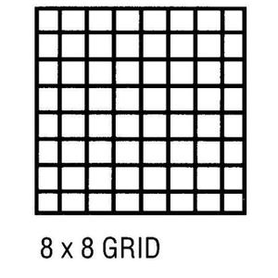
Knowledge Representation
Problem: Can the above chess board that misses the NW&SE corner
be covered by 31 domino pieces that cover 2 fields on a chess board?

Slide 24
Natural Language Understanding
I saw the Golden Gate Bridge flying to San Francisco.
I ate dinner with a friend. I ate dinner with a fork.
John went to a restaurant. He ordered a steak. After an hour John left happily.
I went to three dentists this morning.

Slide 25
COSC 4368 News Jan. 23, 2023
A MS Team called COSC4368 will be associated with the teaching of COSC 4368. Please, join the team using the passcode jtnu9s7 immediately!
The course website will play a key role in the teaching of the course: http://www2.cs.uh.edu/~ceick/4368.html
Problem Set1 should be available next Monday. You should be able to start working on it after the Jan. 30 lecture.
The first 1.5-2 lectures will give an Introduction to AI and will give course information, followed by 4-5 lectures, mostly centering on Search and related topics.
Attendance counts about 3% towards the course grade; we will start taking attendance Jan. 25!
Today, will cover
  Example of Subfields of AI
  More course information
  Stanford’s CS

Slide 26
Planning
http://sanjonmotel.com/wp-content/uploads/2016/10/free-fire-evacuation-plan-template-free-business-template-free-fire-evacuation-plan-template.gif
Objective: Construct a sequence of actions that will achieve a goal.
Example: John wants to buy a house
Characteristics of Planning:
Goals and Subgoals
Operators that potentially make goal predicate true
Parallelism
Dependency between goals / subgoals
Plan and sub-plans might fail, requiring plan modification

Slide 27
Heuristic Search
Heuristo (greek): I find
Copes with problems for which it is not feasible to look at all solutions
Heuristics: rules a thumb (help you to explore the more promising solutions first), based on experience, frequently fuzzy
Main ideas of heuristics: search space reduction, ordering solutions intelligently, simplifications of computations
Example problems: puzzles, traveling salesman problem, chess,…

Slide 28
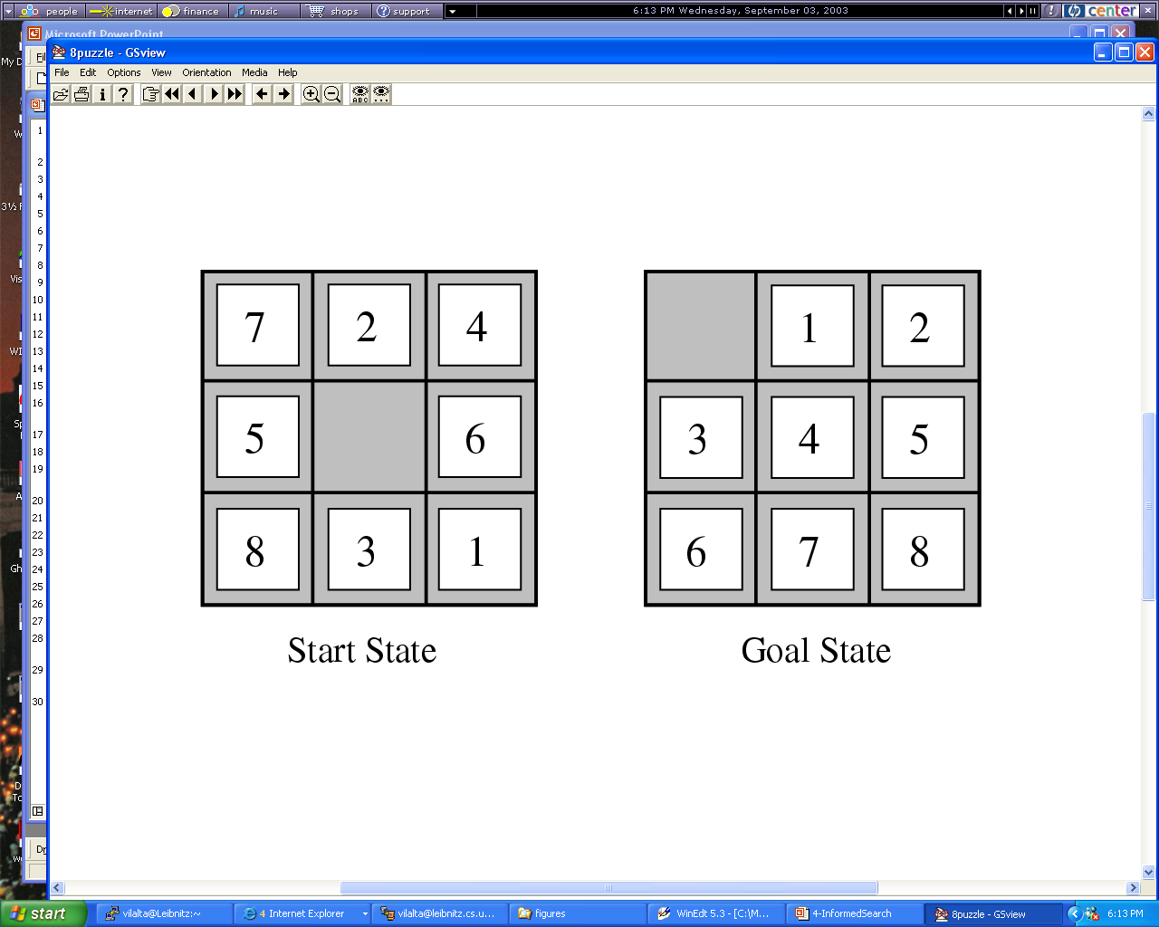
Figure

Slide 29
Evolutionary Computing
http://www2.cs.uh.edu/~ceick/6367/6367.html
Evolutionary algorithms are global search techniques.
They are built on Darwin’s theory of evolution by natural selection.
Numerous potential solutions are encoded in structures, called chromosomes.
During each iteration, the EA evaluates solutions and generates offspring based on the fitness of each solution in the task.
Substructures, or genes, of the solutions are then modified through genetic operators such as mutation or recombination.
The idea: structures that led to good solutions in previous evaluations can be mutated or combined to form even better solutions.

Slide 30
Soft Computing
Conventional Programming:
Relies on two-valued logic
Mostly uses a symbolic (non-numerical knowledge representation framework)
Soft Computing (e.g. Fuzzy Logic, Naïve Bayes, Belief Networks, Hidden Markov Models):
Tolerance for uncertainty and imprecision
Uses weights, probabilities, possibilities
Strongly relies on numeric approximation and interpolation
Remark: There seem to be two worlds in computer science; one views the world as consisting of numbers; the other views the world as consisting of symbols.

Slide 31
Different Forms of Learning
Learning agent receives feedback with respect to its actions (e.g. using a teacher)
  Supervised Learning/Learning from Examples/Inductive Learning: feedback is received with respect to all possible actions of the agent
  Reinforcement Learning: feedback is only received with respect to the taken action of the agent
Unsupervised Learning: Learning without feedback
Notes:
The last technology I like to introduce in today’s presentation are shared ontologies. Shared ontologies are important to standardize communication, and for gathering information from different information sources. Ontologies play an important role for agent-based systems.
Ontologies basically describe...

Slide 32
Machine Learning Classification-
Model Construction (1)
Classification
Algorithms
Training
Data
Classifier
(Model)
IF rank = ‘professor’
OR years > 6
THEN tenured = ‘yes’

Slide 33
Classification Process (2): Use the Model in Prediction
Classifier
Testing
Data
Unseen Data
(Jeff, Professor, 4)
Tenured?

Slide 34

Knowledge Discovery in Data [and Data Mining] (KDD)
Let us find something interesting!
Definition := “KDD is the non-trivial process of identifying valid, novel, potentially useful, and ultimately understandable patterns in data” (Fayyad)
Notes:
The first technology I like to …
The above picture is, in my opinion, a good description of the task of knowledge discovery in that it illustrates a huge search space that contains very very few interesting things, and if applied in practice, KDD is frequently like finding a needle in a hay stack, except that you are not sure what you are looking for...

Slide 35
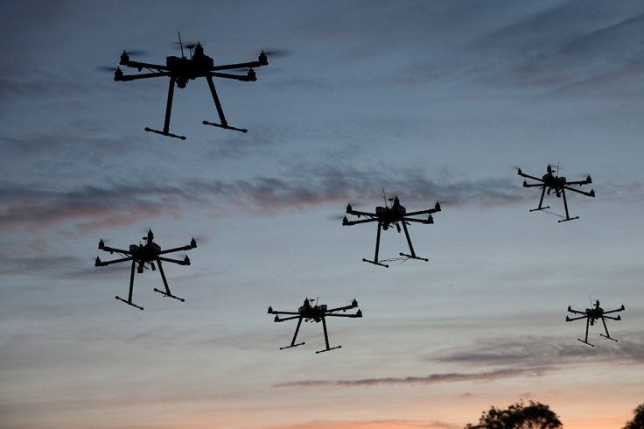
Flying SWARM Robots
http://arstechnica.com/science/2012/03/robots-swarm-the-stage-at-ted/
Watch First 2 minutes. 4:30, 10:15. 15:30
Requires:
  Planning
  Multi-Agent Systems and Distributed AI
  Search
  Reasoning in uncertain Environments
  Machine Leaning
  Computer Vision
  ……
Notes:
The first technology I like to …
The above picture is, in my opinion, a good description of the task of knowledge discovery in that it illustrates a huge search space that contains very very few interesting things, and if applied in practice, KDD is frequently like finding a needle in a hay stack, except that you are not sure what you are looking for...

Slide 36
2. General Course Information
Course Id: COSC 4368: Fundamentals of Artificial Intelligence
Time: MO&WE 2:30-4p
Instructor: Christoph F. Eick
Homepage: http://www2.cs.uh.edu/~ceick
Office Hours MO 4-4:45p TH 2:45-4p (in Team COSC4368)
TAs …
Office Hours see webpage
Classroom: S 105
Online: COSC4368
E-mail: ceick@uh.edu
/

Slide 37
Prerequisites COSC 4368
Prerequisite: COSC 2320 or COSC 2430
Otherwise, the course is self-contained
  Some experience in writing programs with 400+ lines in some programming language (C, C++, Java,Python…)
    Basic knowledge of data structures (particularly trees and graphs); what is taught in an introductory undergraduate data structure course; e.g. COSC 2430;
    No knowledge of LISP, PROLOG and other AI languages is required
  Ability to deal with “abstract mathematical concepts”
  Basic knowledge of probability theory is helpful, but I will give a very basic review in early April…

Slide 38
Textbook
http://aima.cs.berkeley.edu/
Fourth Edition of the textbook was published in late 2020; officially, my hard copy of the textbook came out in 2021.

Slide 39
Group Project and Problem Sets
There will be a 7-week group project centering on reinforcement learning starting Feb. 22, 2022. Group sizes will be 4 (5) students.
There will be 3 Problem Sets consisting of 5-7 Individual Tasks (which require writing software, which us AI tools, tasks in which you conduct experiments and summarize and interpret the results, and a task in which you write essays). The topics associated with the 2022 Problem Sets are as follows:
  Problem Set1: Search
  Problem Set2: Supervised Learning with Emphasis on Neural Networks
  Problem Set3: Reasoning under Uncertainty and Societal Aspects of AI
Problem Sets 1+3 will be somewhat similar to those in 2022, but the plan is that ProblemSet2 will be quite different.

Slide 40

Do collaborate and discuss together, but write up and code independently.
You can discuss what is required to do with other students, but you cannot solve the problems jointly. A few course activities will be group activities.
Do not look at anyone else’s writeup or code.
Do not show anyone else your writeup or code or post it online (e.g., GitHub).
We will run MOSS and similar tools which find similarities in submitted code periodically to detect plagiarism.
If you use code / software / project ideas from the internet, you have to admit this fact in the reports you submit in COSC 4368 by properly referencing the work you used. Not doing so represents a serious academic honesty violation!
Academic honesty violations will be reported to the COSC Department, and two the college if the violation is a second offense of a particular student.
NOTE: PLAGIARISM IS NOT TOLERATED.

Slide 41
2023 Grading Weights COSC 4368
2 Exams (20% +27%) 47%
3 Problem Sets TBDL
Group Project TBDL
Attendance and Group Homework Credit 5-7%
Remark: Weights are subject to change…

Slide 42
Exams
Will be open notes/textbook
Will get a review list before the exam
Exams will center (80% or more) on material that was covered in the lecture
Exam scores will be immediately converted into number grades
.

Slide 43


Two views of AI
AI agents: how can we re-create intelligence?
AI tools: how can we benefit society?

Slide 44
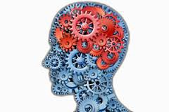
An Intelligent Agent
The starting point for the agent-based view is ourselves.
As humans, we have to be able perceive the world (computer vision), perform actions in it (robotics), and communicate with other agents (NLP,…).
We also have knowledge about the world (from how to ride a bike to knowing the capital of France), and using this knowledge we can draw inferences and make decisions.
Finally, last but not least, we learn and adapt over time. Indeed, machine learning has become the primary driver of many of the AI applications we see today.
Perception Robotics Language
Knowledge
Reasoning
Learning

Slide 45
Motivation: virtual assistant
Tell information
Ask questions
Use natural language!
[demo]
Need to:
Digest heterogenous information
Reason deeply with that information
82

Slide 46
AI tools...
Approach: Provide AI techniques in a non-agent tool setting, e.g.
Learn models from examples
Annotate images with categories
Predict poverty from satellite images
Translate from language to another language
Tools, e.g. belief networks, for probabilistic reasoning
Planning and Scheduling Tools
…
33

Slide 47
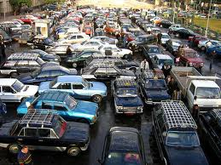
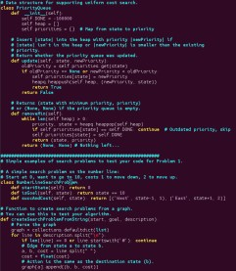
How do we solve AI tasks?

Slide 48
Paradigms
Modeling
Inference
Learning
50

Slide 49
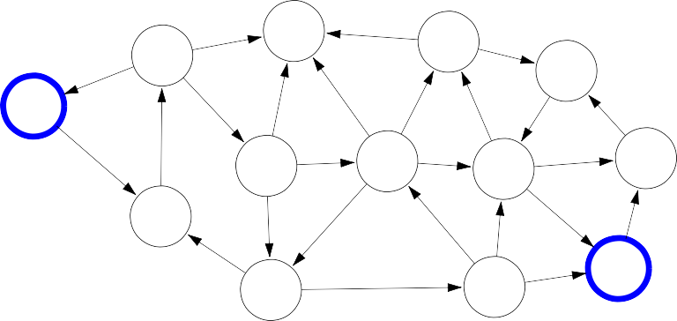
Paradigm: Modeling
But where does the model come from? Remember that the real world is rich, so if the model is to be faithful, the model has to be rich as well. But we can’t possibly write down such a rich model manually.
The idea behind (machine) learning is to instead get it from data. Instead of constructing a model, one constructs a skeleton of a model (more precisely, a model family), which is a model without parameters. And then if we have the right type of data, we can run a machine learning algorithm to tune the parameters of the model.
Real world
Modeling
5
6
7
4
Model
0
8
5
5
3
1
6
3
8
8
1
1
4
7
2
3
6
7
2
6
8
52

Slide 50

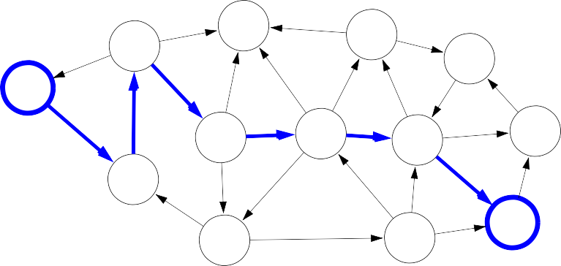
Paradigm: Inference
5
6
7
4
Model
0
8
5
5
3
1
6
3
8
8
1
1
4
7
2
3
6
7
2
6
8
Inference
5
6
7
4
Predictions
0
8
5
5
3
1
6
3
8
8
1
1
4
7
2
3
6
7
2
6
8
54

Slide 51


Paradigm: Learning
?
?
?
?
Model without parameters
?
?
?
?
?
?
?
?
?
?
?
?
?
?
?
?
?
?
?
?
?
+data
Learning
5
6
7
4
Model with parameters
0
8
5
5
3
1
6
3
8
8
1
1
4
7
2
3
6
7
2
6
8
56

Slide 52
COSC 4368 News Jan. 25, 2023
Problem Set1 is already available online---Task2 is still subject to change. You should be able to start working on it after the Jan. 30 lecture.
We will conduction a survey during the lecture on Mo., January 30; please bring your laptops!
Today, will cover
  Stanford’s CS 221 View of AI
  Search 1: Introduction to Search and Classification of Search Problems
  Randomized Hill Climbing (from Search4; kind of out of order)
  Search 2: Problem Solving by Searching
  Search 3: Informed Search and Exploration

Slide 53
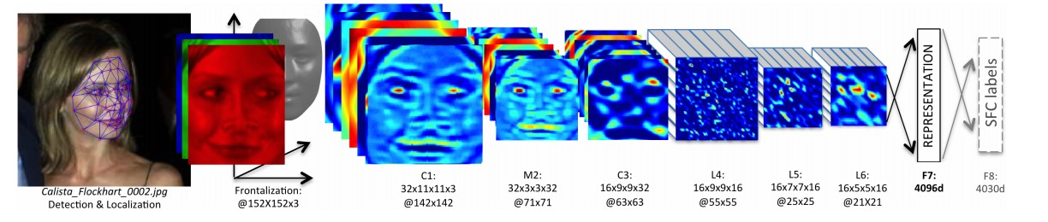
 |  | Reflex-based models
Examples: linear classifiers, deep neural networks
Most common models in machine learning
Fully feed-forward (no backtracking)
The idea of a reflex-based model simply performs a fixed sequence of computations on a given input. Examples include most models found in machine learning from simple linear classifiers to deep neural networks. The main characteristic of reflex-based models is that their computations are feed-forward; one doesn’t backtrack and consider alternative computations. Inference is trivial in these models because it is just running the fixed computations, which makes these models appealing.
CS221 / Autumn 2018 / Liang [reflex]

Slide 54
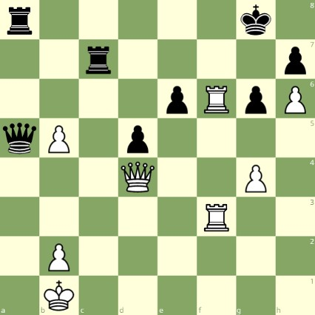
State-based models
Reflex-based models are too simple for tasks that require more forethought (e.g., in playing chess or planning a big trip). State-based models overcome this limitation.
The key idea is, at a high-level, to model the state of a world and transitions between states which are triggered by actions. Concretely, one can think of states as nodes in a graph and transitions as edges. This reduction is useful because we understand graphs well and have a lot of efficient algorithms for operating on graphs.
White to move

Slide 55
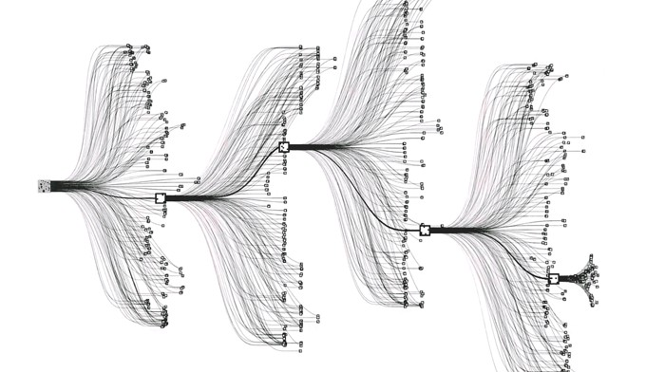
State-based models
Applications:
Games: Chess, Go, Pac-Man, Starcraft, etc.
Robotics: motion planning
Natural language generation: machine translation, image captioning

Slide 56


State-based models
Search problems: you control everything
Markov decision processes: against nature (e.g., Blackjack)
Adversarial games: against opponent (e.g., chess)
70

Slide 57
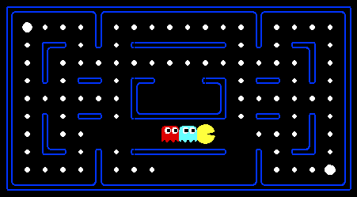
Pac-Man
[demo]

Slide 58
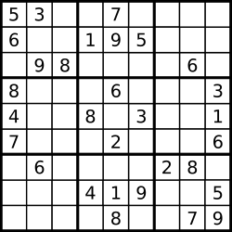
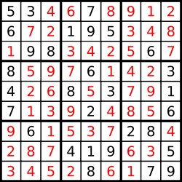
Sudoku: Models with Variables
Goal: put digits in blank squares so each row, column, and 3x3 sub-block has digits 1–9
Note: order of filling squares doesn’t matter in the evaluation criteria!

Slide 59
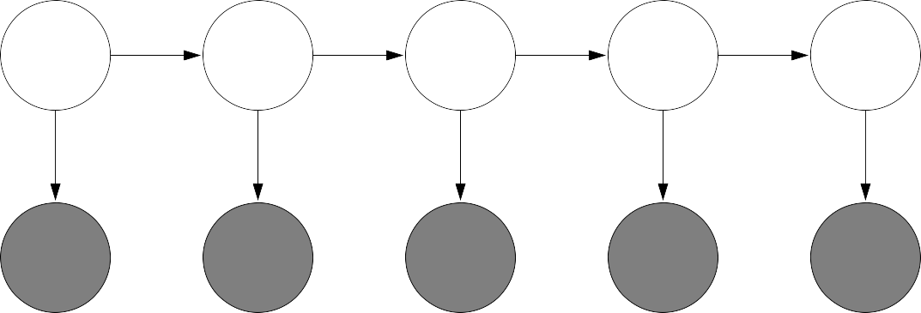
Variable-based models
Constraint satisfaction problems: hard constraints (e.g., Sudoku, scheduling)
X₁ X₂
X₃ X₄
Bayesian networks: soft dependencies (e.g., tracking cars from sensors)
H₁ H₂ H₃ H₄ H₅
E₁
E₂
E₃
E₄
E₅
77
Constraint satisfaction problems are variable-based models where we only have hard constraints. For example, in scheduling, we can’t have two people in the same place at the same time.
Bayesian networks are variable-based models where variables are random variables which are dependent on each other. For example, the true location of an airplane H_{t} and its radar reading E_{t} are related, as are the location H_{t} and the location at the last time step H_{t−1}. The exact dependency structure is given by the graph structure and formally defines a joint probability distribution over all the variables. This topic is studied thoroughly in probabilistic graphical models.

Slide 60
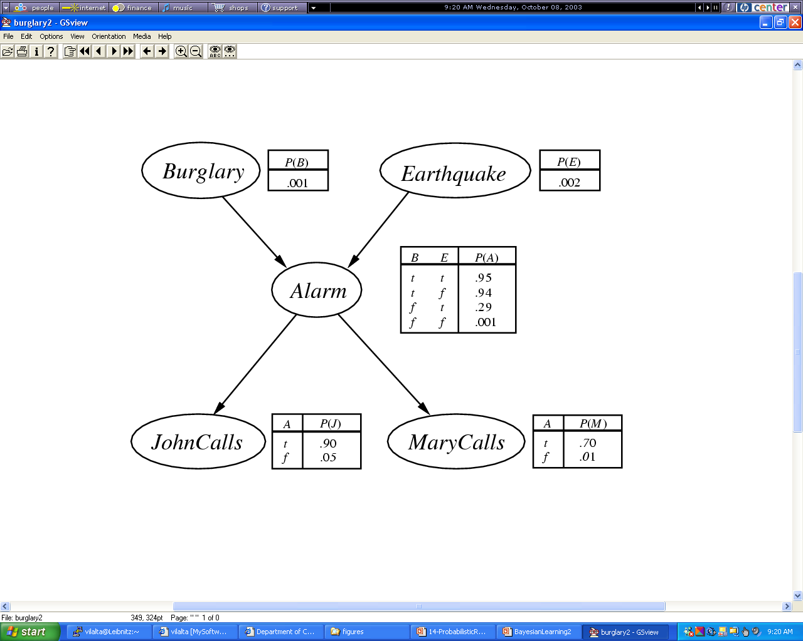
Example 2
Example of a Belief Network
BN: probability of a variable only depends on its direct successors; e.g.
P(b,e,a,~j,m)= P(b)*P(e)*P(a|b,e)*P(~j|a)*P(m|a)=0.01*0.02*0.95*0.1*0.7
Notes:
What is machine learning?

Slide 61
Logic
Dominated AI from 1960s-1980s, still useful in programming systems
Powerful representation of knowledge and reasoning
Brittle if done naively
Open question: how to combine with machine learning or planning?

Slide 62
Stanford’s CS221 View of AI
Search problems Markov decision processes
Adversarial games
States
Constraint satisfaction problems Bayesian networks
Variables
Reflex
Logic
”Low-level intelligence”
”High-level intelligence”
Machine learning
Comment: There are many other things in AI that have little or
nothing to do with Machine Learning such as reasoning, vision, multi-agent system, robotics…

Slide 63


AI
Knowledge Representation
Knowledge-based
and Expert Systems
Planning
Coping with Vague,
Incomplete and
Uncertain Knowledge
Searching
Intelligently
Logical Reasoning
& Theorem Proving
Communicating,
Perceiving and
Acting
Intelligent Agents
& Distributed AI
AI Programming
Learning & Knowledge Discovery

Slide 64
Textbook Search Reading List
Students suggested Textbook reading groups…
  Please read the 4th edition (which appeared in Dec. 2020, I believe) of the textbook and not older editions!
  However, the textbook introduction is hard to follow, I believe---as it assumes a lot of knowledge 4th year undergraduate students do not necessarily have. Moreover, Dr. Eick’s introduction is a mixture of slides of his own and a few slides from the Stanford Introductory AI course and is somewhat different from the textbook introduction.
  However, I give you a textbook search reading list on the next slide.
Chapter 3: mandatory: 63-92, 96-102, 104-106; optional: 92-96, 102-104
Chapter 4: mandatory: 110-115, 141 optional: 116-119 (EC will be covered separately later), 119-122
Chapter 5: mandatory: 146-158, 174-175 optional: 159-161, 164-168
Chapter 6: mandatory: 180-193(skip 6.1.2) optional: 194-199
There are some additional slides, discussing categories of search algorithms, backtracking, randomized hill climbing which are not covered in the textbook!
Remark: all page numbers refer to the 4th Edition from 2021…

