Slide 1
COSC 4368 News Jan. 20, 2026
The course website will play a key role in the teaching of the course: http://www2.cs.uh.edu/~ceick/4368.html
Always use this website to get updated versions of lectures, assignments…
The first 2 lectures will give an Introduction to AI and will give course information, followed by 4-5 lectures, mostly centering on Reinforcement Learning
There will be 4 assignments (one group assignments), 2 exams, and a few in-class activities. Please take a closer look at the course website and syllabus in the next 5 days; there will be a Q&A near the beginning of the lecture on Jan. 27, to answer your questions about the form and content of COSC 4368.
Some coordination with the other section of this course is currently under discussion: we might share teaching material, assignments and in-class activities across the two sections.
We will take attendance every Tuesday starting Jan. 29; there will be also some in-class activities on some Tuesdays and not showing up on Tuesdays you might not get credit for those activities.
There will be group assignment presentations in April.

Slide 2
COSC 4368 and “What is AI?”
Introduction to AI (today and Jan. 22)
  What is AI?
  Sub-fields of AI / Example problems investigated by AI research
  What is going on with respect to AI?
Some Basic Course Information near the end of Today’s lecture.

Slide 3
Part1a: Definitions of AI
“AI centers on the simulation of intelligence using computers”
“AI develops programming paradigms, languages, tools, and environments for application areas for which conventional programming fails”
  Symbolic programming (LISP)
  Functional programming
  Heuristic Programming
  Logical Programming (PROLOG)
  Rule-based Programming (Expert system shells)
  Soft Computing (Belief network tools, fuzzy logic tools boxes,…)
  Object-oriented programming (Smalltalk)

Slide 4
More Definitions of AI
Rich/Knight: ”AI is the study of how to make computers do things which, at the moment, people do better”
Winston: “AI is the study of computations that make it possible to perceive, reason, and act.
Turing Test: If an artificial intelligent system is not distinguishable from a human being, it is definitely intelligent.
https://en.wikipedia.org/wiki/Turing_test
Eugene Goostman Winner 2014 Touring Test: https://en.wikipedia.org/wiki/Eugene_Goostman

Slide 5
Physical Symbol System Hypothesis
“What the brain does can be thought of at some level as a kind of computation”
Physical Symbol System Hypothesis (PSSH): A physical symbol system has the sufficient and necessary means for general, intelligent actions.
Remarks PSSH:
Subjected to empirical validation
If false → AI is quite limited
Important for psychology and philosophy

Slide 6
Questions/Thoughts about AI
What are the limitations of AI? Can computers only do what they are told? Can computers be creative? Can computers think? What problems cannot be solved by computers today?
Computers show promise to control the current waste of energy and other natural resources.
Computer can work in environment that are unsuitable for human beings.
If computers control everything --- who controls the computers?
If computers are intelligent what civil rights should be given to computers?
If computers can perform most of our work; what should the human beings do?
Only those things that can be represented in computers are important.
It is fun to play with computers.

Slide 7
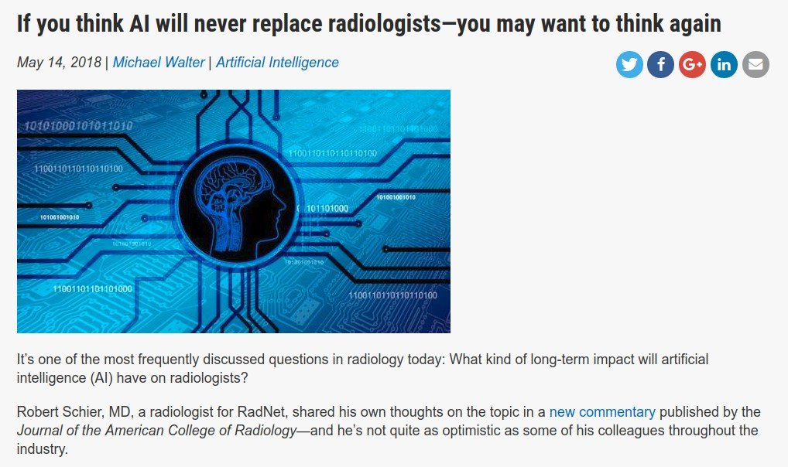
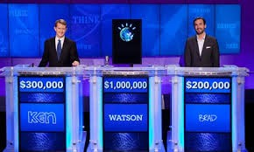
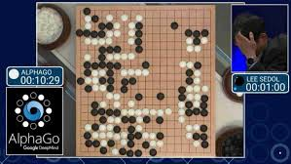
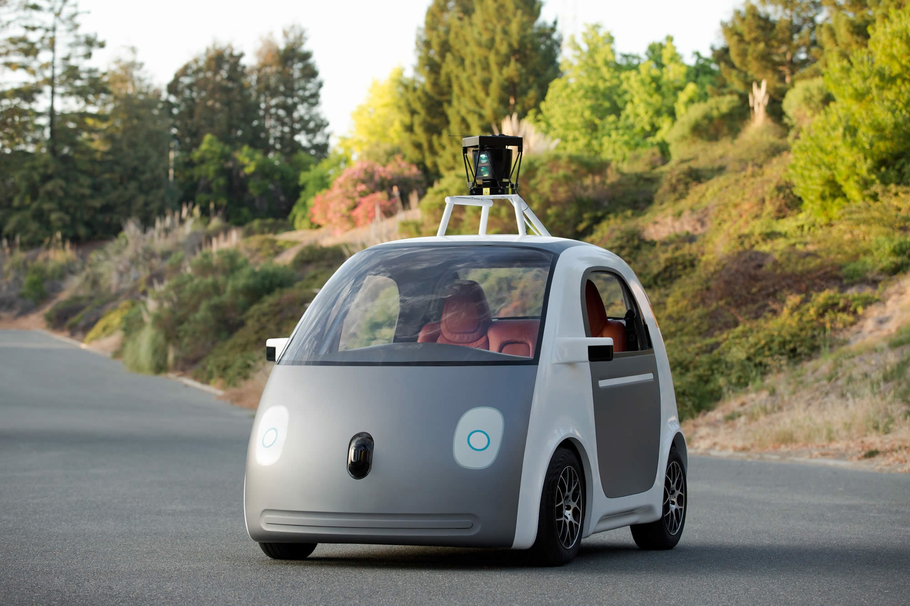
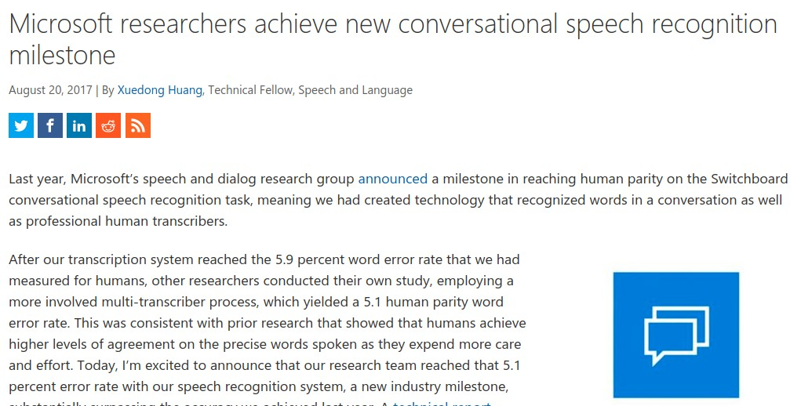
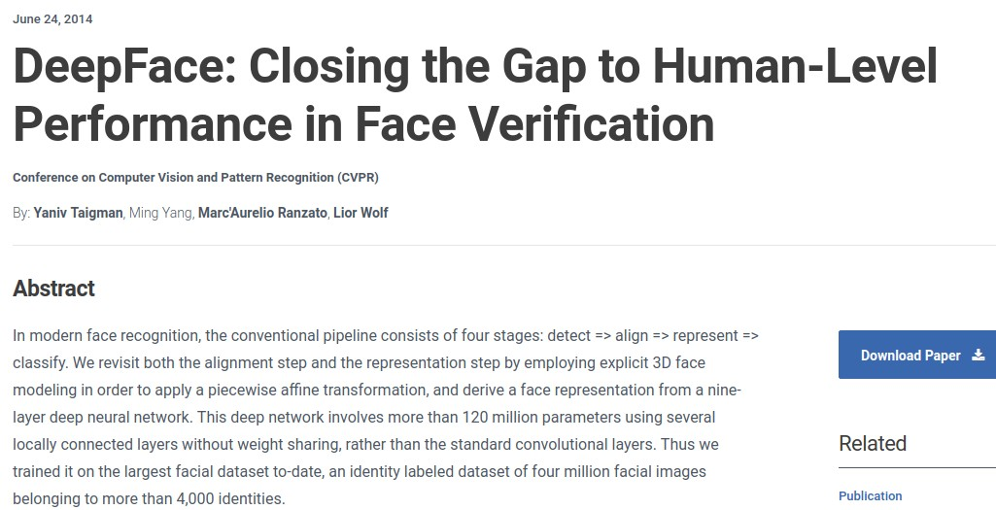
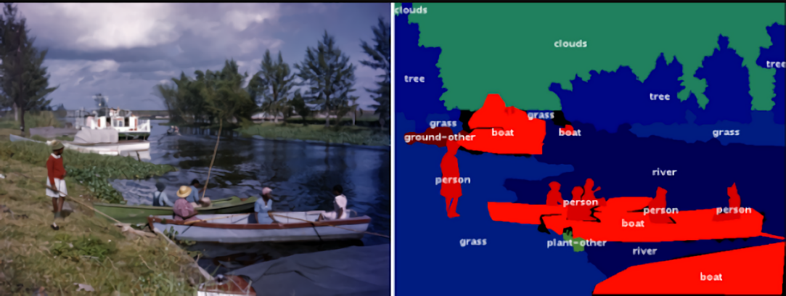
AI Success Stories
https://en.wikipedia.org/wiki/Watson_%28computer%299
https://en.wikipedia.org/wiki/Watson_%28computer%29
https://techcrunch.com/2017/05/24/alphago-beats-planets-best-human-go-player-ke-jie/
Image Annotation
https://www.bosch.com/stories/experience-automated-driving/
https://venturebeat.com/2018/10/22/googles-fluid-annotation-uses-ai-to-speed-up-image-dataset-annotation/

Slide 8



Companies
”An important shift from a mobile first world to an AI first world” [CEO Sundar Pichai @ Google I/O 2017]
Created AI and Research group as 4th engineering division, now 8K people [2016]
Created Facebook AI Research, Mark Zuckerberg very optimistic and invested
Others: IBM, Amazon, Apple, Uber, Salesforce, Baidu, Tencent, etc.

Slide 9
Universities
Universities created new Colleges which center on AI and
Societal Aspects of Computing and Data:
Video: MIT to Spend $1 Billion on Program to Study AI Ethics | PCMag

Slide 10
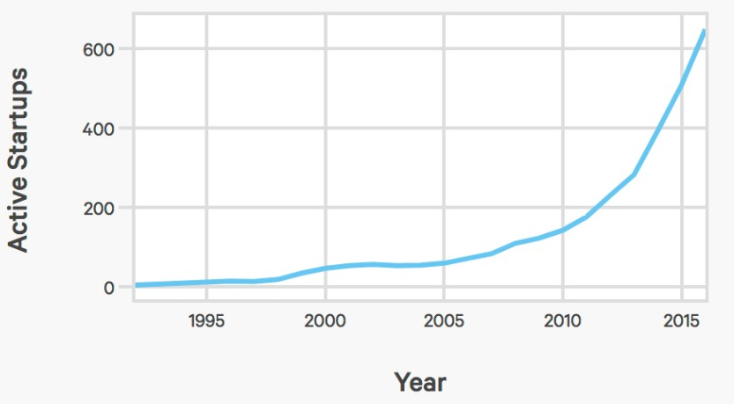
AI index: number of AI startups

Slide 11
AI Trends
Generative AI taking it up a notch
Heightened AI industry regulation
More emphasis on explainable AI
Increased collaboration between humans and AI
Increased Use of ChatGPT and Other Language Models everywhere.
Universities put more emphasis on AI education.
AI replaces programmers / makes the remaining programmers more productive.

Slide 12
Topics Covered in COSC 4368
More general topics:
  Exposure to many search algorithms
  Making sense out of data (kind of Data Science)
  Optional 2026 Topic: Logical reasoning
AI-specific Topics:
  Reasoning in uncertain environments and belief networks
  Heuristic search, Constraint Satisfaction Problems, and Games
  Learning from examples, reinforcement learning and deep learning
  Evolutionary Computing
  Game Theory (short)
  Ethical and Societal Aspects of AI (about 2 lectures)
  Exposure to AI tools (belief networks(??), NN, Decision Trees, Autoencoders. Diffusion Models,

Slide 13
Tentative Course Organization
Introduction to AI
Reinforcement Learning
Search
Evolutionary Computing (short)
Game Theory (short)
Supervised Learning, centering on Basics, Decision Trees and Neural Networks
Deep Learning (will cover autoencoders and diffusion models)
Societal and Ethical Aspects of AI
Decision Making and Reasoning in Uncertain Environments
Optional Topic: Logical Reasoning, centering of First Order Predicate Logic (FOPL)

Slide 14
4368 Homepage http://www2.cs.uh.edu/~ceick/4368.html
Textbook Code Repository
https://github.com/aimacode
IJCAI Conference Homepage
IJCAI 2023 – Cape Town (ijcai-23.org)
Will take a closer look early February
AAAI 2025 Homepage
AAAI-24 – AAAI
Will take a closer look in February

Slide 15
Demoing Subfields
of AI
Using Examples

Slide 16
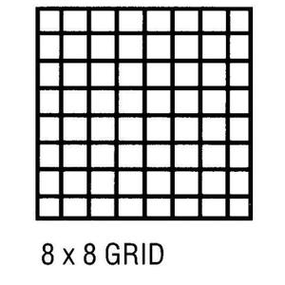
Knowledge Representation
Problem: Can the above chess board that misses the NW&SE corner
be covered by 31 domino pieces that cover 2 fields on a chess board?

Slide 17
Natural Language Understanding
I saw the Golden Gate Bridge flying to San Francisco.
I ate dinner with a friend. I ate dinner with a fork.
John went to a restaurant. He ordered a steak. After an hour John left happily.
I went to three dentists this morning.

Slide 18
Heuristic Search
Heuristo (greek): I find
Copes with problems for which it is not feasible to look at all solutions
Heuristics: rules a thumb (help you to explore the more promising solutions first), based on experience, frequently fuzzy
Main ideas of heuristics: search space reduction, ordering solutions intelligently, simplifications of computations
Example problems: puzzles, traveling salesman problem, chess,…

Slide 19
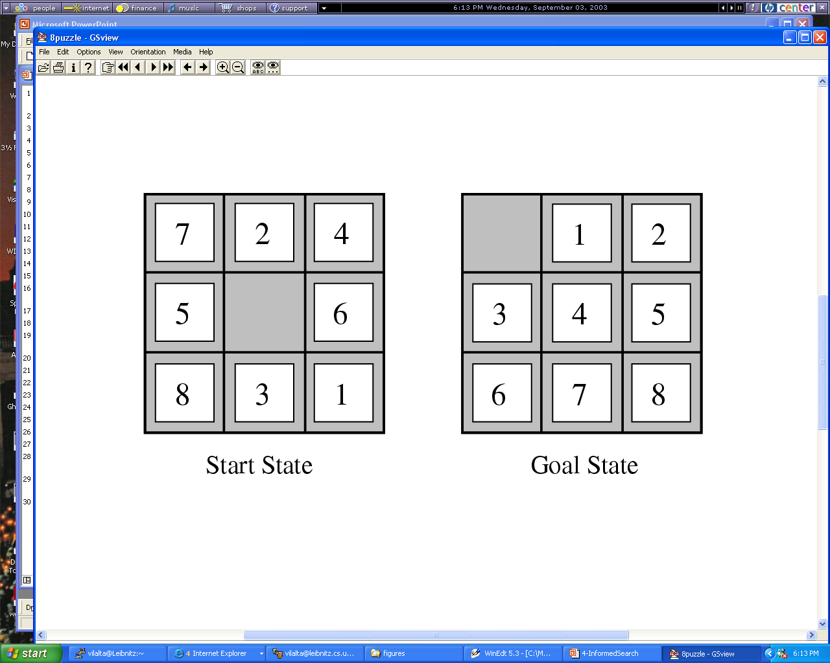
Figure

Slide 20
Planning
http://sanjonmotel.com/wp-content/uploads/2016/10/free-fire-evacuation-plan-template-free-business-template-free-fire-evacuation-plan-template.gif
Objective: Construct a sequence of actions that will achieve a goal.
Example: John wants to buy a house
Characteristics of Planning:
Goals and Subgoals
Operators that potentially make goal predicate true
Parallelism
Dependency between goals / subgoals
Plan and sub-plans might fail, requiring plan modification

Slide 21
Evolutionary Computing
http://www2.cs.uh.edu/~ceick/6367/6367.html
Evolutionary algorithms are global search techniques.
They are built on Darwin’s theory of evolution by natural selection.
Numerous potential solutions are encoded in structures, called chromosomes.
During each iteration, the EA evaluates solutions and generates offspring based on the fitness of each solution in the task.
Substructures, or genes, of the solutions are then modified through genetic operators such as mutation or recombination.
The idea: structures that led to good solutions in previous evaluations can be mutated or combined to form even better solutions.

Slide 22
Tentative Course Organization
Introduction to AI
Reinforcement Learning
Search
Evolutionary Computing (short)
Game Theory (short)
Supervised Learning, centering on Basics, Decision Trees and Neural Networks
Deep Learning (will cover autoencoders and diffusion models)
Societal and Ethical Aspects of AI
Decision Making and Reasoning in Uncertain Environments
Optional Topic: Logical Reasoning, centering of First Order Predicate Logic (FOPL)

Slide 23
News Jan. 22, 2025
We changed the order of assignments and therefore the order of teaching: we will discuss Reinforcement Learning first and then Seach next.
Assignment1 has been posted; it centers on Reinforcement Learning and will be discussed in the Jan. 29 lecture.
How we teach the course will be finalized by Feb. 3, 2026; we know what we will teach. There is still some coordination going on with the other Section of the course which is taught by Raunak Sarbajna.
Today
  2018 Video: MIT to Spend $1 Billion on Program to Study AI Ethics | PCMag
  Continue discussion of Subfields of AI
  Stanford CS 221’s View of AI
  A gentle Introduction to Machine Learning

Slide 24
Soft Computing
Conventional Programming:
Relies on two-valued logic
Mostly uses a symbolic (non-numerical knowledge representation framework)
Soft Computing (e.g. Fuzzy Logic, Naïve Bayes, Belief Networks, Hidden Markov Models):
Tolerance for uncertainty and imprecision
Uses weights, probabilities, possibilities
Strongly relies on numeric approximation and interpolation
Remark: There seem to be two worlds in computer science; one views the world as consisting of numbers; the other views the world as consisting of symbols.

Slide 25
Different Forms of Learning
Learning agent receives feedback with respect to its actions (e.g. using a teacher)
  Supervised Learning/Learning from Examples/Inductive Learning: feedback is received with respect to all possible actions of the agent
  Reinforcement Learning: feedback is only received with respect to the taken action of the agent
Unsupervised Learning: Learning without feedback
Notes:
The last technology I like to introduce in today’s presentation are shared ontologies. Shared ontologies are important to standardize communication, and for gathering information from different information sources. Ontologies play an important role for agent-based systems.
Ontologies basically describe...

Slide 26
Machine Learning Classification-
Model Construction (1)
Classification
Algorithms
Training
Data
Classifier
(Model)
IF rank = ‘professor’
OR years > 6
THEN tenured = ‘yes’

Slide 27
Classification Process (2): Use the Model in Prediction
Classifier
Testing
Data
Unseen Data
(Jeff, Professor, 4)
Tenured?

Slide 28

Knowledge Discovery in Data [and Data Mining] (KDD)
Let us find something interesting!
Definition := “KDD is the non-trivial process of identifying valid, novel, potentially useful, and ultimately understandable patterns in data” (Fayyad)
Notes:
The first technology I like to …
The above picture is, in my opinion, a good description of the task of knowledge discovery in that it illustrates a huge search space that contains very very few interesting things, and if applied in practice, KDD is frequently like finding a needle in a hay stack, except that you are not sure what you are looking for...

Slide 29
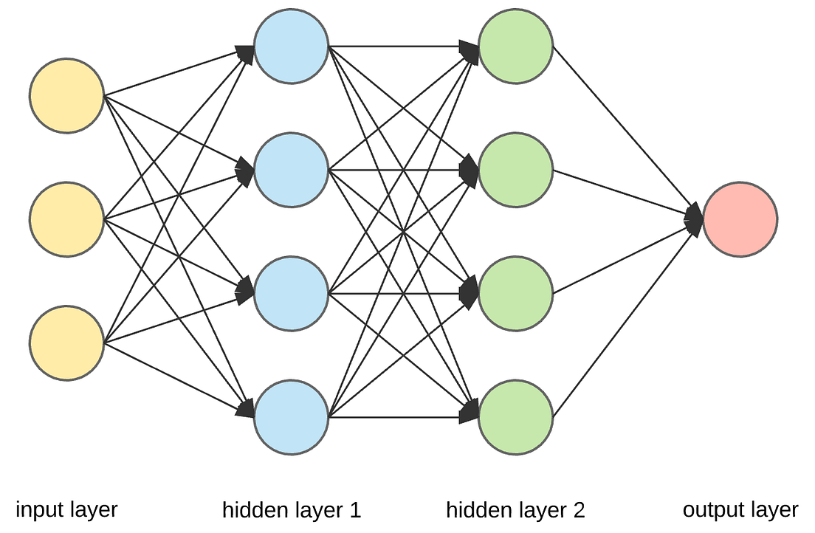

Deep Learning
Deep learning is a subfield of machine learning focusing on learning data representations from datasets as successive layers of increasingly meaningful representations.
Neural Network
learned low-level features
learned mid-level features
learned high-level features
learned classifier
cat

Slide 30
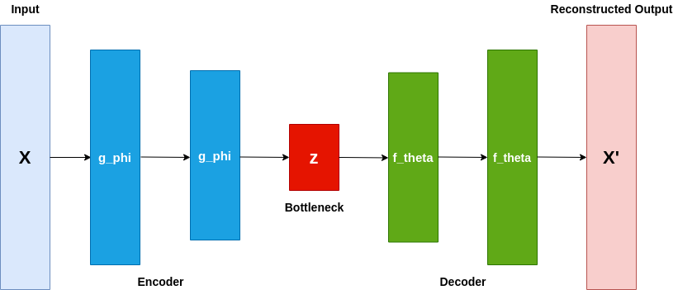
Deep Learning Centering on Autoencoders and Diffusion Models
Latent Space
Autoencoder Architecture
Notes:
The first technology I like to …
The above picture is, in my opinion, a good description of the task of knowledge discovery in that it illustrates a huge search space that contains very very few interesting things, and if applied in practice, KDD is frequently like finding a needle in a hay stack, except that you are not sure what you are looking for...

Slide 31
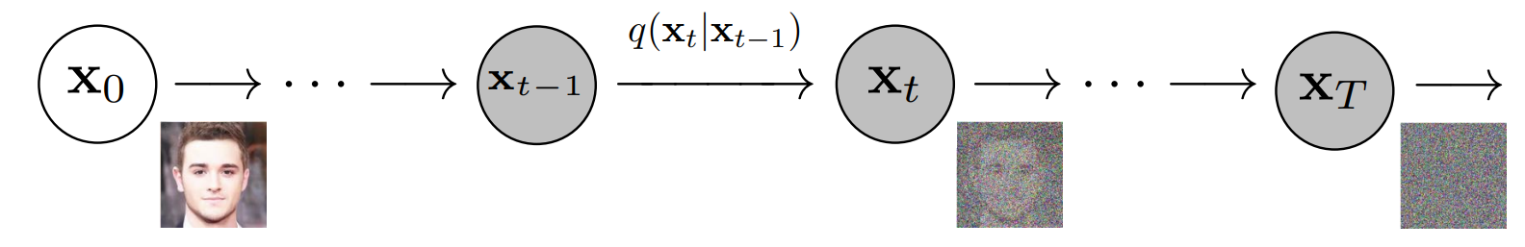
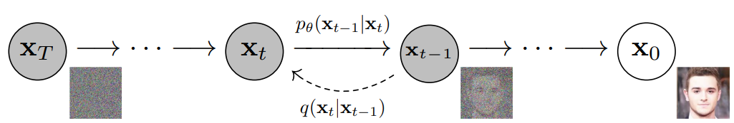
Diffusion Models
Ava Amini’s Video: MIT 6.S191: Deep Learning New Frontiers (youtube.com)
Instructions: Starting watching at 39:39 for 1 minute and then skip to 44:00
Another Video (not shown in Jan. 2024): Bing Videos
Another Video (I hope you will be able to understand it in April 2024!): Bing Videos

Slide 32
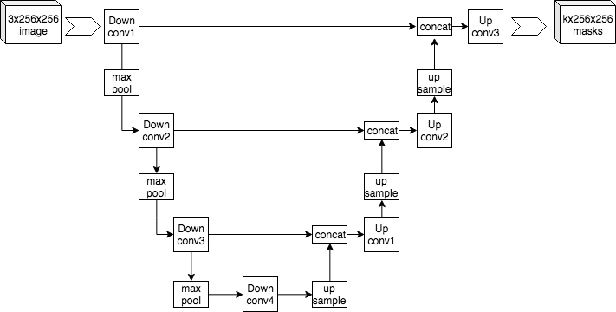
U-Net
U-Net is a convolutional neural network architecture (CNN), which
is quite popular for denoising and dimensionality reduction.

Slide 33
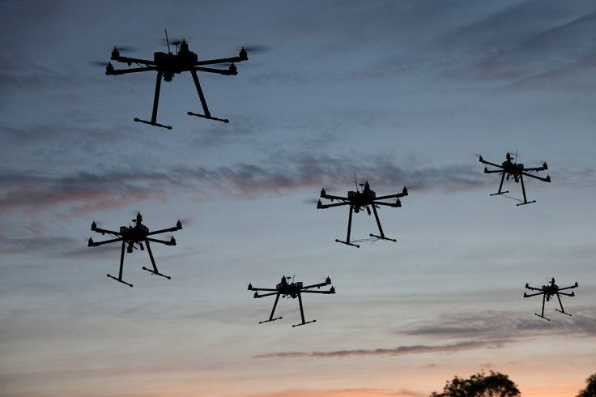
Flying SWARM Robots
http://arstechnica.com/science/2012/03/robots-swarm-the-stage-at-ted/
Watch starting 14:30
Requires:
  Planning
  Multi-Agent Systems and Distributed AI
  Search
  Reasoning in uncertain Environments
  Machine Leaning
  Computer Vision
  ……
Notes:
The first technology I like to …
The above picture is, in my opinion, a good description of the task of knowledge discovery in that it illustrates a huge search space that contains very very few interesting things, and if applied in practice, KDD is frequently like finding a needle in a hay stack, except that you are not sure what you are looking for...

Slide 34
2. General Course Information
Course Id: COSC 4368: Fundamentals of Artificial Intelligence
Time: TU TH 2:30-4p
Instructor: Christoph F. Eick
Homepage: http://www2.cs.uh.edu/~ceick/ceick.html
Office Hours TU 4-5p TH 9-10a
TAs
Office Hours see webpage
Classroom: 103 SEC
Online: MS Team
E-mail: ceick@uh.edu
/

Slide 35
Prerequisites COSC 4368
Prerequisite: COSC 2320 or COSC 2430
Otherwise, the course is self-contained
  Some experience in writing programs with 400+ lines in some programming language (C, C++, Java,Python…)
    Basic knowledge of data structures (particularly trees and graphs); what is taught in an introductory undergraduate data structure course; e.g. COSC 2430;
    No knowledge of LISP, PROLOG and other AI languages is required
  Ability to deal with “abstract mathematical concepts”
  Basic knowledge of probability theory is helpful, but I will give a very basic review in early April…

Slide 36
Main Textbook
Artificial Intelligence: A Modern Approach – Wikipedia
Additional book used for Neural Networks and Deep Learning
Simon Price: Understanding Deep Learning, MIT Press, 2023. (only used for 3-4 lectures)

Slide 37

Do collaborate and discuss together, but write up and code independently.
You can discuss what is required to do with other students, but you cannot solve the problems jointly. A few course activities will be group activities.
Do not look at anyone else’s writeup or code.
Do not show anyone else your writeup or code or post it online (e.g., GitHub).
We will run MOSS and similar tools which find similarities in submitted code periodically to detect plagiarism.
If you use code / software / project ideas from the internet, you have to admit this fact in the reports you submit in COSC 4368 by properly referencing the work you used. Not doing so represents a serious academic honesty violation!
Academic honesty violations will be reported to the COSC Department, and two the college if the violation is a second offense of a particular student.
NOTE: PLAGIARISM IS NOT TOLERATED.

Slide 38
Exams
Will be open notes/textbook
Will get a review list before the exam
Exams will center (80% or more) on material that was covered in the lecture
Exam scores will be immediately converted into number grades
Might use lockdown browsers in 2026
.

Slide 39
Topics Covered in the Four Assignments
Reinforcement Learning
Search
Group Assignment; each group chooses their own topic
Neural Networks and Diffusion Models
.
Remark: Assignment 1 will be posted on Jan. 22; it will be discussed in the Jan. 27 lecture.

Slide 40


Stanford’s CS 221 View of AI
Course Info: CS221: Artificial Intelligence: Principles and Techniques (stanford-cs221.github.io)
AI’s contributions fall into two major categories:
AI agents: how can we re-create intelligence?
AI tools: how can we benefit society?

Slide 41
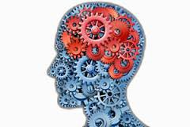
An Intelligent Agent
The starting point for the agent-based view is ourselves.
As humans, we have to be able perceive the world (computer vision), perform actions in it (robotics), and communicate with other agents (NLP,…).
We also have knowledge about the world (from how to ride a bike to knowing the capital of France), and using this knowledge we can draw inferences and make decisions.
Finally, last but not least, we learn and adapt over time. Indeed, machine learning has become the primary driver of many of the AI applications we see today.
Perception Robotics Language
Knowledge
Reasoning
Learning

Slide 42
Motivation: virtual assistant
Tell information
Ask questions
Use natural language!
[demo]
Need to:
Digest heterogenous information
Reason deeply with that information
82

Slide 43
AI tools...
Approach: Provide AI techniques in a non-agent tool setting, e.g.
Learn models from examples
Annotate images with categories
Predict poverty from satellite images
Translate from language to another language
Tools, e.g. belief networks, for probabilistic reasoning
Planning and Scheduling Tools
…
33

Slide 44
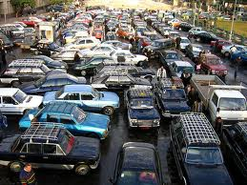
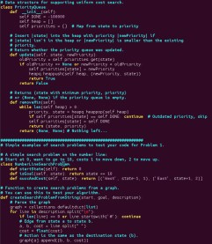
How do we solve AI tasks?

Slide 45
Paradigms
Modeling
Inference
Learning
50

Slide 46
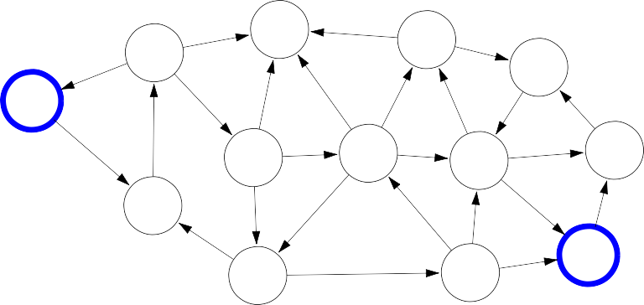
Paradigm: Modeling
But where does the model come from? Remember that the real world is rich, so if the model is to be faithful, the model has to be rich as well. But we can’t possibly write down such a rich model manually.
The idea behind (machine) learning is to instead get it from data. Instead of constructing a model, one constructs a skeleton of a model (more precisely, a model family), which is a model without parameters. And then if we have the right type of data, we can run a machine learning algorithm to tune the parameters of the model.
Real world
Modeling
5
6
7
4
Model
0
8
5
5
3
1
6
3
8
8
1
1
4
7
2
3
6
7
2
6
8
52

Slide 47

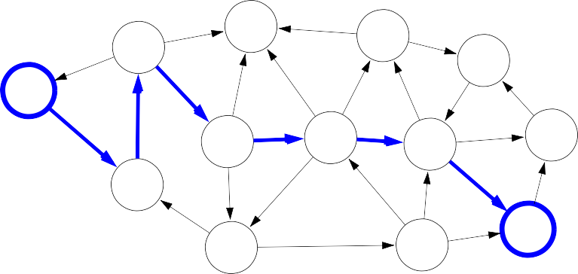
Paradigm: Inference
5
6
7
4
Model
0
8
5
5
3
1
6
3
8
8
1
1
4
7
2
3
6
7
2
6
8
Inference
5
6
7
4
Predictions
0
8
5
5
3
1
6
3
8
8
1
1
4
7
2
3
6
7
2
6
8
54

Slide 48


Paradigm: Learning
?
?
?
?
Model without parameters
?
?
?
?
?
?
?
?
?
?
?
?
?
?
?
?
?
?
?
?
?
+data
Learning
5
6
7
4
Model with parameters
0
8
5
5
3
1
6
3
8
8
1
1
4
7
2
3
6
7
2
6
8
56

Slide 49
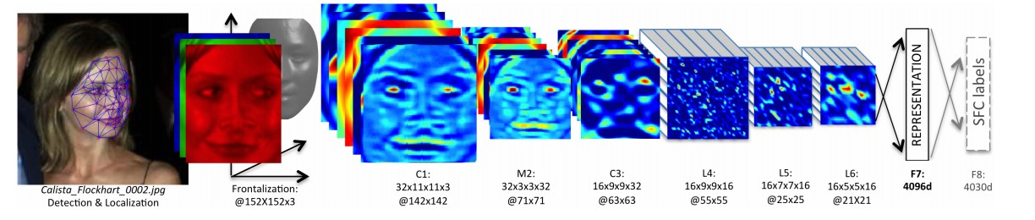
 |  | Reflex-based models
Examples: linear classifiers, deep neural networks
Most common models in machine learning
Fully feed-forward (no backtracking)
The idea of a reflex-based model simply performs a fixed sequence of computations on a given input. Examples include most models found in machine learning from simple linear classifiers to deep neural networks. The main characteristic of reflex-based models is that their computations are feed-forward; one doesn’t backtrack and consider alternative computations. Inference is trivial in these models because it is just running the fixed computations, which makes these models appealing.
CS221 / Autumn 2018 / Liang [reflex]

Slide 50
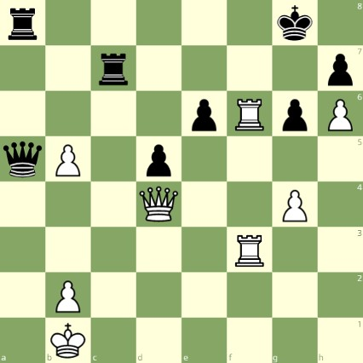
State-based models
Reflex-based models are too simple for tasks that require more forethought (e.g., in playing chess or planning a big trip). State-based models overcome this limitation.
The key idea is, at a high-level, to model the state of a world and transitions between states which are triggered by actions. Concretely, one can think of states as nodes in a graph and transitions as edges. This reduction is useful because we understand graphs well and have a lot of efficient algorithms for operating on graphs.
White to move

Slide 51
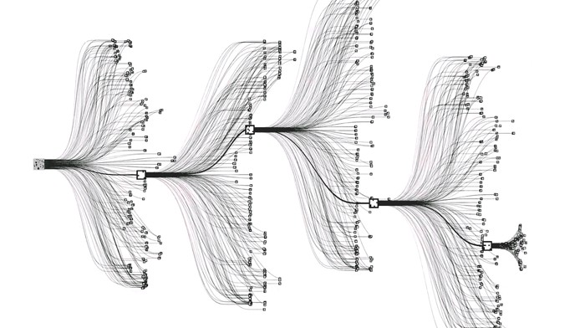
State-based models
Applications:
Games: Chess, Go, Pac-Man, Starcraft, etc.
Robotics: motion planning
Natural language generation: machine translation, image captioning

Slide 52


State-based models
Search problems: you control everything
Markov decision processes: against nature (e.g., Blackjack)
Adversarial games: against opponent (e.g., chess)
70

Slide 53
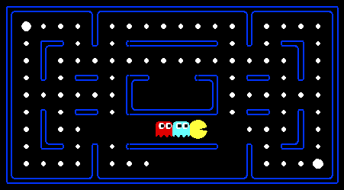
Pac-Man
[demo]

Slide 54
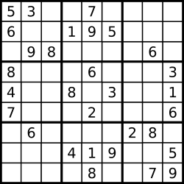
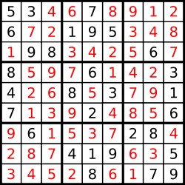
Sudoku: Models with Variables
Goal: put digits in blank squares so each row, column, and 3x3 sub-block has digits 1–9
Note: order of filling squares doesn’t matter in the evaluation criteria!

Slide 55
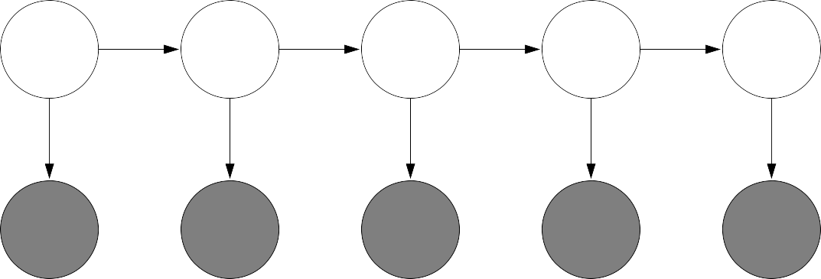
Variable-based models
Constraint satisfaction problems: hard constraints (e.g., Sudoku, scheduling)
X₁ X₂
X₃ X₄
Bayesian networks: soft dependencies (e.g., tracking cars from sensors)
H₁ H₂ H₃ H₄ H₅
E₁
E₂
E₃
E₄
E₅
77
Constraint satisfaction problems are variable-based models where we only have hard constraints. For example, in scheduling, we can’t have two people in the same place at the same time.
Bayesian networks are variable-based models where variables are random variables which are dependent on each other. For example, the true location of an airplane H_{t} and its radar reading E_{t} are related, as are the location H_{t} and the location at the last time step H_{t−1}. The exact dependency structure is given by the graph structure and formally defines a joint probability distribution over all the variables. This topic is studied thoroughly in probabilistic graphical models.

Slide 56
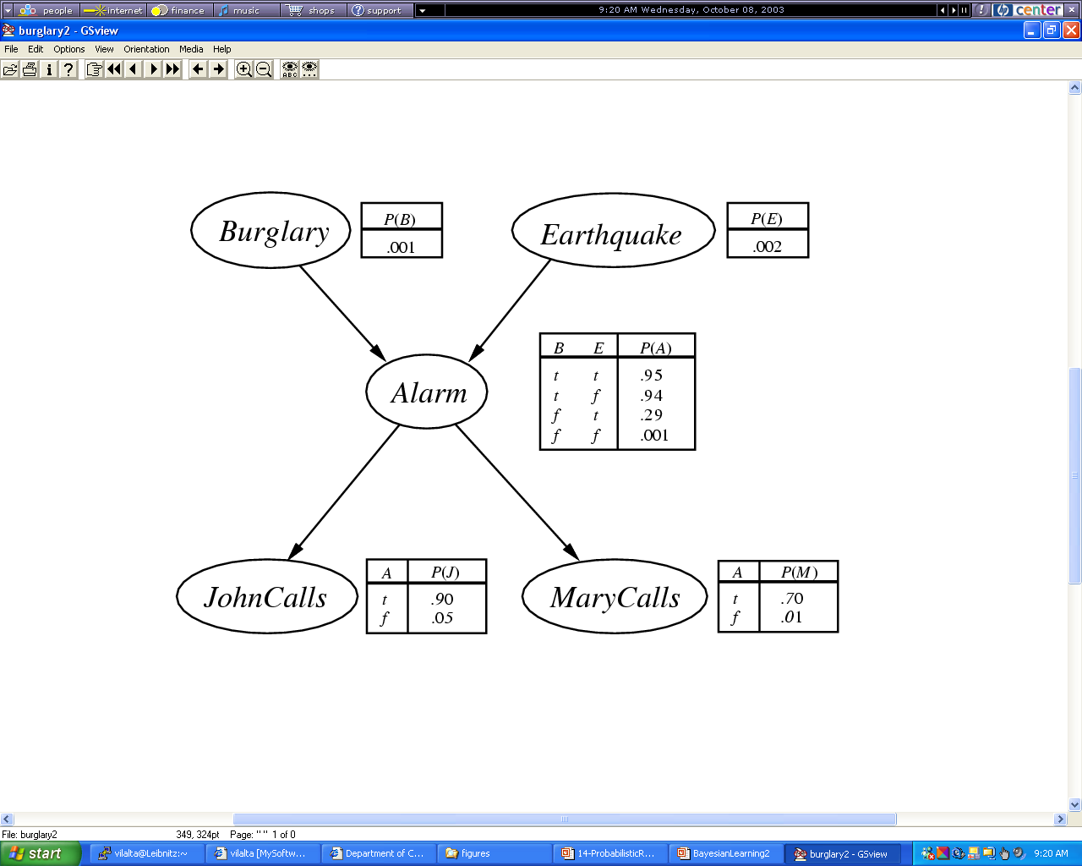
Example 2
Example of a Belief Network
BN: probability of a variable only depends on its direct successors; e.g.
P(b,e,a,~j,m)= P(b)*P(e)*P(a|b,e)*P(~j|a)*P(m|a)=0.01*0.02*0.95*0.1*0.7
Notes:
What is machine learning?

Slide 57
Logic
Dominated AI from 1960s-1980s, still useful in programming systems
Powerful representation of knowledge and reasoning
Brittle if done naively
Open question: how to combine with machine learning or planning?

Slide 58
Stanford’s CS221 View of AI
Search problems Markov decision processes
Adversarial games
States
Constraint satisfaction problems Bayesian networks
Variables
Reflex
Logic
”Low-level intelligence”
”High-level intelligence”
Machine learning
Comment: There are many other things in AI that have little or
nothing to do with Machine Learning such as reasoning, vision, multi-agent system, robotics…

Slide 59


AI
Knowledge Representation
Knowledge-based
and Expert Systems
Planning
Coping with Vague,
Incomplete and
Uncertain Knowledge
Searching
Intelligently
Logical Reasoning
& Theorem Proving
Communicating,
Perceiving and
Acting
Intelligent Agents
& Distributed AI
AI Programming
Learning & Knowledge Discovery

Slide 60
AAAI 2019 #Session Counts
NLP: 20
Vision (and Video Analytics): 12
Game Theory and Economic Paradigms: 10
AI and the Web: 9
Machine Learning: 7
AI for Social Impact: 7
Search, Constraint Satisfaction and Optimization: 7
Knowledge Representation and Reasoning: 6
Deep Learning: 5
Planning, Routing and Scheduling: 4
Reinforcement Learning: 3
Multi-Agent Systems: 3
Reasoning under Uncertainty: 3
Remarks: Only topics with 3 AAAI sessions are mentioned; NLP, vision and AI&Web were aggregated into a single category! AAAI 2018 received 3900 papers, and AAAI 2019 received 7764 paper; about 2500 reviewers were needed to review the papers (Dr. Laszka and Dr. Eick were reviewing papers for AAAI 2019)
Will show a similar statistics
For AAAI 2025 later in the semester.

Slide 61
Textbook Search Reading List
Students suggested Textbook reading groups…
  Please read the 4th edition (which appeared in Dec. 2020, I believe) of the textbook and not older editions!
  However, the textbook introduction is hard to follow, I believe---as it assumes a lot of knowledge 4th year undergraduate students do not necessarily have. Moreover, Dr. Eick’s introduction is a mixture of slides of his own and a few slides from the Stanford Introductory AI course and is somewhat different from the textbook introduction.
  However, I give you a textbook search reading list on the next slide.
Chapter 3: mandatory: 63-92, 96-102, 104-106; optional: 92-96, 102-104
Chapter 4: mandatory: 110-115, 141 optional: 116-119 (EC will be covered separately later), 119-122
Chapter 5: mandatory: 146-158, 174-175 optional: 159-161, 164-168
Chapter 6: mandatory: 180-193(skip 6.1.2) optional: 194-199
There are some additional slides, discussing categories of search algorithms, backtracking, randomized hill climbing which are not covered in the textbook!
Remark: all page numbers refer to the 4th Edition from 2021…

Slide 62
Course Elements
∼26 Lectures
2 Exams (…)
Two 45 minutes Reviews before the two exams
4 Assignments (tasks that involve using AI-tools, tasks that involve some programming, and one essay writing task); Assignment3 is a Group Task.
In-class Activities: Assignment 3 Presentations in April, Group Homework Credit (groups present solutions to homework-style problems during the lecture (7-12 minutes). Each group has a different task) and in class assignments.
Two 45 minutes Reviews before the two exams

Slide 63
2026 Grading Weights COSC 4368
Exam1 (March 12): 22%
Exam2 (April 30): 25%,
Attendance 2%,
In-Class Activities: 8%,
Assignments (4): 43%.
Remark: Weights are subject to change…

Slide 64

COSC 4368 News Aug. 27
Will conduct an online poll during the lecture on Sept. 4 around 3p: https://forms.gle/geB4FdCf631Wevb28
Task1 of ProblemSet1 is already posted; Task2 will be posted by Sept. 5 the latest. Both tasks are individual tasks.
Task3 is a 6 week group task scheduled for Sept. 23-Nov. 6; we will start setting up groups on Sept. 18; preferred group size 4(5)---can form your own group.
GHC groups will be set up and shared during the lecture on Sept. 4 and GHC presentations will start on Sept. 11!
As Data Science I is not a prerequisite for COSC 4368 there is some overlap in the topics covered in both courses.
Today: Continue Introduction to AI, maybe start discussion of Search
Read Task1 Specification before the Sept. 2 lecture!
Our peerless whale-bone pier - Umhlanga Rocks Tourism

Slide 65
Positive Forces for AI
Data Science &Data Mining (KDD) / Learning for Examples
Robotics https://www.wsj.com/articles/robot-hotel-loses-love-for-robots-11547484628?mod=itp_wsj&ru=yahoo
Multi-Agent Systems
AI and NLP: Chatbots, intelligent user interfaces that can communicate in natural language, doing intelligent things with text OpenAI Launches ChatGPT Professional — Premium AI Chatbot That Can Write Essays, Emails, Poems, And Code | by Liquid Ocelot | InkWater Atlas | Jan, 2023 | Medium
AI to create art, stories, videos,…Meta is using AI to generate videos from just a few words | CNN Business
Planning, Routing and Scheduling
Computer Chess/Go and Computer Games in General
Speech Recognition, Image Annotation
Computer Vision and Video Analytics
Deep Learning, particularly Language Models and Constructive AI
Reinforcement Learning
AI for the Social Good
Intelligent “this and that”

