Slide 1
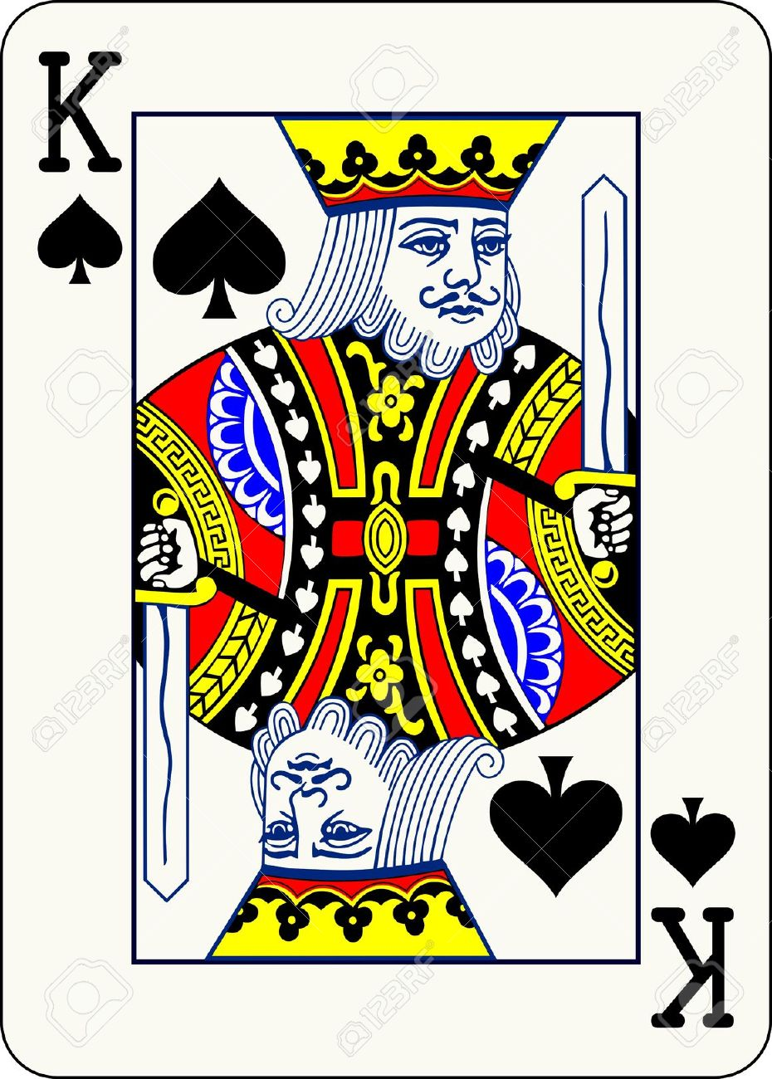
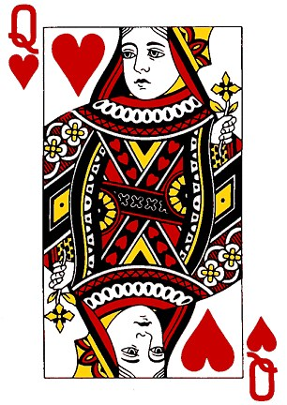
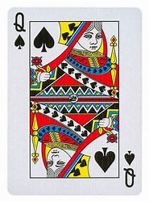
Using Reinforcement Learning to Play UH-Leduc-Poker (UHLPO) Intelligently
Christoph F. Eick
PlaYer 1 Card:
PlaYer 2 Card:
FLOP:
COSC 4368 Spring 2020 Group Project

Slide 2
UH-Leduc-Hold’em Poker Game Rules
Leduc Hold’em is a two player poker game. The deck used in UH-Leduc Hold’em, also call UHLPO, contains multiple copies of eight different cards: aces, king, queens, and jacks in hearts and spades, and is shuffled prior to playing a hand. At the beginning of a hand, each player pays a one chip ante to the pot and receives one private card. A round of betting then takes place starting with player one. After the round of betting, a single public card is revealed from the deck, which both players use to construct their hand. This card is called the flop. Another round of betting occurs after the flop, again starting with player one, and then a showdown takes place. At a showdown, if either player has paired their private card with the public card they win all the chips in the pot. In the event neither player pairs, the player with the higher card (SA>HA>SK>HK>SQ>HQ>SJ>HJ) is declared the winner. The players split the money in the pot if they have the same private card. Moreover, players might fold holding a “bad” hand, avoiding further losses: in this case, the other player wins the money the folding player has bet so far.

Slide 3
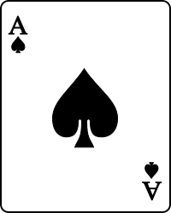
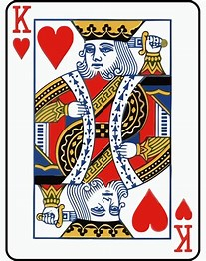
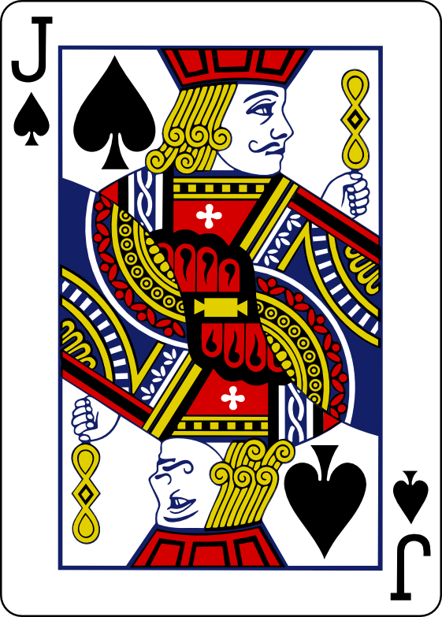
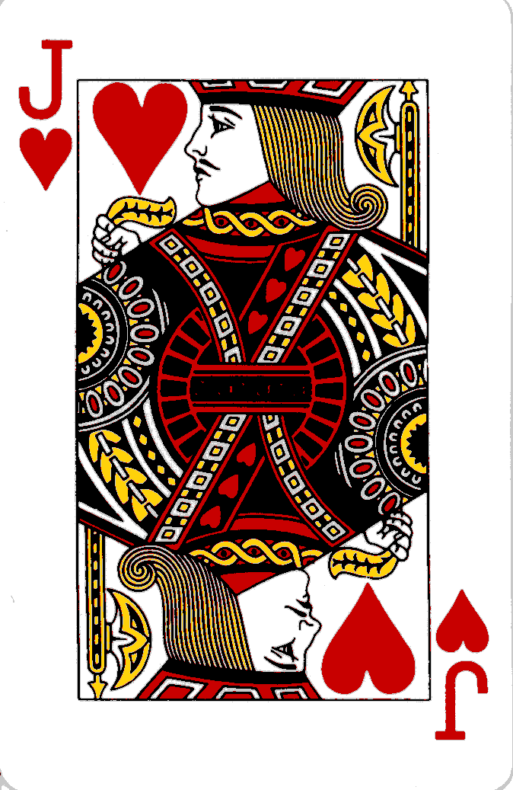
The UH Leduc Hold’em Poker Deck
This is a “queenly” 18-card deck from which we draw the players’ cards and the flop from without replacement. The deck contains three copies of the heart and spade Q and 2 copies of each other card (spade and heart A, spade and heart Q, spade and heart J. That is, the deck contains 50% more queens in comparison to aces, kings and jacks. Therefore, your chance to getting a pair after receiving a queen—although the Q is somewhat low in rank—is significantly higher than holding an ace, king or jack. In general, holding a Q has some “potential” but you do not like to bet a lot in phase 1 not knowing the flop!
18 Card UH-Leduc-Hold’em Poker Deck

Slide 4
UH Leduc Hold’em PokerBetting Restrictions
Ante is $1, raises are $3.
Player S has to bet money after the hand started check-check; in the case the player cannot check she has either to fold losing her money or raise her bet.
Only player 2 called T can raise a raise. After this happens player S can fold her hand or call but cannot raise.
Comment: These restrictions are made to reduce the complexity of the state space!

Slide 5
Example Game1:
Player S private card:
Player T private card:
Phase one Betting: Player S checks, Player T raises to 4 dollars, player S calls; each play has $4 in the pot
The flop is revealed:
Phase two betting: Player S raises to 7 dollars, player T raises to 10 dollars, player S calls.
Payoff: Player S wins 10 dollars and player 2 loses 10 dollars.

Slide 6
Example Game 2:
Player S private card:
Player T private card:
Phase one Betting: Player S raise to 4 dollars and play T calls ; each play has $4 in the pot
The flop is revealed:
Phase two betting: Player S raises to 7 dollars, and player T folds
Payoff: Player S wins 4 dollars and player 2 loses 4 dollars.

Slide 7
Example Game 3:
Player S private card:
Player T private card:
Phase one Betting: Player S checks and player T raises to 4 dollars and player S calls
The flop is revealed:
Phase two betting: Player S checks and player T checks
Payoff: Player S wins 4 dollars and player T loses 4 dollars.

Slide 8
Example Game 4:
Player S private card:
Player T private card:
Phase one Betting: Player S checks, Player T checks
The flop is revealed:
Phase two betting: Player S folds (she was not allowed to check as she did not bet anything in the last round, and did not feel like raising with such a bad hand)
Payoff: Player S loses one dollar and player T wins one dollar

Slide 9
Example Game 5:
Player S private card:
Player T private card:
Phase one Betting: Player S raises to 4 dollars, player T raises to 7 dollars and player S calls.
The flop is revealed:
Phase two betting: Player S raises to 10 dollars, player T raises to 13 dollars, and player S calls; the pot now contains $26.
Payoff: Player S wins the pot as she has the higher private card.

Slide 10
Example Game 6 (Bluff):
Player S private card:
Player T private card:
Phase one Betting: Player 1 checks, Player 2 checks
The flop is revealed:
Phase two betting: Player S raises to 4 dollars and play T folds
Payoff: Player S wins one dollar and player T loses one dollar.

Slide 11
Example Game 7:
Player S private card:
Player T private card:
Phase one Betting: Player S raises to 4 dollars, player T raises to 7 dollars and player S calls.
The flop is revealed:
Phase two betting: Player S raises to 10 dollars, player T raises to 13 dollars, and player S calls; the pot now contains $26.
Payoff: No player wins anything as they share the same private card.

Slide 12
UHLPO Joint Search Space
Player 1 is called S and player 2 is called T
States are assumed to be tuples (player-phase-id, total bet player1, total bet player2, Card the player holds, flop-card or * if unknown) or states are terminal states represented using simple strings such ‘WL7’; payoff occurs in terminal states. For example, the state (t1,4,1,SK,*) represents the fact that player T has to act, player S bet 4 dollars so far and player T bet 1 dollar so far, player T’s hidden card is the spade king, and the flop has not been revealed yet (represented by *). States with prefix s are only in the state space of player S, states prefixed by t only belong to the state space of player T; finally, states that are represented by simple strings are terminal states belonging to the search space of both players.
Terminal states are either showdown states or fold states: e.g. the state WL7 indicates that each player has bet $7 and the player with the better hand will win $7 and the other player will lose $7 or there might be no payoff in case that both players hold the same private card. On the other hand, a player might win money when the other player folds her hand; as far as fold states are concerned for example PT4 represent that fact that player T won 4 dollars because player S folded her hand.
The actual state space is given in the next slides; more complicated or simpler state spaces could be used in the group project. One of those simpler search spaces is discussed at the end of this slideshow.

Slide 13
Joint State Space First Phase
fold
PT1
(s1,1,4,C1,*)
raise
(t1,1,1,C2,*)
check
(s2,1,1,C1,C)
call
check
(s1,1,1,C1,*)
PS1
Initial State
raise
fold
(s2,4,4,C1,C)
(t1,4,1,C2,*)
call
raise
(s1,4,7,C1,*)
call
(s2,7,7,C1,C)
fold
PT4
Remarks:
C1 and C2 represent S’s and T’s private cards,
and C represents the card of the flop, and * represents the fact that the flop card has not been revealed yet.
Note that there will be eight different states for each value of C1 and for each value of C2!
Note that there will be 64 different phase 2 states: one for each C1/C2-C pair!

Slide 14
Joint State Space Second Phase
call
(s2,7,10,C1,C)
WL10
raise
fold
call
WL7
PT7
(t2,7,4,C2,C)
fold
raise
PS4
raise
(s2,4,7,C1,C)
call
WL7
(s2,4,4,C1,C)
check
(t2,4,4,C2,C)
fold
check
WL4
PT4
(s2,4,7,C1,C)
call
WL7
raise
fold
raise
(t2,4,1,C2,C)
call
PT4
(s2,1,1,C1,C)
WL4
fold
fold
PT1
PS1

Slide 15
State Space 2nd Phase continued
WL13
call
(s2,10,13,C1,C)
raise
fold
call
WL10
PT10
(t2,10,7,C2,C)
fold
raise
PS7
raise
(s2,7,10,C1,C)
call
(s2,7,7,C1,C)
check
(t2,7,7,C2,C)
WL10
check
WL7
fold
PT7

Slide 16
Player S State Space
Remark: if an edge has 2 actions, the first
action represents player S’s action and the
second action represent player T’s action!
PT1
(s2,4,7,C1,C)
call
raise raise
WL7
fold
fold
(s2,1,1,C1,C)
raise call
WL4
PT4
PS1
raise fold
PS1
PT1
WL10
raise fold
check check
call
WL7
(s2,7,10,C1,C)
fold
PT7
fold
PS4
(s1,1,1,C1,*)
check raise
raise call
raise raise
WL7
(s1,1,4,C1,*)
raise fold
call
Initial State
(s2,4,7,C1,C)
fold
PT4
raise call
call
check raise
(s2,4,4,C1,C)
WL4
raise raise
check check
PS7
WL7
WL13
call
raise fold
raise call
(s2,10,13,C1,C)
raise raise
fold
PT10
(s1,4,7,C1,*)
call
(s2,7,7,C1,C)
check raise
(s2,7,10,C1,C)
call
WL10
fold
check check
fold
PT4
PT7
WL7

Slide 17
Player T State Space after Player S checks
PT4
PT1
raise fold
raise call
WL7
PT1
(t2,4,4,C2,C)
check
WL4
check fold
PS1
PT4
raise fold
raise call check
WL7
fold
raise fold
raise call
Player S checks
(t1,1,1,C2,*)
check raise
(t2,4,1,C2,C)
call
WL4
raise call raise
raise fold
PT7
(t2,7,4,C2,C)
raise call
fold
WL10
call
PS4
WL7
Remarks:
Player T has 2 initial states (depending on player S’s initial action)
the first action at an edge is always player T’s action and the second and sometimes third action are player S’s action(s).
Note that some states given on this slide are the same as states given on the next page; in general, the T-space has only 7 different non-terminal states.
The first action is the one that needs to be considered by q-learning, the second (and sometime third) action is use to determine the agent’s next state.

Slide 18
Player T State Space after Player S raises
PT4
raise fold
raise call
WL7
(t2,4,4,C2,C)
check
PT7
WL4
raise fold
raise call
WL10
PT4
(t2,7,7,C2,C)
check
WL7
call check
PS4
PT7
PS1
raise fold
raise call check
WL10
fold
raise fold
fold
raise call
Player S raises
(t1,4,1,C2,*)
call raise
(t2,7,4,C2,C)
call
WL7
raise call raise
raise fold
PT10
(t2,10,7,C2,C)
raise call
fold
WL13
call
PS7
WL10

Slide 19
More on the State Spaces S and T
State space S has about 500 non-terminal states and the Q-Table should have at most 1500 entries, assuming 3 operators are applicable for each state. In general, the S-space is deeper than the T-space.
State space T has about 350 non-terminal states and the Q-Table should have at most 1050 entries, assuming 3 operators are applicable for each state. In general, the S-space is deeper than the T-space.
Q-Learning: for each testcase we get q-value updates along the path of S’s or T’s initial state to a terminal state; typically, we update between 1 and 4 q-values in each game for the S space and between 1 and 2 values in the T space. Let us assume this average number is 2 for the S space and 1.5 for the T space.
Assuming we want to update each q value 10 times in the q-learning process, we need at least 7500=1500*5 games for the S space and about 7000=1050*6.667 for the T-space, based on the averages computed before. This means training benchmark sizes for agents to play each other should be between 2500 and 10000 games. Running the Q-learning system for a smaller number of games would make it unlikely to learn the appropriate q-values.
How long does it take to run the system for let us say 5000 (or 1000 games→see next slide) games?

Slide 20
Representing States as Numbers and Further State Space Reduction
You can either represent states as tuples or as numbers which is discussed here!
First, we assign a value to each card as follows: HJ=0,SJ=1,…,SA=7. Next, we drop the s/t prefix, and represent Phase1 states as (TBS,TBT,<players card>); e.g. (4,1,HA) as 04016, where 6 represents the heart ace.
Next, we like to reduce the number of phase2 states by replacing (…,TBS,TBT, player’s card, C) by (TBS,TBT,H) where H=C’⊕C is the hand value of combining the player’s card C’ with the flop card C as follows, assuming that cards are represented as numbers:
If pair(C’,C) and spade(C’) then H:=9 else if pair(C’,C) and heart(C’) then H:=8 else H:=C’
For example, (…,4,4, HK,SQ) will be replaced by (4,4,5) , (…,4,4, HK,SK) will be replaced by (4,4,8) with 8 representing “have a pair with a heart private card”
Finally, heart(C’)=even(C’) and pair(C,C’)=(even(C) and C+1=C’ ) or (odd(C) and C-1=C’)
This transformation reduces the number of phase2 states by a factor of 6.4!
Next, we need to decide how to represent phase2 states such as (10,13,5) as numbers and we use as before 10135 but to distinguish phase2 states from phase1 states we add 100000 to this number obtaining 110135 as the representation of state (10,13,5)
Using these new Phase2 states the number of non terminal states for player S is reduced to just a little under 100 and for player T’s non terminal states is around 70. With this state space reduction now training benchmark containing between 500 and 2000 games become acceptable, but smaller benchmarks are still not acceptable.

Slide 21
Player S Number State Space
Remark: We assume C’ is the number of
Player S’s hidden card and H=C’⊕C is hand
value of S’s hand based on the flop C.
In general, C’∈{0,1,…,7} and H∈{0,1,…,9}
PT1
PS1
fold
raise fold
WL7
WL4
10101H
raise call
raise raise
call
PT4
PS1
fold
10407H
PT1
raise fold
check check
check raise
WL7
WL10
fold
PS4
check raise
call
0101C’
0104C’
raise call
fold
PT7
raise fold
10710H
Initial State
raise call
call
raise raise
10404H
WL4
raise raise
check check
PS7
WL7
WL13
call
raise fold
raise call
11013H
raise raise
fold
PT10
0407C’
call
10707H
check raise
10710H
call
WL10
fold
check check
fold
PT4
PT7
WL7

Slide 22
Player T Number State Space
Not given (to produce this state space the graphs on slides 17 and 18 have to be merged. States that are identical in both graphs have to be merged into a single state, and finally states names have to be renamed following the instructions on slide 20)!

Slide 23
Q(a,s) ← Q(a,s) +
α [ R(s’) − Q(a,s) ]
Q-LEARNING Q-Table Updates
https://en.wikipedia.org/wiki/Q-learning
If s’ is not a terminal state use:
a
S’
s
Q(a,s) ← Q(a,s) +
α [γ*max_{a’}Q(a’,s’) − Q(a,s) ]
However, if s’ is a terminal state use:

Slide 24
Q(a,s) ← Q(a,s) +
α [ R(s’) − Q(a,s) ]
Sarsa-LEARNING Q-Table Updates
a’
If s’ is not a terminal state use:
S’
a
s
Q(a,s) ← Q(a,s) +
α [γ*Q(a’,s’) − Q(a,s) ]
If s’ is a terminal state use:

