Slide 1
UH/COSC Undergraduate Research
Undergraduate Research - University of Houston (uh.edu)
Summer Undergraduate Research Fellowship - University of Houston (uh.edu)

Slide 2
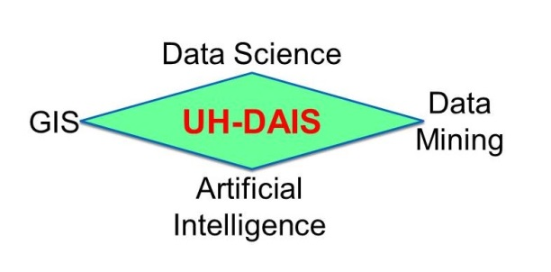
Christoph F. Eick

Slide 3
UH-DAIS Research Projects 1/24-12/24
Spatial and Spatio-temporal Data Analysis Frameworks
Association Analysis and Mining Related Datasets
Summarizing the Composition of Cities (Honor’s thesis topic)
Solving Societal Problems with AI and Data Science
Happiness Analysis (past work; WHR23.pdf (uh.edu))
Identifying Depression from Texts
Modern Slavery
Poverty
Data Set Augmentation
Crowdsourcing for Disaster Response
Supervised Clustering / Design of “Novel” Clustering Algorithms
Christoph F. Eick

Slide 4
K2 Project Goals
Given a set of tweets (or questionnaires soliciting preferences and opinions) with the location (longitude and latitude), time they were posted and their emotional assessment in [-1,+1] (+1:=very positive emotions, 0:=no or even mix of emotions, -1: very negative emotions)
Research Steps and Goals:
Subdivide the dataset into batches, corresponding to different time intervals
Identify spatial clusters of highly positive emotions (e.g. average emotional assessment >0.4) and regions of highly negative emotions (e.g. average emotion assessment < −0.4) for each batch.
Capture patterns of change and evolution of the regions identified in 2.
Based on a selected story type and user preferences, convert results found in steps 2 and 3 into a narrative and animations that tells the story of spatio-temporal evolution of emotions in an region (e.g. Texas, US,…) over a period of time (e.g. 5 years, 1 year, 1 month), similar to: https://www.ted.com/talks/hans_rosling_asia_s_rise_how_and_when

Slide 5
Related Spatial Dataset Mining
Task:
Given a set of spatial datasets over the same observation area; e.g. PM2.5 concentrations, burglary densities, and COVID-19 infection rates over Texas (point-wise functions over longitude and latitude)
Research Questions:
Explore different notions or relatedness: correlation, agreement in hotspots,…
Identify the degree of relatedness of pairs/groups of spatial datasets.
Analyze the role of thresholds in ‘relatedness’
Analyze delays and other temporal relationships with respect to ‘relatedness’
Develop methods to identify regional relatedness
Goal: Find interesting Hypotheses!
Possible Topic for UG Research: To conduct this research we need polygonal hotspot discovery/clustering algorithms which identify regions in a spatial dataset in which the point-wise function is about a particular threshold θ.
UH-DAIS

Slide 6
Collocation Mining Frameworks
Definition:
Spatial colocation patterns represent subsets of spatial events whose instances are often located in close geographic proximity. For example, car break-ins might often occur in close proximity to shopping malls.
Research Themes:
Density-based Collocation Mining Approaches
Algorithms to Discover Regional Collocation Patterns
Collocation Mining Involving Continuous Variables
Spatio-temporal Collocation Mining
UH-DAIS

Slide 7
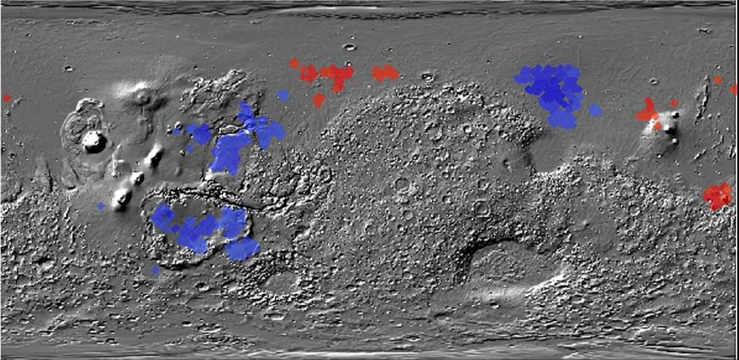
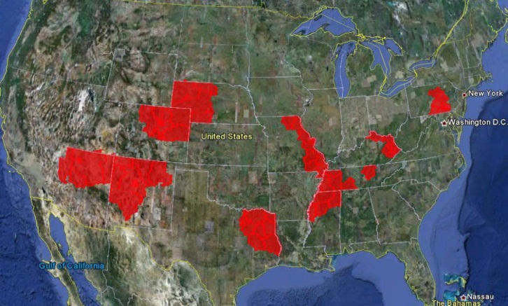
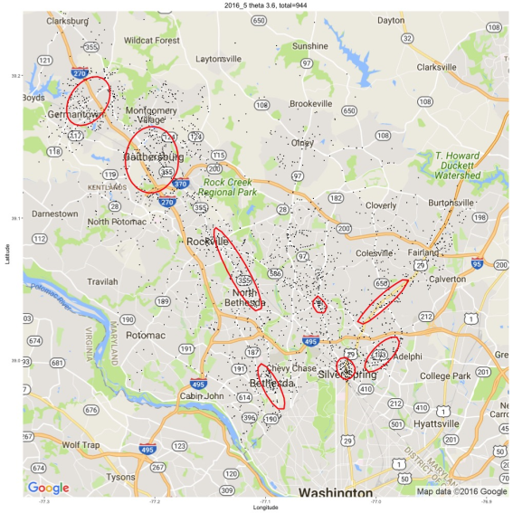
Helping Scientists to Make Sense Out of their Data
Figure 1: Co-location regions involving deep and
shallow ice on Mars
Figure 2: Interestingness hotspots where both income and CTR are high.
Figure 3: Maryland Crime Hotspots
UH-DAIS

Slide 8
Some UH-DAIS Graduates 1
Dr. Wei Ding, Associate Professor, Department of Computer Science, University of Massachusetts, Boston
Christopher T. Ryu, Professor,
Department of Computer Science, California State University, Fullerton
Sharon M. Tuttle, Professor,
Department of Computer Science,
Humboldt State University, Arcata, California
Sujing Wang, Associate Professor,
Department of Computer Science,
Lamar University, Beaumont, Texas
I graduated 16 PhD students and supervised 90+ MS Theses in my career!
Christoph F. Eick

Slide 9
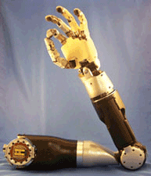
Some UH-DAIS Graduates 2
Yongli Zhang PhD Airbnb
Chun-sheng Chen PhD eBay
Puja Anchlia MS eBay
Chong Wang MS Apple
Justin Thomas MS John Hopkins University Applied Physics Laboratory
Mei-kang Wu MS Microsoft, Bellevue, Washington
Jing Wang MS AOL, California
Rachsuda Jiamthapthaksin PhD Faculty, Assumption University, Bangkok, Thailand
Christoph F. Eick

