Slide 1
INSTALLING PYTHON 3
COSC 1306 Fall 2017

Slide 2
Just for Windows users
Helps to know whether you are running a 32-bit or a 64-bit version of Windows
Click on "Settings" (first entry under "S" of menu)
Click on "System" (top leftmost option)
Click on "About" (last item on the left menu)
If you see
System type: 64-bit operating system, ….
you have a 64-bit version of Windows

Slide 3
Installing Python 3.6.2
Go to python.org
Scroll down until you find Download
Click on Python 3.6.2 at the bottom of the Download paragraph
This will bring you to a new page

Slide 4
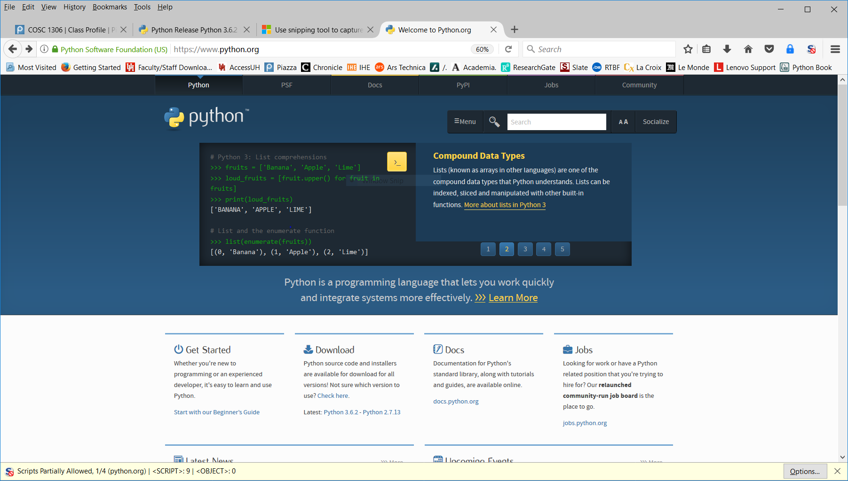
Python.org

Slide 5
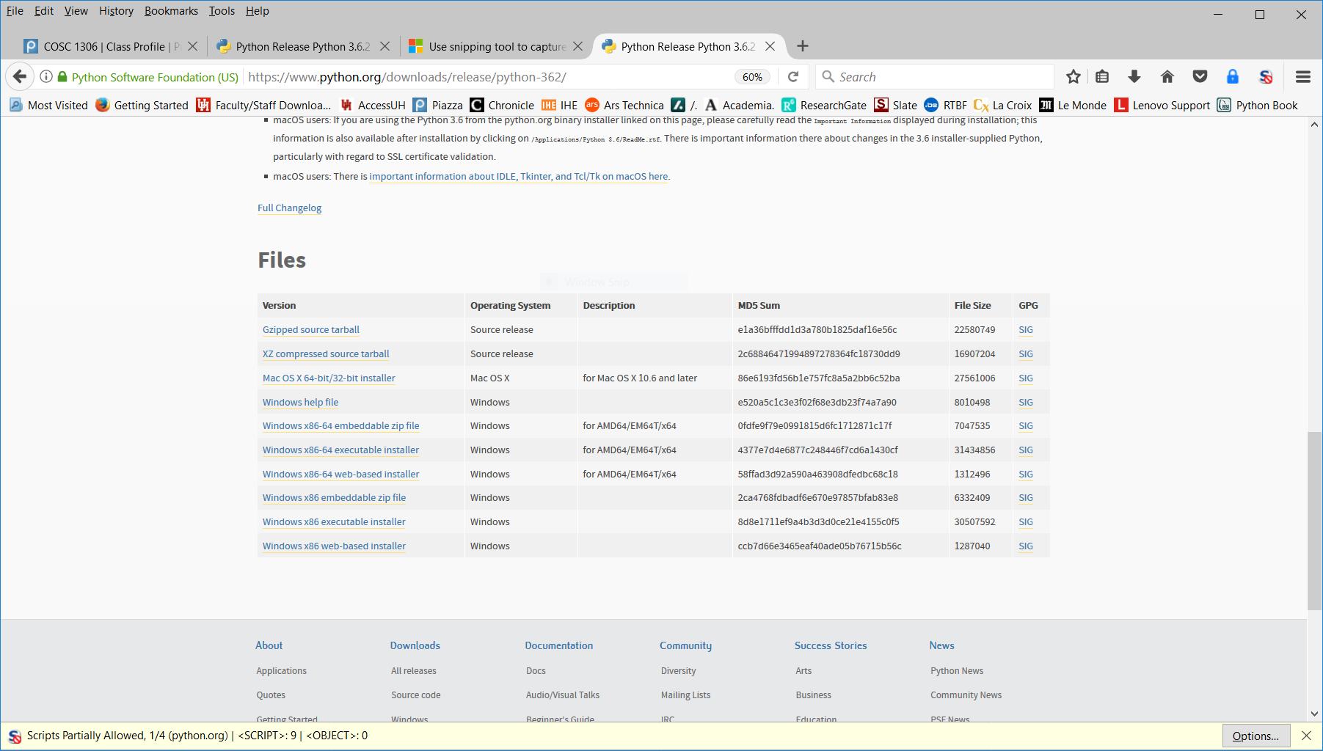
The download page bottom

Slide 6
On Windows (I)
Pick the right version of Python
If you have a 64-bit system, Windows x86-64 executable installer
If you have a 32-bit system Windows x86 executable installer
If you do not know, pick Windows x86 executable installer

Slide 7
On Windows (II)
You will be asked for permission to open one of
python-3.6.2-amd64.exe
python-3.6.2.exe
Click and select Save File
Retrieve saved file from Download folder or Home screen
Double-click to install

Slide 8
On MacOS
Select Mac OS X 64-bit/32-bit installer
Accept to download python-3.6.2-macosx10.6.pkg
Retrieve it from your usual place for downloaded files
Double-click to install

Slide 9
Notes
If you are using Linux, you must
Download the source package Python.3.6.3.tgz (tar + gzip)
Build python from the source files
Can get Python 3 for Android and iOS
Ninety-nine cent iOS app has nice keyboard

Slide 10
A last word
If you or somebody else has already installed an older version of Python 3, keep it
No noticeable difference
Not true for pre-Python 3 versions
Other instructors may prefer Pycharm from JetBrains
Fine with me

