Slide 1
Blood Pressure and Sexual Maturity in Adolescents
Dr. Mo.
By
Mohammed
Alshair

Slide 2
PROBLEM:
SEXUAL MATRURITY
BLOOD PRESSURE
OBESITY

Slide 3
Pre-Processing the Data:
Waist Category
Raw Anger Out
DAY
Cook_Medley Level
Raw Anger Control
MONTH
AGE2
Bored
YEAR
Sleeping Status
HOUR
Rush
MINUTE
Excited
90th Percentile of DBP
Raw State Anger
PLACE
LEAGO
Happy
Sad
Stressed
POSTURE
Irritable
Neutral
Parents, Grand Parent hyp
Awake activity mean > = 50th
Raw Trait Anger
Relaxed
Interested
IS Waist >= 90th
Raw Trait Anger / Reaction
Action score 25 min before BP reading….

Slide 4
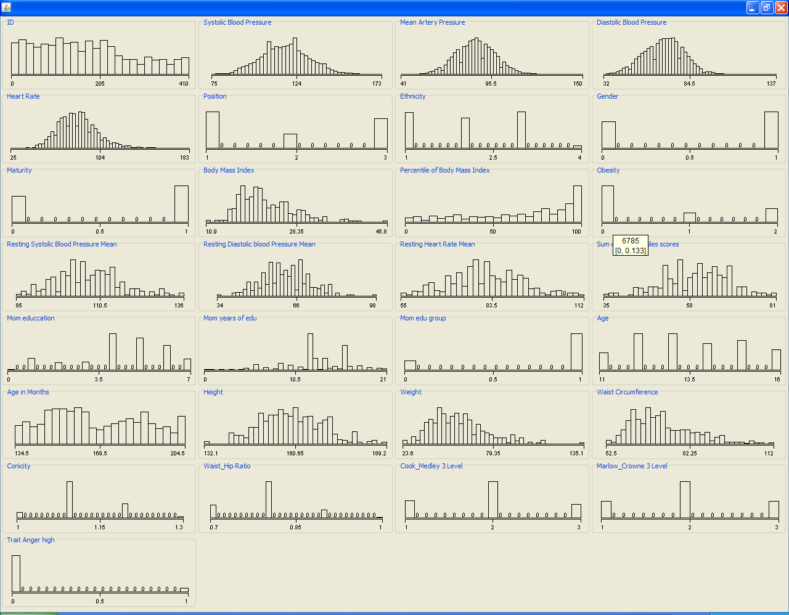
Pre-Processing the Data:

Slide 5
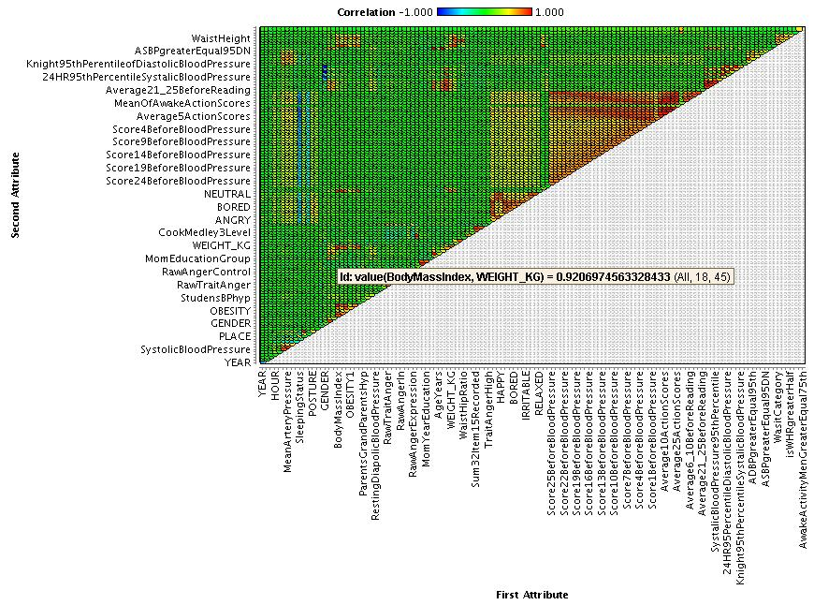
Analyzing the Data:

Slide 6
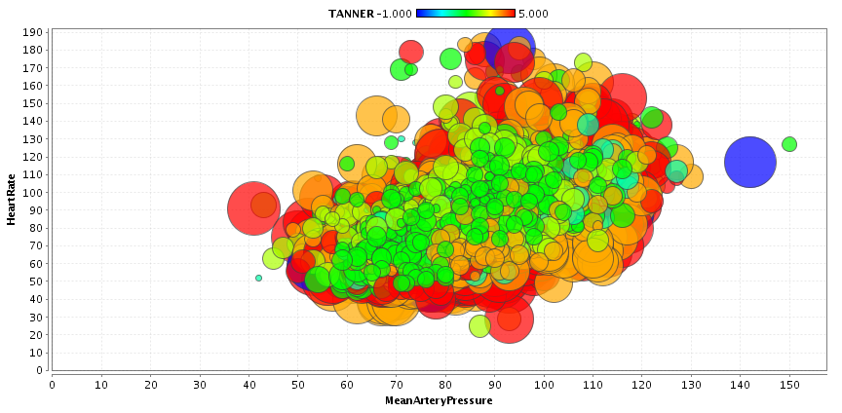
Analyzing the Data:
Heart Rate VS. Mean Artery Pressure VS. Tanner

Slide 7
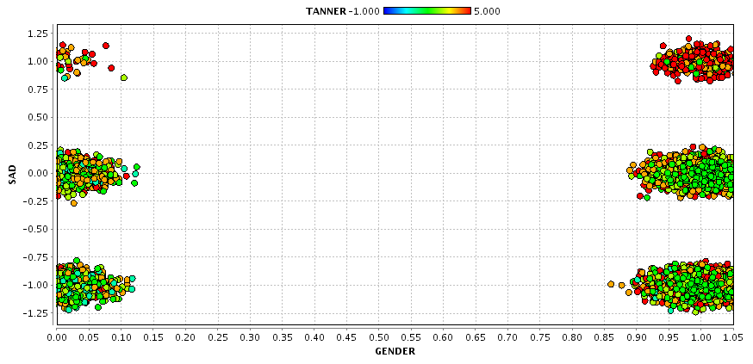
Analyzing the Data:
Emotion VS. Gender VS. Tanner

Slide 8
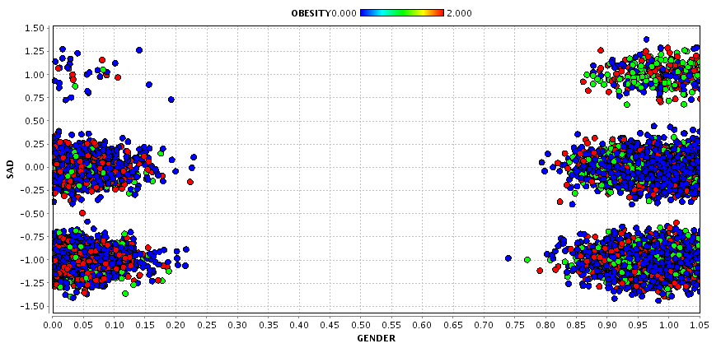
Analyzing the Data:
Emotion VS. Gender VS. Obesity

Slide 9
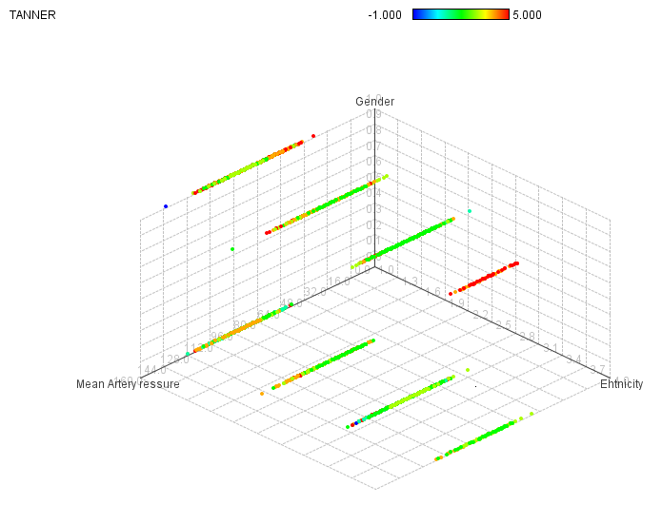
Analyzing the Data:
?

Slide 10
CONCLUSION:
There is a relation between:
Blood pressure & Tanner
Tanner & emotional states
Obesity & emotional states

Slide 11
Questions?

