Slide 1
EPA WATER(UCMR1)
Question 1: Does the water source matter in terms of levels of contaminants
Question 2: Open Ended (Look for an interesting Association)

Slide 2
UCMR1 Rules
Requirements for all large public water systems (PWS) and a representative sample of small PWS to monitor for those contaminants on List 1
Requirements for selected large and small PWS to monitor for those contaminants on List 2
Small public water systems do not need to be analyzed
Contaminants are separated into List 1 and List 2

Slide 3
Pre-Processing
r1r2.txt: An 874MB text file that contains 13 columns and millions of rows/data objects
Issues with Excel: Cannot import a text file with that much data into Excel
Issues with Weka 3.7: Cannot handle my initial text file(have to increase heap size) and all data must be located on one sheet

Slide 4
Splitting Large Text Files
Tried several programs that would split a large text file into smaller text files
Most programs would either split text file into a different file type or corrupt the original text file
Solution: Finally found a program that would successfully split the large text file(split into 118 smaller text files)

Slide 5
Using Excel
Manually imported all 118 text files in Excel only to learn that it was far too much to save into one file(took hours)
Imported the 118 text files into 118 separate excel files that would be edited(remove the data objects that represent small public water systems)

Slide 6
Question 1
Does the water source matter in terms of levels of contaminants
Clustering would not be as useful in this situation, given the fact that the data already specifies the water type for each data object
Tried applying the Apriori Algorithm, but weka would not let me apply my data
Decided to use a decision tree that would classify through visual means (UserClassifier)

Slide 7
Question 1(cont.)
For Round 1 contaminants
X axis(sourcetype) gw=1 sw=2
Y axis(Result) Concentration of contaminants

Slide 8
Open Ended: Comparing the States by means of the number of detections and their concentration (List 1)
Concentration is in terms of ug/L or micrograms per Liter
Separated the text files according to the States
Visualized the number of detections and their concentration(on a state by state basis)

Slide 9
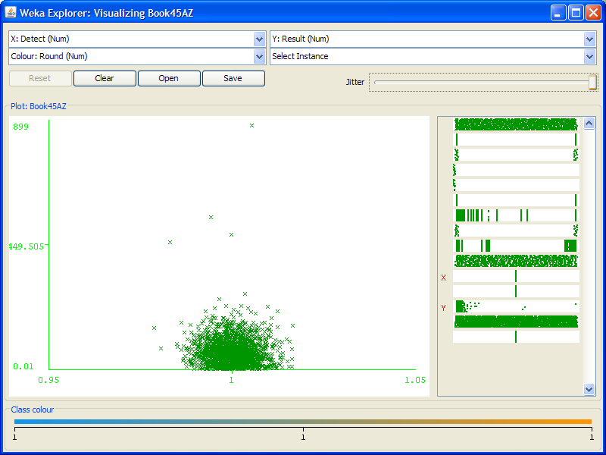
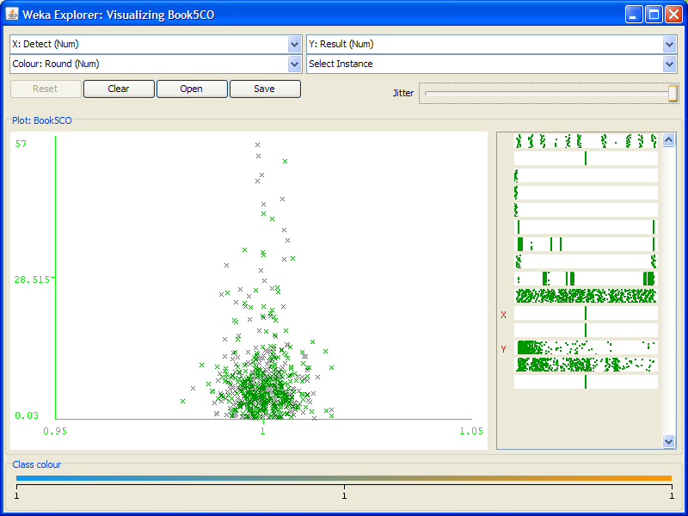
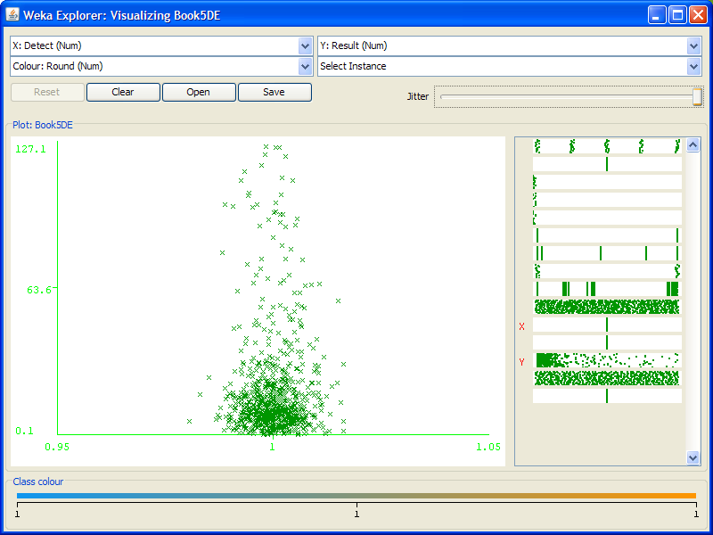
Visualization
Alabama
Arizona
Colorado
Delaware

Slide 10
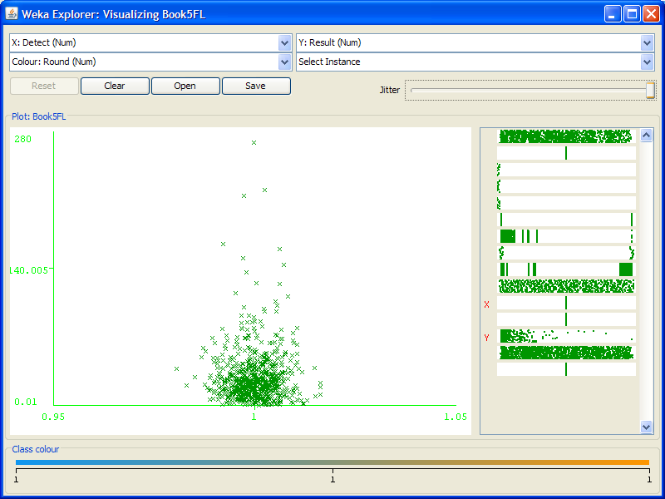
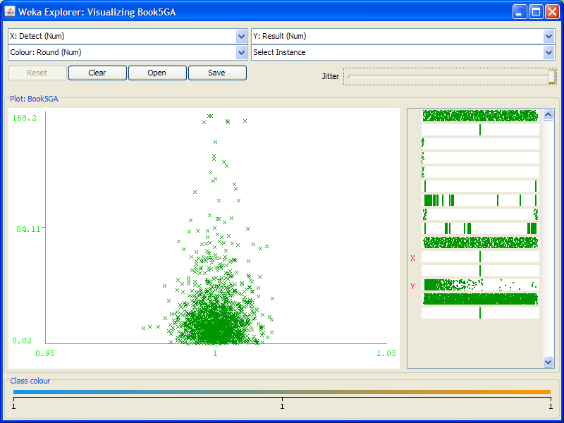
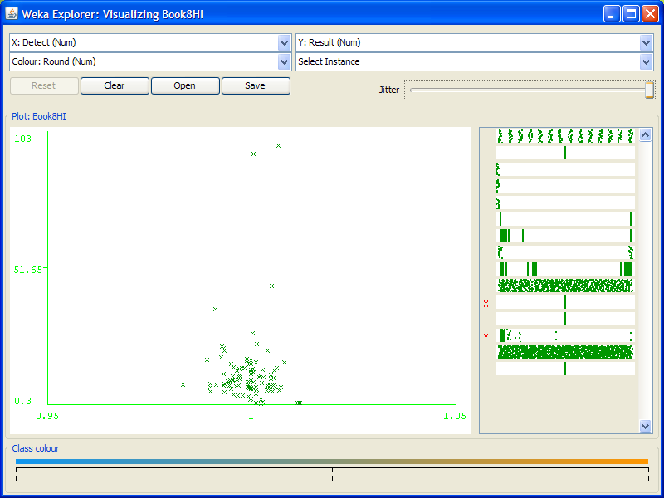
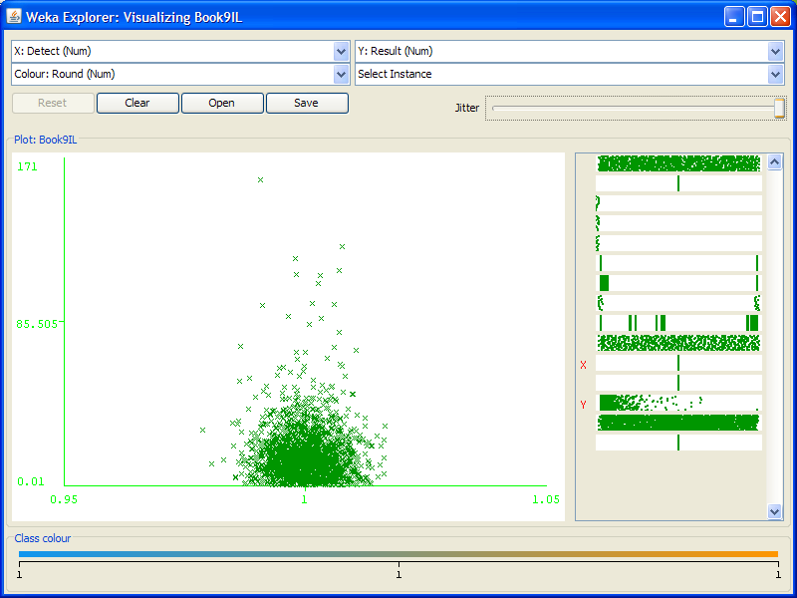
Visualization
Florida
Georgia
Hawaii
Illinois

Slide 11
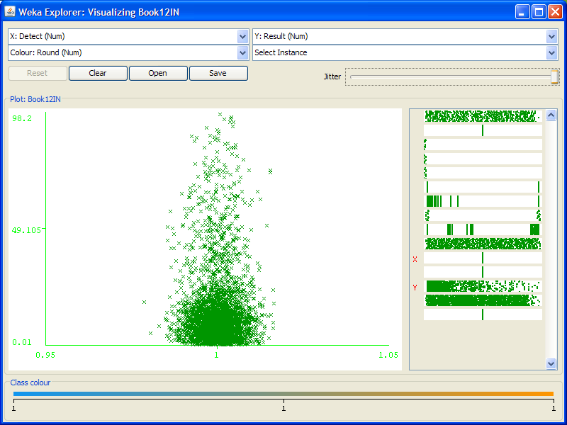
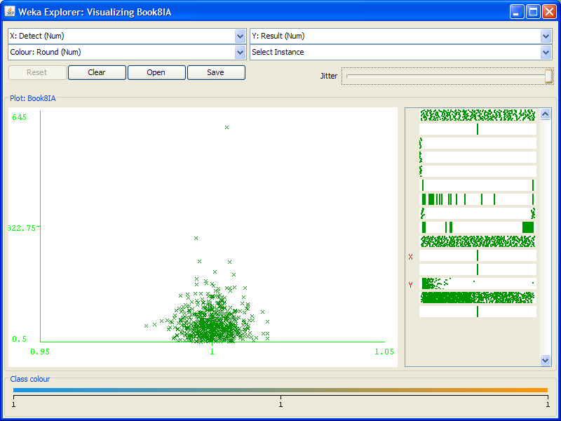
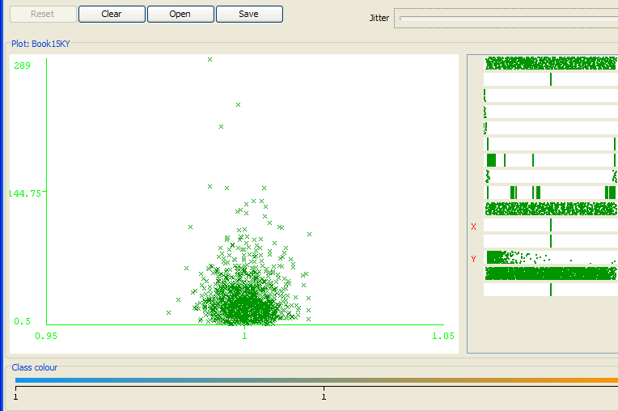
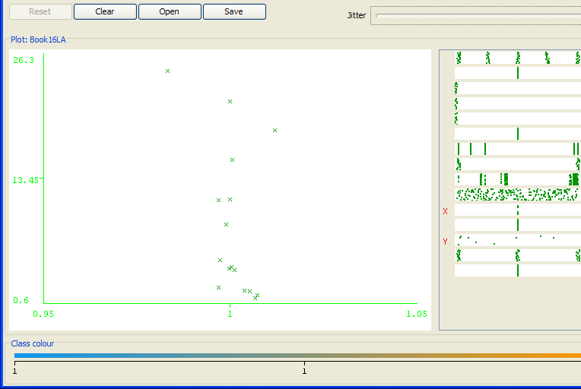
Visualization
Indiana(Highest Number of contaminants with high concentration)
Iowa
Kentucky
Louisiana

Slide 12
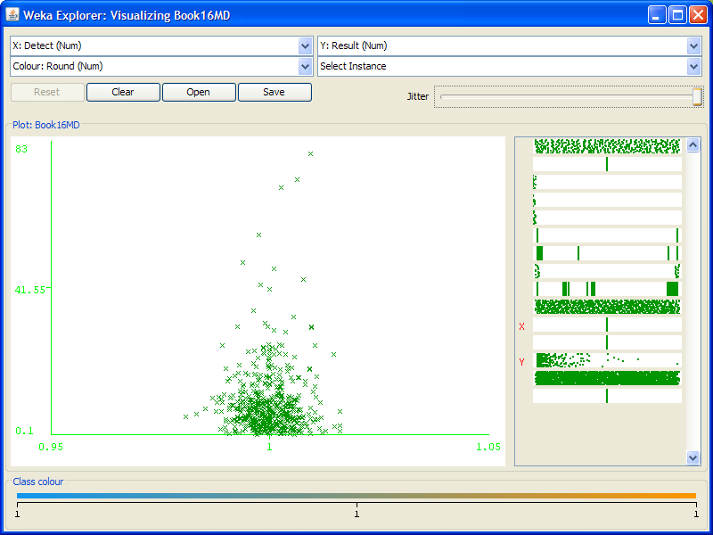
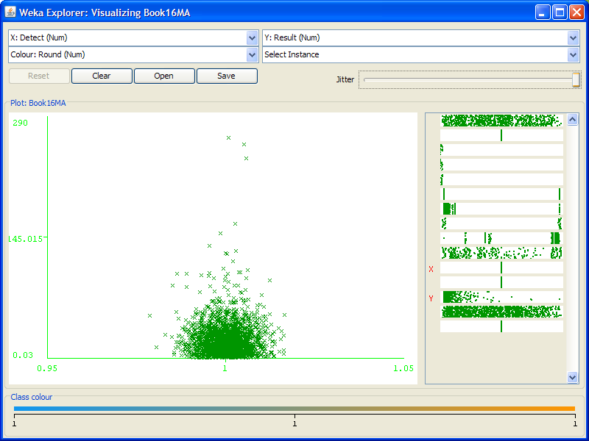
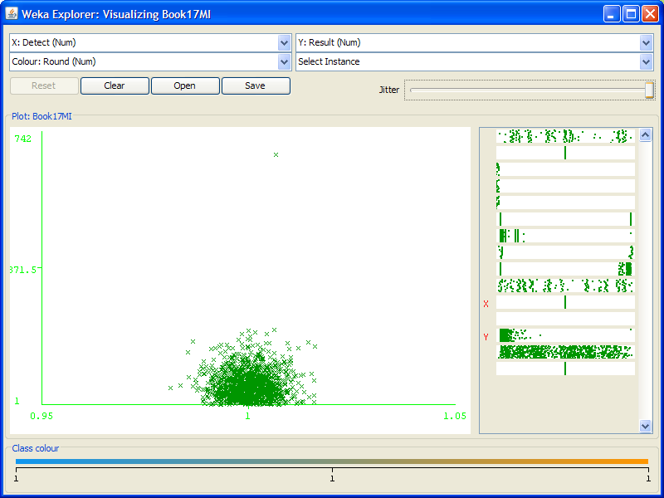
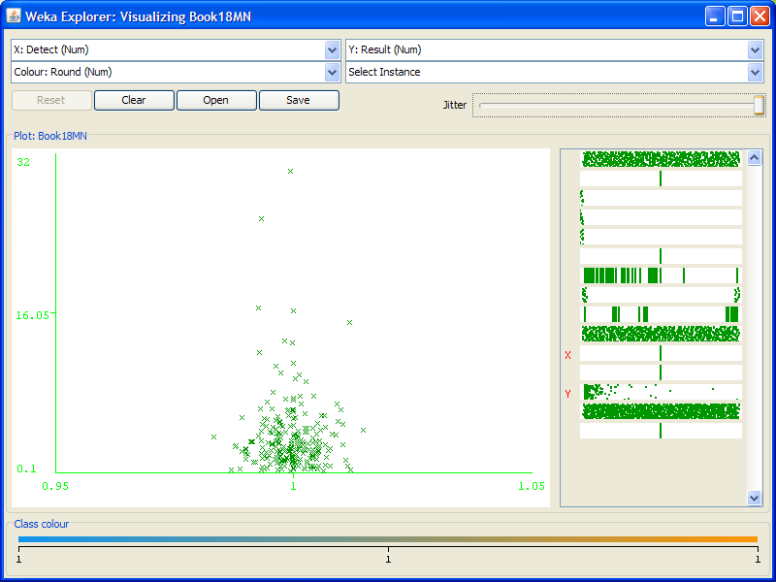
Visualization
Maryland
Massachusetts
Michigan
Minnesota

Slide 13
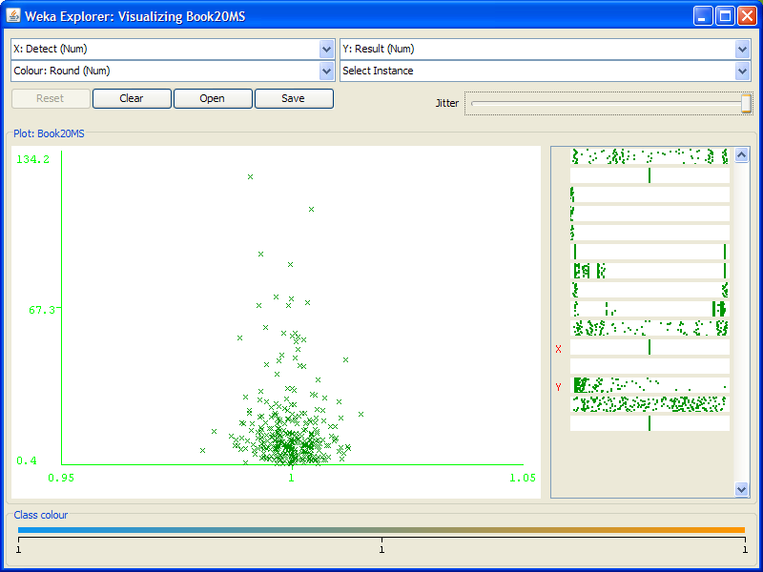
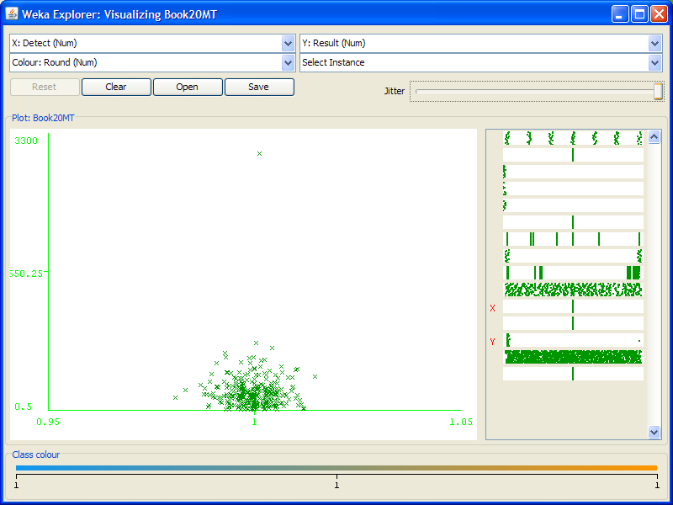
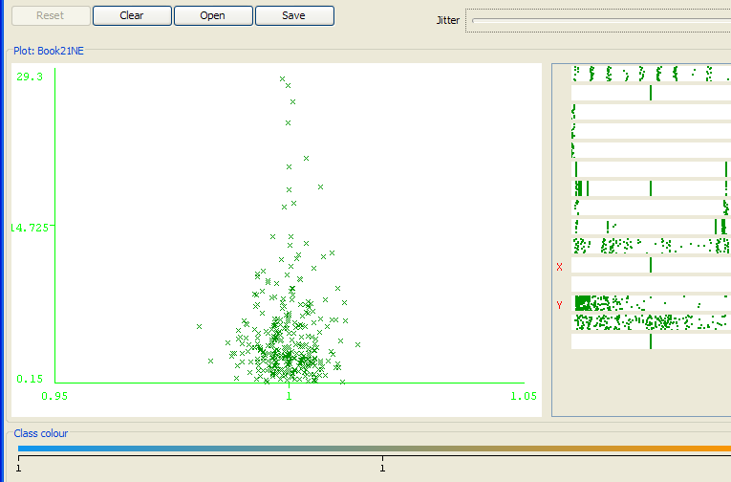
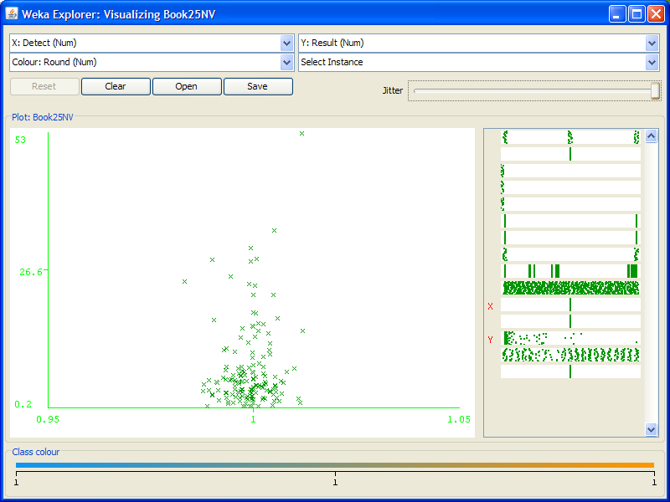
Visualization
Missouri
Montana
Nebraska
Nevada

Slide 14
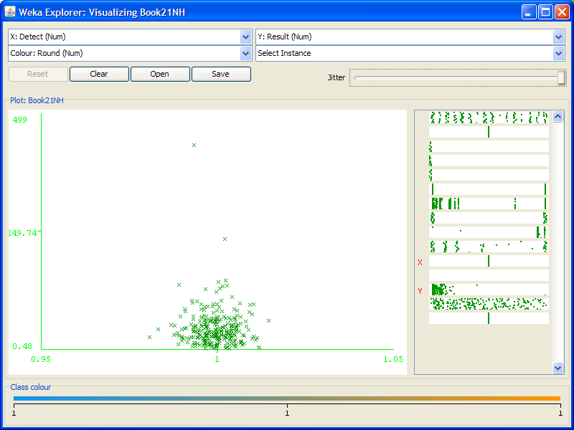
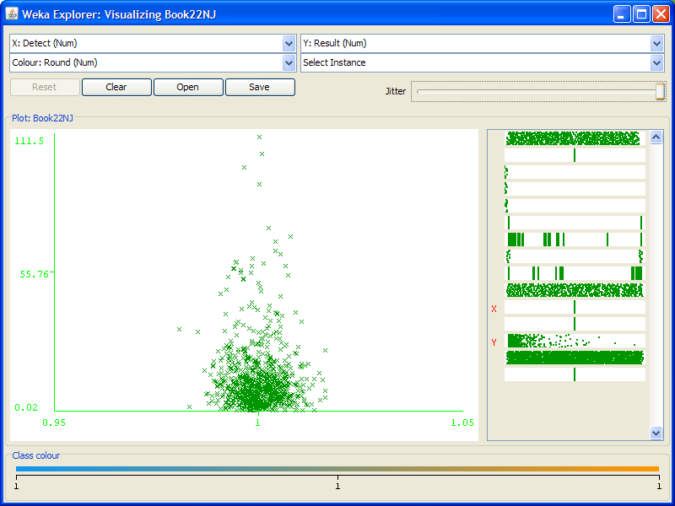
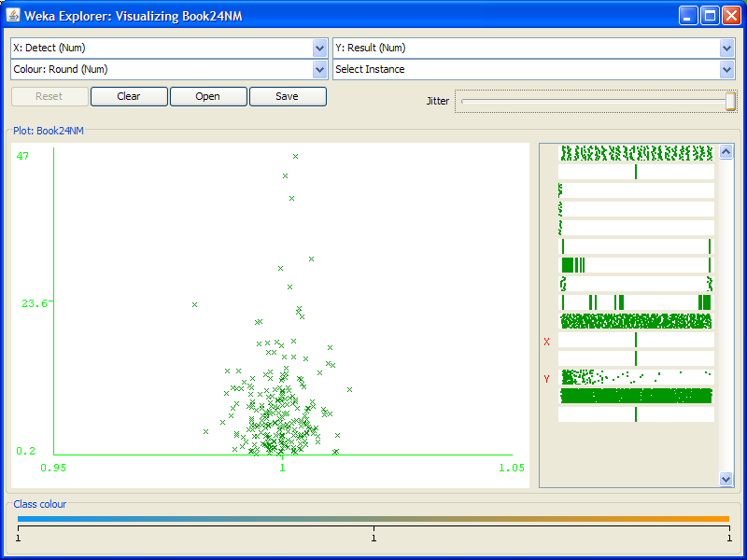
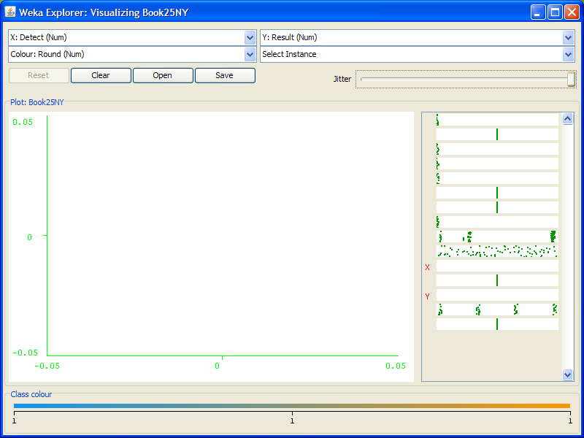
Visualization
New Hampshire
New Jersey
New Mexico
New York

Slide 15
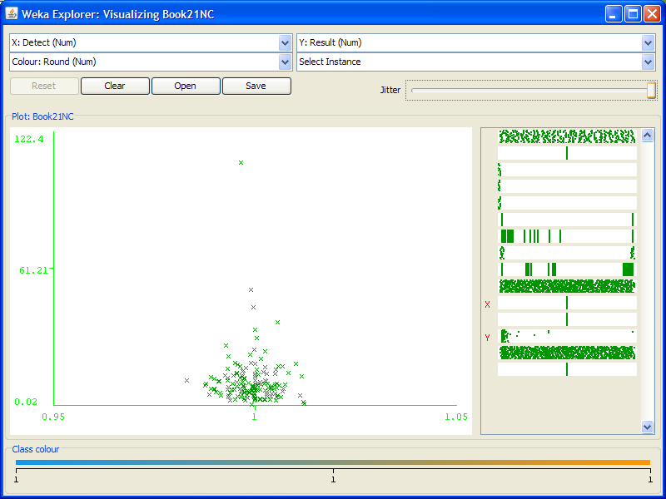
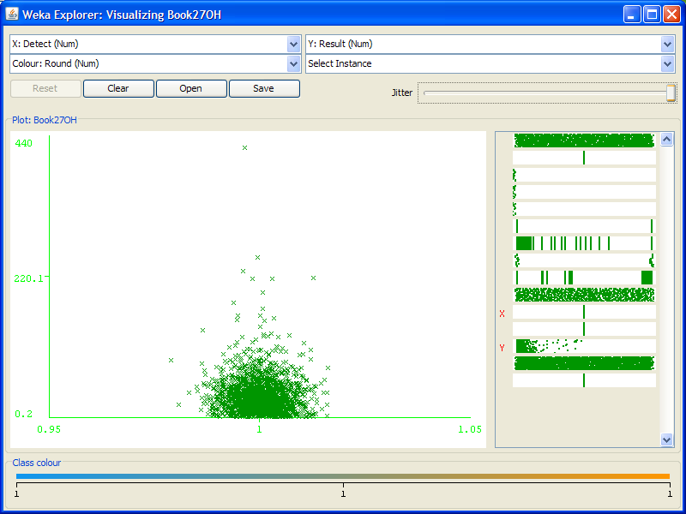
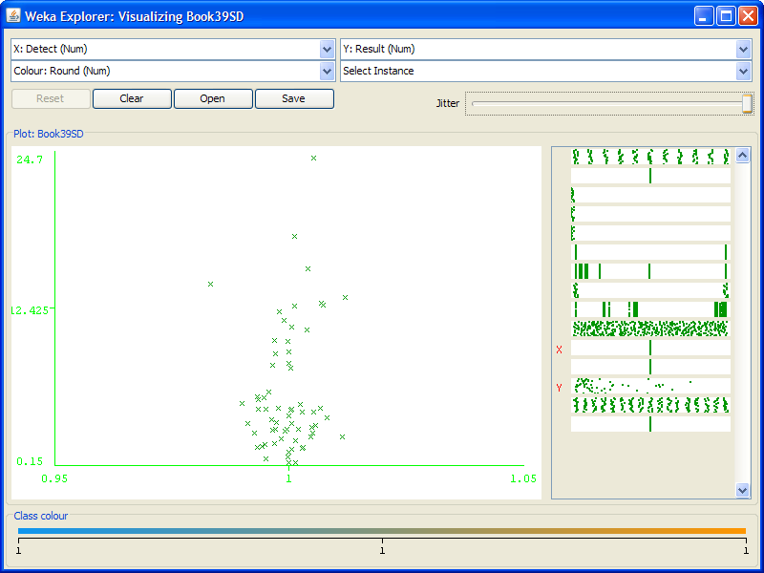
Visualization
North Carolina
Ohio
South Dakota
Tennessee

Slide 16
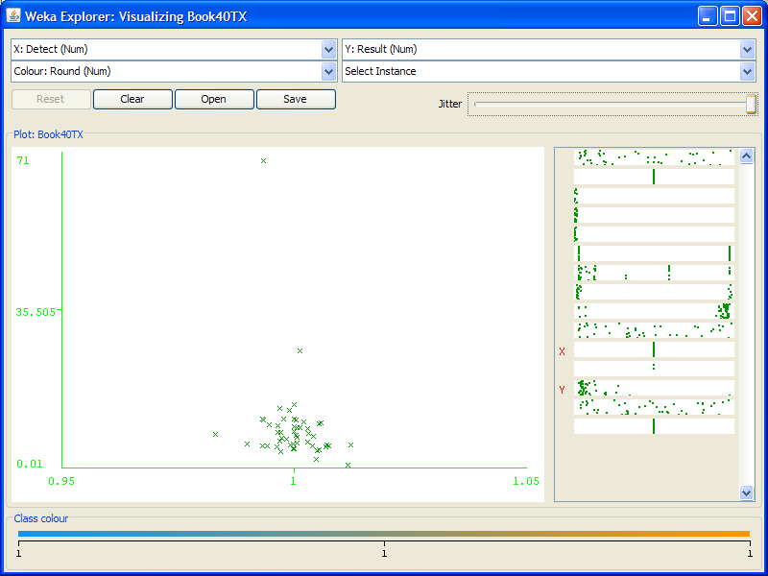
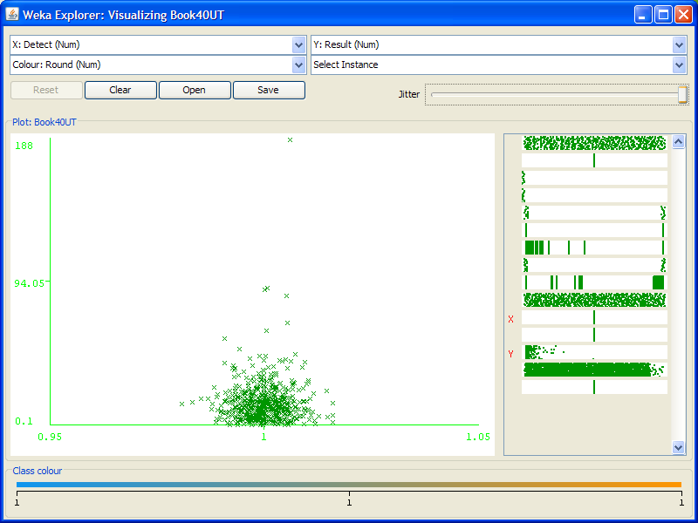
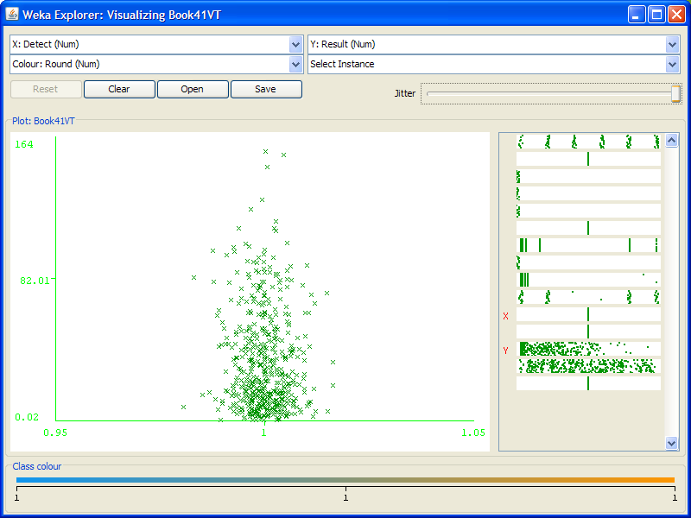
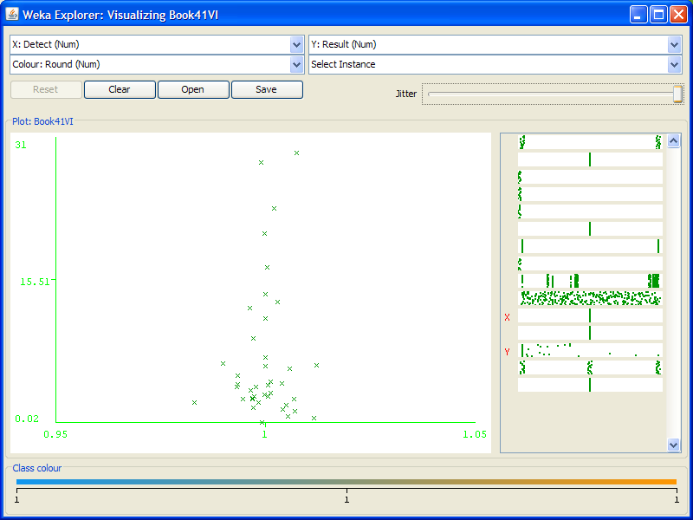
Visualization
Texas
Utah
Vermont
Virginia

Slide 17
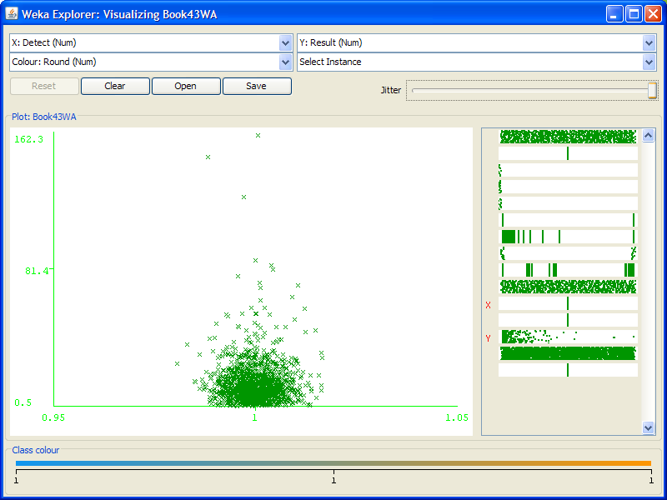
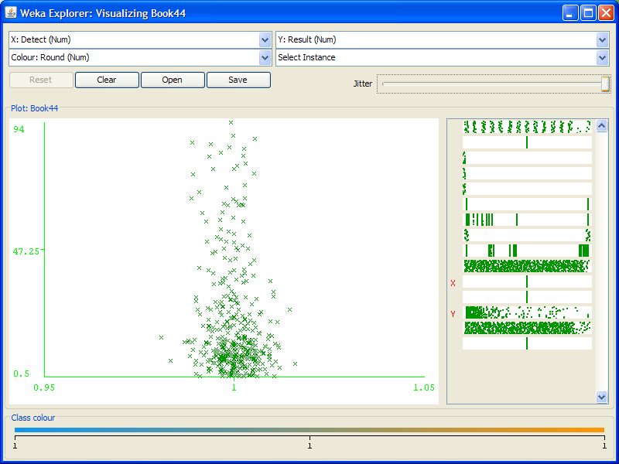
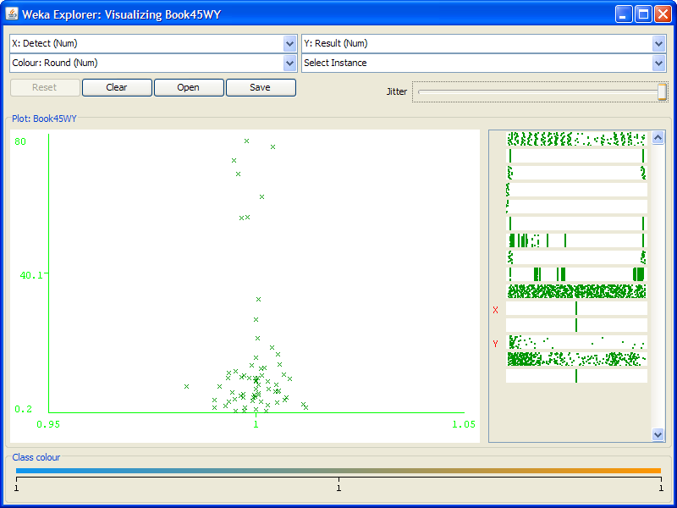
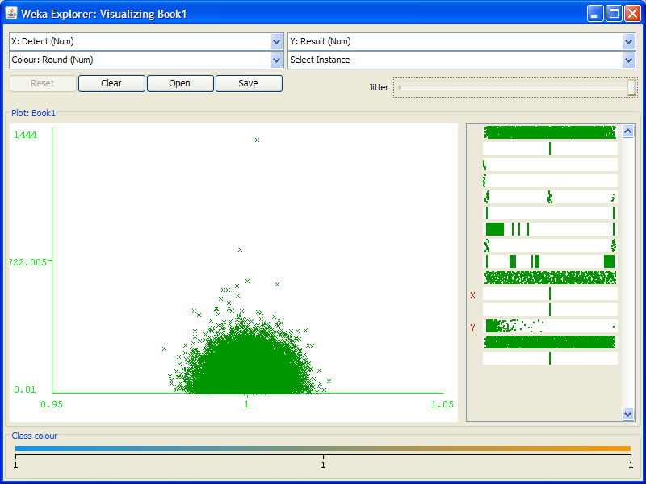
Visualization
Washington
West Virginia
Wyoming
California (Largest Number of Detections)

