Slide 1
Urinary Cancer
SEER Provided Data
Mohammad Afnan Baqai
12/3/2009

Slide 2
Table of Contents
Background
SEER
Goals of SEER
SEERStat
Results

Slide 3
Background
Cancer
Tumor
Symptoms
Blood in the urine
Urgency to urinate
Back or bone pain
Swelling in the legs
Diagnosis
Treatment

Slide 4
SEER
The Surveillance, Epidemiology, and End Results
National Cancer Institute
Collect and Publish information for 26% of the United States
Tasks

Slide 5
Goals of SEER
Collect complete and accurate data on all cancers diagnosed among residents of geographic areas covered by SEER cancer registries.
Conduct a continual quality control and quality improvement program to ensure the collection of high quality data.
Periodically report the cancer burden as it relates to cancer incidence and mortality, and patient survival overall and in selected segments of the population.

Slide 6
Goals of SEER (cont)
Identify unusual changes and differences in the patterns of occurrence of specific forms of cancer in population subgroups defined by geographic, demographic, and social characteristics.
Describe temporal changes in cancer incidence, mortality, extent of disease at diagnosis (stage), therapy, and patient survival as they may relate to the impact of cancer prevention and control interventions.

Slide 7
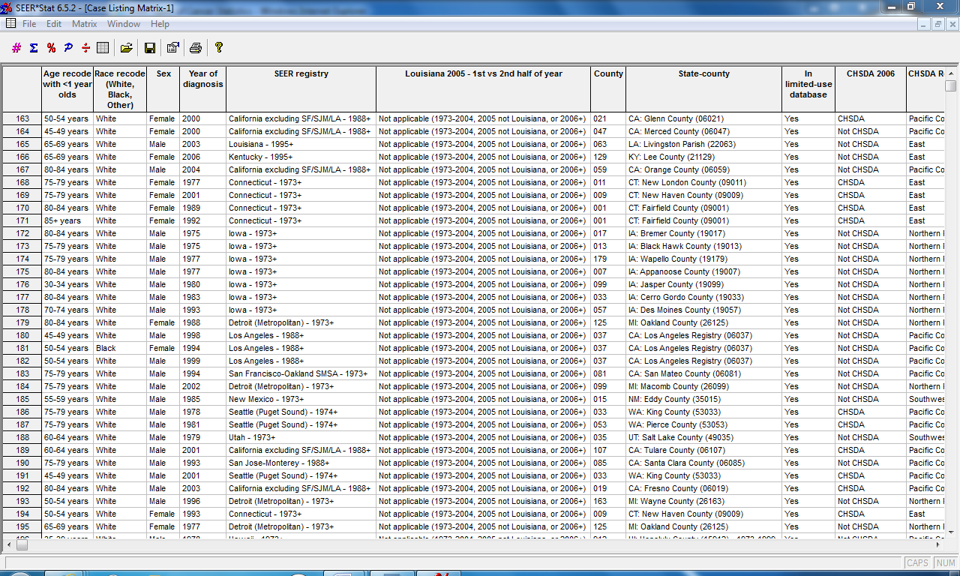
SEERStat

Slide 8
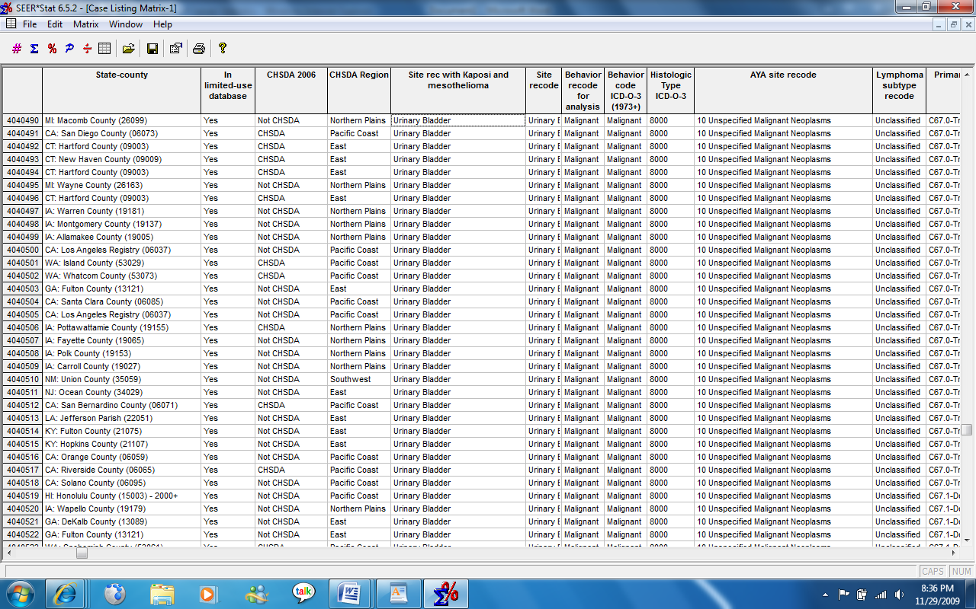
SEERStat

Slide 9
Results
85+:
White Female
No Surgery on Patients
One patient with radiation
80-84:
White Female
70% Surgery
Beam radiation
75-79:
White Male
Majority had surgery
Low outcome of radiation

Slide 10
Results
70-74:
White Females
Surgery
No Radiation
65-69:
Females
Small % of other race in men
Surgery Recommended
55-59:
White Males
Bladder
90% Surgery & high success rate

Slide 11
Conclusions
Problems
Questions?

