Slide 1
Identifying NaK Objects in Space Debris
Johanne Christensen

Slide 2
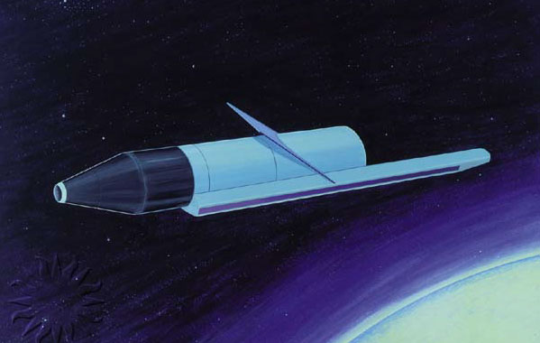
Problem
Soviet RORSAT satellites were deployed between 1967 to 1988
Some of the satellites had nuclear reactors
The nuclear satellites were decommissioned in the 1980s by boosting the satellite to a graveyard orbit and jettisoning the reactor
NaK coolant was leaked due to a faulty seal in 16 satellites
Can we identify which groups of NaK objects originated from each satellite?
RORSAT

Slide 3
Data
1076 data objects with 10 attributes
Data comes from the MIT Haystack Radar in MA
75° Elevation East is examined
Haystack can only identify objects larger than 5mm
Data contains location information (alt, range, range-rate, inclination) and wavelength information
Wavelength information gives the information on the composition of the object
Additional data about the RORSAT satellites (orbit heights and inclination) was also given

Slide 4
Preprocessing
Correlated all the columns
Alt and Range have very high correlation >.99
High correlation among the wavelength data (PP, OP, RCS)
Low correlation between the location data and wavelength data
Can omit the wavelength data
Tells us that the objects are all NaK

Slide 5
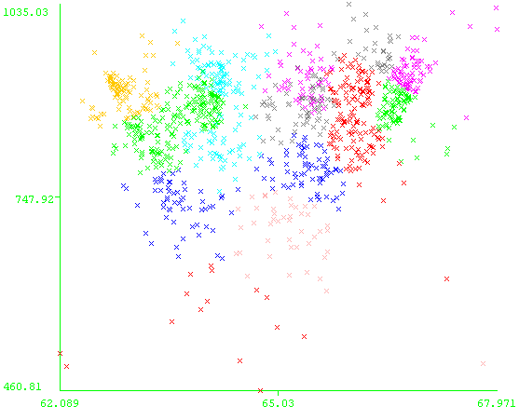
Clustering
Inclination and Altitude by Cluster
Need to remove outliers, since they will skew the clusters
Used DBScan and removed noise point
Used visualization and removed a point with significantly higher rdot
K-means with 16 clusters
Attributes Used: Alt, Inclination, Range-Rate

Slide 6
Refining Clusters
Running the clustering algorithm produces several clusters with centroids under 800km
Does not match satellite data
Many of the objects are below 700km, while 15 of the satellites are orbiting at 900km
Orbital decay is likely – most of the low altitude objects are small (<1cm)

Slide 7
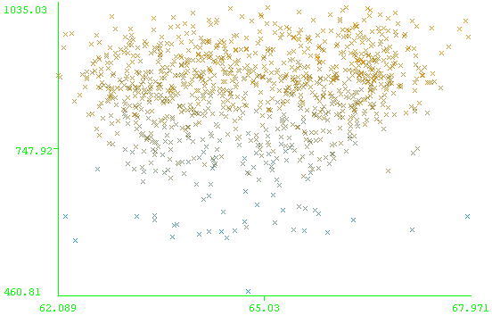
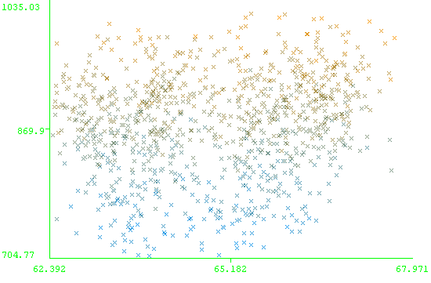
Refining Clusters
Removed objects at low altitude, below 700km
Clustered with K-means, 30 clusters
Inc and Alt Before and After Removing Low Altitudes

Slide 8
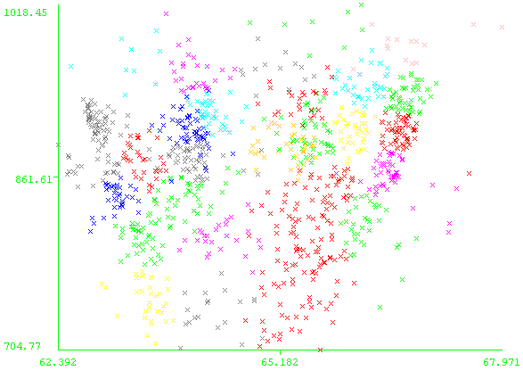
Postprocessing
Merged similar clusters based on inclination and range-rate
Accounts for orbital decay, since objects decay at different rates

Slide 9
Merged Clusters

