Slide 1
97% of all e-mail is spam
100 billion spam email per day
Easy to setup spam networks
Low cost of operation
Millions of dollars worth of time and
equipment to combat spam

Slide 2
Techniques used to combat spam
header tests
address whitelist/blacklist
collaborative spam identification
DNS blocklists
body phrase tests.
The last technique is of interest to the field of data mining. Using natural language
processing, classifiers can be built to determine if incoming messages conform to a pattern
common to known spam messages.

Slide 3
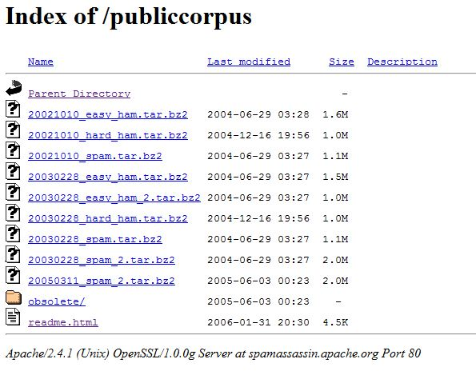
Dataset
Apache Software Foundation – SpamAssassin Project
http://spamassassin.apache.org/publiccorpus/

Slide 4
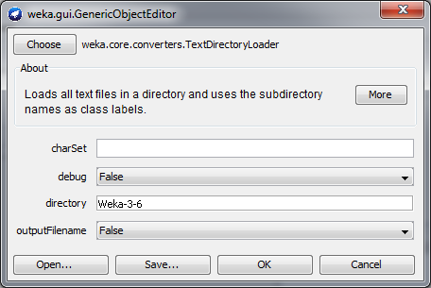
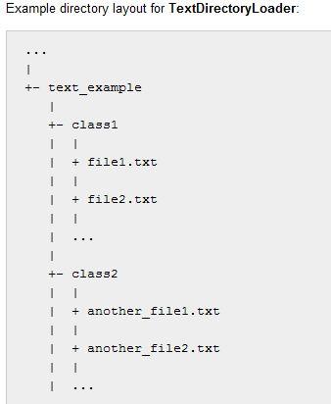
Data Parsing
weka.core.converters.TextDirectoryLoader
@relation D__email2
@attribute text string
@attribute @@class@@ {easy_ham,spam}
@data'From exmh-workers-admin@redhat.com Thu …trunc… \n\n',easy_ham
@data'From Steve_Burt@cursor-system.com Thu Aug 22 …trunc… \n\n\n\n',easy_ham
@data'From timc@2ubh.com Thu Aug 22 13:52:59 2002 …trunc… \n\n\n\n',easy_ham

Slide 5
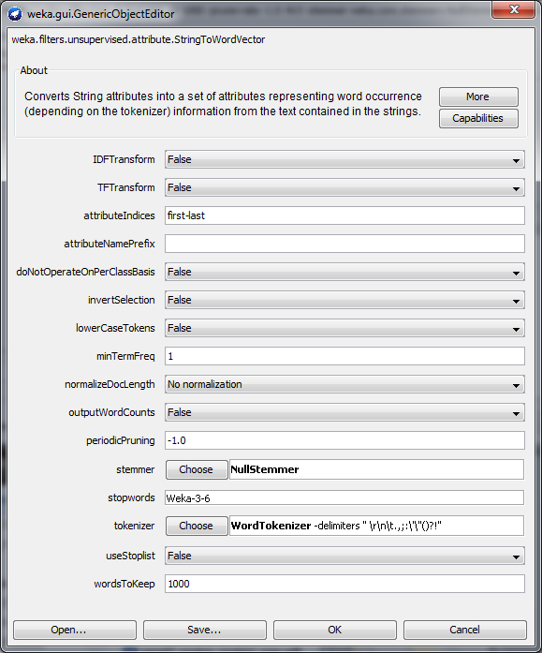
Data Conversion and Preprocessing
weka.filters.unsupervised.attribute.StringToWordVector
Vectorization (binary/term frequency)
Stemming (SnowballStemmer)
Stop word removal
Table 1 - ARFF files email2_nostop_nostem_freq.arff email2_nostop_nostem_pres.arff email2_nostop_stem_freq.arff email2_nostop_stem_pres.arff email2_stop_nostem_freq.arff email2_stop_nostem_pres.arff email2_stop_stem_freq.arff email2_stop_stem_pres.arff

Slide 6
ARFF after preprocessing
@attribute thinkgeek numeric
@attribute thought numeric
@attribute thu numeric
@attribute thursday numeric
@attribute time numeric
@data{8 2,10 3,16 1,24 6,25 1,27 6,28 5,35 4,43 13,48 1,49 2, … }
{8 5,14 1,17 1,19 1,20 1,23 5,24 1,31 1,39 1, … 43 6,55 1,61 1,}
{8 4,14 1,15 2,17 1,19 1,20 1,23 5,24 1,31 1,39 1,43 6,57 1, … 61 2,68 2,70 5,76 5,97 1}
…
{0 spam,8 2,15 1,24 2,26 1,43 7,44 1,51 1,58 1,61 1,63 1, … 68 2,75 1,82 2,86 2,95 1,98 2}
{0 spam,8 2,24 1,43 6,44 3,58 1,61 1,63 1,68 2,72 1,76 1, … 82 2,86 2,89 3,98 2,100 1,103 6}
{0 spam,4 1,8 2,10 1,15 4,24 1,41 3,43 6,44 2,45 1,48 1,51 1, … 53 1,61 1,63 1,68 2,70 1,80 1}

Slide 7
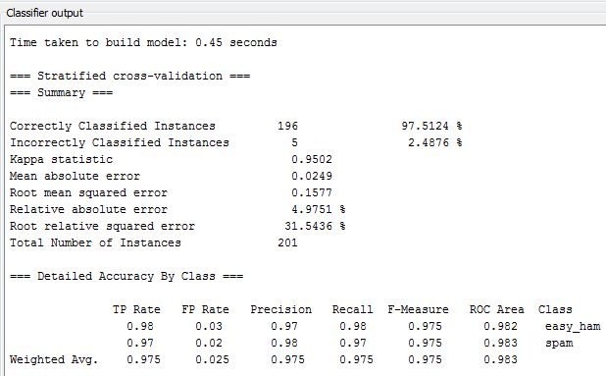
Classification
Naïve Bayes
multinominal Naïve Bayes
dataset | Naive Bayes | multinomial Naive Bayes
email2_nostop_nostem_freq.arff | 97.51% | 95.52%
email2_nostop_nostem_pres.arff | 97.01% | 97.51%
email2_nostop_stem_freq.arff | 97.51% | 95.52%
email2_nostop_stem_pres.arff | 97.01% | 97.51%
email2_stop_nostem_freq.arff | 97.51% | 96.02%
email2_stop_nostem_pres.arff | 97.51% | 98.51%
email2_stop_stem_freq.arff | 97.51% | 96.02%
email2_stop_stem_pres.arff | 97.51% | 98.51%

Slide 8
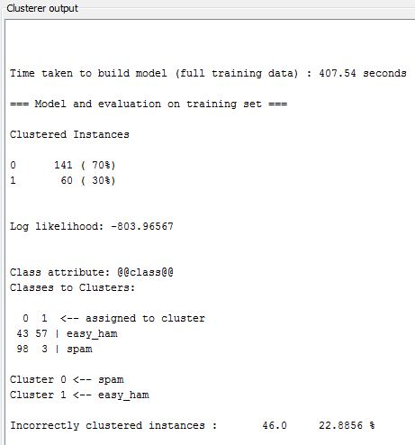
Clustering
email2_nostop_nostem_freq.arff
EM
DBScan
SimpleKMeans
HierarchicalCluster
Incorrectly clustered instances:
EM | 22.89%
DBScan | -
SimpleKMeans | 45.77%
HierarchicalCluster | 49.25%

