Slide 1
On Exploring Boundaries
There is always a limit on what you can still do / cannot do.
However, these boundaries are dynamic and can be changed through training
Analogy: Training for an Olympic Marathon…
Several of the papers we will read will be not easy to understand
If you read the papers we discuss in the course now you will understand 25% of the contents; hopefully, on December 2, 2015 you will understand 70% of the papers discussed…
You should believe into yourself that you can extend and challenge these boundaries. A statement like “I will never understand this paper is not practical” is not productive…
Being not afraid of boundaries is particularly important for personal growth and research.

Slide 2
Analogy: Training to win a Medal at an Olympic Marathon
You need to have some basic talent to have a chance --- but a lot of people have talent…
You have to be committed and have to believe that you have a chance
You have to have some luck
At least 50% depends on the training you do. Dilemma:
If you train too hard you get injured
If you train a little you have no chance
Marathon training is about extending your boundaries without getting hurt...
To be successful you need a coach (or even a team of coaches)
What you can do in a year
What you can do today

Slide 3
Some Ingredients for Success
Time,
Money,
Food,
Friends,
Place to live,
…
Talent
Training
Self Confidence
and Commitment
Luck
Persistance

Slide 4
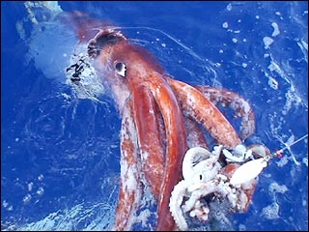
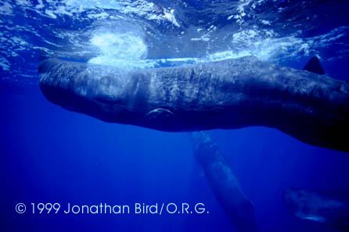
Another Example: Finding the Giant Squid
10 meters
18 meters
Kubodera said catching the squid on film
was the result of 10 years of sleuthing.
We knew that sperm whales fed on the squid, and
we knew when and how deep they dived,”
Kubodera said. “So we used them to lead us to the squid.”
Giant Squid Sperm Whale
Story: http://www.msnbc.msn.com/id/9503272/
On sperm whales: http://animals.nationalgeographic.com/animals/mammals/sperm-whale/
Giant Squid vs Sperm Whale: https://www.youtube.com/watch?v=_z2Lfxpi710

Slide 5
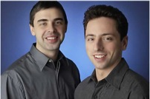
Sergey Brin CV (Сергей Михайлович Брин) (see also http://en.wikipedia.org/wiki/Sergey_Brin )
Sergey Brin is co-founder and President, Technology at Google. Originally a native of Moscow, he received a bachelor of science degree with honors in mathematics and computer science from the University of Maryland at College Park. He is currently on leave from the Ph.D. program in computer science at Stanford University, where he received his master's degree. Sergey is a recipient of a National Science Foundation Graduate Fellowship as well as an honorary MBA from Instituto de Empresa. It was at Stanford that he met Larry Page and worked on the project that became Google. Together they founded Google Inc. in 1998, and Sergey continues to share responsibility for day-to-day operations with Larry Page and Eric Schmidt.
Sergey's research interests include search engines, information extraction from unstructured sources, and data mining of large text collections and scientific data. He has published more than a dozen academic papers and has been a featured speaker at several international academic, business and technology forums, including the World Economic Forum and the Technology, Entertainment and Design Conference. He has shared his views on the technology industry and the future of search on the Charlie Rose Show, CNBC, and CNNfn. In 2004, he and Larry Page were named "Persons of the Week" by ABC World News Tonight.
See also http://money.cnn.com/magazines/fortune/fortune_archive/2006/10/02/8387489/index.htm?postversion=2006100210 for more about Google’s work philosophy.
Sergey

