Slide 1
Non-Parametric Density Functions
Christoph F. Eick
8/21/2015

Slide 2
Non-Parametric Density Estimation
Goal is to obtain a density function: http://en.wikipedia.org/wiki/Probability_density_function
Parametric (single global model), semiparametric (small number of local models)
Nonparametric: similar inputs have similar outputs
Keep the training data;“let the data speak for itself”
Given x, find a small number of closest training instances and interpolate from these
Aka lazy/memory-based/case-based/instance-based learning

Slide 3
Influence Functions
The influence function of a data object is a function f_{B}^{y} : F^{d} → R₀⁺ which is defined in terms of a basic influence function f_{B}
Examples of basic influence functions are:

Slide 4
Example: Kernel Density Estimation
D={x1,x2,x3,x4}
f^{D}_{Gaussian}(x)= influence(x1) + influence(x2) +
influence(x3) influence(x4)= 0.04+0.06+0.08+0.6=0.78
x1
0.04
x3
y
0.08
x2
x4
0.06
x
0.6
Remark: the density value of y would be larger than the one for x

Slide 5
Notations
O={o₁,…,o_{n}} is a dataset whose density has to be measured
r is the dimensionality of O
n is the number of objects in O
d: F^{r}X F^{r}→ R₀⁺ is a distance function for the objects in O; d is assumed to be Euclidian distance unless specified otherwise
d_{k}(x) is the distance of x its k-nearest neighbor in O

Slide 6
Gaussian Kernel Density Functions
Density functions f_{B}: defined as the sum of the influence functions of all data points. Given N data objects, O={o₁,…, o_{n}} the density function is defined as—normalized version:
Non-Normalized Version:
Example: Gaussian Kernel Non-parametric Density Function f
Remark: σ is called kernel width; called h in our textbook!

Slide 7
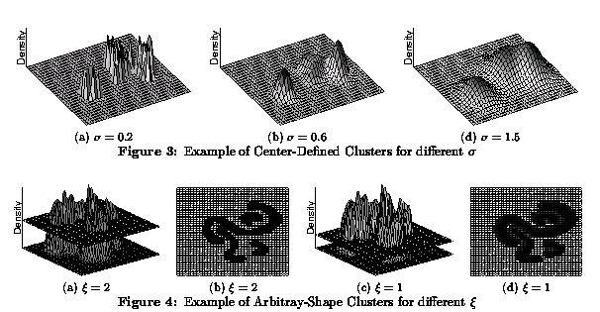
Density Functions for different values of h/σ
Remark:

Slide 8
kNN-based Density Functions
Example: kNN density function with variable kernel width—width is proportional to d_{k}(x) in point x: the distance of the k^{th} nearest neighbor in O to x; is usually difficult to normalize due to the variable kernel width; therefore, the integral over the density function does not add up to 1 and usually is ∞.
Parameter selection: Instead of the width σ, k has to be selected!
or Alpaydin mentions the following variation:

