Slide 1
CHAPTER 4: Parametric Methods

Slide 2
Parametric Estimation
Given X = { x^{t} }_{t}
goal: infer probability distribution p(x)
Parametric estimation:
Assume a form for p (x | θ) and estimate θ, its sufficient statistics, using X
e.g., N ( μ, σ²) where θ = { μ, σ²}
Problem: How can we obtain θ from X?
Assumption: X contains samples of a one-dimensional random variable
Later multivariate estimation: X contains multiple and not only a single measurement.
Example; Gaussian Distribution http://en.wikipedia.org/wiki/Normal_distribution

Slide 3
Maximum Likelihood Estimation
Density function p with parameters θ is given and x^{t}~p (X |θ)
Likelihood of θ given the sample X
l (θ|X) = p (X |θ) = ∏_{t} p (x^{t}|θ)
We look θ for that “maximizes the likelihood of the sample”!
Log likelihood
L(θ|X) = log l (θ|X) = ∑_{t} log p (x^{t}|θ)
Maximum likelihood estimator (MLE)
θ* = argmax_{θ} L(θ|X)
Homework: Sample: 0, 3, 3, 4, 5 and x~N(μ,σ)? Use MLE to find(μ,σ)!

Slide 4
Bayes’ Estimator
Treat θ as a random var with prior p (θ)
Bayes’ rule: p (θ|X) = p(X|θ) * p(θ) / p(X)
Maximum a Posteriori (MAP): θ_{MAP} = argmax_{θ} p(θ|X)
Maximum Likelihood (ML): θ_{ML} = argmax_{θ} p(X|θ)
Bayes’ Estimator: θ_{Bayes’} = E[θ|X] = ∫ θ p(θ|X) dθ
Comments:
ML just takes the maximum value of the density function
Compared with ML, MAP additionally considers priors
Bayes’ estimator averages over all possible values of θ which are weighted by their likelihood to occur (which is measured by a probability distribution p(θ)).
For MAP see: http://en.wikipedia.org/wiki/Maximum_a_posteriori_estimation
For comparison see: http://metaoptimize.com/qa/questions/7885/what-is-the-relationship-between-mle-map-em-point-estimation

Slide 5
Parametric Classification
kind of p(C_{i}|x)

Slide 6
Parametric Classification
Data
ML/MAP
P(x|C_{i})
kind of p(C_{i}|x)
Using Bayes Theorem
P(C₁|x)=P(C₁)xP(x|C₁)/P(x)
P(C₂|x)=P(C₂)xP(x|C₂)/P(x)
As P(x) is the same in both formulas, we can drop it!

Slide 7
Given the sample
ML estimates are
Discriminant becomes

Slide 8
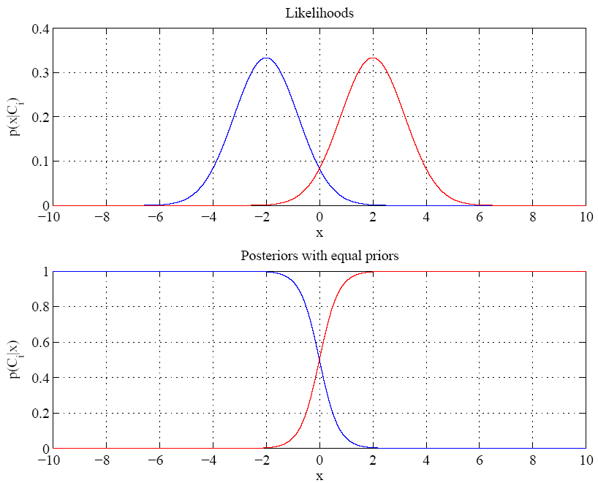
Equal variances
Single boundary at
halfway between means

Slide 9
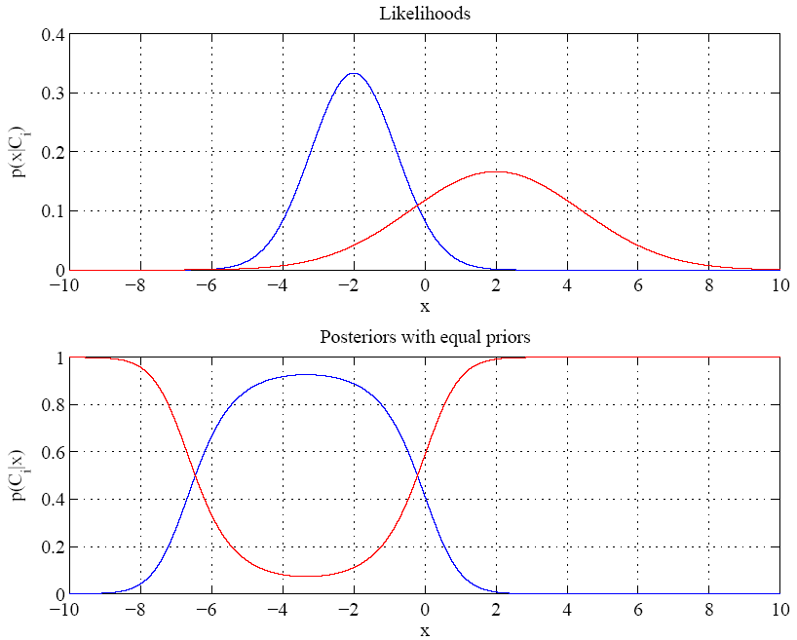
Variances are different
Two boundaries
Homework!

Slide 10
Model Selection
Remark: will be discussed in more depth later: Topic 11
Cross-validation: Measure generalization accuracy by testing on data unused during training
Regularization: Penalize complex models
E’=error on data + λ model complexity
Akaike’s information criterion (AIC), Bayesian information criterion (BIC)
Minimum description length (MDL): Kolmogorov complexity, shortest description of data
Structural risk minimization (SRM)

Slide 11
CHAPTER 5: Multivariate Methods
Normal Distribution: http://en.wikipedia.org/wiki/Normal_distribution
Z-score: see http://en.wikipedia.org/wiki/Standard_score

Slide 12
Multivariate Data
Multiple measurements (sensors)
d inputs/features/attributes: d-variate
N instances/observations/examples

Slide 13
Multivariate Parameters
Example: 16 0 0
0 16 -3
0 -3 1
Correlation: http://en.wikipedia.org/wiki/Correlation

Slide 14
Parameter Estimation
http://en.wikipedia.org/wiki/Multivariate_normal_distribution
http://webscripts.softpedia.com/script/Scientific-Engineering-Ruby/Statistics-and-Probability/Multivariate-Gaussian-Distribution-35454.html

Slide 15
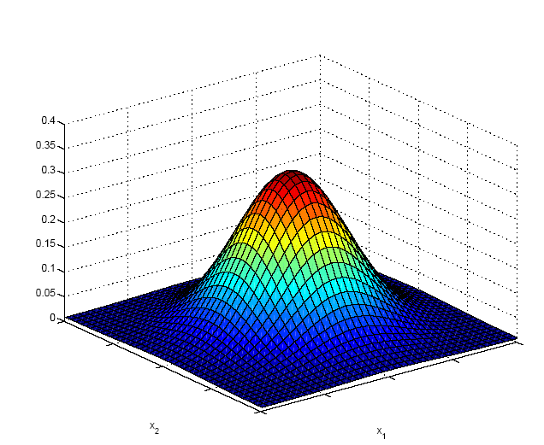
Multivariate Normal Distribution
Mahalanobis distance between x and μ
(5.9)

Slide 16
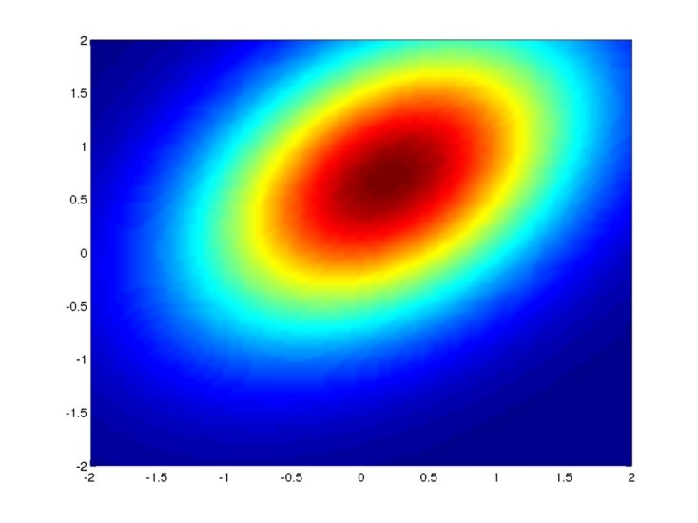
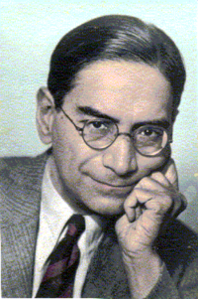
Mahalanobis Distance
http://en.wikipedia.org/wiki/Mahalanobis_distance
The Mahalanobis distance is based on correlations between variables by which different patterns can be identified and analyzed. It differs from Euclidean distance in that it takes into account the correlations of the data set and is scale-invariant.
Mahalanobis distance between x and μ
http://www.analyzemath.com/Calculators/inverse_matrix_3by3.html

Slide 17
Multivariate Normal Distribution
Mahalanobis distance: (x – μ)^{T} ∑^{–1} (x – μ)
measures the distance from x to μ in terms of ∑ (normalizes for difference in variances and correlations)
Bivariate: d = 2
Remark: ρ is the correlation between the two variables
Called z-score zi for xi

Slide 18
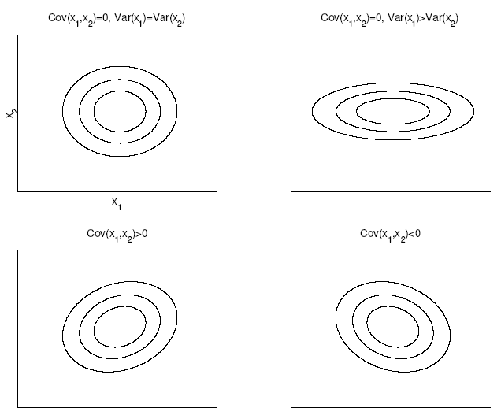
Bivariate Normal

Slide 19
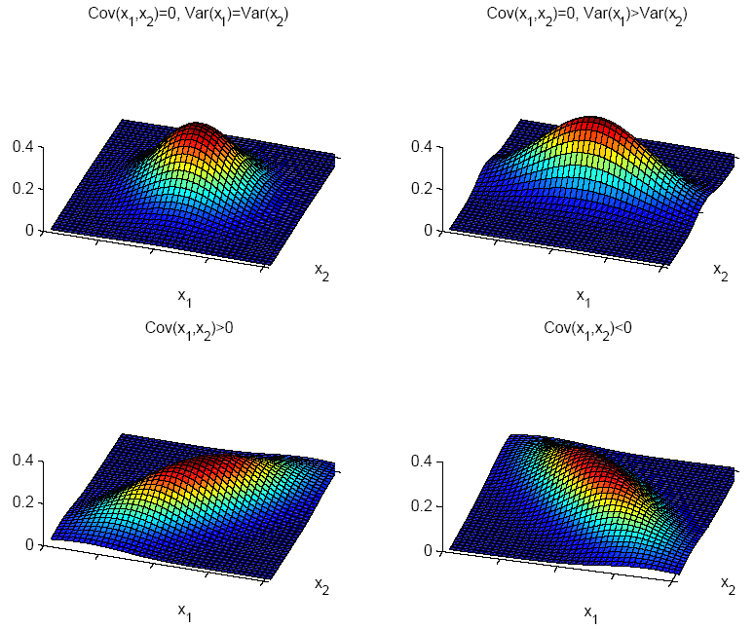

Slide 20
Model Selection
Assumption | Covariance matrix | No of parameters
Shared, Hyperspheric | S_{i}=S=s²I | 1
Shared, Axis-aligned | S_{i}=S, with s_{ij}=0 | d
Shared, Hyperellipsoidal | S_{i}=S | d(d+1)/2
Different, Hyperellipsoidal | S_{i} | K d(d+1)/2
As we increase complexity (less restricted S), bias decreases and variance increases
Assume simple models (allow some bias) to control variance (regularization)

