Slide 1
Introduction to Adaboost
By Yongli Zhang
Nacer Khalil

Slide 2
Outline
Introduction
The On-line Allocation Algorithm-Hedge(β)
Applications of Hedge(β)
Algorithm AdaBoost
Extending AdaBoost to Multiclass and Regression
History of AdaBoost
Existing Software and Packages
Conclusions

Slide 3
Introduction
Goal of AdaBoost:
Convert a “weak” PAC learning algorithm that performs just slightly better than random guessing into one with arbitrarily high accuracy.
-Note: PAC- probably approximately correct

Slide 4
Introduction
On-line allocation model:
The allocation agent A has N options or strategies to choose from;
At each time step t=1, 2, ..., T, the allocator A decides on a distribution P^{t} over the strategies; that is, P^{ti} >=0 is the amount allocated to strategy i,and .
Each strategy i then suffers some loss l ^{t} which is determined by the (possibly i adversarial) ``environment.'' The loss suffered by A is then
In this paper, assume loss is bounded,

Slide 5
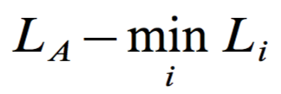
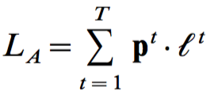
Introduction
On-line allocation model:
Goal of Algorithm A is to minimize the net loss---its accumulative loss relative to the loss suffered by the best strategy:
Where, L_{A} is the total cumulative loss suffered by algorithm A on the first T trials:
Where, L_{i} is strategy i’s cumulative loss:

Slide 6
Introduction
On-line allocation model:
Littlestone and Warmuth’s “weighted majority” algorithm can be generalized to solve this problem.
The generalized version of the algorithm is called Hedge(β)

Slide 7
Outline
Introduction
The On-line Allocation Algorithm-Hedge(β)
Applications of Hedge(β)
Algorithm AdaBoost
Extending AdaBoost to Multiclass and Regression
History of AdaBoost
Existing Software and Packages
Conclusions

Slide 8
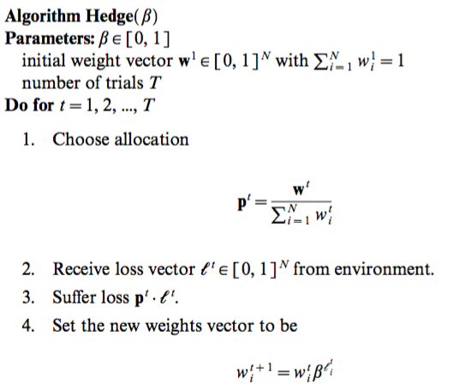
2. The On-line Allocation Algorithm-Hedge(β)
1. The algorithm maintains a weight vector whose
value at time t is denoted as:
2. The weight vector is P_{i}^{t} referred before,
which is the weights assigned to strategies.
3. we will want to choose the initial weights so as to
give the most weight to those strategies which we
expect are most likely to perform the best. Naturally,
if we have no reason to favor any of the strategies,
we can set all of the initial weights equally to 1/N.

Slide 9
2. The On-line Allocation Algorithm-Hedge(β)
The main idea of Hedge(β) is to derive upper and lower bounds on ,which, together, imply an upper bound on the loss of the algorithm.
In case that initial weights:
Through analysis and calculation, we get the upper bound of the loss:
Conclusion:
Hedge(β) does not perform ``too much worse'' than the best strategy i for the sequence.
Since it depends only logarithmically on N, this bound is reasonable even for a very large number of strategies.
For any choice of β, the bound is proved reasonable.

Slide 10
2. The On-line Allocation Algorithm-Hedge(β)
So far, it is proved that for a given choice of β, Hedge(β) has reasonable bound for loss.
Next, how to choose β?
In practice, we will often want to choose β so as to maximally exploit any prior knowledge we may have about the specific problem at hand.
Lemma:

Slide 11
2. The On-line Allocation Algorithm-Hedge(β)
For example, suppose we have N strategies, and we also know a prior bound on the loss of the best strategy, In general, if we know ahead of time the number of trials T, then we can use =T as an upper bound on the cumulative loss of each strategy i.
We set:
Through analysis and calculation, this β will help obtain an explicit bound on the rate at which the average per-trial loss of Hedge(β) approaches the average loss for the best strategy.

Slide 12
Outline
Introduction
The On-line Allocation Algorithm-Hedge(β)
Applications of Hedge(β)
Algorithm AdaBoost
Extending AdaBoost to Multiclass and Regression
History of AdaBoost
Existing Software and Packages
Conclusions

Slide 13
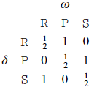
3. Applications of Hedge(β)
A specific example----Game: ``rock, paper, scissors''
Decision space ∆={R, P, S};
A space of outcome Ω={R, P, S};
Loss function is defined by the matrix:
The decision ઠ represents the learner's play, and the outcome ω is the adversary's play; then , the learner's loss λ(ઠ,ω), is 1 if the learner loses the round, 0 if it wins the round, and 1/2 if the round is tied.

Slide 14
3. Applications of Hedge(β)
A specific example----Game: ``rock, paper, scissors''
The cumulative loss of the learner(or an expert) is the expected number of losses in a series of rounds of game play.
Result:
In repeated play, the expected number of rounds lost by algorithm Hedge(β) will converge quickly to the expected number that would have been lost by the best of the experts (for the particular sequence of moves that were actually played by the adversary).

Slide 15
Outline
Introduction
The On-line Allocation Algorithm-Hedge(β)
Applications of Hedge(β)
Algorithm AdaBoost
Extending AdaBoost to Multiclass and Regression
History of AdaBoost
Existing Software and Packages
Conclusions

Slide 16
Algorithm AdaBoost
Adaboost stands for adaptive boosting
Adaboost is derived from the on-line allocation algorithm-Hedge(β)
Takes a set of weak learners (WeakLean) and combines them to form a more performant classifier
We assume a set of N training examples (x1,y1)....(xn,yn)
We use boosting to find hypothesis which is consistent with most sample (h(xi) = yi)

Slide 17
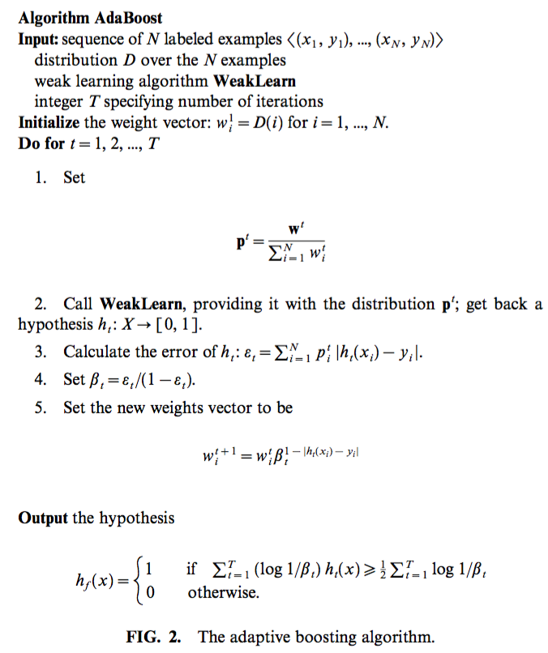
Algorithm Adaboost

Slide 18
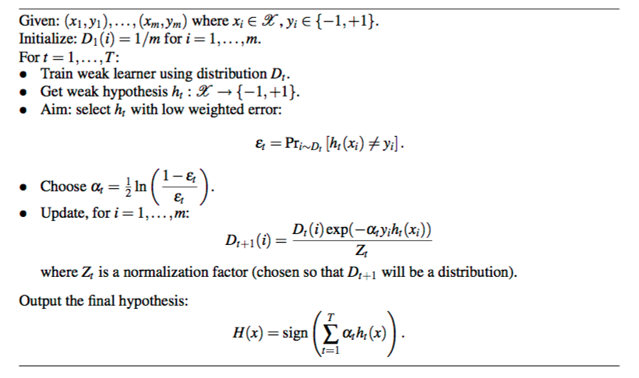
Algorithm Adaboost
Courtesy to Rob E. Schapire: Explaining Adaboost

Slide 19
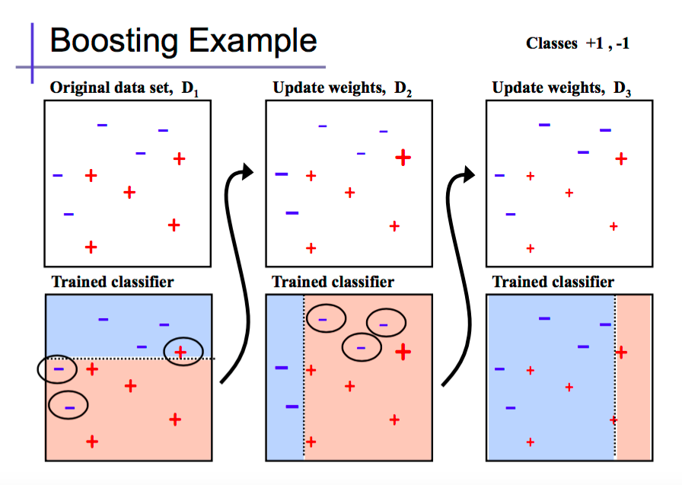
Algorithm Adaboost - Example
courtesy to Alexander Ihler http://sli.ics.uci.edu/Classes/2012F-273a?action=download&upname=10-ensembles.pdf

Slide 20
Algorithm Adaboost - Example
courtesy to Alexander Ihler http://sli.ics.uci.edu/Classes/2012F-273a?action=download&upname=10-ensembles.pdf

Slide 21
Outline
Introduction
The On-line Allocation Algorithm-Hedge(β)
Applications of Hedge(β)
Algorithm AdaBoost
Extending AdaBoost to Multiclass and Regression
History of AdaBoost
Existing Software and Packages
Conclusions

Slide 22
Adaboost Multi-class extension
The original Adaboost expects a 2-class dataset
The authors proposed 2 extensions to support multi-class datasets
Rather than using the usual prediction error, we ask the weak learners to perform relative

Slide 23
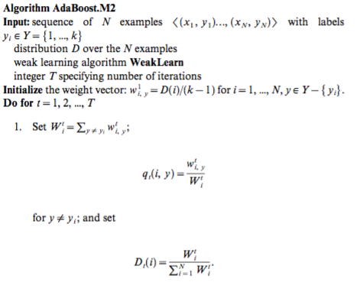
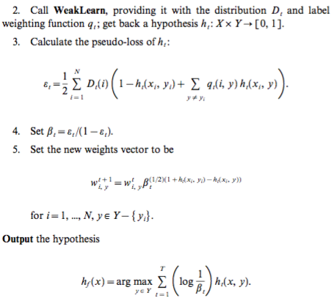
Adaboost Multi-class extension

Slide 24
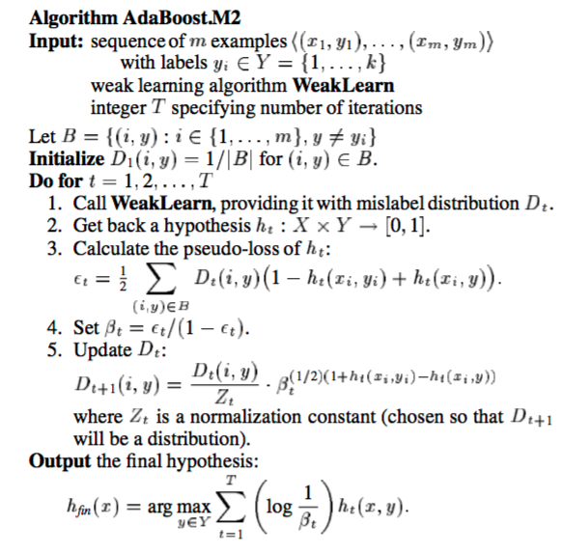
Adaboost Multi-class extension

Slide 25
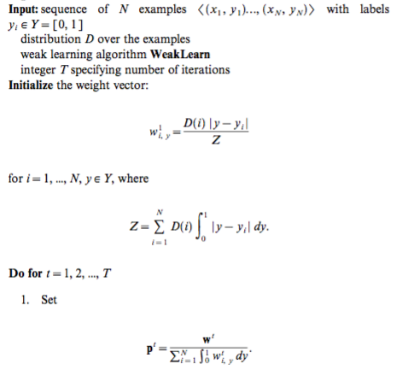
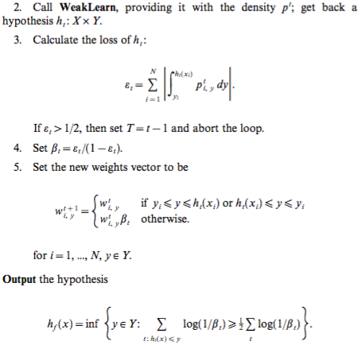
Adaboost extension to regression

Slide 26
Outline
Introduction
The On-line Allocation Algorithm-Hedge(β)
Applications of Hedge(β)
Algorithm AdaBoost
History of Adaboost
Conclusions

Slide 27
History of Adaboost- What happened after this paper?
Improved Boosting Algorithms Using Confidence-rated Predictions
By Schapire and Singer, Springer 1999
Provide a generalization of AdaBoost
This generalization can provide an interpretation of Boosting as a gradient-descent method
Provided method of combining boosting with error-correcting output codes

Slide 28
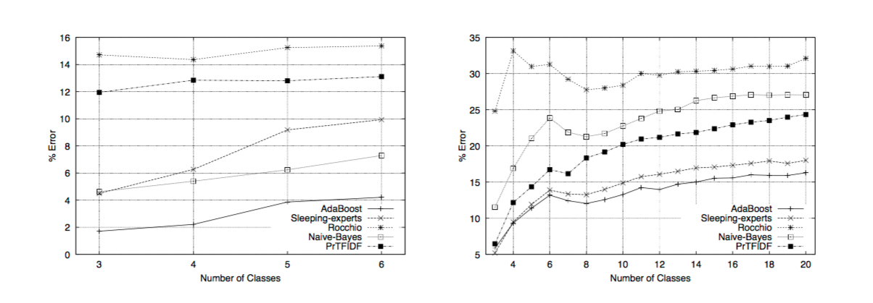
History of Adaboost- What happened after this paper?
BoosTexter: A boosting-based system for text categorization
by Schapire and Singer, Springer 2000

Slide 29
History of Adaboost- What happened after this paper?
Fast and Robust Classification using Asymmetric AdaBoost and a Detector Cascade
by Viola and Jones. NIPS’2001
They showed how Adaboost could be used to create face detector with false positive of 10^-6
They used over 100k features
Combined lots of weak classifiers

Slide 30
History of Adaboost- What happened after this paper?
Multi-class AdaBoost, J Zhu et al., 2009
Propose a multi-class AdaBoost algorithm that is equivalent to a forward stagewise additive modeling algorithm that minimizes exponential loss.

Slide 31
Outline
Introduction
The On-line Allocation Algorithm-Hedge(β)
Applications of Hedge(β)
Algorithm AdaBoost
Extending AdaBoost to Multiclass and Regression
History of AdaBoost
Existing Software and Packages
Conclusions

Slide 32
7. Existing Software and Packages
R package- ‘Adabag’
Author(s) Author: Esteban Alfaro-Cortes, Matias Gamez-Martinez and Noelia Garcia-Rubio, with contributions from Li Guo Maintainer: Esteban Alfaro-Cortes
Suppose the y value (yes or not) is (+1, -1).
Key idea: first find a weak classifier with N observations (assign each observation equal weight 1/N); calculate errors between predicted y values and real y values; use the errors as information to reweigh each observation (the total weight is set to be 1); repeat this process T times; finally output the sign of a combination of all classifier outputs.

Slide 33
7. Existing Software and Packages
R package- ‘Adabag’: Pseudocode
Step 1: suppose we have N observations, we weight each observation with 1/N weight (Wi). Di=Wi/sum(Wi). In other word, Di is the normalized weight.
Step 2: To the following sub-steps for t=1 to T (repeat T times):
Sub-step2.1: select a base classifier “h” (can be CART, Logit, probit, etc), and train data with the given weight
Sub-step2.2: Typically, we recognize the err of the classifier: Err(t)=sum(D(i)*I(yi^=ht((xi))). In other word, we sum D(i) for all the observations with the predicted value not equal to the true value. a(t) =1/2*ln((1-Err(t))/Err(t)).
Sub-step2.3: update Weight Wi(t+1) = Di(t)*exp(-a(t)*Yi*ht(Xi))
Sub-step2.4: normalized weight for each observation: Di(t+1)=Wi(t+1)/Sum(Wi(t+1)). In other word, Di(t+1) is normalized Wi(t+1) in t+t step.
Step 3: H(x)=sign(sum(a(t)*ht(x))). t from 1 to T.

Slide 34
7. Existing Software and Packages
R package- ‘Adabag’
This package implements the Freund and Schapire’s Adaboost.M1 algorithm.
The “weak” classifier used in this algorithm is CART.
Notice that before install adabag package, you first need: rpart, mlbench, caret, lattice, reshape2, plyr, cluster, foreach packages. Some of them are pre-install by default in R.

Slide 35
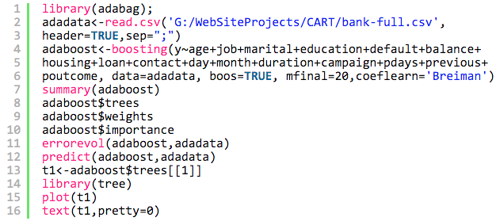
7. Existing Software and Packages
R package- ‘Adabag’
Code:
Here, mfinal=20 indicates the times of repeated process is 20. Coeflean=”Breiman” indicates using M1 algorithm proposed by Breiman. Other options are “Freund” and “Zhu”. The differences are in the calculation of a(t) .
Errorevol function can be used to show the evolution of error during the boosting process.
Prdict function can be used to predict new data based on the existing adaboost trees.
In reality, we can use adaboost$trees to get all 20 trees, and also use adaboost$weights to get all weights, then calculate the predict result for new data by ourselves (saving time).

Slide 36
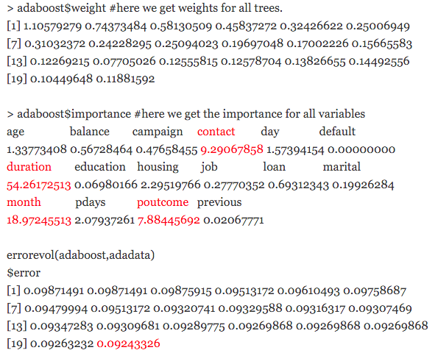
7. Existing Software and Packages
R package- ‘Adabag’
Result:
We compare the final error: 9.243%. It seems slightly better than random forest: 9.27%, while in CART post, we observe 10.98% mis-classification (error) rate.

Slide 37
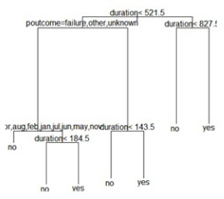
7. Existing Software and Packages
R package- ‘Adabag’
Result:
Only 1 out of 20 decision
trees is plotted

Slide 38
7. Existing Software and Packages
R package- ‘Adabag’
Conclusion:
Good thing:
less error based on ensemble method;
suitable if the initial model is pretty bad.
Bad thing:
time and computation expensive;
hard to implement in real-time platform (like credit card decision platform);

Slide 39
7. Existing Software and Packages
Python package- sklearn.ensemble
The module sklearn.ensemble provides methods for both classification and regression via gradient boosted regression trees.
About Regression:
GradientBoostingRegressor supports a number of different loss functions for regression which can be specified via the argument loss; the default loss function for regression is least squares ('ls').

Slide 40
7. Existing Software and Packages
Python package- sklearn.ensemble
About Regression:
Parameters of regression function:
http://scikit-learn.org/stable/modules/generated/sklearn.ensemble.GradientBoostingRegressor.html

Slide 41
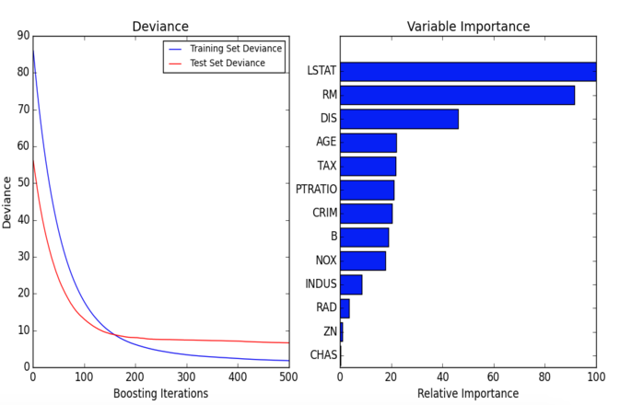
7. Existing Software and Packages
Python package- sklearn.ensemble
The figure below shows the results of applying GradientBoostingRegressor with least squares loss and 500 base learners to the Boston house price dataset (sklearn.datasets.load_boston). The plot on the left shows the train and test error at each iteration. Plots like these can be used to determine the optimal number of trees (i.e. n_estimators) by early stopping. The plot on the right shows the feature importances.
http://scikit-learn.org/stable/auto_examples/ensemble/plot_gradient_boosting_regression.html#example-ensemble-plot-gradient-boosting-regression-py

Slide 42
Outline
Introduction
The On-line Allocation Algorithm-Hedge(β)
Applications of Hedge(β)
Algorithm AdaBoost
Extending AdaBoost to Multiclass and Regression
History of AdaBoost
Existing Software and Packages
Conclusions

Slide 43
8. Conclusions
Adaboost can be used in conjunction with many other types of learning algorithms to improve their performance.
The output of the other learning algorithms ('weak learners') is combined into a weighted sum that represents the final output of the boosted classifier.
AdaBoost is adaptive in the sense that subsequent weak learners are tweaked in favor of those instances misclassified by previous classifiers.
AdaBoost is sensitive to noisy data and outliers.
In some problems, however, it can be less susceptible to the overfitting problem than other learning algorithms.
The individual learners can be weak, but as long as the performance of each one is slightly better than random guessing, the final model can be proven to converge to a strong learner.

Slide 44
8. Conclusions
Other learning algorithms will tend to suit some problem types better than others, and will typically have many different parameters and configurations to be adjusted before achieving optimal performance on a dataset.
AdaBoost (with decision trees as the weak learners) is often referred to as the best out-of-the-box classifier. When used with decision tree learning, information gathered at each stage of the AdaBoost algorithm about the relative 'hardness' of each training sample is fed into the tree growing algorithm such that later trees tend to focus on harder to classify examples.

Slide 45
References
Alfaro-Cortes, Esteban, et al. "Package ‘adabag’." (2012).
Freund, Yoav, and Robert E. Schapire. "A desicion-theoretic generalization of on-line learning and an application to boosting." Computational learning theory. Springer Berlin Heidelberg, 1995.
http://scikit-learn.org/stable/modules/ensemble.html#adaboost
https://en.wikipedia.org/wiki/AdaBoost
https://qizeresearch.wordpress.com/2013/12/05/short-example-for-adaboost/

