Slide 1
Density Estimation in R
Ha Le and Nikolaos Sarafianos
COSC 7362 – Advanced Machine Learning
Professor: Dr. Christoph F. Eick

Slide 2
Contents
Introduction
Dataset
Parametric Methods
Non-Parametric Methods
Evaluation
Conclusions
Questions

Slide 3
Introduction
Parametric Methods: A particular form of the density function (e.g. Gaussian) is assumed to be known and only the parameters (e.g. mean, covariance) need to be estimated.
Non-parametric Methods: Adopt no assumption on the form of the distribution, however, a lot of examples are required.

Slide 4
Datasets
Created a synthetic dataset containing 10000 samples that follow a randomly generated mixture of 2 Gaussians

Slide 5
Parametric Methods
Maximal Likelihood estimation
Bayesian estimation

Slide 6
Maximum Likelihood Estimation
Statement of the Problem:
  Density function p with parameters θ is given and x^{t}~p (X |θ)
    Likelihood of θ given the sample X
l (θ|X) = p (X |θ) = ∏_{t} p (x^{t}|θ)
  We look θ for that “maximizes the likelihood of the sample”!
L(θ|X) = log l (θ|X) = ∑_{t} log p (x^{t}|θ)
  Maximum likelihood estimator (MLE)
θ* = argmax_{θ} L(θ|X)
Notes:
For example, if we plan to take a random sample X₁, X₂,..., X_{n} for which the X_{i} are assumed to be normally distributed with mean μ and variance σ², then our goal will be to find a good estimate of μ, say, using the data x₁, x₂,..., x_{n} that we obtained from our specific random sample.

Slide 7
Maximum Likelihood Estimation (2)
Advantages:
  they become unbiased minimum variance estimators as the sample size increases
  they have approximate normal distributions and approximate sample variances that can be calculated and used to generate confidence bounds
  likelihood functions can be used to test hypotheses about models and parameters
Disadvantages:
  With small numbers of failures (less than 5, and sometimes less than 10 is small), MLE's can be heavily biased and the large sample optimality properties do not apply
  Calculating MLE's often requires specialized software for solving complex non-linear equations.

Slide 8
Maximum Likelihood Estimation (3)
Stats4 library
  Fitting a Normal Distribution to the Old Faithful eruption data(mu = 3.487, sd = 1.14

Slide 9
Maximum Likelihood Estimation (4)
Other libraries:
  Bbmle : has mle2() which offers essentially the same functionality but includes the option of not inverting the Hessian Matrix.

Slide 10
Bayesian estimation
The Bayesian approach to parameter estimation works as follows:
  Formulate our knowledge about a situation
    Define a distribution model which expresses qualitative aspects of our knowledge about the situation. This model will have some unknown parameters, which will be dealt with as random variables
    Specify a prior probability distribution which expresses our subjective beliefs and subjective uncertainty about the unknown parameters, before seeing the data.
  Gather data
  Obtain posterior knowledge that updates our beliefs
    Compute posterior probability distribution which estimates the unknown parameters using the rules of probability and given the observed data, presenting us with updated beliefs.

Slide 11
Bayesian estimation (2)
Available R packages
  MCMCpack is a software package designed to allow users to perform Bayesian inference via Markov chain Monte Carlo (MCMC).
  Bayesm package for Bayesian analysis of many models of interest to marketers. Contains a number of interesting datasets, including scanner panel data, key account level data, store level data and various types of survey data

Slide 12
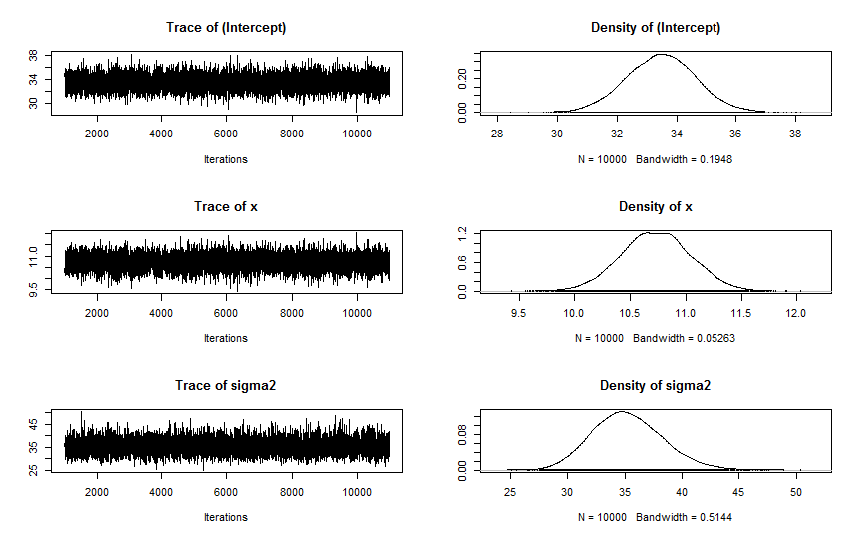
Bayesian estimation (3)
Credible intervals and point estimates for the parameters.
Iterations = 1001:11000
Thinning interval = 1
Number of chains = 1
Sample size per chain = 10000
1. Empirical mean and standard deviation for each variable,
plus standard error of the mean:
Mean SD Naive SE Time-series SE
(Intercept) 33.48 1.1593 0.011593 0.011593
x 10.73 0.3174 0.003174 0.003174
sigma2 35.24 3.0619 0.030619 0.031155
2. Quantiles for each variable:
2.5% 25% 50% 75% 97.5%
(Intercept) 31.21 32.70 33.49 34.26 35.76
x 10.11 10.52 10.73 10.94 11.35
sigma2 29.72 33.10 35.07 37.22 41.68

Slide 13
Non-Parametric Methods
Histograms
The naive estimator
The kernel estimator
The nearest neighbor method
Maximum penalized likelihood estimators

Slide 14
Histograms
Given an origin x₀ and a bin width h
Bin of histogram: [x₀+mh, x₀+(m+1)h)
The histogram:
Drawback
  Sensitive to the choice of bin width h
  Number of bins grows exponentially with the dimension of data
  Discontinuity

Slide 15
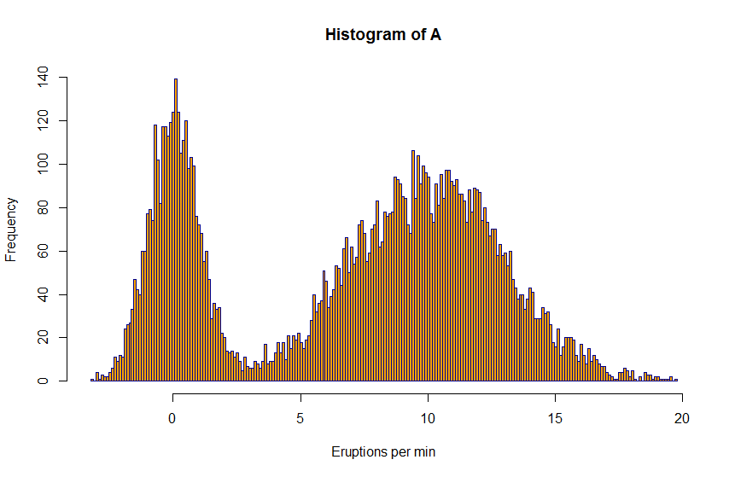
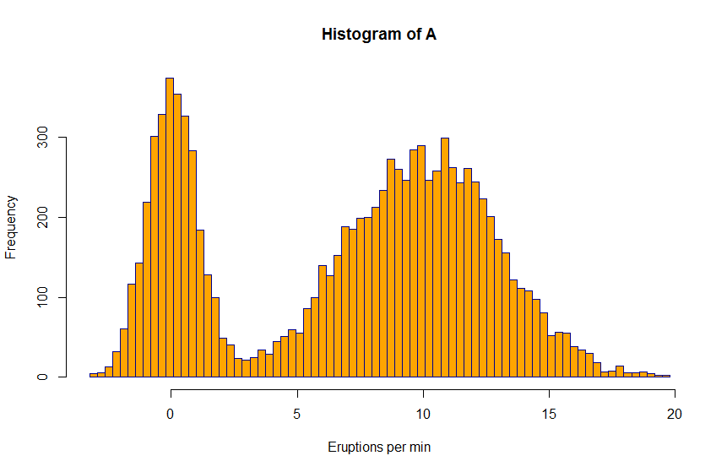
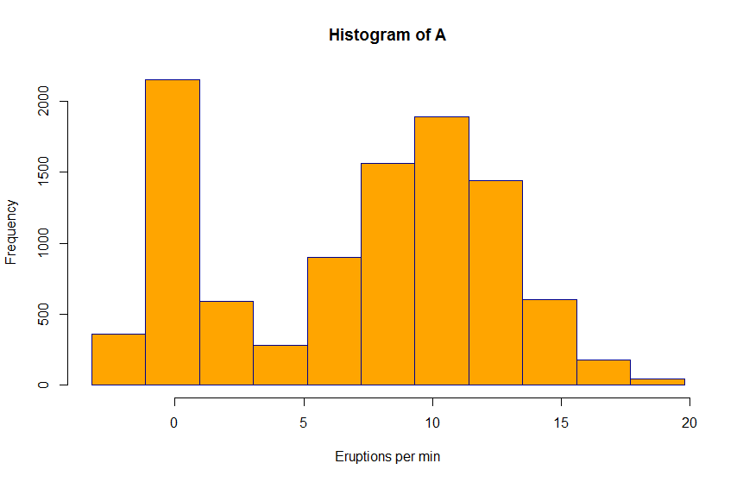
Histograms
Packages
  graphics::hist

Slide 16
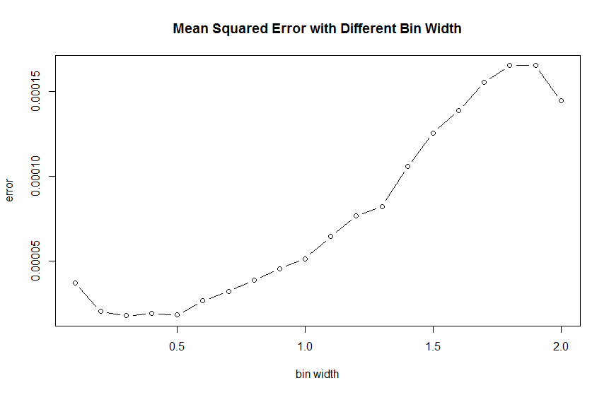
Histograms
The optimal bin width is 0.3

Slide 17
The Naïve Estimator
The naïve estimator:
Drawback
  Sensitive to the choice of width h
  Discontinuity

Slide 18
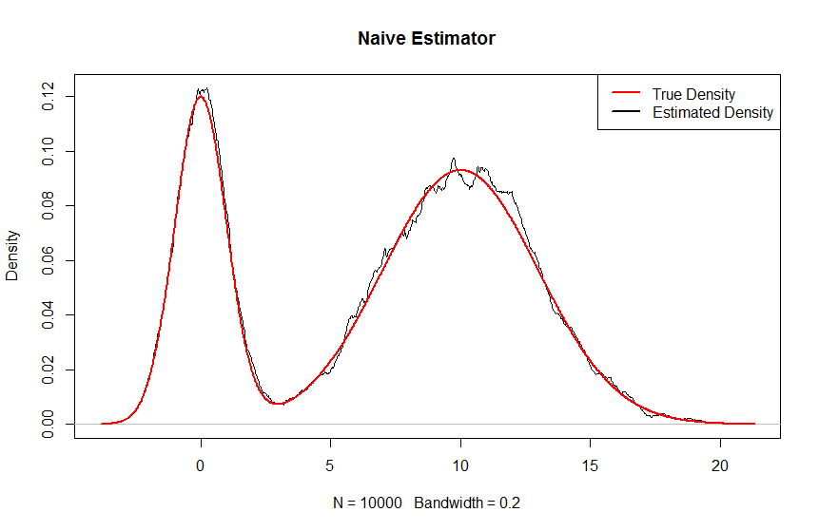
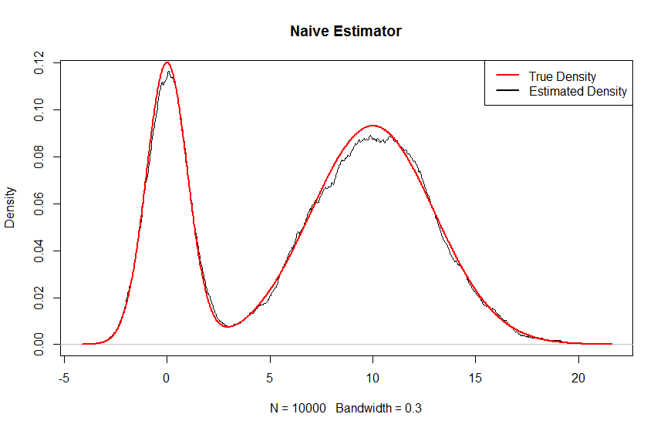
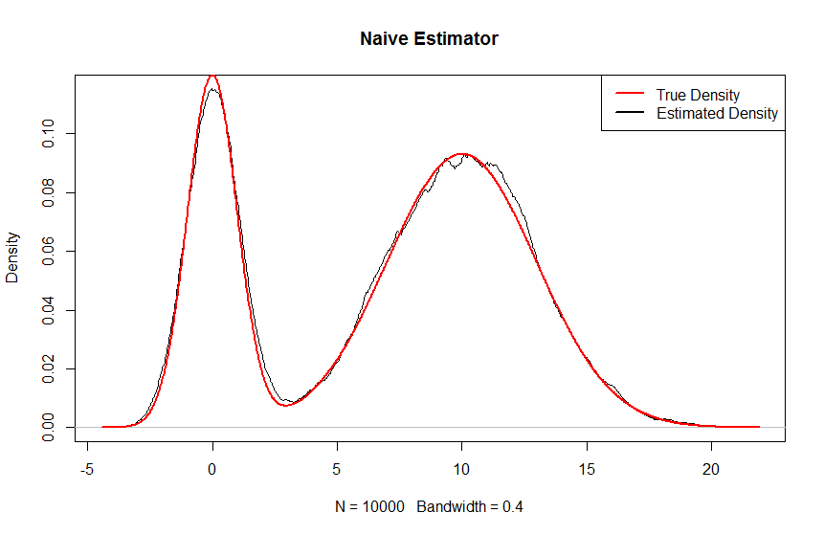
The Naïve Estimator
Packages
  stats::density

Slide 19
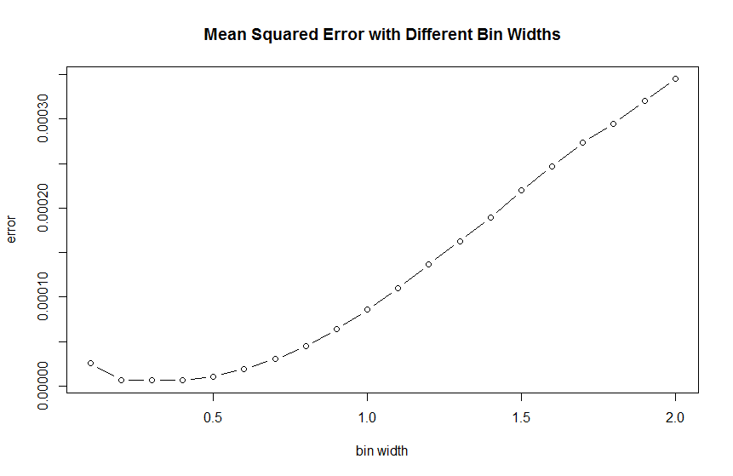
The Naïve Estimator
The optimal bin width is 0.4

Slide 20
The kernel estimator
Kernel estimator:
K: a kernel function that satisfies:
h: window width
F is continuous and differentiable
Drawback
  Sensitive to window width
  Add more noise to long-tailed distributions

Slide 21
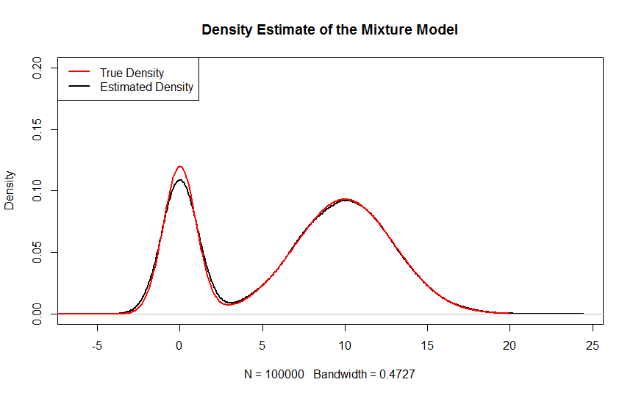
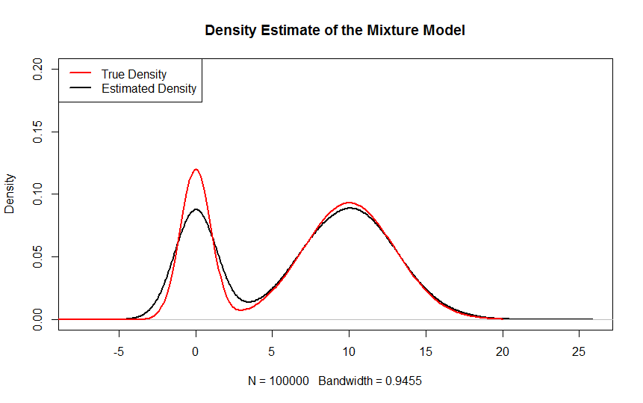
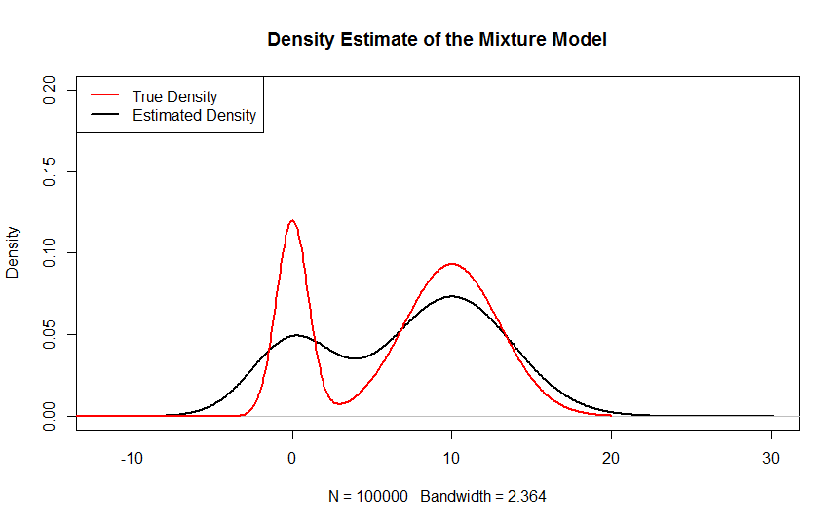
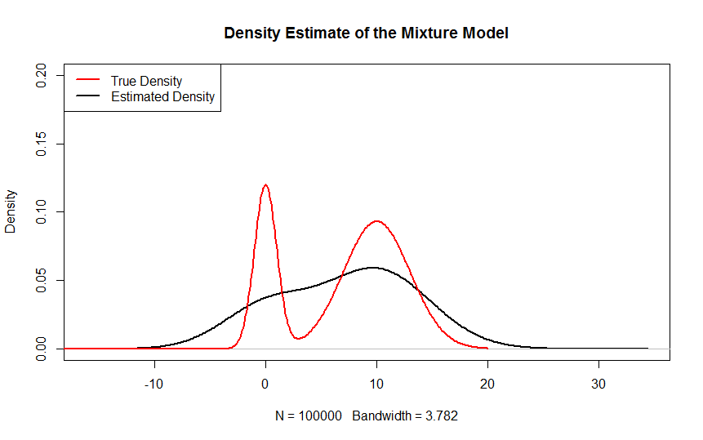
The kernel estimator (2)
Using the density function and a synthetic dataset

Slide 22
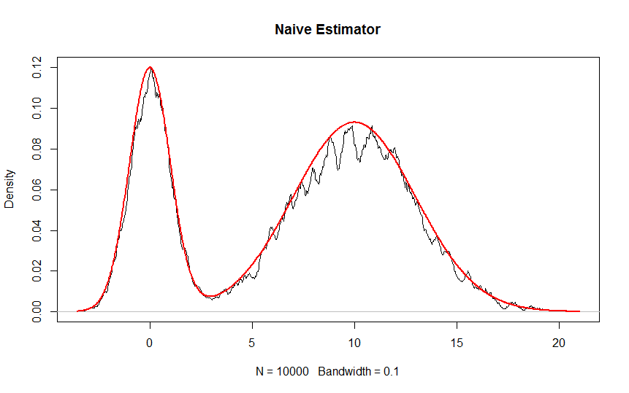
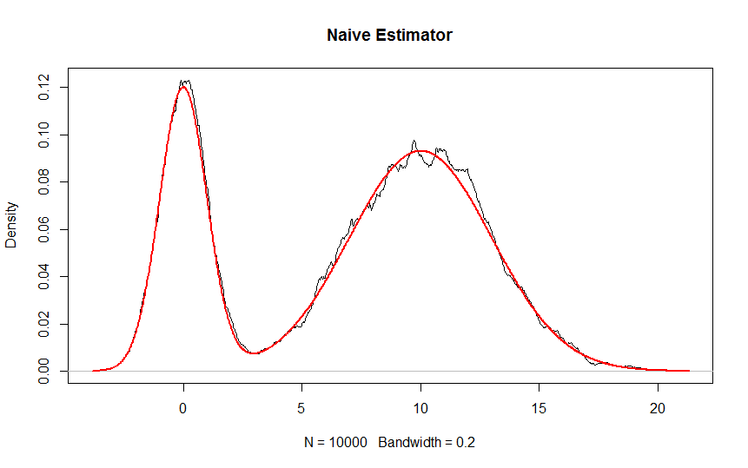
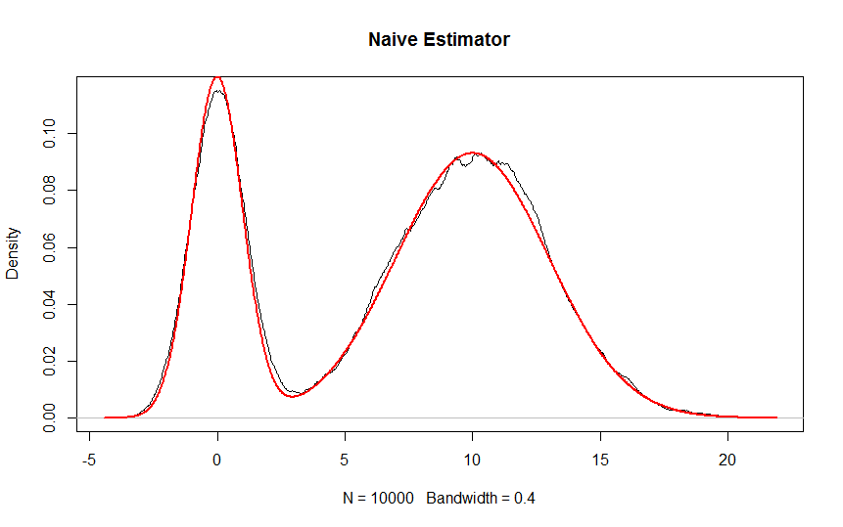
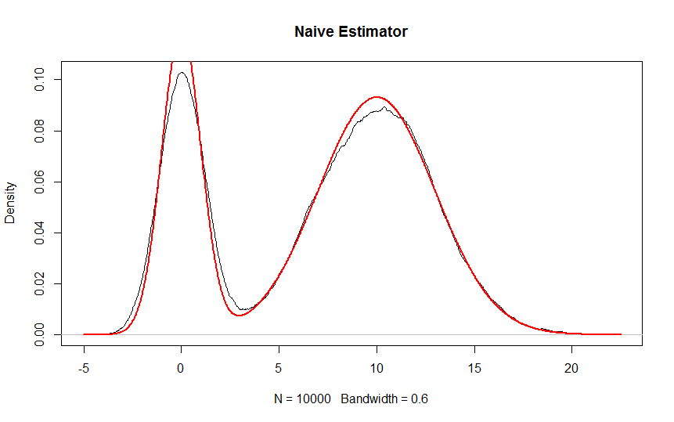
The kernel estimator (3)
Using the a triangular kernel and a different smoothing parameter

Slide 23
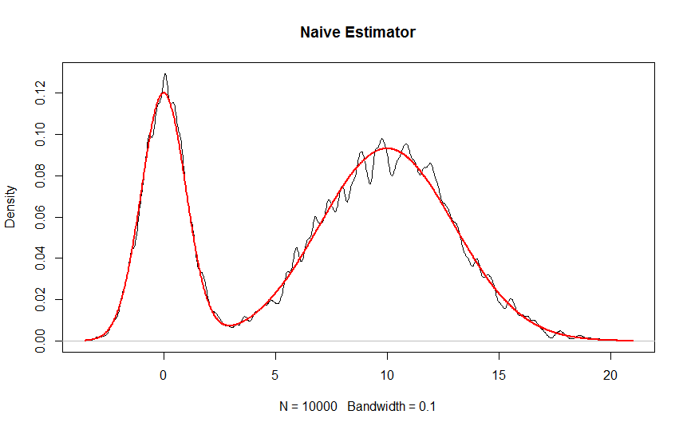

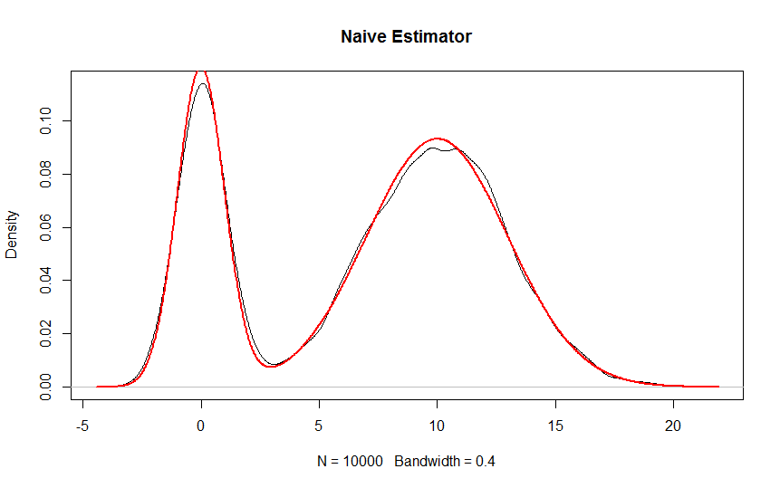

The kernel estimator (4)
Using the a Gaussian kernel and a different smoothing parameter

Slide 24
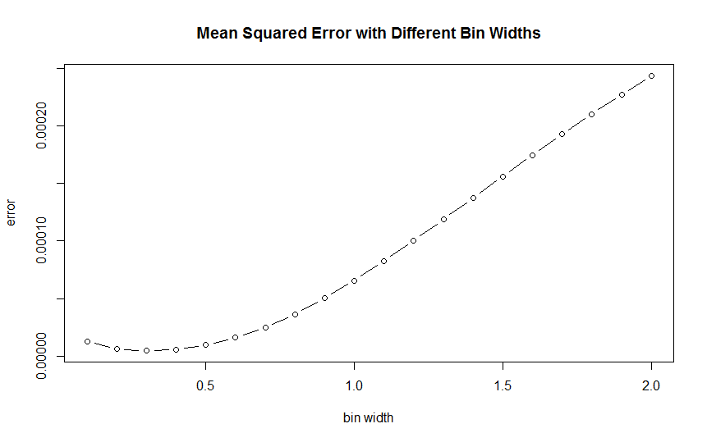
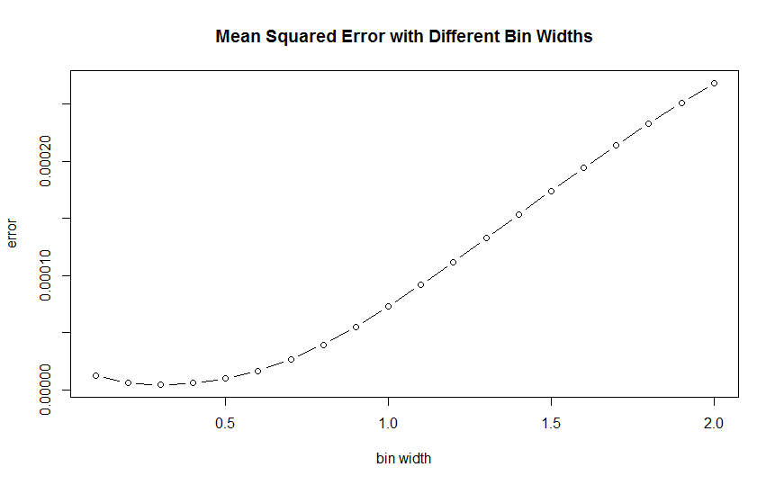
The kernel estimator (5)
Errors for the triangular and the Gaussian Kernels

Slide 25
The k^{th} nearest neighbor method
The k^{th} nearest neighbor density estimator:
The heavy tails and the discontinuities in the derivative are clear

Slide 26
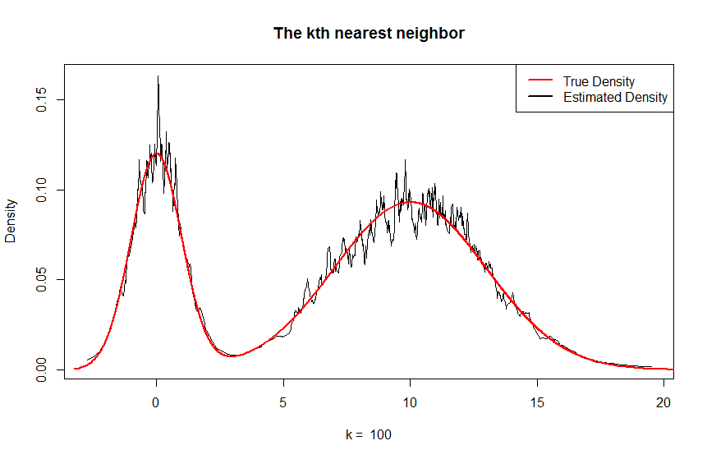
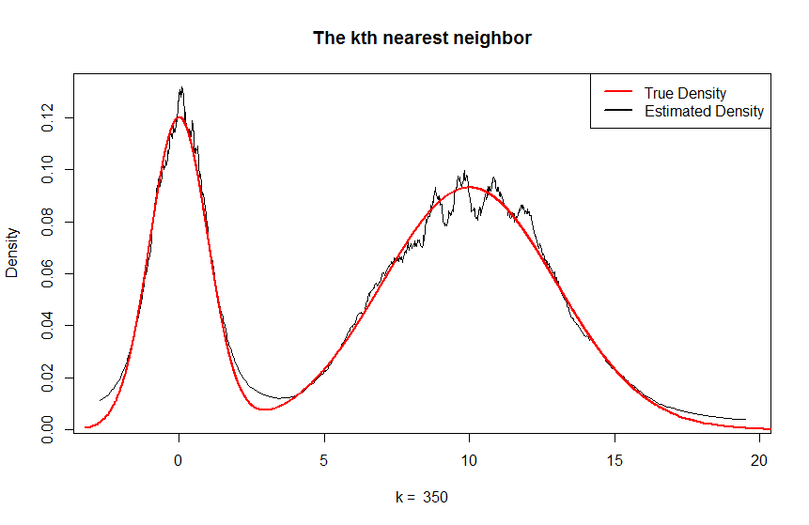
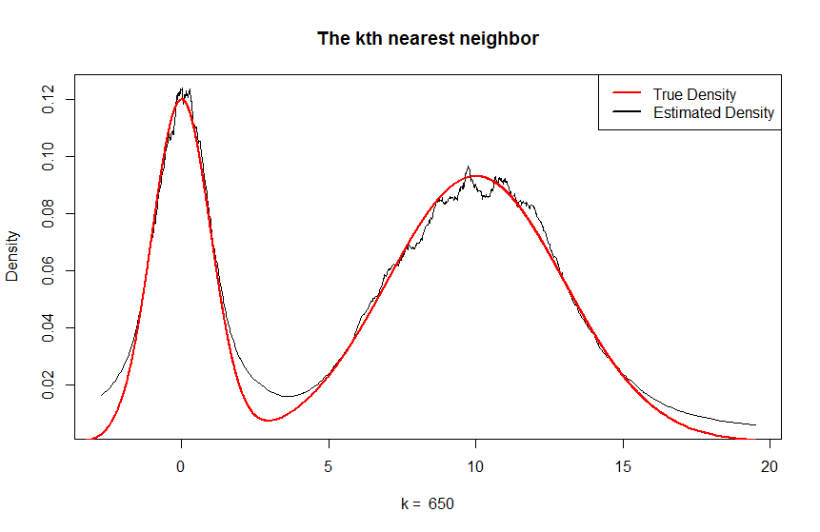
The k^{th} nearest neighbor method
Packages
  FNN::knn

Slide 27
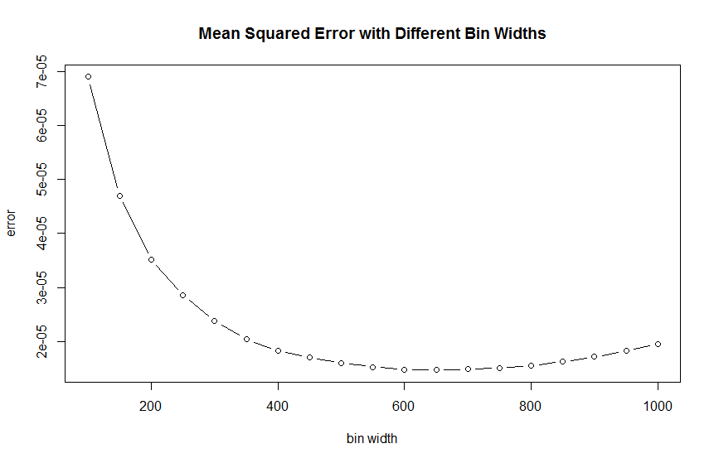
The k^{th} nearest neighbor method
The optimal k is 650

Slide 28
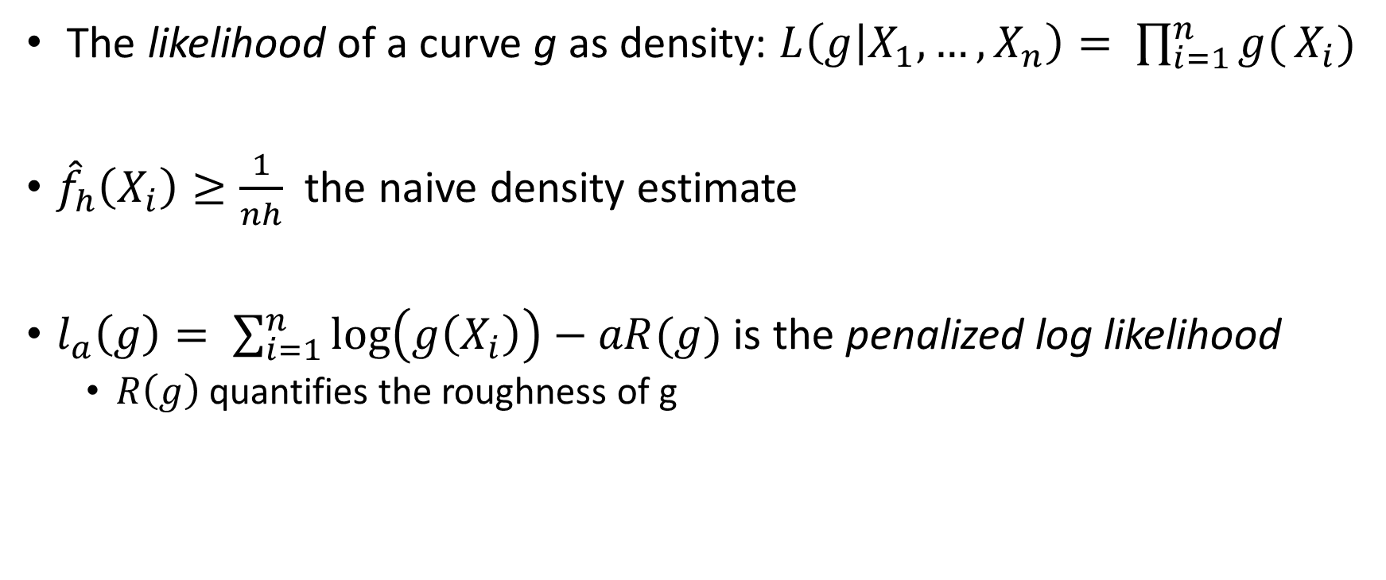
Maximum penalized likelihood estimators
The likelihood of a curve g as density: $L\left(g | X_{1},…,X_{n}\right)= \prod_{i=1}^{n}{g(}X_{i})$
${\hat{f}}_{h}\left(X_{i}\right)≥\frac{1}{nh}$ the naive density estimate
$l_{a}\left(g\right)= \sum_{i=1}^{n}{\log\left(g\left(X_{i}\right)\right)−aR(g)}$ is the penalized log likelihood
  $R\left(g\right)$ quantifies the roughness of g

Slide 29
Penalized Approaches
R packages: gss uses a penalized likelihood technique for nonparametric density estimation

Slide 30
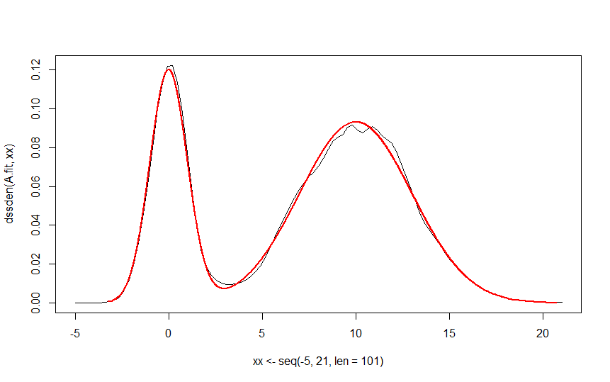
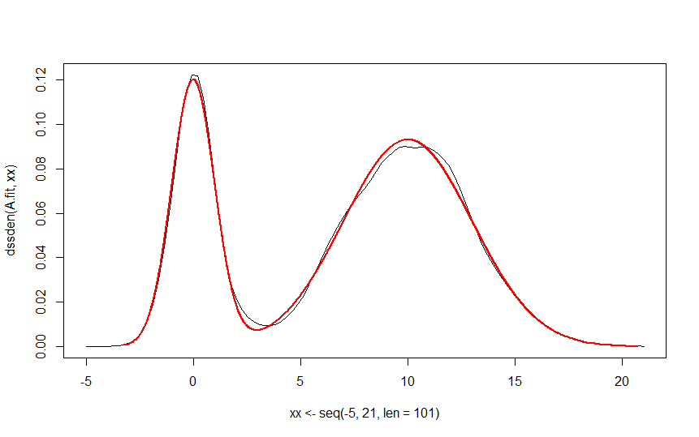
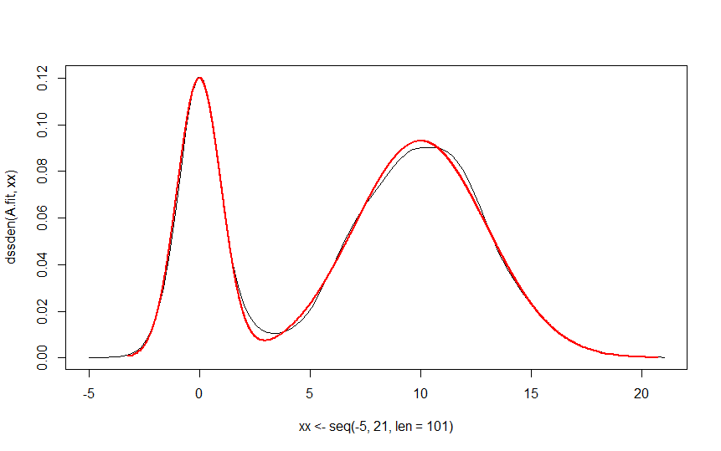
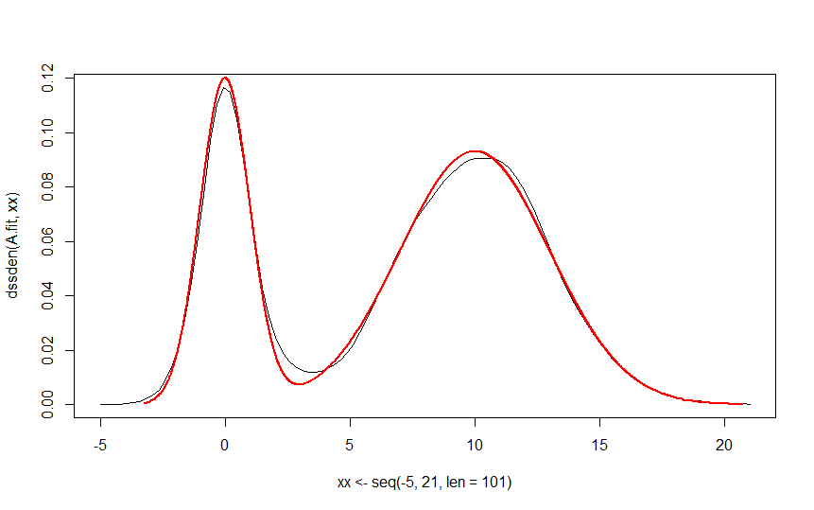
Penalized Approaches (2)
Estimate probability densities using smoothing spline ANOVA models (Ssden function)

Slide 31
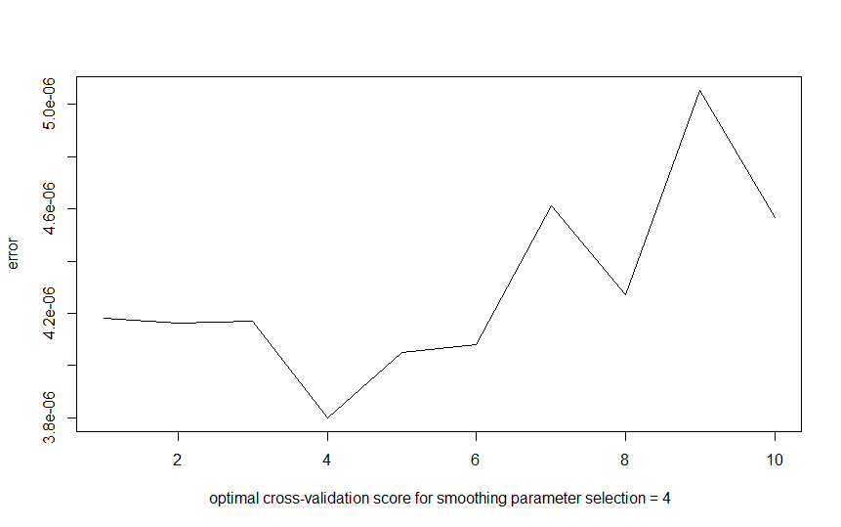
Penalized Approaches (3)

Slide 32
Additional R Packages for Non-Parametric methods
General weight function estimators:
  Wle package http://www.dst.unive.it/rsr/BelVenTutorial.pdf
Bounded domains and directional data:
  BelVen package http://www.dst.unive.it/rsr/BelVenTutorial.pdf

Slide 33
Evaluation
Method | Error
Histogram with bw=0.3 | 1.79E-05
Naïve Estimator with bw=0.4 | 6.29E-06
Triangular Kernel with bw =0.3 | 4.53E-06
Gaussian Kernel with bw=0.3 | 4.69E-06
kth nearest neighbor with k=650 | 1.47E-05
Penalized Approaches with a = 4 | 3.798E-06

Slide 34
Conclusions
The initial mean and the sd affect the MLE performance
Since our data are balanced, different kernels do not affect the error of the kernel estimation
The knn estimator is slow and inaccurate, especially in a large dataset.
The penalized approach which estimates the Probability Density Using Smoothing Splines is also slow but more accurate than the kernel

Slide 35
References
[1] Silverman, Bernard W. Density estimation for statistics and data analysis. Vol. 26. CRC press, 1986.
[2] Deng, Henry, and Hadley Wickham. "Density estimation in R." Electronic publication (2011).
[3]http://homepages.inf.ed.ac.uk/rbf/CVonline/LOCAL_COPIES/AV0809/eshky.pdf

Slide 36

Questions

