Slide 1
Trajectory Classification Using Switched Dynamical Hidden Markov Models
Professor: Christoph F. Eick
Presenter: Ha Le
Advanced Machine Learning
November 10, 2015

Slide 2
Introduction
A two-layer hierarchical model for human activity recognition
Lower layer: A bank of dynamical models
Describe a specific motion regime
Higher layer: Switching among lower layer dynamical systems
Learn a Hidden Markov Model (HMM)
Dynamical models
Estimated using EM on a finite mixture models (unsupervised)
The number of models: obtained using a Minimum Message Length (MML)
Notes:
For example, the trajectory of a person entering a shop can be decomposed into a set of segments. Each segment is described by a different dynamical model.

Slide 3
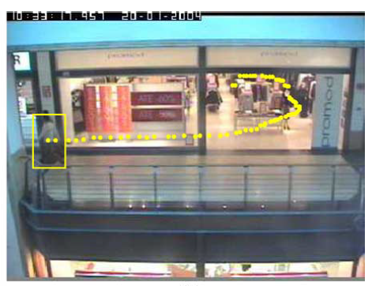
Class-Conditional Generative Model
Inputs: Trajectories of the centers of mass of the tracked people
$x=\left(x_{1},{…,x}_{n}\right)$ with $x_{t}∈R^{2}$
Activity classes: $a∈\left\{1,…,A\right\}$
Class-conditional generative model: $p\left(x|a\right)$
Trajectories of a person leaving a shop
Notes:
The class-conditional generative model describes the actual distribution of each class.

Slide 4
At Lower Layer (1/2)
A trajectory x is described by M dynamical models
At time t:
$z_{t}∈\left\{1,…,M\right\}$: low level model at time t
$w_{t}$: random vector of zero mean, identity covariance Gaussian
$T_{z_{t}}$: mean displacement vector of each model
$Q_{z_{t}}$: covariance matrix of the random displacements under each model
Notes:
t: 1,..,n
Model the transition between time t-1 and t using a Gaussian distribution

Slide 5
At Lower Layer (2/2)
Probability density of a trajectory x, given a model labels z:
Assumption: M low level dynamical models are the same for all the classes.
➔ $p\left(x | z,a\right)=p(x|z)$

Slide 6
At Higher Layer (1/3)

Slide 7
At Higher Layer (2/3)
Transition matrix $B_{a}$ which associated with class $a$
Dimension: $M×M$
$B_{ij}^{(a)}$: element of $B_{a}$ at $\left(i,j\right)$

Slide 8
At Higher Layer (3/3)
The final class-conditional generative model

Slide 9
Notations
Training set: $T=\left\{\left(x^{(1)},a_{1}\right),…,\left(x^{(N)},a_{N}\right)\right\}$
Training trajectory: $x^{(j)}=\left(x_{1}^{(j)},…,x_{n_{j}}^{(j)}\right)$
Activity class: $a_{j}∈\left\{1,…,A\right\}$
Length of the training trajectory $x^{(j)}$: $n_{j}$
Low level model parameters: $θ=\left\{T_{1},…,T_{M},Q_{1},…,Q_{M}\right\}$
High level model parameters: $\left\{B_{1},…,B_{A}\right\}$

Slide 10
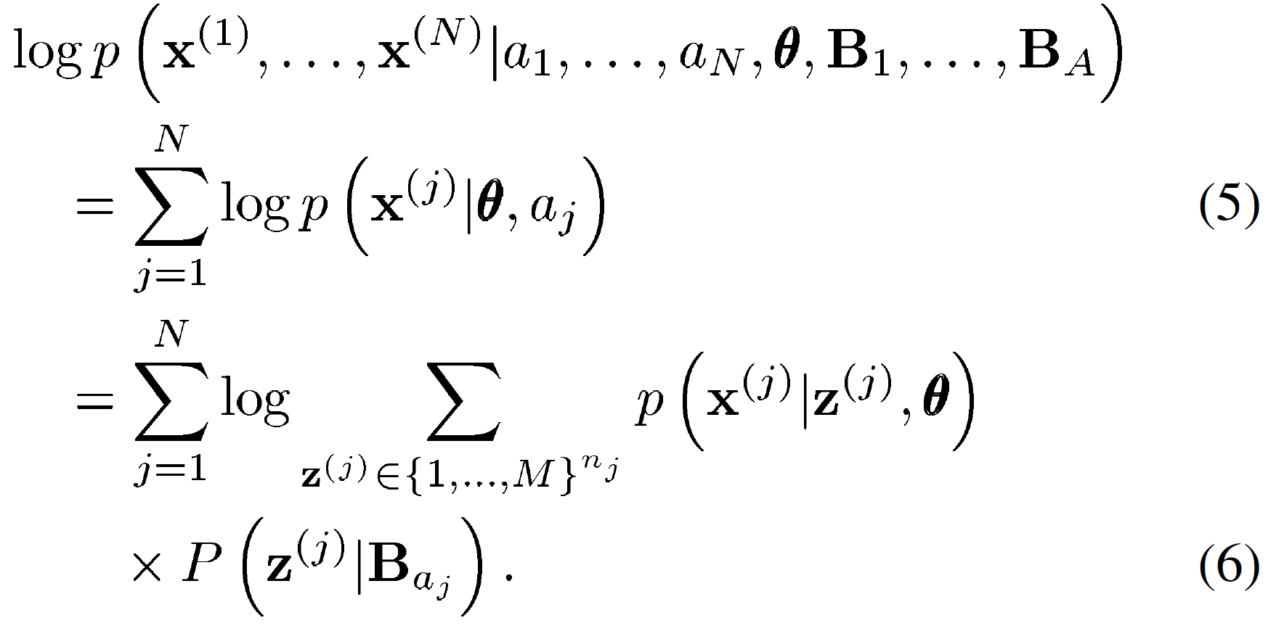
Optimization Problem
Notes:
Maximize the log likelihood given the model parameters

Slide 11
Estimation of Low Level Model
M low level dynamical models are independent of all the classes
➔ Estimate low level model parameters $θ$ in unsupervised way
Training set
$$X=\left\{x^{(1)},…,x^{(N)}\right\}$$
Observed increments of $x^{(j)}$
$\left\{d_{t}^{(j)}=x_{t}^{(j)}−x_{t−1}^{j}, t=2,…,n_{j}\right\}$

Slide 12
Estimation of Low Level Model
Set of all observed increments
$$D=\left\{d_{1},…,d_{N^{′}}\right\}$$
The total number of increments: $N﷮′=\sum_{j=1}^{N}{\left(n_{j}−1\right)}$
Model $D$ as independent samples from a mixture of Gaussian with M components and parameters $θ$
➔ How to find an optimal M?

Slide 13
How to find an optimal M?
Optimize M using a modified version of EM based on the MML criterion:
Initialize with a large number of components
Optimize during E step
Annihilate components during M step
Update parameters
Repeat until convergence

Slide 14
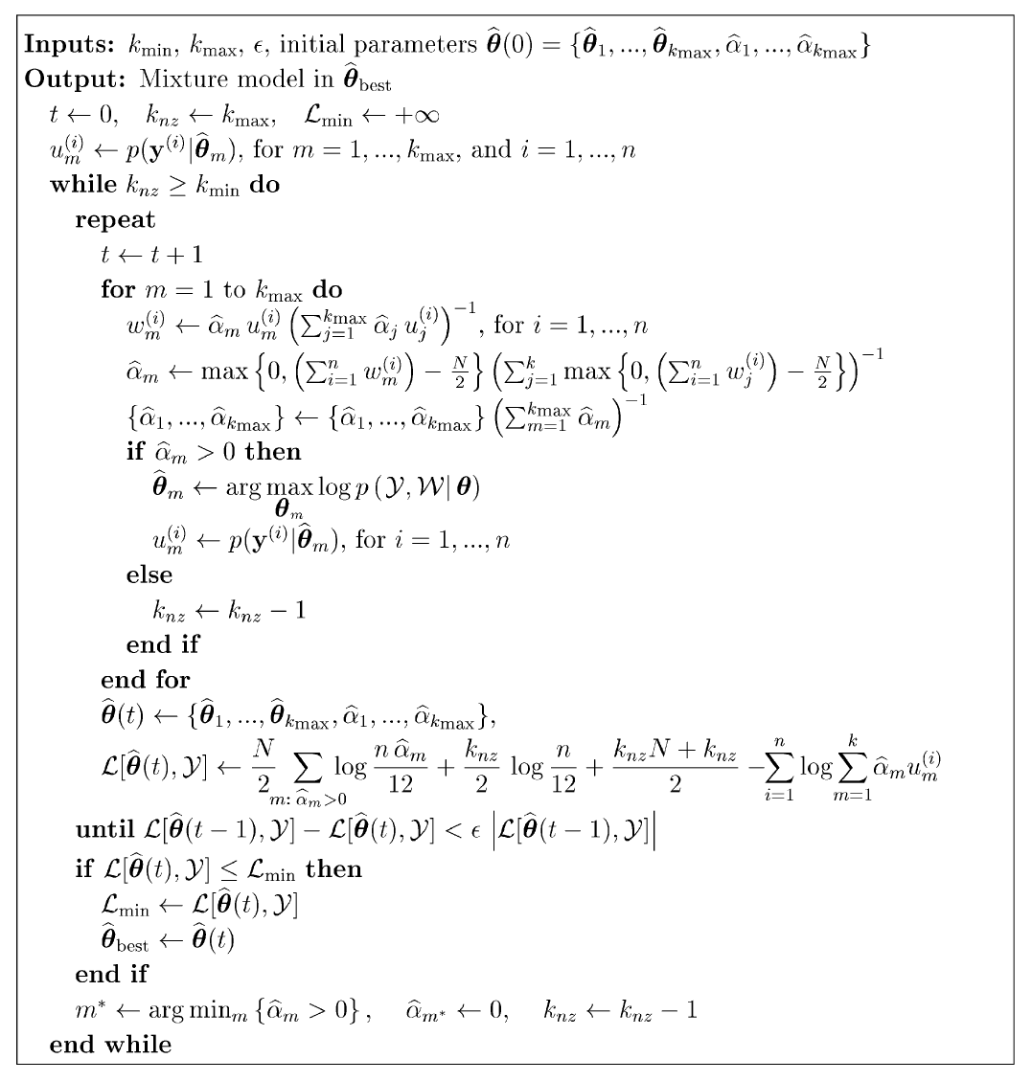
Modified EM

Slide 15
Estimation of High Level Model
Estimate $\hat{B_{a}}$ for each class a
Training set: $T_{a}=\left\{x^{(1)},…,x^{(N_{a})}\right\}$
Apply Baum-Welch but keeping frozen the emission density parameters

Slide 16
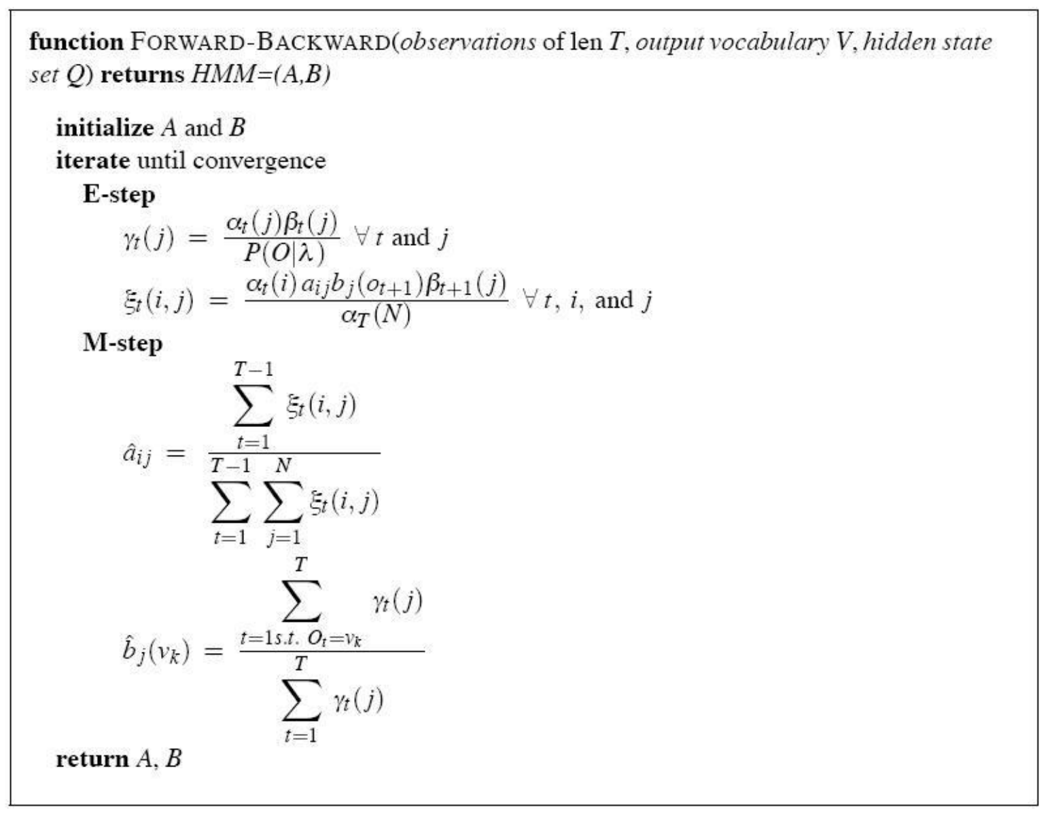
Baum-Welch Algorithm

Slide 17
Classification
Maximum a posterior
$P(a)$: prior probability

Slide 18
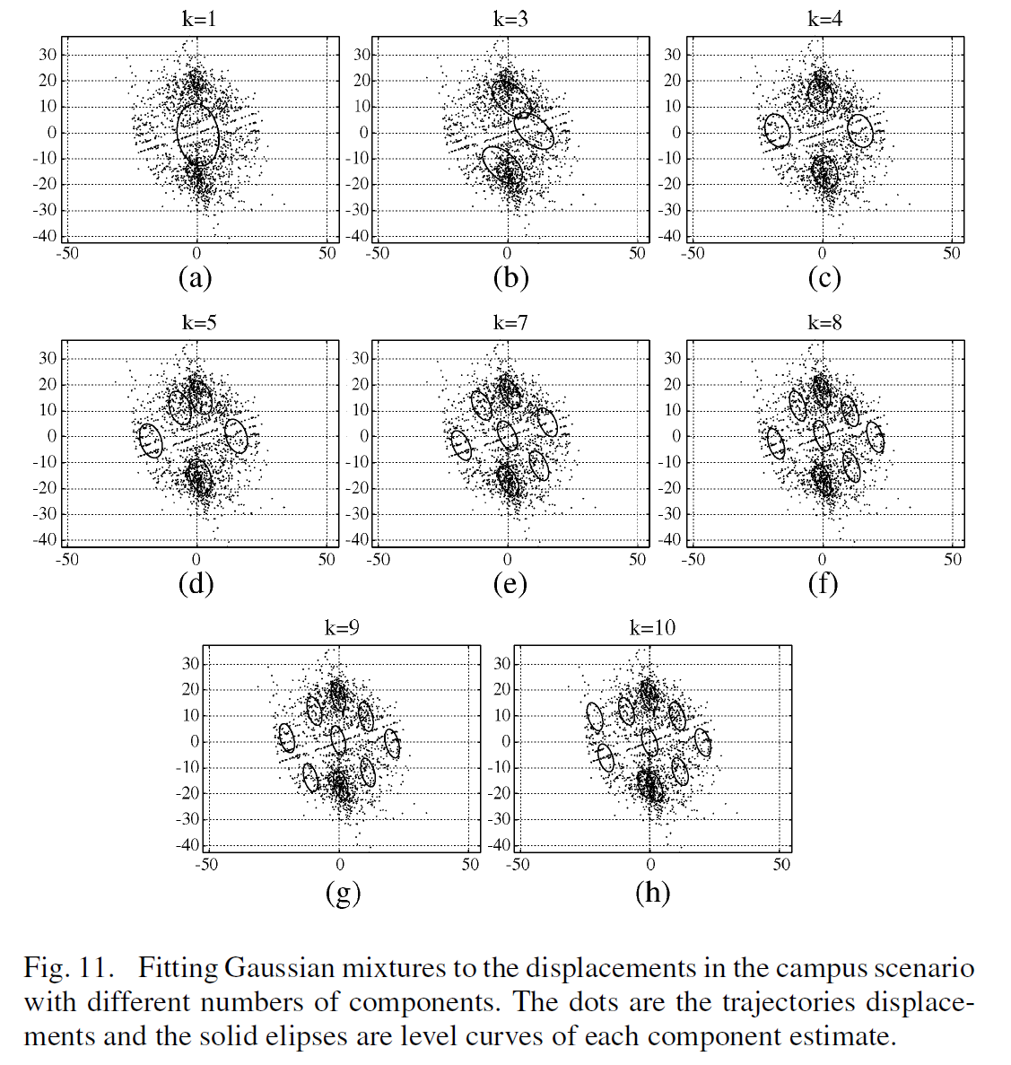
Experiments on Low Level Model Estimation

Slide 19
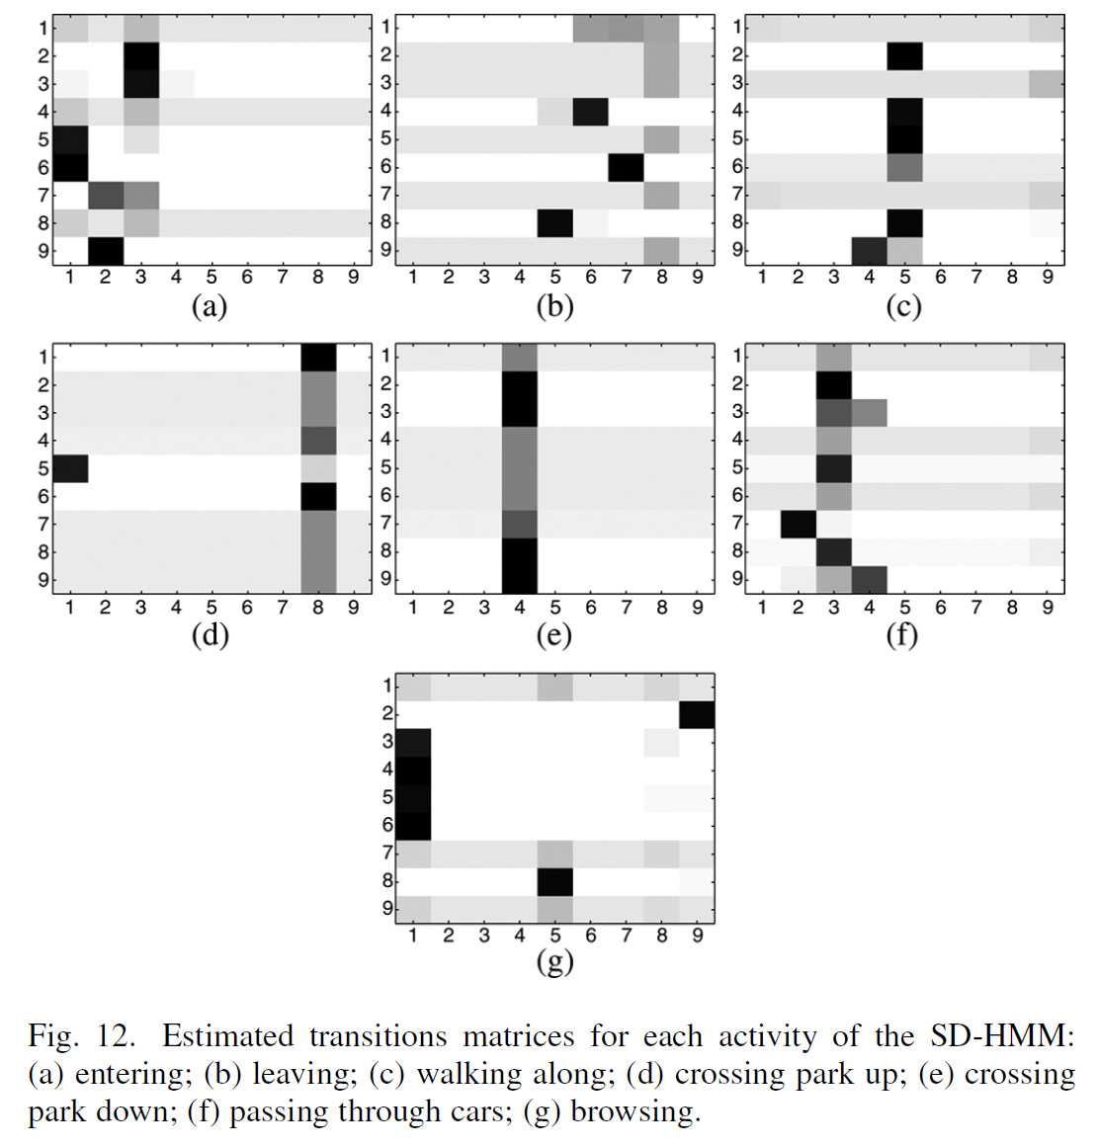
Experiments on Transition Matrix Estimation

Slide 20
Thank you!

