Slide 1
Distance-Based Outlier Detection: Consolidation and Renewed Bearing
Gustavo Henrique Orair
Federal University of
Minas Gerais
Wagner Meira Jr.
Federal University of Minas Gerais
Presented by Kajol
UH ID : 1358284

Slide 2
PURPOSE OF THE PAPER
Distance-Based Outlier Detection has gained attention from
Financial fraud analysis
Network intrusion applications
Clinical diagnosis of diseases.
Purpose of the paper is to perform outlier detection more effectively.
Several distance-based optimizations have been assessed and evaluated to improve performance, but which optimization is better.
What can we learn from the design of the existing algorithms? Can we infer some guidelines for designing better outlier detection algorithms?
In this paper Outlier detection framework has been implemented followed by factorial design experiment to understand efficiency gains of various optimizations on real life datasets.

Slide 3
DISTANCE-BASED OUTLIER DETECTION
Outlier detections is fundamental step in data quality, data management, and data analysis tasks.
We have always been speaking more about Model-Based approach to detect outliers but in such approaches its sometimes hard to determine the underlying data distribution and parameters.
In this paper we use Distance-Based Outlier Detection approach, it is defined as : For each object o, examine the other objects in the r-neighborhood of o, where r is a user-specified distance threshold . An object o is an outlier if most of the objects are not in the r-neighborhood of o.
These algorithms are :
1. Model Free
2. They rely on distance functions between objects.
3. They rely on approximate nearest neighbor approaches.
4. They scale well to large datasets.

Slide 4
DISTANCE-BASED ALGORITHMS
ORCA - Nested Loop algorithm
Approximate Nearest Neighbor Search (ANNS)
Use partitioning algorithms for preprocessing
Pruning partitions when searching neighbors
Ranking

Slide 5
NOTATIONS – A Glance
SYMBOL | DESCRIPTION
n | Number of outliers in result set to be identified in the database
k | Number of nearest neighbors to be considered
D^{k}(p) | Distance between point p and its kth closest neighbor
D^{k} ^{min} | Smallest distance between a point and its kth nearest neighbor from result set
R(P) | The MBR diagonal value of a partition P
MINDIST | Minimum distance between an object and MBR structure
MAXDIST | Maximum distance between an object and MBR structure

Slide 6
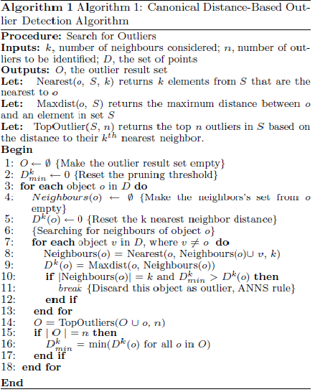
CANONICAL ALGORITHM

Slide 7
VARIOUS OPTIMIZATIONS
APPROXIMATE NEAREST NEIGHBOR SEARCH
Important pruning rule defined by Ramaswamy, we may disregard an object p as an outlier, if D^{k} (p) < D^{k} min
PRUNING
Goal is to organize the objects into clusters or partitions so that its not necessary to perform all distance calculations.
Indexing data structures has been used as a strategy in various approaches but it suffers the curse of dimensionality.

Slide 8
Clustering based Pruning strategies
Pruning Partitions during Search for neighbors (PPSN)
Prunes partitions that are far from an object while searching for neighbors. Uses the concept of Minimum Bounding Rectangle (MBR).
If MINDIST > D^{k} (p) , none of the objects in that partition can be among the k-nearest neighbors of p.
Pruning Partitions during Search for Outliers (PPSO)
Two-phase partition based algorithm, which eliminates whole partitions that do not contain outliers based on the summary statistics generated in clustering phase.
It uses bounds , D^{k}min lower bound of D^{k} (p) to prune partitions that do not contain outliers followed by a bound to prune partitions that do not contain k^{th}-NN for points from a partition P.

Slide 9
RANKING
It aims to improve the efficiency of ANNS pruning rule ( D^{k} min > D^{k} (p)) by increasing D^{k} min. ANNS depends on order of evaluation of both the objects and their neighbors.
Ranking Objects Candidates for Neighbors(ROCN)
It ranks the order in which the neighbors of a point are processed, and aims to increase D^{k} min so that ANNS pruning rule is triggered earlier.
ORCA, an algorithm based on nested loops, randomized ranking and ANNS gives near linear time performance even though quadratic in worst case.
Ranking Objects Candidates for Outliers(ROCO)
Determines which objects are more likely to be outliers and also focuses on increasing D^{k} min . It uses Bayesian method, Probabilistic Pruning method.

Slide 10
RANKING IN CONJUCTION WITH PARTITIONING
ROCN with Partitions
RBRP is a two-phase algorithm , first phase is partitioning phase that bins the data space into grid-like partitions. Second phase, uses fast map style of projection of points to rank neighbors.
It achieves log-linear performance on average.
ROCO with Partitions
It is a novel approach in this paper. Summary of each cluster such as number of objects within a cluster, partition volume, density of partition is computed to rank clusters based on their likelihood to contain outliers.
Large partitions with low-density regions will increase D^{k} min and may contain outliers and is likely to achieve better performance overall.

Slide 11
TAXONOMY OF EXISTING WORK
Summary of distance-based outlier detection algorithms and strategies

Slide 12
THE DIODE FRAMEWORK
Distance-Based Outlier Detection (DIODE) framework is used to perform experiments in isolation or combination, and the strategies employed to improve the effectiveness of the pruning process.
It employs a clustering pre-processing step using RBRP-style recursive partitioning and divisive bisection k means clustering algorithm. They can be threshold to a user-defined size( size of partition cannot be more than 16000 points is assumed in this paper).They scale well to large datasets.
Preprocessing is followed by ranking strategies, ANNS pruning rule , then factorial design study.

Slide 13
Implementation of Pruning and Ranking using the DIODE framework.
PPSO
It considers D^{k} min , which monotonically increases with the execution of the algorithm, once its large enough significant partitions will be pruned.
PPSN
It uses the concept of if MINDIST > D^{k} (P), a partition P may be discarded.
3. ROCN
Uses same approach as of RBRP
4. ROCO
Objects are ranked based on the low density regions as they contain more outliers . Density is estimated by using
Density = |P|/R(P)
Where |P| - number of objects in partition P
R(P) - MBR diagonal length of P

Slide 14
EXPERIMENTAL SETUP AND RESULTS
Summary of factorial design study is presented now , it evaluates different pruning and ranking strategies.
The average execution time to detect outliers using various strategies on synthetic and real large datasets is measured.
Execution time gains are achieved by various optimization strategies.
It is shown form the results that the reduction in execution time is observed significantly only when there is an interaction in between various optimizations.
Significance of PPSN optimization strategy is also illustrated.

Slide 15
EXPERIMENTAL SETUP
Various real and synthetic datasets have been used.
Experiments were performed on AMD and top 30 outliers were looked for.
ANNS pruning rule and clustering pre-processing is used as a baseline approach

Slide 16
FACTORIAL DESIGN MODEL
Experiments have been performed that either enable “+1” or disable “-1” each of the four factors(strategies).
Factorial design model explains impact for each factor and possible interactions of factors on data . It is defined by the equation :
Y = Qo + $\sum_{iεF}{Q}ᵢ ∗Xᵢ$
where F = { A,B,C,D,AB,AC,AD,BC,BD,CD,ABC,ABD,ACD,BCD,ABCD }
Qo = average value from all executions
Qᵢ = value of factors and interactions on execution time

Slide 17
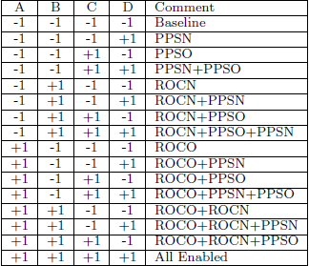
FACTORIAL DESIGN MODEL

Slide 18
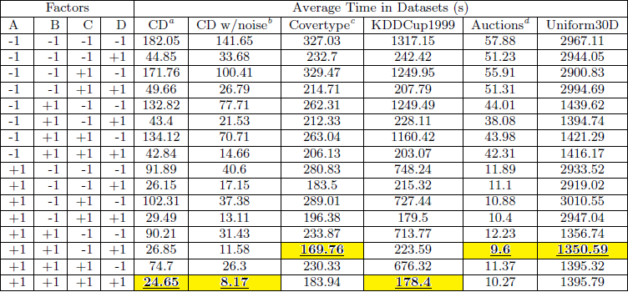
EXPERIMENTAL RESULTS
Average execution times of the outlier detection process for all factor combinations.

Slide 19
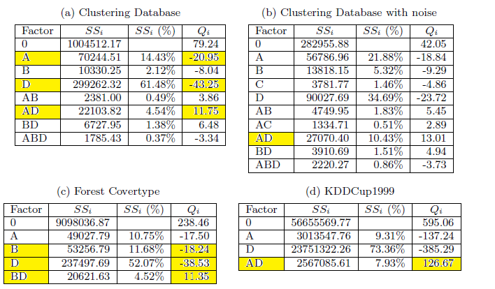
EXPERIMENTAL RESULTS
Factor values on several datasets

Slide 20
EXPERIMENTAL RESULTS
Factor values on several datasets
Where, SSᵢ - sum of squares due to factor i
SSᵢ % - Percentage of variation by each factor
Qᵢ - Execution time gain
PPSN, is most effective strategy overall.
Only in auction government and Uniform 30D, ROCN is most effective.

Slide 21
CONCLUSION
Distance-Based Clustering algorithms have exploited the design space detection algorithms.
The paper presented new strategies for ranking and processing outliers.
After conducting a full factorial design experiment implemented on DIODE framework certain conclusions have been derived .
Firstly, its proved that proposed optimizations are extremely useful for large datasets.
Secondly, It can be concluded that effectiveness of any single optimization or combination of optimizations always depends on dataset characteristics.

Slide 22
PERSONAL CONCLUSION
The good things about the paper is it presets a different approach to detect outliers.
It considers both already proposed distance-based strategies and novel approaches to evaluate the results by giving significant importance to algorithms which get ignored by advance methods.
The references mentioned in the paper are too old thereby causing a problem to search more information.
Some sections of the paper are really badly presented with improper references.

Slide 23
FUTURE DIRECTIONS AND REFERENCES
Better outlier ranking techniques such as Locality Sensitive Hashing scheme can be explored.
Still room to look for faster methods to preprocess data and approximate the appropriate bounds of ANNS pruning rule .
REFERENCES
Gustavo H. Orair, Carlos Teixeira and Wagner Meira Jr., Distance-Based Outlier Detection: Consolidation and Renewed Bearing, Department of Computer Science, UFMG, Brazil
E. M. Knorr and R. T. Ng. Finding intentional knowledge of distance-based outliers. In VLDB ’99: 25th Int. Conf. on Very Large Data Bases, pages 211–222, San Francisco, CA, USA, 1999. Morgan.

Slide 24
ANY QUESTIONS ?

